Slide 1

Klickitat Valley Health
Bold Vision 20/20 Project
Presentation for PRC Approval GCCM Project Delivery
September 27, 2018

Slide 2
Agenda – [Lead orchestrate Dick]
Introductions - Dick
Klickitat Valley Health - Leslie
Project Team - Dick
Purpose of GCCM Application - Dick
Phase 1 Programming - Dick
Project Description - David
Benefits of GCCM Project Deliver – Dick
Associated Projects CUP - Jonathan
Schedule - Dick
Summary/Questions - Leslie

Slide 3
Klickitat Valley Health LH
Building On KVH Past
In April of 1946, the community of Goldendale became the first in the state to take advantage of the new Hill-Burton Act. The Act was established to assure health care services in rural communities and provided low interest money to help rural providers construct new facilities or enhance existing services. Over the years the District has garnered strong community support, enabling facility renovations in 1959, 1969 and 1986.
Community support for KVH latest bond measure in 2005 funded a 20,000 sq. ft. Hospital addition that includes a new Diagnostic Imaging Department and enlarged Emergency Services capacity, along with numerous technology and facility upgrades.
2017 Renovation Project
Building For The Future - Bold Vision 20/20
  Strategic Plan
  Roadmap for Campus Advancement

Slide 4
Project Team DB
  KVH-Leslie Hiebert CEO
    Overall Responsibility
  KVH – Jonathan Lewis Director of Services
    CUP Management
    Daily Inspections
    Interface with DBPM
  DBPMLLC-Dick Bratton Owner 1/2018
    Project Management
    Onset to Completion
    Ongoing GCCM Experience w/SPMC and LCCHC
    Directed A/E Solicitation and Selection
  Mahlum-David Perzik Project Manager 4/2018
    Variety of GCCM Project Experience
    Considerable Healthcare Experience
    GCCM Credible A/E Team Composition DCI/PAE Engineers
  Perkins Coie-Graehm Wallace Partner
    Contract Experience with RCW 39.10
    AIA A133/201 and AIA B133 in draft form

Slide 5
Purpose of GCCM Application DB
KVH Project Importance
  Project Meets GCCM Criteria
    Critical Scheduling, Phasing, Transition
    Early GCCM Interaction Required for Successful Project
    3 step selection process
  Schedule and Operational Management
  Cost Advice
  Rural Location
  Industry Forces
  Early Team Interaction for Scope Evaluations
  Public Interaction/Agency Interaction
  Viable to Community Confidence and Bond Influence
  KVH Team Fully Prepared
  Bring GCCM on board 3/2019

Slide 6
Phase 1 Program Models DB
Selected Design Team
Design Team/KVH Collaboration to Date
  Building Committee
  Board
  Departments
  Design Presentations
  Options and Cost Evaluations 1-4
    Budget Development and Advice
  Concept Selection Forward with Scheme 4

Slide 7

Project Description DP
Scope Scheme 4
Size 12,000 SF new
Budget Influences
Programs
  Surgery
  Med/Surgery Beds
  Renovations
  Adjacent CUP Interaction

Slide 8
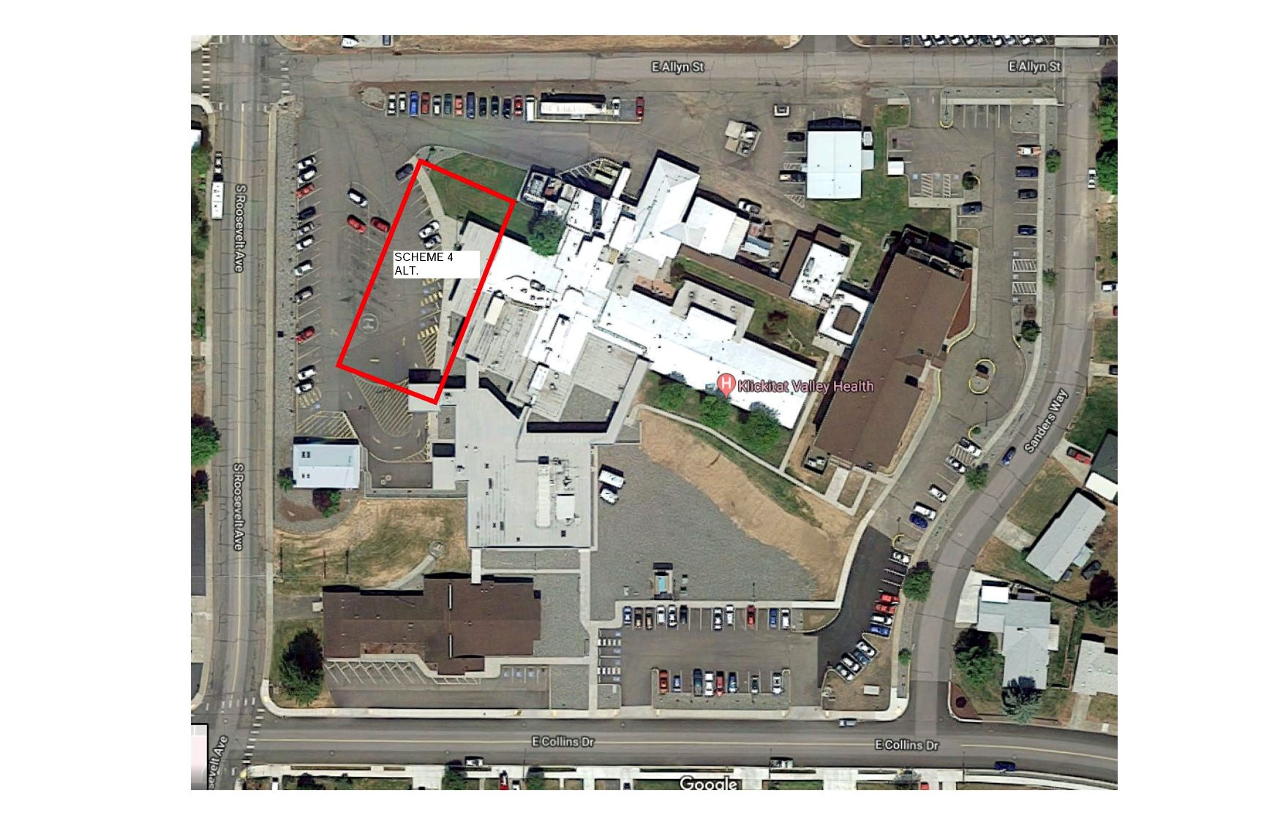

Slide 10
Scheme 4
Plan View

Slide 11
Benefits of GCCM Project Delivery DB
Owner/Designer/Contractor Early Collaboration
  Utilize Team Expertise Early at SD
Compliant to RCW 39.10 P&P
Early Review of SD/Site Challenges
Coordination with Proposed CUP Project
Establish Budget/Provide DD with Budget Advice
Identify and Coordinate Long Lead Items
Full CD Set Detailed with GCCM Input
MACC at 90% CD, VE and Budget Reconciliation
Interactive Design/Contractor/PM Team Group Effort for BIM Modeling and Clash Mitigation
GCCM Influence and Coordination of Move Transition

Slide 12
Benefits of GCCM Delivery Summary
Manage project associated with functioning Hospital
GCCM at Precon essential to integrate as team:
  Phasing
  Scheduling
  Budget Control
  VE/Constructability
  Parallel with CUP
  Public Benefit

Slide 13
Associated Projects JL
CUP Scope and Schedule
Benefit to Align with GCCM on Board
  Site Coordination
  Cost Advice
  MEP Interface
  Campus Functionality

Slide 14
Schedule DB
Item | Task | Hold design for Bond Approval**, then SD commences
Project Predesign and Financial Feasibility Study/Market Analysis |  | Completed (Sept 2018)
1 | GC/CM PRC Application | August 20, 2018
2 | LCCHC PRC Presentation | Sept 27, 2018
3 | GC/CM Delivery Approval | Sept 27, 2018
4 | Official State Authority Notice | Oct 7, 2018
5 | GC/CM RFP | Jan 28, 2019
6 | GC/CM Selection | Mar 7, 2019
** | Bond Vote | April 2019
** | Bond Funding Released | June 2019
7 | Schematic Design Complete | Sept 27, 2019
8 | Baseline Estimate | Oct 27, 2019
9 | GC/CM Budget - 50% DD | Jan 15, 2020
10 | VE/Constructability | Jan/Feb 2020
11 | Design Development Complete | Feb 16, 2020
12 | Construction Docs Complete | June 15, 2020
13 | Mini MACC - 90% CDs | May 2020
14 | Permitting | Aug 1, 2020
15 | MACC | Aug 4, 2020
16 | Site Mobilization | Sept 4, 2020
17 | Construction | Sept 4, 2020

Slide 15
Summary LH
Applicant [KVH]Final Comments
Questions
  PRC issued [2] questions on 9/20 answered 9/21

