Slide 1

Lake Stevens School District
Lake Stevens High School Modernization
Application to use the GC/CM Delivery Method
January 26, 2017
“Our students will be contributing members of society and lifelong learners, pursuing their passions and interests in an ever-changing world.”

Slide 2
Introductions

Slide 3
The Project Team
Here Today
Robb Stanton, Executive Director of Operations, LSSD
Amy Beth Cook – Superintendent, LSSD
Tim Jewett – Principal-in-Charge, Dykeman Architects
Trish Sherman – Project Manager, Dykeman Architects
Dan Cody, GC/CM Procurement & Project Manager, Parametrix
Jim Dugan, GC/CM Program Advisor, Parametrix
Not Here Today
Graehm Wallace, Perkins Coie, External GC/CM Legal Advisor

Slide 4
Agenda
The District
The Project
Project Budget
Project Schedule
Why GC/CM
Qualifications
Organization
Summary

Slide 5
The District

Slide 6
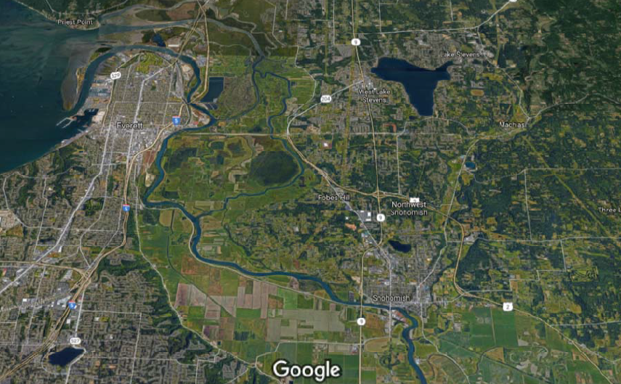
Lake Stevens School District
Lake Stevens

Slide 7
District Statistics
Located In Snohomish County
28.5 square miles encompassing the City Of Lake Stevens, a portion of the City of Marysville & portions of unincorporated Snohomish County
Current estimated population Of 43,026
8,319 students in total
Ten (10) schools comprised of:
  Six (6) Elementary Schools
  Two (2) Middle Schools
  One (1) Mid-high School (8th to 9th grade)
  One (1) High School (10th to 12th grade)
900 Teachers, Administrators And Support Staff

Slide 8
District – 2016 Bond Program
Capital bond approved February 2016 - $116 M
Replace, expand and modernize selected buildings at Lake Stevens High School
Build new Elementary School & Early Learning Center
Districtwide improvements to school safety & security
Districtwide infrastructure improvements
Prior To 2016, Last Capital Bond Passed In 2005 - $65.5M

Slide 9
The Project

Slide 10
Lake Stevens High School Existing Conditions
Built 1979 w/ additions in 1995 & 2007
Single story wood & masonry
1860 students, grades 10-12
Surrounded by single-family residential developments
Pre-Bond studies Identified:
  Lack of space for Special Education, Music, Athletic Programs and STEM
  The open style of campus is difficult to safely secure
  Infrastructure is reaching end of life
  Classrooms are functionally inadequate for current teaching methods

Slide 11
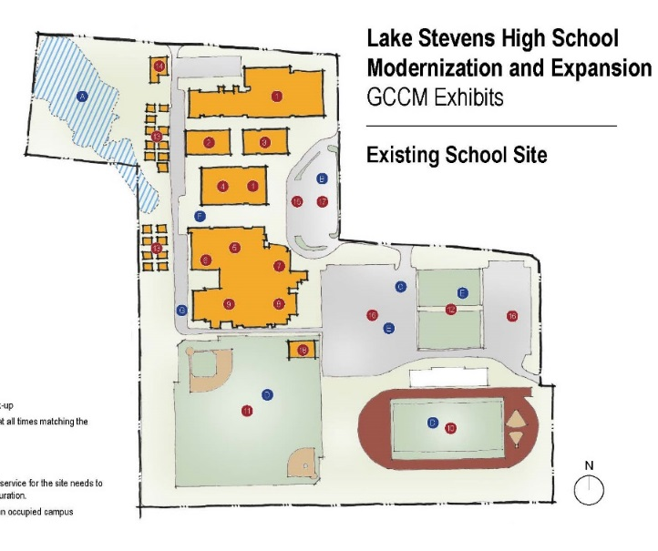
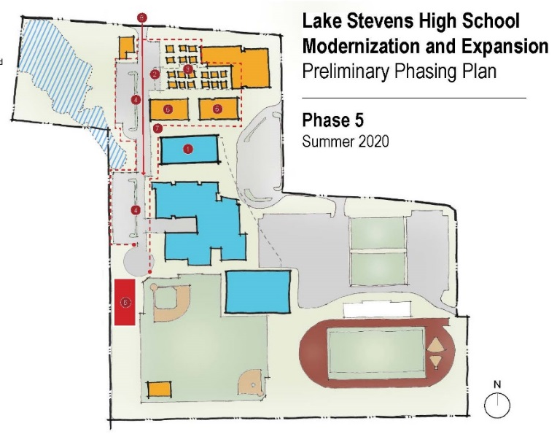
Lake Stevens High School Project Description
New academic and athletic buildings
New spaces designed for music and special education
Improvements to swimming pool and locker rooms
Replacement of heating, ventilation, roofing and electrical systems
Upgraded restroom facilities and finishes throughout the campus
System upgrades for campus security and emergency response
Improvement to student parking, drop off and bus loading areas

Slide 12
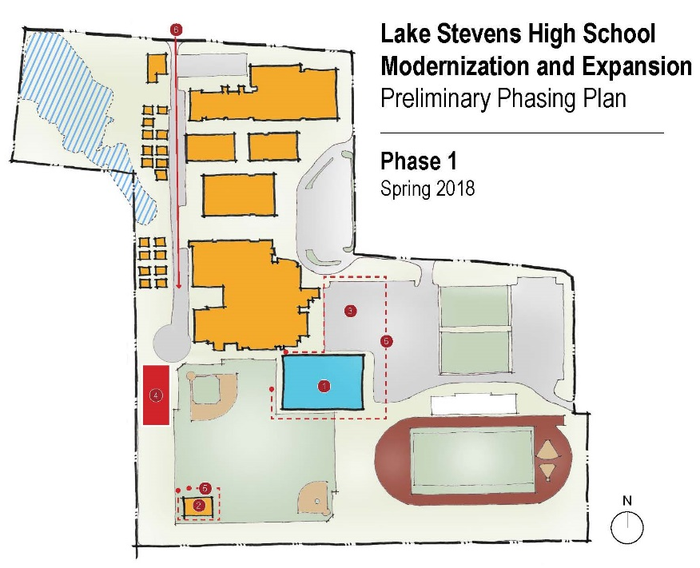
Lake Stevens High School
Phase 1
PHASING FEATURES
Construct New Gym & Athletic Building
Relocate Batting Cages
Modify parking Lot
Construction staging area
Phase 1 construction area
Construction access

Slide 13
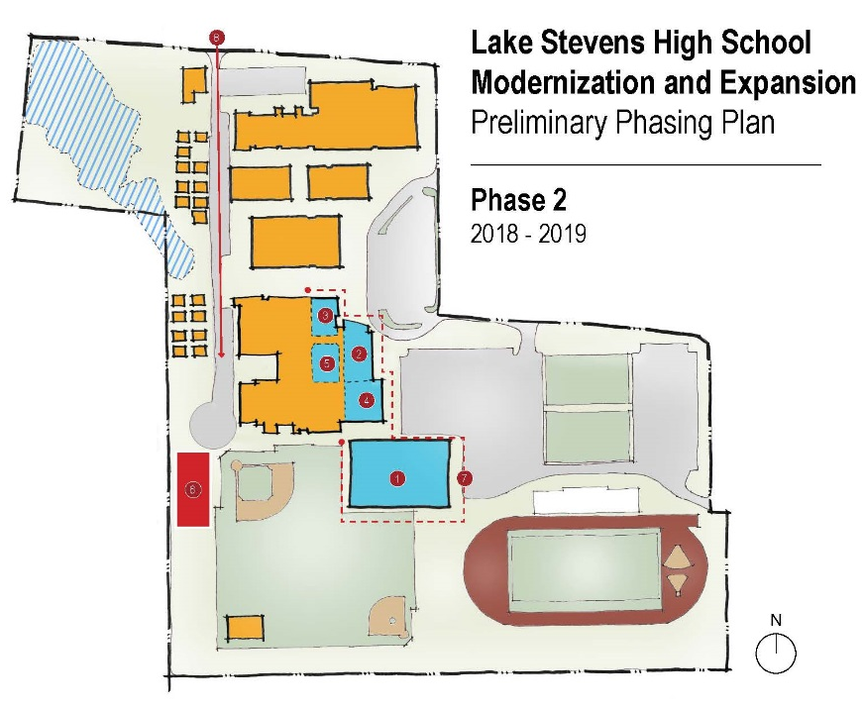
Lake Stevens High School
Phase 2
PHASING FEATURES
Move Gym & Athletics to new facility
Modernize PAC
Modernize Admin
Modernize Pool
Modernize Music
Construction staging area
Phase 2 construction area
Construction access

Slide 14
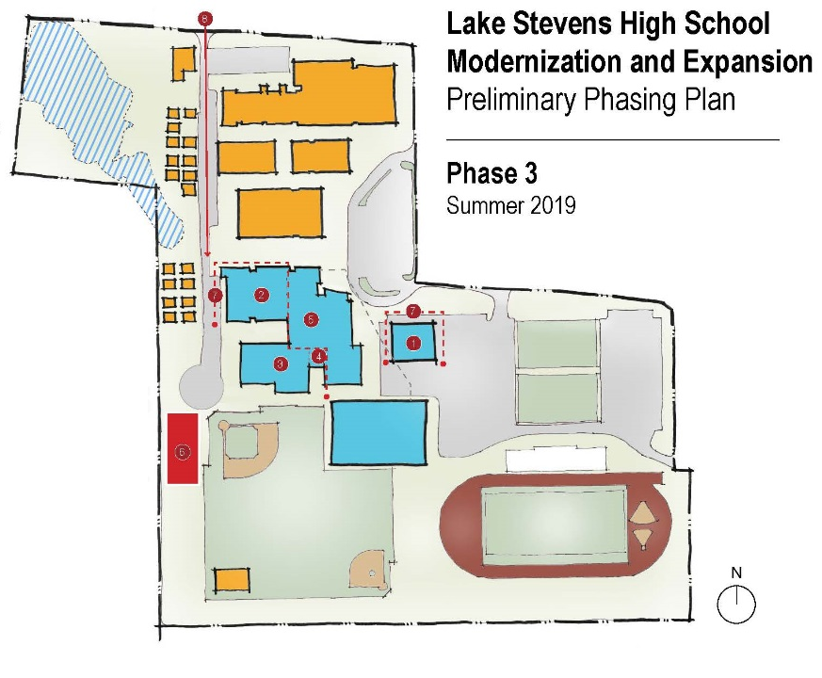
Lake Stevens High School
Phase 3
PHASING FEATURES
Construct Temp Commons/Cafeteria
Modernize commons
Modernize existing Gym/ Athletics into CTE & Art
Construct Drama
Move Music to new facility
Construction staging area
Phase 3 construction area
Construction access

Slide 15
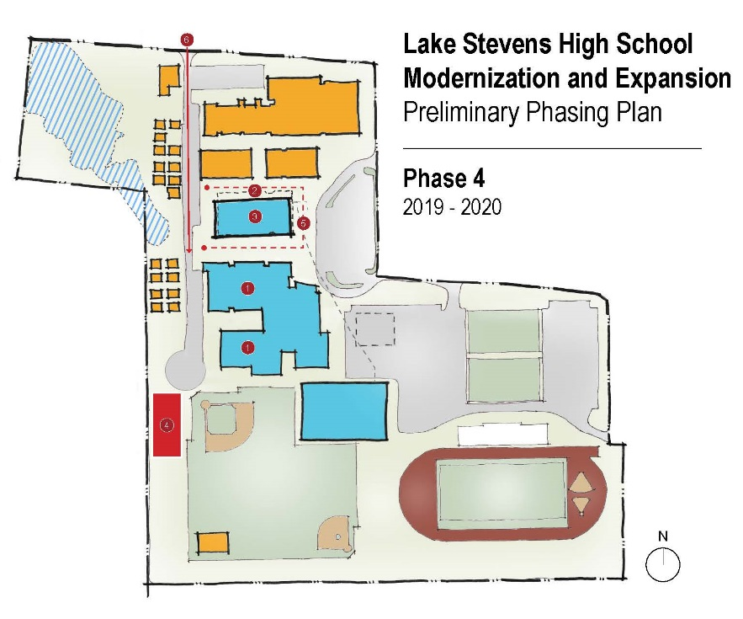
Lake Stevens High School
Phase 4
PHASING FEATURES
Move CTE & Art, Drama, and Commons to new facility
Demo existing 400 Building
Construct Science, Business, Special Education, & Library Wing
Construction staging area
Phase 4 construction area
Construction access

Slide 16

Lake Stevens High School
Phase 5
PHASING FEATURES
Move Science, Business, Special Education, & Library Wing into new facility
Demo ½ of 100 Building
Move Portables
Replace staff parking and bus loop
Demo 200 & 300 Buildings
Construction staging area
Phase 5 construction area
Construction access

Slide 17
Lake Stevens High School Project Budget
Category | Budget
GC/CM MACC (Includes GC/CM Risk Contingency @ 3% of MACC) | $54,000,000
GC/CM Fees, SGC’s, Pre-Con Serv. & NSS Allowances (10% of MACC) | $6,000,000
Subtotal (Owner’s MACC) | $60,000,000
Contingencies –Owner’s Construction (5% of MACC) | $3,000,000
Contingencies – Owner’s Project (2.5% of MACC) | $1,500,000
Fixtures, Furniture, Equipment & Technology (7% of MACC) | $4,200,000
Professional Services Allowance (Architectects & Engineers) (10% of MACC) | $6,000,000
Owner’s Consultants (Survey, Geo-Tech, Hazmat, Insp., etc) (2.5% of MACC) | $1,500,000
Contract Administration Cost (PM/CM, etc) (6% of MACC) | $3,600,000
Other Related Project Costs (Permits, Fees, etc) | $1,860,000
Sales Tax (8.9% of MACC) | $5,340,000
TOTAL: | $87,000,000

Slide 18
Lake Stevens GC/CM Schedule
Presentation to the PRC | January 26, 2017
Release GC/CM RFP | January 30, 2017
SOP’s Due | February 10, 2017
Shortlist SOP’s and Send Invitation to Interview | February 14, 2017
Interviews | March 1, 2017
Shortlist Interviews and Release GC/CM RFFP | March 3, 2017
RFFP Opening and Selection of GC/CM | March 13, 2017
Pre-Con Work Plan Due | March 31, 2017
School Board Approval of Selected GC/CM | April 12, 2017
Pre-Con Agreement Executed | April 17, 2017
Pre-Con Services | April 2017 to March 2018
Complete Schematic Design | May 2017
Construction | June 2018 thru June 2021

Slide 19
Why GC/CM Delivery Method

Slide 20
GC/CM Statutory Criteria
(1) Implementation of the project involves complex scheduling, phasing, or coordination.
(2) The project involves construction at an occupied facility which must continue to operate during construction.
(3) The involvement of the General Contractor/Construction Manager during the design stage is critical to the success of the project.
(4) The project encompasses a complex or technical work environment.
(5) The project requires specialized work on a building that has historic significance.

Slide 21
GC/CM Statutory Criteria
(1) Implementation of the project involves complex scheduling, phasing, or coordination.
(2) The project involves construction at an occupied facility which must continue to operate during construction.

Slide 22
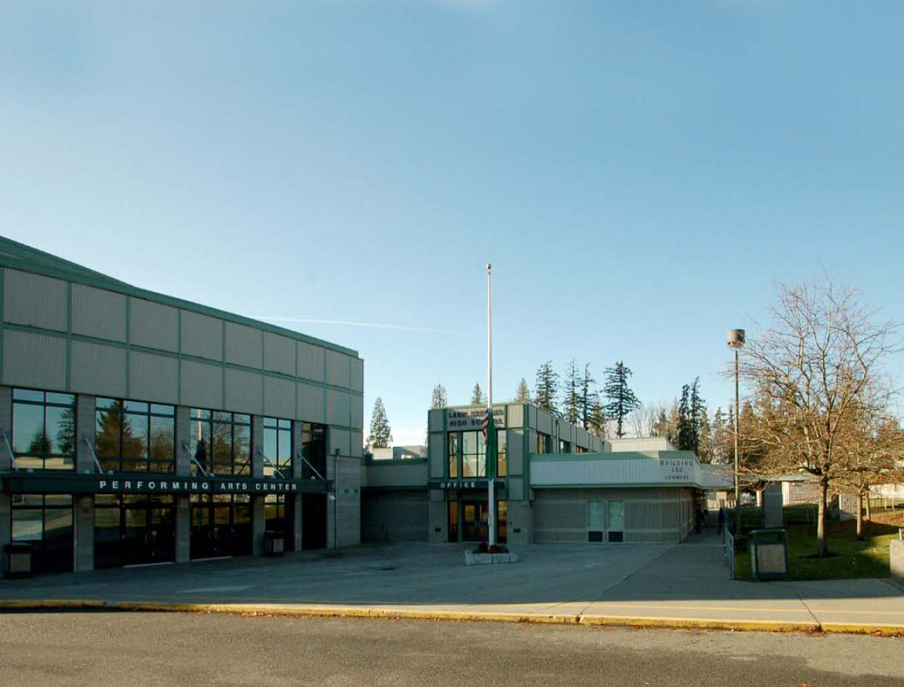

Other Critical GC/CM Factors
Safety: Tight site with close proximity of students and construction activities.
Risk Management: Continuous increases in market costs and decreased resource availability.
Partnership: Strong desire to have collaborative relationship with Owner/Architect/Contractor project team that develops from early in design and has continuity through construction.

Slide 23
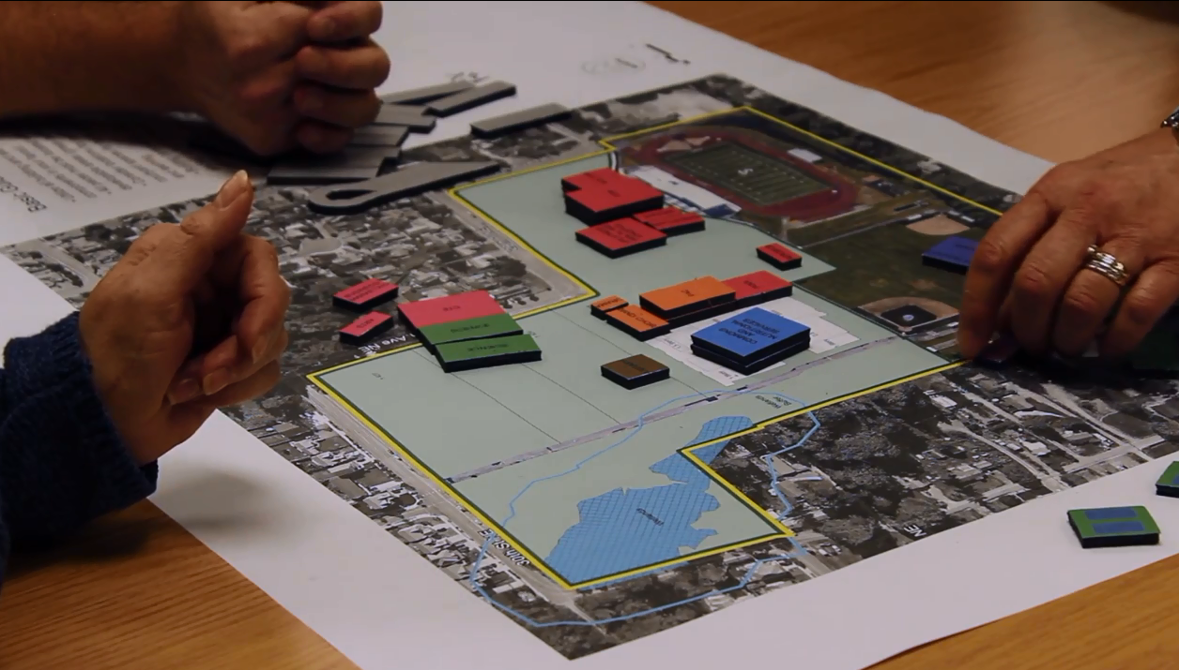
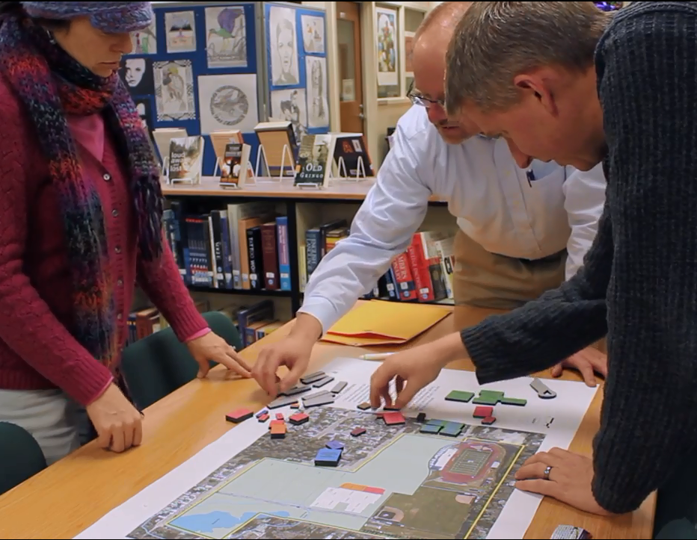
Public Benefit: To this ……
  Ensure student, staff and public safety
  Cost/risk management (= less $ in contingency, more in program space)
  Ensure project completion on schedule/budget
  Outreach to build community relationships
  “Open book” estimating/buyout = fiscal accountability

Slide 24
Public Body Qualifications

Slide 25
LSHS GC/CM Leadership Team
This is the District’s first project using GC/CM method of project delivery.
Executive Director of Operations was AGC GC/CM trained on January 19-20, 2017.
Districts recent construction experience includes a new 220,000 sf mid-high school campus, modernization of three elementary schools, replacement of the high school football stadium and several small capital projects, all of which have been delivered using Design-Bid-Build.
Augmentation of District staff by hiring consultant team members with breadth of GC/CM experience.
  Parametrix hired for GC/CM Procurement, Advisor, Program Management and Project Management services.
  Dykeman Architects hired as Project Architects.
  Retained Graehm Wallace as their attorney and GCCM Legal Advisor.
LSSD satisfies the public body qualifications by staff augmentation with consultants.

Slide 26
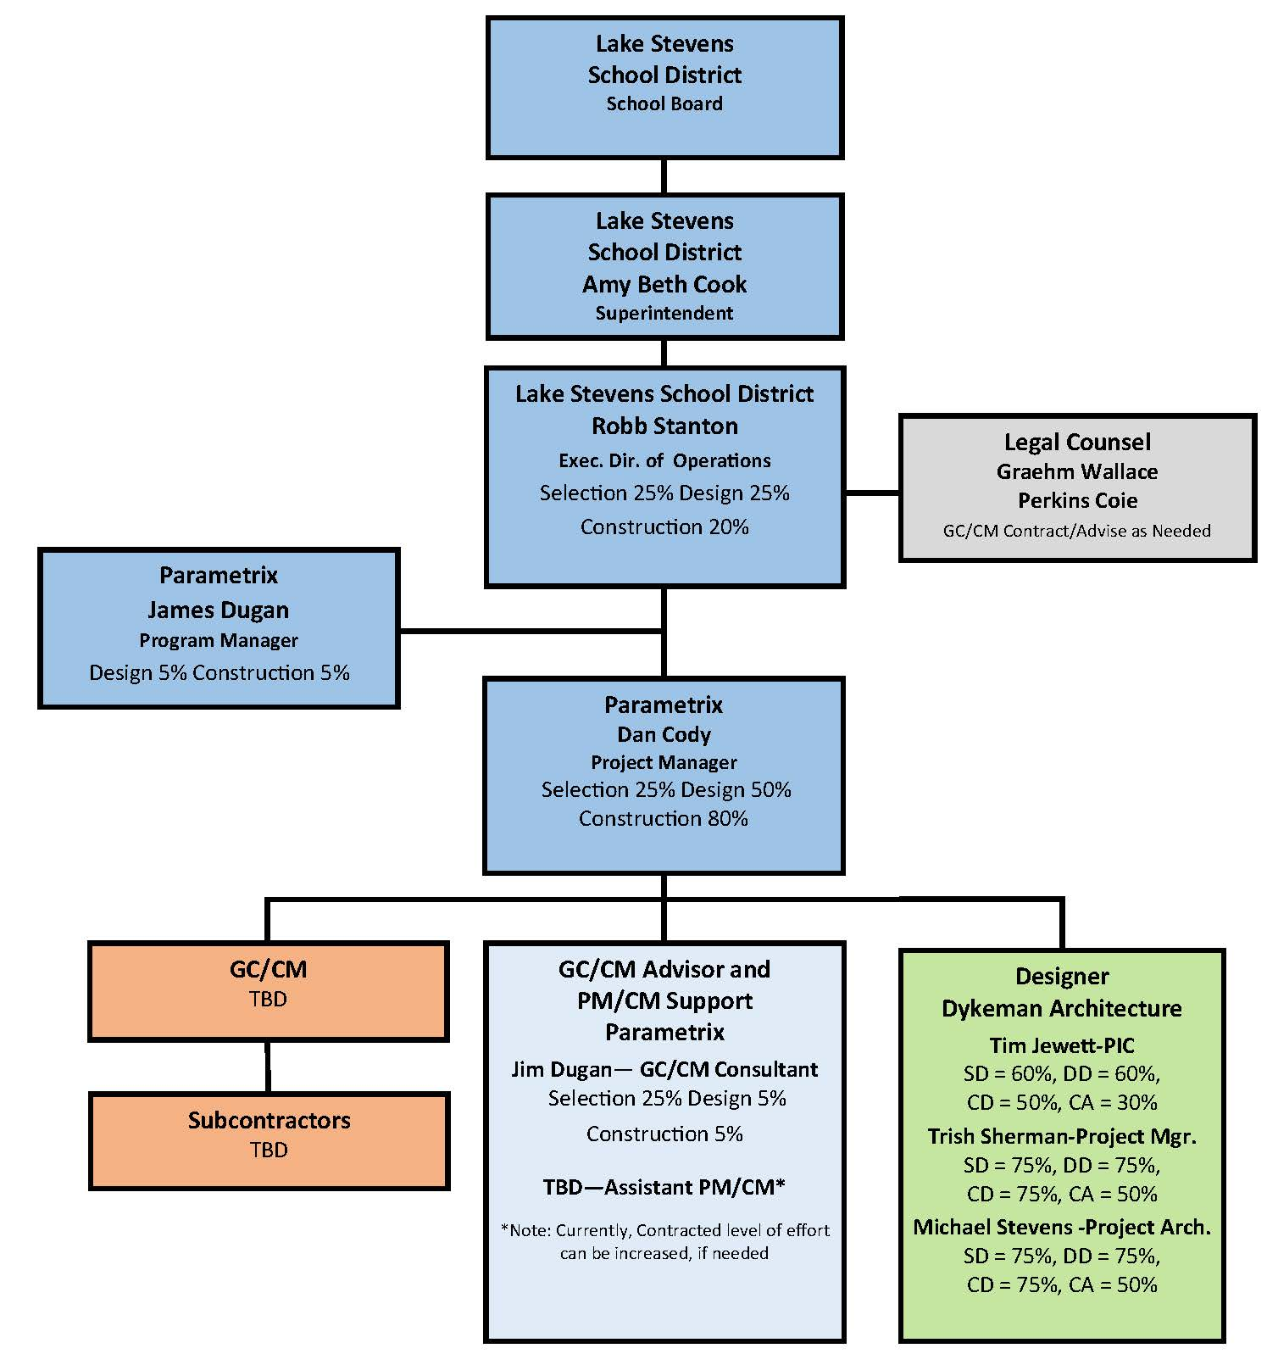
Lake Stevens High School
Project Organizational Chart

Slide 27
Project Team GC/CM Experience

Slide 28
Name | Experience
Robb Stanton Executive Director of Operations Lake Stevens School District | 24 Years Construction/Project Management 15 Years in K-12 AGC GC/CM Training January 2017 1st GC/CM Project
Jim Dugan GC/CM Advisor Parametrix | 39 Years Program/Project Management 12 GC/CM Projects: TPS: Stadium HS, McCarver ES, Stewart MS, Browns Point ES COT: Tacoma Convention and Trade Center, MPT: Eastside Community Center CKSD: Central Kitsap HS/MS and Olympic HS MVSD: East Division ES, Madison ES, and Old Main HS BISD: Blakely ES Tacoma Public Schools, Board of Director: 2005 – 2011 Appointed to the Project Review Committee July 1, 2016 – 3 Year Term
Dan Cody GC/CM Procurement & Project Manager Parametrix | 30 Years Program/Project Management 8 GC/CM Projects: TPS: Browns Point ES MPT: Eastside Community Center CKSD: Central Kitsap HS/MS and Olympic HS MVSD: East Division ES, Madison ES, and Old Main HS BISD: Blakely ES Registered Architect in the State of Washington
Tim Jewett, AIA, A4LE, NCARB Principal-in-Charge Dykeman Architects | 20 Years with Dykeman Architects 20+ Years K-12 Experience 3 GC/CM Projects: Bellingham School District: Sehome High School, Northshore School District: North Creek High School & Bothell High School (Phases 2 &3)
Trish Sherman, ASSOCIATE AIA, A4LE Project Manager Dykeman Architects | 26 Years with Dykeman Architects 20+ Years K-12 Experience 2 GC/CM Projects: Northshore School District: North Creek High School & Bothell High School (Phase 2)

Slide 29
Summary
The project is an ideal fit for the use of the GC/CM method of delivery.
  Project is funded with the appropriate budget.
  Project meets qualifying RCW 39.10 criteria.
  Project Management Plan for project is developed and have clear and logical lines of authority.
  Project team has the necessary experience and continuity
  Project team has the capacity.
  Project team is prepared and ready to move forward.

Slide 30
Thank you

