Slide 1
State of Washington CPARB Project Review Committee
Lake Washington School District
GC/CM – Public Body Approval
May 22, 2014

Slide 2
Agenda
Introductions
About the Lake Washington School District
Project Team Qualifications
GC/CM Projects
Candidate Projects
Summary
Questions?
Notes:
Dan

Slide 3
Introductions
Forrest Miller CFM, REFP, EFM
LWSD Director of Support Services
Dan Chandler PE, AIA (OAC)
Program Manager
Randy Barber PE, CVS, Associate DBIA (OAC)
Deputy Program Manager
Nicole Brown (OAC)
Project Manager
Notes:
Dan

Slide 4
About the District
“Every Student Future Ready”
Established 1944
Service area
Number of students/school types
District recognition
Serial builder
25 projects since 1998, $700M
Notes:
Forrest

Slide 5
Project Team Qualifications
Forrest Miller CFM, REFP, EFM
Director of Support Services
22 years at Lake Washington School District
Director at SS for 9 years
Past chair OSPI Facilities Tech Advisory Comm
Overseen $700M in construction since 1998
GC/CM projects overseen:
Lake Washington High School
Mann Elementary
Rush Elementary
Notes:
Forrest

Slide 6
Project Team Qualifications
Dan Chandler PE, AIA (OAC Services)
Program Manager
30 years construction experience
PRC Board Member (Co-chair 2014)
Extensive Alternative delivery project oversight
Clover Park JBLM ES’s
Nine Mile Falls ES’s
Olympia City Hall
US Courthouse, Billings
Notes:
Dan

Slide 7
Project Team Qualifications
Randy Barber PE, Assoc. DBIA, CVS
Deputy Program Manager
30 years construction experience
Extensive education project experience
GC/CM project experience:
(Garfield ES) Olympia School District
ORLA
Tahoma High School
Nine Mile Falls ES
Notes:
Randy

Slide 8
Project Team Qualifications
Nicole Brown (OAC Services)
Project Manager
16 years construction experience
Extensive public project experience
GC/CM project experience:
Kenmore City Hall
Ft Vancouver New Main Library
City of Yakima-Capitol Theatre Expansion
MTA- Transit Community Center
Notes:
Nicole

Slide 9
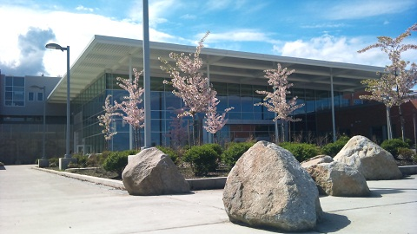
GC/CM Experience
Lake Washington
High School
Replacement
$87M
GC/CM: Lydig Construction
Completed 2011
Phased construction, occupied site
On-time and under budget
Notes:
Randy

Slide 10
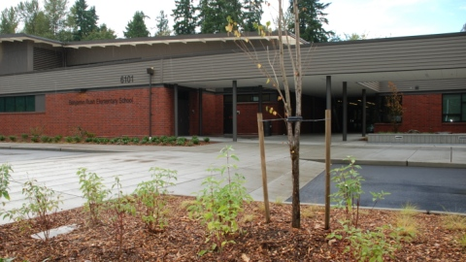
GC/CM Experience
Rush Elementary
School
Replacement
$31.9M
GC/CM: Mortenson Construction
Completed 2013
Occupied and constricted site
On-time and under budget
Notes:
Randy

Slide 11
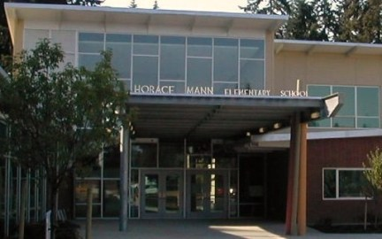
GC/CM Experience
Mann Elementary
School
Replacement
$12.6M
GC/CM: Kirtley Cole
Completed 2003
Occupied and constricted site
On-time and 2.25% over budget-UC
Notes:
Randy

Slide 12
Candidate Projects
Juanita HS Replacement/STEM School
Constricted, occupied site, phased construction
Lake Washington High School Addition
Occupied site, phased construction
New Redmond Ridge Middle School
Constricted site, planned development community
Notes:
Dan

Slide 13
Summary
Extensive GC/CM team experience
Highly qualified project managers
Established internal processes
Experienced builders
Notes:
Dan

Slide 14
Questions?

