Slide 1
Lakehaven Water & Sewer District New Headquarters
APPLICATION FOR APPROVAL TO UTILIZE GC/ CM PROJECT DELIVERY
SEPTEMBER 26, 2019 PRESENTATION
The Lakehaven Water and Sewer District is committed to the continued delivery of safe, reliable and high quality drinking water and environmentally responsible sewer service to our customers.

Slide 2
Agenda
Introductions
Lakehaven Water & Sewer District The Project
Project Budget Project Schedule
Why GC/CM
Public Body Qualifications Organization Chart Project Team Experience Summary

Slide 3
Introductions

Slide 4
The Project Team: Here Today
Lakehaven Water & Sewer District
Ron Nowicki, Commissioner
Peter Sanchez, Commissioner
Ken Miller, P.E., Engineering Manager
John Bowman, P.E., District General Manager
Parametrix
Jim Dugan, GC/CM Program Advisor
Dan Cody, GC/CM Procurement Manager & PM/CM Support
Joe Missel, Assistant PM/CM
Helix Design Group
Bruce McKean, AIA, Managing Principal
Jeff Blachowski, RA, Architect Project Manager
District External Legal Counsel
Graehm Wallace, Perkins Coie

Slide 5
The Project Team: Not Here Today
Lakehaven Water & Sewer District
Steve Pritchett, District General Counsel
Michael E. Purdy Associates, LLC
Mike Purdy, PM Advisory Consultant

Slide 6
Lakehaven Water & Sewer District
Located between Seattle and Tacoma in King and Pierce Counties
Provides service within most of the City of Federal Way and small portions of the cities of Auburn, Pacific, Tacoma, Des Moines, Kent, Algona, Edgewood and Milton
Service area encompasses an area of approximately 35 square miles and serves a population of 120,000 people
The District has, under one name or another, provided service to the Federal Way area for more than 60 years.
On October 16, 2016 the name was officially changed to Lakehaven Water and Sewer District

Slide 7
The Project

Slide 8
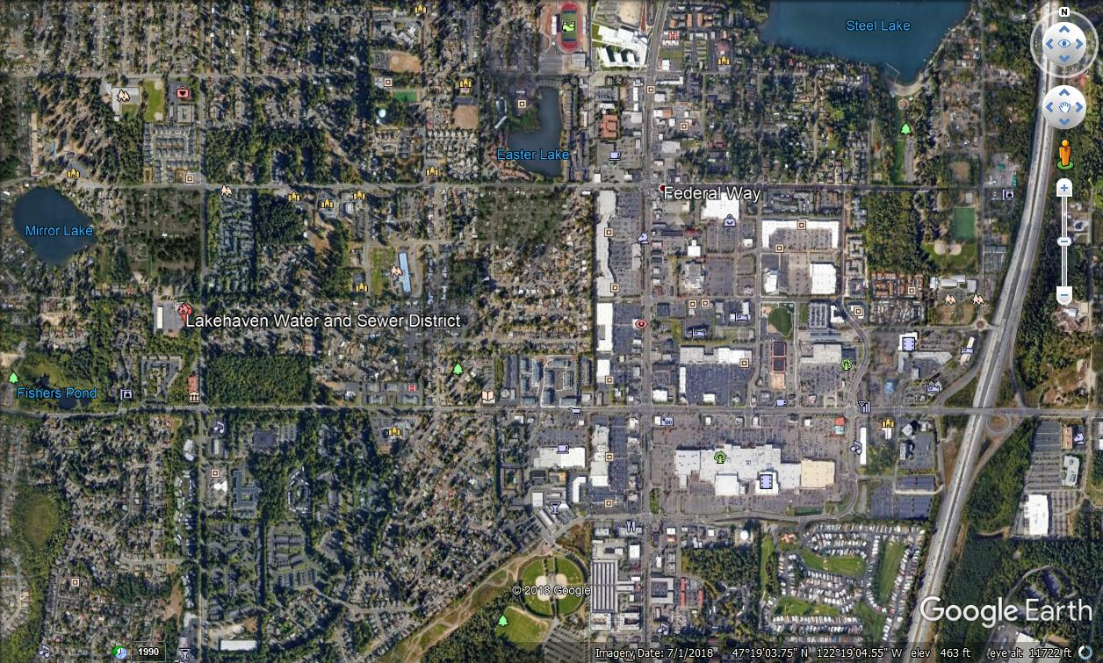
Lakehaven Vicinity Map

Slide 9
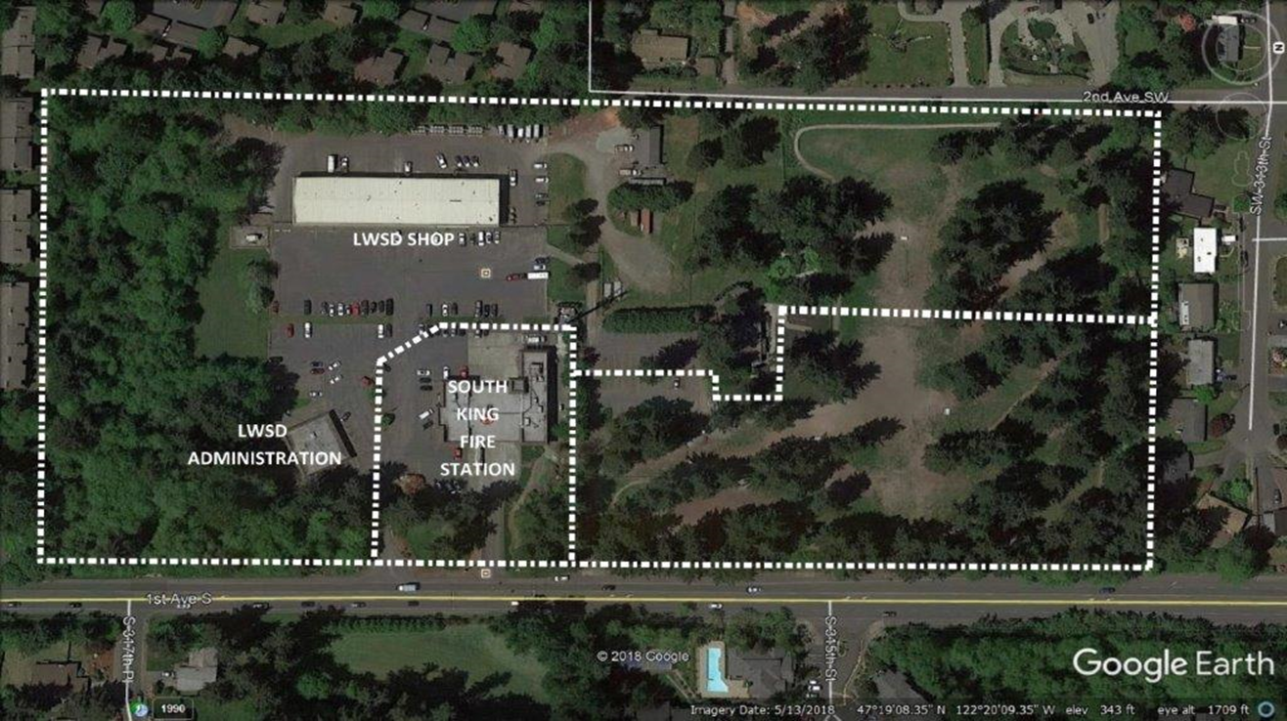
Location

Slide 10
Lakehaven Water & Sewer District New Headquarters
New and replacement buildings are proposed on the existing site.
The proposed project consists of:
A new 40,000 sq. ft. 2-story administration building with approximately 145 parking stalls (Will be designed structurally as an “essential facility”.)
A new vehicle storage building
Remodel of the existing maintenance building (a.k.a. ‘Water Shop”)
Replacement of the existing storm water system
New underground utility work
Demolition of the existing administration building
New material storage areas and other miscellaneous buildings and features
Offsite improvements on 1st Avenue South

Slide 12
New Headquarters Building

Slide 13
Lakehaven Water & Sewer District New Headquarters Project Budget
Category | Budget
Costs for Professional Services (A/E, Legal, etc.) | $ 2,721,142
Estimated project construction costs (including construction & risk contingencies) | $ 29,382,515
Equipment and furnishing costs | $ 2,529,158
Off-site costs | $ included
Contract administration costs (Owner, PM/CM, etc.) | $ 1,400,000
Contingencies (owner project contingency @ 5%) | $ 2,108,348
Other related project costs (Assessments/Fees & BR Insurance) | $ 834,638
Sales Tax (Construction and FF&E @ 10%) | $ 3,191,167
Total | $ 42,166,968

Slide 14
Project Funding
The District currently has $55M in cash reserves on hand that could fully fund the design and construction costs for the project.
To preserve the cash reserves for other possible needs, the District is pursuing the issuance of $40M in revenue bonds to fund the majority of the project.
Funding for the A/E design, GC/CM advisor services and the GC/CM preconstruction services are being provided from the cash reserves until the revenue bonds are in place.

Slide 15
Lakehaven Water & Sewer District New Headquarters Facility Schedule
GC/CM Schedule | Start | Finish
PRC Presentation |  | September 26, 2019
First publication of RFP for GC/CM Services |  | October 1, 2019
Second publication of RFP for GC/CM Services |  | October 8, 2019
Project Information Meeting |  | October 11, 2019
RFP Submittal Deadline |  | October 18, 2019
Open & Score RFP Submittals Received | October 21, 2019 | October 23, 2019
Notify Submitters of Most Highly Qualified Submitters & Invite to Interview |  | October 25, 2019
Interviews with Short-Listed Firms |  | November 4, 2019
Notify Submitters of Finalists Firms & Invite to Submit a response to RFFP |  | November 6, 2019
RFFP Submittal Deadline & Opening |  | November 20, 2019

Slide 16
Lakehaven Water & Sewer District New Headquarters Facility Schedule
GC/CM Schedule | Start | Finish
Notify Submitters of Scoring and Most Qualified GC/CM |  | November 25, 2019
Pre-Con Work Plan Due |  | December 20, 2019
Board Approval of GC/CM Selection |  | January 9, 2020
GC/CM Agreement w/Pre-Con Services Executed |  | January 13, 2020
Pre-Con Services | January 13, 2020 | November 2020
GMP Negotiation (90% CDs) | November 2020 | December 2020
Board Approval of GMP and GMP Contract Amendment Executed |  | January 2021

Slide 17
Lakehaven Water & Sewer District New Headquarters Facility Schedule
Design & Construction Schedule | Start | Finish
Schematic Design | October 2019 | February 2020
Site Development and Land-use Review | January 2020 | June 2020
Design Development | March 2020 | July 2020
Construction Documents | August 2020 | January 2021
Building Department Review/Planning | October 2020 | March 2021
Construction | March 2021 | June 2022
Substantial Completion |  | June 2022
Final Completion/Closeout | June 2022 | August 2022
Sitework Warranty Period | June 2022 | May 2023

Slide 18
Why GC/CM Delivery Method for the New Headquarters Project

Slide 19
RCW 39.10.300 GC/CM Statutory Compliance
Complies with 2 of the 5 Statutory Criteria
Implementation of the project involves complex scheduling, phasing, or coordination.
The project involves construction at an occupied facility which must continue to operate during construction
The involvement of the General Contractor/Construction Manager during the design stage is critical to the success of the project.
The project encompasses a complex or technical work environment.
The project requires specialized work on a building that has historic significance.

Slide 20
Advantages to GC/CM Delivery
Improved cost control – “open book” cost accounting of the work
Allocation of risk – GC/CM understands the nature and scope of construction long before it bids, reducing the “learning curve”, and lowers the potential for surprises that add cost/time during construction.
Schedule compliance – GC/CM is motivated to maintain a schedule they helped to develop.
Fiscal accountability through GC/CM participation in constructability reviews, value analysis and design-team/contractor/Owner coordination
Bidding coordination – GC/CM will plan, coordinate and execute subcontractor bid packages for best responsiveness and lower risk of gaps and duplication in subcontractor bidding and buy-out.

Slide 21
Public Body Qualifications

Slide 22
Lakehaven
The Lakehaven Water & Sewer District has a successful history of planning and executing capital projects, including a $187 million GC/CM water filtration plant project built by the City of Tacoma in partnership with Lakehaven, the City of Kent, and Covington Water District.
Water & Sewer District Leadership Team
LWSD Project Manager, Ken Miller, has been a licensed professional engineer for 35 years. Ken performs the role of Engineering Manager and is responsible for the planning, engineering and construction of the capital program for LWSD.
Lakehaven Water & Sewer District is new to the GC/CM method of project delivery, but has augmented their staff with Parametrix as their APD Consultants.
GC/CM Consultant: The staff at Parametrix will provide advisory services related to GC/CM and RCW 39.10, GC/CM procurement, and PM/CM services for the duration of the project. Jim Dugan GC/CM Advisor; Dan Cody GC/CM Procurement & PM/CM; Joe Missel, Assistant PM/CM.
The Lakehaven Water & Sewer District satisfies the public body qualifications by staff augmentation with consultants experienced in GC/CM delivery and RCW 39.10.

Slide 24
Project Team APD Experience

Slide 25
Name | Experience
John Bowman Civil Engineer District General Manager Lakehaven Water & Sewer District | Appointed General Manager of LWSD in 2011 25 Years as a licensed Civil Engineer GC/CM Projects: $187 million water filtration plant built by City of Tacoma in partnership with Lakehaven, City of Kent and Covington Water District
Jim Dugan GC/CM Program Advisor Parametrix | 40 yrs. Program/Project Management 30+ GC/CM Projects: Recent GC/CM: VPS McLoughlin MS/Marshall ES, TPS Birney ES, TPS Grant ES, ASD Dick Scobee ES, ASD Olympic Middle School, LSSD Lake Stevens HS, MVSD Old Main Building, MVSD Madison Elementary, MVSD East Division Elementary, BISD Blakely Elementary School, MPT Eastside Community Center, TPS Browns Point Elementary School; CKSD Central Kitsap HS/Central Kitsap MS, CKSD Olympic HS Project Review Committee Chairman: Term Ends June 2020
Dan Cody GC/CM Procurement and PM Support Parametrix | 32 yrs. Design & PM/CM 3 GC/CM Projects: VPS McLoughlin MS/Marshall ES, LSSD Lake Stevens HS, MPT Eastside Community Center 24+ GC/CM Procurement: Recent GC/CM Procurement: VPS McLoughlin MS/Marshall ES/Lieser, TPS Birney ES, ASD Elem #15/Elem #16/Lea Hill ES, TPS Grant ES, ASD Dick Scobee ES/Pioneer ES/Chinook ES/Terminal Park ES, ASD Olympic Middle School, LSSD Lake Stevens HS, MVSD Old Main Building, MVSD Madison Elementary, MVSD East Division Elementary, BISD Blakely Elementary School, MPT Eastside Community Center, TPS Browns Point Elementary School; CKSD Central Kitsap HS/Central Kitsap MS, CKSD Olympic HS

Slide 26
Name | Experience
Mike Purdy PM Advisory Consultant Michael E. Purdy Associates, LLC | 30 yrs. Project Management 12+ GC/CM Projects: William Shore Pool District Expansion & Renovation Project, PTSD Grant Street ES, Port of Pasco Tri-Cities Airport Expansion/Modernization, City of Everett Water Pollution Control Facility Phase C, Ridgefield Schools, Ridgefield Capital Improvement Project, Kennewick School District, Kennewick Elementary, Kitsap County Pump Station 16/67 Upgrades Project, City of Bellingham Post Point Wastewater Treatment Plant, City of Tacoma (Water) Green River Filtration Facility, City of Seattle, Fire Station 14 Renovation, LOTT Clean Water Alliance Budd Inlet Treatment Plant, Sound Transit University of Washington Station
Bruce McKean AIA, Principal in Charge Helix Design Group | Relevant Experience: Bruce has over 30 years of experience completing a broad range of projects including work with multiple local municipalities, the State of Washington, the Department of Transportation, Department of Defense, and other private clients. Bruce is an experienced manager and has coordinated multi-discipline projects exceeding $30 million in construction value. Bruce is also Helix Design Group’s Founding Principal, and has throughout his career exhibited exceptional management skills, both as a business executive and as Principal-in-Charge for a wide variety of design projects including those that include alternative delivery.

Slide 27
Name | Experience
Jeff Blachowski RA, LEED AP Architect Project Manager Helix Design Group | Relevant Experience: Over the course of his 22-year career, Jeff Blachowski has been a project architect, project manager, and construction administrator for a diverse range of new and renovation projects that encompass educational, municipal, commercial, housing, hospitality, medical, automotive, retail and light industrial facilities. His experience spans both the private and public sectors and has been involved in many successful alternative delivery projects. Jeff's creative design skills, alongside his strong, detail-oriented management, technical skills, and team approach have contributed to his ability to guide successful projects from concept development through completion.

Slide 28
Summary
Project meets qualifying RCW 39.10 criteria
Project team has GC/CM delivery knowledge and experience
Project team is sufficiently staffed with experienced personnel
Project Management Plan is developed and has clear and logical lines of authority
There is appropriate funding and time to execute the project
PM/CM personnel is knowledgeable in GC/CM process
LWSD has no unresolved audit findings
Project team is prepared and ready to proceed

Slide 29
Thank you

