Slide 1

Mount Vernon High School
Old Main Building Historic Modernization
Application to use the GC/CM Delivery Method
December 1, 2016
“To expect, encourage, and facilitate the pursuit of excellence and life-long learning in our students, equipping them for future success and happiness”

Slide 2
Agenda
Introductions
MVSD Capital Improvement Plan
The Project
Project Budget
Project Schedule
Why GC/CM
Qualifications
Organization
Summary

Slide 3
Introductions

Slide 4
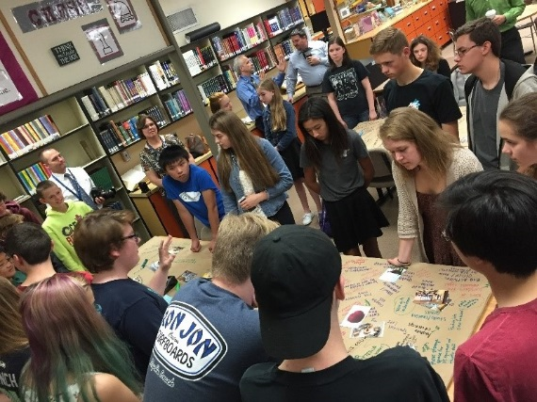
The Project Team
Here Today
Suzanne Gilbert, Director of Capital Projects, MVSD
Dan Cody, GC/CM Procurement & Project Manager, Parametrix
Jim Dugan, MVSD GC/CM Program Advisor, Parametrix

Slide 5
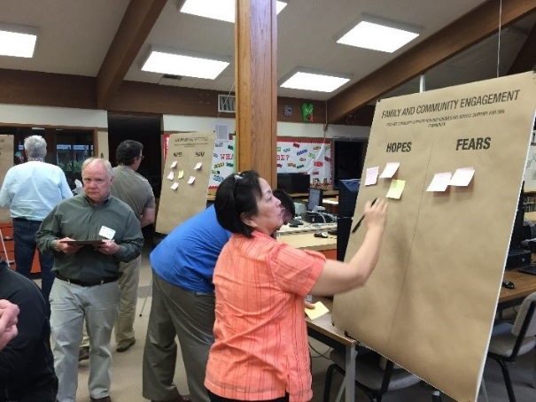
The Project Team
Not Here Today
Carl Bruner, Superintendent, MVSD (Recovering from Surgery)
Tom Theisen, Assistant Project Manager (On Vacation Oversees)
Graehm Wallace, Perkins Coie, External GC/CM Legal Advisor

Slide 6
The Project Team
Not Selected Yet
The design team
Not selected yet by design
Based on lessons learned on previous historic modernization & additions projects
District desires to have the selected GC/CM participate in the design team selection process
The volume and nature of interaction between the design team and the contractor is extreme and demands a good chemistry and fit to be successful

Slide 7
Mount Vernon School District Capital Improvement Program

Slide 8
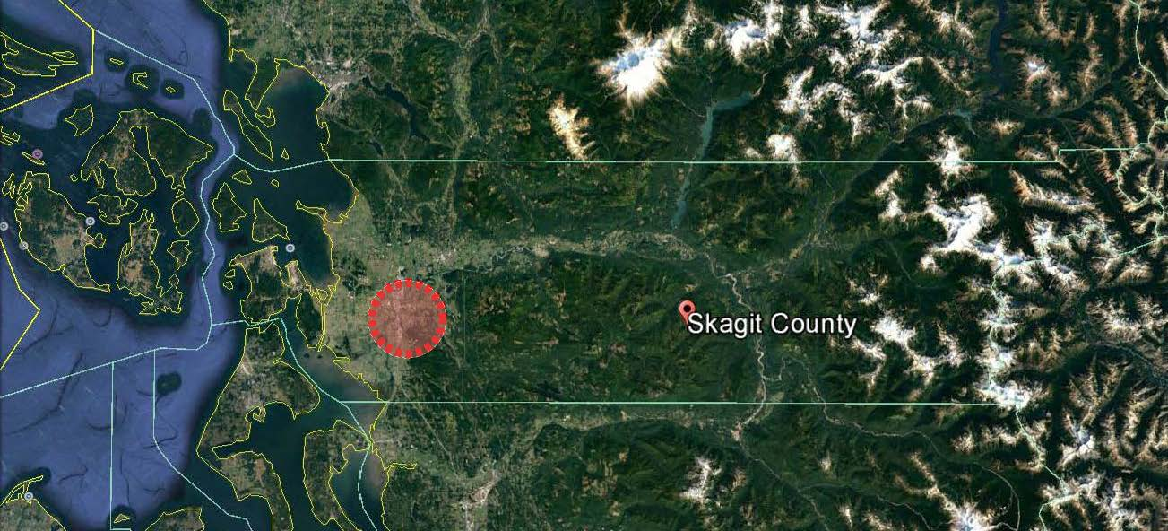
Mount Vernon School District

Slide 9
District Statistics
Located in western Skagit County
Third largest employer in Skagit County
Began serving students in 1891
6,400 students in total
Ten (10) schools comprised of:
  Six (6) Elementary Schools
  Two (2) Middle Schools
  One (1) High School
  One (1) Homeschool Parent Partnership
950 teachers, administrators and support staff
Prior to 2016, last capital bond passed in 2001

Slide 10
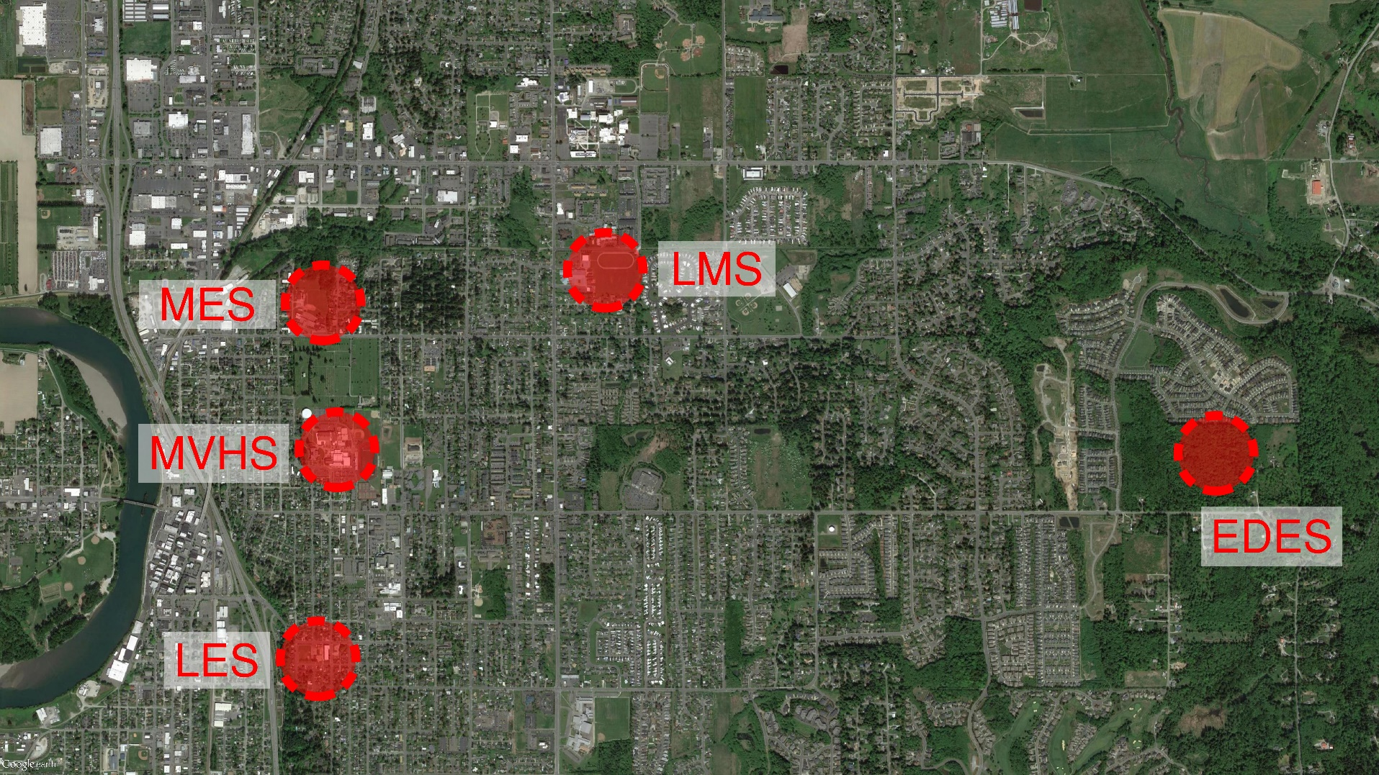
MVSD Capital Improvement Program $106,463,549
Capital Bond Approved February 2016

Slide 11
2016 MVSD Capital Bond Program Projects
Today’s PRC Presentation
Mount Vernon High School (MVHS) – Historic Modernization & Additions
Projects Currently Underway (GC/CM)
East Division Elementary School (EDES)– New School
Madison Elementary School (MES) – Replacement School
Remaining MVSD Capital Projects
Mount Vernon High School – New CTE Building
LaVenture Middle School (LMS) – Modernization & Additions
Lincoln Elementary School (LES) – TBD

Slide 12
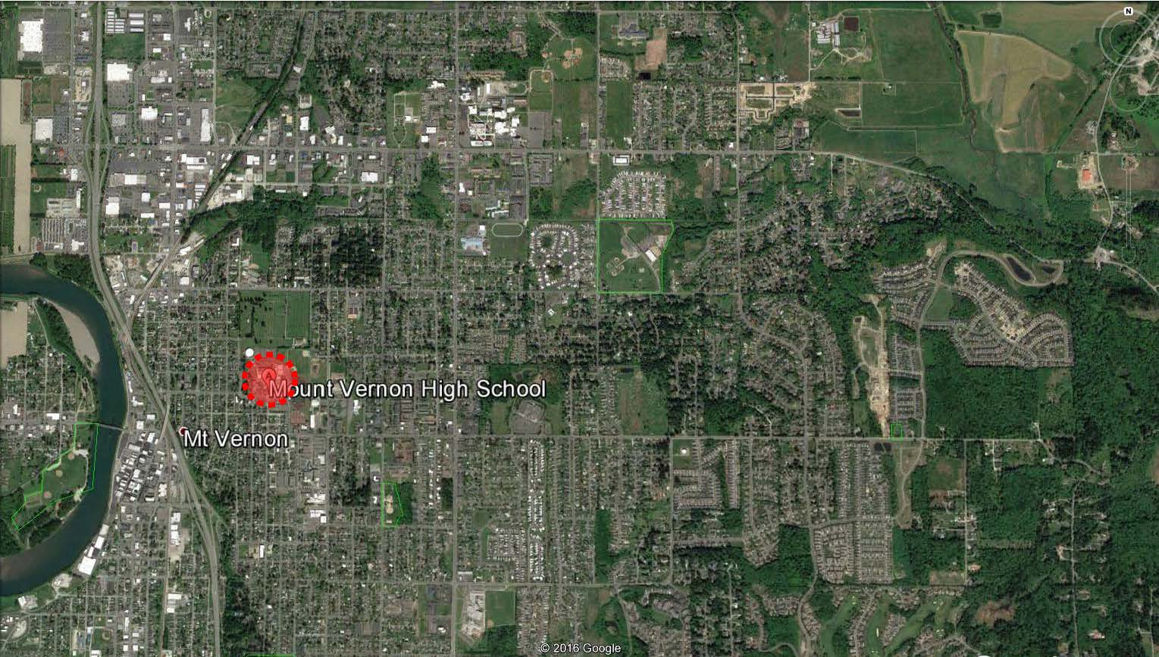
Mount Vernon High School
Old Main Building

Slide 13
The Project

Slide 14
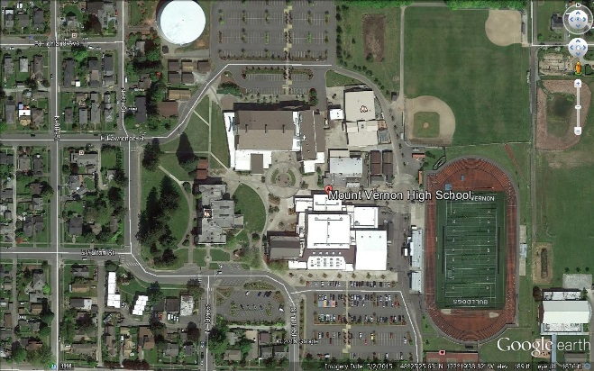
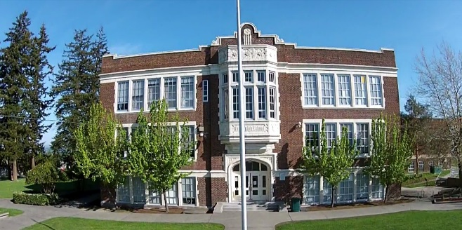
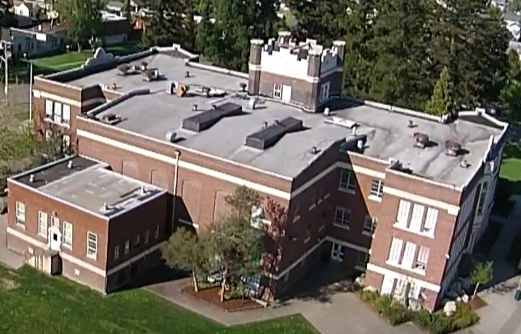
MVHS Old Main Building
Historic Building - Circa 1922
Occupied Campus – 1900 Students
Adjacent to Residential Areas
Haz-Mat Abatement
Heavy Demolition Work
Structural/Seismic Upgrades
Replace All Building Systems
Existing Building 54,000 SF
Anticipated Owners MACC: $20.5 M
Construction Start: July 2018
Occupancy: January 2020

Slide 15
Mount Vernon High School Campus

Slide 16
MVHS Old Main Project Budget
Category | Budget
GC/CM MACC (includes GC/CM risk contingency @ 3% of MACC) | $17,015,000
GC/CM Fee, SGC’s, NSS Allowance and Pre-Con Services Fee | $2,450,000
Contingencies – Design, Construction and Owner | $2,460,000
Fixtures, Furniture, Equipment & Technology | $1,435,000
Professional Services Fee (Architects & Engineers) | $2,870,000
Contract Administration (PM, CM, etc) | $615,000
Owner Consultants | $512,500
Other Costs (utilities, permits, special inspections, etc.) | $359,000
Sales Tax | $1,783,500
TOTAL: | $29,500,000

Slide 17
Old Main GC/CM Schedule
Presentation to the PRC | December 1, 2016
Release GC/CM RFP | December 5, 2016
SOP’s Due | January 4, 2017
Shortlist SOP’s and Send Invitation to Interview | January 10, 2017
Interviews | January 24, 2017
Shortlist Interviews and Release GC/CM RFFP | January 27, 2017
RFFP Opening and Selection of GC/CM | February 13, 2017
Pre-Con Work Plan Due | March 3, 2017
MVSD School Board Approval of Selected GC/CM | March 15, 2017
Pre-Con Agreement Executed | March 20, 2017
Pre-Con Services | March 2017 to June 2018
Construction Phase | July 2018 thru January 2020

Slide 18
Why GC/CM Delivery Method for MVHS Old Main Building

Slide 19
Complies with all 5 Statutory Criteria
(1) Implementation of the project involves complex scheduling, phasing, or coordination.
  School moves out of building and into temporary housing
  Contractor Sets up perimeter fencing for safety
  Complex Site Logistics will require complex coordination
    Maintain access for student and staff to surrounding campus and neighborhood
    Coordinate delivery of equipment and materials with peak arrival/departure
    Small laydown area requires detailed scheduling of material delivery dates
(2) The project involves construction at an occupied facility which must continue to operate during construction.
  Surrounding campus will be fully occupied during the school year.
  After-hours school activities on surrounding campus during the school year.
  Community use of athletic facilities year around.
(3) The involvement of the General Contractor/Construction Manager during the design stage is critical to the success of the project.
  Confirmation of existing building and systems
  Constructability review/input
  Value engineering review/input
  Market based cost estimating
  Reconciliation of estimates and budget control
  Marketing of project to potential subcontractors and suppliers

Slide 20
Complies with all 5 Statutory Criteria
(4) The project encompasses a complex or technical work environment.
  Retrofit of a 1922 building to accommodate current day building systems (Electrical, HVAC, Fire Sprinkler, A/V, Data).
  Restoration of existing masonry requires highly skilled labor
  Restoration of unique, historic building materials (plaster, terrazzo, woodwork, etc.) requires highly skilled labor
(5) The project requires specialized work on a building that has historic significance.
  Building constructed originally in 1922
  Building has huge historical and cultural significance to the community.

Slide 21
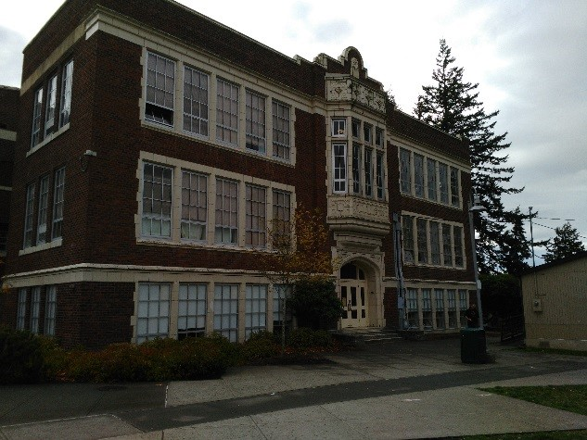
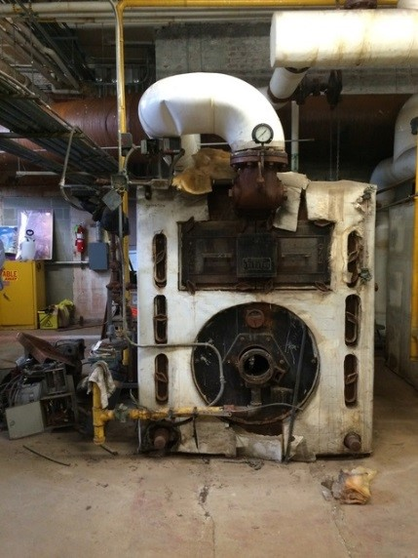
Other Critical Factors
Neighborhood Communication, Access/Egress & Traffic Management
Inflation - Escalating Market Costs
Possible Early Abatement and Demolition Package(s)
Possible Early Procurement of Long Lead Items
Critical compliance requirement to test, document, abate and monitor for hazardous materials

Slide 22
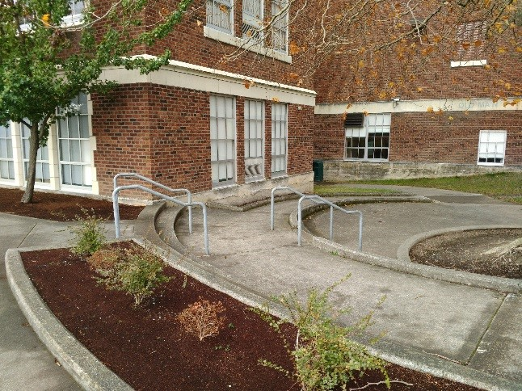
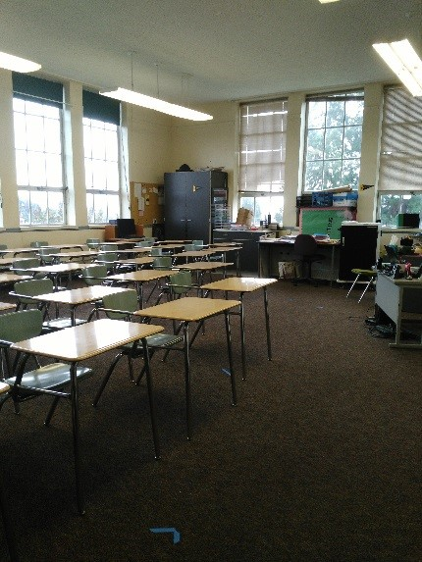
Public Benefit: To this ……
  Public and District Safety
  Cost/Risk Management
  Ensure Project Completion
  on Schedule and Budget
  Community Relationships
  Fiscal Accountability

Slide 23
Public Body Qualifications

Slide 24
MVSD Leadership Team
First round of major capital projects in more than a decade.
Recent work has consisted primarily of small capital and maintenance projects, all of which have been delivered using Design-Bid-Build.
The District is fairly new to the GC/CM method of project delivery.
The project is ideal for the use of the GC/CM method of delivery.
MVSD Director of Capital Projects was AGC GC/CM trained in June 2016.
MVSD hired Parametrix for GC/CM experience, Program Management and Project Management services.
MVSD retained Graehm Wallace as their attorney – depth of GC/CM experience.
Will make GC/CM experience a key factor in selection of the Contractor and Architect.
MVSD satisfies the public body qualifications by staff augmentation with consultants.

Slide 25
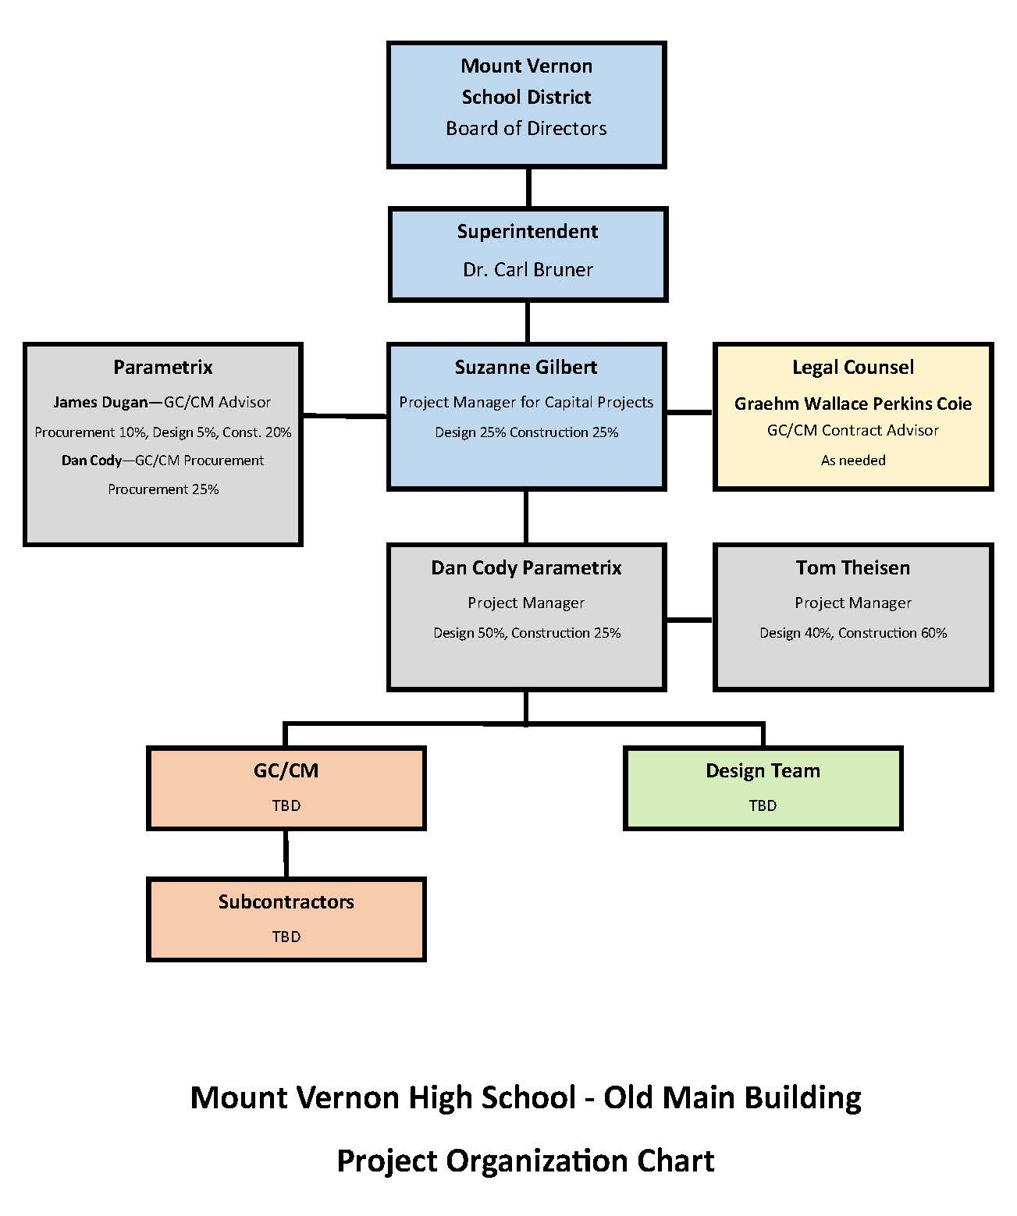
Old Main Project Organizational Chart

Slide 26
Jim Dugan – Project Commitments and Capacity
GC/CM Program Advisor – Jim Dugan
TPS McCarver ES construction is Complete.
TPS Stewart MS GC/CM Construction is Complete.
TPS Browns Point ES GC/CM Procurement is Complete .
MPT Eastside Community Center GC/CM Procurement is Complete.
CKSD Olympic HS and Central Kitsap HS/MS GC/CM Procurement is Complete.
MVSD EDES/MES GC/CM Procurement is Complete.
BISD BES GC/CM Procurement is Complete.
All Other GC/CM Principal and Project Executive Roles are Minimal.
Ample capacity for the MVSD GC/CM Procurement and Advisor Role.
Additional capacity for other responsibilities.

Slide 27
Project Team GC/CM Experience

Slide 28
Name | Experience
Suzanne Gilbert Director, Capital Projects Mount Vernon School District | 30 Years Program/Project Management 25 Years as a Registered Architect 20 Years in K-12 AGC GC/CM Training June 2016 2 GC/CM Projects: East Division Elementary School; Madison Elementary School
Jim Dugan GC/CM Advisor Parametrix | 38 Years Program/Project Management 20+ Years K-12 Experience 11 GC/CM Projects: TPS Stadium High School, COT Tacoma Convention and Trade Center, TPS McCarver Elementary School; TPS Stewart Middle School, MPT Eastside Community Center, TPS Browns Point Elementary School, CKSD HS/MS and OHS Projects, MVSD East Division Elementary School, MVSD Madison Elementary School, BISD Blakely Elementary School TPS Board of Director: 2005 – 2011 Appointed to the Project Review Committee: Start of 3 Year Term – July 1, 2016
Tom Theisen Project Manager Support | 38 Years Project Management/Project Design 33 Years as a Registered Architect 30+ Years K-12 Experience Registered for AGC GC/CM Training January 2017 3 GC/CM Projects: Mount Vernon Christian School, MVSD East Division Elementary School, MVSD Madison Elementary School
Dan Cody GC/CM Procurement & Project Manager Parametrix | 30 Years Project/Construction Management 21 Years as a Registered Architect 15+ Years K-12 Experience AGC GC/CM Training January 2016 7 GC/CM Projects: MPT Eastside Community Center, TPS Browns Point Elementary School; CKSD HS/MS and OHS Projects, MVSD East Division Elementary School, MVSD Madison Elementary School, BISD Blakely Elementary School

Slide 29
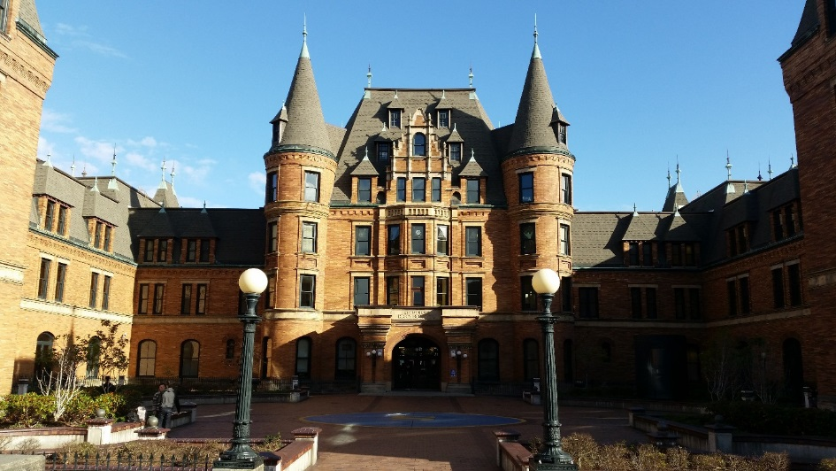
Stadium High School
Historic Modernization and & Additions
Planned Start: 2004
Actual Start: 2004
Planned Finish: 2006
Actual Finish: 2006
Planned Budget: $108,000,000
Actual Budget: $107,967,536
Budget Variance: -0.03%

Slide 30
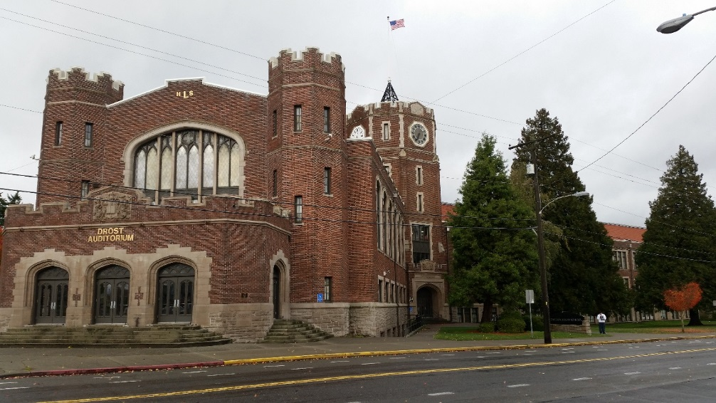
Lincoln High School
Historic Modernization and & Additions
Planned Start: 2006
Actual Start: 2006
Planned Finish: 2008
Actual Finish: 2007
Planned Budget: $75,000,000
Actual Budget: $75,170,798
Budget Variance: 0.23%
Completed one year ahead of schedule.

Slide 31
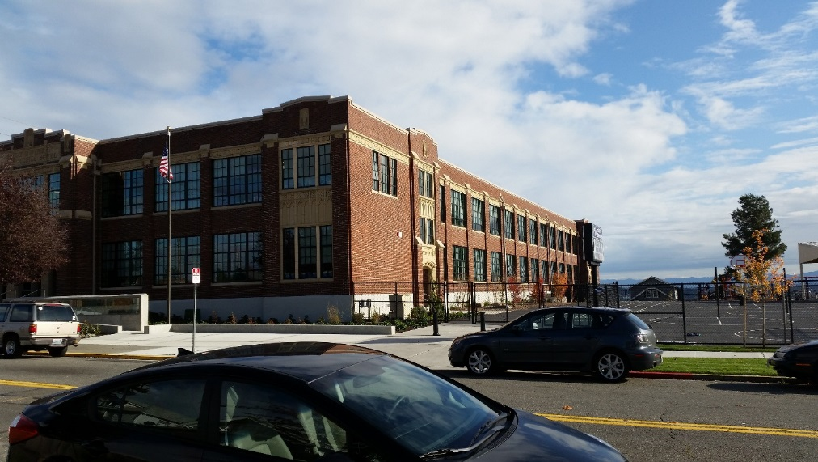
McCarver Elementary School
Historic Modernization
Planned Start: 2015
Actual Start: 2015
Planned Finish: 2016
Actual Finish: 2016
Planned Budget: $39,000,000
Actual Budget: $38,765,433
Budget Variance: -0.60%

Slide 32
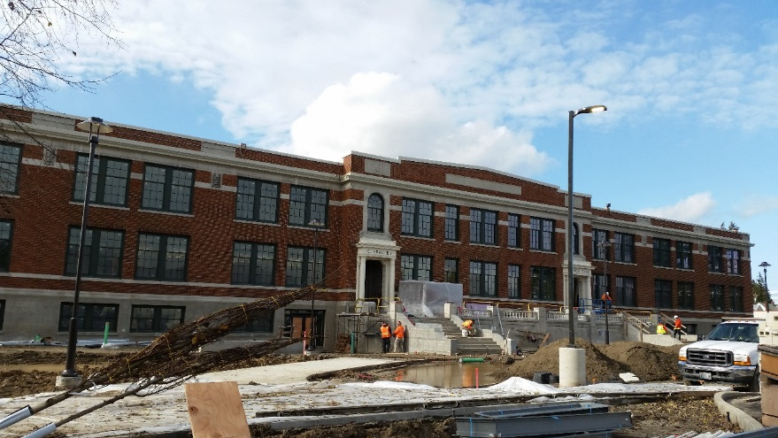
Stewart Middle School
Historic Modernization and & Additions
Planned Start: 2015
Actual Start: 2015
Planned Finish: Feb 2017
Actual Finish: N/A
Planned Budget: $66,000,000
Actual Budget: TBD (In Construction)
Budget Variance: TBD
7 months ahead of schedule!

Slide 33
GC/CM Historic Modernization & Additions: Lessons Learned
The critical importance of extensive due diligence with investigations when designing in older buildings – get the GC/CM on board sooner than the end of Schematic Design (McCarver ES). Best to get the GC/CM on board to assist with the selection of the design team.
The clear definition of risk allocation early in the project, and the careful use of contractor and owner and design team contingency and allowances throughout the project to mitigate the remaining risks (Stewart MS).

Slide 34
Summary
Project is funded with the appropriate budget.
Project meets qualifying RCW criteria.
Project Management Plan for both projects are developed and have clear and logical lines of authority.
Project team has the necessary experience.
  Prior GC/CM and Historic Modernization experience will be a key criteria in the selection of the Contractor and Architect.
Project team has the capacity for the project.
Project team is prepared and ready to move forward.

Slide 35
Thank you

