Slide 1

Mason General Hospital’s
Application for GC/CM Approval
July 27, 2017

Slide 2
Agenda
  Introductions
  What are Hospital Work Requirements
  Master Planning Efforts Completed to Date
  Project Procurement Knowledge and Experiences
  GCCM Experience and Qualified Experience
  Up and Coming Projects
  Serving the Community and Mason County Patients
Notes:
Eric to Kick Off Meeting.

Slide 3
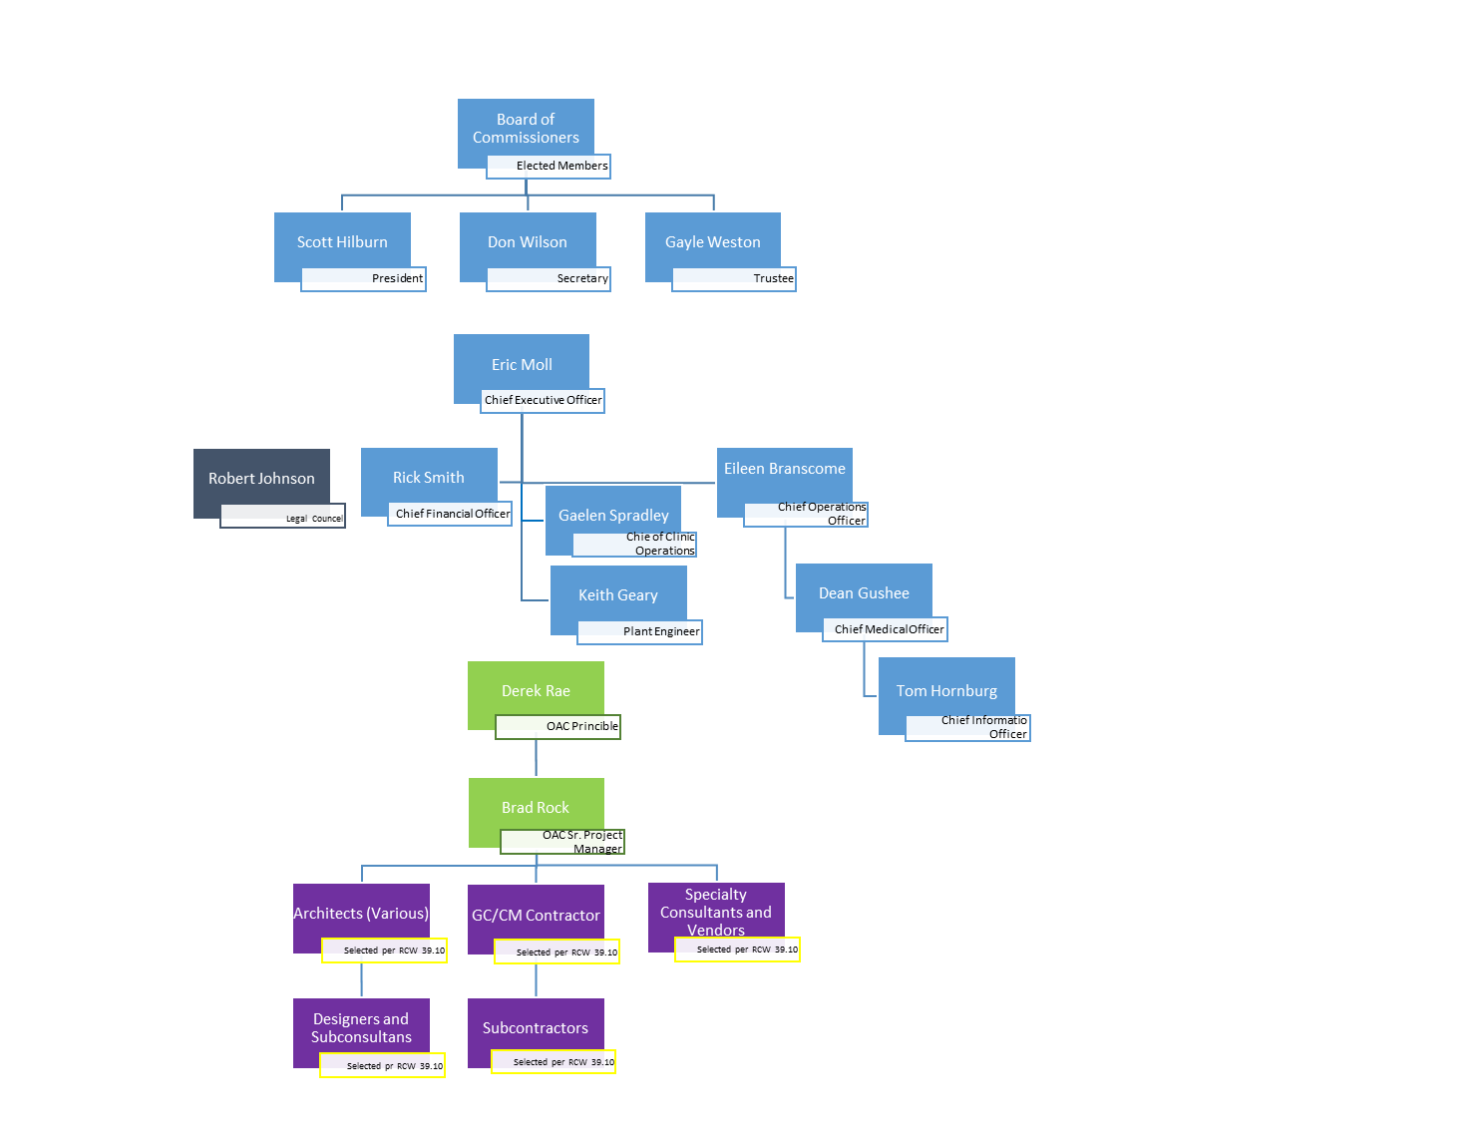
Introductions
  3.ii. Personnel
  with appropriate construction experience
Notes:
MGH’s Team and OAC Team (Eric to present)
Team & Construction Experience. (addressing ii. Personnel with appropriate construction experience) (Eric to Present)
GCCM Knowledge. (i. Project delivery knowledge and experience) (Eric to transition to Derek, Derek to Present GCCM past Experience)
It is unclear from the organization chart and description regarding the actual project management. Will Mason General Hospital (MGH) staff be managing the design or construction firm or will OAC be directly responsible to manage the firms? (Eric to Respond to question)
It seems OAC is primarily tasked with performing the execution, who are then reporting to Facilities Director? Does MGH have owner representation in the form of dedicated project manager at the table for the day-to-day construction management with OAC? (Eric to Respond to question)
Please clarify Rick Smith’s GCCM experience. It is noted that Rick has been at MGH 3+ years and was involved in the last GCCM project that was completed 4 years ago, please clarify. (Eric to address)

Slide 4
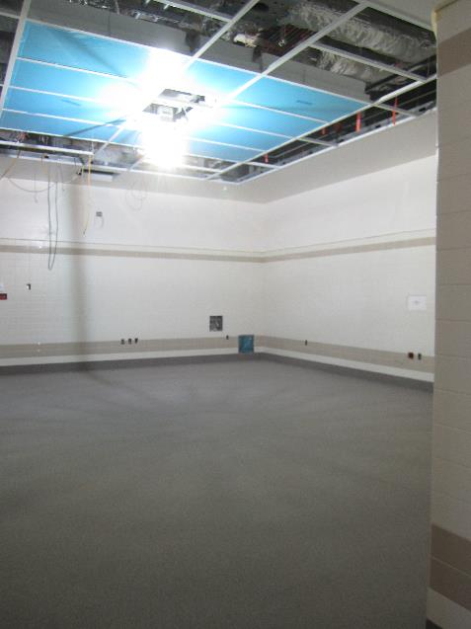
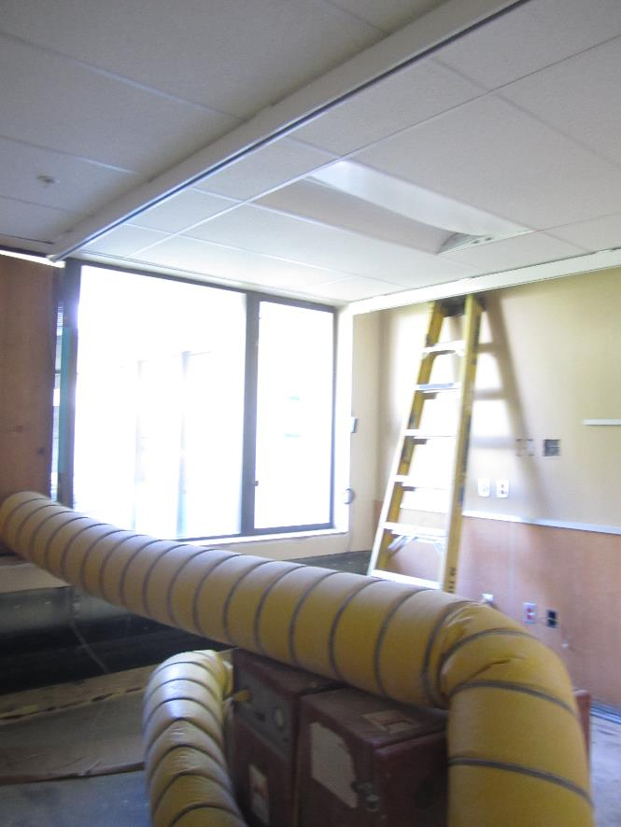
Hospital Work Requirements
  3.iii. Management plan and rationale for alternative public works projects
Notes:
Presented by Keith.
What is Hospital Work Requirements (ICRA, Fire Life Safety) (iii. Management plan and rationale for alternative public works projects)

Slide 5
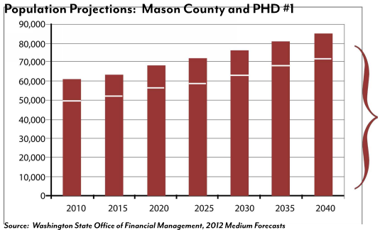
Master Planning Efforts
Mason County Growth Projections
  3.vi. Ability to properly manage its capital facilities plan, including project planning and budget experience
Notes:
Presented by Eric .
Master Plan Efforts Completed to date (vi. Ability to properly manage its capital facilities plan, including project planning and budget experience)
KEY POINTS:
Continue population growth = quick response required to keep up with the community.
Needing to be nimble in approach. (explain today’s growth rate outpacing current forecasted rates of growth) In one years time, we are already meeting future projections today.

Slide 6
\
Up and Coming Projects
  3.vi. Ability to properly manage its capital facilities plan, including project planning and budget experience
Notes:
Presented by Brad to Present. Recap $70 Million Proposed Projects (vi. Ability to properly manage its capital facilities plan, including project planning and budget experience
Key Points:
Over the next 3 years, MGH has a large group of projects which align with the need for GCCM delivery.
The interior renovation projects are quick construction efforts, however can be completed very quickly.
MGH is still anticipates to use other procurement methods based on the project need.
MGH looks to complete these projects as GCCM delivery method and as a Certified Agency this will allow cost savings to MGH and provide expediency to the market place to better serve the community.

Slide 7
\
Up and Coming Projects
  3.vi. Ability to properly manage its capital facilities plan, including project planning and budget experience
Notes:
Key Points:
MGH looks to complete these projects as GCCM delivery method and as a Certified Agency this will allow cost savings to MGH and provide expediency to the market place to better serve the community.

Slide 8
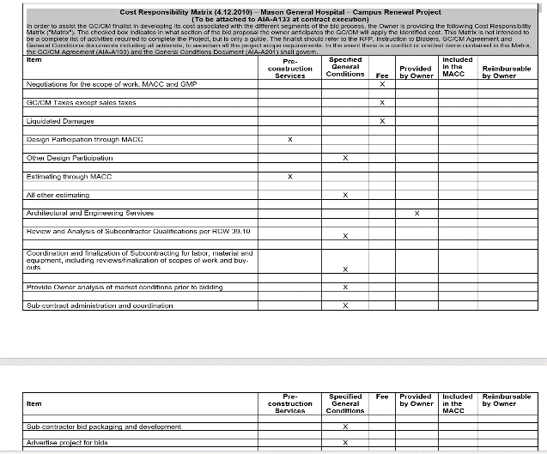
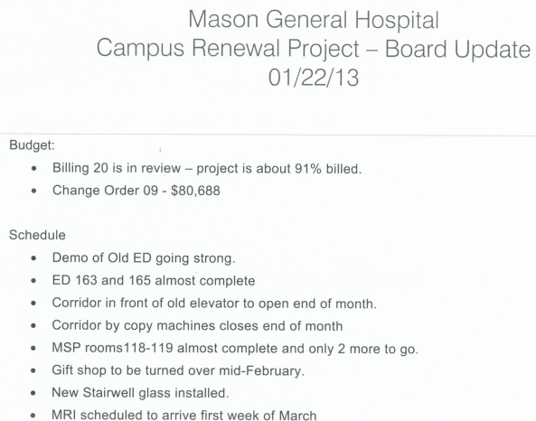
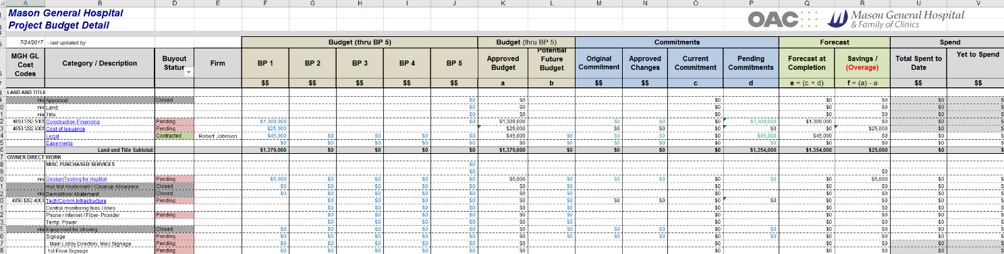
Project Procurement Knowledge & Experience
  3.iv. Demonstrated success in managing public works projects
  A. Applicant has the necessary experience to determine which of its projects are appropriate for use of alternative contracting procedures.
Notes:
Presented by Brad.
1. Will the MGH CEO have to approve all change orders, or will some value amount be delegated to a director?
2. Have MGH staff completed or plan to complete AGC GCCM training?
MGH Construction Project Success (iv. Demonstrated success in managing public works projects & A. Applicant has the necessary experience to determine which of its projects are appropriate for use of alternative contracting procedures.)
Recap MGH’s Procurement Methods (vi. Ability to properly manage its capital facilities plan, including project planning and budget experience)

Slide 9
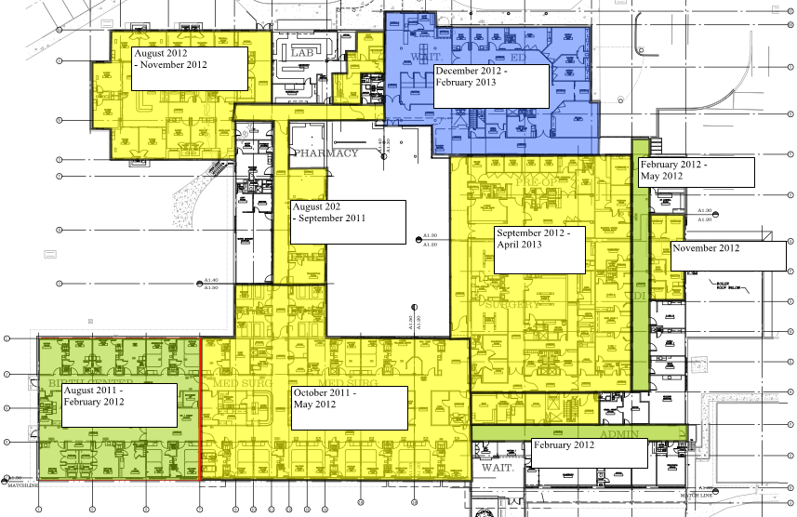
GC/CM and Qualified Experience
GC/CM & Qualified Experience
  3. vii. Ability to meet requirements of RCW 39.10)
Notes:
Presented by Keith.
There are several references to MGH staff being involved in all GCCM projects, has there been more than the one GCCM project listed at MGH? If so, please included them as background information. ?
Have MGH staff completed or plan to complete AGC GCCM training?
Ongoing Retention of OAC’s to Manage Construction Projects. (vii. Ability to meet requirements of RCW 39.10)
Key Points:
Last GCCM project was multi project phased
OAC and MGH teaming efforts (Schedule provided by OAC, MGH works with departments)

Slide 10
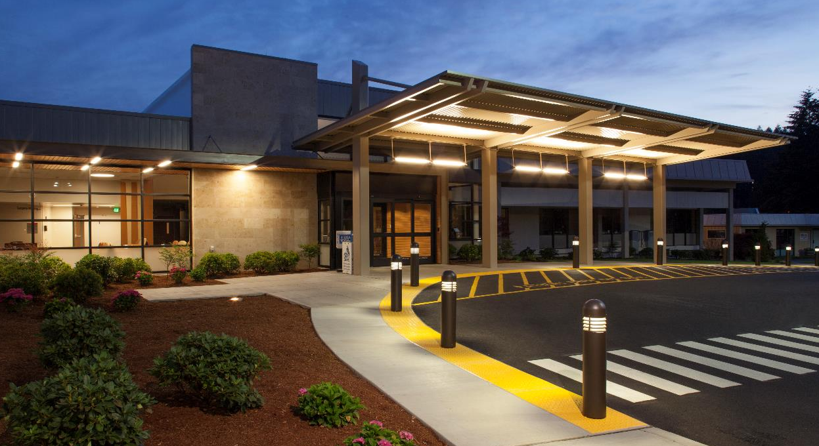
Serving the Mason County Community and it’s Patients
Notes:
Presented by Don and Eric.
Board of Commissioner Support of GCCM
Public Need for Nimble GCCM Contracting.
Past usage of GCCM was highly successful and look to continue to use as a Certified GCCM Agency

