Slide 1
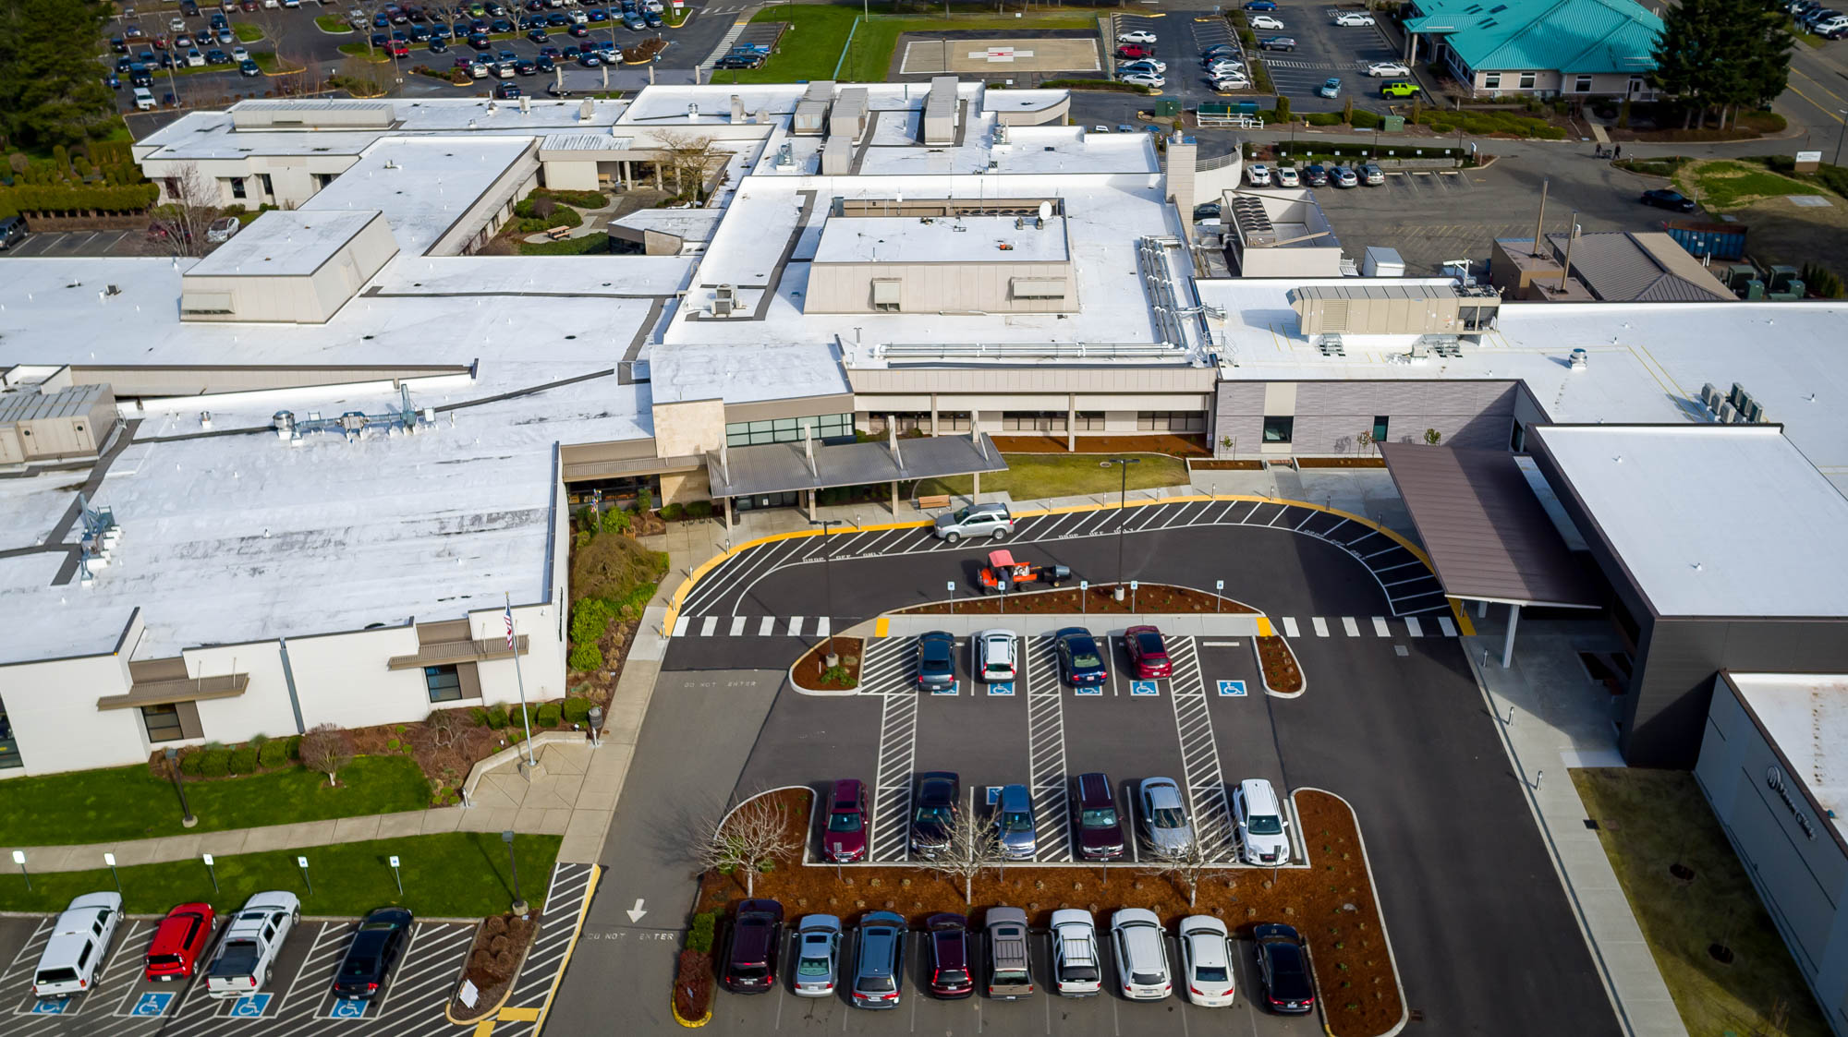


Mason Health
Public Body GC/CM Recertification
May 28, 2020
Notes:
Honored that you are joining us for this special occasion.
It’s definitely a new day at Mason Health.

Slide 2


About Mason Health
Mason General Hospital:
Birth Center
Diagnostic Imaging
Emergency Services
Laboratory
Rehabilitation Services
Surgery
Mason Clinic:
Ophthalmology
Primary Care
Orthopedics
Women’s Health
Pediatrics
General Surgery
Walk-in
Podiatry
Diagnostic Imaging
Laboratory
Behavioral Health
Mason Clinic Hoodsport
Notes:
Mason Clinic is a true multi-specialty clinic comprising 50 providers.
Touch on range of specialties.
Note that we will maintain Hoodsport Clinic.

Slide 3
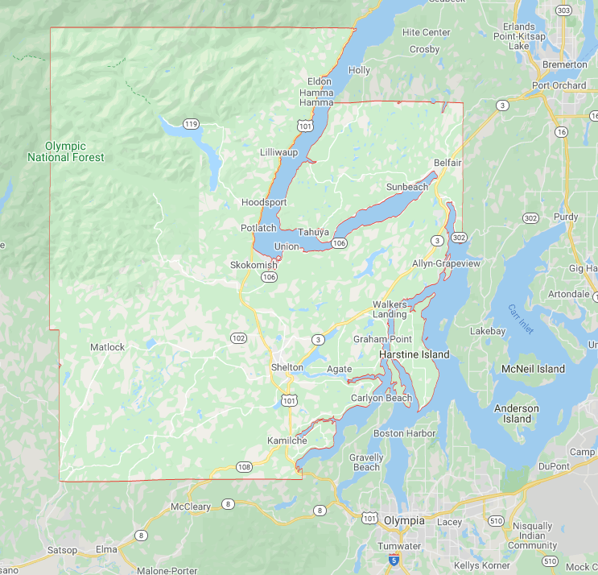
About Mason Health
Rural Public Hospital District
Service Area: Mason County
Notes:
Mason Clinic is a true multi-specialty clinic comprising 50 providers.
Touch on range of specialties.
Note that we will maintain Hoodsport Clinic.

Slide 4
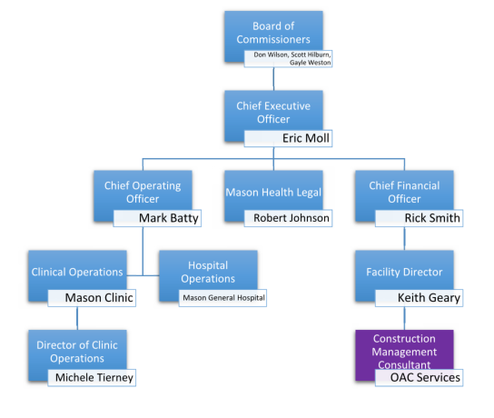

Project Delivery Team
Notes:
Amazing group of providers joining Mason Health.
Providers that have trained at places like Stanford, Gonzaga and John Hopkins. We have former Army officers that have joined our team.
These are providers that could go anywhere, but want to be part of Mason Health and put roots down in the South Sound.

Slide 5
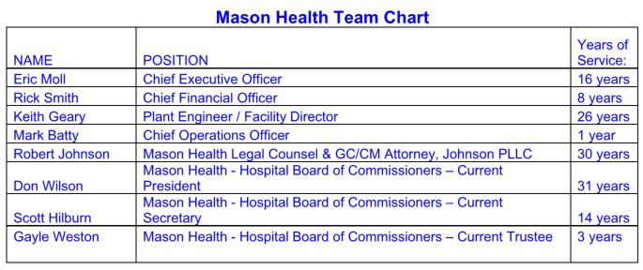
Project Delivery Team
A strong, experienced team
Several years working together at Mason Health
Addition of Mark Batty, COO, in 2019 – 15 years experience as Hospital Exec
All team members listed have GC/CM experience
  Many were involved with the 2012 Campus Renewal Project
  All were involved with the 2018-2020 MOB, Mason Clinic
Notes:
Amazing group of providers joining Mason Health.
Providers that have trained at places like Stanford, Gonzaga and John Hopkins. We have former Army officers that have joined our team.
These are providers that could go anywhere, but want to be part of Mason Health and put roots down in the South Sound.

Slide 6

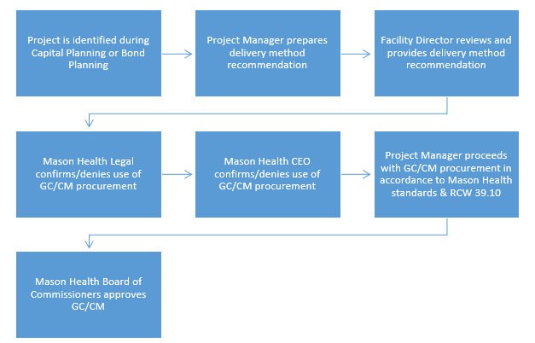
GC/CM Project Delivery Selection
Change from previous application

Slide 7
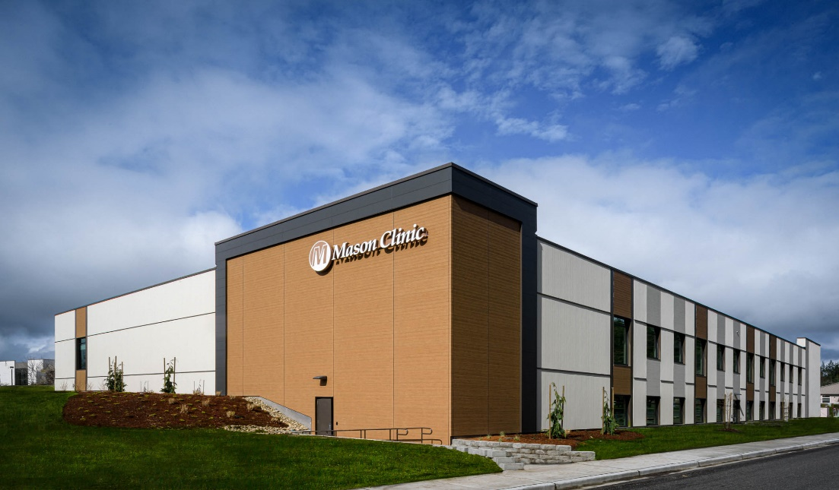
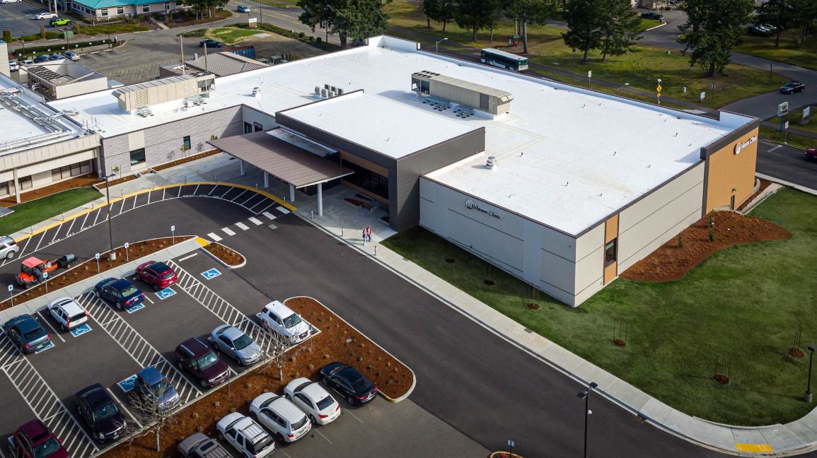

GC/CM Experience – Mason Clinic
Two-story, 60,000 square foot building
$43.5M final construction budget
GC/CM Delivery w/Skanska USA
Why GC/CM?
  Budget development & GC input during design phase
  Coordination to connect to hospital
  New driveway
Status: Project completed Feb 2020
No disputes or litigation
No issues to date, future audit anticipated
Fantastic project with great partners
Notes:
The Mason Clinic is a 60,000 square foot building that will increase the patient access by 50% in the clinic by giving us 110 patient exam rooms.
Mason Clinic will have two x-ray rooms and expanded laboratory services.
We have successful recruitment of 14 new providers who will join the District between July 2019 and July 2020.
Construction budget of $43.5 million will finish under budget. Acknowledge Skanska and OAC and Keith.

Slide 8
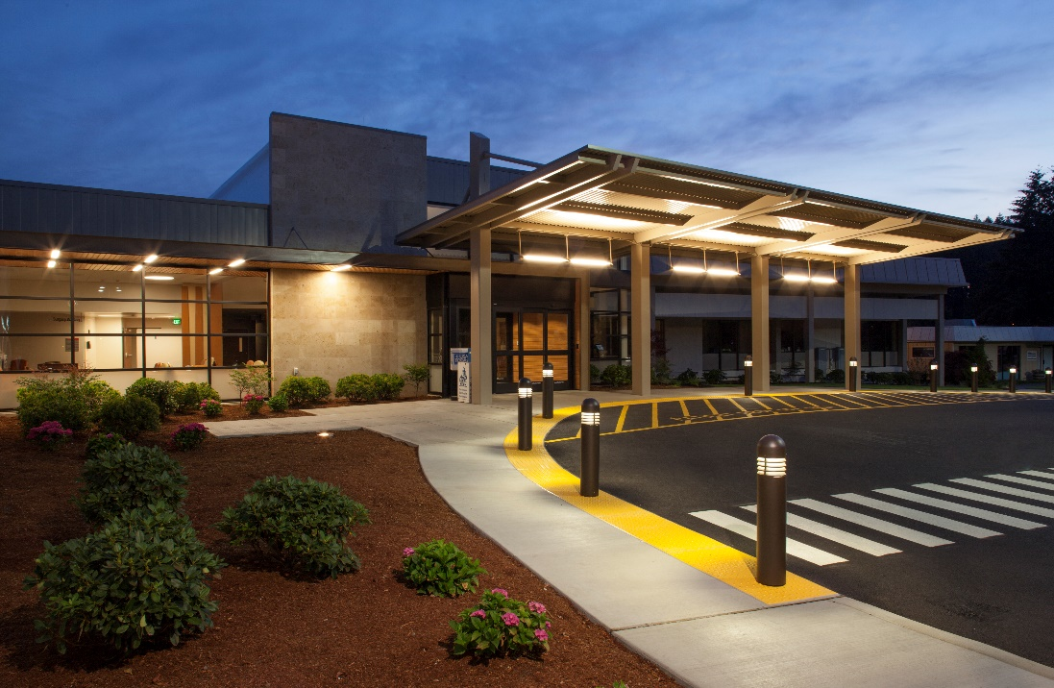
Previous GC/CM Experience
Campus Renewal Project
  Multiple phases during hospital renovations & expansion (more than 40 phases)
  Addition of Surgical Center
  Team Members - The same team 8 years later!
    Eric Moll
    Keith Geary
    Don Wilson (Board of Commissioners)
    Scott Hilburn (Board of Commissioners)
    Rick Smith
    OAC Services
  Status: Completed in 2012
  No disputes or litigation
  No audit findings
Notes:
The Mason Clinic is a 60,000 square foot building that will increase the patient access by 50% in the clinic by giving us 110 patient exam rooms.
Mason Clinic will have two x-ray rooms and expanded laboratory services.
We have successful recruitment of 14 new providers who will join the District between July 2019 and July 2020.
Construction budget of $43.5 million will finish under budget. Acknowledge Skanska and OAC and Keith.

Slide 9
Panel Question #1
Under discussion point 2 will these future projects, anticipated to be using GC/CM as a result of the 2020 master planning, be ready within the next 3 years or would it be better to apply as a project approval? Could you be more specific, there are no GC/CM project qualifiers indicated within the next 3 years.

Slide 10
Response to Panel Question #1
Healthcare organizations need to be nimble and act quickly. Public Body approval gives us this flexibility.
PAC & Rehab tenant improvement project
Campus Master Planning:
  Working w/TGB Architects & OAC now
  Developing project list, board approval 3rd quarter 2020
  Plans to start top priority projects 4th quarter 2020 or 1st quarter 2021
  11 departments identified w/URGENT Space/Facility needs within the hospital. Many will meet all 5 criteria for GC/CM

Slide 11
In Summary
Past success with alternative project delivery
GC/CM will be key for upcoming Master Planning projects
Our request
Notes:
Continue to maintain a low tax rate. In fact the tax rate decreases more than 10% in 2020 to .33 per $1,000.
Continue to sustain a strong financial performance. We are one of less than 100 rural hospitals out of over 2,000 across the country to receive an A- Bond Rating by S&P.
This resulted a historically low interest rate of 2.53%, which will be financed out of operations.
Awesome teamwork across all part of Mason Health.

Slide 12
Closing
Thank you!
Any questions?
Notes:
Continue to maintain a low tax rate. In fact the tax rate decreases more than 10% in 2020 to .33 per $1,000.
Continue to sustain a strong financial performance. We are one of less than 100 rural hospitals out of over 2,000 across the country to receive an A- Bond Rating by S&P.
This resulted a historically low interest rate of 2.53%, which will be financed out of operations.
Awesome teamwork across all part of Mason Health.

