Slide 1

East Division Elementary School and Madison Elementary School
Application to use the GC/CM Delivery Method
July 28, 2016
“To expect, encourage, and facilitate the pursuit of excellence and life-long learning in our students, equipping them for future success and happiness”

Slide 2
Agenda
Introductions
MVSD Capital Improvement Plan
The Projects
Project Budgets
Project Schedules
Why GC/CM
Qualifications
Organization
Summary

Slide 3
Introductions

Slide 4
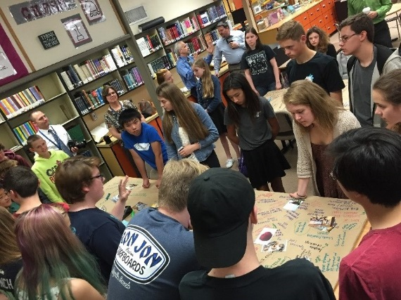
The Project Team
Here Today
Carl Bruner, Superintendent, MVSD
Suzanne Gilbert, Director of Capital Projects, MVSD
Richard Moewe, Project Manager, MVSD
Brian Fitzgerald, Principal in Charge, TCF
Brian Ho, Design, Project Manager / Lead Designer, TCF
Howard Hillinger, Internal GC/CM Advisor, Parametrix
Jim Dugan, MVSD GC/CM Program Advisor, Parametrix

Slide 5
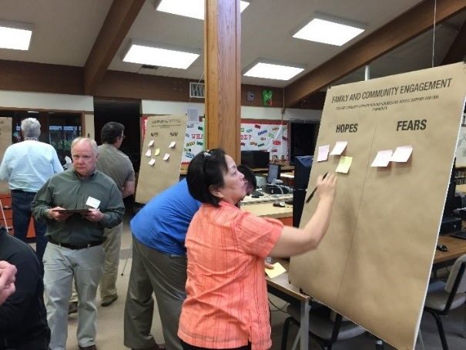
The Project Team
Not Here Today
Dan Cody, GC/CM Procurement Support, Parametrix
Shannon Thompson, Program Mgmt Support, Parametrix
Doug Holen, GC/CM External Advisor
Graehm Wallace, Perkins Coie, External GC/CM Legal Advisor

Slide 6
Mount Vernon School District Capital Improvement Program

Slide 7
Mount Vernon School District

Slide 8
The District
Located in Skagit County
Third largest employer in Skagit County
Began serving students in 1891
6,400 students in total
Ten (10) schools comprised of:
  Six (6) Elementary Schools
  Two (2) Middle Schools
  One (1) High School
  One (1) Homeschool Parent Partnership
950 teachers, administrators and support staff
Last capital bond passed in 2001

Slide 9
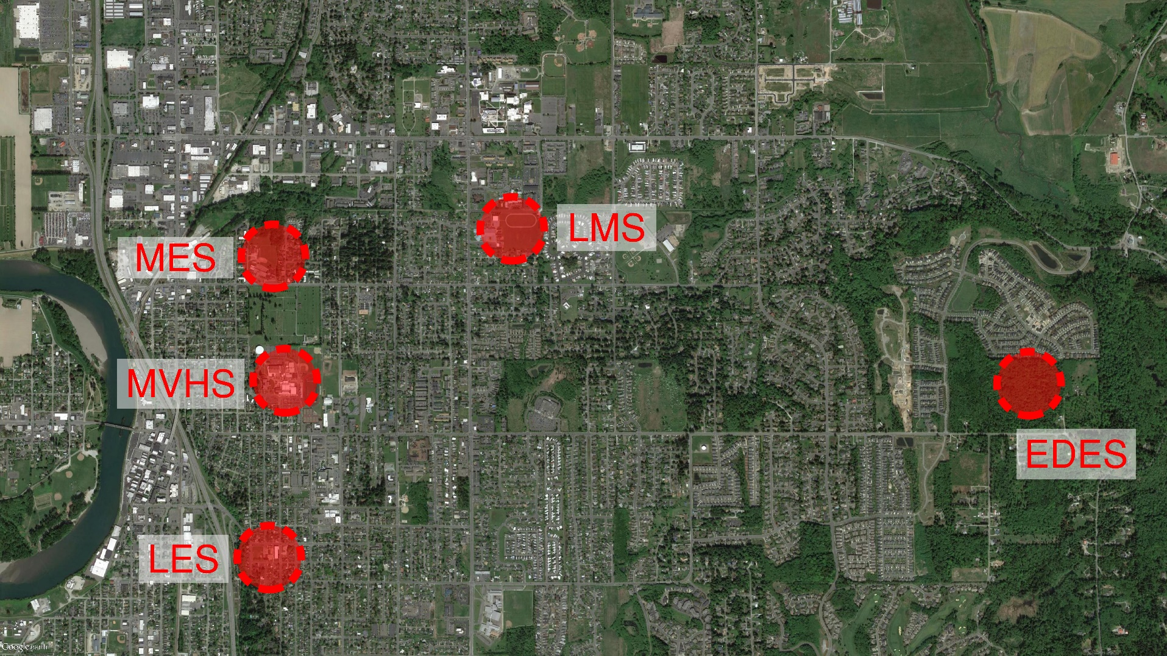
MVSD Capital Improvement Program $106,463,549
Capital Bond Approved February 2016

Slide 10
2016 Capital Bond Program
Today’s PRC Presentation
East Division Elementary School (EDES)– New School
Madison Elementary School (MES) – Replacement School
Remaining MVSD Capital Projects
Mount Vernon High School (MVHS) – Historic Modernization & Additions
Mount Vernon High School – New CTE Building
LaVenture Middle School (LMS) – Modernization & Additions
Lincoln Elementary School (LES) - TBD

Slide 11
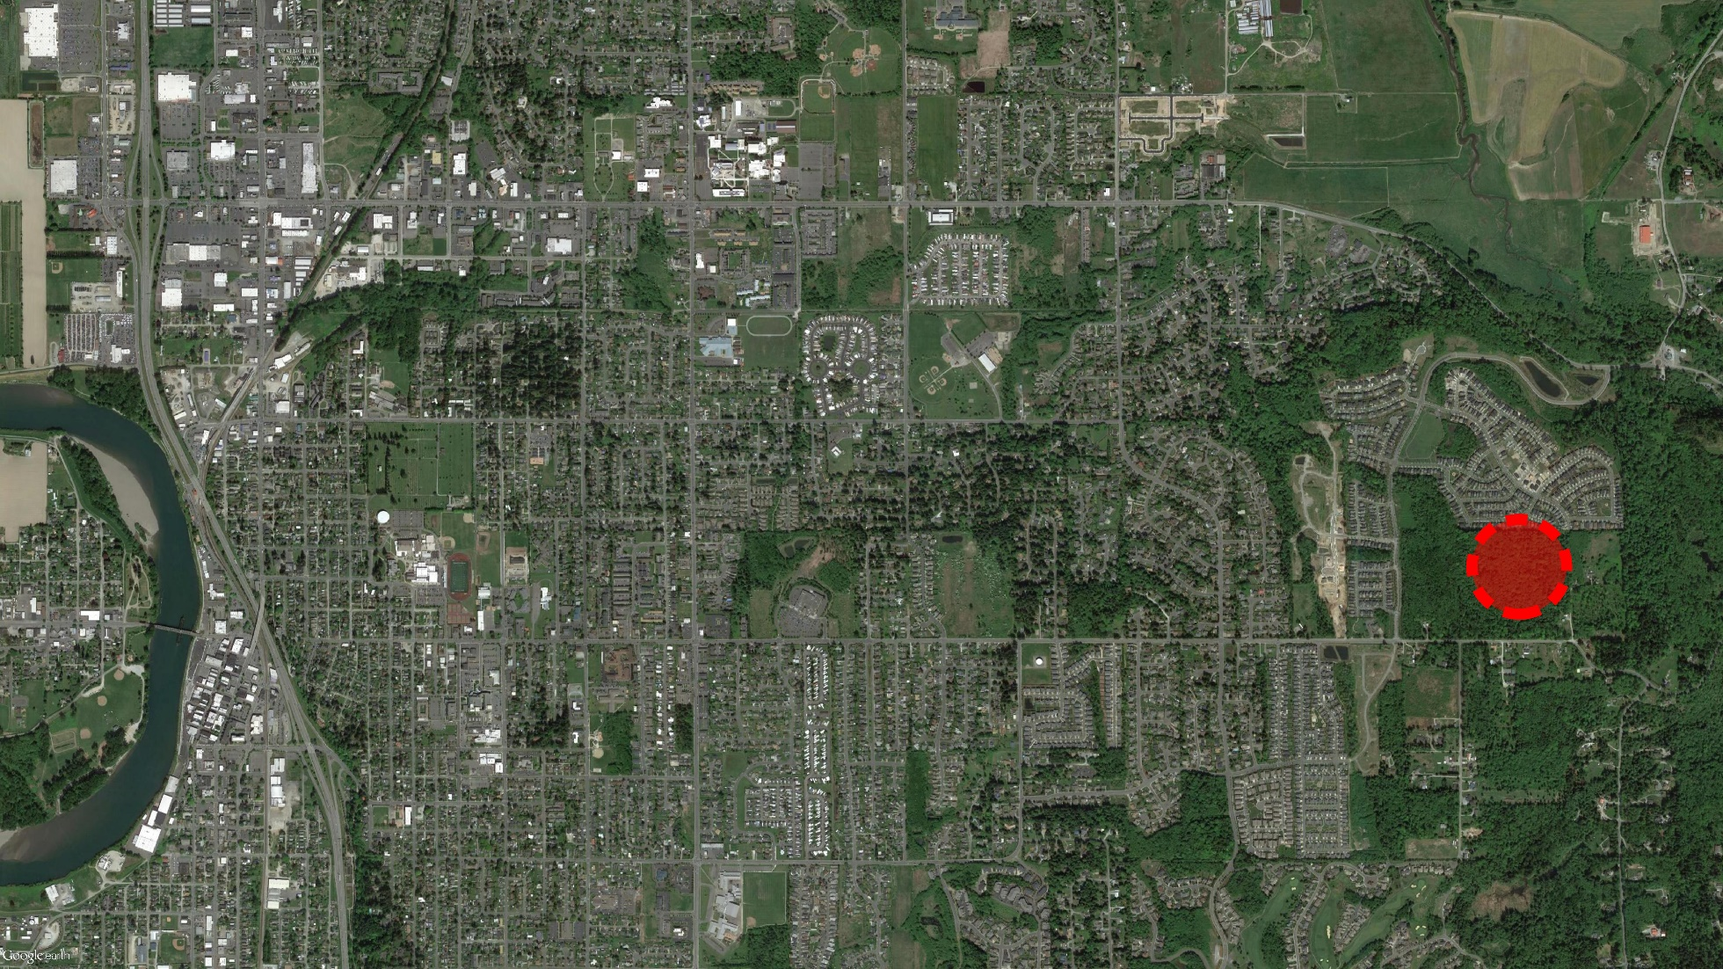
East Division Elementary School

Slide 12
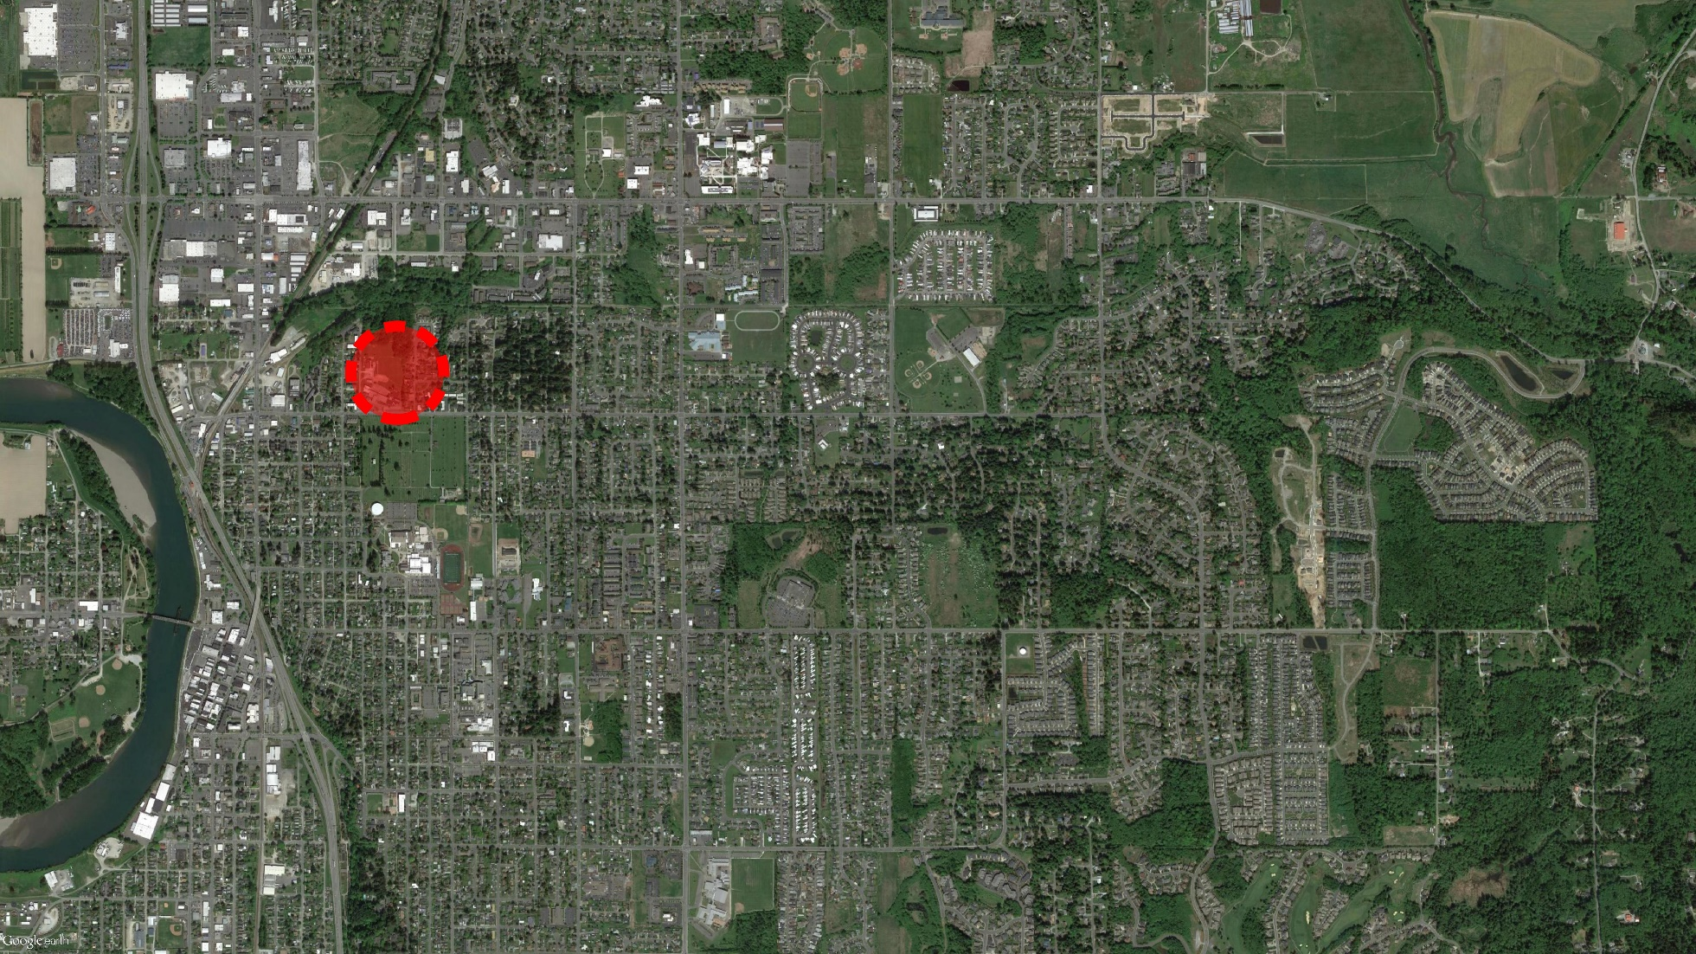
Madison Elementary School

Slide 13
The Projects

Slide 14

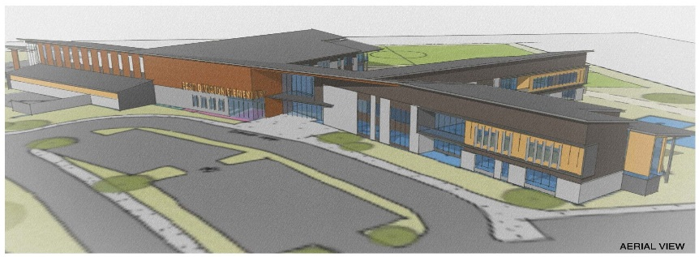
East Division Elementary School
New Construction
15.8 Acre Native Site
50% Wetlands
Multiple Critical Areas
Adjacent to Residential Areas
82,000 SF Building
Two Story
618 K-5 Students
Start of the MVSD Capital Program
Swing School for Madison ES
Anticipated MACC: $28 M
Phased Construction Start: May 2017
Occupancy: September 2018

Slide 15
East Division Elementary School

Slide 16

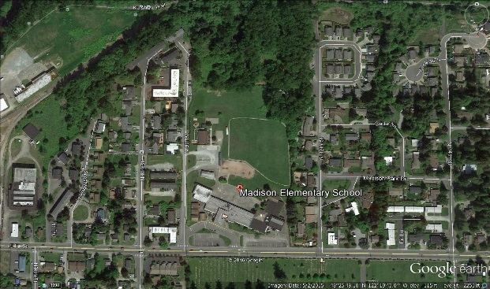
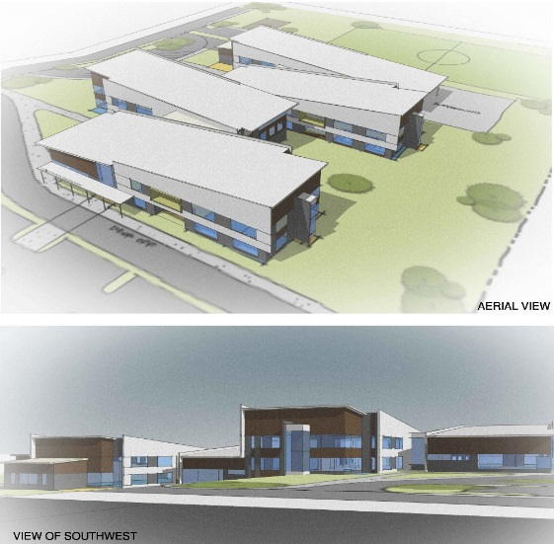
Madison Elementary School
Replacement School
Wetlands
Critical Areas
Adjacent to Residential Areas
Adjacent to Railway Lines
Occupied On Site Pre-School and YMCA Facility
79,500 SF, Two Story Building
600 K-5 Students
MES Students Relocated to EDES for 2018/2019 School Year
Anticipated MACC: $28.5 M
Construction Start: June 2018
Occupancy: September 2019
New School Name: TBD

Slide 17
Madison Elementary School

Slide 18
EDES Project Budget
Category | Budget
Professional Services (A/E, etc.) | $2,512,730
Project MACC (includes GC/CM risk contingency @ 3% of MACC) | $25,127,300
Contingencies – Design, Construction and Owner | $3,140,912
Fixtures, Furniture, Equipment & Technology @ 7.5% | $1,884,547
GC/CM Fee, NSS Allowance and Pre-Con Services Fee | $2,862,730
Contract Administration (PM, CM, etc) | $753,819
Owner Consultants | $628,182
Other Costs (utilities, permits, special inspections, etc.) | $703,705
Sales Tax | $2,186,075
TOTAL: | $39,800,000

Slide 19
EDES GC/CM Schedule
Presentation to the PRC | July 28, 2016
Release GC/CM RFP | August 1, 2016
SOP’s Due | August 22, 2016
Shortlist SOP’s and Send Invitation to Interview | August 26, 2016
Interviews | September 8, 2016
Shortlist Interviews and Release GC/CM RFFP | September 9, 2016
RFFP Opening and Selection of GC/CM | September 23, 2016
Pre-Con Work Plan Due | October 10, 2016
MVSD School Board Approval of Selected GC/CM | October 19, 2016
Pre-Con Agreement Executed | October 21, 2016
Pre-Con Services | October 2016 to May 2017
Construction Phase | Summer 2017 thru Summer 2018

Slide 20
MES Project Budget
Category | Budget
Professional Services (A/E, etc.) | $2,557,320
Project MACC (includes GC/CM risk contingency @ 3% of MACC) | $25,573,200
Contingencies – Design, Construction and Owner | $3,196,650
Fixtures, Furniture, Equipment & Technology @ 7.5% | $1,917,990
GC/CM Fee, NSS Allowance and Pre-Con Services Fee | $2,907,320
Contract Administration (PM, CM, etc) | $767,196
Owner Consultants | $639,330
Other Costs (utilities, permits, special inspections, etc.) | $716,126
Sales Tax | $2,224,868
TOTAL: | $40,500,000

Slide 21
MES GC/CM Schedule
Presentation to the PRC | July 28, 2016
Release GC/CM RFP | August 1, 2016
SOP’s Due | August 22, 2016
Shortlist SOP’s and Send Invitation to Interview | August 26, 2016
Interviews | September 8, 2016
Shortlist Interviews and Release GC/CM RFFP | September 9, 2016
RFFP Opening and Selection of GC/CM | September 23, 2016
Pre-Con Work Plan Due | October 10, 2016
MVSD School Board Approval of Selected GC/CM | October 19, 2016
Pre-Con Agreement Executed | October 21, 2016
Pre-Con Services | January 2017 thru February 2018
Construction Phase | May 2018 thru July 2019

Slide 22
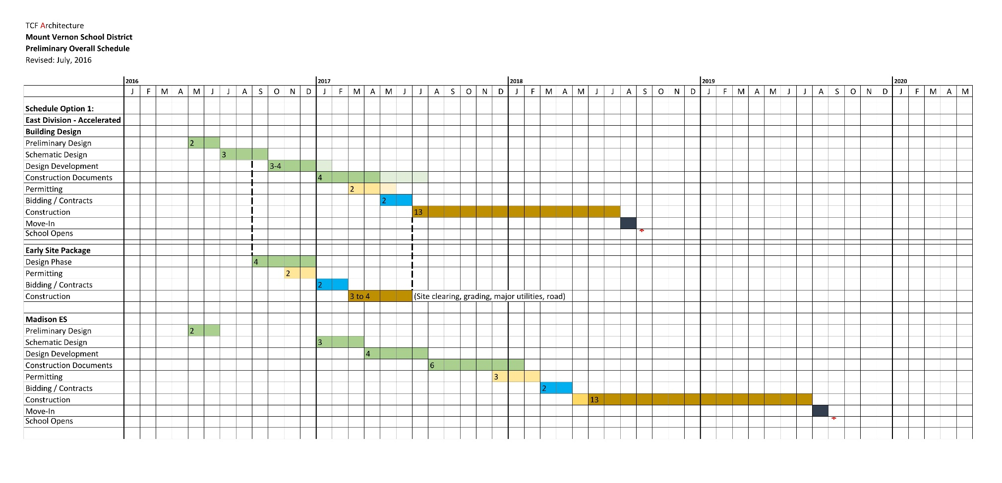
Combined EDES and MES Development Schedules
Critical Phasing and Cost Savings

Slide 23
Why GC/CM Delivery Method for both EDES and MES

Slide 24
Complies with 4 of the 5 Statutory Criteria
(1) Implementation of the project involves complex scheduling, phasing, or coordination.
(2) The project involves construction at an occupied facility which must continue to operate during construction.
(3) The involvement of the General Contractor/Construction Manager during the design stage is critical to the success of the project.
(4) The project encompasses a complex or technical work environment.
(5) The project requires specialized work on a building that has historic significance.

Slide 25
Projects involve complex scheduling, phasing, and coordination on an occupied site and in a wetland and adjacent to residential neighborhoods

Slide 26
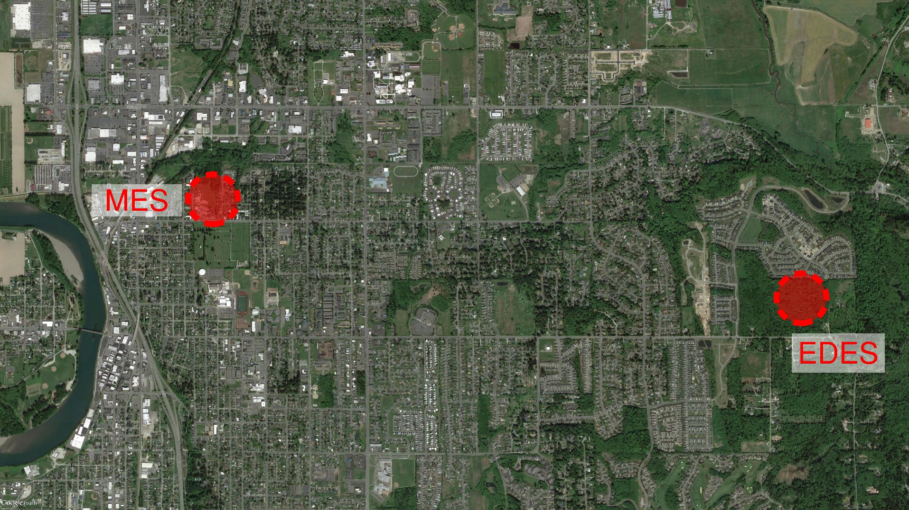
Projects involve complex scheduling, phasing, and coordination on an occupied site and in a wetland and adjacent to residential neighborhoods

Slide 27
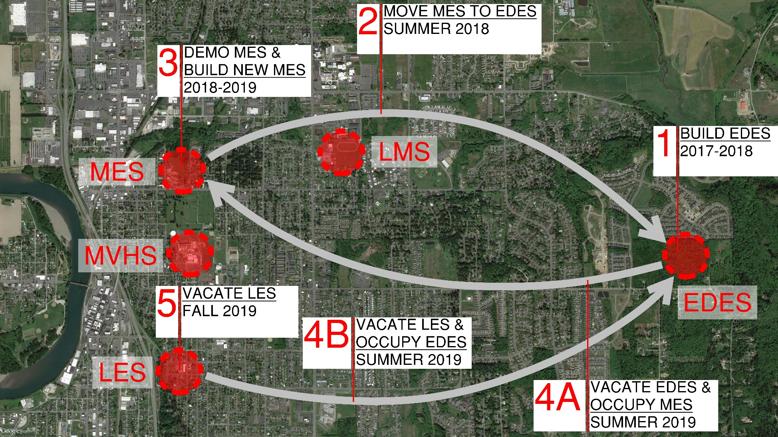
Projects involve complex scheduling, phasing, and coordination on an occupied site and in a wetland and adjacent to residential neighborhoods

Slide 28
Projects involve complex scheduling, phasing, and coordination on an occupied site and in a wetland and adjacent to residential neighborhoods
Build EDES
Wetlands, Critical Areas and Residential Adjacency
Complete by Summer 2018
Move MES into EDES in the Summer of 2018
Demolish Existing MES and Build MES Replacement
Complete by Summer 2019
Occupied Site - Pre-School and YMCA
Vacate EDES: Move MES back into a new MES Summer 2019
Vacate Lincoln ES: Move into EDES

Slide 29
Other Critical Factors
Neighborhood Access/Egress & Traffic Management
Inflation - Escalating Market Costs
Early Site Package(s)
Early Procurement of Long Lead Items
Cost Savings – GC/CM Overhead Reduction with Two Projects and One GC/CM
Critical compliance requirement to plan, execute and document wetlands and critical areas conformance
Critical need to manage and communicate with both neighborhoods
Baseline for the entire capital development program

Slide 30
Two Projects – One GC/CM
Saw the cost savings at Clover Park SD combined projects
Key factor to savings – same design team on both projects
Experienced the cost savings at Tacoma Public Schools
McCarver ES and Stewart MS Historic Modernizations
Projects maintain separate project teams
Savings achieved in reduced overall company overhead, combined procurement
Approximate savings in the $1 M range
RFP includes asking for this kind of experience
Depth of experience by our leadership team and our design team and having the same design team for both – forms the basis for this two project GC/CM approval request

Slide 31

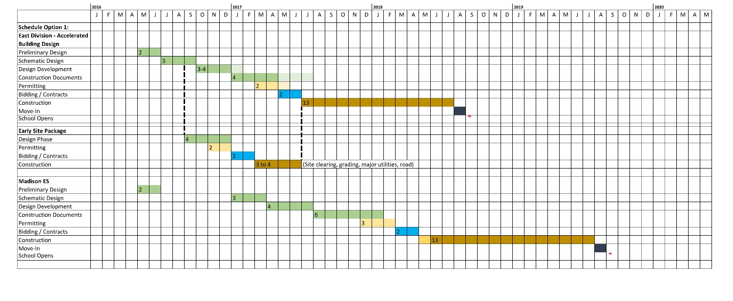
Public Benefit: From this ….

Slide 32


Public Benefit: To this ……
  Public and District Safety
  Cost Savings
  Ensure Project Completions
  on Schedule and Budget
  Community Relationships
  Fiscal Accountability

Slide 33
Public Body Qualifications

Slide 34
MVSD Leadership Team
First major capital projects in more than a decade
Consisted primarily of small capital and maintenance projects
All of which have been delivered using Design-Bid-Build
The District is new to the GC/CM method of project delivery
The combined projects are uniquely perfect for the use of the GC/CM method of delivery
MVSD Director of Capital Projects was AGC GC/CM trained on June 13/14
MVSD hired Parametrix for GC/CM experience, Program Management and Project Management services
Parametrix retained Doug Holen and Howard Hillinger
MVSD retained Graehm Wallace and TCF Architecture – depth of GC/CM experience
MVSD satisfies the public body qualifications by staff augmentation with consultants

Slide 35
MVSD EDES Project Organizational Chart

Slide 36
MVSD MES Project Organizational Chart

Slide 37
Jim Dugan – Project Commitments and Capacity
GC/CM Program Advisor – Jim Dugan
TPS McCarver ES and Stewart MS GC/CM Procurement are Both Complete
TPS Browns Point ES GC/CM Procurement is Complete
MPT Eastside Community Center GC/CM Procurement is Complete
CKSD Olympic HS and Central Kitsap HS/MS GC/CM Procurement is in Progress
All Other GC/CM Principal and Project Executive Roles are Minimal
Ample capacity for the MVSD GC/CM Procurement and Advisor Role
Additional capacity for other needs

Slide 38
Project Team GC/CM Experience

Slide 39
Name | Experience
Suzanne Gilbert Director, Capital Projects Mount Vernon School District | 30 Years Program/Project Management 25 Years as a Registered Architect 20 Years in K-12
Jim Dugan GC/CM Advisor Parametrix | 38 Years Program/Project Management 8 GC/CM Projects: TPS Stadium High School, COT Tacoma Convention and Trade Center, TPS McCarver Elementary School; TPS Stewart Middle School; MPT Eastside Community Center, TPS Browns Point Elementary School; CKSD HS/MS and OHS Projects TPS Board of Director: 2005 – 2011 Appointed to the Project Review Committee: Start of 3 Year Term – July 1, 2016
Howard Hillinger Internal GC/CM Advisor Parametrix | 30 Years Program/Project Management 6 GC/CM Projects: TPS McCarver ES and Stewart MS; Seattle Multi-Modal Terminal at Coleman Dock; Washougal School District – Jemtegaard Middle school and Excelsior High School; Grays Harbor County Public Hospital SPMC Medical Office Building. Currently a member of the Project Review Committee: 3 Year Term Ends June 2017
Richard Moewe MVSD Project Manager Parametrix | 35 Years Program/Project Management 4 GC/CM Projects: Summit Pacific Medical Center; WSDOT State Ferries Coleman Dock; NYPD Office Facility Replacement; World Trade Center Reconstruction Depth in Program Management and Large Project Experience
Doug Holen External GC/CM Advisor Parametrix | 33 GC/CM Projects GC/CM External Delivery Method Advisor
Brian Fitzgerald and Brian Ho Design Team PIC and PM TCF Architecture | 37 Years Specializing in K-12 Facility Design Services Supporting 20 School Districts 4 GC/CM Projects: Browns Point ES, Lake Wilderness ES; Washington ES; Olympia Regional Learning Academy; Lincoln High School

Slide 40
Summary
Projects are funded with the appropriate budgets
Projects meet qualifying RCW criteria
Project Management Plan for both projects are developed and have clear and logical lines of authority
Project team has the necessary experience in addition to continuity for both projects
Project team has the capacity for both projects
Project team is prepared and ready to move forward

Slide 41
Thank you

