Slide 1


CHALLENGER & HORIZON RENOVATION & ADDITIONS
Capital Projects Advisory Review Board
Project Review Committee
Request for GC/CM Project Delivery Method
September 24, 2020
1

Slide 2
AGENDA
Project Team
Project Background & Overview
  Traditional delivery method not desirable
Meets Qualifying GC/CM Criteria
  Qualifying Project
  Management Plan
    Project Team
    Schedule
    Budget & Funding
Project Summary
Questions
2

Slide 3
PROJECT TEAM
MUKILTEO SCHOOL DISTRICT
Karen Mooseker, Executive Director of District Support Services
  7 years experience with K-12 construction projects
  GC/CM experience – 4 projects
  Member of Capital Projects Advisory Review Board (CPARB)
Shelly Henderson, Director of Capital Projects
  25 years experience with K-12 construction projects
  GC/CM experience – 8 projects
Will Thomsen, Planning Administrator
  5 years experience with K-12 construction projects
  GC/CM experience – 4 projects
Amy Stenvall, Fiscal Analyst
  10 years experience with K-12 construction projects
  GC/CM experience – 6 projects
John Mannix, Director of Facilities
  27 years experience with K-12 construction projects
  GC/CM experience – 6 projects
  Founding member of Project Review Committee
3

Slide 4
PROJECT TEAM
PACIFICA LAW GROUP – LEGAL COUNSEL
Zak Tomlinson, Partner
  Extensive GC/CM Experience
OAC SERVICES – GC/CM ADVISOR
Steve Murakami, Vice President
  23 years experience with K-12 construction projects
  Extensive GC/CM experience leading and assisting Tacoma Public Schools and Lake Washington School District
Dan Chandler, Principal
  40 years of construction experience
  GC/CM experience - 46 GC/CM projects and 20 DB projects
DYKEMAN ARCHITECTS
Tim Jewett, Principal-in-Charge
  23 years of experience with K-12 construction projects
  GC/CM experience – 6 projects
Trish Sherman, Project Manager
  25 years of experience with K-12 construction projects
  GC/CM experience – 4 projects
Michael Stevens, Project Architect
Julia Park, Project Architect
Hannah Melling, Project Support
4

Slide 5
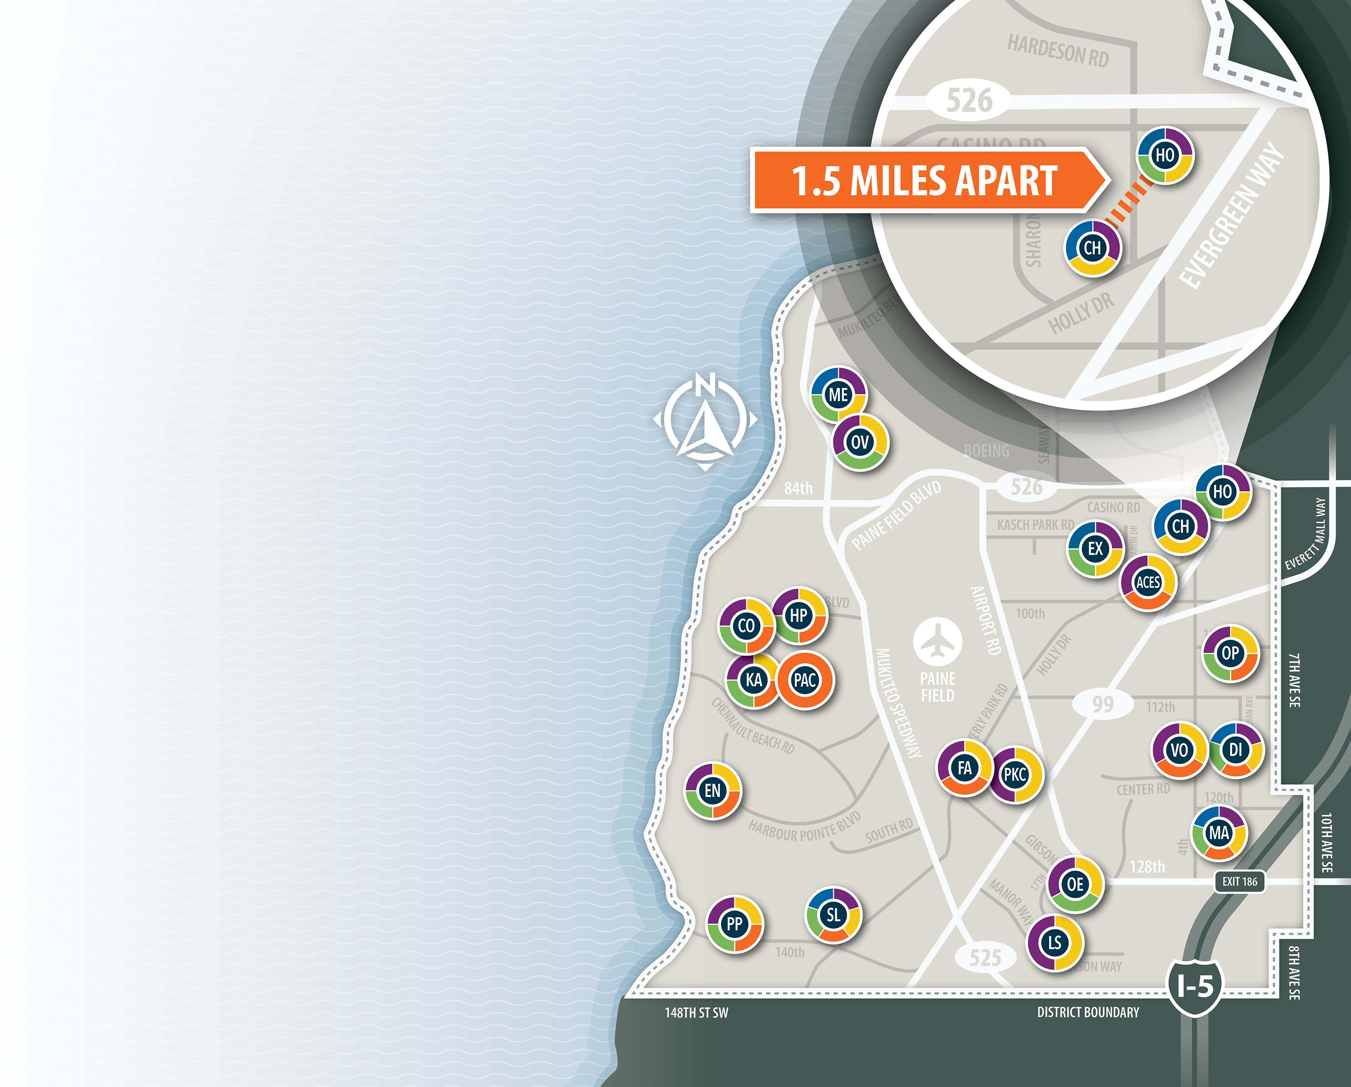
PROJECT BACKGROUND
2020 CAPITAL BOND:
  $240 million bond approved by voters in February 2020
  $105 million for elementary projects
    Increase capacity
    Improve/Expand common support spaces
    Phased replacement of oldest buildings
CHALLENGER ES (CH):
  Original 1987 Structure plus 12 portable classrooms
  Expand & improve common support spaces
HORIZON ES (HO):
  Original 1989 structure plus 7 portable classrooms
  Expand & improve common support spaces
  Add classrooms
TWO PROJECTS – ONE GC/CM
  Sites roughly 1.5 miles apart
  Similar scope & schedule
  Realize efficiencies – procurement, labor, schedule
5

Slide 6
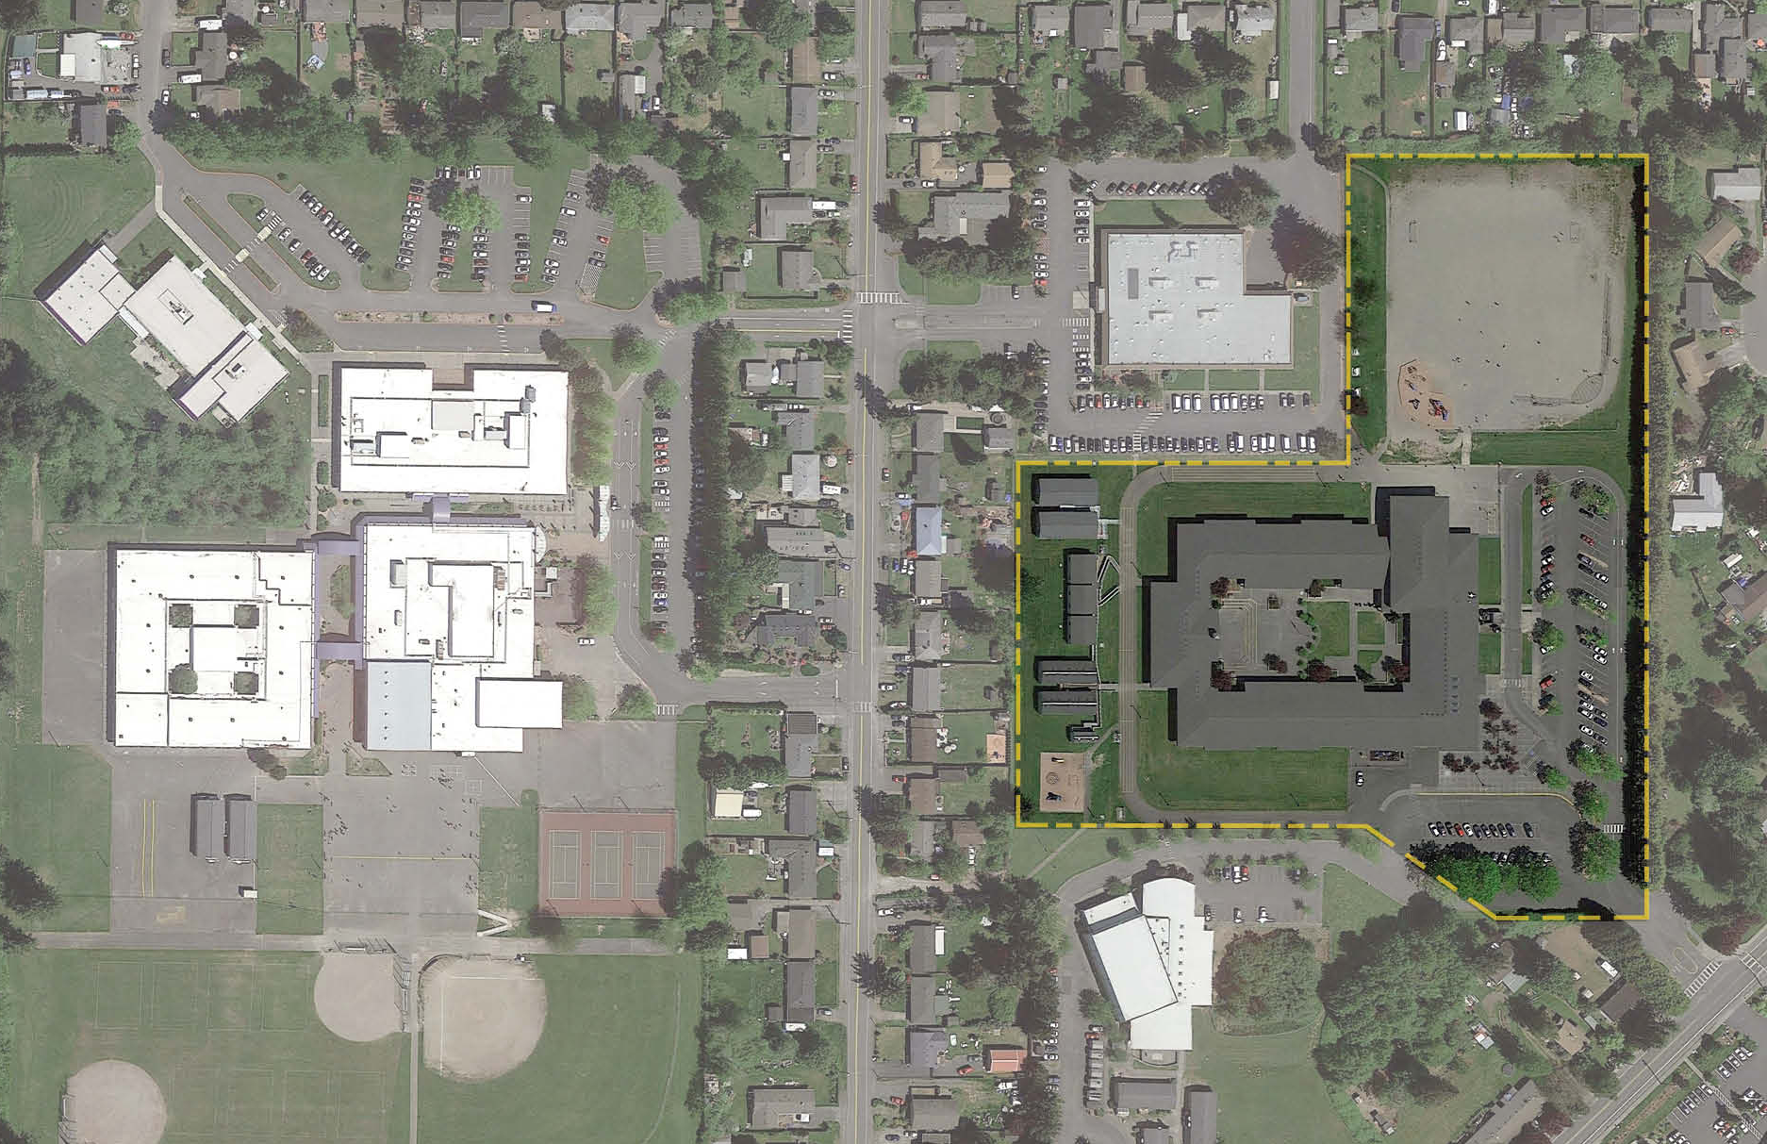

CHALLENGER OVERVIEW – EXISTING SITE
MUKILTEO SCHOOL
DISTRICT OFFICE
EXPLORER MIDDLE SCHOOL
ACES HIGH SCHOOL
6

Slide 7
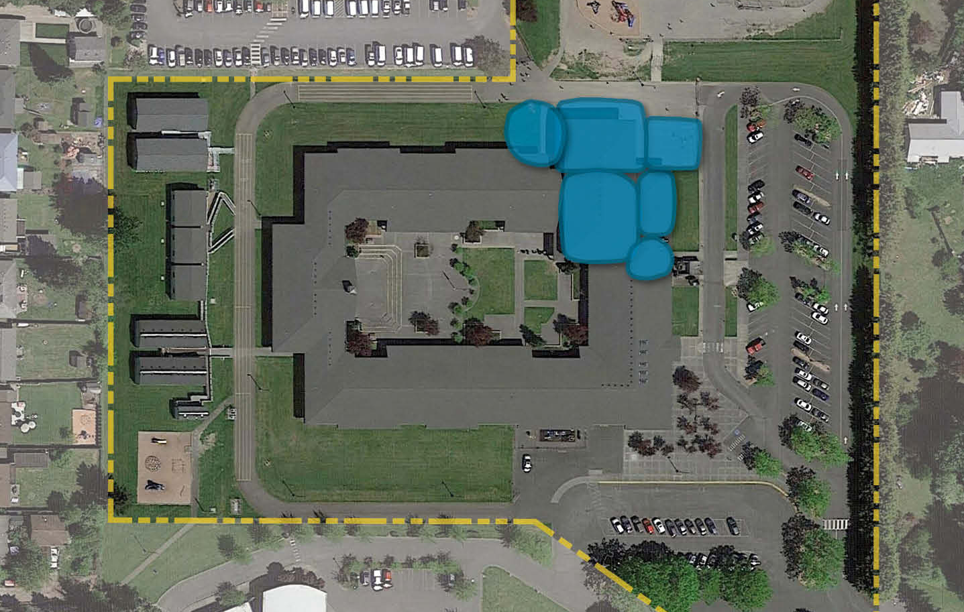
CHALLENGER OVERVIEW – EXISTING SITE
SOFT PLAY
NEW MUSIC
NEW
COVERED
PLAY
NEW
GYM
NEW MULTI-PURPOSE
NEW KITCHEN
EXTENDED
ADMIN
PARKING
PICK UP & DROP-OFF
PORTABLES
COURTYARD
MAIN
ENTRY
BUS LOOP
7

Slide 8
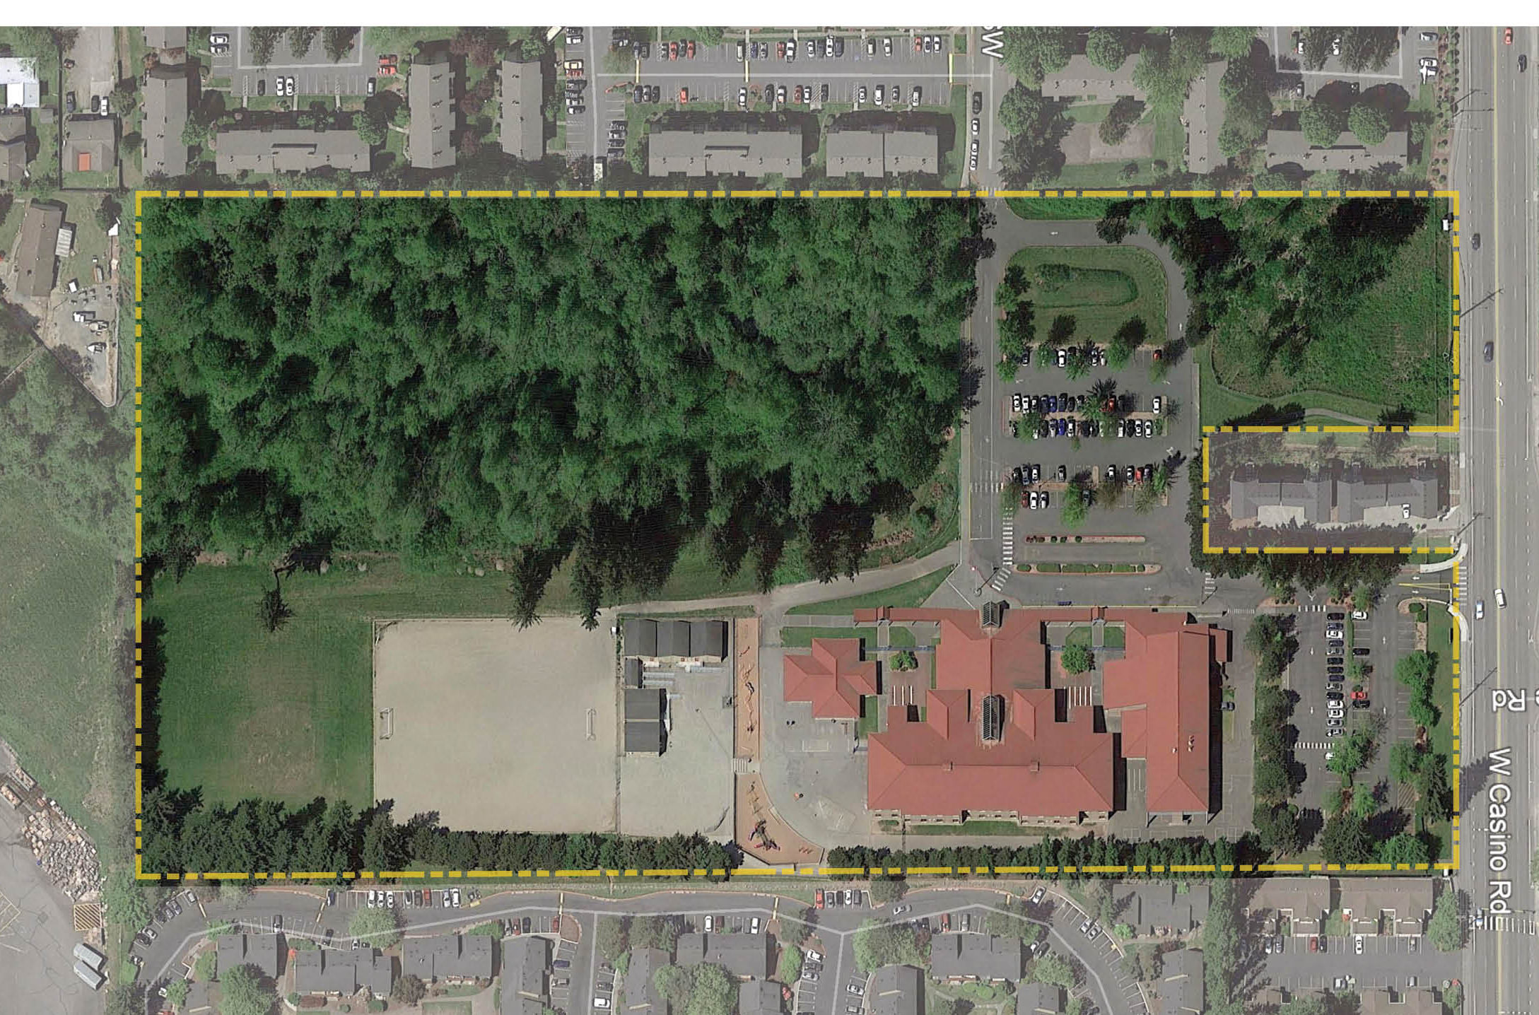

HORIZON OVERVIEW – EXISTING SITE
8

Slide 9
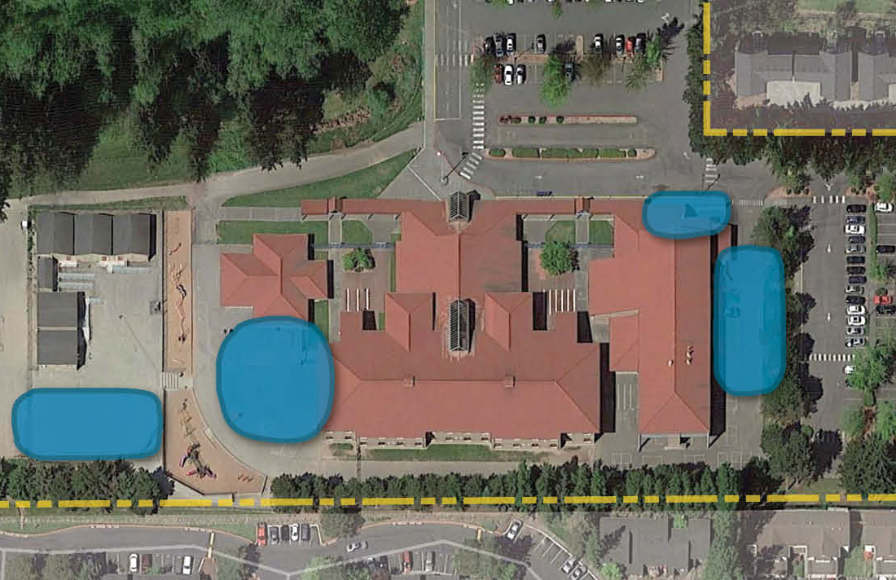
HORIZON OVERVIEW – EXISTING SITE
PARKING
PICK UP & DROP-OFF
MAIN
ENTRY
KITCHEN
MODERNIZATION
BUS LOOP
PORTABLES
NEW
GYM
NEW CLASSROOM WING
NEW COVERED PLAY
SOFT PLAY
9

Slide 10

QUALIFYING GC/CM PROJECT
(RCW 39.10.340)
This project meets 4 of the 5 criteria.
Implementation of the project involves complex scheduling, phasing or coordination.
The project involves construction at an existing facility that must continue to operate during construction
Involvement of the GC/CM during the design stage is critical to the success of the project
The project encompasses a complex or technical work environment.
The project requires specialized work on a building that has historical significance.
10

Slide 11
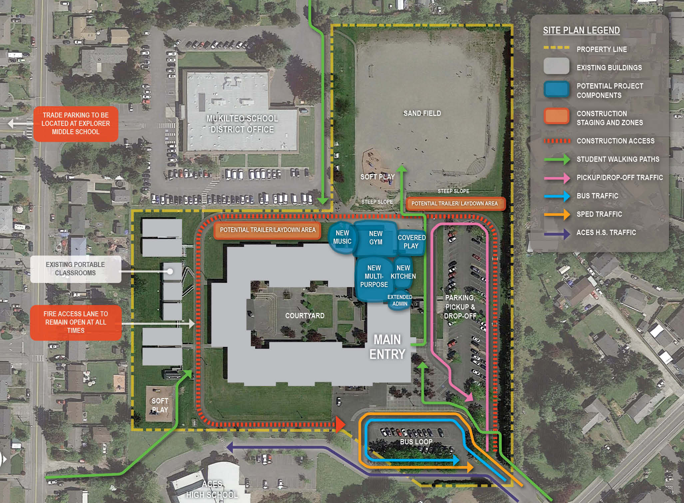
1. COMPLEX SCHEDULING, PHASING & COORDINATION
2. OCCUPIED SITE
QUALIFYING GC/CM PROJECT - CHALLENGER
  Renovating support spaces used daily by all students
  Construction between buildings/ portables and play areas & next to administrative offices
  Addition where current covered play area is
  Construction entrance shared with ACES HS, staff, buses, parents
  Confined building site with minimal laydown area & staging area
  Maintain fire loop & walking pathways
11

Slide 12
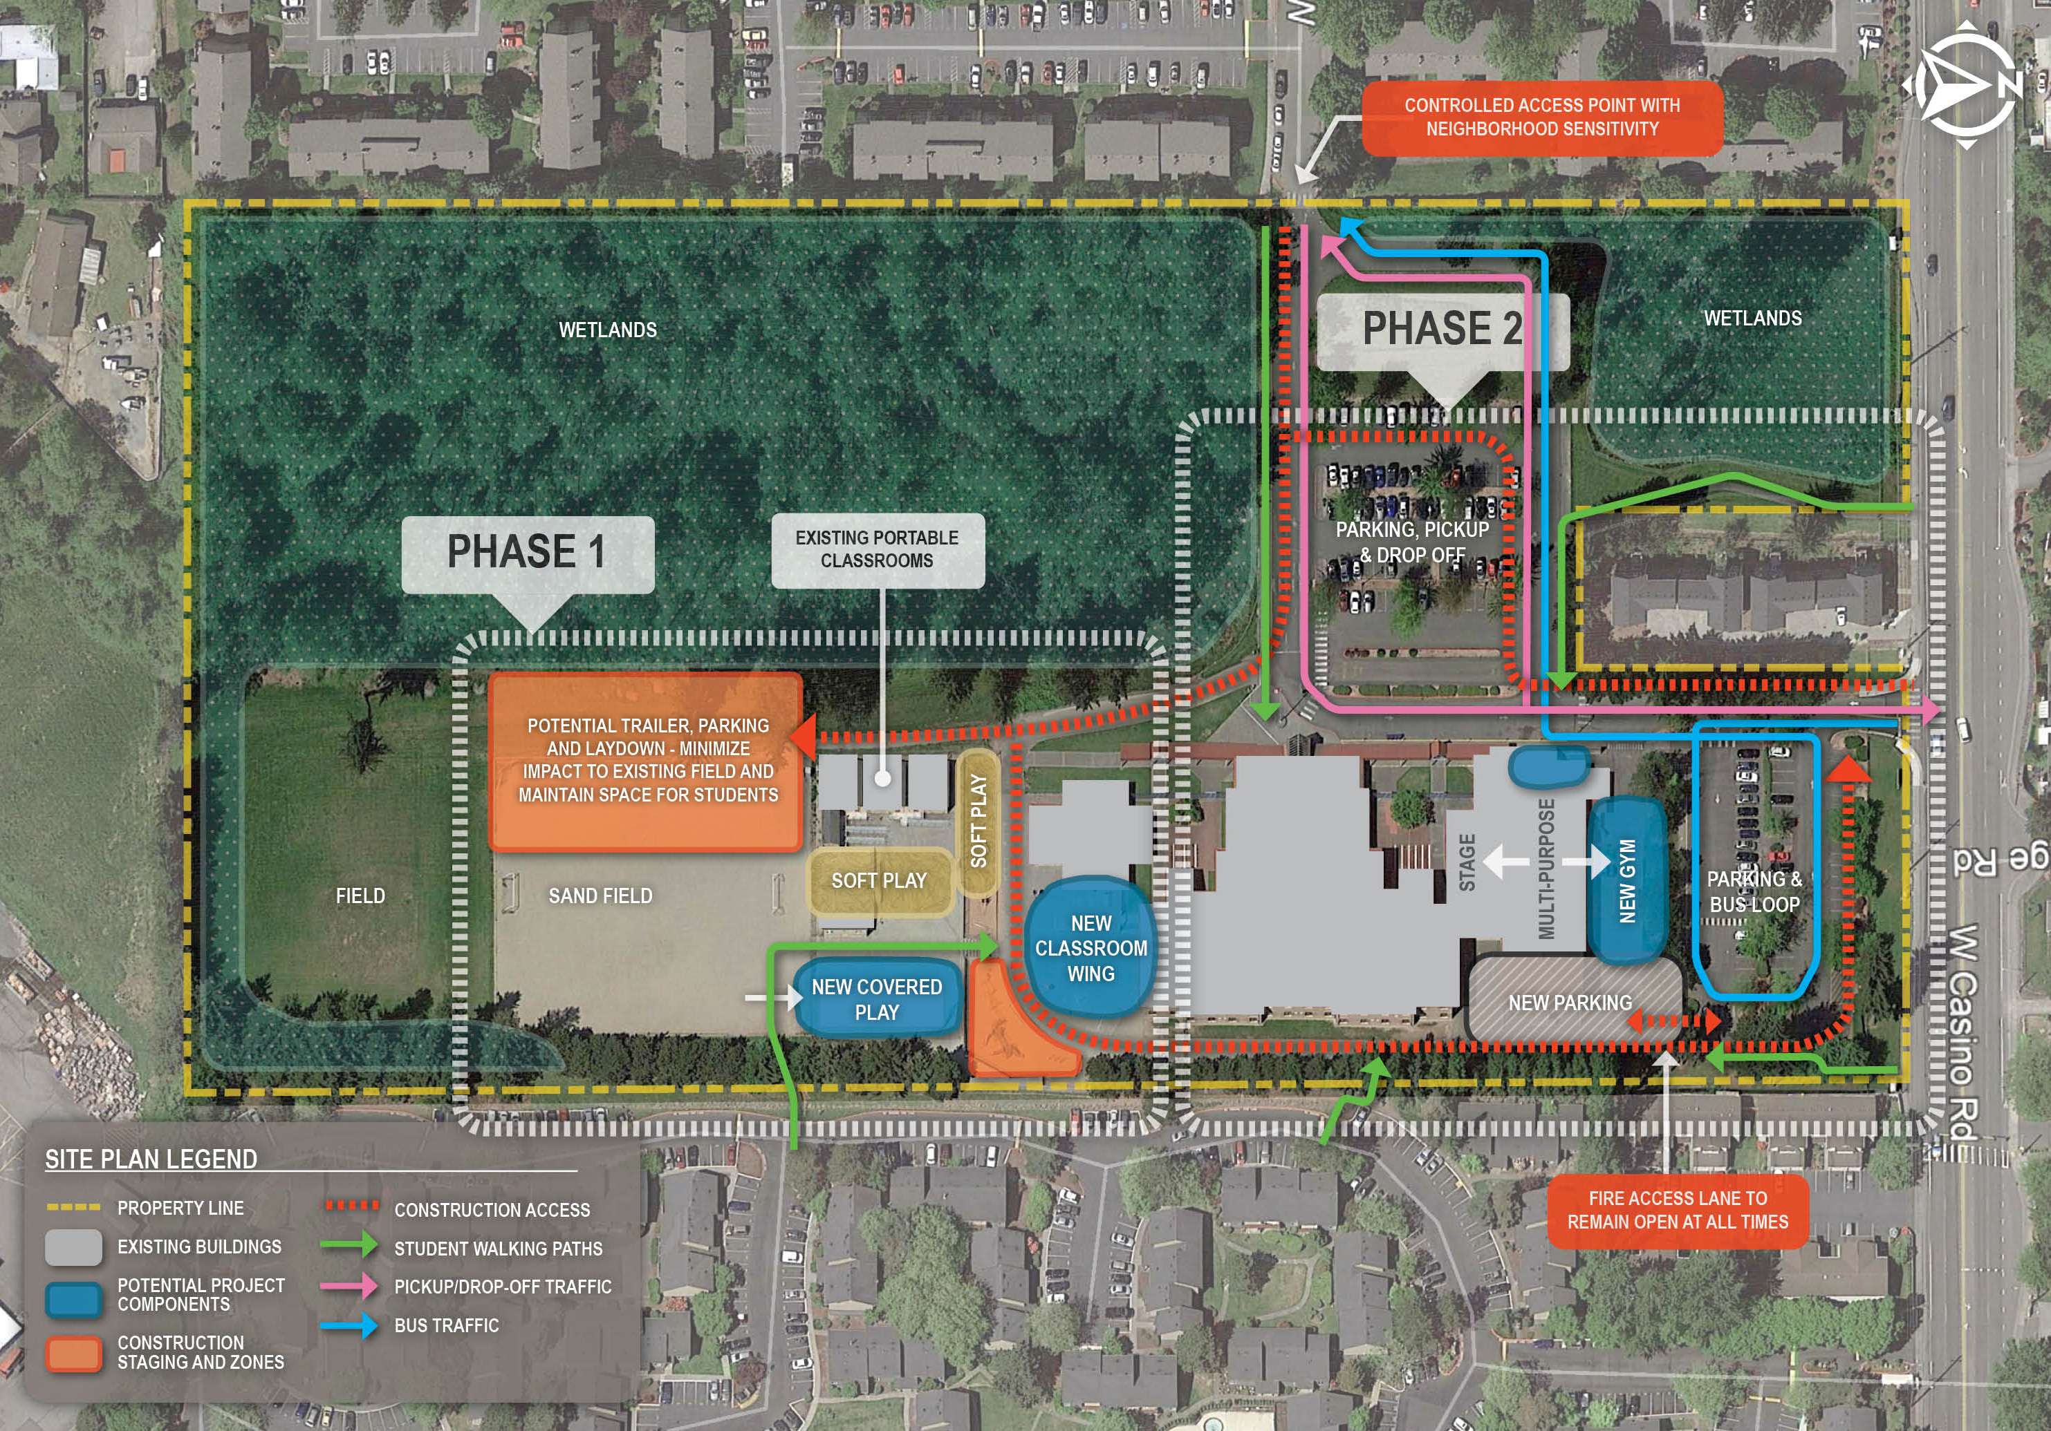
1. COMPLEX SCHEDULING, PHASING & COORDINATION
2. OCCUPIED SITE
QUALIFYING GC/CM PROJECT - HORIZON
  Renovating support spaces used daily by all students
  Addition where current covered play area is
  Construction entrance shared with staff, buses, parents
  Confined building site with minimal laydown area & staging area.
  Construction at opposite ends of school
  Maintain fire loop & walking pathways
12

Slide 13
QUALIFYING GC/CM PROJECT
CHALLENGER & HORIZON
3. GC/CM INVOLVEMENT IS CRITICAL TO THE SUCCESS OF THE PROJECT
GC/CM brought on during Schematic Design
  Prioritize options from conceptual design to ensure a truly integrated design process.
  Understand market for labor and materials to determine early procurement and early site work and maximize efficiencies of two concurrent projects
GC/CM assistance with initial site and building investigation a significant benefit.
GC/CM input on access, phasing, and safety plans tailored around site restraints.
GC/CM has time to understand school operations and provide input on plans to mitigate noise, vibration, dust, and other issues that may adversely impact the educational environment
13

Slide 14
4. Complex Work Environment
QUALIFYING GC/CM PROJECT - CHALLENGER
  District property surrounded by homes
  Main entry shared with ACES High School, staff, buses & parents
  Limited parking, Challenger staff use District Office parking. Construction may need to use Explorer Middle School parking across the street
  58% of students at Challenger live in walk area
  Utility work on existing systems for renovations and additions
14

Slide 15
4. Complex Work Environment
QUALIFYING GC/CM PROJECT - HORIZON
  Both possible construction access points surrounded by homes
  Apartments along east side of campus where construction happening
  Main entry shared with staff, buses, & parents
  70% of students at Horizon live in walk area
  Utility work on existing systems for renovations and additions
15

Slide 16
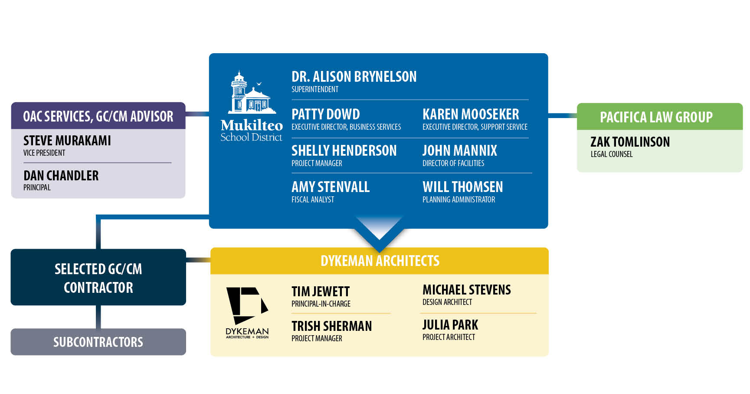
MANAGEMENT PLAN & PROJECT TEAM
Experience
All members of the project team have GC/CM experience.
  Controls
  Minimum monthly, high-level team meeting with principal-level involvement.
  Regular school board updates & approvals.
  Procurement
  OAC & Pacifica Law Group guidance.
  Formal selection with 3-step RFP process, and General Conditions & Agreement.
16

Slide 17
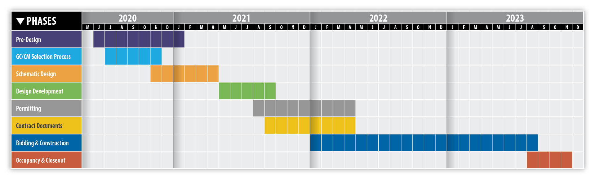
MANAGEMENT PLAN
CHALLENGER - PROJECT SCHEDULE
HORIZON - PROJECT SCHEDULE
17

Slide 18
MANAGEMENT PLAN
PROJECT BUDGET
 | Challenger | Horizon
Costs for Professional Services | $616,500 | $1,237,500
Estimated Project Construction Costs | $6,850,000 | $13,750,000
Equipment and Furnishing Costs | $342,500 | $687,500
Contract Administration Costs | $342,500 | 687,500
Contingencies | $685,000 | $1,375,000
Other Related Project Costs (Utility Fees, permits, bid advertising, moving, etc.) | $478,500 | $887,500
Sales Tax | $685.000 | $1,375,000
TOTAL: | $10,000,000 | $20,000,000
FUNDING
  Funding from proceeds of a $240 million capital bond issue passed by voters in February 2020.
  $30 million of the bond processed are designated as the total project cost for these projects.
18

Slide 19
PROJECT SUMMARY
Traditional delivery method is not desirable
Meets four qualifying criteria
GC/CM will be under contract early in Schematic Design phase
Public body is qualified
Public benefits
19

Slide 20
QUESTIONS?
20

