Slide 1
North Mason Regional Fire Authority
Headquarters Fire Station
Project Review Committee | Project Approval Process
March 26, 2020

Slide 2
ATTACHMENT A – NORTH MASON REGIONAL FIRE AUTHORITY HQ FIRE STATION
PROJECT ORGANIZATIONAL CHART
Robynne Thaxton (Parkinson)
JD, DBIA DB Legal Counsel
Thaxton Parkinson, PLLC
Beau Bakken
Project Director
Fire Chief
North Mason Regional Fire Authority
Board of Commissioners
Construction Manager
D-B RFQ/RFP - 10%
Design - On-call
Construction - On-call
D-B RFQ/RFP - 10%
Design - 10%
Construction - 10%
Gregory Heinz Principal-in-Charge Hill International, Inc.
Project Committee
Scott Cooper, Assistant Fire Chief, Design Advisor
Renee Wassenaar, Contract and Procurement Advisor
Construction Manager
D-B RFQ/RFP - 10%
Design - 5%
Construction - 5%
D-B RFQ/RFP - 50%
Design - 80%
Construction - 60%
Charles Westover Project Manager
Hill International, Inc.
Becky Blankenship Construction Manager
Hill International, Inc.
Progressive
Design-Builder
D-B RFQ/RFP - 30%
Design - 100%
Construction - 10%
D-B RFQ/RFP - 100%
Design - 20%
Construction - 100%
Design - 100%
Construction - 100
Merry Anna Valdez
Project Scheduler Hill International, Inc.
Aron Aston Estimator Hill International, Inc.
Mamie Kamada Document Controls Specialist Hill International, Inc.
D-B RFQ/RFP - 10%
Design - 10%
Construction - 15%
D-B RFQ/RFP - 10%
Design - 10%
Construction - 15%
D-B RFQ/RFP - 10%
Design - 10%
Construction - 15%

Slide 3
HQ Fire Station Facility Overview
Replace existing facility that no longer meets our needs
New facility - approximately 20,200 SF
Office and living space, including:
Kitchen/dining area;
Fitness room;
Day room;
Sleeping quarters;
Indoor classes and training; and
Apparatus bay for fire, ambulance and command vehicles

Slide 4
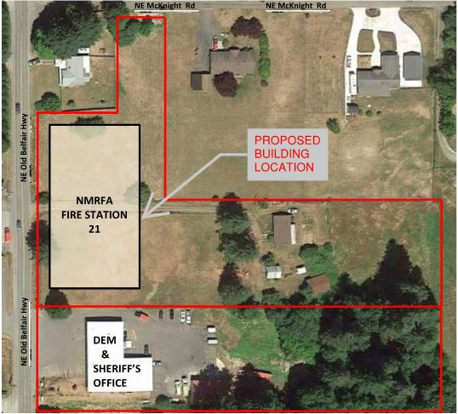
Proposed HQ Fire Station Site

Slide 5
HQ Fire Station Project Budget
Professional Services $ 700,000
Construction Cost $ 7,100,000
Off-site Costs $ 360,000
Contract Admin/Other $ 200,000
NMRFA Contingency $ 700,000
Other Related Project Expenses $ 150,000
WSST $ 790,000
Total Project Cost $ 10,000,000

Slide 6
Schedule
D-B RFQ Advertisement Apr 02, 2020
D-B SOQ Due Apr 29, 2020
Shortlist Finalists May 06, 2020
Issue RFP May 12, 2020
DB Team/Owner Interactive Mtg May 18, 2020
Proposal Due May 26, 2020
DB Team Interviews Jun 10, 2020
Selection of DB Team June 22, 2020
NTP Jul 2020
Set GMP Jan 2020
Construction Phase Jan 2021 thru Mar 2022

Slide 7
Procurement Approach
Request for Qualifications
Successful Experience with Projects of Similar Scope and Complexity – Fire Stations or other Municipal facilities with unique equipment or functions
Team Organization
Experience developing GMP collaboratively with Owner
Shortlist no more than three finalists
History in soliciting and/or utilizing OMWBE subcontractors
Request for Proposal
Management approach specific to the project
Innovation and Problem Solving
Interactive Proprietary Meetings
Statutorily required evaluation factors
Price related factor: Fee
$5,000 honorarium
Limited required proposal submittals
Consistent with other projects

Slide 8
Design-Build Agreement
Phase 1 - Validation and GMP Development Period
Validate information from the Owner
Examine options to identify innovation
Commercially reasonable examination of site
Develop Basis of Design Documents, Project Schedule, GMP
Contract Amendment
2. Phase 2 - GMP Execution Period
Complete Design
Construction
Close out

Slide 9
Benefits of Design-Build Delivery
RCW 39.10.300(1)(b) “Greater Innovation or efficiencies between the designer and the builder”
Maximum possibility for coordination of design and construction phasing to provide greatest project value, cost efficiency and design for specialized fire equipment and processes.
RCW 39.10.300 (1)(c) “significant savings in project delivery time”
Progressive Design-Build is the fastest delivery method. Starting construction work prior to completion of design results in a significantly reduced schedule.
An earlier completion date for the NMRFA HQ Fire Station will allow greater efficiency in emergency response services at an earlier date. This is critical for serving a broader portion of the community as soon as possible.
RCW 39.10.280(2)(a) “Substantial Fiscal Benefit”
The budget is limited to fit within the Fire Authority’s project budget. The Design-Builder will be required to design within that budget.
The Design-Builder’s involvement in the development of the scope shifts more risk of the performance of the project to the design-build team.
With one team managing the coordination of the various aspects of the project, the Fire Authority’s risk of claims by various contractors performing adjacent projects are reduced.

Slide 10
Additional Questions
QUESTION
The relationship of the Design-Builder to those listed in the organization chart is unclear.
RESPONSE
Organization chart has been updated to clarify the relationship of the Design-Builder to the rest of the project team.

Slide 11
Additional Questions
QUESTION
Was an Independent Cost Estimator considered for this project?
RESPONSE
During our early programming phase, we engaged an Independent Cost Estimator to validate our initial target budget. For the next project phase, we’ve included a cost estimator on our team, as shown on our Organizational Chart. Aaron Aston is an employee of our 3rd party consultant, Hill International. He has recent experience with fire stations and with many other projects in the greater Seattle area, and is highly familiar with construction cost trends as they pertain to the proposed project.

Slide 12
Additional Questions
QUESTION
What level of construction contingencies is included in the Project Budget on Page 1 of 8?
RESPONSE
We are at a very conceptual phase in planning for this project, so the breakdown shown on Page 1 is only an estimate. At this time we have assumed a construction contingency of 5% to 6%, and we expect the allocations of cost will change as we align the design with the GMP.

Slide 13
Thank you!

