Slide 1
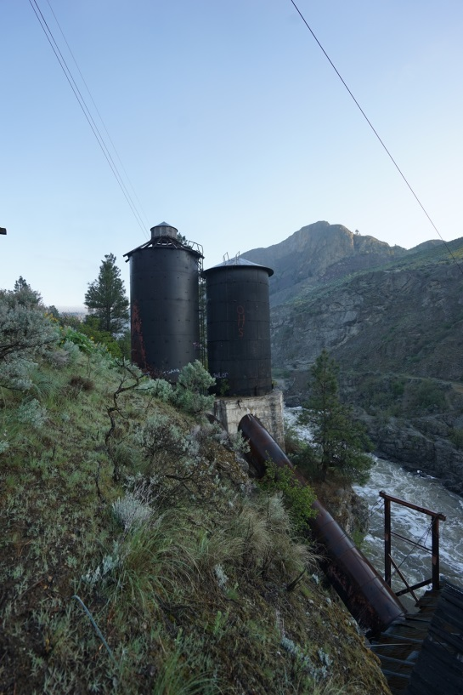

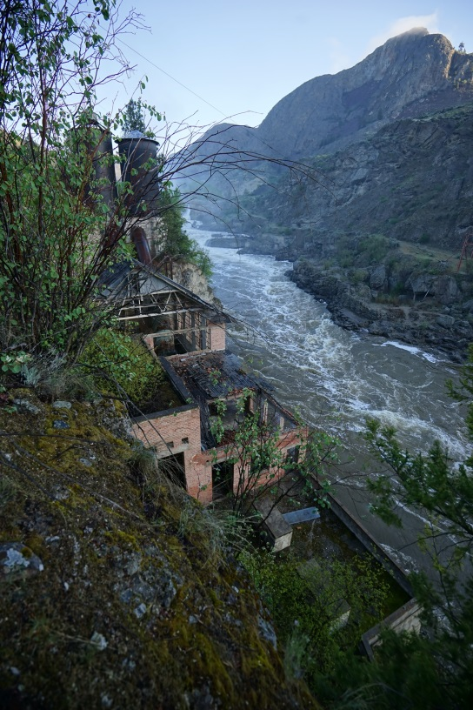
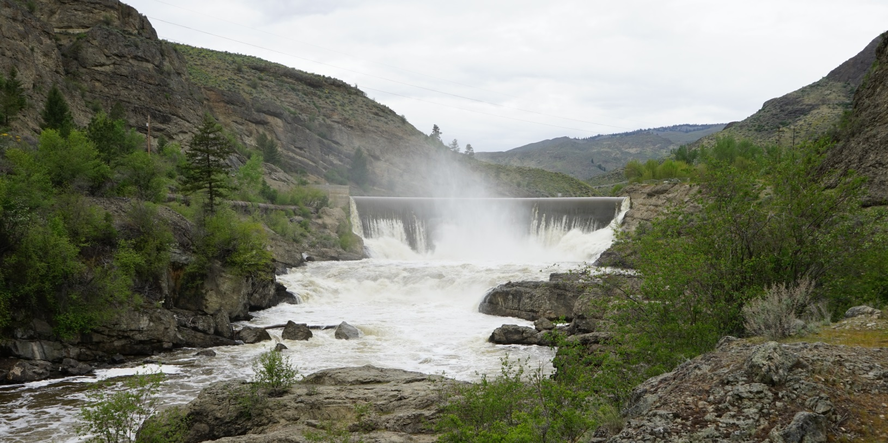
Okanogan PUD | Enloe Dam
Project Review Committee | Project Approval Presentation |
Design Build Contracting
December 1, 2016

Slide 2

Overview
District Background
Project Location and Scope
District’s Goals
Team Organization Chart
Project Budget and Schedule
Approach to D-B Procurement and Agreement
Benefits of Design Build Approach
Questions

Slide 3

District
Public Utility District No. 1 of Okanogan County (District) serves the electricity and broadband needs of Okanogan County (largest county in Washington – 5315 sq-miles).
District formed by voters in 1939. In 1945 District completed purchase of Washington Water Power electric system (including Enloe Dam and Power Plant).
Today
  15,700 customers
  104 miles of 115-kV transmission line and 16 substations.
  1373 miles of overhead and 437 miles of underground distribution line.
  Enloe Dam and retired power plant
  Main electric power sources – BPA, Wells Hydro, Nine Canyon Wind Farm
  100 Employees
  Standard and Poor’s A bond rating; Moody’s A1 bond rating

Slide 4
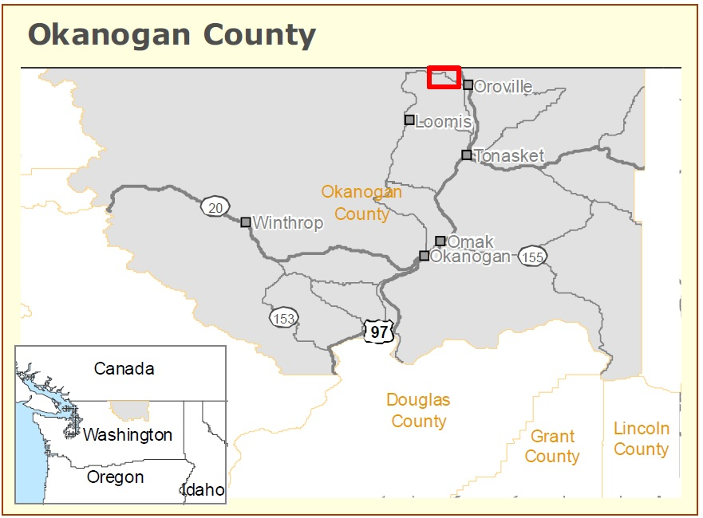
Project Location

Slide 5
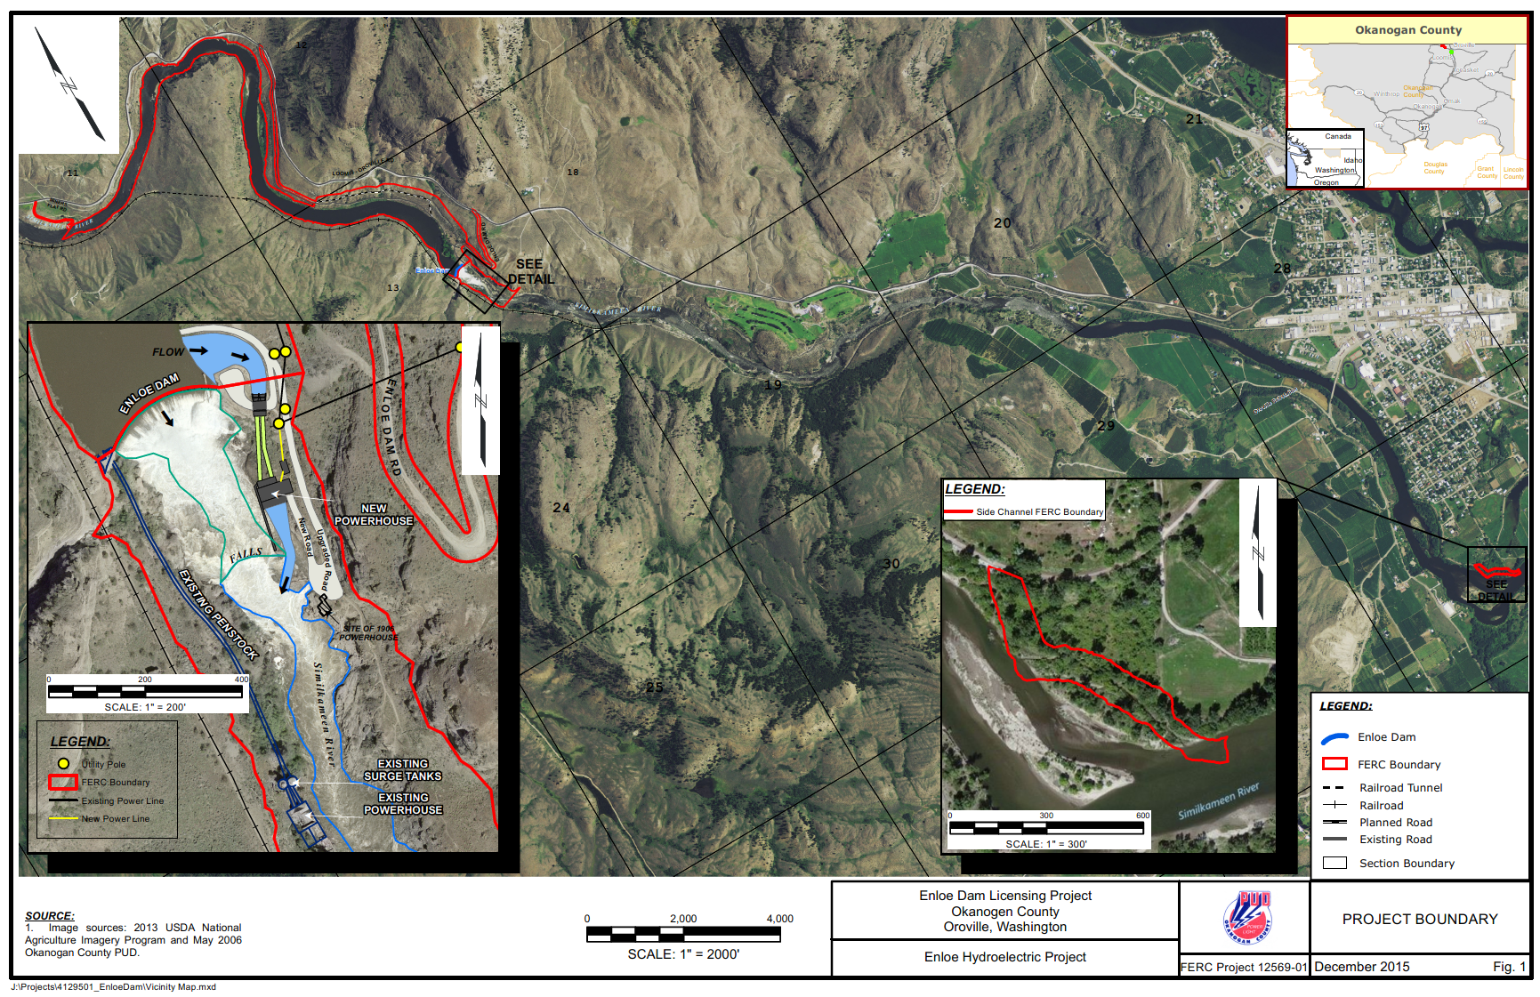
Project Map
Location – Similkameen River near Oroville, WA.
FERC License for a 9 MW power plant issued July 2013.

Slide 6
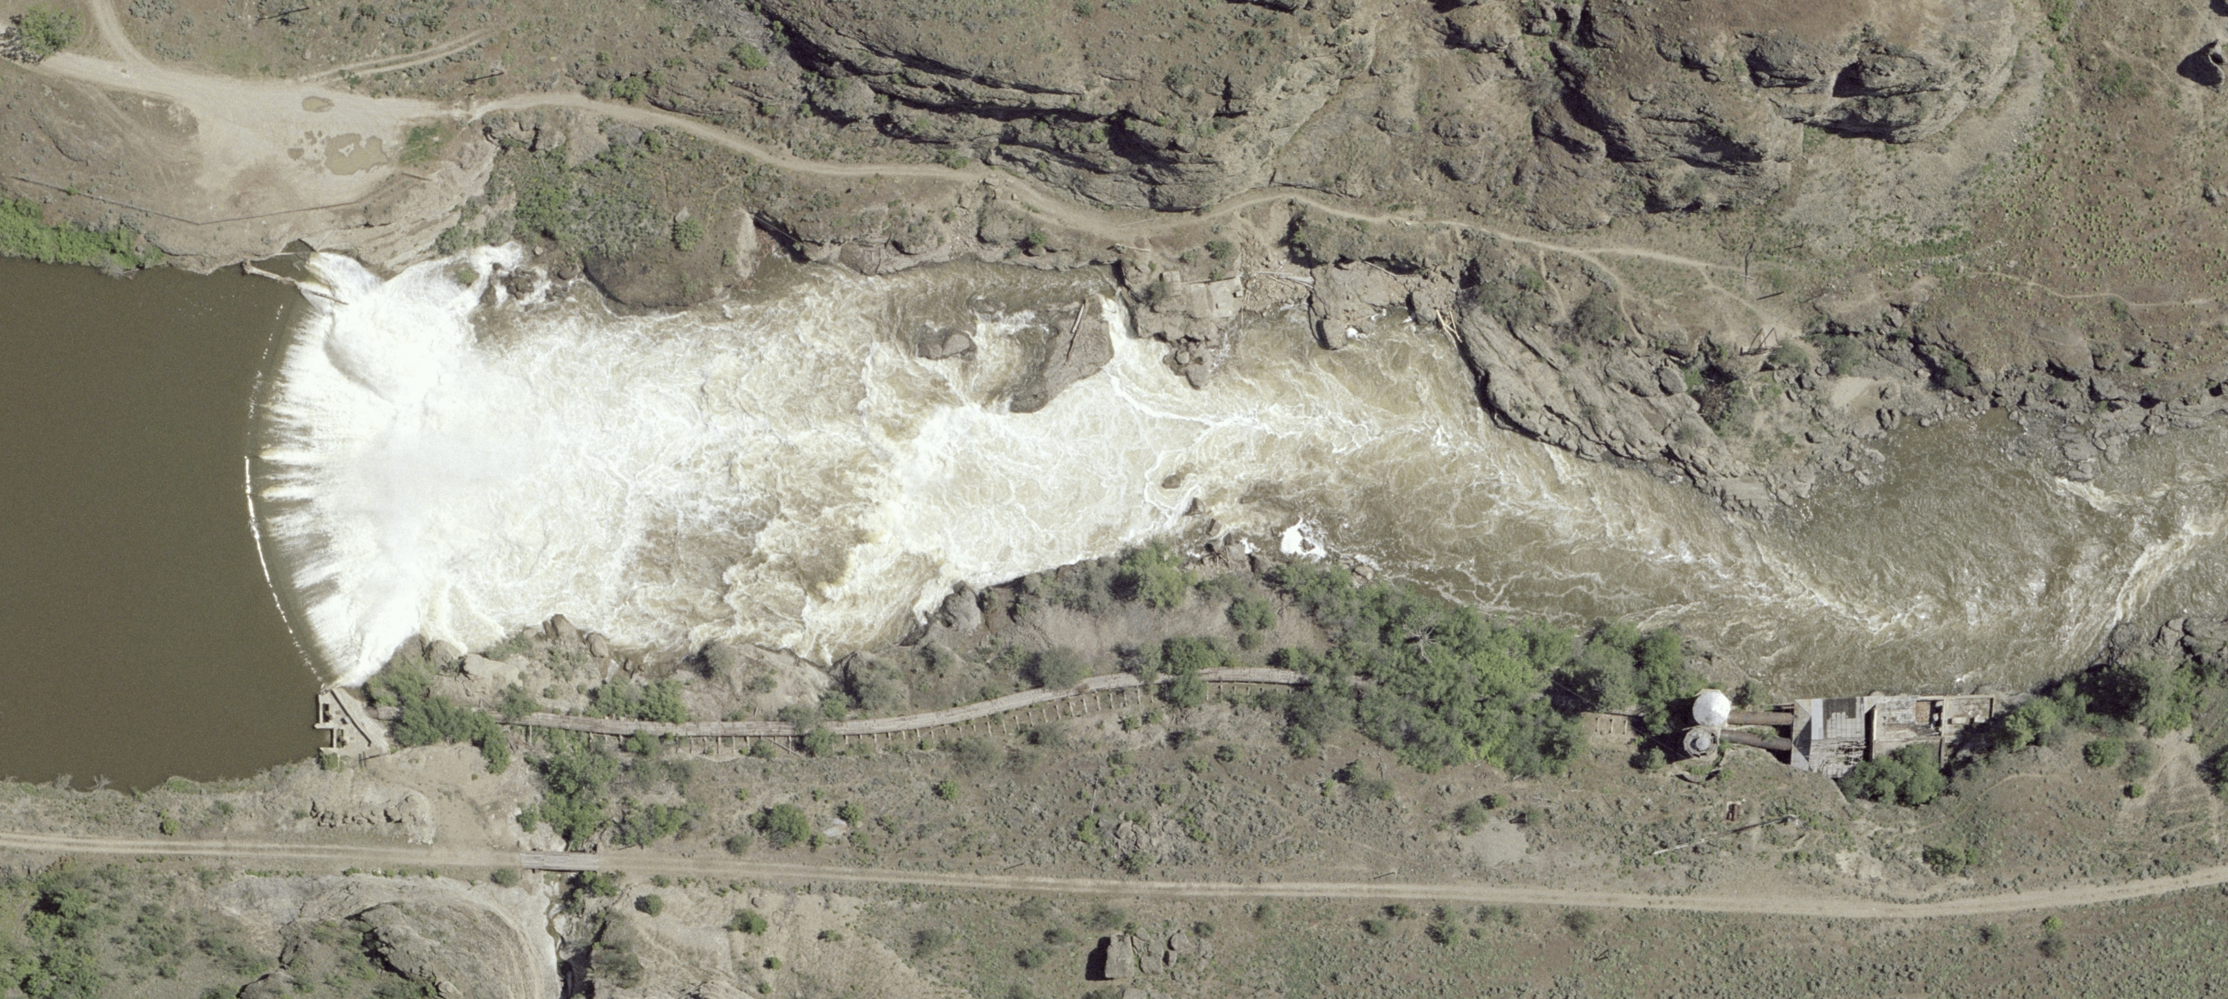
Enloe Dam History
Dam and 3.6-MW hydroelectric power plant constructed in 1920s.
Power plant decommissioned in 1958 when low-cost electric power from Bonneville System became available.
Notes:
3.5 Miles NW of Oroville.
Similkameen flows into the Okanogan river below Oroville and the Okanogan river flows into the Columbia near Brewster.
Dam built by Eugen Enloe between 1919 and 1920.
54’ high, 315’ long gravity arch dam. We affectionately call it chubby.
FERC process was kicked off in 2007.

Slide 7
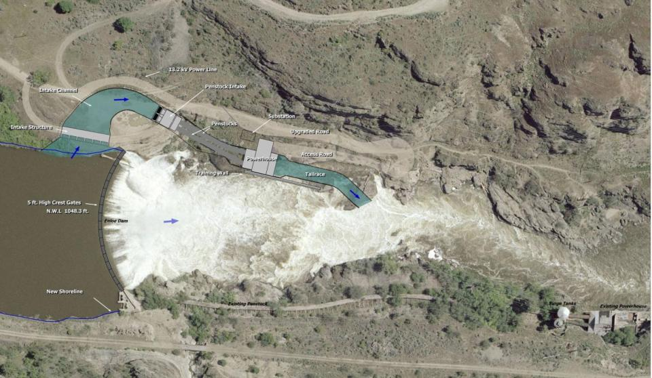
New Power Plant

Slide 8
New Power Plant Scope
Enloe Dam Modifications – Addition of crest gates and outlet works,

Slide 9
Crest Gates & Outlet Works

Slide 10
New Power Plant Scope
Enloe Dam Modifications – Addition of crest gates and outlet works,
Power Headworks - New intake channel, power intake, and penstocks on the east bank next to the existing dam,

Slide 11
Intake Channel, Power Intake & Penstocks

Slide 12
New Power Plant Scope
Enloe Dam Modifications – Addition of crest gates and outlet works,
Power Headworks - New intake channel, power intake, and penstocks on the east bank next to the existing dam,
Power Plant - New 9-MW hydroelectric power plant and tailrace channel on east bank of the river downstream of the existing dam,

Slide 13
Power House & Tailrace

Slide 14
New Power Plant Scope
Enloe Dam Modifications – Addition of crest gates and outlet works,
Power Headworks - New intake channel, power intake, and penstocks on the east bank next to the existing dam,
Power Plant - New 9-MW hydroelectric power plant and tailrace channel on east bank of the river downstream of the existing dam,
Interconnection - New electric substation and a short interconnection to the District’s existing distribution system.

Slide 15
Electric Substation

Slide 16
New Power Plant Scope
Enloe Dam Modifications – Addition of crest gates and outlet works,
Power Headworks - New intake channel, power intake, and penstocks on the east bank next to the existing dam,
Power Plant - New 9-MW hydroelectric power plant and tailrace channel on east bank of the river downstream of the existing dam,
Interconnection - New electric substation and a short interconnection to the District’s existing distribution system.
Other Features
  Improvements to public recreation facilities.
  New fish habitat enhancement facilities.
Electric Power Generation - Estimated average output - 45 GWh/year.

Slide 17
District Goals
Cost - Minimize cost of owning Enloe Dam including incremental costs and benefits of hydropower generation.
Project Finance, Operations and Maintenance – Best fit with District’s ongoing commitments, operations and resources.
Quality – Meet electric utility quality standards.
Safety – Maintain safety of human life and property.
Climate Change – Help reduce carbon emissions.
Environment – Resource stewardship and enhancement.
Compliance – Comply with laws, permits and approvals.
Collaboration – Partnership with D-B Team and Regulators.
Risk – Best allocation between participants.
Schedule – Meet milestone dates in FERC License.
Notes:
The PUD is committed to provide dependable, not for profit, public utility services governed by and for the benefit of our customers in a safe and environmentally friendly manner.

Slide 18
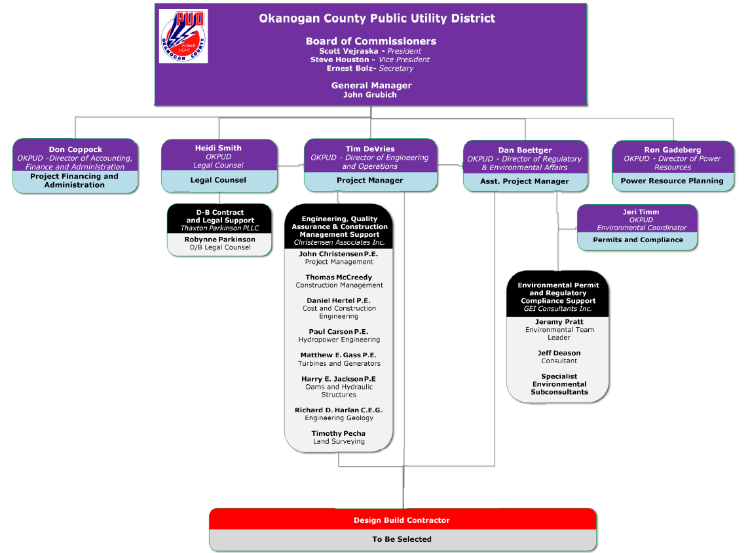
Organizational Chart

Slide 19
Project Budget
Item | Cost ($)
Professional Services | $5,807,000
Design & Construction Costs | $15,050,000
Equipment and Furnishings | $9,879,000
Contingencies | $4,415,000
Other Related Project Costs | $4,653,000
Use Tax | $2,696,000
Total | $42,500,000

Slide 20
Schedule (updated)
Date | Activity
December 9, 2016 | Issue RFQ
January 6, 2017 | SOQ Due Date
January 13, 2017 | Notification of Shortlisted Finalists
January 20, 2017 | Issue RFP
TBD | Proprietary Interactive Meetings
March 3, 2017 | Proposal Due Date
March 17, 2017 | Notification of Highest Scored Finalist

Slide 21
Procurement Approach
  RFQ
      Team Organization
      Successful Experience with Projects of Similar Scope and Complexity
      Experience developing GMP collaboratively with Owner
      Shortlist - no more than five finalists
  RFP
      Approach to meeting District Goals.
      Interactive Proprietary Meetings.
      Innovation/Problem Solving.
      Collaboration approach with District and Regulators.
      Proposed honorarium - $5,000 - $10,000.
        Alternate DFBOM proposals invited.

Slide 22
Design-Build Agreement
Validation Period
  Validate information from the Owner.
  Refine owner requirements and project scope.
  Develop design criteria - Basis of design documents.
  Innovation and value engineering options.
  Permitting/Compliance approach.
  Develop target schedule and budget.
  Develop GMP, Fixed Price or other price approach.
  Update schedule
  Contract amendment.
2. Execution Period
  Complete permitting in collaboration with District
  Ongoing regulatory compliance with District.
  Complete engineering design.
  Equipment procurement.
  Construction.
  Operation (Optional).

Slide 23
Benefits of Design-Build
RCW 39.10.280(2)(a) “will provide a substantial fiscal benefit”
  Innovation, cost savings and other benefits from value engineering executed by the District/D-B team.
  Cost-risk benefits in allocating design, integration and performance risk to the D-B team.
  Alternative financing, operations and maintenance proposal will provide District with significant benefit.
RCW 39.10.300(1)(a) “The construction activities are highly specialized and a design-build approach is critical in developing the construction methodology”
  Hydro power plant construction requires close collaboration between designer, generating equipment supplier and installation contractor.
RCW 39.10.300(1)(b) “The projects selected provide opportunity for greater innovation or efficiencies between the designer and the builder”
  Early contractor involvement to address constructability issues, develop practical construction plans and to finalize environmental plans and protection measures.
  Integration of design, permitting, procurement and construction of power facilities creates opportunities for innovative and cost-effective solutions.
RCW 39.10.300(1)(c) “significant savings in project delivery time would be realized”
  Project delivery time reduced by early initiation of equipment procurement and by overlapping final engineering design with equipment procurement and construction.

Slide 24
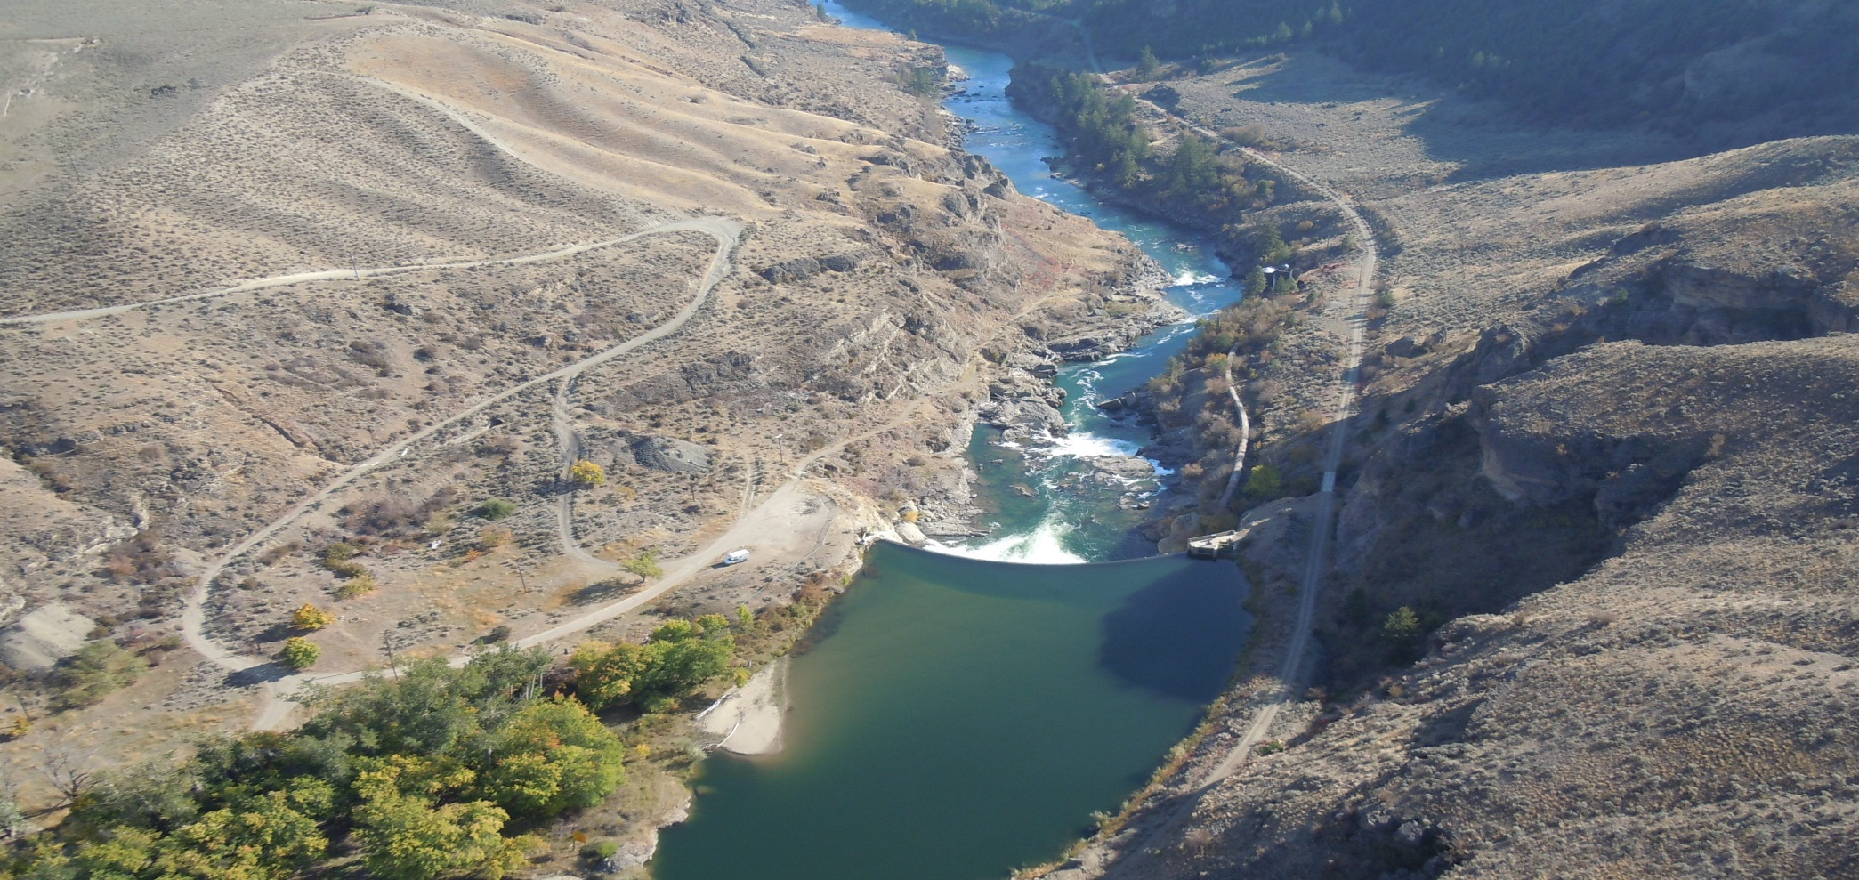
Questions?

