Slide 1
Rock Island Dam Powerhouse #2
Main Generator Leads Replacement
Application to use the Progressive D/B Delivery Method
May 29, 2020 Presentation
“To provide sustainable, reliable utility services that enhance the quality
of life in Chelan County.”
Notes:
Jim Dugan to introduce Project and presentation participants

Slide 2
Agenda
Introductions
Chelan County PUD
The Project
Project Budget
Project Schedule
Why Progressive Design-Build
Qualifications
Organization Chart
Summary
Notes:
JD

Slide 3

Introductions
Notes:
JD

Slide 4
The Project Team – Here Today
Chelan County Public Utility District No. 1
John Sagerser, Rock Island EPM Manager
Devin Myers, Rock Island Project Manager
Parametrix
Jim Dugan, D/B Program Advisor
Dan Cody, D/B Procurement & D/B PM/CM Support
Maggie Anderson, Project Controls Specialist
Notes:
JD

Slide 5
The Project Team:
Other Team Members
Chelan County Public Utilities District No. 1
Steve Wright, General Manager
Justin Erickson, Managing Director - District Services
Sam Nott, Lead Electrical Engineer
Katie Yount, Internal Legal Counsel
Chuck Boss, Construction Manager
Perkins Coie
Graehm Wallace, D/B Legal Advisor
Hydro Design Consultant
Stantec Consulting
Notes:
JD

Slide 6
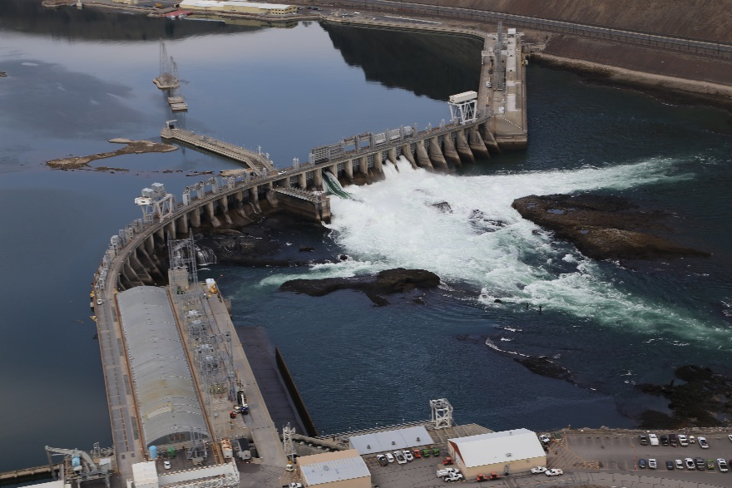
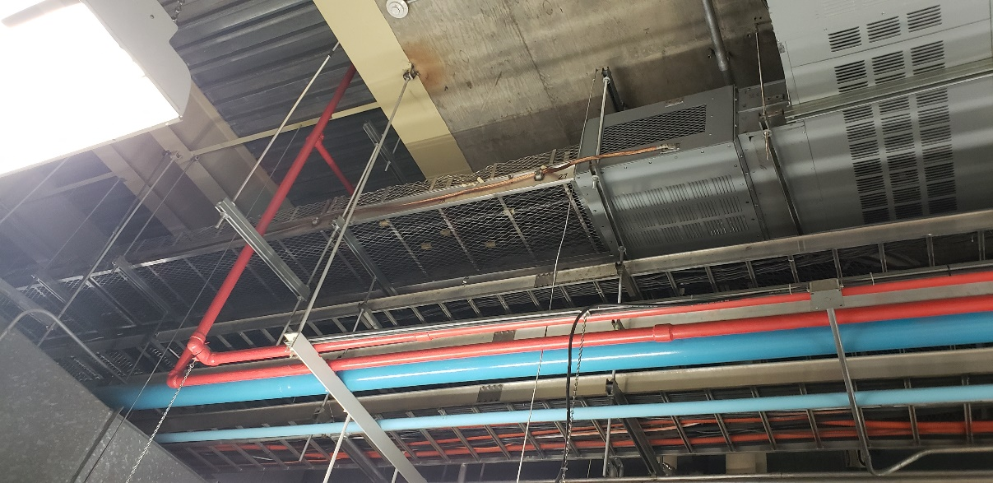
Chelan County PUD
Notes:
John Sagerser present the District information

Slide 7
The District
Chelan County PUD was established in 1936
Second largest, non-federal, publicly owned hydro generation capacity in the U.S.
800 Employees
50,000 Customers
3,000 sq. mile service territory
Approximately 2,000 megawatts of generating capacity
35% of hydropower generated serves county residents, the remainder is sold through contracts and into the energy market.
Three Hydroelectric projects
  Lake Chelan Dam –Built in 1927
  Rock Island Dam – First Powerhouse built in 1933,
                Second Powerhouse built in 1979
  Rocky Reach Dam – Built in 1961
Operate
  Water/wastewater – approx. 5,000 customers
  Fiber & telecom – 13,000 customers
  Parks & recreation – 14 parks along the Columbia River and Lake Chelan
Notes:
JS

Slide 8

The Project
Notes:
JS

Slide 9
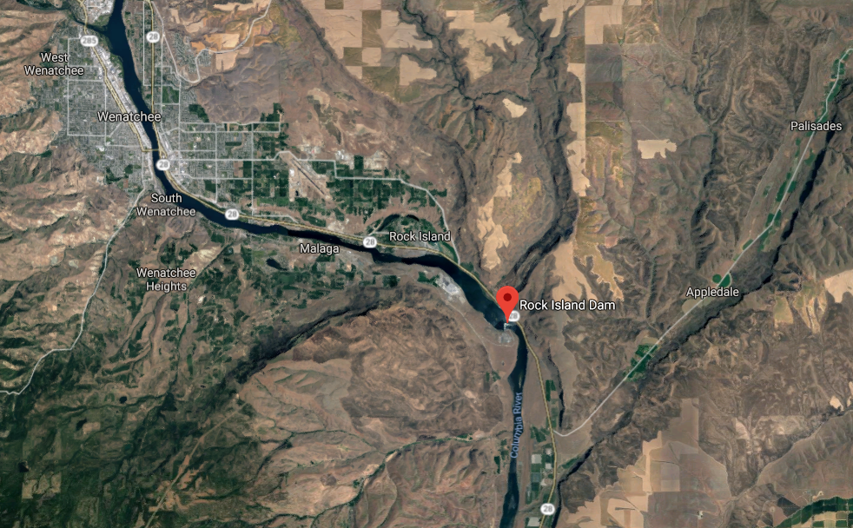
Rock Island Dam
Notes:
JS

Slide 10
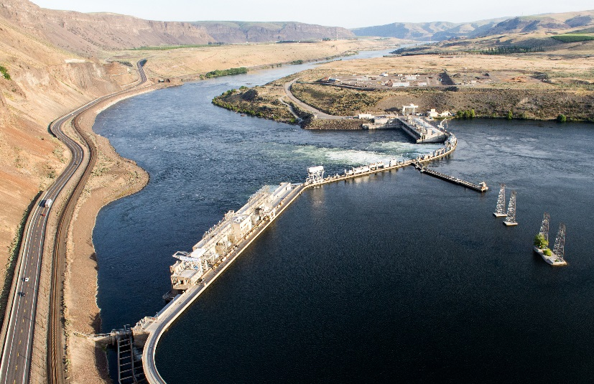
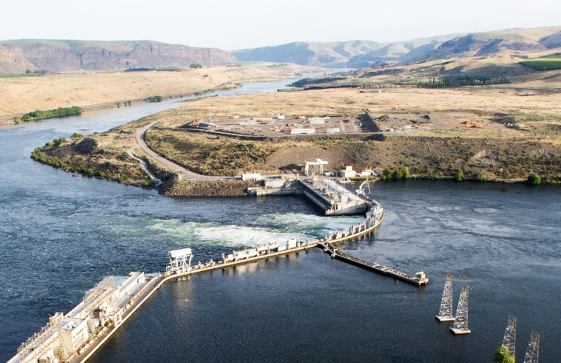
Rock Island Dam
First Powerhouse built in 1933
First Hydropower project on the Columbia River
Second Powerhouse built in 1979
Last Hydropower project on the Columbia River
Eight (8) original turbine-generator units installed in Powerhouse #2
Turbine-generators and associated Balance of Plant systems have exceeded their 40-year useful life
Generator Main Lead Replacement will help ensure another 40 years of reliable/efficient operation
Replacements will be phased to minimize disruption to power generation capability
Notes:
JS

Slide 11
Rock Island Dam
Main Generator Leads Replacement
Removal of existing cable bus system for all units, which is 6 – 1000mcm conductors per phase
Replace all bus sections from generator bus to generator breaker, and from generator breaker to transformer for all eight units
Design and supply new bus system designed for 40 year design life
New bus system to be rated for 5000 amps per phase, rated for 15kv, 3 phase
Install new bus system, approximately 1400 feet of bus
Bus system must meet seismic requirements for the site
All labor, supervision, tooling, scaffolding, bus supports, hardware, terminations, and materials supplied for a complete installation
Scheduling to be coordinated with District generator outage
Notes:
Devin Myers to present Project specific information

Slide 12
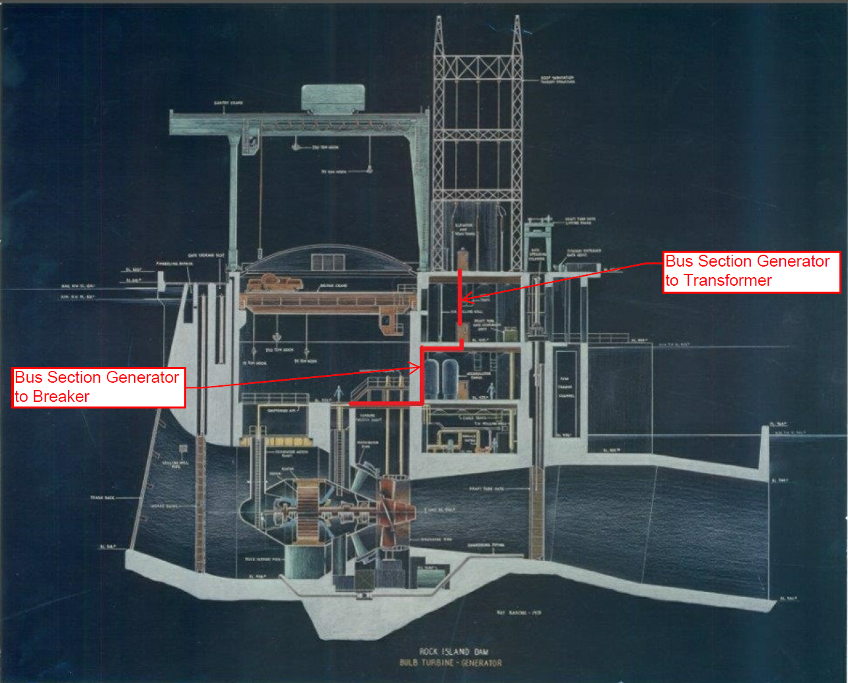
Notes:
DM

Slide 13
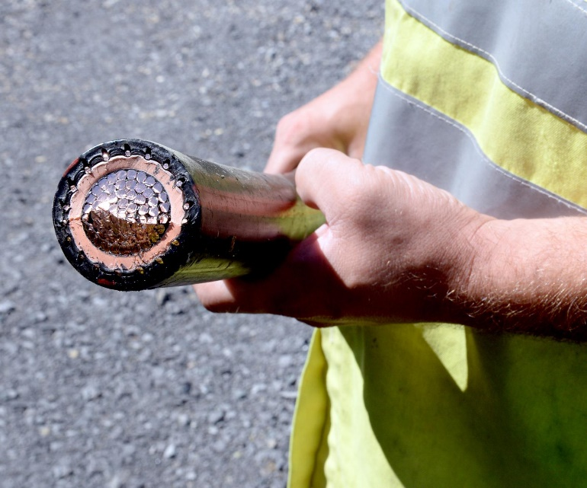
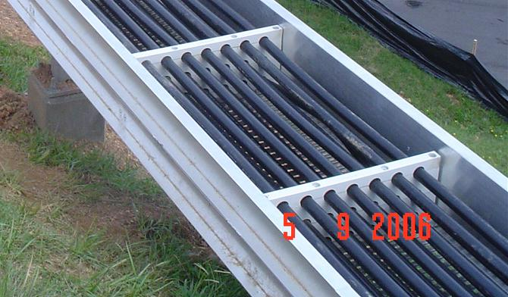
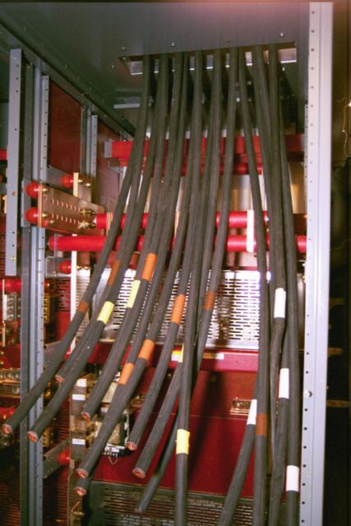
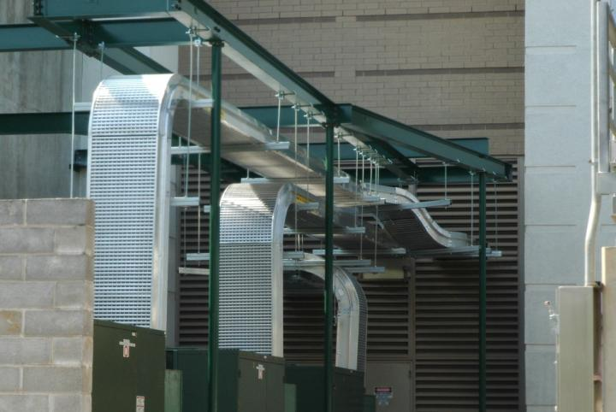
Rock Island Dam Powerhouse #2
Main Generator Leads Replacement Project
Generator Cable Bus Installation
Notes:
DM

Slide 14
Rock Island Dam Powerhouse #2
Main Generator Leads Replacement Project Budget
Category | Budget
Costs for Professional Services (A/E, Legal, etc.) | $ 125,000
Removal of Existing Cable Bus | $ 259,680
Supply of New Bus System | $ 1,584,048
Installation of New Cable Bus System | $ 4,284,720
Testing of New Cable Bus System | $ 108,200
District Administration and Project Management | $ 75,000
Total | $ 6,436,648
Note: All design and construction costs identified above include 8.3% sales tax, 5% owners project contingency and a combined 15% contingency for design, construction, escalation and inflation
Notes:
DM

Slide 15
Project Funding
  Overall project scope, schedule and budget were presented as part of the Powerhouse Two Rehabilitation Program to District Board of Commissioners in November 2017
  Approved 2019 and 2020 capital funds associated with the project
  District currently plans to fund project with cash reserves until 2022
  District has not issued bonds for capital projects since 2009
  Average capital expenditure of $44M between 2010 and 2017 using cash reserves
  District’s current bond rating is AA+/Stable, one of the top five public utilities
  Ability to fund project after 2022 using external debt is high
Notes:
DM

Slide 16
Rock Island Dam Powerhouse #2 Main Generator Leads Replacement Project D/B Schedule
Project Schedule | Estimated Date
PRC Presentation | May 29,2020
Publication of RFQ for Design/Build Services | June 2, 2020
Project Information Meeting (Date subject to change.) | June 11, 2020
RFQ Submittal Deadline | July 1, 2020
Open & Review/Score Submittals Received | July 2-8, 2020
Identify Finalists & Issue RFP & Proprietary Meeting Notifications | July 10, 2020
Proprietary Meeting #1 | July 30 - August 6, 2020
Proprietary Meeting #2 (if required) | August 18-21, 2020
RFP Submittal Deadline (Proposals & Cost Factors) | September 2, 2020
Open & Review Proposals (Cost Factors not reviewed) | September 3-9, 2020
Open Cost Factors & Score Proposals | September 11, 2020
Design/Builder Interviews | September 13-16, 2020
Notify Design/Builders of Scoring and Most-Qualified Design/Builder | October 5, 2020
Notes:
DM
June Second or as soon after as possible

Slide 17
Rock Island Dam Powerhouse #2 Main Generator Leads Replacement Project D/B Schedule
Project Schedule | Estimated Date
Design/Build Contract Negotiation | October 16-November 13, 2020
Execute Design/Build Agreement with Preconstruction Phase | December 2020
Preconstruction Phase/GMP Negotiation | December 2020-January 2021
GMP Amendment Executed | January 2021
Manufacturing – First Unit and Unit Common | March 2021 – July 2021
Site Set-up and Mobilization | July 2021 – September 2021
Construction Phase | September 2021 – January 2029
Notes:
DM

Slide 18
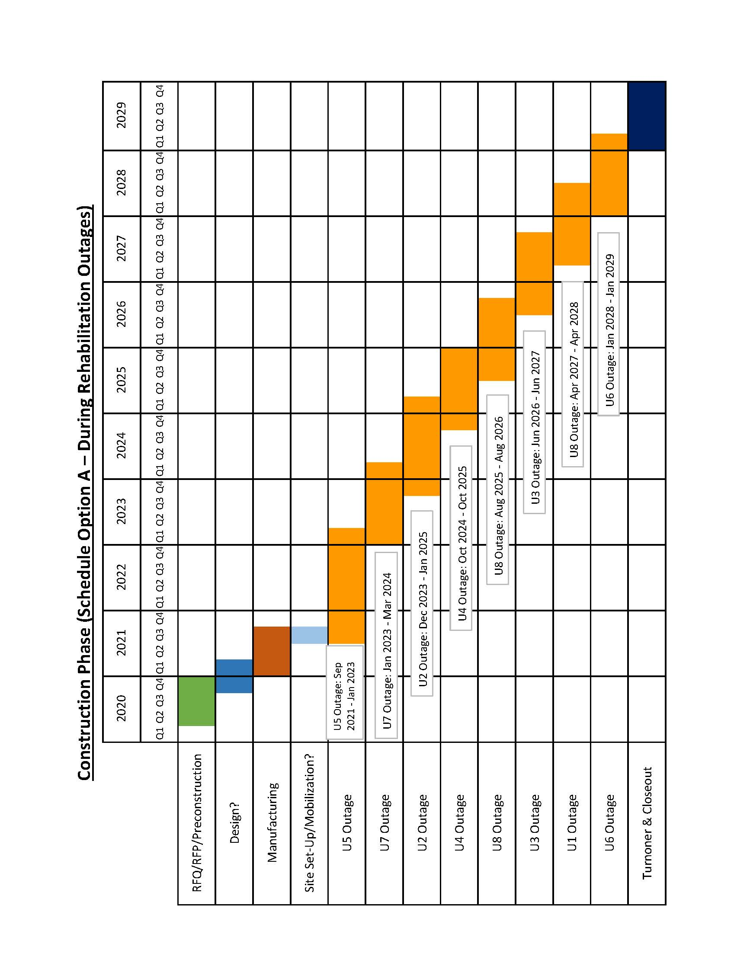
Rock Island Dam Powerhouse #2 Main Generator Leads Replacement Project Development Schedules
Critical Phasing
Notes:
DM

Slide 19
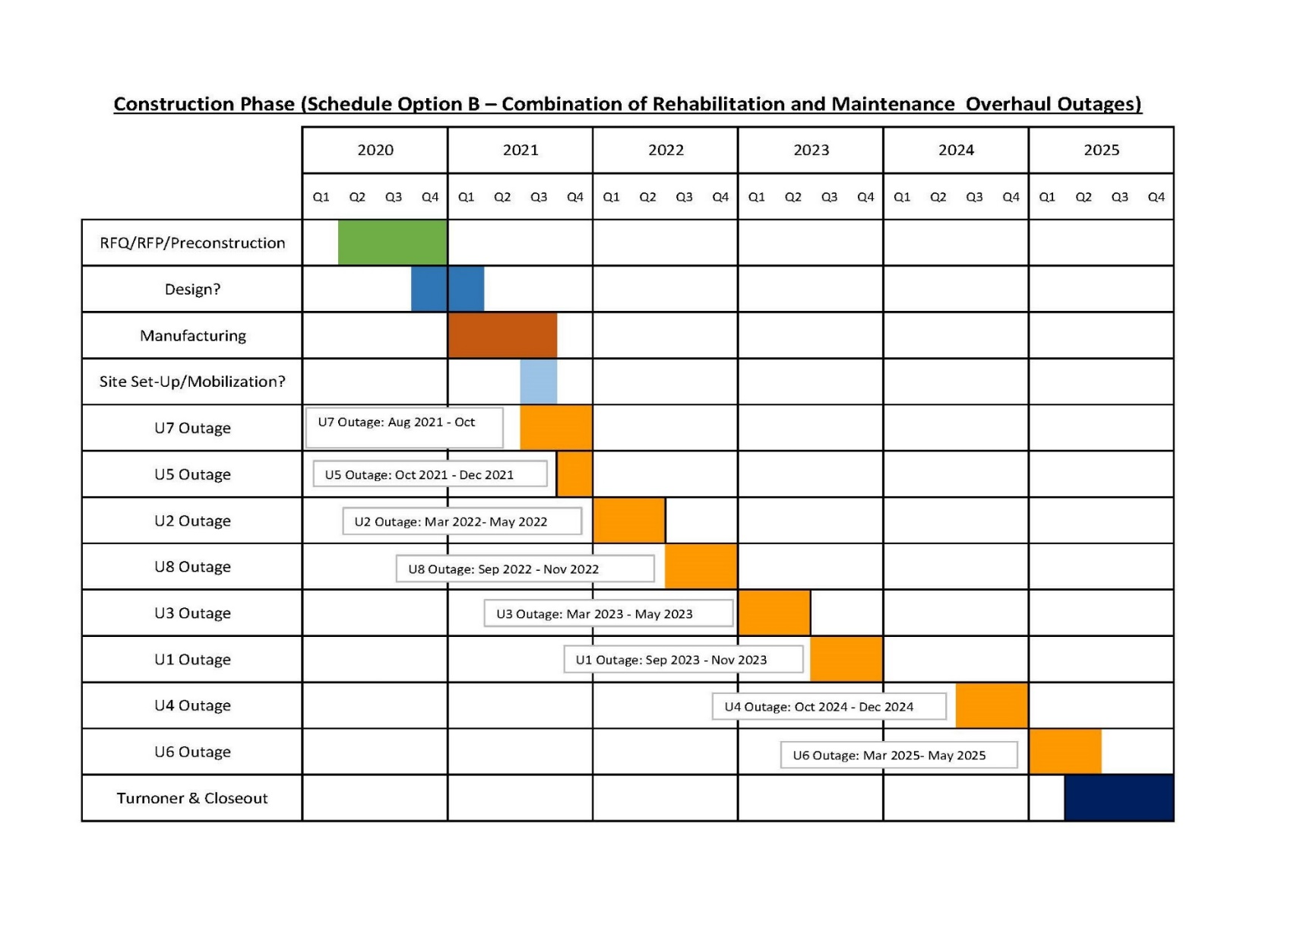
Rock Island Dam Powerhouse #2 Main Generator Leads Replacement Project Development Schedules
Critical Phasing
Notes:
DM

Slide 20
Why D/B Delivery Method for Rock Island Dam Powerhouse #2 Main Generator Leads Replacement Project
Notes:
DM

Slide 21
RCW 39.10 D/B Statutory Compliance
(5.1) If the construction activities are highly specialized and a D/B approach is critical in developing the construction methodology
  Rock Island Powerhouse 2 is critical infrastructure.
  “Bulb” turbine-generator rare in the U.S.
  Powerhouse 2 is an operating power plant. Phased construction required to minimize operational impacts on power generation
  Limited access for removal and reinstallation
  Precise routing of bus is required to fit
  Installation will require special procedures due to the size and weight of the bus
  Medium voltage terminations are critical to plant safety
(5.2) If the project provides opportunity for greater innovation and efficiencies between the designer and builder
  The existing bus system has had temperature rise problems that can be corrected with a new design
  The medium voltage and high current capacity bus requirements for this project can be designed in numerous ways
  Proprietary design solution can be leveraged to achieve the technical requirements for this project
  Design may vary based on specific condition and needs of each unit
  Owner does not have expertise to specify options for improvement to existing systems
(5.3) If significant savings in project delivery time would be realized
  It will be imperative that the contractor is involved in scheduling and phasing of the work.
  Scheduling and installation innovation can reduce the outage time required
Notes:
DM
Existing essential/critical facility operational, schedule.

Slide 22
Public Body Qualifications
Notes:
JS

Slide 23
CCPUD Leadership Team
CCPUD has extensive construction experience including projects of similar scope and complexity
  Long history of projects delivered using Design-Bid-Build or Negotiated Contract.
  Long track record of building projects on-time and within budget.
CCPUD is relatively new to the Design Build method of project delivery
  CCPUD is currently using Progressive Design-Build for RI PH2 Generator and Turbine Rehabilitation
  CCPUD is currently using GC/CM for two facilities projects.
CCPUD team members have attended the upcoming AGC Design-Build Workshop
CCPUD team members have attended and are registered to attend the upcoming DBIA Certification Workshop
Parametrix: Dan Cody D/B PM Support and Jim Dugan Internal D/B Advisor
Graehm Wallace, (Perkins Coie): External D/B Legal Counsel
CCPUD satisfies the public body qualifications by staff augmentation with consultants.
Notes:
JS

Slide 24
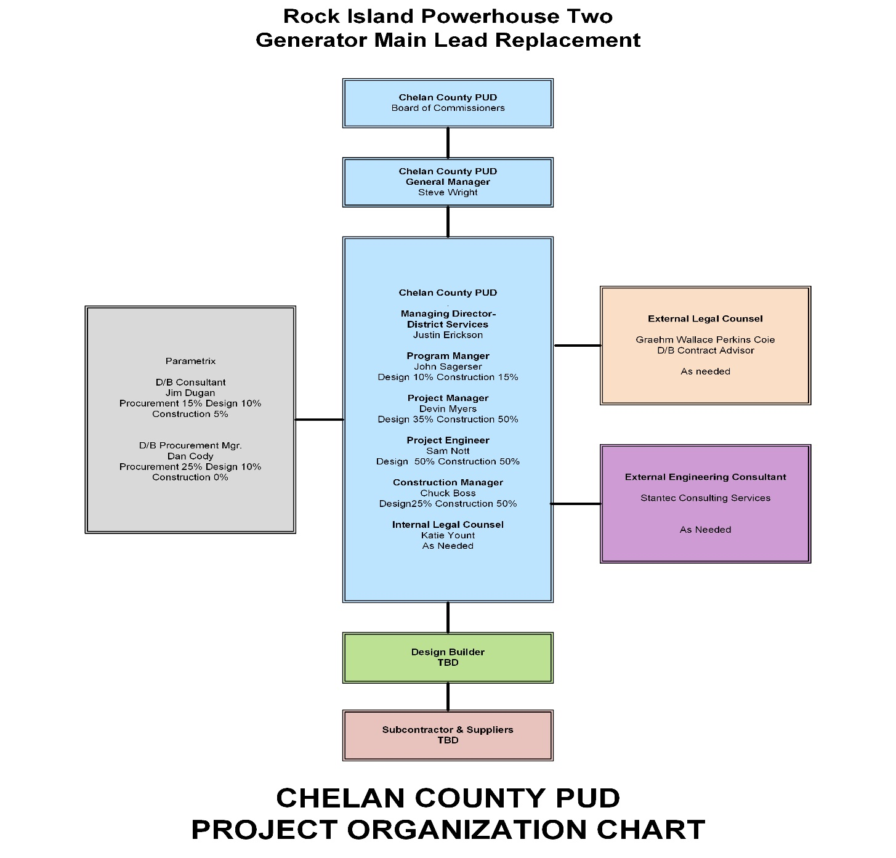
Rock Island Dam Powerhouse #2 – Main Generator Leads Replacement
Project Organizational Chart
Notes:
JS

Slide 25
Rock Island Dam Powerhouse #2 – Main Generator Leads Replacement
Project Organizational Chart
Project Team Member | Generator Main Lead Project |  | Draft Tube Gate HPU and Cylinder Upgrade Project |  | Other Duties
 | Procurement & Design | Construction | Procurement & Design | Construction
District Project Team
John Sagerser – Program Manager | 10% | 10% | 10% | 10% | 80%
Devin Myers – Project Manager | 15% | 20% | 15% | 20% | 60%
Sam Nott – Project Engineer | 50% | 50% | 0% | 0% | 50%
Chuck Boss – Construction Manager | 15% | 35% | 15% | 35% | 30%
Katie Yount – Internal Legal Counsel | As Needed | As Needed | As Needed | As Needed
Consultant Project Team
Jim Dugan – D/B Consultant | 25% | 5% | 25% | 5%
Dan Cody – D/B Procurement Mgr. | 35% | 0% | 25% | 0%
Graehm Wallace – External Legal Counsel | As Needed | As Needed | As Needed | As Needed
Stantec Consulting Services – External Engineering Consultant | As Needed | As Needed | As Needed | As Needed
Chelan PUD Organizational Structure:
The District is currently in the process of rehabilitating powerhouse two at Rock Island Dam. This project is a balance of plant project that will be executed as part of the full powerhouse rehabilitation project. Several of the Project team members are participating in two DB projects being presented today. Through the DB procurement process, we will secure contracts with experienced teams of Contractors that will need limited support and oversight from the project team during the execution phase of this project. The District does, however have a deep bench including internal personnel in addition to Service Agreements for engineering and project administrative personnel if needed.
Notes:
DM or JS

Slide 26
Project Team D/B Experience
Notes:
JS

Slide 27
Name | Experience
John Sagerser Rock Island EPM Manager Chelan County PUD | 28 yrs. Electrical Engineering/Project Management Experience 17 yrs. Hydro Engineering/Project Management Experience Project Manager for Lake Chelan Hydro Modernization ($35M 2006 to 2010) Project Manager for Rock Island Powerhouse 1 Rehabilitation (2015 to 2018)
Devin Myers Rock Island Project Manager Chelan County PUD | 17 yrs. Hydroelectric Industry Maintenance Planning/Project Management RI PH2 Draft Tube Gate Refurbishment($4.4M 2016 to 2019) RI PH2 Storage Building (Initiation through Bidding) ($3.4M 2016-2017) RI PH2 Oil Handling System($650K 2016 to 2018)
Chuck Boss Construction Manager Chelan County PUD | 20 yrs. Industrial Engineering/Construction Management Experience 12 yrs. Hydro Construction Management/Quality Control Experience Construction Manager Rock Island Powerhouse 1 Rehabilitation QA/QC Representative Rock Island Powerhouse 1 Rehabilitation Construction Manager Rock Island Denil Installation/Removal
Jim Dugan D/B Program Advisor Parametrix | 40 yrs. Program/Project Management Projects: TPS – Boze Elementary School; TPS Hunt Middle School; Willapa Elementary School Gym; Multiple large D/B projects (>$100 M each) worldwide with The Austin Company Project Review Committee Member: Term Ends June 2023
Notes:
JS

Slide 28
Name | Experience
Dan Cody D/B Procurement and PM Support Parametrix | 30 yrs. Of Design & PM/CM 4 D/B Projects: South Puget Sound Community College – Lacey Campus; Building #1; Tacoma Public Schools – Boze Elementary School; Tacoma Public Schools – Hunt Middle School; Willapa Elementary School Gym
Graehm Wallace Outside Legal Counsel Perkins Coie | Graehm has prepared Design-Build contract documents under RCW 39.10 for the Washington State School Directors Association, the Tacoma School District, and the Willapa Valley School District as well as Design-Build contract documents for dozens of private projects. Graehm has over twenty-two years legal counsel experience working in all areas of construction and has provided legal assistance to over 100 Washington public entities. His work has covered all aspects of contract drafting and negotiating. This includes preconstruction, architectural, engineering, construction-management, GC/CM, Design-Build and bidding. Graehm has also provided legal advice during construction, claim prosecution and defense work.
Notes:
JS

Slide 29
Summary
Project is funded with the appropriate budgets
Projects meet qualifying RCW criteria
Project Management Plan is developed and has clear and logical lines of authority
Project team has the necessary experience
Project team has the capacity
Project team is prepared and ready to proceed
Notes:
Jim Dugan

Slide 30
Thank you
Notes:
All

