Slide 1
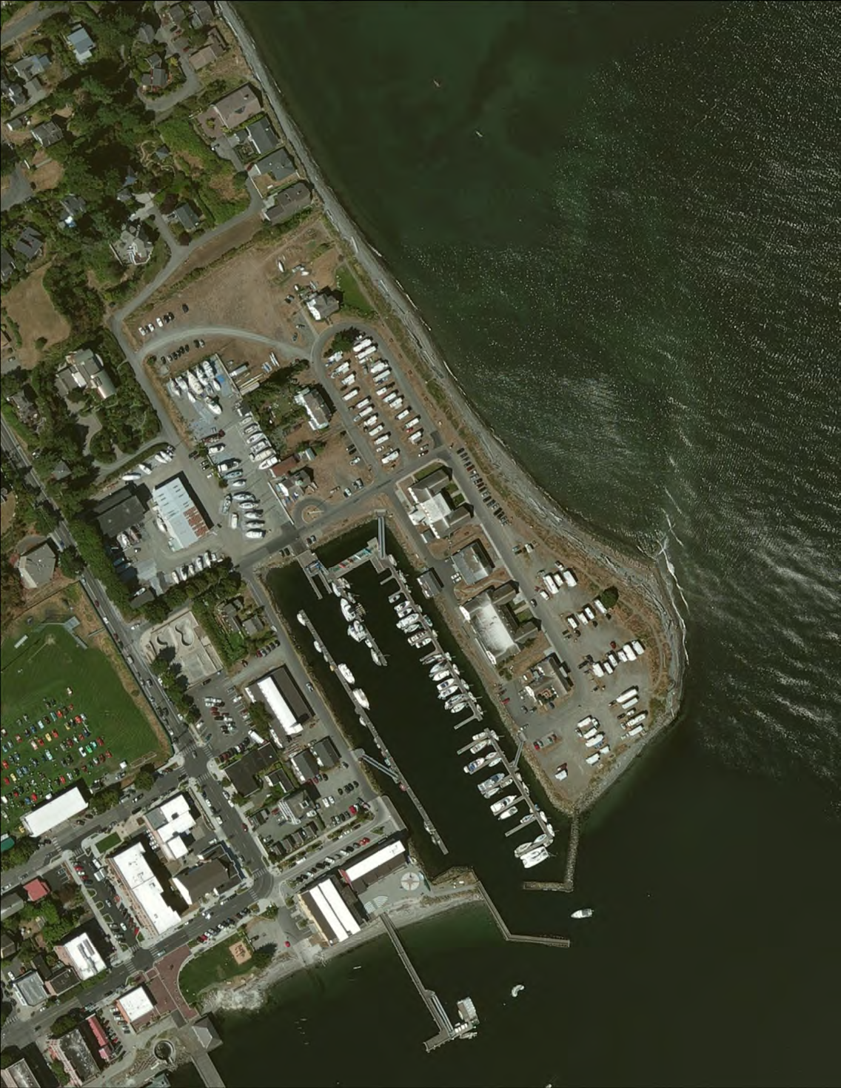
PORT OF PORT TOWNSEND
Application for Project Approval
Point Hudson Jetty (South) Renovation Project
Project Review Committee Meeting
March 28, 2019

Slide 2
AGENDA
Project Team
Project Setting
Project Scope
Consistency with RCW 39.10
Project Schedule
Budget & Funding
Questions

Slide 3
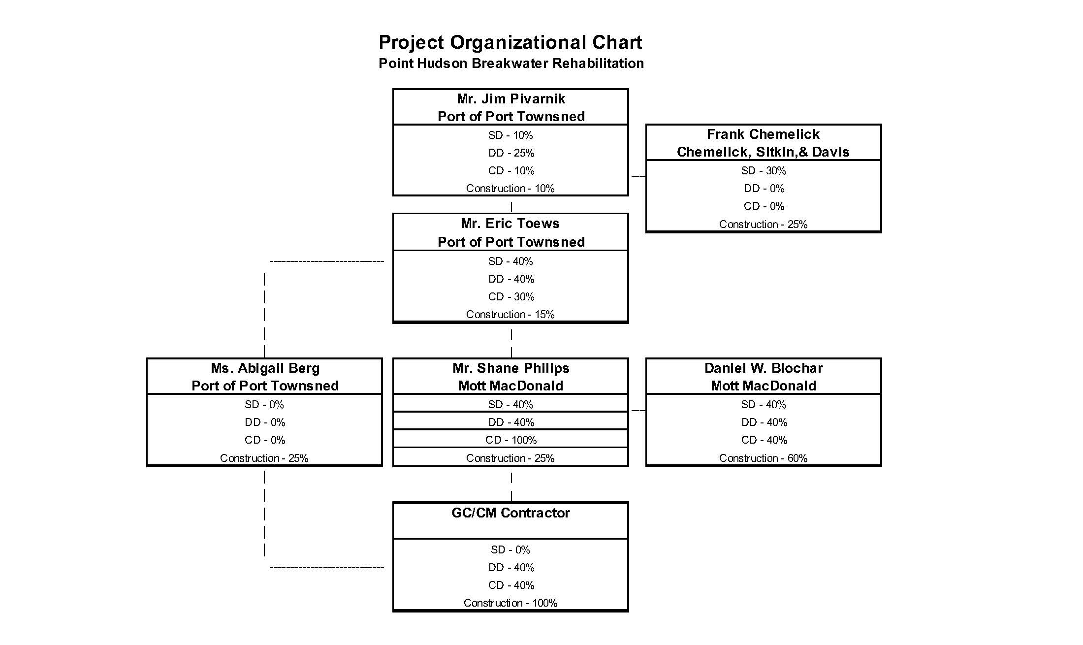
Project Organizational Chart
Point Hudson Jetty (South) Renovation Project

Slide 4
Mott MacDonald Involvement in
Project Delivery
Engineer of Record
Conduit to Port Administration & Commission
Work with Port Administration to Administer Budget
Participate in Contractor Selection Process
Lead Procurement Process

Slide 5
Mott MacDonald Involvement in
Project Delivery, Continued
Lead the Design Process and Development of Construction Documents:
  Collaborate with the Port and GC/CM
  Work with Port Staff to Develop and Communicate Strategies for Attaining Project Goals
  Construction Contract Administration
  Review of Submittals
  Construction Quality Monitoring
  Contract Closeout

Slide 6
GC/CM Involvement in
Project Delivery
Preconstruction Services:
  Collaboration on Strategies to Achieve Project Goals
  Collaboration on Subcontracting Options (if needed)
  Collaboration on Site Logistics and Means and Methods
Facility Renovation:
  Safety
  Quality
  Budget
  Schedule

Slide 7
Project Setting:
Point Hudson Marina & Jetty

Slide 8
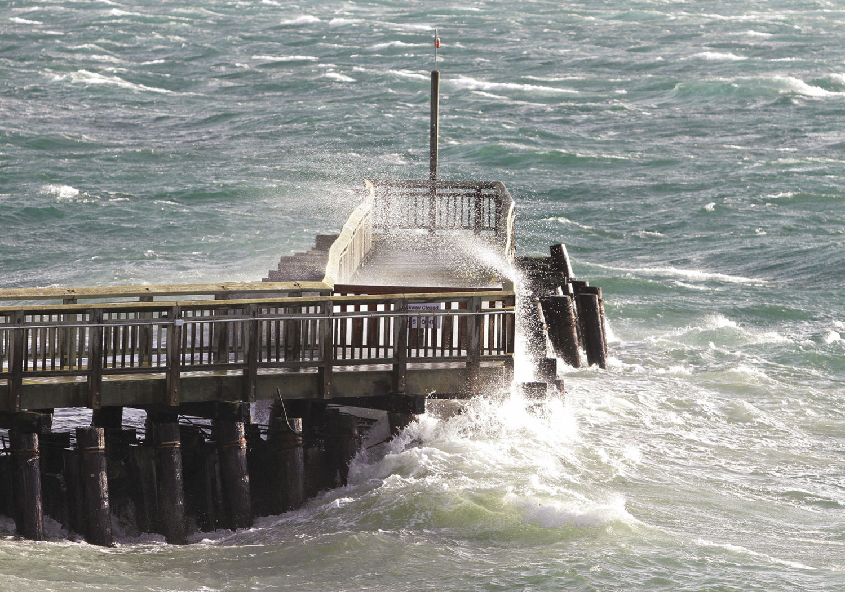
The Project Setting on a Winter’s Day

Slide 9
Existing Jetty Plan

Slide 10
South Jetty Renovation:
Proposed Section

Slide 11
Project Scope
Comprehensive Renovation of 258’ long South Jetty:
  Removal of 150+ Creosote Treated Batter Piles
  Progressive Incremental Replacement of Old Piles with New Galvanized Steel Batter Piles
  Backfill Core of Batter Pile Framework with Granite Quarry Spalls
  Tie Pile Tops Together with Galvanized Steel Cross-Bracing
  Dredge Main Entrance Channel to Marina to Remove Rock Debris and Sediment

Slide 12
Consistency with RCW 39.10.340
Project Meets All 5 Statutory Criteria:
  Project Involves Complex Scheduling, Phasing and Coordination in a Challenging Marine Work Environment
  Marina Must Remain Protected and Open Throughout the Project
  GC/CM Involvement is Critical to the Design Phase
  Project Encompasses a Complex/Technical Work Environment (space constraints/habitat protection)
  Historically Significant (constructed in 1934)

Slide 13
Point Hudson Jetty (South)
Renovation Overview Schedule
GC/CM Consultant Team Procurement - Completed
GC/CM Contract Award – May 2019
Begin & Complete Construction Docs – March to August 2019
Negotiate GMP Contract (90% CD) – August 2019
Construction – September 2019 to January 2020
Substantial Completion – January 29, 2020
Final Completion – April 29, 2020

Slide 14
Point Hudson Jetty (South)
Renovation Budget
Cost of Professional Services (A/E, Legal, etc.): $75,000
Construction Costs (including contingencies): $2,500,000
Equipment & Furnishings: $0
Off-Site Costs: $0
Contract Administration Costs (Owner, CM, etc.): $60,000
Contingencies (Design & Owner): $220,000
Other Related Project Costs (Permits, Bid Advertising, etc.): $25,000
Sales Tax: $283,500
TOTAL: $3,163,500

Slide 15
Point Hudson Jetty Renovation (South)
Funding
Project Design & Permitting Funded by Public Infrastructure Fund Grant ($150,000)
Construction Funding to be Provided Via Bank Loan
Full Funding Anticipated (loan issuance) in August of 2019

Slide 16
PRC Application for Project Approval
Point Hudson Jetty (South) Renovation Project
Questions?
The Port of Port Townsend
Port Townsend, Washington

