Slide 1
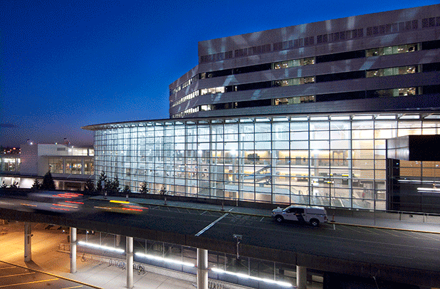
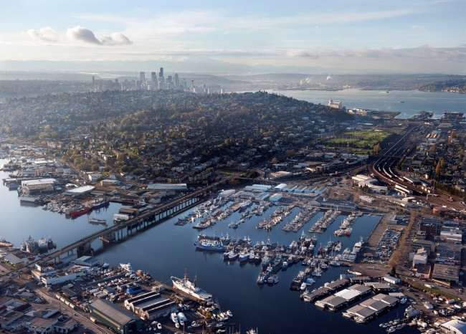



Port of Seattle
Public Body Recertification for GC/CM and Design-Build
September 22, 2016

Slide 2
About the Port Of Seattle
Seattle-Tacoma International Airport
Two cruise terminals
Fisherman’s terminal
Four public marinas
Real estate holdings
Four cargo handling terminals
Port of Seattle
Aviation
Economic Development
NW Seaport Alliance
Maritime

Slide 3
Project Delivery Leadership Team
Ralph Graves – Senior Director, Capital Development
Tina Soike – Director of Engineering
Janice Zahn – Assistant Director of Engineering, Construction
Bob Maruska – Assistant Director of Engineering, Design
Nora Huey – Director, Central Procurement Office
Amanda Mazucca – Interim Manager, Major Construction
Wayne Grotheer – Director, Aviation Project Management Group
Rick Jenkins – Director, Seaport Project Management

Slide 4
Alternative Public Works Projects
Last 3 Years

Slide 5
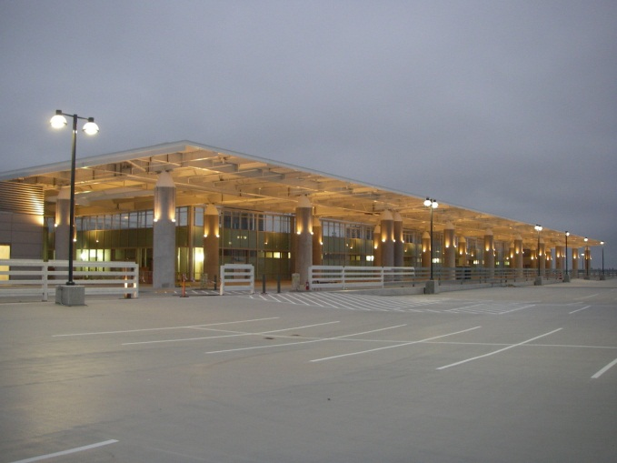
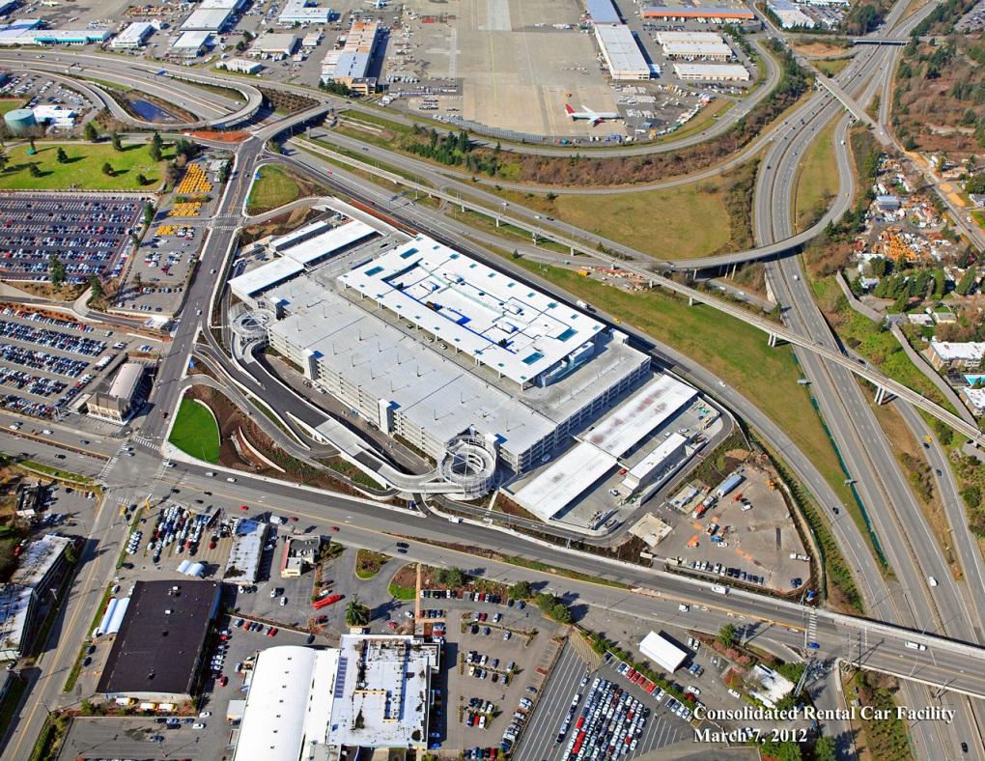
GC/CM
Rental Car Facility
Total Project Cost:
$412 Million
Construction Start:
  May 2008
Construction Complete:
  May 2012

Slide 6
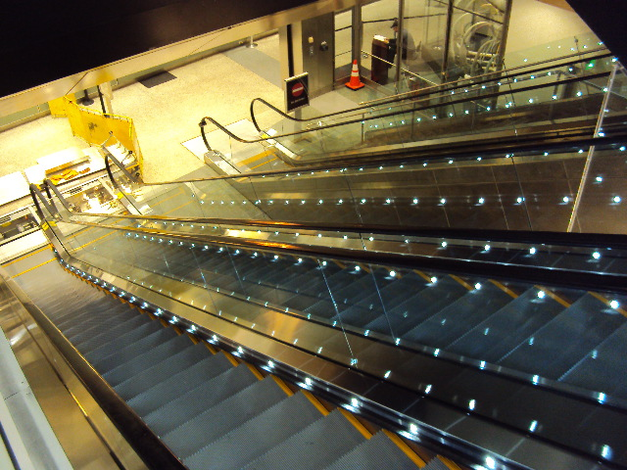
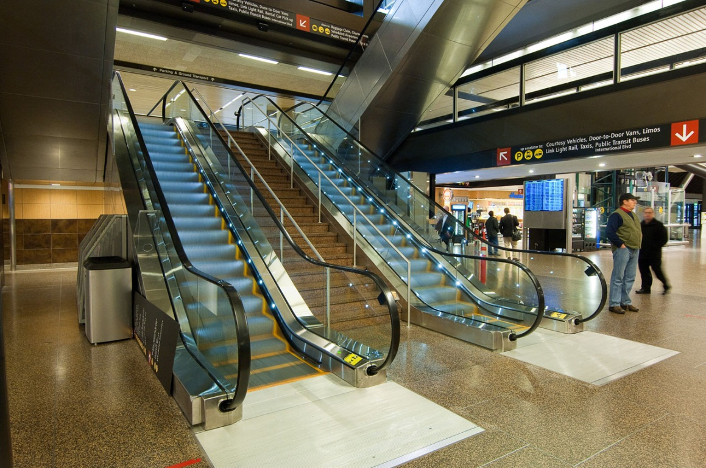
Traditional Design-Build
(Lump Sum)
Terminal Escalator Modernization
Total Project Cost:
$31 Million
Construction Start:
July 2011
Construction Complete:
May 2013

Slide 7
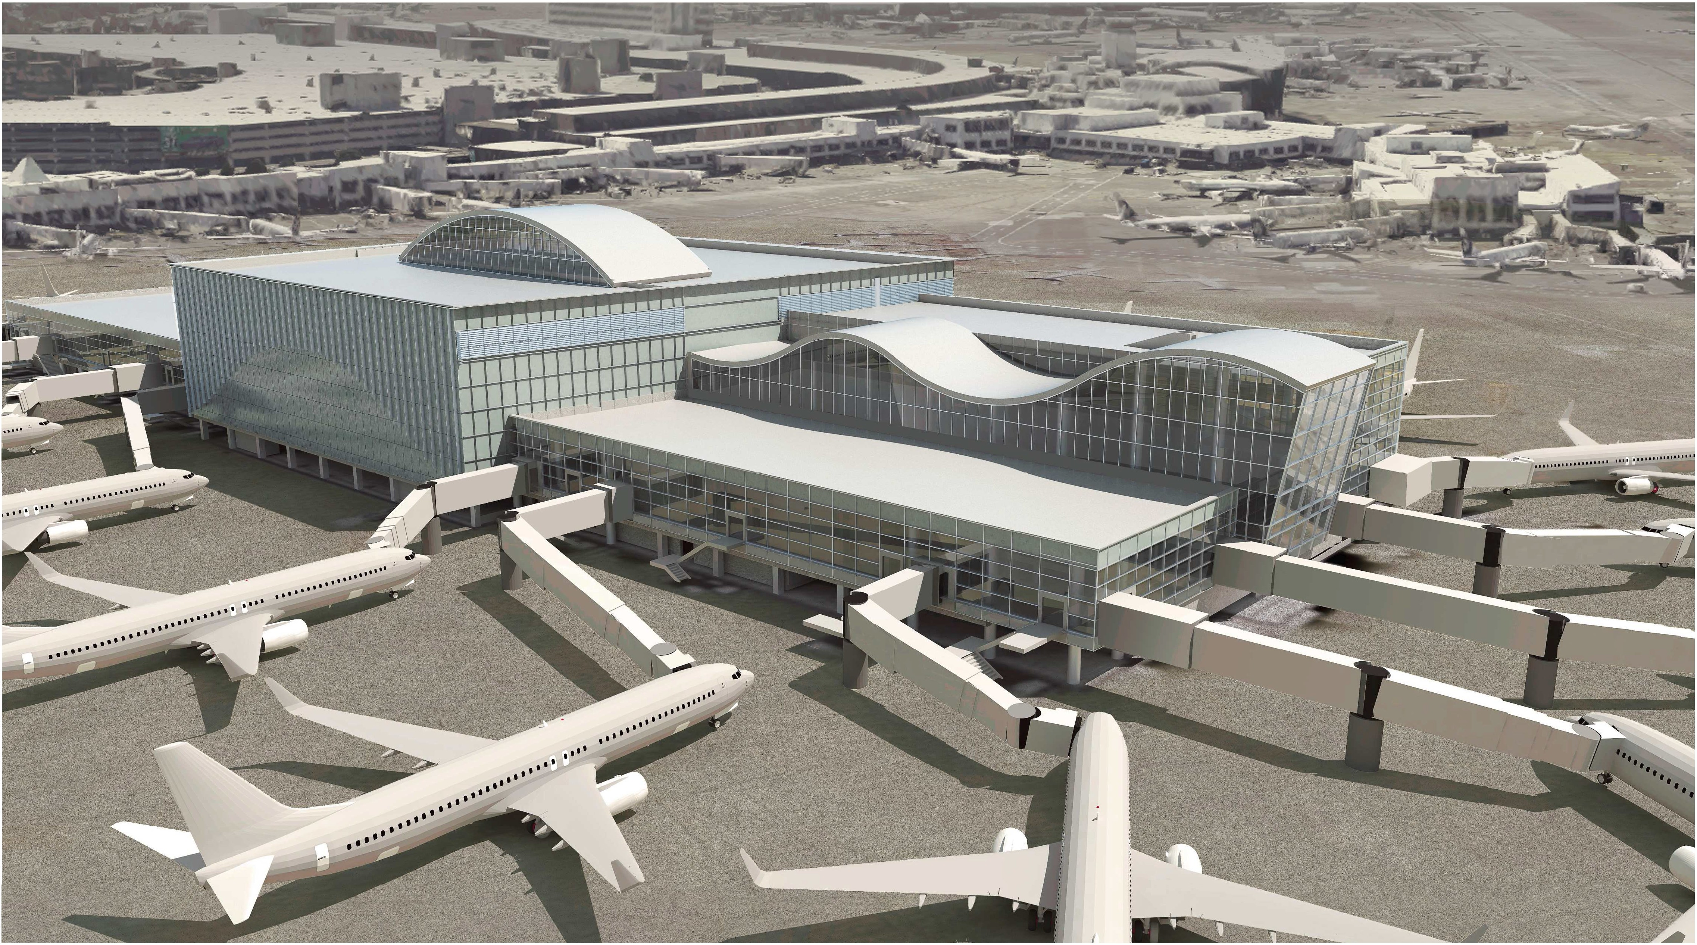
GC/CM with MC & EC/CM (project underway)
North Satellite Expansion
Total Project Cost: $543 Million
Construction Start: June 2016
Construction Complete: June 2021

Slide 8
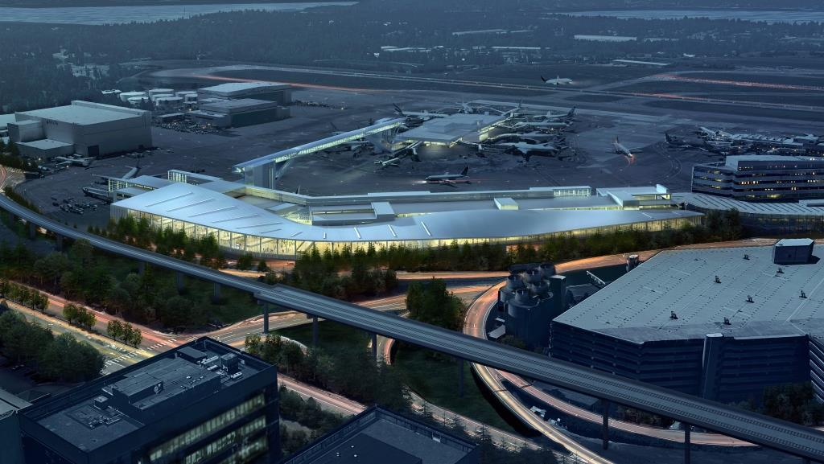
Progressive Design Build
(project underway)
International Arrivals Facility
Total Project Cost: $608 Million
Construction Start: Q4 2016
Construction Complete: Q3 2019

Slide 9
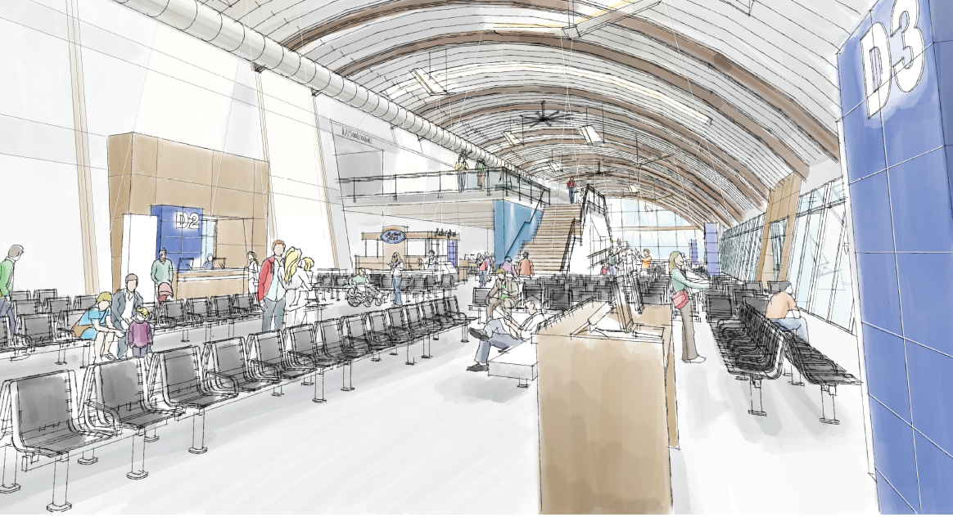
Traditional Design Build
(procurement underway)
Concourse D Hardstand Terminal
Total Project Cost: $39 Million
Construction Start: Q3 2017
Construction Complete: Q2 2018

Slide 10
Port of Seattle Alternative Delivery Industry Engagement and Learning
Capital Projects Advisory Review Board (CPARB)
CPARB Subcommittees
Project Review Committee (PRC)
Design Build Association of America (DBIA) Owners Subcommittee
Public Owners Roundtables
Training and Education

Slide 11
Small Business and
Workforce Development

Slide 12
The Port’s overall mission as defined in its Century Agenda is to create economic vitality in the region by promoting access and opportunity to small businesses on Port Projects.
As part of the Century Agenda, the Port endeavors to utilize qualified small businesses on Construction, Consulting, and Goods and Services contracts on 40% of the Port’s eligible dollars.

Slide 13
The Port’s 2016 small business goal is to achieve 35% of all eligible spending to small businesses, including 5.1% to MWDBE.
Currently updating small business contract specifications and will seek AGC review.

Slide 14
Panel Question #1
The Port is well experienced and has an excellent management team in place. Please share the lessons learned by the Port in relation to the use of the Alternative Public Works RCW.

Slide 15
Response to Question #1
Overall Lessons Learned
Owners need to understand differences between alternative delivery methods - GC/CM, DB, PDB, JOC, Engineered Building System and relationships among the parties:
      Driven by different statute language
      Requires different contract forms
      Allocates risk differently
      Determines price differently
      Subcontracts differently

Slide 16
GC/CM What We Learned
  Early GCCM engagement adds value for sequencing and phasing, especially when changes occur
MCCM and ECCM provides innovative ideas and valuable feedback that directly improved design and construction
An agreed plan with defined GC compensation mechanism for the Early Work during procurement would be useful

Slide 17
GC/CM What We Learned (Cont’d)
Defining Building Information Modeling (BIM) standards upfront helps with setting level of effort and compensation
Difficult when key team members from proposal unavailable
Leverage the Cost Allocation Matrix to define SOW and payment mechanisms – including MCCM and ECCM aspects

Slide 18
Traditional Design-Build
What We Learned
Clearly understand and articulate project goals and priorities in RFP
Leadership commits resources for timely decision-making
Partnering, consistent communication and co-location
Define critical phasing requirements early
Perform preliminary field investigation prior to RFP
Better team understanding of multi-phased schedule

Slide 19
Progressive Design-Build
What We Learned (so far)
Define project team roles upfront
Educate stakeholders about their roles to support project
Co-location of key personnel is important
Establish a methodology for documenting owner decisions
Define critical phasing requirements early
Less detailed Program Definition Documents in RFP

Slide 20
Panel Question #2
Section 2 – Please elaborate on the Port’s Acquisition Planning process. Describe any changes/ improvements made to the evaluation process from lessons learned and/or experienced gained.

Slide 21
Our Project Delivery Method
Selection Process
Response to Question #2
Owner defines project goals & business case
Key success factors are expressed in Project scope, quality, schedule and budget
Decision matrix to select best project delivery method

Slide 22
PORT PROJECT DELIVERY METHOD FLOW CHART
PM conducts Acquisition Planning Meeting with CM, Contracting Managers, key stakeholders and their respective team and senior managers to evaluate the specific project and best delivery options
PM initiates Project Notebook process to document preliminary scope, schedule and budget
PM follows CPO-8 Policy on Acquisition Planning Process to strategize and determine how project should best be delivered/procured
PM obtains concurrence from Investment Committee and CD Senior Director
PM documents recommended project delivery/procurement methodology
PM obtains final approval from Port of Seattle Commission
Legend
PM: Project Manager
CM: Construction Manager
CD: Capital Development

Slide 23
Panel Question #3
Please elaborate regarding Planned vs Actual Completion Date/Cost on the matrix for Section 3. There is a date and a cost, and a reference to significant disputes. How far from the Planned Cost/Schedule did you end up? Since this is the only alternative delivery project to be completed since the previous certification, we would like to see the Port’s track record.

Slide 24
Response to Question #3
Consolidated Rental Car Facility
Original Contract | $224.8mil
Final Contract | $245.2mil
Planned Construction Completion | June 2011
Actual Construction Completion | May 2012

Slide 25
Schedule:
8 month project suspension post NTP with base construction work
3 months of power-on electrical L&I delays
~ 1 month of weather and misc. delays
Costs:
Low bid electrical sub-bid
Electrical design issue
Impacts from project suspension/restart

Slide 26
Panel Question #4
Section 4 –
a. Please clarify the staff members that have changed since the last approval.
b. The new staff identified on the org chart should be included in the matrix where the Port lists their personnel and relevant experience.
c. Please explain the positions listed at TBD in the organizational chart.

Slide 27
Cross-dept. staff shown as TBD are assigned by project:
Project Manager, Resident Engineer, Contract Administrator

Slide 28
Response to Question #4
Staff members with Alternative Delivery Experience who left since PRC Certification:
Paul Powell Josh Ferrel
Andrea DeMuro Jeff Nelson
Staff members with Alternative Delivery Experience hired since PRC Certification:
Mike Dysart Greg Carey
Jesse Giordano

Slide 29
Panel Question #5
Has the internal audit process yielded any findings as referenced in Item 5 “the Port has a robust internal audit program and the Internal Audit Department reports directly to the Port CEO.”

Slide 30
Response to Question #5
The Port’s internal auditors have conducted capital project audits and there have been no audit findings. In addition to the internal audits, the Port is also audited annually by the State Auditor’s Office (SAO) and there have been no audit findings by these external auditors.

Slide 31
In Summary
Port is committed to:
Leveraging best practices from industry
Continued training of staff and augmenting project teams with experienced consultants
Improving the industry in alternative delivery
Leveraging alternative delivery projects to
increase our small business participation

Slide 32
Thank You
Questions?

