Slide 1
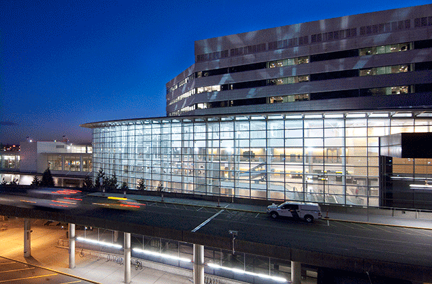
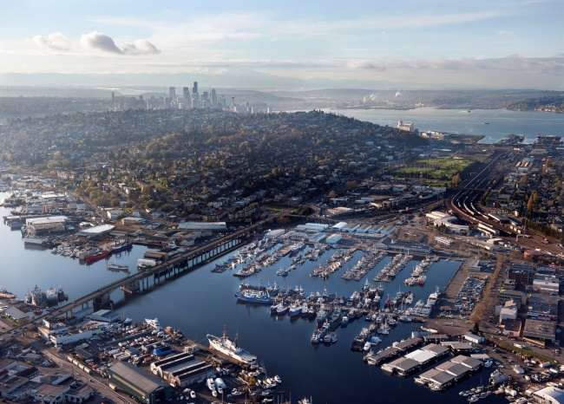
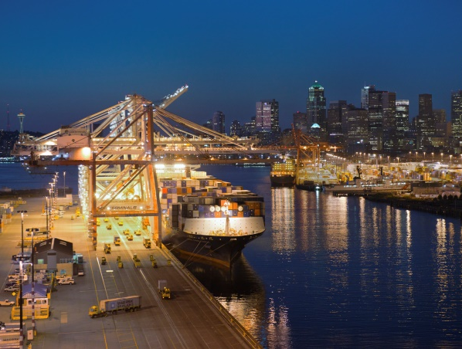


Port of Seattle
Public Body Recertification for GC/CM and Design-Build
January 23, 2020

Slide 2
Introducing the Team
Tina Soike – Director of Engineering
Janice Zahn – Assistant Director of Engineering, Construction
Nora Huey – Director, Central Procurement Office
Kyle Dilbert – Senior Manager, Construction Contracting
Wayne Grotheer – Director, Aviation Project Management Group
Lawrence Coleman – WMBE Program Manager
Angela Peterson – Manager, Construction Contracting

Slide 3
About the Port Of Seattle
Seattle-Tacoma International Airport
Two cruise terminals
Fisherman’s terminal
Four public marinas
Real estate holdings
Four cargo handling terminals
Port of Seattle
Aviation
Economic Development
NW Seaport Alliance
Maritime

Slide 4
Project Delivery Leadership Team
Elizabeth Leavitt – Senior Director, Engineering, Environment and Sustainability
Tina Soike – Director of Engineering
Janice Zahn – Assistant Director of Engineering, Construction
Nora Huey – Director, Central Procurement Office
Kyle Dilbert – Senior Manager, Construction Contracting
Wayne Grotheer – Director, Aviation Project Management Group
Anne Porter – Director, Seaport Project Management
Mian Rice – Director, Diversity in Contracting

Slide 5
Our Project Delivery Method
Selection Process
Owner defines project goals & business case
Key success factors are expressed in Project scope, quality, schedule and budget
Decision matrix to select best project delivery method

Slide 6

PORT PROJECT DELIVERY REVIEW FLOW CHART
PM initiates Project Notebook process to document preliminary scope, schedule and budget
PM follows CPO-8 Policy on Acquisition Planning Process to strategize and determine how project should best be delivered/procured
PM conducts Acqusition Planning Meeting with CM, Contracting Managers, key stakeholders and their respective team and senior managers to evaluate the specific project and best delivery options
PM documents recommeneded project delivery/procurement methodolgy
PM obtains concurrence from Investment Committee
PM obtains final approval from Port of Seattle Commission
Legend
PM: Project Manager
CM: Construction Manager

Slide 7
Port of Seattle Organization Charts

Slide 8
Aviation Project Management Group

Slide 9
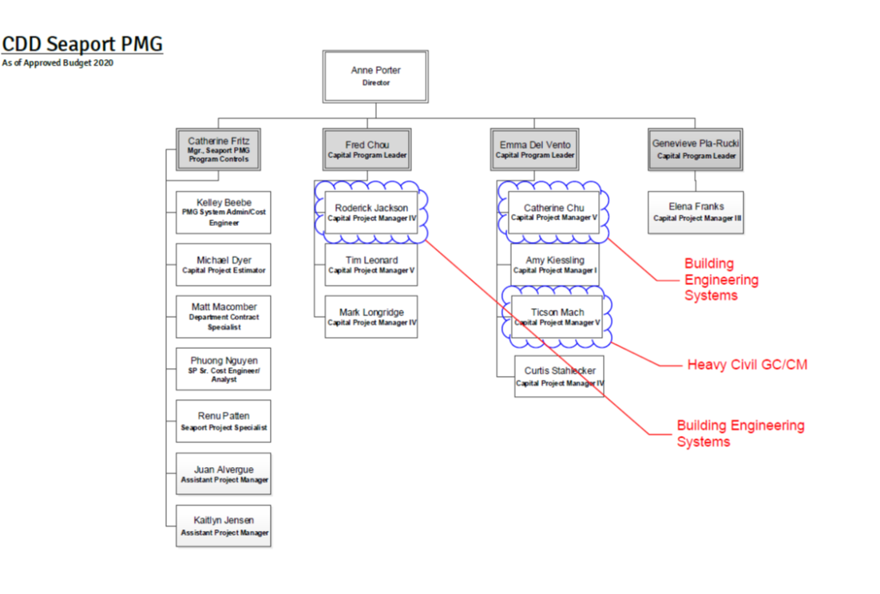
Seaport Project Management Group

Slide 10
Construction Management

Slide 11
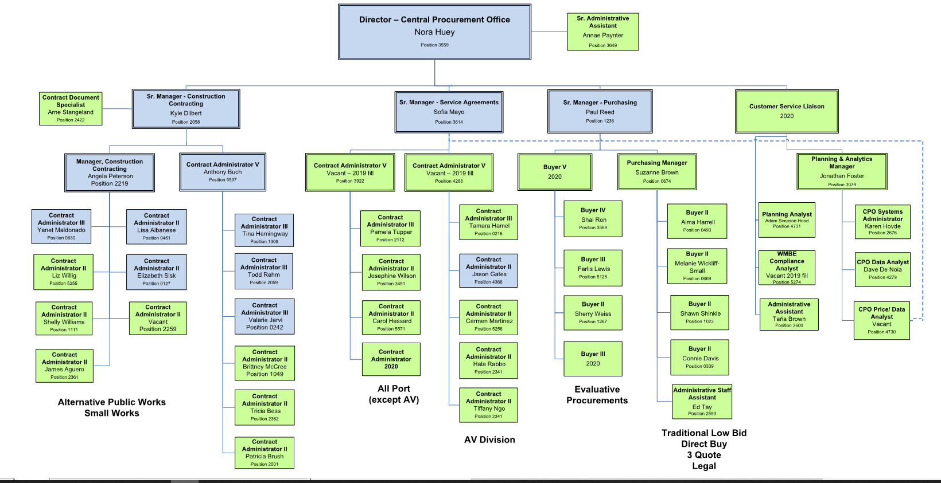
Central Procurement Office

Slide 12

Economic Development - Diversity in Contracting

Slide 13
Alt Public Works Projects -Last 3 Years
Project Name | Project Delivery Type | Status | Construction Start/ Completion Dates | Projected/ Actual Construction Cost | Cost overrun, delay, litigation or disputes
Concourse D Hardstand Project | DB | Done | Aug ’17 - Oct ‘18 | $26 M | Schedule delay due to varying site conditions
Alternate Utility Facility | Building Engineering Systems | Done | Sep ’17 – Mar ‘18 | $30M | None
Pier 69 Solar | Building Engineering Systems | Done | May ’18 – Apr ‘19 | $323K | Schedule delay due to permit issue

Slide 14
Alt Public Works Projects -Last 3 Years
Project Name | Project Delivery Type | Status | Construction Start/ Completion Dates | Projected/ Actual Construction Cost | Cost overrun, delay, litigation or disputes
International Arrivals Facility | Progressive D-B | In construction | Oct ’16 – Nov ‘20 | $774 M | TBD
North Satellite Expansion Program | GC/CM with MC & EC/CM | In construction | May ’16 – Oct ‘21 | $482 M | None
Main Terminal Low Voltage | GC/CM | In early preconstruction | Sep ’22 – Sep ‘25 | $58 M | None
Site 23 and 25 Restoration | Heavy Civil GC/CM | In preconstruction | Apr ’20 – Feb ‘21 | $15 M | None
Telecommunication Meet Me Room | DB | In procurement | Jun ’20 – Feb ‘21 | $2.5 M | None
Interim Westside Firestation | DB | In Design | Apr’20 – Nov’20 | $4.6M | None

Slide 15
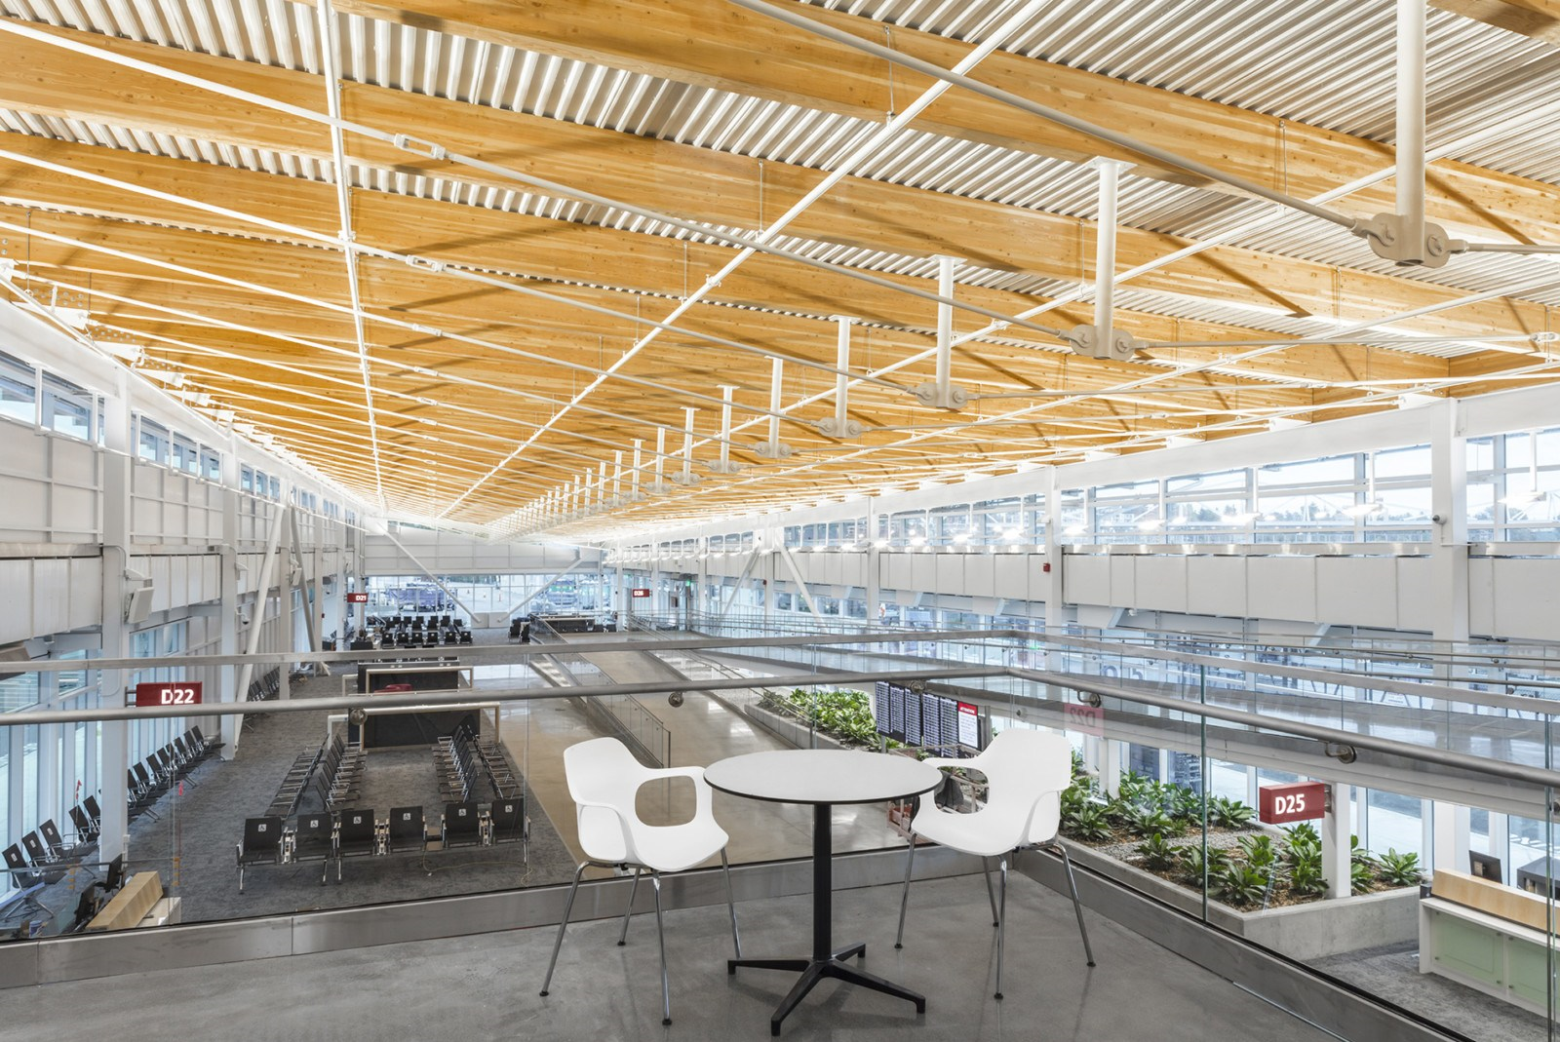
Traditional Design Build
(Completed)
Concourse D Hardstand Holdroom
Total Contract Cost: $26 Million
Construction Start: Aug 2017
Construction Complete: Oct 2018

Slide 16
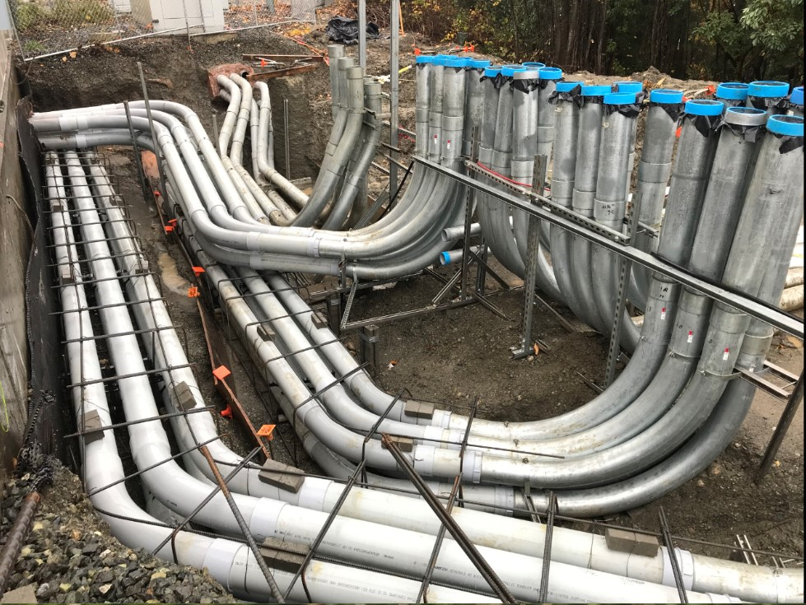
Building Engineering System
(Lump Sum)
Alternate Utility Facility
Total Contract Cost:
$30 Million
Construction Start:
Sept 2017
Construction Complete:
March 2018

Slide 17
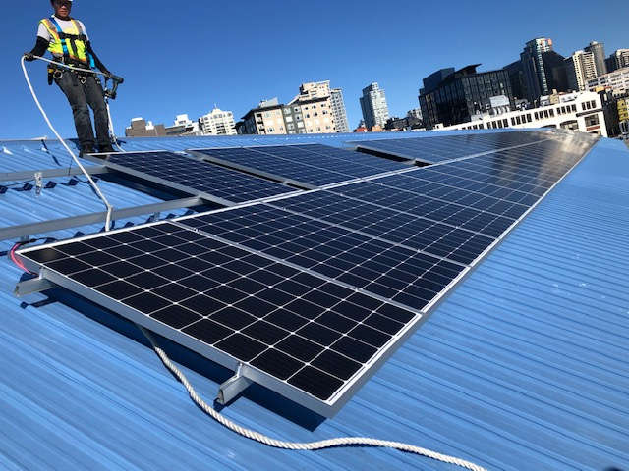
Building Engineering System
Pier 69 Solar
Total Contract Cost:
  $323k
Construction Start:
  May 2018
Construction Complete:
  April 2019

Slide 18
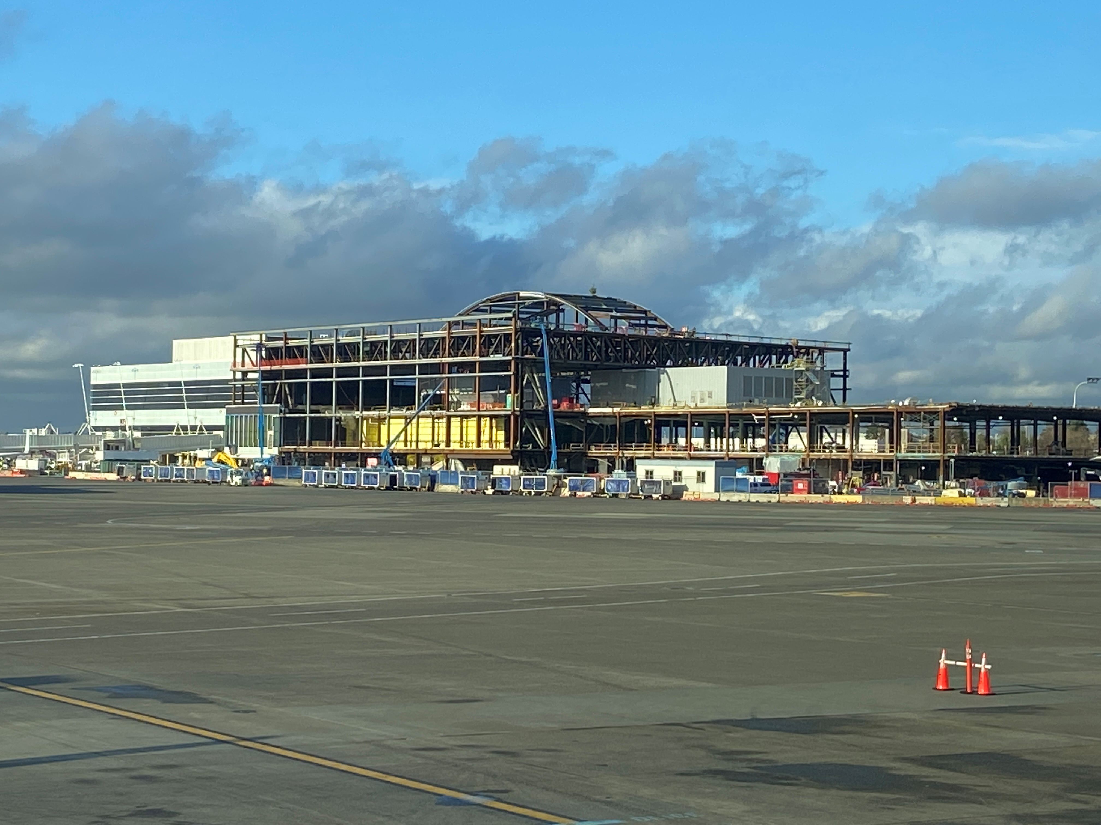
GC/CM with MC & EC/CM
(in construction)
North Satellite Expansion
Total Contract Cost: $482 Million
Construction Start: May 2016
Construction Complete: Oct 2021

Slide 19
Subcontract Bidding Summary
NORTH SATELLITE | CONTRACTOR NAME | TOTALS
Total work bid to be self-performed by the GCCM | Hensel Phelps | None
Total work bid out by the GCCM |  | $ 201,337,015
Total work self performed by the MCCM | Hermanson Mechanical | $ 48,088,048
Total work bid out by the MCCM |  | $ 20,267,024
Total work self performed by the ECCM | VECA Electric | $ 69,624,307
Total work bid out by the ECCM |  | $ 12,308,028
Total Subcontractors |  | $ 351,624,422

Slide 20
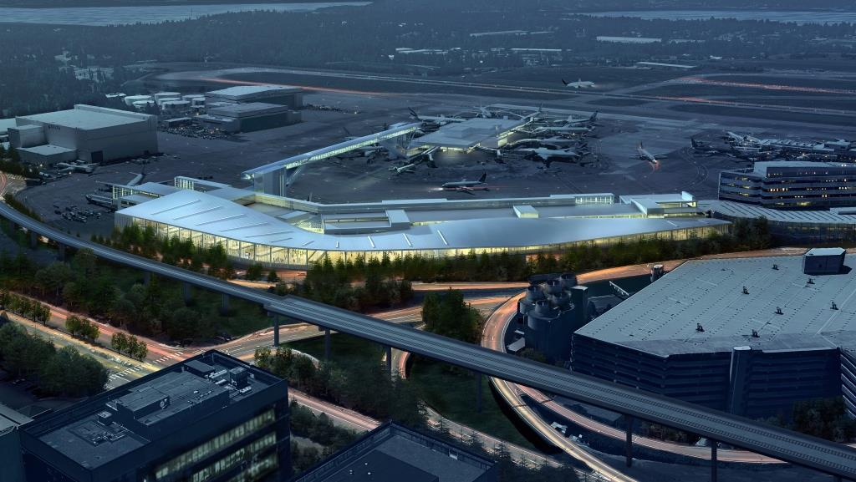
Progressive Design Build
(in construction)
International Arrivals Facility
Total Contract Cost: $774 Million
Construction Start: Oct 2016
Construction Complete: Nov 2020

Slide 21
GC/CM with EC/CM
(in pre-construction)
Main Terminal Low Voltage
Total Contract Cost: $58 Million
Construction Start: Sept 2022
Construction Complete: Sept 2025

Slide 22
Traditional Design Build
(In Design)
Interim Westside Fire Station
Total Contract Cost: $4.9 Million
Construction Start: April 2020
Construction Complete: Nov 2020

Slide 23
Heavy Civil GC/CM
(in pre-construction)
Site 23 and 25 Restoration
Total Contract Cost: $15 Million
Construction Start: April 2020
Construction Complete: Feb 2021

Slide 24
Traditional Design Build
(in procurement)
Telecommunications Meet Me Room
Total Contract Cost: $2.5 Million
Construction Start: June 2020
Construction Complete: Feb 2021

Slide 25
Port of Seattle Alternative Delivery Industry Engagement and Learning
Capital Projects Advisory Review Board (CPARB)
CPARB Subcommittees
Project Review Committee (PRC)
Design Build Association of America (DBIA) Owners Subcommittee
Public Owners Roundtables
AGC DB Training and Education

Slide 26
Small Business and Diversity in Contracting
Previous Goals:
Small Business - aspirational goals
Small Contractors Supplier – requirements
Goals moving forward:
Diversity in Contracting

Slide 27
Workforce Development
Apprenticeship goals
Priority Hire Program within Project Labor Agreements

Slide 28
Panel Question #1
Professional Services contracts:
What is your WMBE participation on professional services contracts?
What percentage of those contracts have been primed by the WMBEs?

Slide 29
Response to Question #1
# of Contracts | 270
Total paid (year to date Q3-2019) | $30,997,807.45
# of Contracts with WMBE Prime | 69
Percent of Contracts to WMBE Prime | 25.60%
Total paid to WMBE Primes | $5,505,796.47
WMBE participation by Spending | 18.78%
Total paid to WMBE firms | $5,822,646.95

Slide 30
Panel Question #2
Professional Services contracts:
Have you had complaints from any WMBEs working on your contracts?
a. How did you resolve those complaints?
What steps did you implement to ensure those
complaints would not happen again?

Slide 31
Response to Question #2
Our Diversity in Contracting department staff are the advocate for WMBE firms and addresses complaints on Port contracts
The Port offers many services to support WMBE firms doing business with the Port, including:
  PortGen Program
  Kickoff meetings
  Dispute Resolution Process

Slide 32
Panel Question #3
3. What is the ratio of Port of Seattle WMBE dedicated support staff to WMBE contracts?
RESPONSE:
5 Diversity in Contracting Department Staff (2 more FTE’s scheduled for 2020)
plus
1 Contract Administrator per contract

Slide 33
Panel Question #4
Construction/Design-Build contracts:
1. Do you use inclusion managers to assist WMBEs navigate the Design-Build process and/or Construction contracts?

Slide 34
Response to Question #4
Through Prime’s dedicated WMBE liaison officer, and the Port’s Diversity in Contracting staff
Port uses “PortGen” to provide WMBE businesses project info prior to pre-proposal or pre-bid meetings
During the PortGen events, WMBE businesses have opportunities with staff to understand the design and construction process, and to strategize teaming partnerships with potential primes (or prime-subs) that are in attendance or signed-up on the Port’s plan holders list.

Slide 35
Panel Question #5
Since the Port uses Project Labor Agreements. Does the Port have a dual benefit reimbursement process to level the playing field for WMBEs and Open shop contractors? (See Sound Transit, City of Seattle and King County for examples of the Dual Benefit Reimbursement process.)
RESPONSE: No. We continue to monitor this program with other public agencies.

Slide 36
Overall Lessons Learned
Continue to set owner and team culture for partnership in alternative delivery methods
Provide opportunity for proposers to give input to contract terms and conditions
Utilize the pre-construction (GC/CM) and Validation periods (DB) to leverage the knowledge of contractor to influence design, schedule and constructability
Greater possibility to increase WMBE utilization

Slide 37
In Summary
Port is committed to:
Leveraging best practices from industry
Continued training of staff and augmenting project teams with experienced consultants
Improving the industry in alternative delivery
Leveraging alternative delivery projects to
increase our diversity in contracting

Slide 38
Thank You
Questions?

