Slide 1


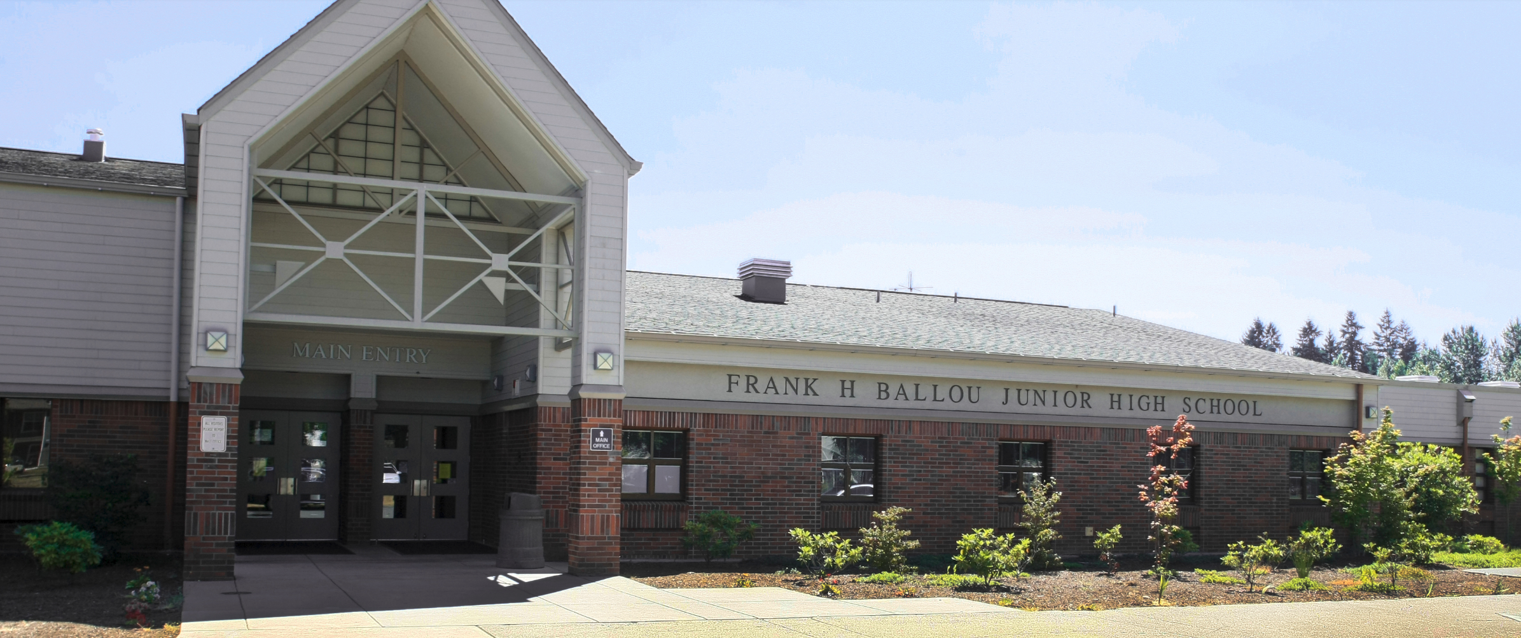
Puyallup School District
Ballou Junior High GC/CM Presentation
1
Notes:
Intro: Gary ( 1.5 min )
Thanks for opportunity, very excited about pursuing GC/CM 1st project, setting stage for two future HS projects in which the district hopes to use GC/CM
Introduce the Project Team here today

Slide 2
Ballou Junior High
School – Introductions
Gary Frentress Puyallup Schools
Mike Meadows Puyallup Schools
Steven Moore CBRE | Heery
Dan Gendreau CBRE | Heery
David Mount Mahlum Architects
Graehm Wallace Perkins Coie
2
Notes:
Agenda; Gary
Introduce Team here today. Other team members such as Mario Casello and Beck Hutchinson with Mahlum

Slide 3
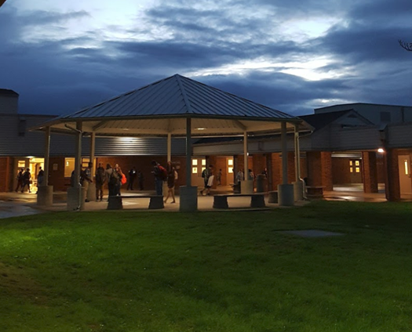
Ballou Junior High
School – Presentation Overview
1. Introduction
2. Project Overview
3. Why Ballou is suited for GC/CM
4. Team Qualifications
5. Conclusion
6. Questions &
Answers
3
Notes:
Agenda; STEVE ( .5 min )
Good morning, thank you again for allowing us to present today on the Ballou Junior High we are very excited about the opportunity. My name is Steven Moore with CBRE Heery and we are assisting Puyallup in their application to get approval to utilize GC/CM on this project. Our goal today is show why Ballou Junior High project is suited for GC/CM. We are going to start off with David from Mahlum, providing us a project overview looking at the proposed scope with both the addition but also work that is to occur in the existing occupied building and on the site. Gary is going to provide the committee a financial overview of the project quickly discussing the different budget categories. We’ll then dive into why we think Ballou Junior High is a good candidate for the use of GC/CM and walk through the specific criteria that we think the project meets. David and Mike are going to go into detail of those unique aspects of Ballou that show the complexity and the need for a GC/CM partner. We’ll then discuss team qualifications and show that the district has brought together an experienced team to oversee a GC/CM project and then conclude with recap why Ballou is a good candidate.

Slide 4
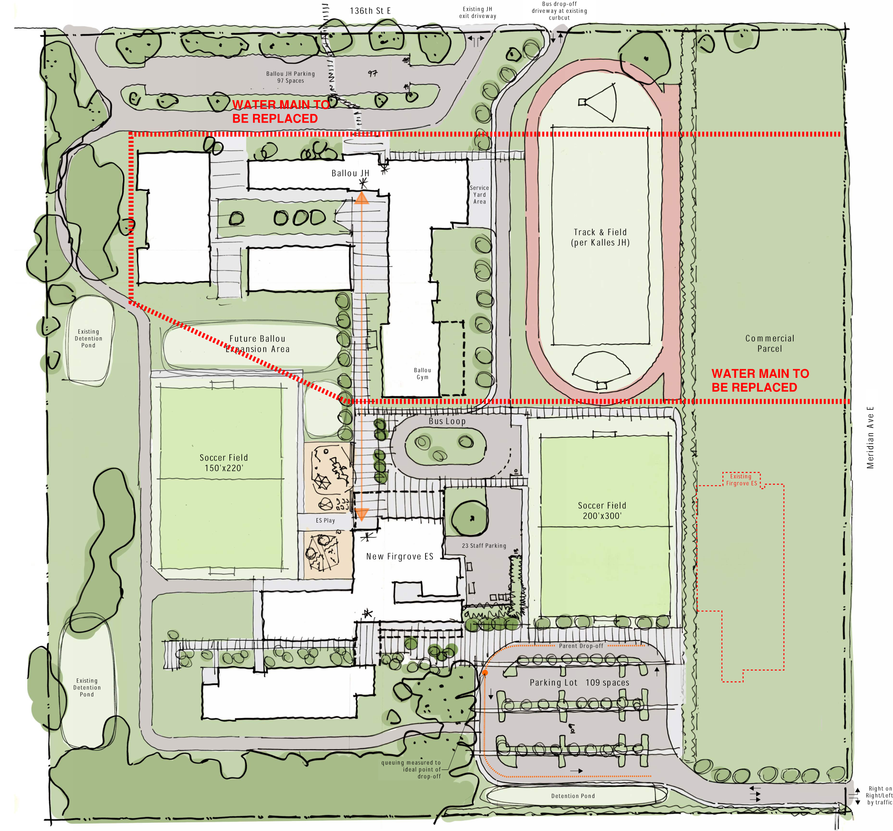
Ballou Junior High
School – Project Overview
4
Notes:
Project Facts; DAVID ( 4 min )
Existing Building dates, size
Addition size, capacity, rough location…remember need GC/CM to help identify opportunities, pros/cons
Current Firgrove Construction

Slide 5
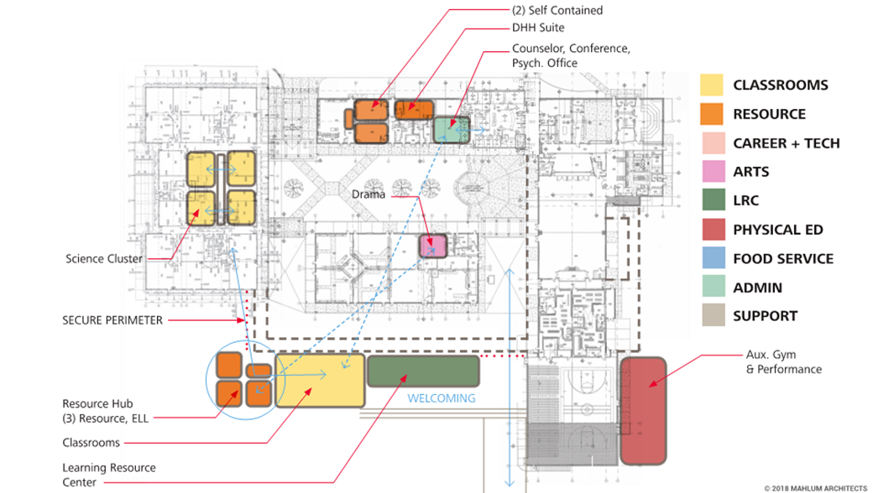
Ballou Junior High
School – Project Overview
5
Notes:
Project Facts; DAVID

Slide 6
Ballou Junior High
School – Project Overview
Project Budget
Costs for Professional Services (A/E, Legal etc.) $1.5 million
Estimated project construction costs (incl. construction cont): $10.6 million
Equipment and furnishing costs $1.1 million
Off-site costs $incl.constr.
Contract administration costs (owner, cm etc.) $0.7 million
Contingencies (design & owner) $1.5 million
Other related project costs (briefly describe) $0.5 million
Sales Tax $1.0 million
Total $16.9 million
6
Notes:
Project Facts; Gary ( 2 min )
The required 5% contingency is included in the construction costs

Slide 7
Why Ballou Junior High is Suited for GC/CM
“An Occupied Site with Complex Construction”
7
Notes:
Summary: Steve

Slide 8
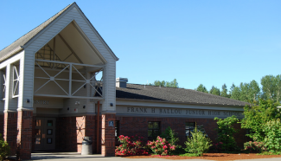
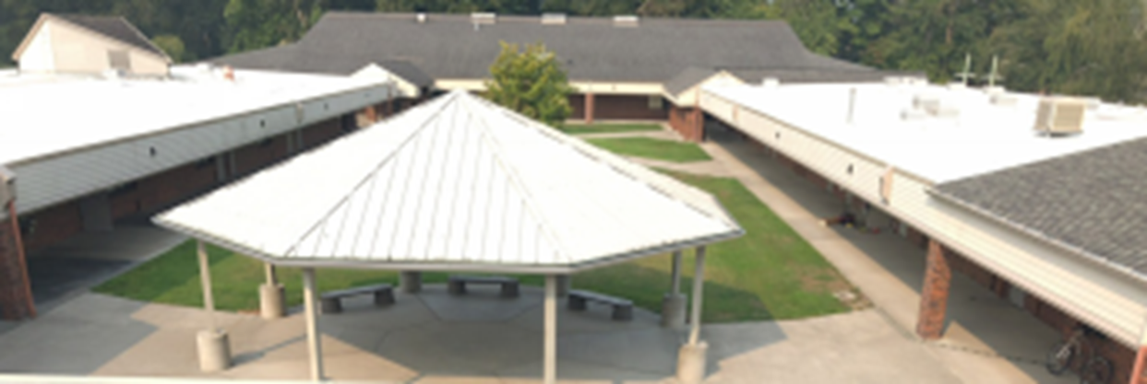
Ballou Junior High
School – GC/CM Presentation
Complex Planning
Occupied Site
Requires GC/CM during Design Phase
Complex & Technical Working Environment
Necessary Project Team Experience with Advisor
8
Notes:
Summary; STEVE ( approx 1 min )
Out of the 5 Criteria for this type of project we feel this project meets 4 of the 5 criteria, go through Criteria.
(1) Implementation of the project involves complex scheduling, phasing, or coordination; there will be significant coordination on this project to limit impacts to the schools.
(2) The project involves construction at an occupied facility which must continue to operate during construction; you will hear a common message through this presentation that safety is out Utmost concern.
(3) The involvement of the general contractor/construction manager during the design stage is critical to the success of the project; having a GC/CM onboard early will increase our success in working through the scheduling and minimize impacts. They will also help control costs on this very tight budgeted project.
(4) The project encompasses a complex or technical work environment; ensuring that life safety and other systems are not compromised is critical
(5) The project requires specialized work on a building that has historic significance;
This project is well suited for GC/CM and we feel that the team has the experience to make this method very successful. These project conditions align with numerous other projects that have successfully used GC/CM.
Mike and David are going to get into the details of these challenges.

Slide 9
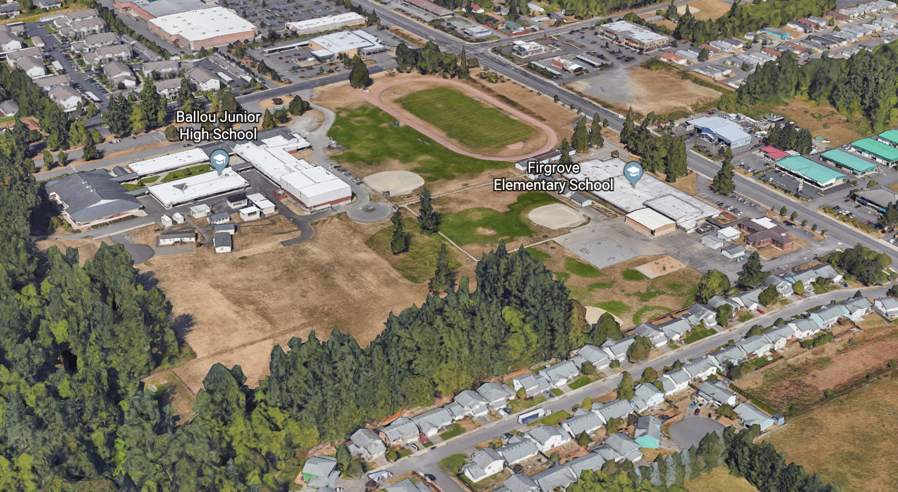
Ballou Junior High
School – Project Challenges
Occupied Site with three Schools
Safety is Utmost Concern
Adjacent Community Concern
9
Notes:
Challenges; Mike ( 1 min )
High level

Slide 10
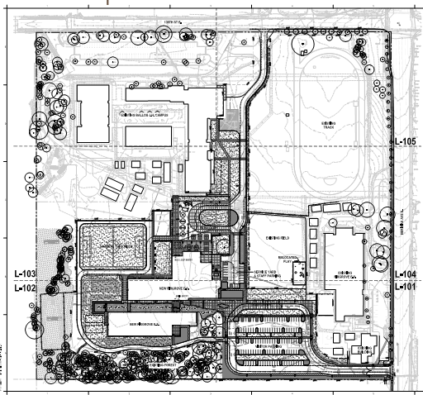
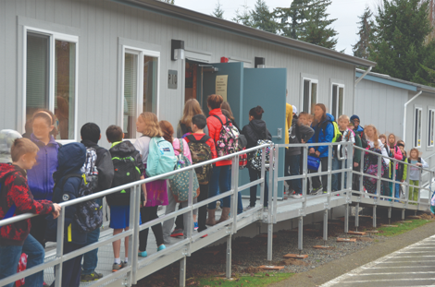
Ballou Junior High
School – Project Challenges
Urgent Capacity Issues
Schedule Critical
Portable Relocation
10
Notes:
Challenges; Mike ( 1 min )
What is driving this project. Inadequate space for students in portables. Correcting this is an urgent concern for the district.

Slide 11
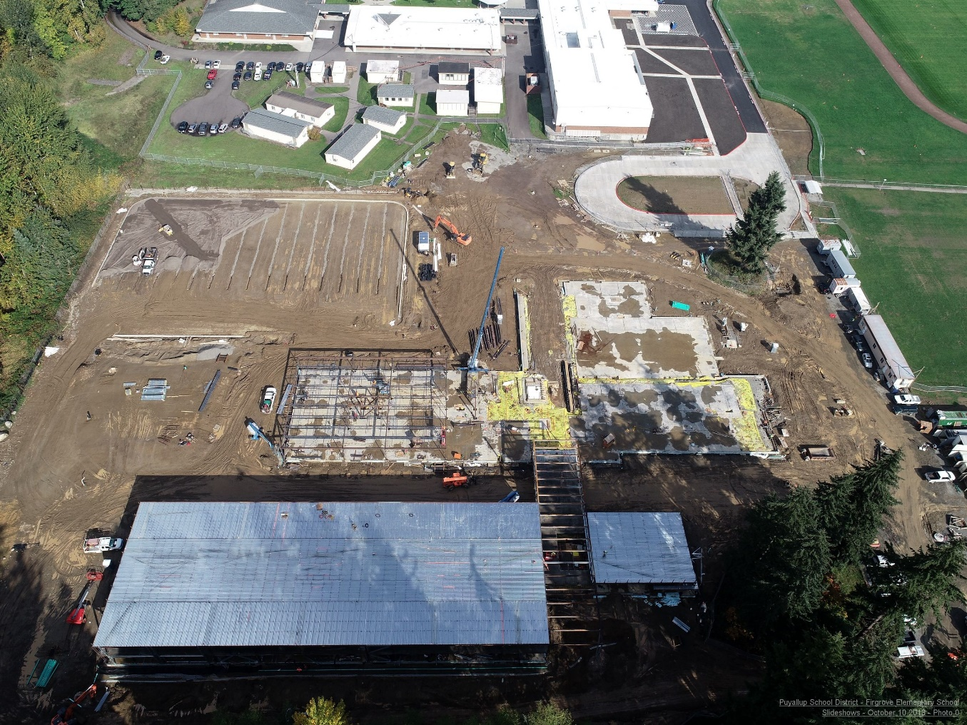
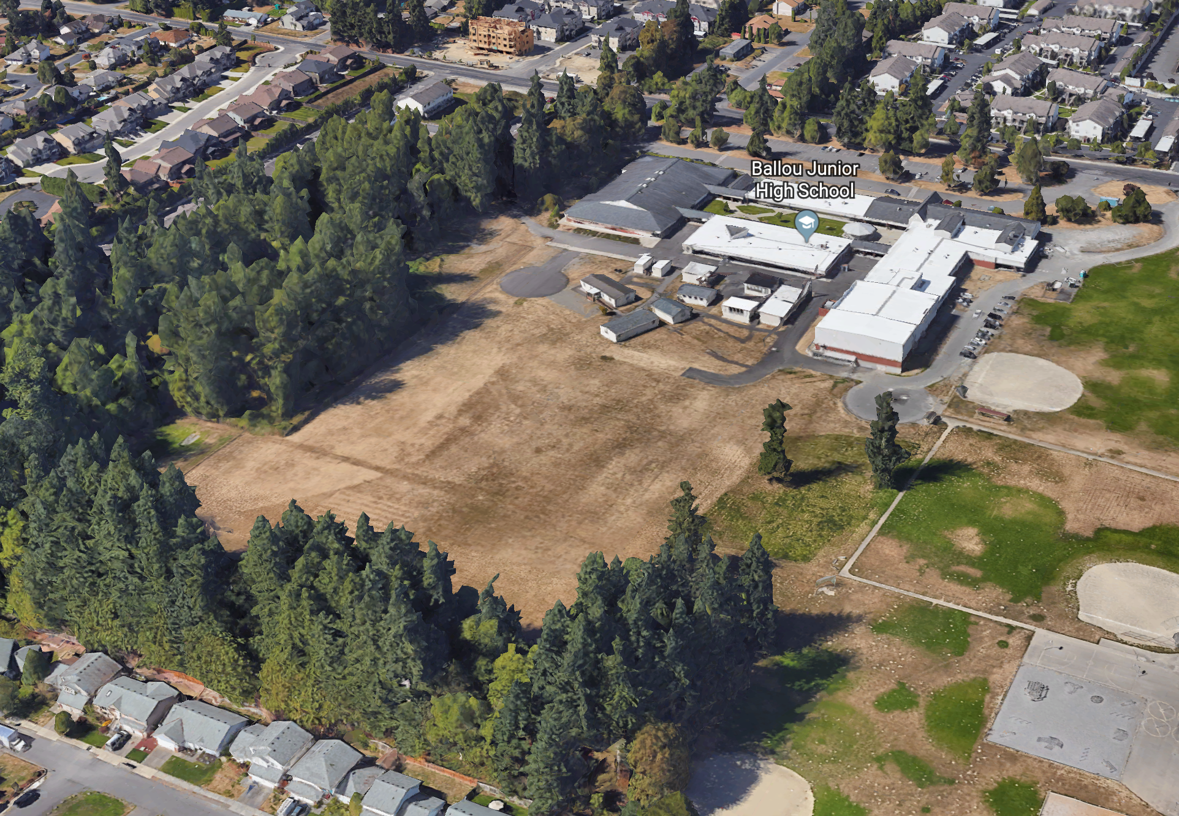
Ballou Junior High
School – Site Challenges
Construction Coordination
Construction Impacts to School Operation
11
Notes:
Challenges; (David 1 min )

Slide 12
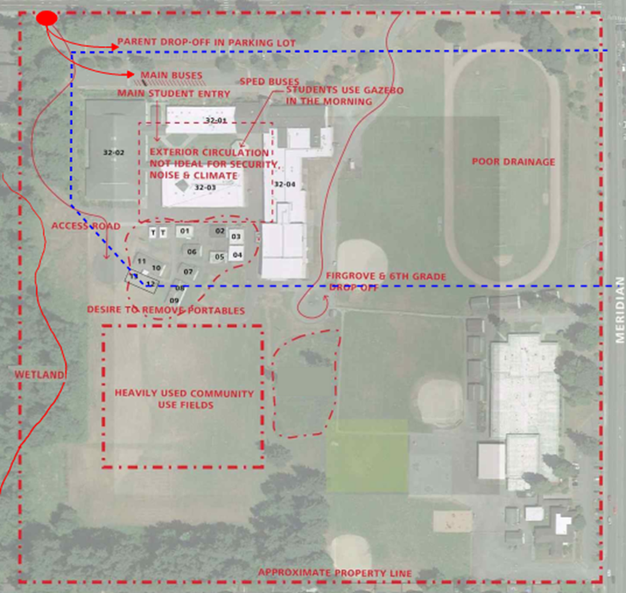
Ballou Junior High
School – Project Challenges
  Require heightened attention to Safety of Student, Staff and Community
  Construction sequencing
  Water main replacement
  Renovations to existing building
  Constructability Reviews
  Wetlands, Drainage Concerns
  Laydown….
12
Notes:
Why Ballou; David ( 1.5 min )

Slide 13
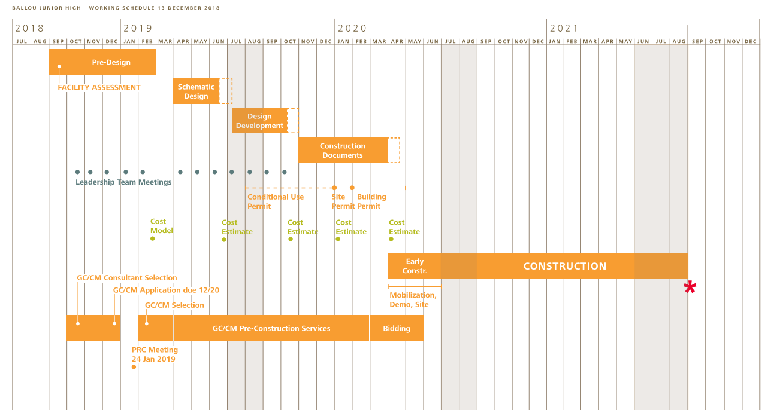
Ballou Junior High
School – Schedule
  GC/CM Involved with Planning and Scheduling
  Saturated Construction Industry
  District Capacity Issues
13
Notes:
Schedule: STEVE ( 0.5 min )
We feel that we are bringing a GC/CM onboard at the ideal timing.
We are starting with GC/CM advertisement at end of month, targeting a mid April contract. This will align with schematic design which is starting in April.
*Additionally we wanted to note, that due to the saturated market, the district felt that its essential to secure a partner early and work with them to help maximize subcontractor interest in this project
*Finally, we need a team member that will push hard to maintain the schedule so the district can address capacity issues which Mike discussed earlier.

Slide 14
Why Our Team is Suited for GC/CM
Successful Experienced Team
14
Notes:
Qualifications: Steve (0.5 min)
We believe the district has put together a solid team with the necessary experience to run a successful GC/CM project. We feel there is a solid track record of successful GC/CM projects lead by numerous people on this team. The district does have GC/CM experience but felt it was beneficial to bring on another team member to help coordinate and educate the district on the process.

Slide 15
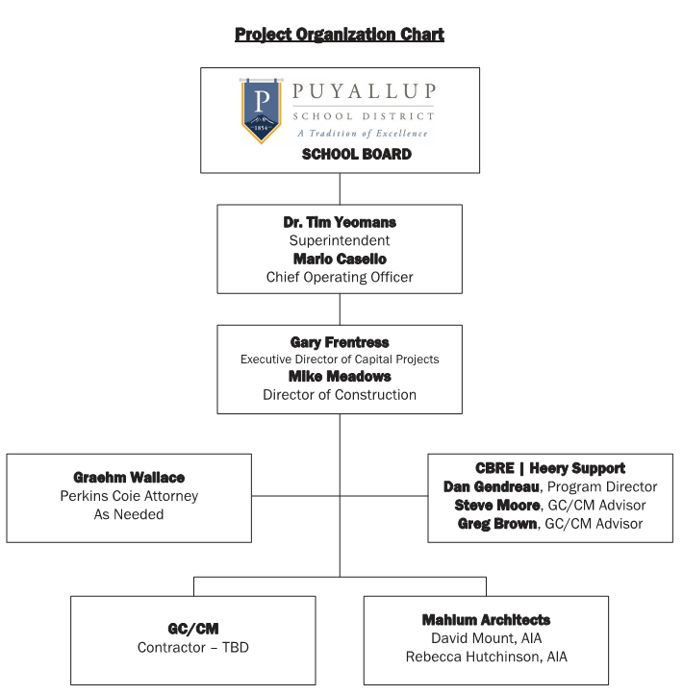
Ballou Junior High
School – Project Team
15
Notes:
Organization: Gary ( 1 min )
High level brief, district does have GC/CM experience but felt like they need another team member that brought additional GC/CM expertise.

Slide 16
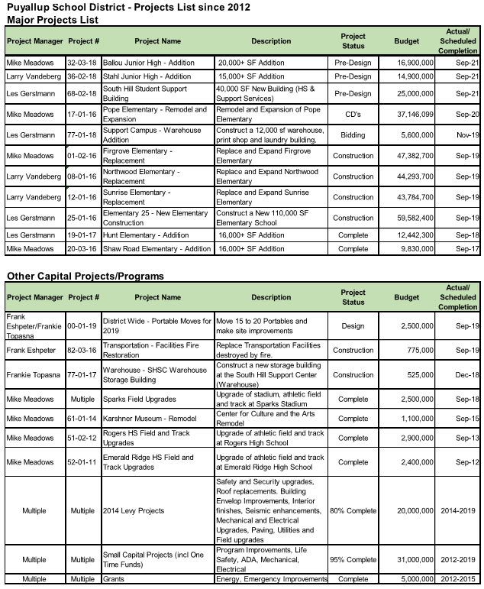
Ballou Junior High
School – PSD Experience
  Significant Capital Experience
  $677M of Capital Experience in last 14years
  Motivated to pursue Alternative procurement contracting
  Proactively seeking GC/CM Advisor with regional expertise
Notes:
District; Gary ( 1 min )
Brief high level, Amount of Projects in past 14years ranging
District is very excited about the GC/CM opportunity

Slide 17
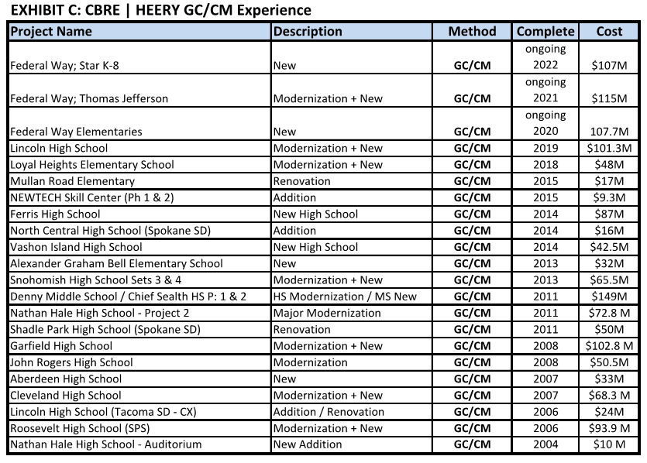
Ballou Junior High
School – CBRE Heery Experience
Notes:
District; Steve ( 0.5 min )
CBRE Heery brings a wealth of knowledge with the number of GC/CM in past 14years ranging from $9.3M additions to $115M high school renovations.

Slide 18
Ballou Junior High
School – Team Qualifications
Mario Casello, Puyallup School District
Chief Operating Officer, Oversight of 2015 Bond
Over 20 Years in K-12 Education
Gary Frentress, Puyallup School District (20%) Executive Director of Capital Projects
Over 35 Years of industry experience – Significant Capital Experience, Oversight of 2004, 2014, 2015 Bonds and Levy
Mike Meadows, Puyallup School District (100%)
Director of Construction
35 Years of industry experience – three GC/CM and four D/B
Graehm Wallace, Perkins Coie LLP. (as needed)
Partner, District General Counsel
Over 22 years of construction legal representation, over 100 public agencies served
18
Notes:
Team; Steve ( 2.5 min all Team Slides )

Slide 19
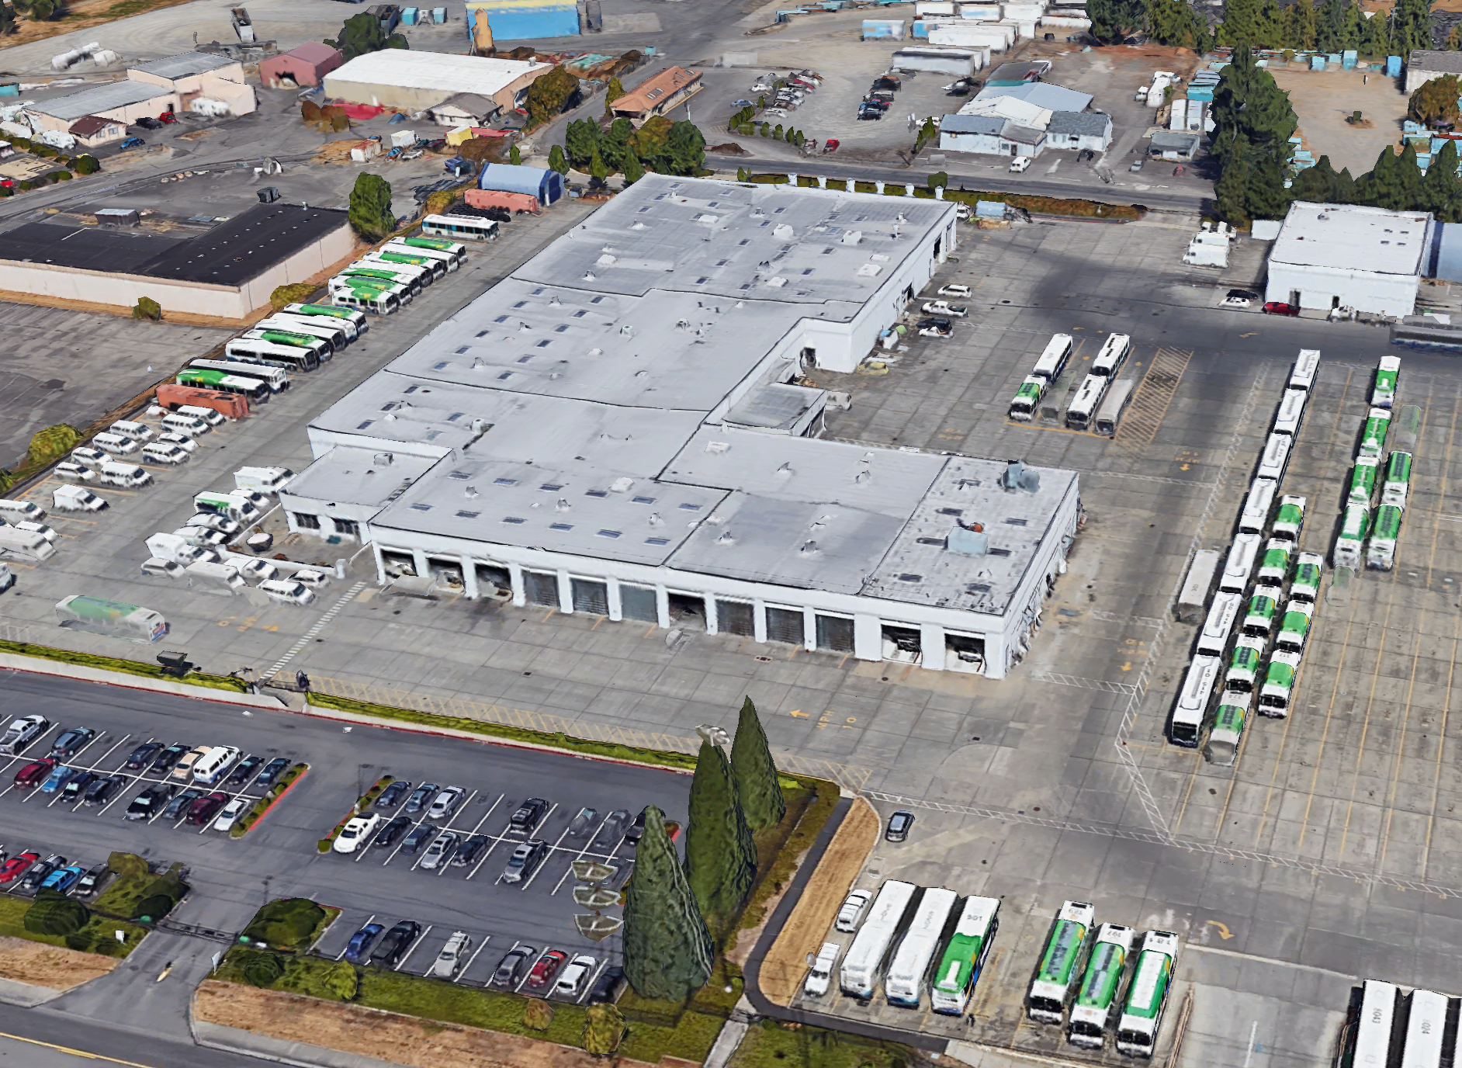
Ballou Junior High
School – Team Qualifications
Mike Meadows, Puyallup School District Director of Construction
Over 35 Years of industry experience
GC/CM project experience
Pierce Transit Maintenance Base
Tacoma Convention Center
Tacoma Dome Station
Design / Build
WPUDA Headquarters
Pierce Transit Training Center
South Hill Mall Transit Center
Bonney Lake Transit Center
Pierce Transit Maintenance Base
19
Notes:
STEVE
Though the district does have GC/CM experience they felt it was important to make a well rounded team and bring in some additional expertise.

Slide 20
Ballou Junior High
School – Team Qualifications
Steven Moore, CBRE | Heery (10%) Senior Project Manager, GC/CM Advisor 20 Years of industry experience – Four GC/CM projects
Greg Brown, CBRE | Heery (as needed)
Program Manager
32 Years of industry experience – Thirteen GC/CM projects
Dan Gendreau, CBRE | Heery (as needed)
Program Manager
28 Years of industry experience – Five GC/CM projects
David Mount, Mahlum Architects (20%)
Principal in Charge
24 Years of industry experience - Ten GC/CM Projects
Becky Hutchinson , Mahlum Architects (50%)
Project Architect
12 Years of industry experience - Two GC/CM Projects
20
Notes:
STEVE

Slide 21
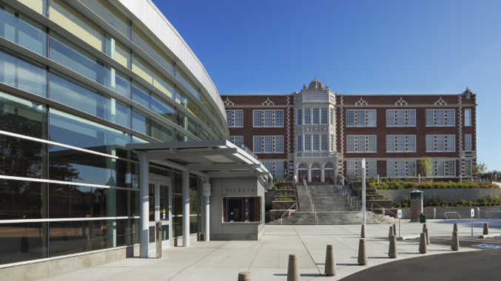
Ballou Junior High
School – Team Qualifications
Steven Moore, CBRE | Heery Senior Project Manager
20 Years of industry experience
GCCM Experience
Lincoln High School
Loyal Heights Elementary School
GC/CM Advisor Federal Way School District
Garfield High School – Seattle Schools
Snohomish High School – Snohomish Schools
GC/CM Certified by AGC
Other Schools Experience
Snohomish School District Program Manager
Garfield High School
21
Notes:
STEVE

Slide 22
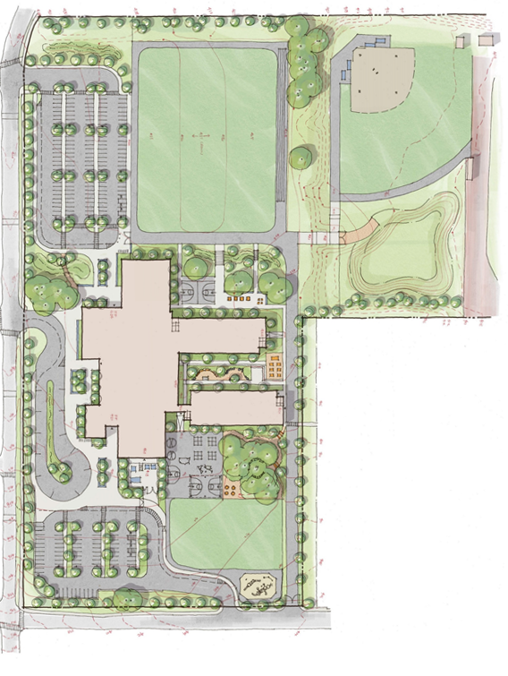
Ballou Junior High
School – Team Qualifications
Dan Gendreau, CBRE | Heery, Program Manager GC/CM Advisor
26 Years of industry experience
K-12 and Commercial
GC/CM project experience
Federal Way School District (3 projects)
Project Mgr. for Star Lake /
Totem Campus Project
Seattle Public Schools (2 projects),
Project Executive
Star / Totem Campus
22
Notes:
STEVE

Slide 23
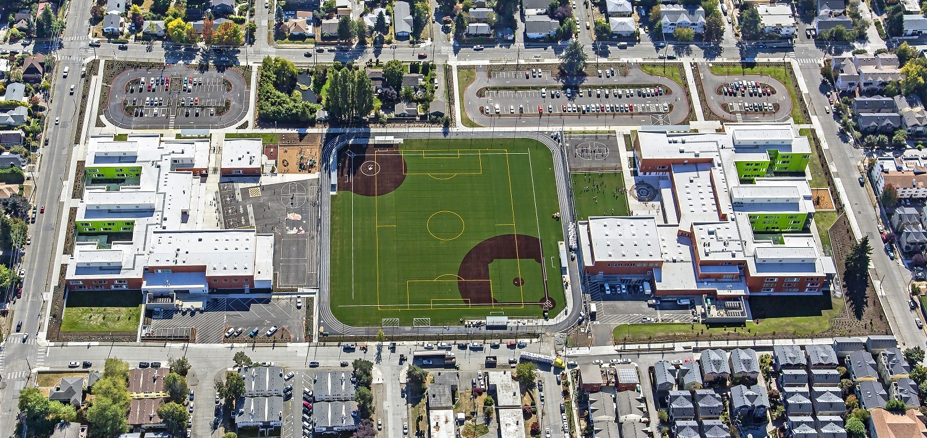
Ballou Junior High
School – Team Qualifications
David Mount, Mahlum Architects
Principal in Charge
Registered Architect in State of Washington
24 Years of industry experience
Principal in Charge for GCCM Schools
Bainbridge High School Bldg 100
Kellogg Middle School
Madrona School
Lynndale Elementary
Pine Lake Middle School
Early Learning Center
Issaquah Middle School
Robert Eagle Staff MS
Cascadia Elementary School
Robert Eagle Staff MS and Cascadia ES
23
Notes:
STEVE

Slide 24
Ballou Junior High
School – Team Qualifications
Graehm Wallace, Perkins Coie LLP.
Partner
22 Years of legal counsel experience for public entities
Legal Counsel for over 100 Washington public entities
Auburn School District
Bainbridge Island School District
Bellingham School District
Centralia School District
Central Kitsap School District
Central Valley School District
Clover Park School District
Edmonds School District
Evergreen School District
Federal Way School District
Fife School District
Kalama School District
Lake Stevens School District
24
Notes:
STEVE

Slide 25
Is Ballou Suited for GC/CM?
We Think So
25
Notes:
Qualifications: Gary

Slide 26
Ballou Junior High
School – GC/CM Presentation
RCW 39.10.340
Criteria Met
Complex Planning
Occupied Site
Complex & Technical Working Environment
Requires GC/CM during Design Phase
Necessary Project Team Experience with Advisor
26
Notes:
Summary; Gary ( approx 2 min or less )
Criteria for GC/CM this project meets 4 of the 5 criteria, go through Criteria. This project is well suited for GC/CM and we feel that the team has the experience to make this method very successful.

Slide 27
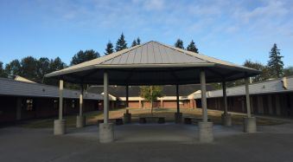
Ballou Junior High
School – GC/CM Presentation
QUESTIONS AND ANSWERS
27
Notes:
Q&A; Gary ( .5 min )
Answers to question and THANKS, very Excited
Note that answers to questions had been provided, but willing to discuss.

