Slide 1

Republic School District
Application for Project Approval for Progressive Design Build
Replacement 6-12 School
July 23, 2020
Notes:
Jeff with an intro and pass to kevin

Slide 2
Agenda
  Team
  Scope
  Why PDB
  RCW 39.10
  Schedule
  Budget and Funding
  Questions
Notes:
Kevin to take this

Slide 3
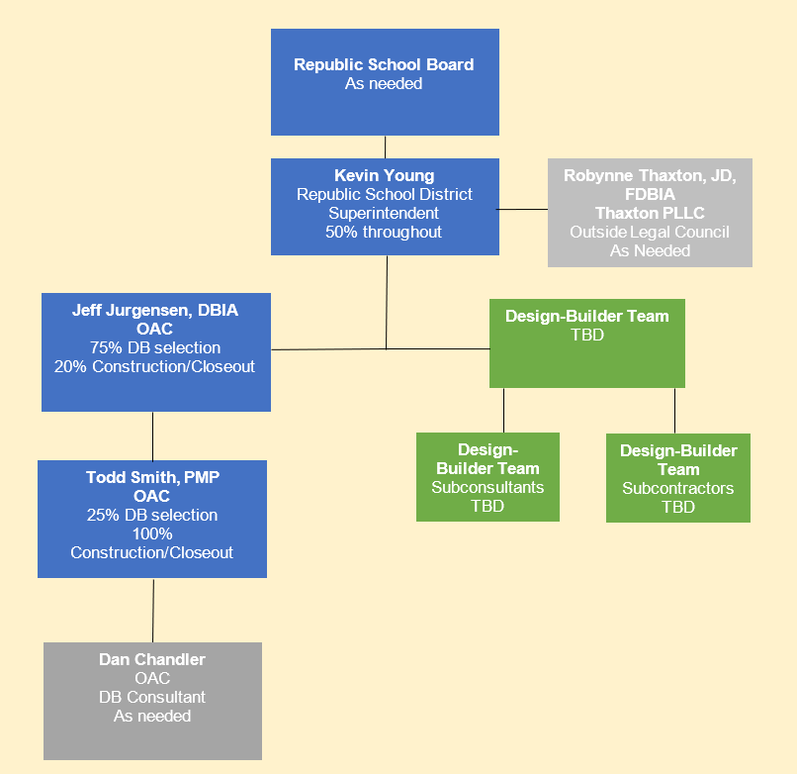
Project Team
Notes:
Kevin to discuss this. I have you at 50% but you will be involved more sometimes and less sometimes. Talk about the need for experts due to location, building experience and one in a lifetime opportunity for the community.

Slide 4
Scope of Replacement High School
New 48,000 to 50,000 sq. ft. Secondary School Facility
Demolition of existing high school
Attached to an existing elementary school
Limited field work
High School and Middle School students will be in existing middle school building to be saved
Combine the District Office into the new facility
Notes:
Kevin to discuss the scope

Slide 5
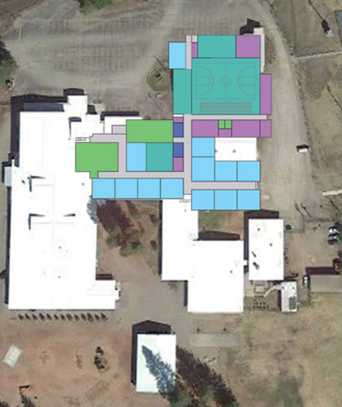
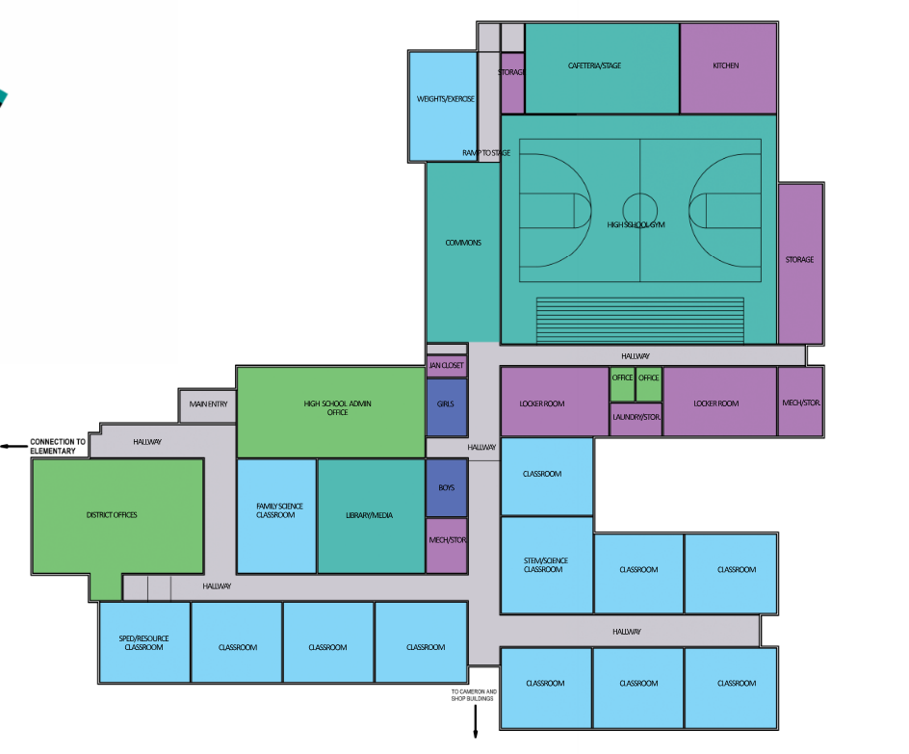
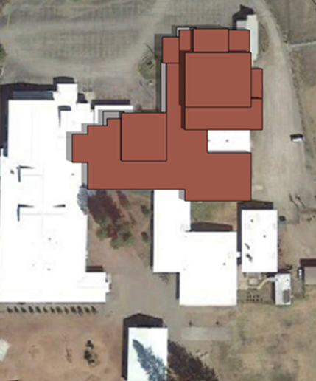
Bond Renderings
Notes:
Kevin to discuss the buildings. Occupied campus etc.

Slide 6
Why Progressive Design Build?
Predictability: Align Budget and Scope
Time to Market and Expedited Schedule
Early Cost Certainty
Single Contract for Owner with DB Team
Ability to involve Community & local Sub-Contractors
Notes:
Robynne discusses compliance with statute

Slide 7
RCW 39.10.300
The project meets all criteria of the RCW:
This project will be provided opportunity for greater innovation and efficiencies…
This project will realize significant savings in project delivery time…
The involvement of design build team is critical to in developing the construction methodology due to the location of the project…
The School District has put together an experienced team.
Notes:
Robynne discusses compliance with statute.

Slide 8
Replacement High School Schedule
Description* | Start | Finish
PRC Meeting/Approval Letter | 7/23/2020 | 7/23/2020
Issue RFQ & due date | 8/17/2020 | 9/10/2020
Mandatory RFQ Meeting | 8/31/2020 | 8/31/2020
Addendum 1 issued if needed | 9/5/2020 | 9/5/2020
SOQ Due | 9/10/2020 | 9/10/2020
Issue RFP | 9/22/2020 | 9/22/2020
Interviews/Meetings | 9/29/2020 | 9/29/2020
RFP Submission | 10/13/2020 | 10/13/2020
Design Builder Selection & Notify | 10/20/2020 | 10/27/2020
Design & Construction | 11/01/2020 | 8/31/2022
Project Completion/Punch/Move –in & Closeout | 7/31/2022 | 8/31/2023
Notes:
Jeff to review the schedule. Input from Robynne

Slide 9
Replacement High School Budget
August 4, 2020 is the ballot for a Bond. 60% approval needed
Costs for Professional Services (A/E, Legal etc.) $1,108,700
Estimated project construction costs (including construction contingencies): $15,800,00
Equipment and furnishing costs $1,226,000
Off-site costs $200,000
Contract administration costs (owner, cm etc.) $800,000
Contingencies (design & owner) $1,025,000
Other related project costs (briefly describe) $300,000
Sales Tax (Construction & Design) included above
Total $20,500,000
Notes:
Jeff to work on Budget

Slide 10
Special Consideration
The District passes a bond for $4.5 million
  District will receive $9 million in distressed school grant (Counts as local money)
  District uses the above $13.5 million to get School Construction Assistance Program Matching money in amount of $6 to $7 million
  Received additional $100k for planning and prep for project
Brings total to $20.5 million for the Total Project Costs
Notes:
Kevin to discuss this.

Slide 11
What Have We Done with Prep Grant
Completed Educational Specifications
Completed the Hazardous Material Survey of Facility
Completed a boundary survey & limited topographic survey
Completed the SEPA checklist and issued a DNS
Completed a limited Geo Technical Investigation along with a Stormwater Retention Study
WE ARE ALL READY TO GO GET TO WORK
Notes:
Jeff

Slide 12
Responses to Questions
Question 1 – The School District hired MMEC to provide preliminary information for the bond committee and develop Ed Specs to get staff and community involved prior to the bond vote. MMEC’s work was very preliminary and will be provided to all proposers, and they will not have an advantage over other proposers.
Question 2 – This is a one-time grant, if the bond fails on August 4, 2020 the project will not move forward. The RFQ will not be issued until after the vote.
Notes:
Robynne to take this

Slide 13
Questions?
Notes:
Kevin to close. Jeff and Robynne to say thank you

