Slide 1
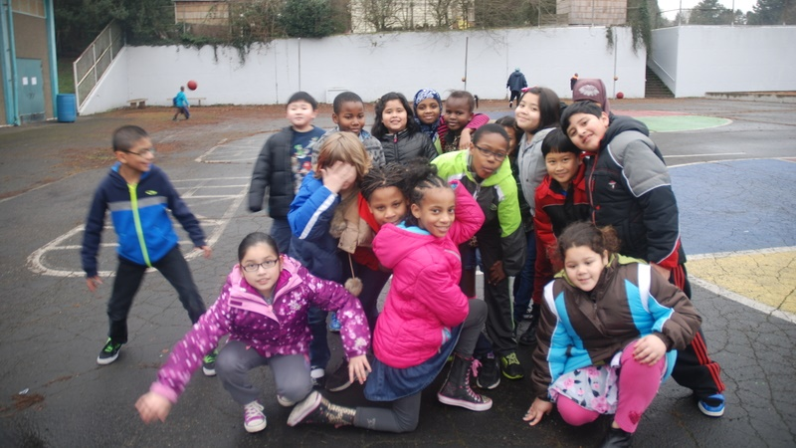


Northgate Elementary School
Project Review Committee Presentation – Seattle Public Schools September 26, 2019
Notes:
Eric

Slide 2

PRESENTATION AGENDA
Introduction of Key Team Members
Project Overview
GC/CM as Appropriate Method
Public Benefit
Agency Experience
Team Organizational Chart and Qualifications
Summary
Questions
Notes:
Eric Intro team

Slide 3
RCW 39.10 Alternative Project Works Criteria
At least one of:
Involves complex scheduling, phasing, or coordination
Construction at an occupied facility which must continue operation
GC/CM during the design stage is critical to the project’s success
Complex or technical work environment
(Heavy civil construction not applicable)
Notes:
Eric Intro team

Slide 4
PROJECT OVERVIEW – SCOPE AND BUDGET
Funding Source: BEX V Levy, approved February 2019 and School Construction Assistance Program from OSPI
Approximately 95,000 SF replacement elementary school for 650 Students
Existing school to remain fully operational through construction
$90.2M total project cost
$65M construction cost (including construction contingencies)
Potential Landmark status pending
Notes:
Eric

Slide 5
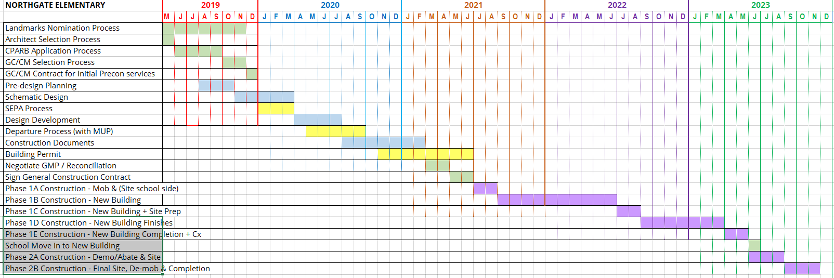
PROJECT OVERVIEW – PRELIMINARY SCHEDULE
Notes:
Vince – note integrated schedule planning with GC/CM, address details later. current status. Construction phasing is very prelim pending GC/CM involvement. Note this is self nominated (leave other for QA)

Slide 6
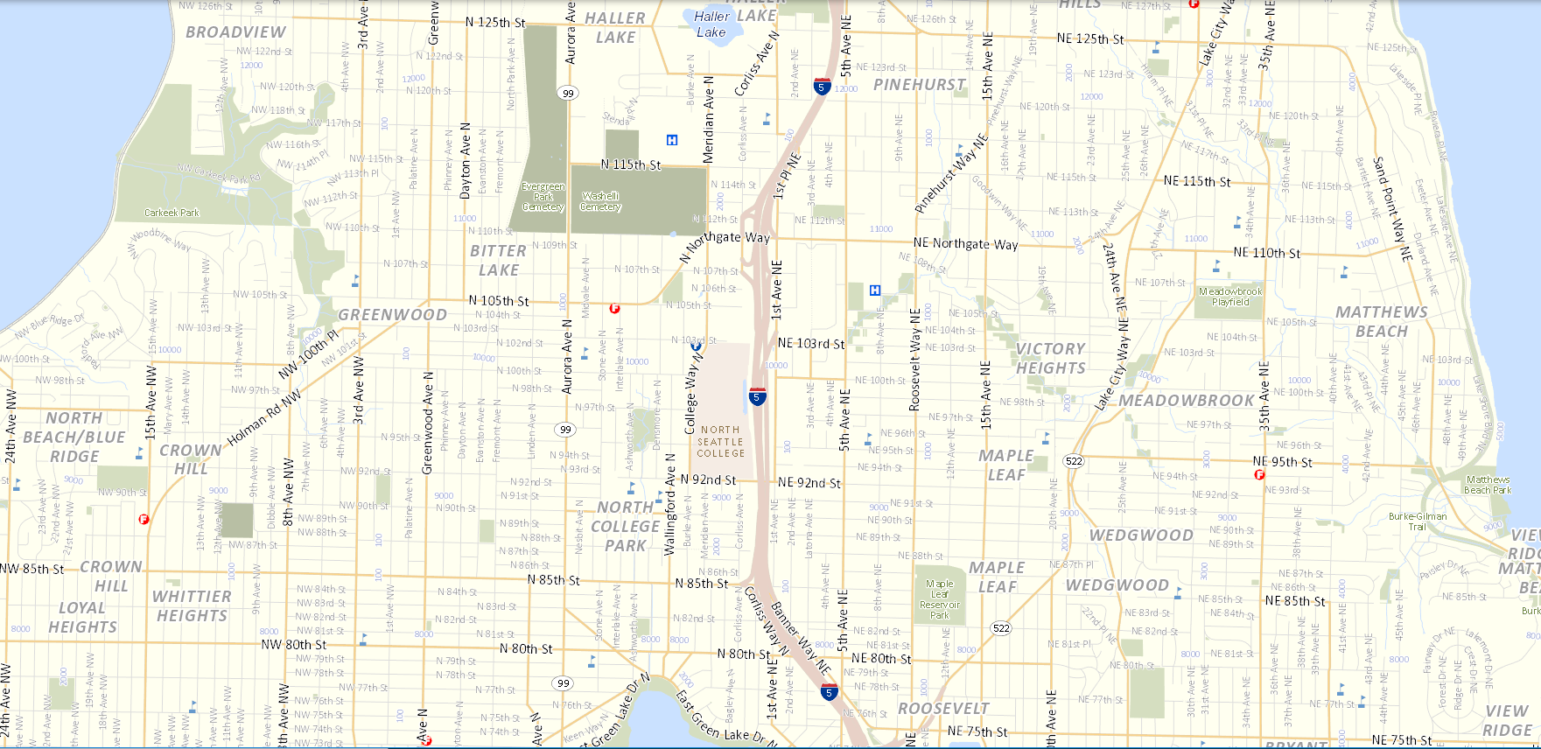
PROJECT OVERVIEW – Site location in North Seattle
PROJECT SITE
11725 1ST Ave NE
Seattle, WA
Northgate Light-rail station (open 2021)
½ Mile from school
Notes:
Vince

Slide 7
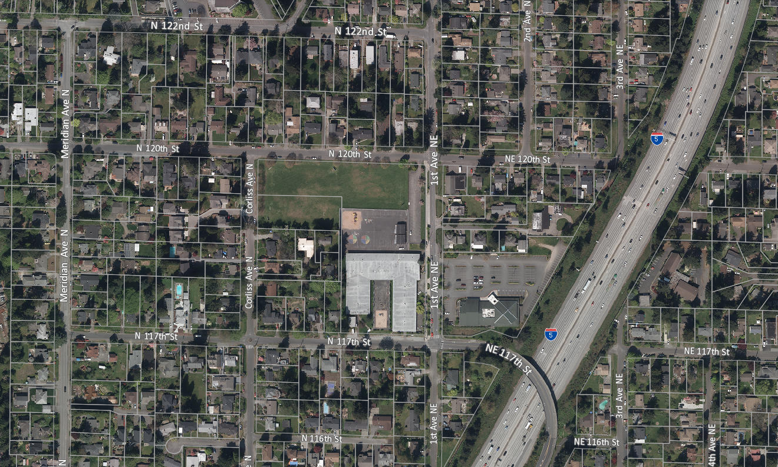
PROJECT OVERVIEW – NEIGHBORHOOD
Primarily Single Family Residential
Multi-family and MHA up-zoning 3 blocks south
Projected growth and density due to light rail Northgate station and up-zoning
PROJECT SITE
Notes:
Vince

Slide 8
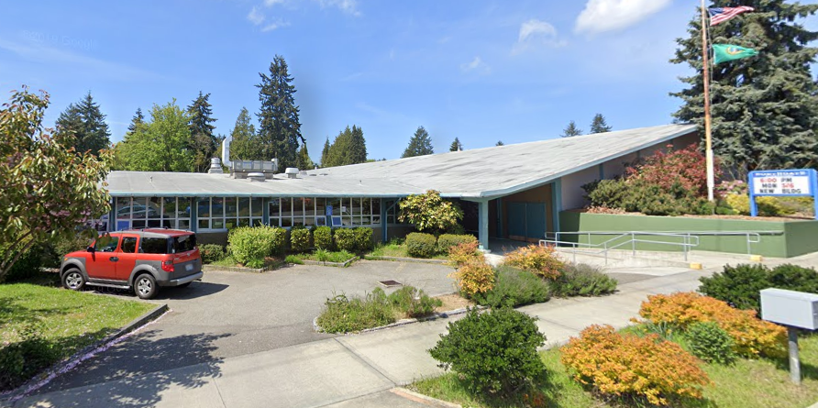
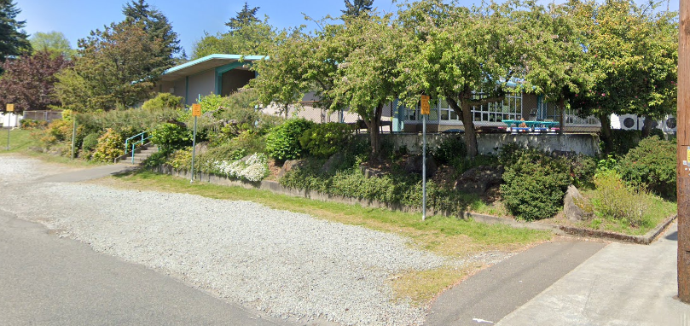
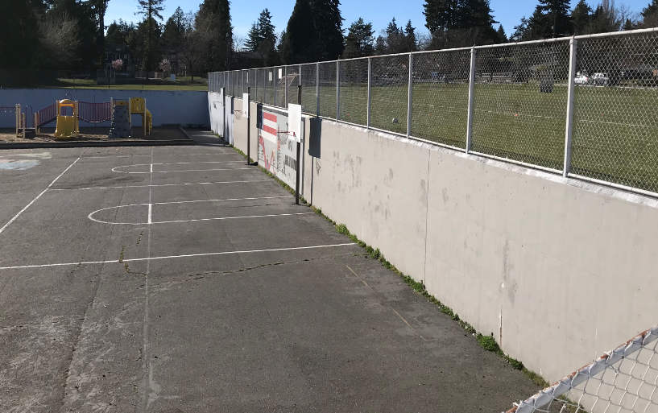
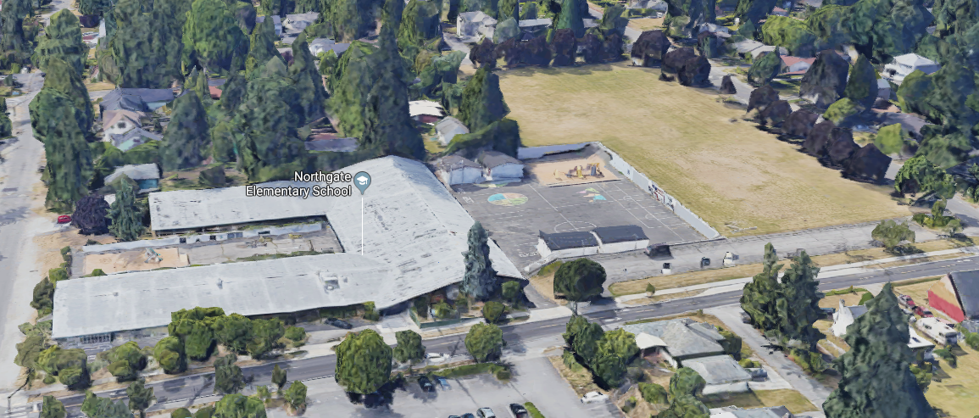

PROJECT OVERVIEW – EXISTING PHOTOS
SOUTHWEST CORNER
RETAINING WALL (12’+)
ENTRY
BIRDS EYE VEIW FROM WEST
ENTRY
Notes:
Matt

Slide 9
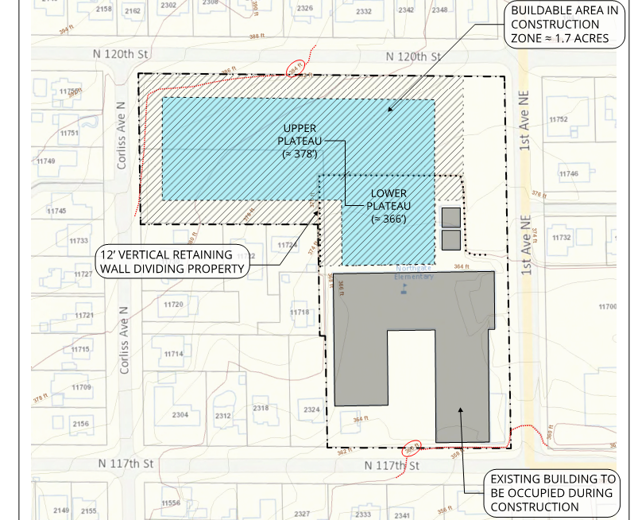
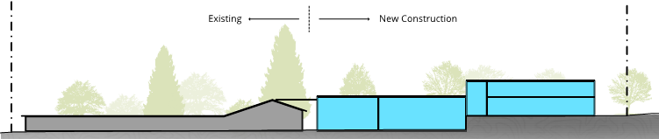

PROJECT OVERVIEW – SITE EVALUATION
Total site area is 5.7 Acre
Construction Area is limited to ~1.7 acres after setbacks and protection of active school zone is set.
L-Shaped site limits area of possible development
20’ Topo change including 12’ retaining wall separating the site
Possible exceptional trees on perimeter
Public Storm line runs through site
SITE SECTION
Notes:
Matt – issues that will benefit from Cpntractor involvment in design

Slide 10
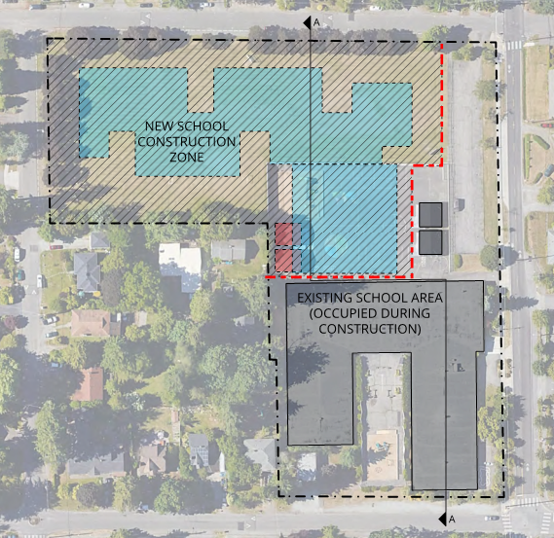
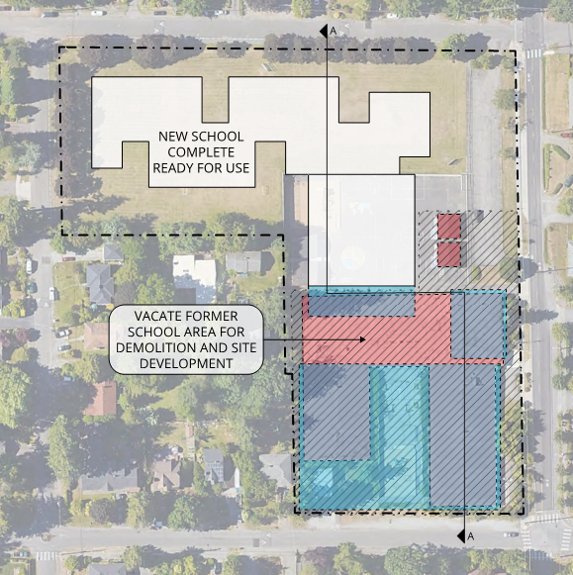
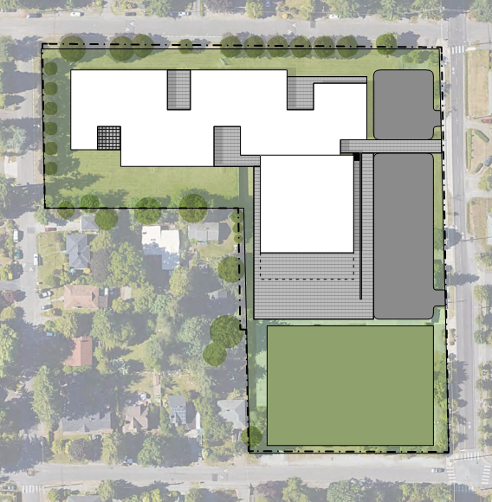

PROJECT OVERVIEW – CONCEPTUAL PHASING
New 2 story school building
Parking / Drop-off areas
Gym on lower plateau
Play areas
Earlier Phases of Construction
Extensive coordination needed for productive school and construction activities.
Coordinate temp areas for play, parking, drop-off etc.
Later Phases of Construction
Coordinate move from existing building to new.
Coordinate temp area for play and parking in new school zone while demo and site work proceed at existing school zone
Project Completion
Coordinate transition from temp heat source to final geo-well ground source
(note proposed design study is preliminary)
Notes:
Matt

Slide 11
GC/CM AS APPROPRIATE DELIVERY METHOD
There is no interim site for this school so this will be phased occupied construction.
This is a very constrained site for the scope of work (size, shape and topo).
Critical coordination needed with contractor and school to ensure a safe and secure school setting during construction.
School has 25% homeless and 40% transient students leading to the higher need for special programs and afterschool services. A highly qualified GC/CM is critical to coordinate construction with specialized needs of school.
Current market conditions indicate labor shortages, bidders are more reluctant to hard bid technically challenging project like this.
Residential neighborhood and limited site area requires added planning of construction hauling, staging and laydown areas.
Notes:
Matt

Slide 12
PUBLIC BENEFIT
GC/CM selection based on qualifications and relevant experience will be critical to success of project with significant site constraints, schedule requirements and sensitivity to active school needs.
Design participation will improve GC/CM familiarity with issues and reduce errors or omissions, thus saving cost and improving quality.
GC/CM will participate in developing the schedule and phasing to help ensure timely turn-over of spaces.
Top tier contractors are more likely to compete for this project as a GC/CM, leading to likelihood of improved quality, timely completion, better sub coverage and better safety and integration with school.
Earlier cost information to better manage budget and prioritize needs.
Notes:
Richard

Slide 13

AGENCY EXPERINCE
Seattle Public Schools list of major projects last 6 years and all GC/CM projects:
Project Name | Scale / Description | Delivery Method | Completion | Project Cost |  | Project Name | Scale / Description | Delivery Method | Completion | Project Cost
Nathan Hale High School Auditorium | New Addition | GC/CM | 2004 | $10 M |  | Thornton Creek Elementary School | New | D/B/B | Fall 2016 | $42.8 M
Roosevelt High School | Complete Renovation | GC/CM | 2006 | $84.5 M |  | Cascadia Elementary School | New | GC/CM | Fall 2017 | $45.7 M
Cleveland High School | Complete Renovation | GC/CM | 2007 | $67 M |  | Cedar Park - New School | Modernization | D/B/B | Fall 2017 | $1.5 M
Garfield High School | Complete Renovation | GC/CM | 2008 | $87.5 M |  | Decatur New School | Modernization | D/B/B | Fall 2017 | $1.5 M
Denny Middle School / Chief Sealth High School Project 3 | Community / Athletic Fields | GC/CM | 2011 | $5.9 M |  | Jane Addams Middle School | Modernization | D/B/B | Fall 2017 | $13.1 M
Denny Middle School / Chief Sealth High School Projects 1 & 2 | Sealth HS 230,000 SF Modernization / Denny MS -New Building | GC/CM | 2017 | $149 M |  | Meany Middle School | Modernization | D/B/B | Fall 2017 | $30 M
Ingram High School | Classroom Addition | GC/CM | 2019 | $41 M |  | Olympic Hills Elemetnary School | Replacement | GC/CM | Fall 2017 | $45.2 M
Fairmont Park Elementary School | Modernization & Addition | D/B/B | Fall 2014 | $19.4 M |  | Robert Eagle Staff MS/Liction Springs Program | New | GC/CM | Fall 2017 | $76.4 M
Mann Middle School | Modernization | D/B/B | Winter 2014 | $12.8 M |  | Loyal Heights Elementary School | Modernizatoin & Addition | GC/CM | Fall 2018 | $46.5 M
Cedar Park - Interim Site | Modernization | D/B/B | Fall 2015 | $10.7 M |  | Lincoln High School | Modernization | GC/CM | Fall 2019 | $101.3 M
Arbor Heights Elementary School | Replacement | D/B/B | Fall 2016 | $40.9 M |  | Queen Ann Elementary School | Addition | D/B/B | Fall 2019 | $19.3 M
Genessee Hill Elementary School | Replacement | D/B/B | Fall 2016 | $41.2 M |  | Bagley Elementary School | Modernization & Addition | GC/CM | Fall 2020 | $40.3 M
Hazel Wolf K8 | Replacement | D/B/B | Fall 2016 | $39.6 M |  | Wing Luke Elementary School | Wing Luke Elementary School | D/B/B | Fall 2021 | $47.5 M
Seattle World School @TT Minor | Modernization | D/B/B | Fall 2016 | $20.2 M
2011
Notes:
Richard

Slide 14
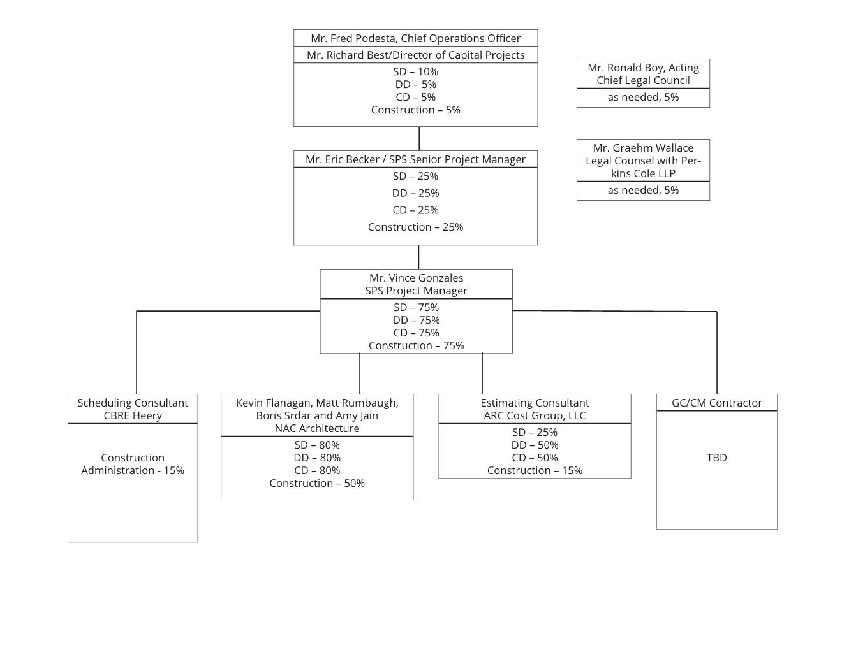
PROJECT TEAM – ORGANIZATIONAL CHART

Slide 15
PROJECT TEAM’S QUALIFICATIONS
Richard Best, Seattle Public Schools
Director of Capital Projects and Planning
32 years of industry experience, 7 GC/CM projects
Eric Becker, Seattle Public Schools
Senior Project Manager
30 years of industry experience, 6 GC/CM projects
Vincent Gonzales, Seattle Public Schools
Project Manager
21 years of industry experience, 3 GC/CM project
Kevin Flanagan, NAC Architecture
Principal in Charge, Educational Planner
30 years of industry experience, 4 GC/CM project
Matt Rumbaugh, NAC Architecture
Senior Project Manager, Principal
23 years of industry experience, 2 GC/CM project
Amy Jain, NAC Architecture
Project Architect
17 years of industry experience, 1 GC/CM project
Notes:
Richard

Slide 16
SUMMARY
Project meets the criteria for GC/CM.
Project team has the necessary qualifications.
GC/CM delivery provides a fiscal benefit for a phased occupied project on a site with multiple constraints.
Notes:
Eric

Slide 17

QUESTIONS
Notes:
Eric

