Slide 1
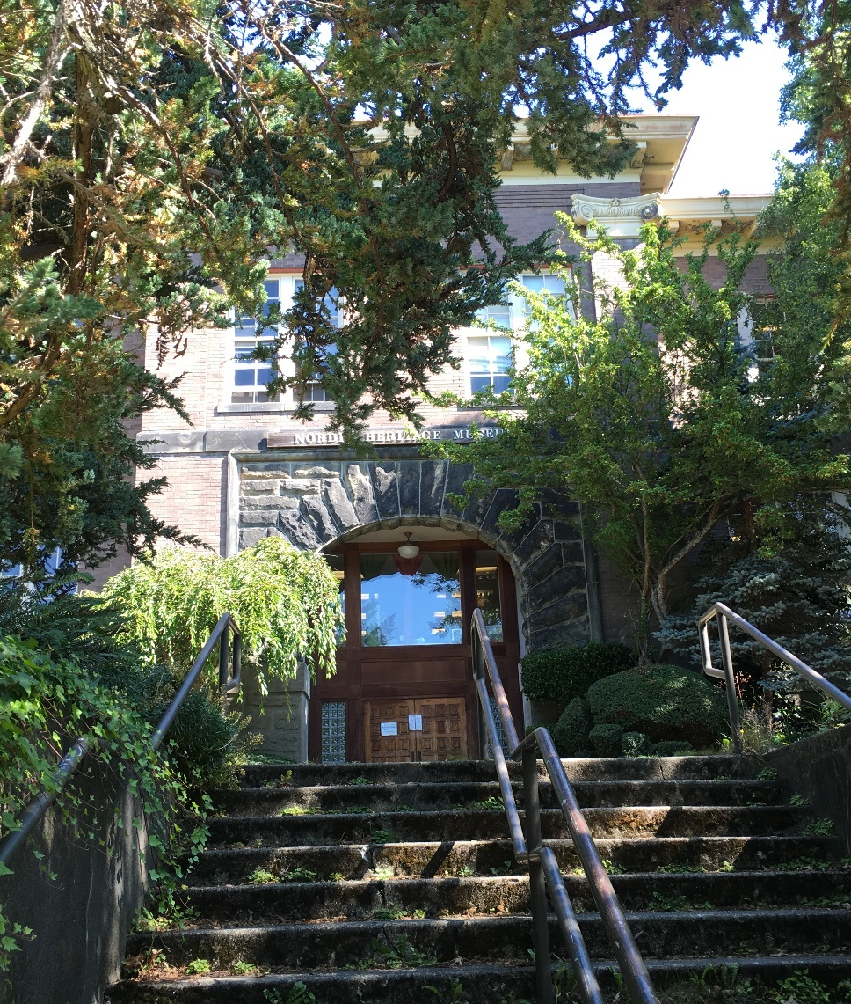
Modernization and Addition at
Webster elementary School Project
Project Review Committee Presentation - Seattle public school district
September 22, 2016

Slide 2
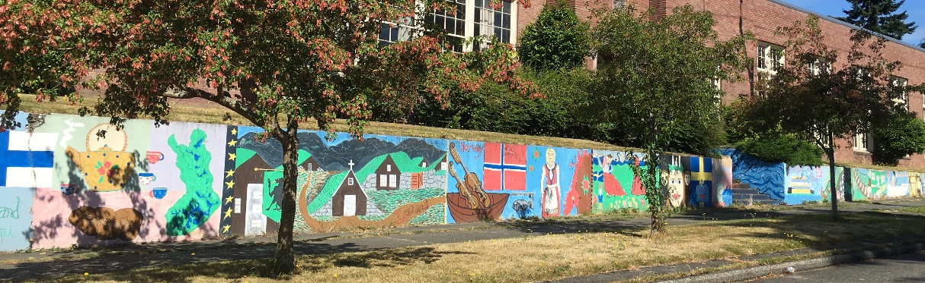
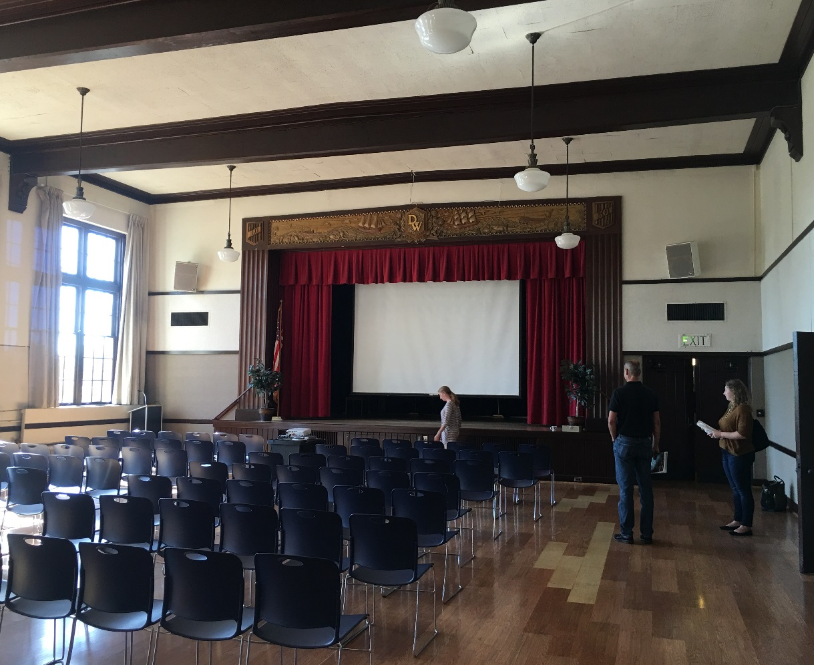

Presentation AGENDA
Introductions of key team members
Project overview
GC/CM as appropriate delivery method
Agency/Team qualifications
Public benefit
Summary
Questions
Retaining wall on East side
Landmarked Auditorium

Slide 3
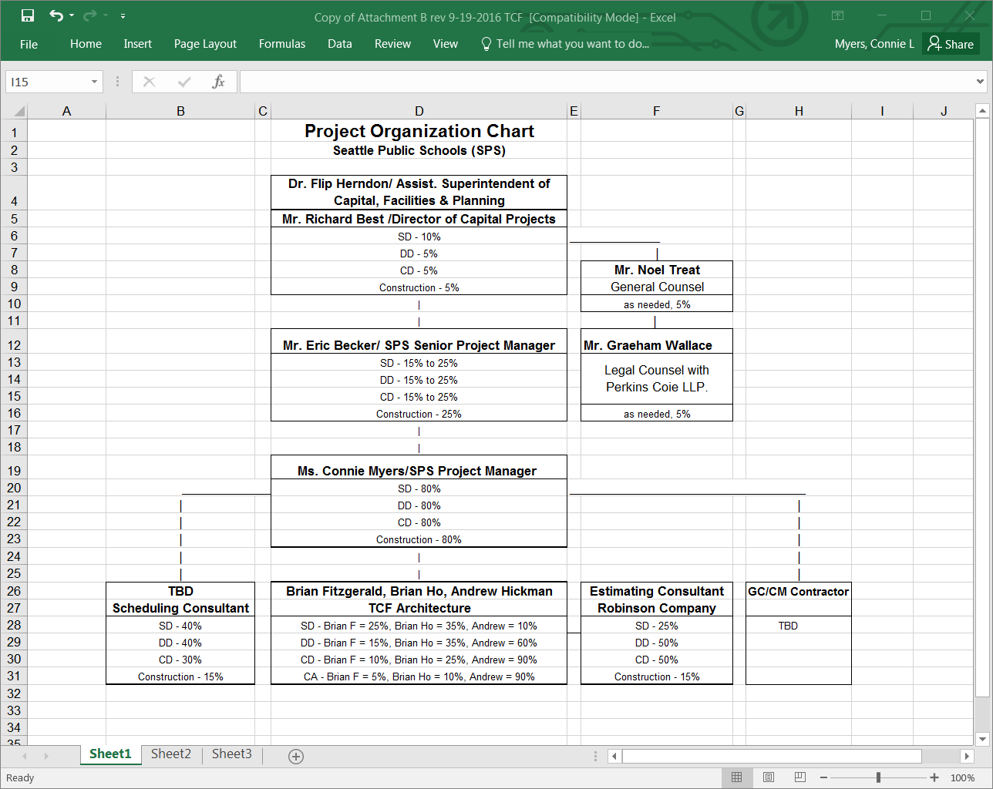
Project Team Introductions:
Here today

Slide 4
Project Overview – Budget
Overall project expected to cost: $31.7 million, including contingency & escalation
Estimated construction costs (MACC): $17.2 million
Funding source: BTA IV levy approved by voters 2/2016
No OSPI funding assistance available

Slide 5
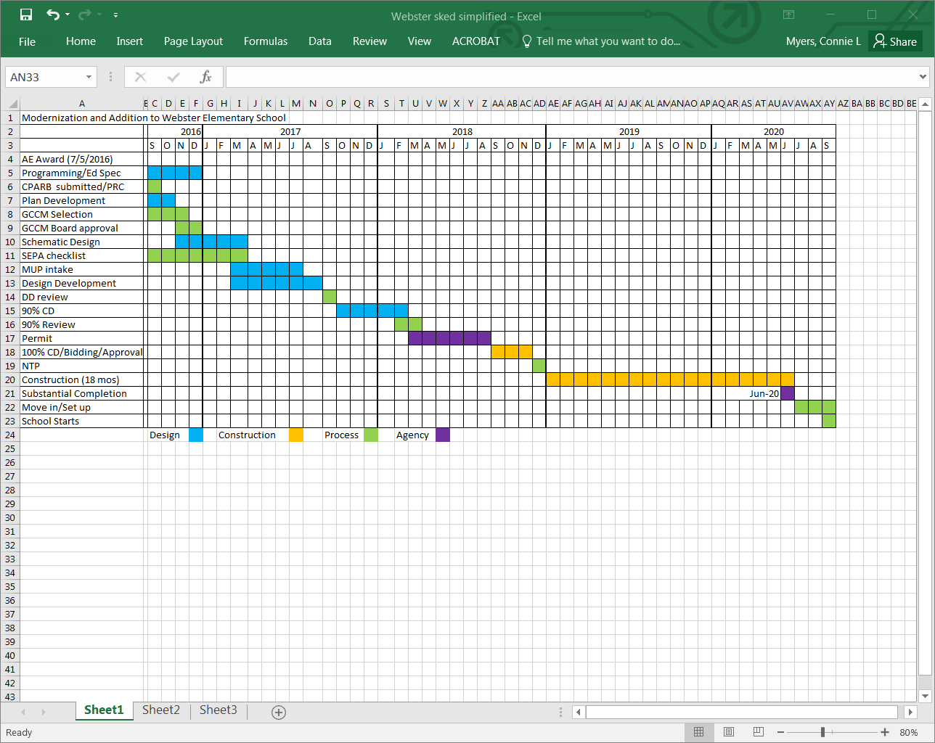
Project Overview – schedule

Slide 6
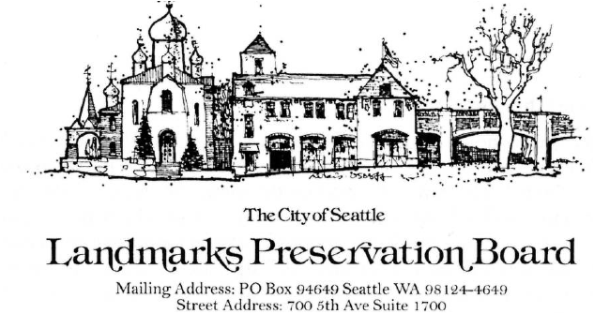
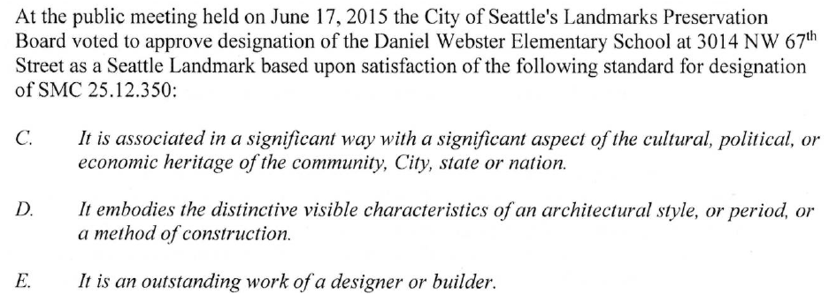

Project Overview – historical features

Slide 7
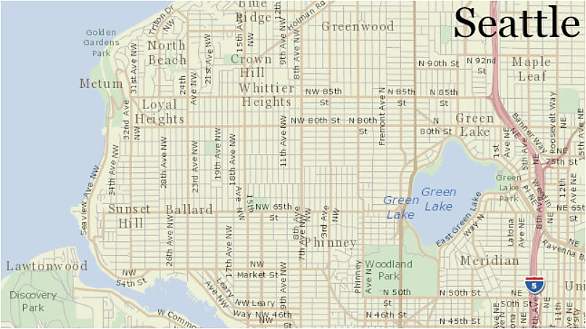
Project Overview – Located in NW Seattle
Project Site

Slide 8
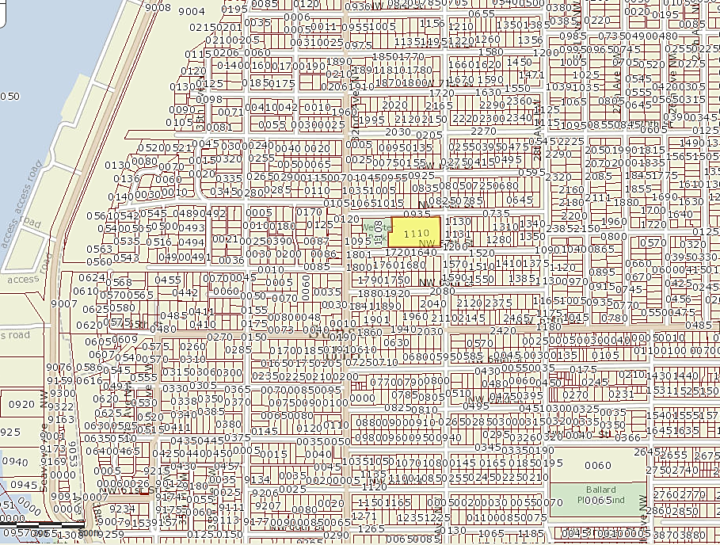
Project Overview – Located within a well -established Ballard neighborhood
Shilshole Bay
Project Site in the middle of a residential neighborhood.

Slide 9
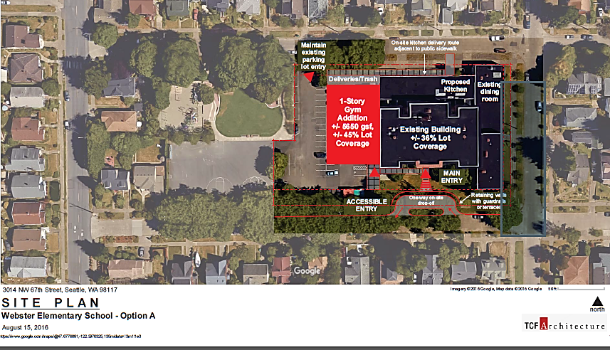
Project Overview – Site concept (1.5 Acres)

Slide 10
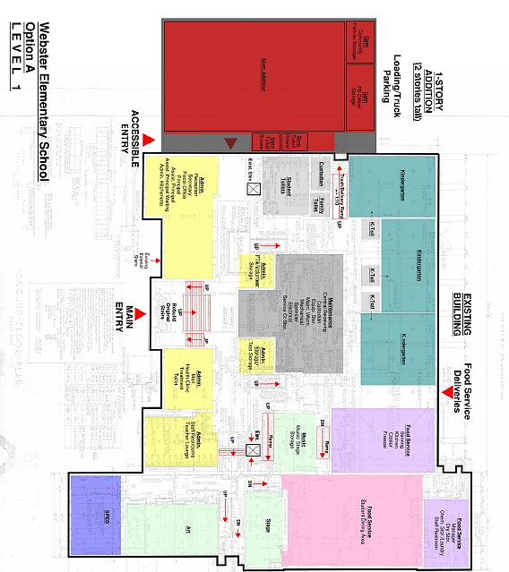
Project Overview – 1st Floor Concept

Slide 11
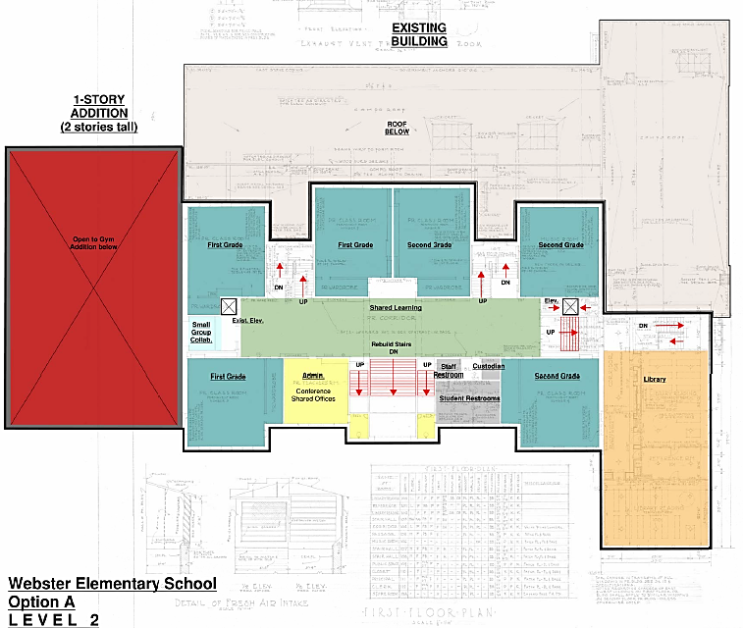
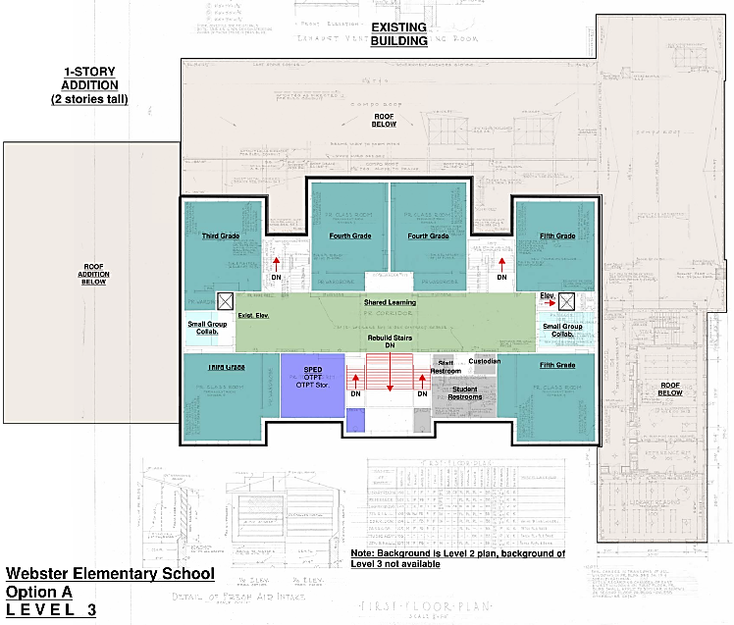
Project Overview – 2nd and 3rd Floor Concept

Slide 12
GC/CM as appropriate delivery method- RCW
Historic significant building
Site Constraints/Urban Setting –complex coordination
Complex, technical work environment
  No as-builts
  Complicated modernization: seismic improvements, utility systems replacement, repair/upgrade building envelope (retain historical features & meet energy codes)
  Share site with an operating City Park with a shared access point, south and east sides 6’ above roads (retaining walls)

Slide 13
GC/CM as appropriate delivery method- RCW
Early involvement of GC/CM is critical
  Verification of existing conditions
  Constructability of addition, seismic improvements, new utility systems, upgrades to building envelope and roof to meet energy codes.
  Permitting process requires description of construction methods and scheduling
  Current construction market with labor shortages early planning required (examples: elevators, glazing)

Slide 14

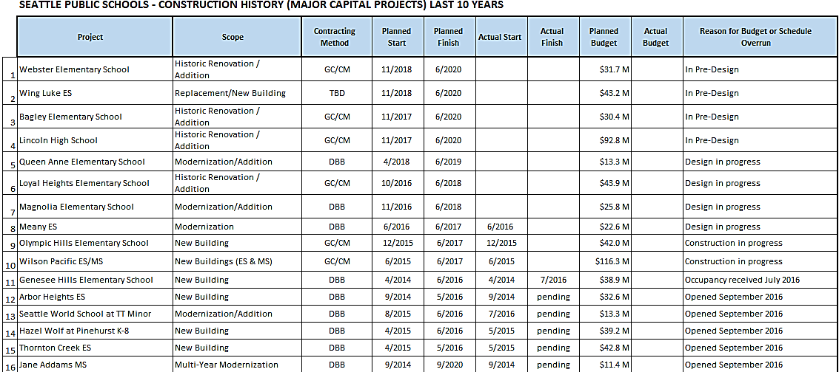
Agency experience
Active projects = 16 projects. 6 completed this summer.
5 are GC/CM: 3 under design and 2 under construction.

Slide 15
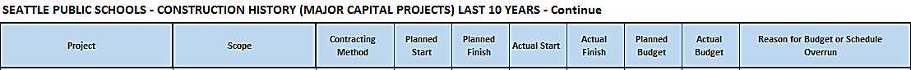
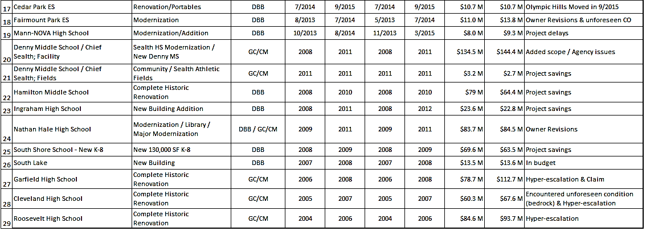
Agency experience - continue
Summary: Total of 29 Major Projects where 12 are GC/CM projects.

Slide 16
Project Team

Slide 17
Team’s qualifications
Richard Best, Seattle Public Schools
Director Capital Projects
31 years of industry experience – Five GC/CM projects
Eric Becker, Seattle Public Schools
Senior Project Manager
29 years of industry experience – Four GC/CM projects
Connie Myers, Seattle Public Schools
Project Manager
30 years of industry experience – Seven GC/CM-type projects
Brian Fitzgerald, TCF Architecture
Principal in Charge
37 years of industry experience – Five GC/CM projects

Slide 18
Public Benefit
Ability to select general contractors with historical building experience
Ability to maintain safe environment in close proximity with adjacent park and neighborhood
Ability to adhere to complex permit requirements
Earlier project cost information to inform design and budget decisions

Slide 19
summary
Project meets criteria to use GC/CM delivery
Project team has necessary qualifications
GC/CM delivery provides fiscal benefit for a historically significant building

Slide 20


