Slide 1



Einstein and Kellogg Middle Schools
GC/CM PROJECT APPLICATION TO THE PRC
SHORELINE SCHOOL DISTRICT
September 28, 2017
Notes:
Howard to start

Slide 2

AGenda
Introductions
Project Background
Meets Applicable Criteria
  Qualifying Project
  Management Plan
    Project Team
    Schedule
    Budget
    Funding
  Public Benefits
Summary
Notes:
Howard to present

Slide 3
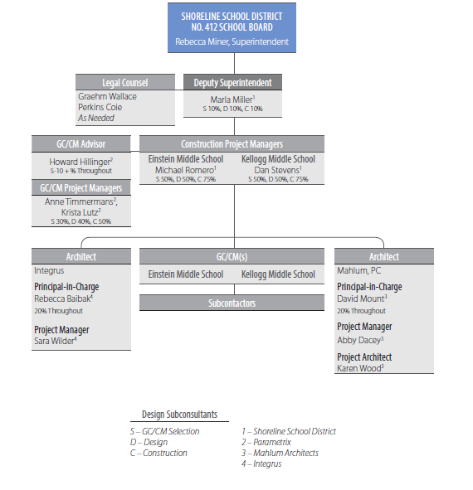
Project Team
Parametrix staff available to increase involvement as needed
Notes:
Howard to present

Slide 4
Project Team
Notes:
Howard to present

Slide 5
Project team
Marla Miller, Shoreline Public Schools Deputy Superintendent
  20+ years experience in school construction
  GC/CM experience – Meadowdale Middle School, Edmonds S.D.
Michael Romero, Shoreline Public Schools Project Manager
  18+ years experience in school and public construction
  GC/CM experience – Early Learning Center
  Completed AGC UW GC/CM workshop
Dan Stevens, Shoreline Public Schools Manager of Capital Projects
  30+ years experience in construction
  Completed AGC GC/CM workshop
Howard Hillinger, Parametrix
  31+ years PM-CM experience, CCM
  GC/CM: 10 projects including Tacoma Schools and WSF Colman Dock
  Member: PRC, GC/CM Heavy Civil Task Force
Anne Timmermans, Parametrix
  15 years PM-CM experience, CCM, LEED AP BD+C
  GC/CM experience: Port of Seattle Rental Car Center and North Satellite Renovation projects
Krista Lutz, Parametrix
  19 years PM-CM experience, CCM
  GC/CM experience: WSF Colman Dock, Pike Place Market Renovation Phases 1-3
Notes:
Howard to introduce
Each attendee give short intro

Slide 6
Project team CONTINUED
Graehm Wallace, Perkins Coie
  Legal counsel
  Extensive GC/CM experience
David Mount, Mahlum Architects
  Lead for Kellogg Middle Schools
  23+ years experience
  GC/CM experience – Seattle Public Schools, Edmonds School District, Issaquah School District, Western Washington University
Rebecca Baibak, Integrus Architecture
  Lead for Einstein Middle School
  25 years experience
  GC/CM experience – Lake Washington School District, Monroe School District, Northshore School District
Notes:
Howard to coordinate
Each attendee introduce themselves

Slide 7
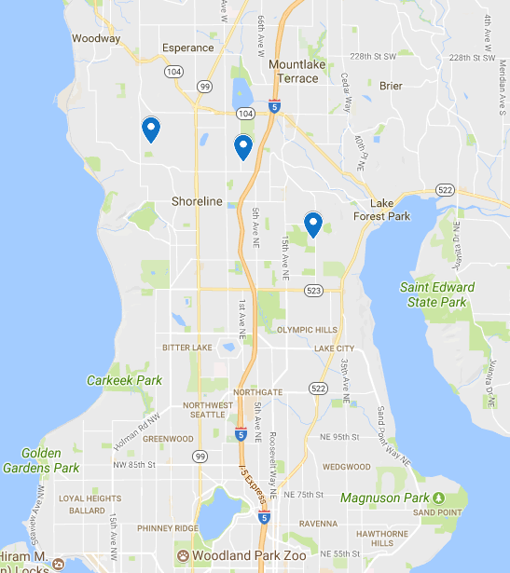
PROJECT LOCATION
Einstein Middle School
2 miles
Shoreline School
District Headquarters
2.7 miles
4.2 miles
Kellogg
Middle School
Notes:
Marla to present

Slide 8
Project Background
Notes:
Marla to introduce

Slide 9
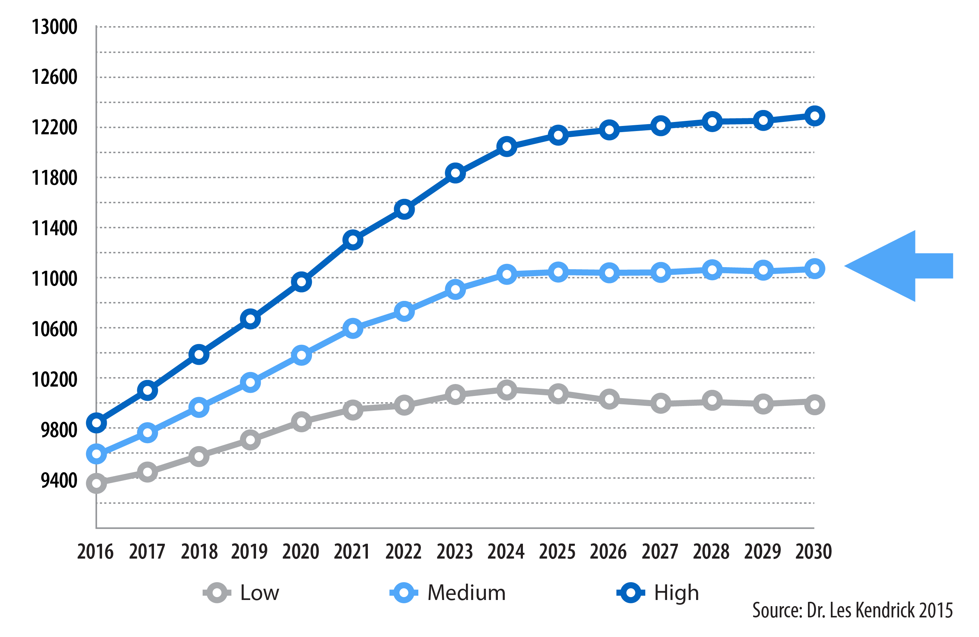
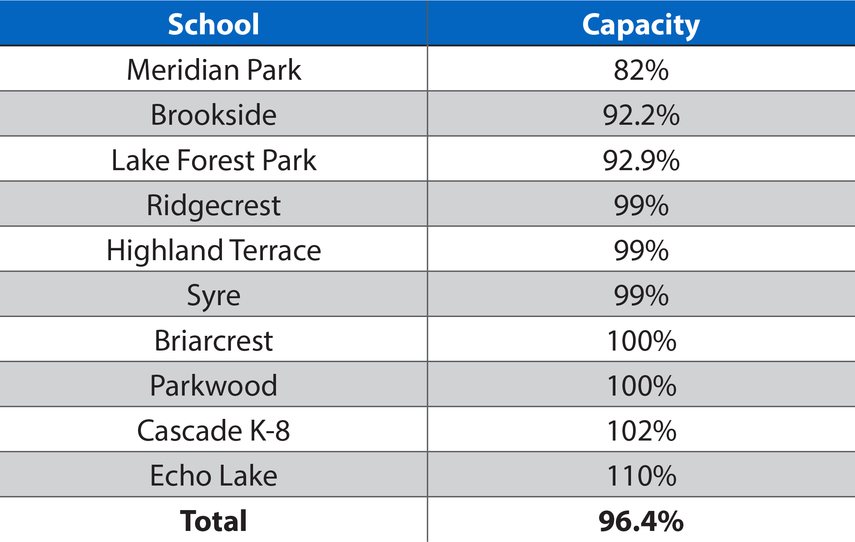
ENROLLMENT IS EXCEEDING CAPACITY
At Capacity
Most likely
Duration for bond program
Notes:
Marla: Enrollment projections are tracking to this graphic
Focus on bond issue and timeframe and how it relates to capacity and enrollment being full at 2018
Note: Rebuilding these two schools will resolve crowding issues at Shoreline elementary schools for the foreseeable future, but will require reconfiguration and reconstruction of the District’s existing two middle schools on their existing sites

Slide 10
BOND PROGRAM PLAN
2016-17
Early Learning Center Design Phase
North City Renovated as Elementary School
Middle Schools Planning
2017-18
Early Learning Center Construction
ELC programs at NC
Parkwood Design Phase
Einstein & Kellogg Design Phases and
GC/CM Procurement Fall 2017
2018-19
Early Learning Center Opens
Parkwood Elementary at North City
Parkwood Construction Phase
Einstein& Kellogg Construction Phases
2019-20
Parkwood Elementary Re-Opens
Middle School Construction Continues
2020-21
Middle Schools Re-Open in August 2020
Early Learning Center PRC approval for GC/CM on 5/25/17
Middle Schools Must Open in 2020
Middle Schools must Start Construction in 2019
PRC application 9/28/17
Funding approved by voters 2/14/17
Notes:
Marla to present
Middle schools must open in 2020 to free-up the K-5 capacity
Mention Fall 2017 = E&K Design Start, as well as GC/CM Procurement

Slide 11
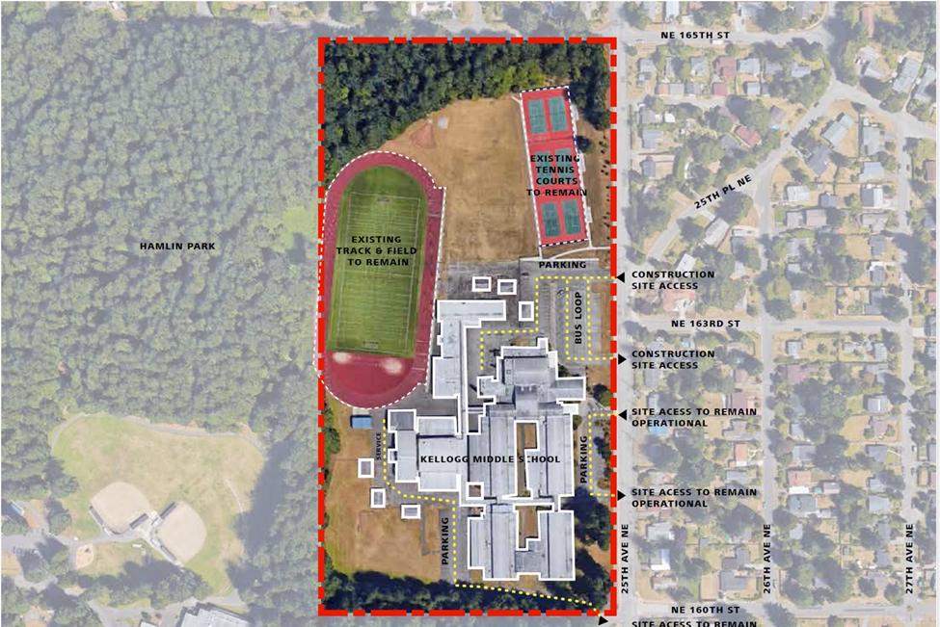
KELLOGG SITE (EXISTING)
Notes:
Dan to cover

Slide 12



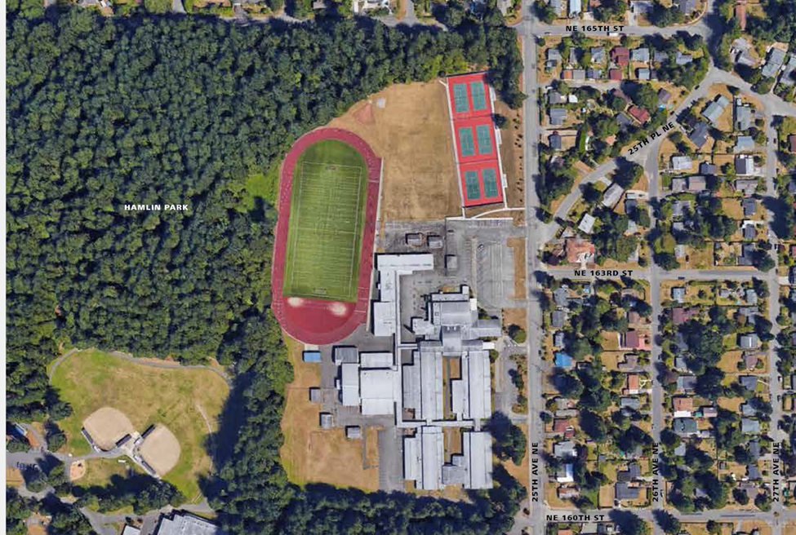
KELLOGG COMPLEXITIES
$55.6 MACC
150,000 s.f. of new school
Adding 6th Grade to Middle School Campus
Hamlin Park borders three sides
Residential Neighborhoods to East
Site Access
Maintain existing tennis courts, track, field
City and YMCA partnerships
Notes:
Dan to present
Overview what’s going into the school, as well as what is happening in/around it
Review Hamlin Park, YMCA/City of Shoreline
New school will hold approximately 1,000 students

Slide 13
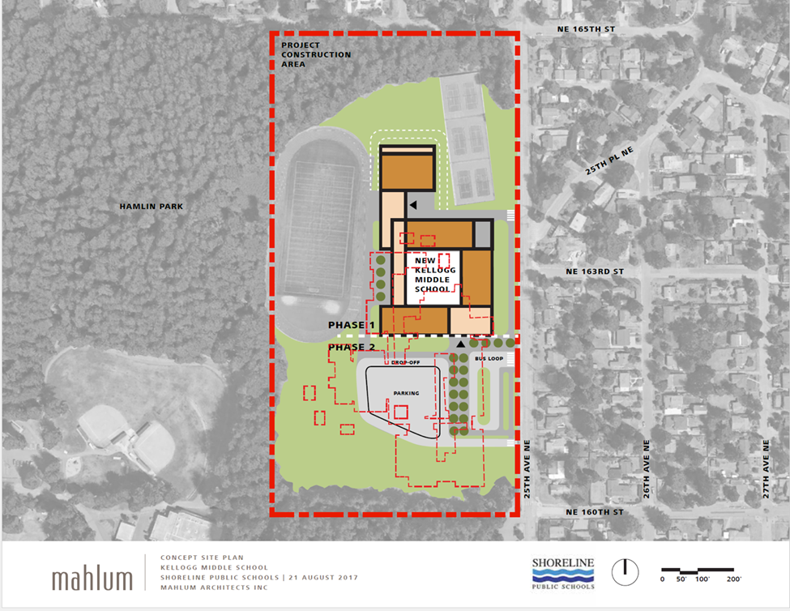
KELLOGG SITE
Existing Tennis
Courts
Neighboring Park
Existing Track
&
Field
Neighboring
Residential Community
Notes:
Dan to present

Slide 14
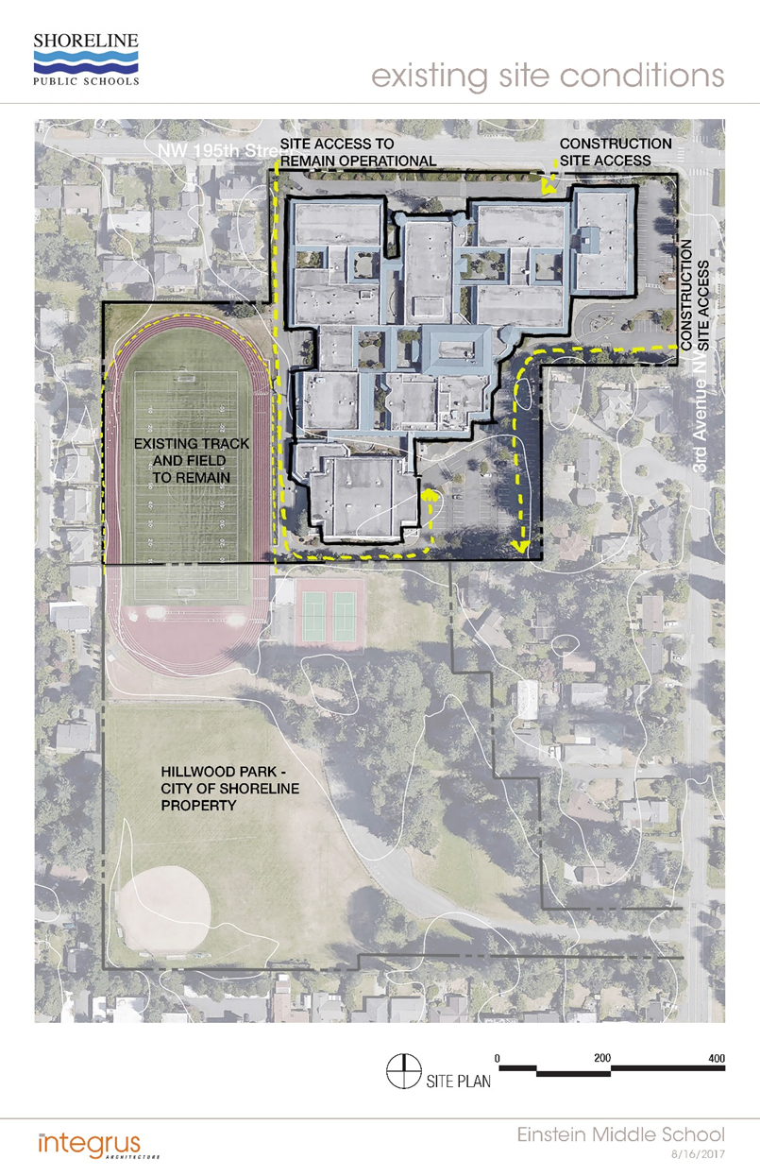
EINSTEIN SITE (EXISTING)
Notes:
Michael to Present

Slide 15
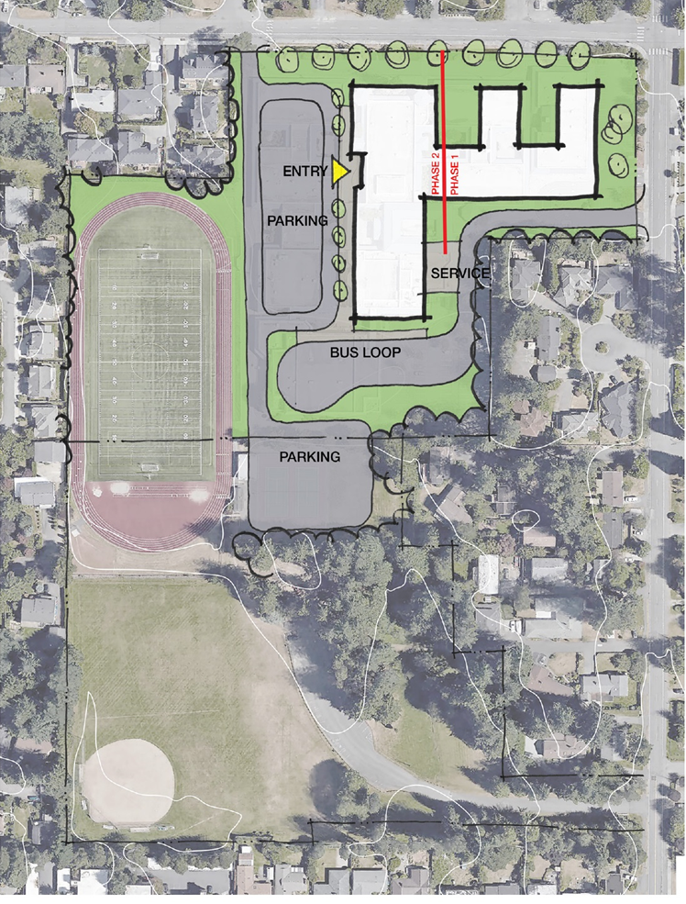
EINSTEIN SITE OVERVIEW
Existing Track
&
Field
Neighboring Park
Neighboring Residential Community
Notes:
Michael to Present

Slide 16
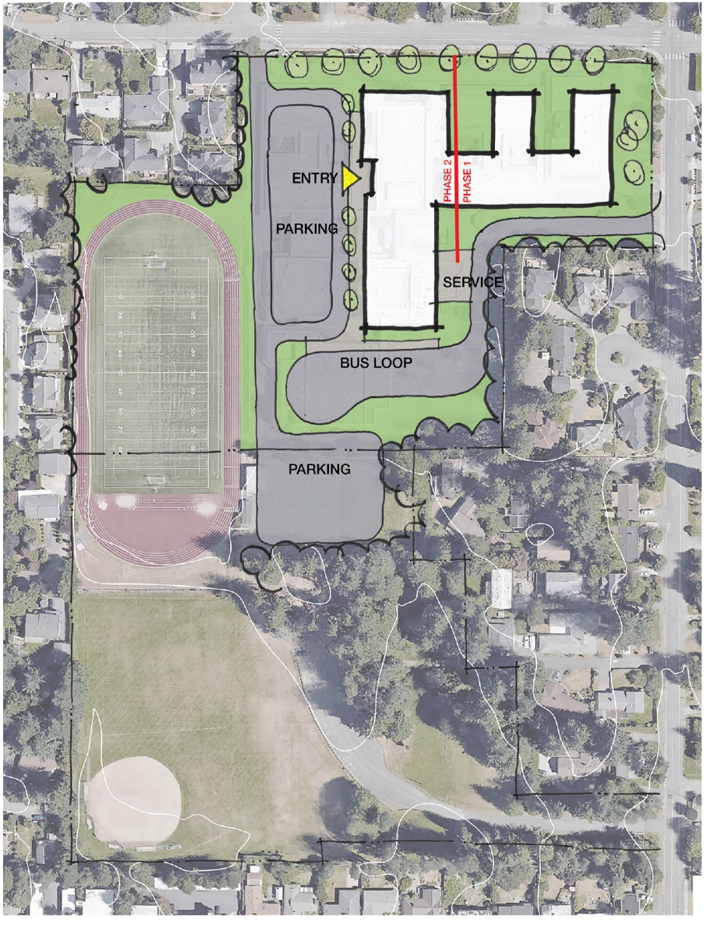
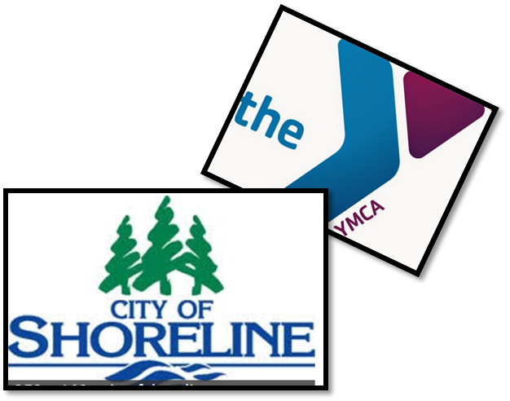
EINSTEIN COMPLEXITIES
$55.6 million MACC
~150,000 SF
Extremely tight site
Hillwood Park is part of site
Borders Track and Field
Construction access
Maintain operations during construction
City of Shoreline and YMCA Partnerships
Notes:
Michael to Present

Slide 17
GC/CM QUALIFICATION
Notes:
Howard

Slide 18
Qualifying Criteria
Complex scheduling, phasing or coordination
Involves construction at an occupied facility
Involvement of the GC/CM during design is critical
Complex or technical work environment-N/A
Historic significance – N/A
Heavy Civil – N/A
Notes:
Howard to Present

Slide 19
Construction at an occupied site: KELLOGG
Temp. Facilities
Temp. Facilities/
Laydown
Notes:
Howard
Construction at occupied campus, phasing options
No impact to Hamlin Park
Maintain Track and Field, and Tennis Courts
No Impact to Surrounding Community
No disruption to YMCA or City of Shoreline partnerships, events, or activities

Slide 20
Construction at an occupied site: Einstein
Notes:
Occupied campus
No impact to Hillwood Park
Maintain Track and Field, and Tennis Courts
No Impact to Surrounding Community
No disruption to YMCA or City of Shoreline partnerships, events, or activities

Slide 21
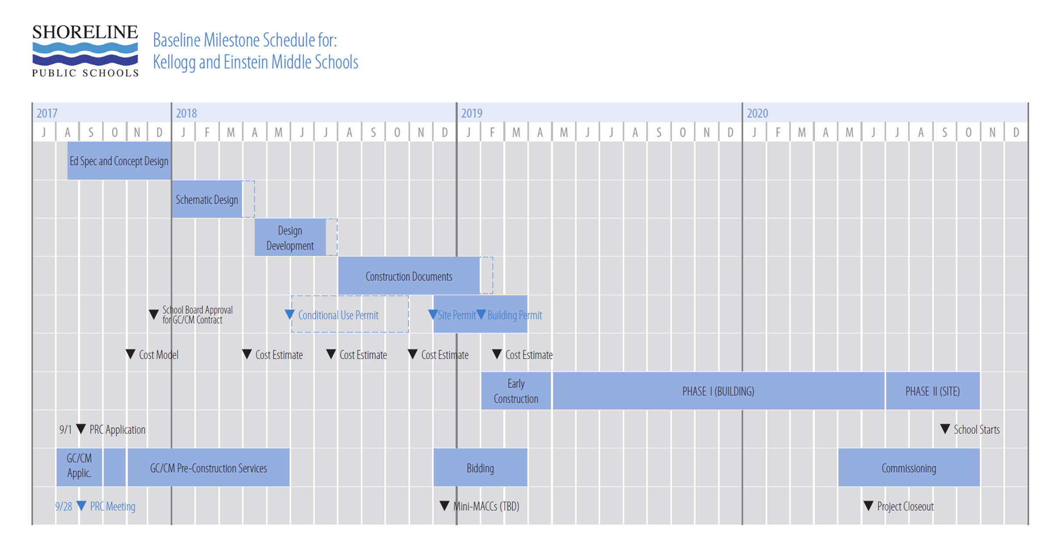
Complex Scheduling
GC/CM Involvement is critical
Occupied Site Phasing Development
VE/Cost Control
Constructability
Both Schools Open September 2020
Notes:
Howard to present
Point out key GC/CM duties beginning with preconstruction

Slide 22
MANAGEMENT AND FUNDING
Notes:
Howard to present

Slide 23
Budget, Funding & Schedule
Project is fully funded by February 14, 2017 Bond Issue
Budget includes adequate contingencies
  GC/CM Contingency - 3%
  Owner Contingencies:
    Construction Contingency - 7%
    Project & Program Contingencies - 3%
GC/CM Selection:
  Both projects will be procured in single solicitation
  October to December 2017
  Notification of Most Qualified GC/CM(s) anticipated in early December
  Projects are currently in programming
    GC/CM to begin preconstruction early in Schematic Design phase
Notes:
Howard to present

Slide 24
PUBLIC BENEFITS
Notes:
Michael to present

Slide 25
Public benefitS
Safety
  Construction at occupied campuses
Avoid Construction Disruption to Surrounding Communities
  Public outreach for construction activities at both schools
  Minimize impact to neighborhoods, adjacent parks, and events/after-school programs
Target Schedule
  Build strategic bidding schedules to maximize the market
  Minimize schedule risks
Risk Management
  Create mitigation plans for long lead items during pre-construction
  Team approach for phasing and construction sequencing
Enhanced Cost Control
  Type of structure, packaging (mini MACCs), subcontractor coverage
  Opportunities for bundling work and efficiencies
Notes:
Howard to present

Slide 26
Summary
Meets Three Qualifying Criteria
  Occupied site
  Complex schedule
  Involvement of the GC/CM during design is critical
GC/CM will be under contract by early in Schematic Design phase
Public body is qualified
  Experienced personnel
  Clear and logical management plan
  Necessary funding including contingencies
Public benefits: risk management, time, cost
Notes:
Howard to provide summary

Slide 27
QUESTIONS?

