Slide 1


EARLY LEARNING CENTER
GC/CM APPLICATION TO THE PRC
SHORELINE SCHOOL DISTRICT
May 25, 2017

Slide 2
AGenda
Introductions
Project Background
Meets Applicable Criteria
  Qualifying project
  Management Plan
    Project Team
    Schedule
    Budget
    Funding
  Public benefits
Summary
Notes:
Michael to present

Slide 3
Project Background

Slide 4
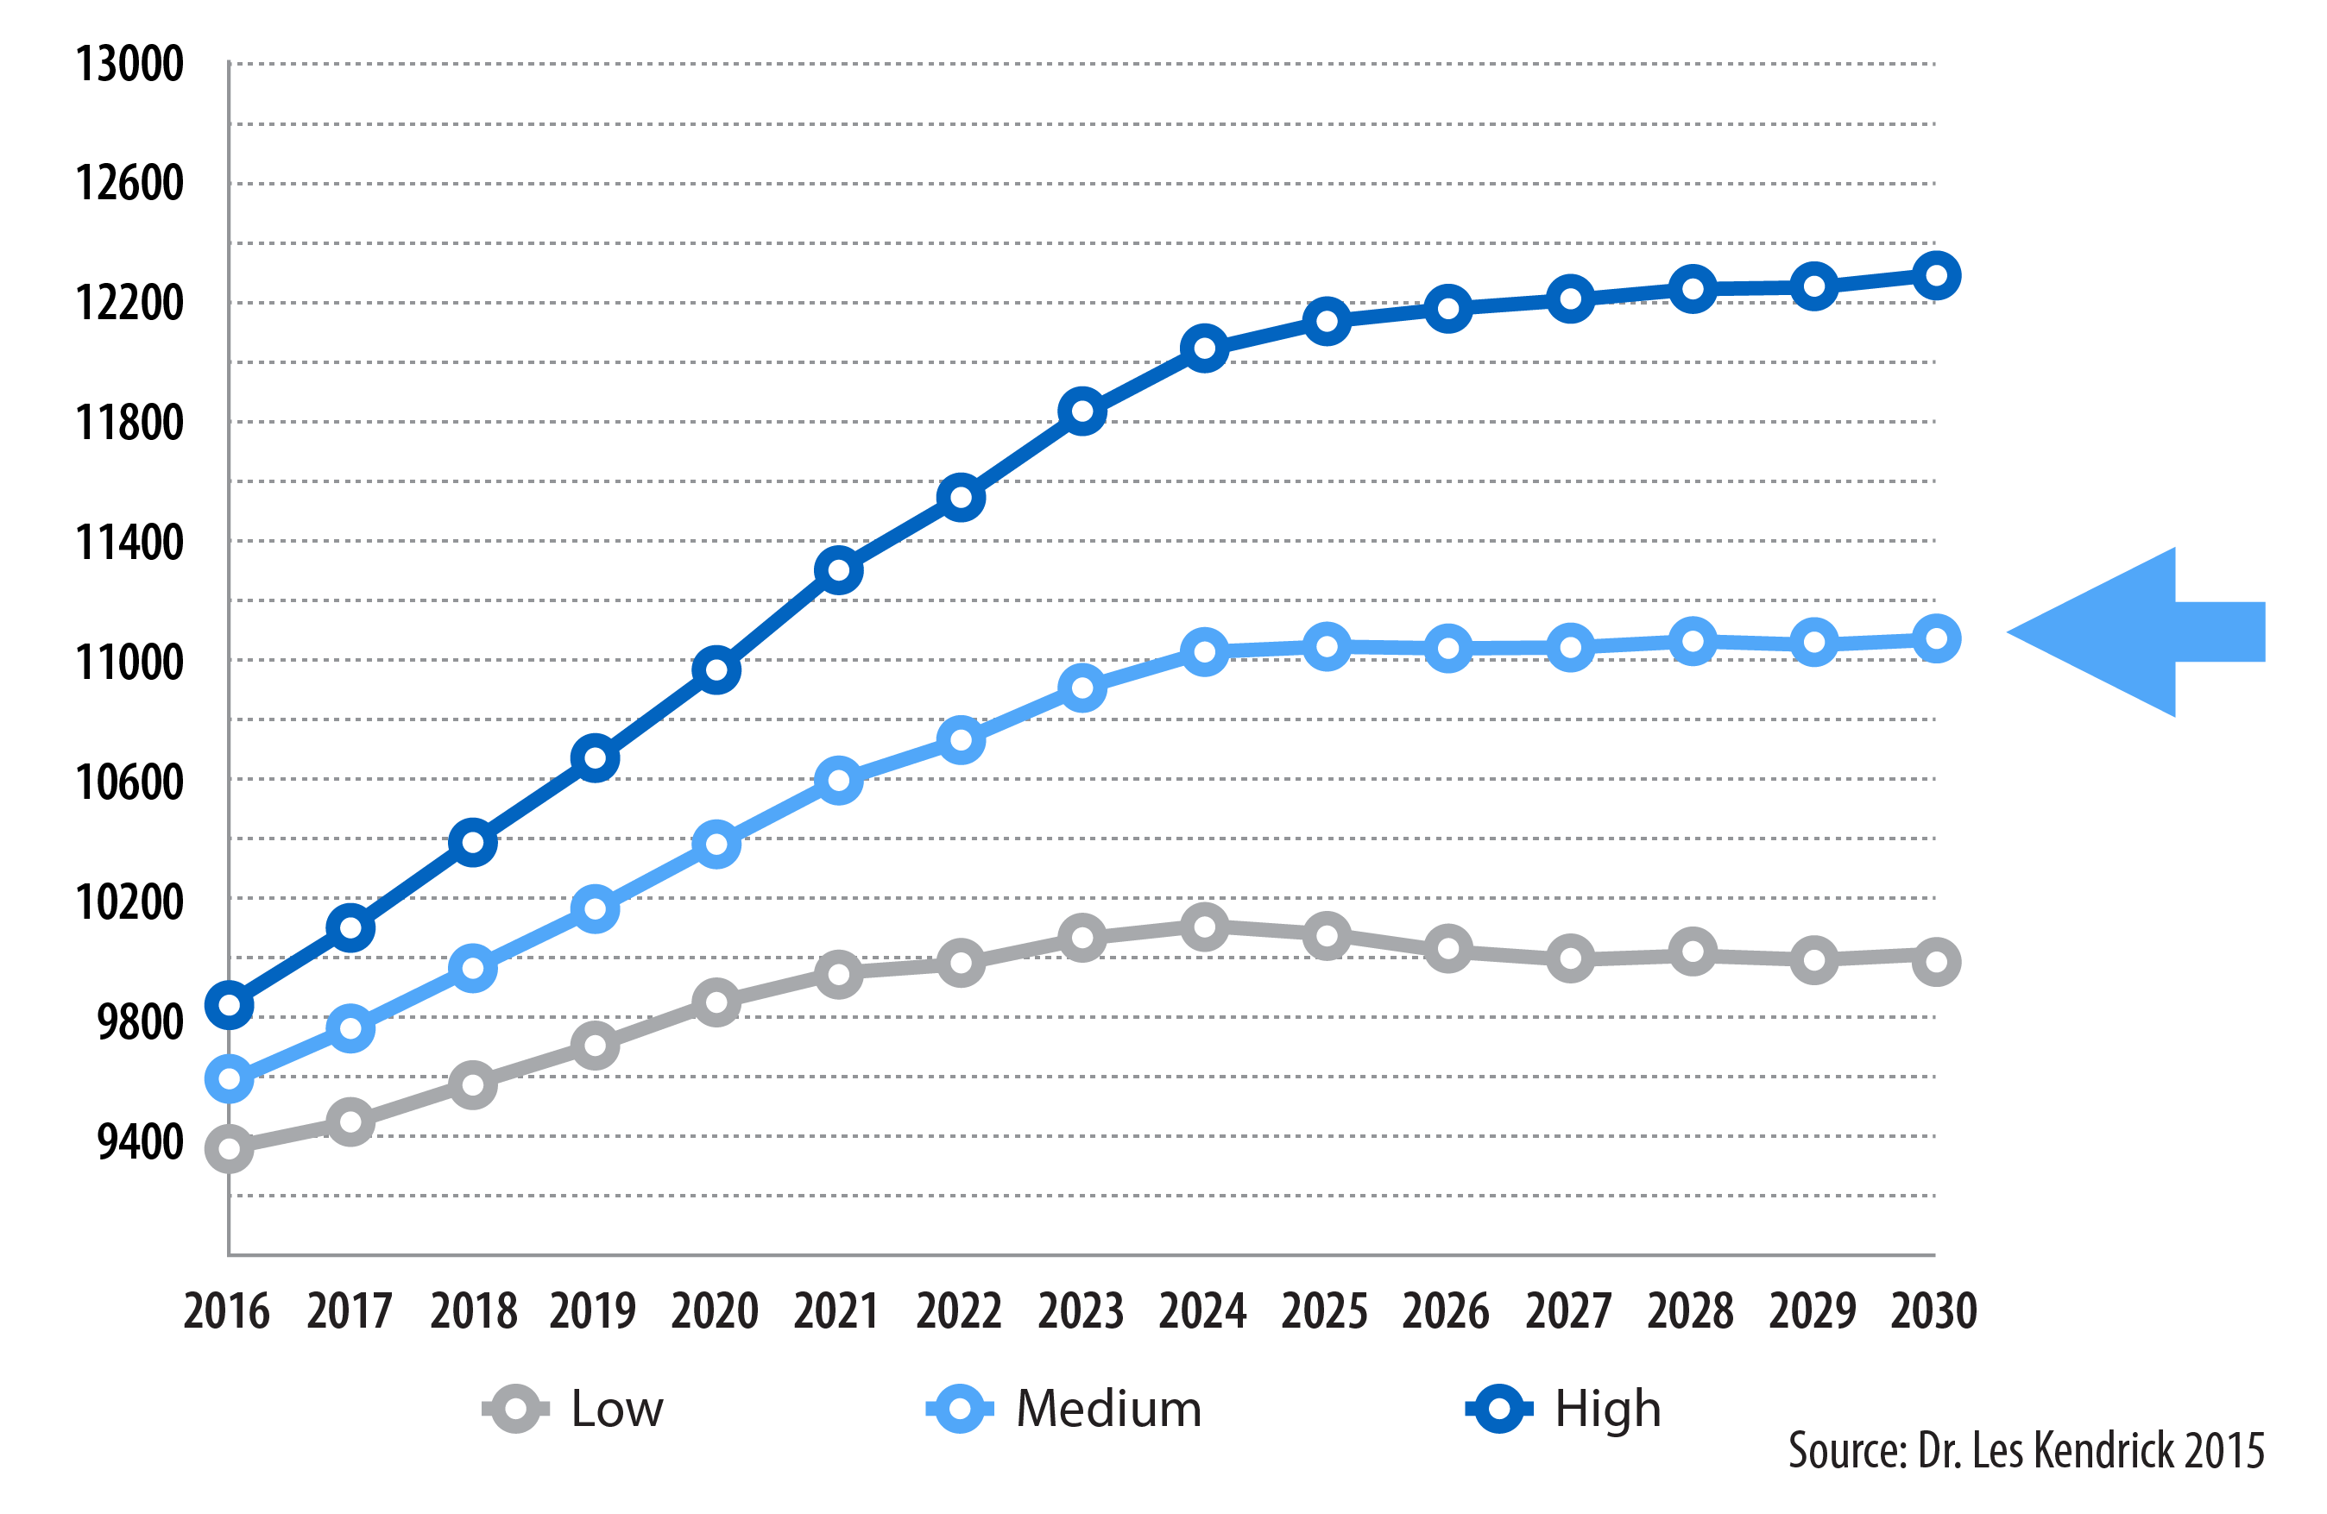
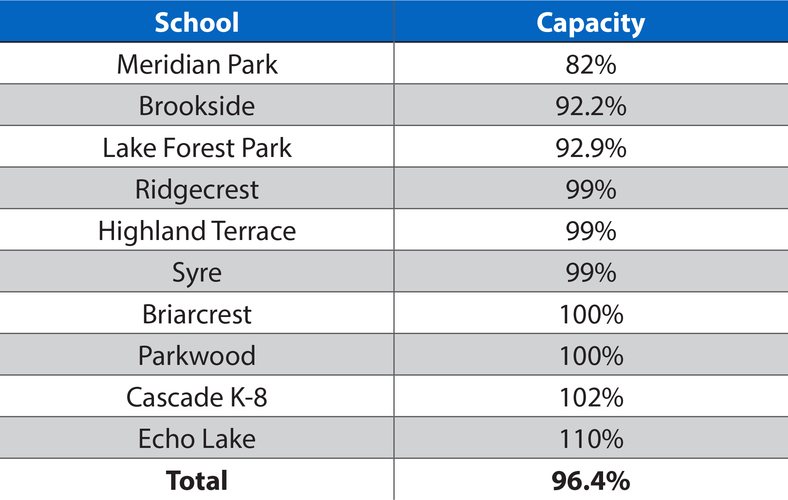
ENROLLMENT IS EXCEEDING CAPACITY
Capacity
Most likely
Bond Issue Approved by voters on February 14, 2017
Notes:
Marla: Focus on bond issue and timeframe and how it relates to capacity and enrollment being full at 2018

Slide 5
Bond Program Plan
2016-17
Early Learning Center Design Phase
North City Renovated as Elementary School
2017-18
Early Learning Center Construction
ELC programs at NC
Parkwood Design Phase
Einstein & Kellogg Design Phase
2018-19
Early Learning Center Opens
Parkwood Elementary at North City
Parkwood Construction Phase
Middle School Construction Phase
2019-20
Parkwood Elementary Re-Opens
Middle School Construction Continues
2020-21
Middle Schools Re-Open
ELC must be complete Aug 2018
Notes:
HH to present
NOTES: 1. Building the Early Learning Center first addresses our school that ranked lowest on the Building Condition Assessment and frees up classrooms at MP in 2017-18.
2. Parkwood opening adds more classroom capacity in Fall 2019 at new PW and at North City.
3. Not having a middle school transition site may be unrealistic.
4. Efficient use of resources for design/construction – single purpose uses of remodeling/construction projects.

Slide 6
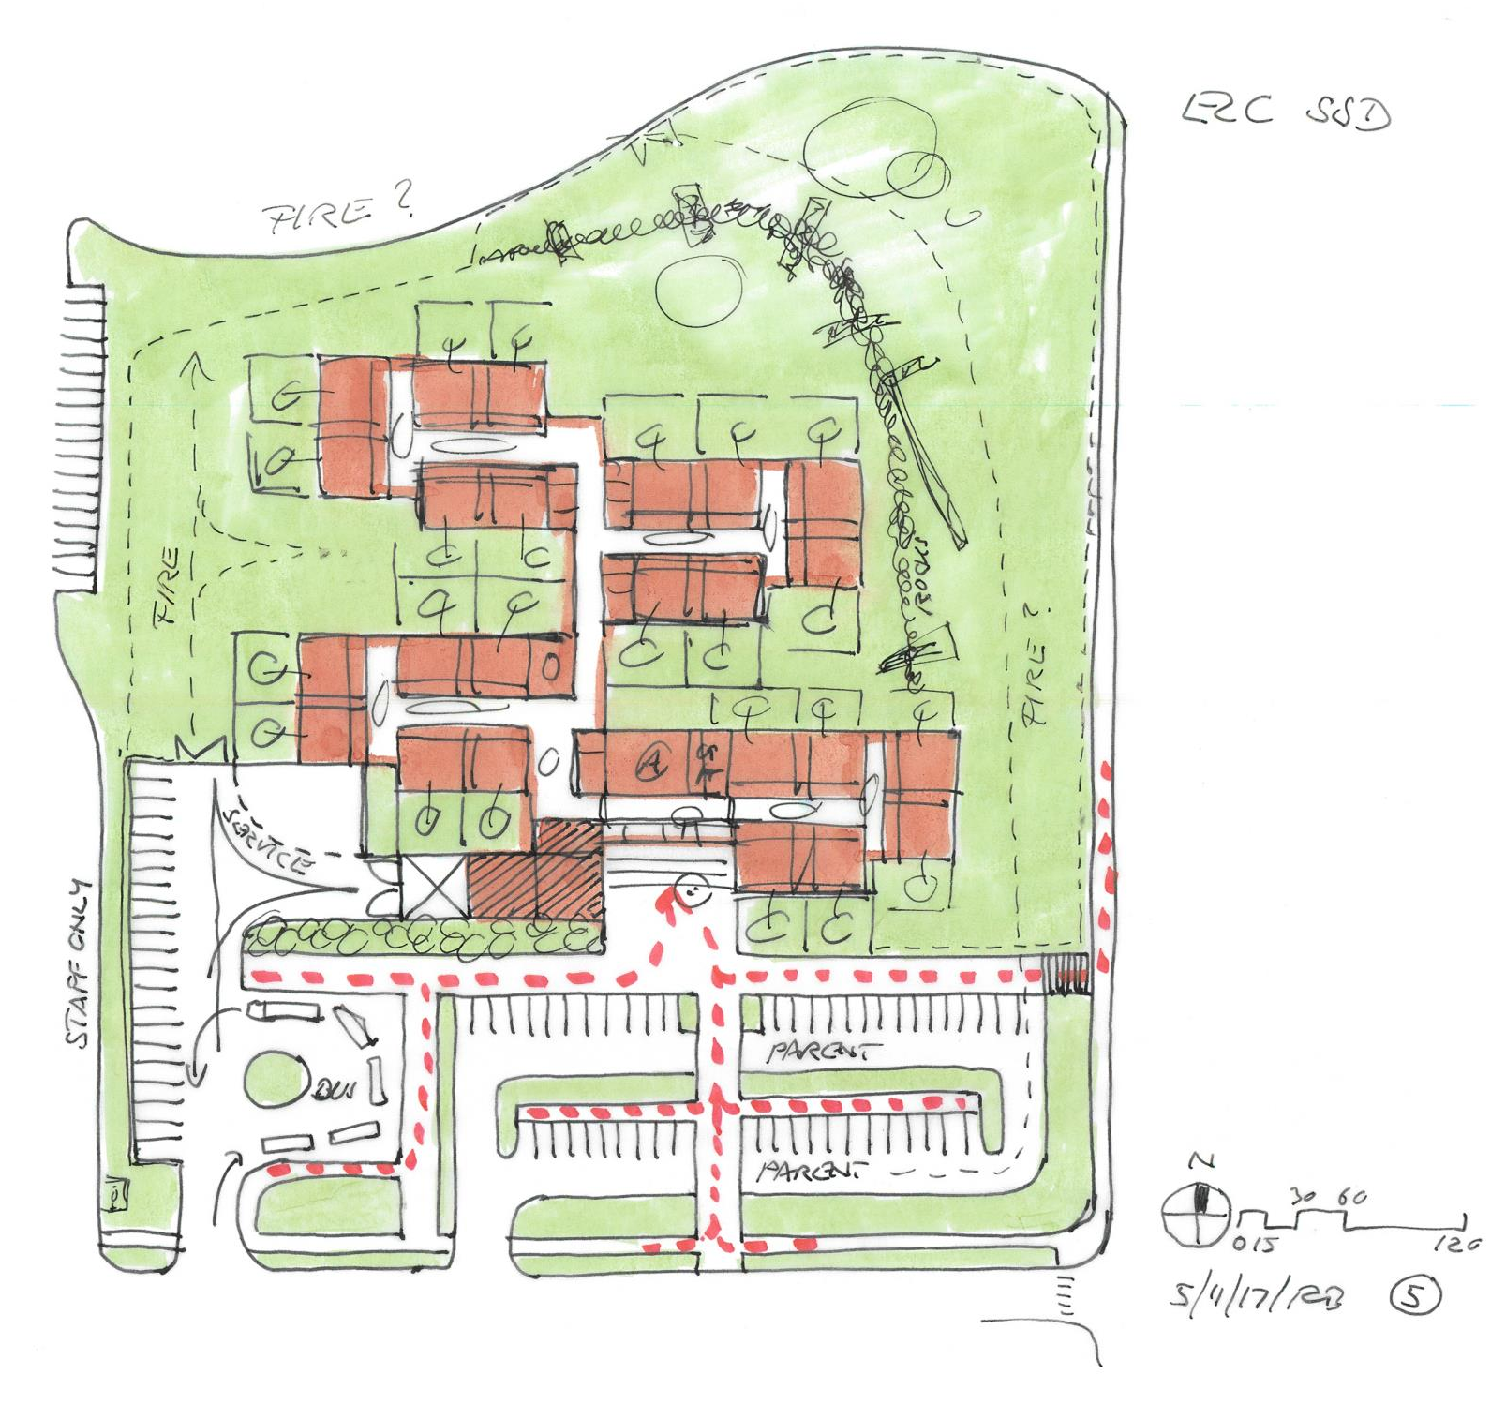
EARLY LEARNING CENTER PROJECT
~45,000 SF
$13-15 million MACC
Facility to house three early learning programs, approximately 450 children and 50 staff
Building to be vacated during construction, beginning end of August
Existing elementary school and ball fields to remain in use
Phased permits anticipated from City of Shoreline
Notes:
Marla to present

Slide 7
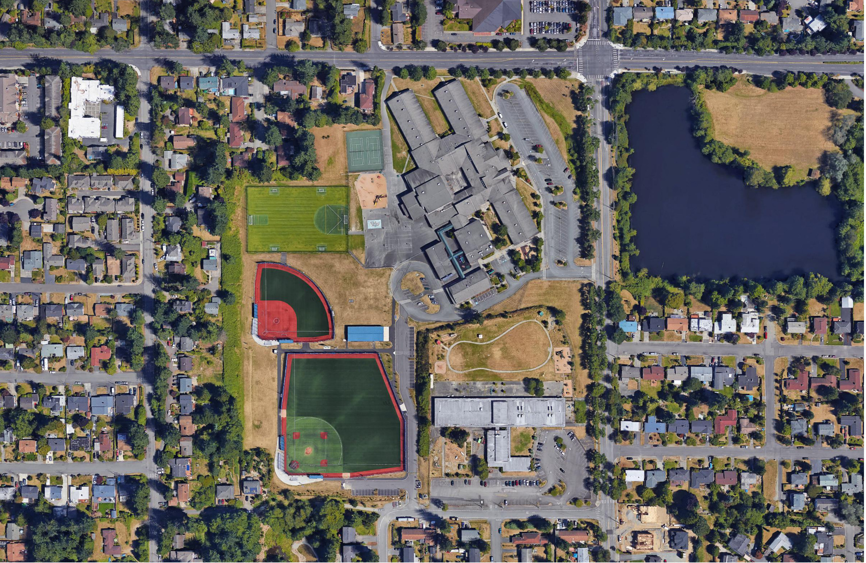
ELC Site
Meridian Park Elementary
Athletic Fields
Early Learning Center
Notes:
Marla to present

Slide 8
GC/CM Qualification
Notes:
HH

Slide 9
Qualifying Criteria
Complex scheduling, phasing or coordination
Involves construction at an occupied facility
Involvement of the GC/CM during design is critical
Complex or technical work environment
Historic significance – N/A
Heavy Civil – N/A
Notes:
HH

Slide 10
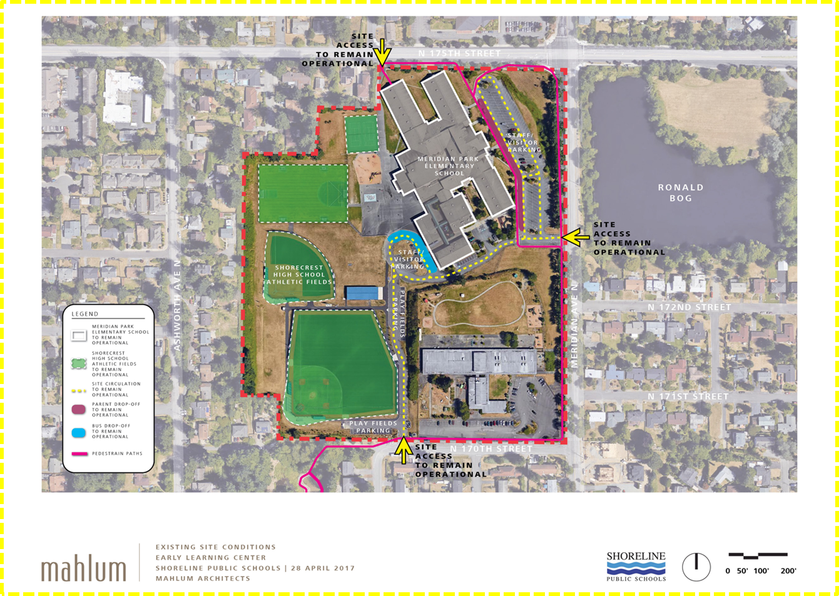


OCCUPIED FACILITY
Maintain Operation
Maintain Operation
Street improvements
Shorewood HS Athletic Fields
Maintain Access
Early Learning Center
PEDESTRIAN PATHS
Notes:
List utilities on site
Discuss access points
Discuss what the City of Shoreline will be doing in ROW and with utilities during construction
Mention careful coordination of shutdowns, etc. due to multi uses of ball fields and elementary school by surrounding community

Slide 11
COMPLEX SCHEDULING
2016-17
Early Learning Center Design Phase
North City Renovated as Elementary School
2017-18
Early Learning Center Construction
ELC programs at North City
Parkwood Design Phase
Einstein & Kellogg Design Phase
2018-19
Early Learning Center Opens
Parkwood Elementary at North City
Parkwood Construction Phase
Middle School Construction Phase
2019-20
Parkwood Elementary Re-Opens
Middle School Construction Continues
2020-21
Middle Schools Re-Open
ELC must be complete by August 2018
Notes:
HH to present
NOTES: 1. Building the Early Learning Center first addresses our school that ranked lowest on the Building Condition Assessment and frees up classrooms at MP in 2017-18.
2. Parkwood opening adds more classroom capacity in Fall 2019 at new PW and at North City.
3. Not having a middle school transition site may be unrealistic.
4. Efficient use of resources for design/construction – single purpose uses of remodeling/construction projects.

Slide 12
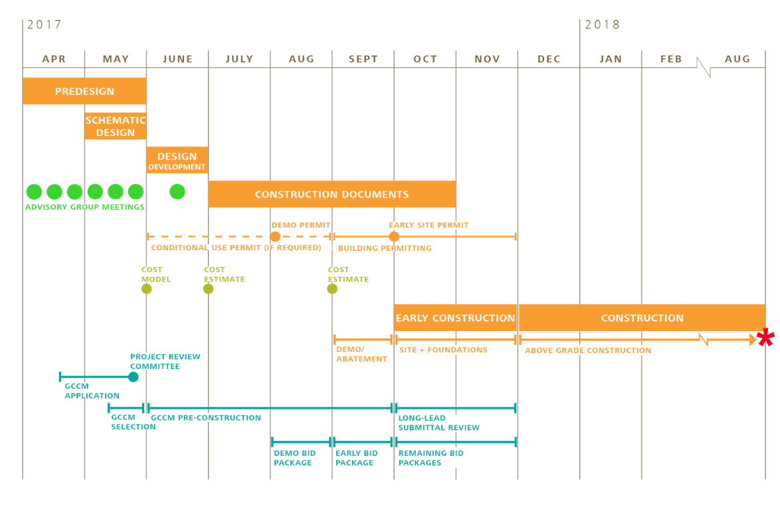
Complex Scheduling
GC/CM Involvement is criticAL
Notes:
HH

Slide 13
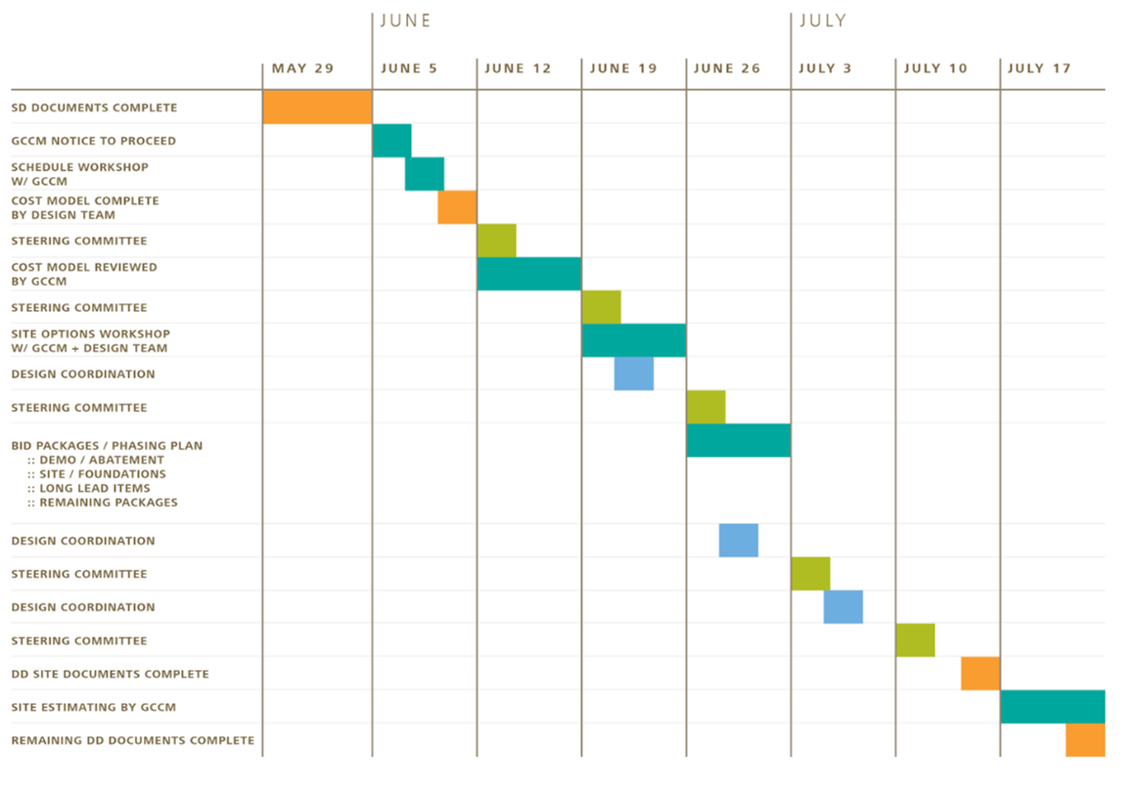
GC/CM Involvement is criticAL
Notes:
HH
List utilities on site
Discuss access points
Discuss what the City of Shoreline will be doing in ROW and with utilities during construction
Mention careful coordination of shutdowns, etc. due to multi uses of ball fields and elementary school by surrounding community

Slide 14
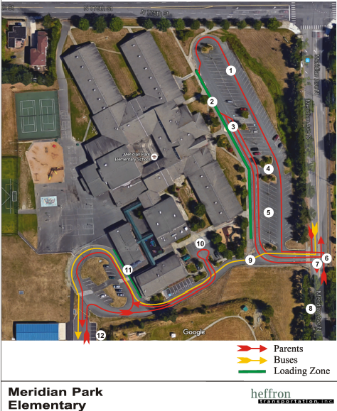
Complex or technical environment
High volumes of parent-vehicle drop-off (AM)/pick-up (PM) for enrollment level compared to typical rates
  Peak flow of students arriving: 8:50 and 9:10 A.M
  Peak afternoon pick-up: 3:15 and 3:45 P.M.
  Primary loading zone (460’ long) where most parents unloaded/loaded in AM and PM.
  Loading zone tends to fill up completely about 20 minutes before students are dismissed in PM
Queuing of vehicles on southbound Meridian could impact construction deliveries and access to site
  Limited adjacent areas where parents can wait in PM prior to picking up students
Seasonal events, baseball games, and community gatherings will be occurring at the ball fields and elementary school
City of Shoreline will be commencing ROW utilities and roadway work during the summer of 2017
Sound Transit Lynnwood Link
Notes:
HH

Slide 15
Management and Funding
Notes:
Michael to present

Slide 16
Budget, Funding & Schedule
Project is fully funded by February 14, 2017 Bond Issue
Budget includes adequate contingencies
  GC/CM Contingency
  $0.4m (3%)
  Owner Construction Contingency $1.1m (7%)
  Owner Project & Program Contingencies $0.4m (3%)
Schedule:
  GC/CM will be on board at beginning of Design Development
  Mini-MACCs will allow final MACC to be negotiated in late Fall 2017
Notes:
Michael to present

Slide 17
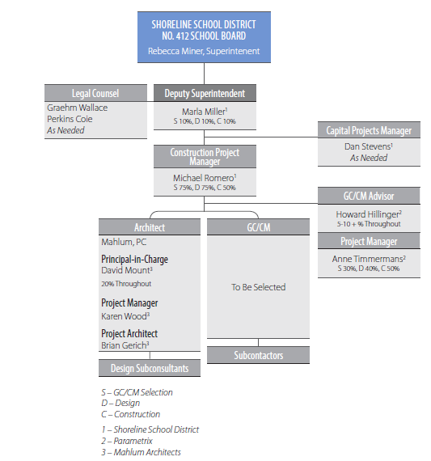
TEAM ORGANIZATIONAL CHART
Parametrix staff available to increase involvement as needed
Notes:
Michael to present

Slide 18
Project team
Marla Miller, Shoreline Public Schools Deputy Superintendent
  20+ years experience in school construction
  GC/CM experience – Meadowdale Middle School, Edmonds S.D.
Michael Romero, Shoreline Public Schools Project Manager
  18+ years experience in school and public construction
  Completed AGC UW GC/CM workshop
Dan Stevens, Shoreline Public Schools Manager of Capital Projects
  30+ years experience in construction
  Registered for June 8 AGC GC/CM workshop
Howard Hillinger, Parametrix
  31+ years PM-CM experience, CCM
  GC/CM: 10 projects including Tacoma Schools and WSF Colman Dock
  Member: PRC, GC/CM Heavy Civil Task Force
Anne Timmermans, Parametrix
  15 years PM-CM experience, CCM, LEED AP BD+C
  GC/CM experience: Port of Seattle Rental Car Center and North Satellite Renovation projects
David Mount, Mahlum Architects
  23+ years experience
  GC/CM experience – Seattle Public Schools, Edmonds School District, Issaquah School District, Western Washington University
Graehm Wallace, Perkins Coie
  Legal counsel
  Extensive GC/CM experience
Notes:
Michael to present

Slide 19
PUBLIC BENEFITS
Notes:
Michael to present

Slide 20
Public benefitS
Schedule
  Avoids additional year of escalation and cost of temporary facilities
Risk management
Enhanced Cost Control
  Type of structure, packaging, subcontractor coverage
Predictable schedule management
Notes:
Michael to present

Slide 21
Summary
Meets Four Qualifying Criteria
  Occupied site
  Complex schedule with multiple linkages
  Technically complex
  Involvement of the GC/CM during design is critical
GC/CM will be under contract by 30% design
  Target date is June 5, 2017
Public body has necessary management plan
  Experienced personnel
  Clear and logical management plan
  Necessary funding and budget includes contingencies
Public benefits: risk management, time, cost

Slide 22
Questions?

