Slide 1
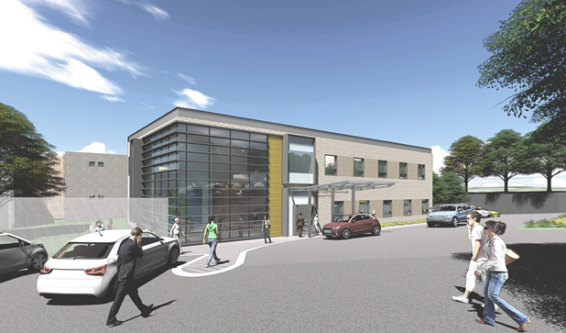
Application for Project Approval
Snohomish County
North Sound Behavioral Health Treatment Facility
Notes:
Dave
Thank you,
Introduce attendees
Jennifer
Who the building serves
Why is the project needed
2 minutes

Slide 2
Agenda
Scope
Schedule
Budget and Funding
Team
Meets Statute Requirements
Questions
Notes:
Dave
Reviews agenda

Slide 3
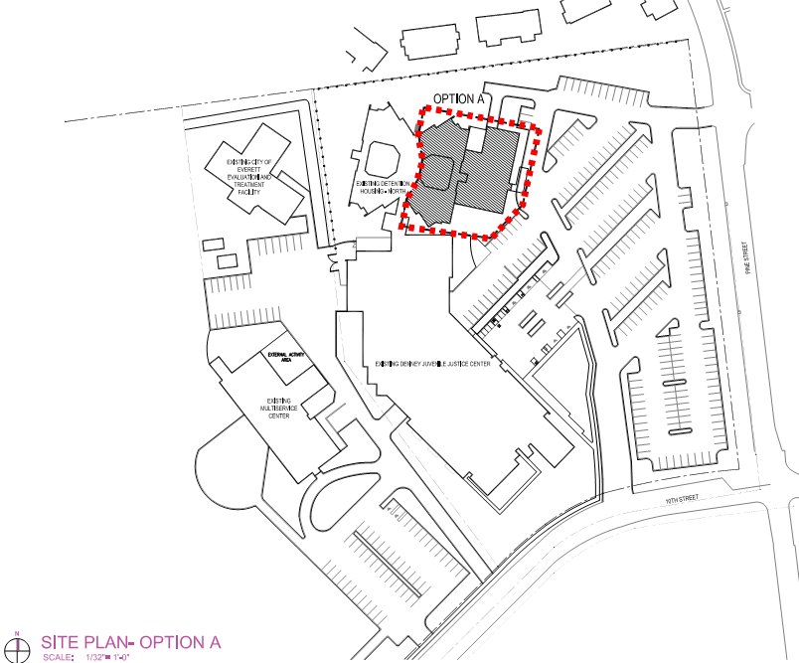
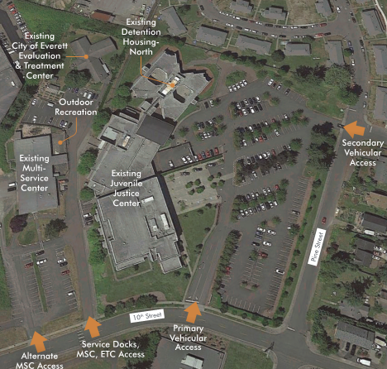
Scope
Notes:
Chris
Brief comment on location
15 seconds

Slide 4
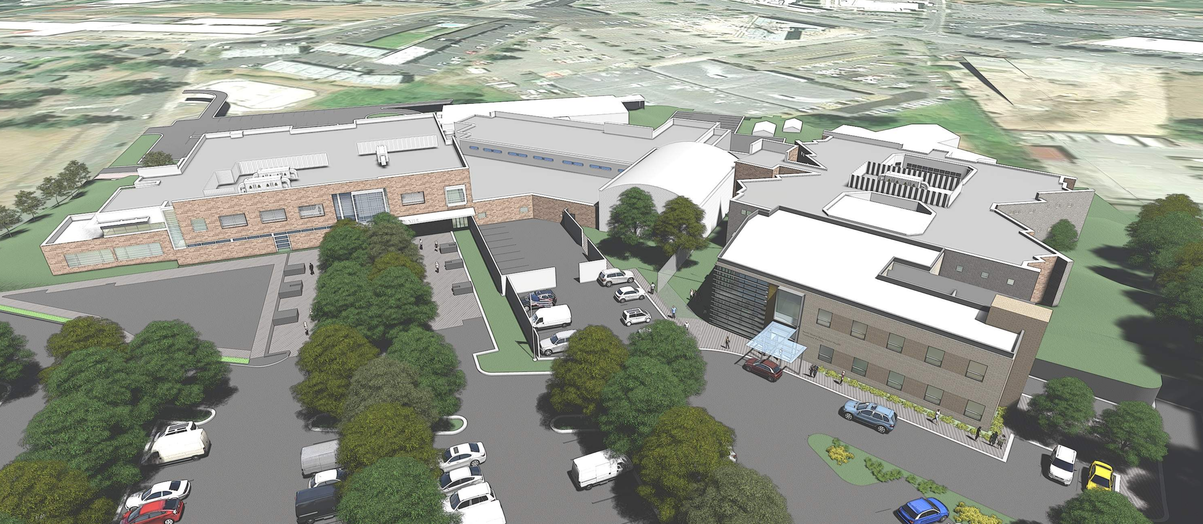
Scope North Sound Behavioral Health Treatment Facility
Notes:
Chris
Review current process on user programming and scoping efforts
Site constraints
2 minutes

Slide 5
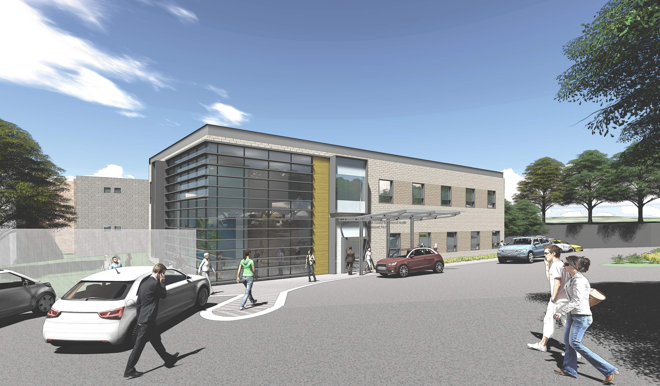
Scope
Addition & Renovation to the North Wing of the Existing Denney Juvenile Justice Facility
Addition SF: 10,201
Renovation SF: 13,732
Total SF: 23,933
Two Separately Operated 16-bed Facilities
Shared Clinical Support, Administrative Functions, Facility Support Services
Notes:
Chris
Outline overall project scope
County’s focus on delivery, tight budget, program
Work at occupied building
Potential for construction impact on users
Starting entitlement process (pre-app, SEPA, NCU modification)
2 minutes

Slide 6
Schedule
SCHEDULE EVENT | START | FINISH
PRC Application | 4/20/2018 | 4/20/2018
PRC Meeting | 5/24/2018 | 5/24/2018
Preliminary Design | 1/5/2018 | 4/25/2018
GCCM Procurement & Contracting | 5/25/2018 | 7/24/2018
Design | 4/26/2018 | 1/11/2019
Final Estimate and Validation | 1/12/2019 | 2/11/2019
Negotiate GMP / Approval | 2/12/2019 | 3/14/2019
Construction | 3/15/2019 | 3/14/2020
Cx / Systems Training / Shake-down | 3/15/2020 | 4/14/2020
Move-in, Furnish, Set-up, Closeout | 4/15/2020 | 6/14/2020
Notes:
Dave
Overview schedule,
Early assembly of team to focus on
Budget, Scope, Design and Construction Delivery
MCCM / ECCM team assembly to work with design team on best / efficient systems
2 minutes

Slide 7
Budget
Costs for professional services (A/E, legal, Cx, testing & inspections etc.) | $1,500,000
Estimated project construction costs (including construction contingencies): | $9,500,000
Equipment and furnishing costs | $600,000
Off-site costs | $500,000
1% for art | $95,000
Contract administration costs (owner, cm, etc.) | $750,000
Contingencies (design & owner) | $950,000
Sales tax | $1,105,000
Total approved budget | $15,000,000
Notes:
Jennifer
Overview of funding authorization
User / stakeholder group communication & coordination
Dave
Development budget put together, tight, $15M
Early scope and budget definition / confirmation is critical to the success of the project.
GCCM team on board early will assist in design / scope decision making to help guide the design to maintain budgets
Strong GCCM with tested preconstruction experience
Immediate budget / scoping evaluation after award
2 minutes

Slide 8
Project Team
Notes:
Jeff
Review project team focus on:
Managing users, stakeholders
OAC augmenting SnoCo with juvenile justice, healthcare, GCCM expertise, PM support and day / day management of teams
KMD strong behavioral health expertise, excellent designers, collaborative team (Skagit Valley 2003 GCCM)
MCCM / ECCM involved early with MEP designers to facilitate early design, long lead procurement, possible design assist delivery of documents.
2 minutes

Slide 9
Project Management Expertise
Project Leadership
Jeff Hencz—Snohomish County
Special Projects Manager
30 year industry veteran
Extensive negotiated delivery experience
GCCM trained and Courthouse experience
Dave Jobs—OAC Services, Inc.
Sr. Associate, Program Manager
25 year industry veteran
DBIA Certified, CCM, extensive alternative delivery experience
Healthcare and Juvenile Justice
Chris Rubright—KMD Architects
Principal, Director of Healthcare Planning
30 year industry veteran
Behavioral health
GCCM delivery
Kenmore’s downtown development
Notes:
Jeff
Highlight leadership team of Jeff, KMD and OAC
Collaborative efforts
Jeff and OAC have worked together for 5 years
KMD…add Chris
1 minute

Slide 10
Project Management Expertise
Project Support
Dan Chandler, OAC Services
Principal
30 years industry experience
Extensive alternative delivery expertise
Healthcare and Juvenile Justice
John Parnass, Pacifica Law Group
Partner
Extensive GCCM expertise
Notes:
Dave / Jeff
Highlight support team of GCCM experts
Dan and John involvement:
RFQ, agreement and selection process
Dan will provide advisory support if needed
John will provide guidance to County
30 seconds

Slide 11
Exceeds Statute Requirements
RCW 39.10
Complex phasing and scheduling
Addition and renovation to existing, operating and secure facility
GCCM involvement in design is critical
Project involves complex and technical environment
Notes:
Dave
Talk about how this project meets criteria for GCCM delivery
2 minutes

Slide 12
Public Benefit
RCW 39.10
Increase predictability of delivery and reduce financial risks
Likely to attract a more highly qualified construction team
Planning, coordinating and executing complex building systems is best done with collaboration between designers and builders
Notes:
Dave
Expand on bullet points
1 minute

Slide 13
PRC Application for Project Approval
Questions?
Notes:
Dave
1 minute

