Slide 1


City of Spokane Parks & Recreation
Project Review Committee | Project Approval Process
December 1, 2016

Slide 2
Pavilion Overview
Repurpose Iconic 1974 Worlds Fair Pavilion
  Create outdoor venue and public plaza for community events, sporting exhibitions and performing arts
  Renovate west pavilion building for administration offices and outdoor venue support
  Create Central Green Plaza to draw visitors from Howard Street Promenade to the Pavilion
  Demolish Imax, skating venue, east pavilion building and other structures
  Perform cable structure deferred maintenance

Slide 3
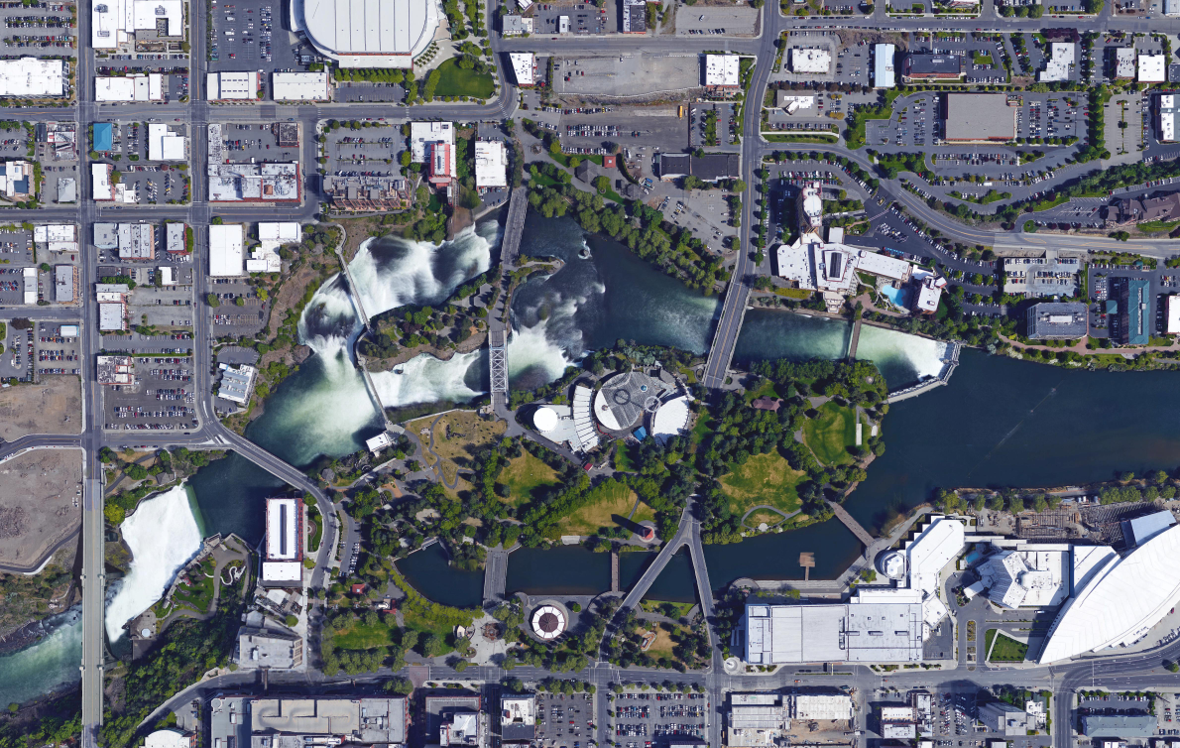
Riverfront Park Map
NORTH BANK PROJECT
NORTH PROMENADE
PROJECT
BLUE BRIDGE
PROJECT
WEST HAVERMALE
PROJECT
PAVILION
PROJECT
HOWARD STREET SOUTH BRIDGE
PROJECT
ICE RIBBON
SKYRIDE PROJECT
LOOFF
CARROUSEL
PROJECT
Notes:
Ice Ribbon, Howard St. Bridge, Looff Carrousel (south bank) projects complete 2017
Pavilion Renovation: fall 2017 - 2018
North Bank: Spring 2018 - 2018
Blue Bridge Replacement: Mid 2018 - Mid-2019
West Havermale: Mid 2019 – Spring 2020
North Promenade: Mid 2019 – Spring 2020

Slide 4
Organizational Chart
Notes:
BD – Overall park authority
ET - Program decision making authority / ET member composition
PMO – Program implementation / Staff + Hill
PM – Responsible for day-to-day pavilion operations / Matt Walker

Slide 5
Pavilion Project Budget
  Professional Services $ 1,780,000
  Construction Cost $ 12,986,000
  Owner FFE $ 825,000
  Contract Admin/Other $ 400,000
  City Contingency $ 1,742,000
  Other Related Project Expenses $ 702,000
  WSST $ 1,260,000
  Total Project Cost $ 19,695,000

Slide 6
Schedule
  PRC Presentation Dec 1, 2016
  D-B RFQ Advertisement Dec 5, 2016
  D-B SOQ Due Jan 9, 2017
  Shortlist Finalist Jan 19, 2017
  Issue RFP Jan 26, 2017
  Proposal Due Mar 6, 2017
  Selection of D-B Team Mar 17, 2017
  Notice to Proceed Mar 31, 2017
  Design Phase Apr 2017 thru Feb 2018
  Construction Phase Oct 2017 thru Dec 2018
  Close Out Phase Jan 2019 thru Mar 2019

Slide 7
Procurement Approach
  Request for Qualifications
    Successful Experience with Renovation Projects of Similar Scope and Complexity
    Team Organization
    Experience developing GMP collaboratively with Owner
    Shortlist no more than five finalists
  Request for Proposal
    Management approach specific to the project
    Innovation and Problem Solving
    Interactive Proprietary Meetings
    Price related factor: Fee
    $10,000 - $15,000 honorarium
      Limited required proposal submittals
      Consistent with other projects

Slide 8
Design-Build Agreement
  Validation and GMP Development Period
  Validate information from the Owner.
  Examines options to identify innovation
  Commercially reasonable examination of site
  Develop Basis of Design Documents, Project Schedule, GMP
  Contract Amendment
  2. GMP Execution Period
Complete Design
Construction
Close out

Slide 9
Benefits of Design-Build Delivery
RCW 39.10.300(1)(b) “Greater Innovation or efficiencies between the designer and the builder”
  Maximum possibility for coordination of design, demolition and construction phasing to provide greatest project value and cost efficiency
RCW 39.10.300 (1)(c) “significant savings in project delivery time”
  Progressive Design-Build is the fastest delivery method. Starting demolition work prior to completion of design is beneficial to the schedule
RCW 39.10.280(2)(a) “Substantial Fiscal Benefit”
  The budget is limited to fit within the City’s project budget. The Design-Builder will be required to design within that budget.
  The Design-Builder’s involvement in the development of the scope shifts more risk of the performance of the project to the design-build team
  With one team managing the coordination of the various aspects of the project the City’s risk of claims by various contractors performing adjacent projects are reduced.

Slide 10
Additional Questions
High overhead maintenance work: steel cable system. Early design-builder involvement: cost-effective and safest method
Adjacent concurrent bridge work: replacement of the Howard Street mid-channel bridge. Design-builder greater collaboration; reduce potential conflicts
Roles and responsibilities of key PMO team members:
Garrett Jones, Park Department Liaison
Berry Ellison, Program Manager
Jo-Lynn Brown, Program Coordinator.
Matt Walker, Project Manager
Lorraine Mead, Program Scheduler
Time commitment of key project team members
City PMO staff (Berry and Jo-Lynn) hired to manage the Riverfront Park program. Projects are phased
Hill’s Pavilion contract amendment reflective of Org Chart percentages.

Slide 11
Cont’d Additional Questions
How will decision making work, who will contractor interface with and how will decisions be made without delay to the project?
PMO makes recommendations weekly to the executive team (ET). Matt Walker communicates direction to the design–builder.
When Park Board design/contract approval required; ET make recommendations to the Park Board. Matt Walker will communicate direction to design–builder.
Contract/amendment approval protocol - establishes PMO and ET dollar limits for contract modifications. Special board meetings to expedite approval when necessary.

Slide 12
Thank you!

