Slide 1

Spokane Valley Fire Department
Application for Project Approval for Progressive Design Build
New Maintenance Facility
January 23, 2020
Notes:
Tim to do brief introductions and thank the PRC panel etc.

Slide 2
Agenda
  Team
  Scope
  Why PDB
  RCW 39.10
  Schedule
  Budget and Funding
  Questions
Notes:
Tim to briefly address.

Slide 3
Project Team
Damon Gardella has been removed from the org. chart that was included in the PRC Application
Notes:
Tim to talk about the team and the roles. Tim to explain his background on construction projects and what his role was. Each person to do a brief introduction of themselves. Tim emphasize his past with OAC, and why he is working with us.

Slide 4
Scope of Maintenance Facility
New 10,000 sq. ft. five (5) bay Maintenance Facility
New greenfield eight (8) acre site
Extended bays to accommodate tiller trucks
“Drive through” bays for accessibility and safety
New Facility will increase “in-house” services
Notes:
Tim to discuss the inadequacies of existing maintenance facility and what the new one will offer.

Slide 5
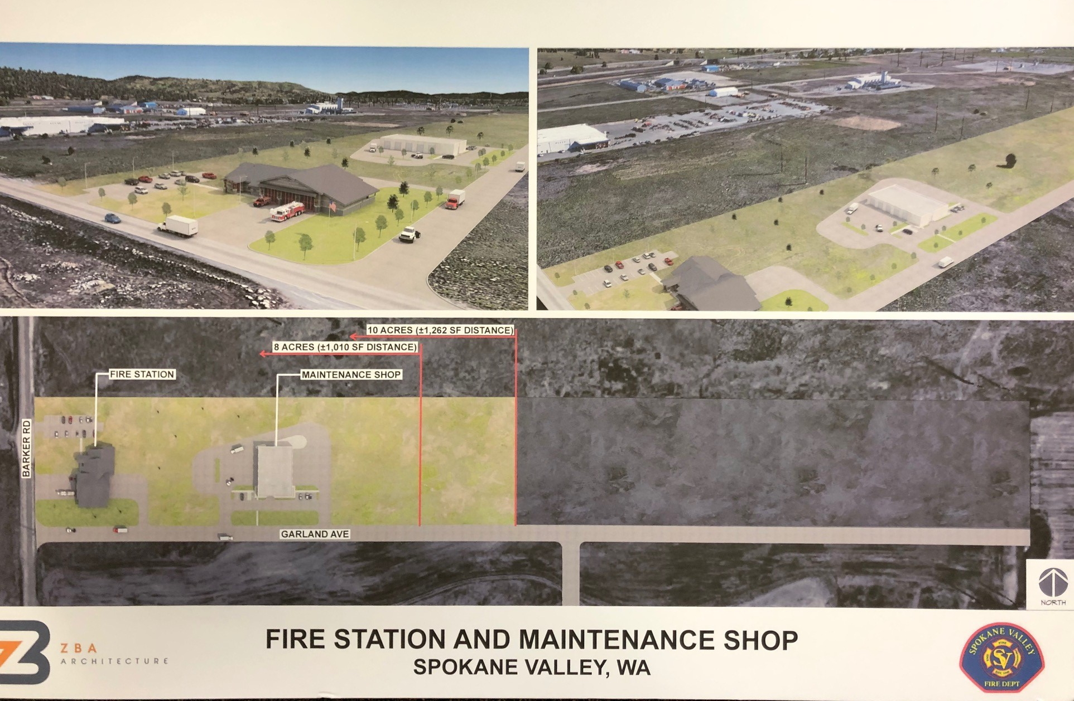
Site Plan Renderings
Notes:
Tim to talk about the project and the needs.

Slide 6
Why Progressive Design Build?
Predictability: Align Budget and Scope
Efficiency and Innovation: Design Development
Time to Market and Expedited Schedule
Early Cost Certainty
Single Point of Responsibility for Owner
Notes:
Tim speak to the plan with assistance from Jonathan and Dan. Side note: Spokane market is well suited for design build with experienced firms.

Slide 7
RCW 39.10.300
The project meets 2 of 3 criteria of the RCW:
This project will be provided opportunity for greater innovation and efficiencies…
This project will realize significant savings in project delivery time…
Notes:
Jonathan to cover why and how the project meets RCW 39.10.300. Dan to expand if needed.

Slide 8
Maintenance Facility Schedule
Description* | Duration | Start | Finish
PRC Meeting/Approval Letter | 1 day | 1/24/2020 | 1/24/2020
Draft RFQ/Ad/Outreach/Q&A | 4 weeks | 1/27/2020 | 2/21/2020
PDB RFP Process | 4 weeks | 2/24/2020 | 3/20/2020
PDB Interviews | 3 weeks | 3/23/2020 | 4/10/2020
Design Builder Selection | 1 day | 4/10/2020 | 4/10/2020
PDB Contracting | 3 weeks | 4/13/2020 | 5/01/2020
Early Site Package Design | 3 months | 5/04/202 | 8/01/2020
Early Site Package Construct | 2 Months | 8/01/2020 | 10/01/2020
Ongoing PDB Design/Permitting | 4 Months | 8/01/2020 | 12/01/2020
Final Design | 1 day | 12/01/2020 | 12/01/2020
Negotiate GMP | 2 weeks | 12/01/2020 | 12/15/2020
PDB Construct | 6 Months | 10/01/2020 | 4/01/2021
Project Completion/Punch/Move -in | 2 months | 4/01/2021 | 6/01/2021
Closeout | 2 months | 6/01/2021 | 7/31/2021
Notes:
Jonathan to talk about the schedule. Jonathan to explain that the schedule is partially driven by cash flow from the levy.

Slide 9
Maintenance Facility Budget
In February 2019 SVFD voters passed a $113M M&O levy for maintenance, equipment, and capital project improvements.
Costs for Professional Services (A/E, Legal etc.) $500,000
Estimated project construction costs (including construction contingencies): $3,100,000
Equipment and furnishing costs $250,000
Off-site costs $200,000
Contract administration costs (owner, cm etc.) $300,000
Contingencies (design & owner) $400,000
Other related project costs (briefly describe) $100,000
Sales Tax $400,000
Total $5,250,000
Notes:
Tim to explain the Levy that was passed, and what it covers. Jonathan to cover the budget overview.

Slide 10
Questions?
Notes:
We should try to be complete in 15 minutes

