Slide 1



Application for Project Approval
New Maintenance Facility
Thursday, May 28, 2020

Slide 2


Agenda
  Project Team / Introductions
  Scope
  Schedule
  Budget & Funding
  Why this Project is Suited for GC/CM
  Questions
Notes:
Brian

Slide 3
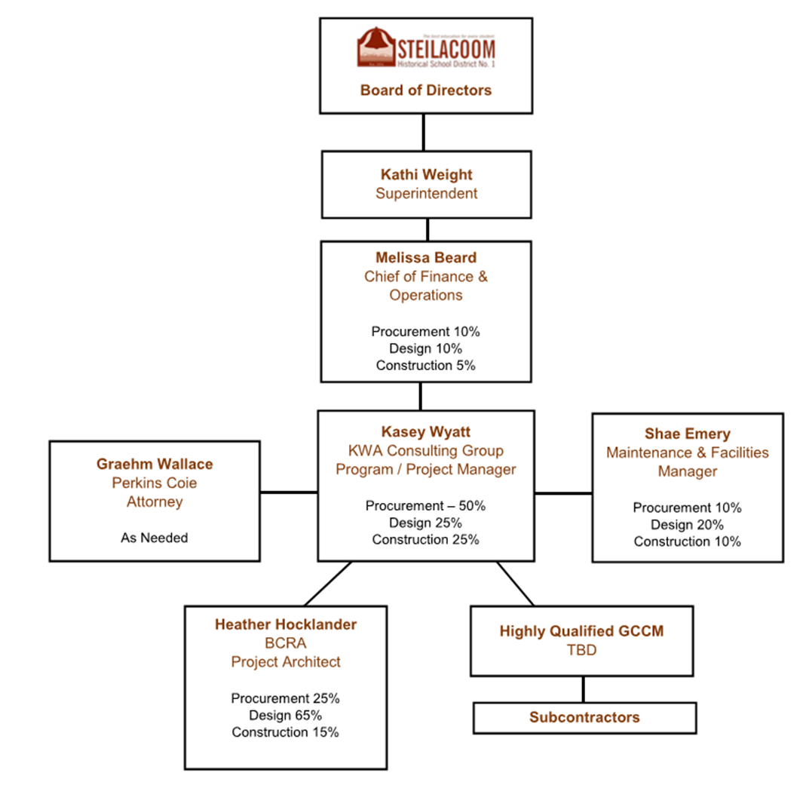
Project Team
Notes:
Kasey Wyatt

Slide 4

Project Team
  Kasey Wyatt, Program/Project Manager
    25-year Industry Veteran
    Extensive GC/CM Experience
    Over $1 Billion in K12 Project Experience
  Heather Hocklander, Architect Project Manager
    20-year Industry Veteran
    K12 Design Expertise
    Extensive GC/CM & DB Experience
Notes:
Kasey Wyatt

Slide 5
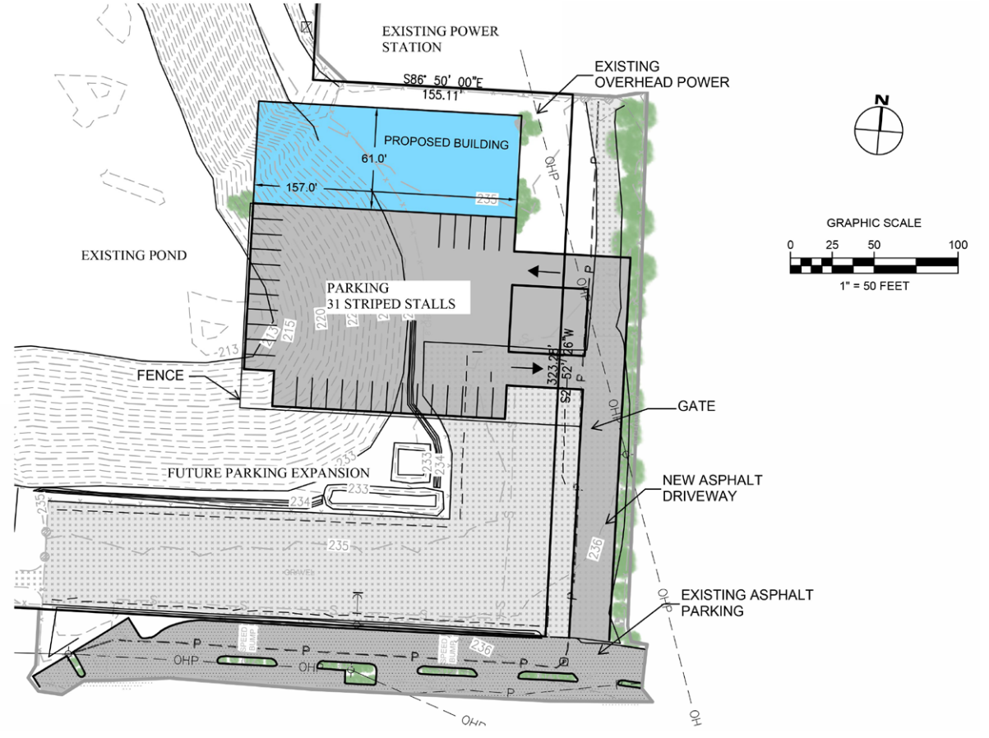
New Maintenance Facility Scope
10,000 SF Building
13 Acres Site Development
Program – admin area, maintenance/small repair warehouse with bays, and district record storage
Parking for 10 personal and 25 fleet vehicles
Notes:
Heather

Slide 6

SHSD New Maintenance Facility
Schematic Design July 2020 – September 2020
GC/CM Process June 2020 – July 2020
  PRC GC/CM Consideration May 28, 2020
  1st Advertisement for GC/CM RFQ June 1, 2020
  2nd Advertisement for GC/CM RFQ June 8, 2020
  GC/CM Presubmittal Meeting June 10, 2020
  Statement of Qualifications Due June 17, 2020
  Short-list Most Qualified GC/CM’s June 24, 2020
  Interview GC/CM’s July 13, 2020
  Open GC/CM Fee Proposals July 15, 2020
  School Board Award of GC/CM July 22, 2020
Preconstruction Start July 2020
Construction Start April 2021
Substantial Completion September 2021
Notes:
Kasey

Slide 7

SHSD New Maintenance Facility
Cost for Professional Services (A/E, Legal, etc) $ 468,500
Estimated project construction costs (including contingency) $ 3,360,000
Equipment and furnishing costs $ 25,000
Offsite costs $ 100,000
Contract Admin. (Owner, CM, etc.) $ 96,000
Contingencies (Owner) $ 215,000
Other project costs (permits, utilities, moving, testing, etc.) $ 300,000
Sales Tax $ 332,640
Total approved budget $ 4,897,140
Notes:
Kasey

Slide 8

Why Project is Suited for GC/CM
4 Criteria RCW 39.10
Complex Schedule, Phasing and Coordination
Occupied Facility
Involvement of GC/CM is Critical
Complex or Technical Work Environment
Notes:
Brian

Slide 9
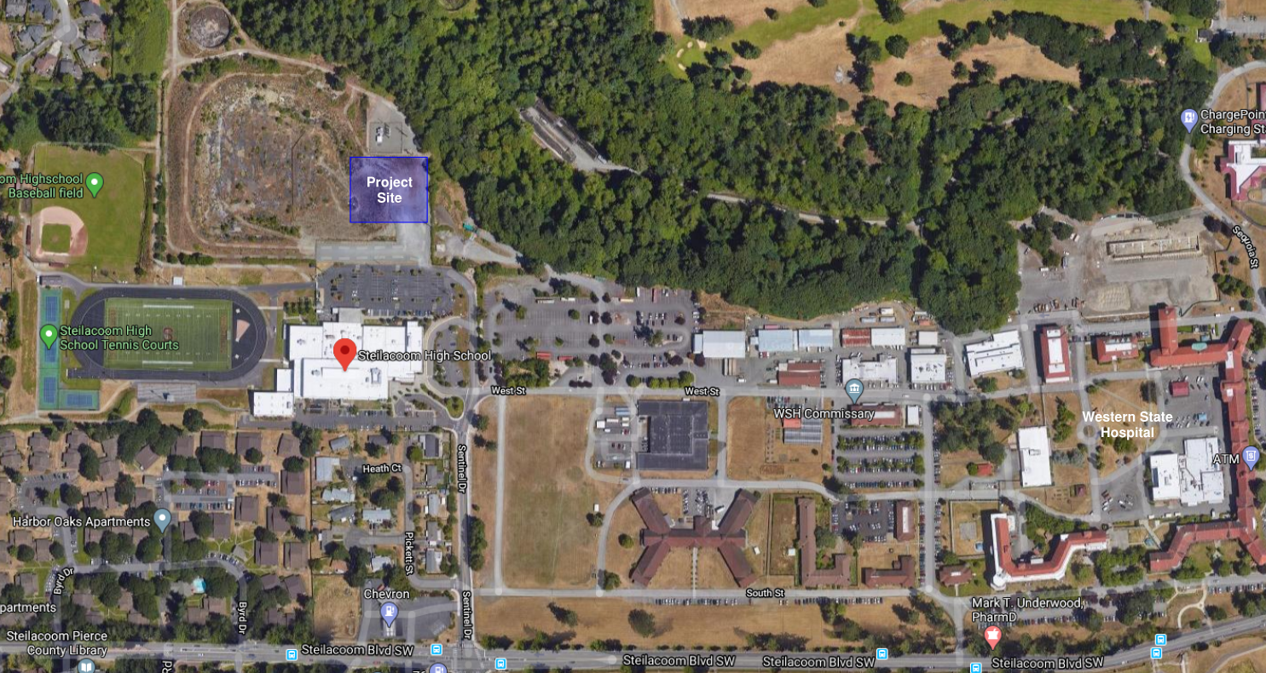

Slide 10
Questions?

