Slide 1


Application for Certification of a Public Body
RCW 39.10 Alternative Public Works Contracting – GC/CM
December 1, 2016

Slide 2

Agenda
Agency Presenting Team
Tacoma Public Schools
Agency Organization Chart
Capital Planning & Construction Org Chart
Visioning Document
Capital Project History
GC/CM Experience
GC/CM Lessons Learned
Delivery Method Determination
GC/CM Candidate Projects
TPS as a Leader – Education and Development
Business Equity – TPS Community Inclusion Commitment Plan
Summary

Slide 3
Agency Presenting and Support Team
Stephen Murakami - Chief Operating Officer
Rob Sawatzky - Director, Planning & Construction
Christie Barrie - Capital Project Supervisor
Kristine Anderson -Capital Project Supervisor
Julius Pallotta - Capital Project Supervisor
Bobbie Knapp- Document Controls
Anne Cummings- Senior Financial Analyst
Alicia Lawver- Facilities Communication Coordinator
Paul Popovich - Capital Project Supervisor
Jim Dugan – Program Manager

Slide 4
Tacoma Public Schools
Founded in 1869
Comprised of:
    36Elementary Schools
    11 Middle Schools
    10 High Schools
    Numerous Special Programs
4th largest school district in the State of Washington
One of the largest employers in Tacoma
Approximately 30,000 students
Over 5,000 employees
Serving Pre-K thru 12th grade
2010 58% Grad rate-Strategic Goal to reach 85% by 2020. We just reached that goal.

Slide 5
Tacoma Public Schools

Slide 6
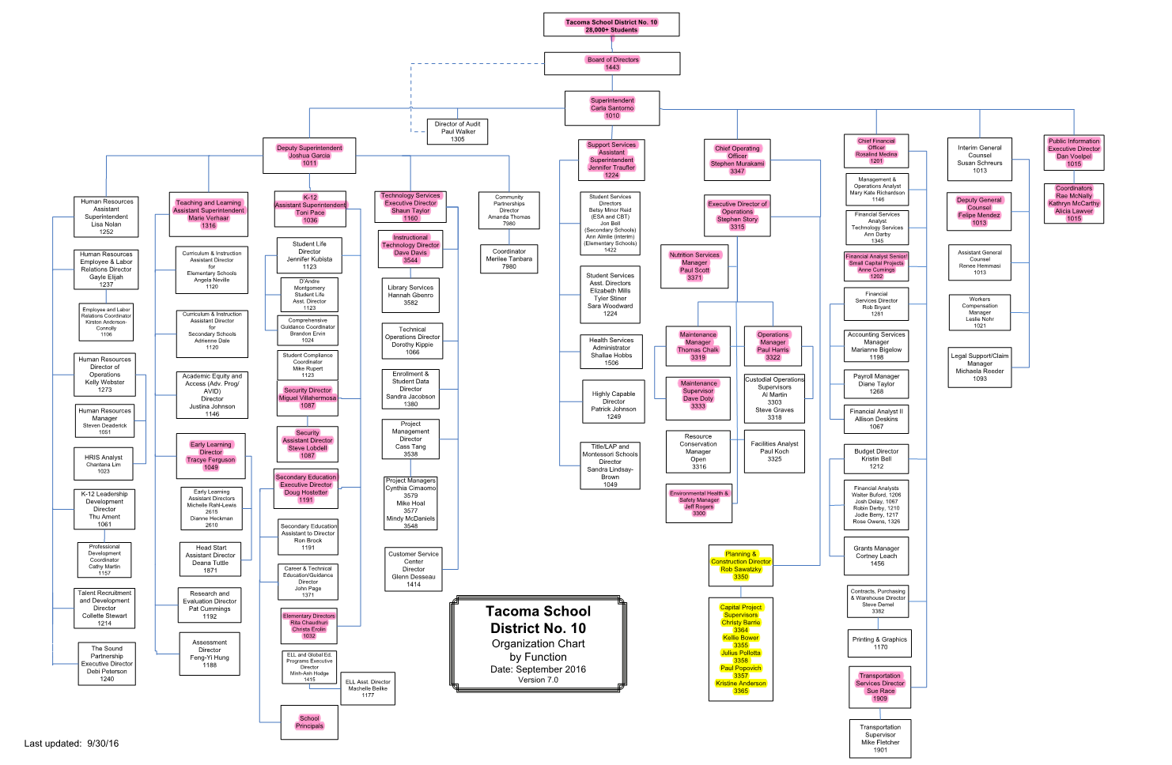
Agency Organization Chart

Slide 7
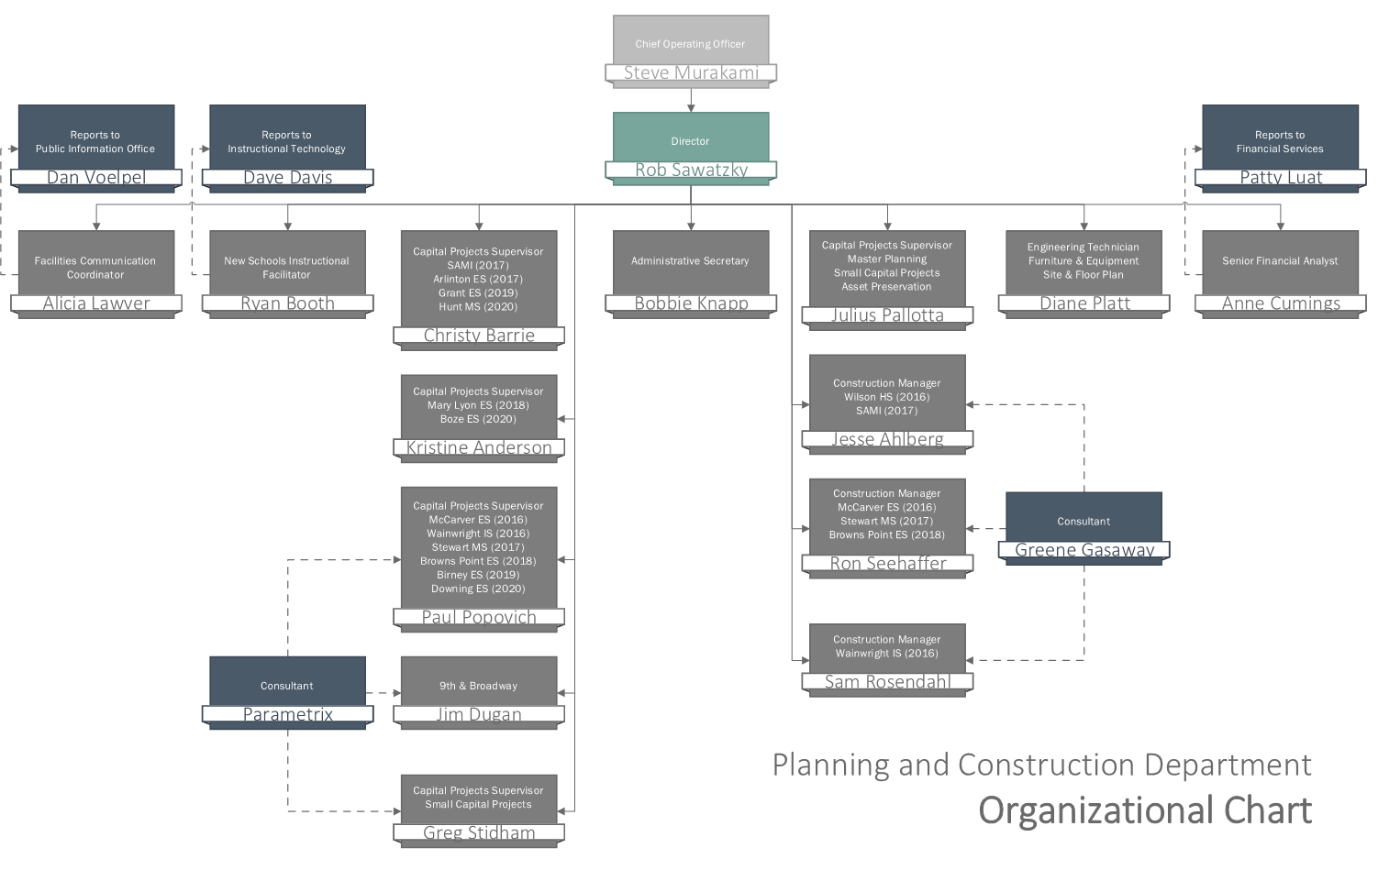
Capital Planning & Construction
Organization Chart

Slide 8
A Vision for the Elementary Learning Environment
Guidelines for Building Planning & Design

Slide 9

Innovation: Vision Document
The education landscape has changed
  -Next Generation Learners (Poverty, Social Media, Attention, Multi-racial, Hobbies as jobs)
  -Partnerships and Community Use
  -Learning Methodologies (Think, Impart, Create, Discover, Exchange)
  -Innovative Schools (STEM, IDEA, SAMI, SOTA, THRIVE)
Wrapping best Instructional Practice with the building.
  -Self Directed, Project Based, Maker Spaces, Inquiry, Extended Learning
Notes:
TPS is about Innovation:
Teaching and Learning
OR
Alternative Delivery

Slide 10

Capital Project History

Slide 11
Tacoma Public Schools: 1983
TPS Leadership took an aggressive and deliberate stand on improving our educational facilities
Called it: “The 30 Year Plan”
Goal: Improve the entire inventory of building assets within the District
Started with a 1984 capital bond issue
Followed by six capital levies between 1988 and 1997
Aggregate value of $299 M
Just the beginning
Notes:
Beginning work on the next 30 year Master Plan

Slide 12
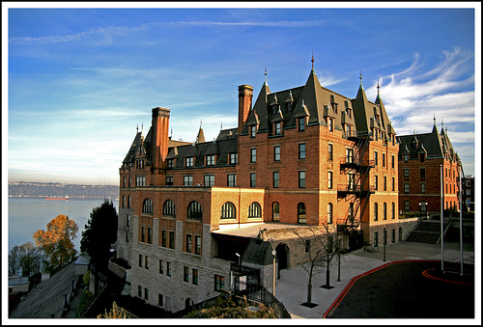
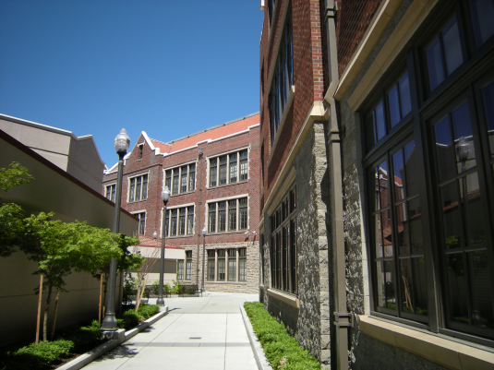
Tacoma Public Schools: 2001
Tacoma approved a $450 M capital bond issue
Comprised of 19 major capital projects
Included two GC/CM projects:
(1) Stadium High School (SHS)
(2) Lincoln High Schools (LHS)
SHS was the District’s first GC/CM
Successfully completed both projects

Slide 13
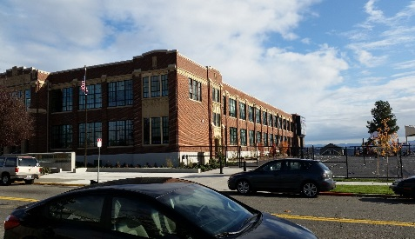
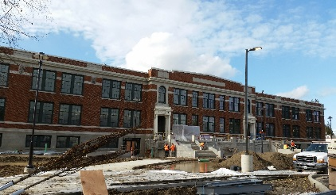
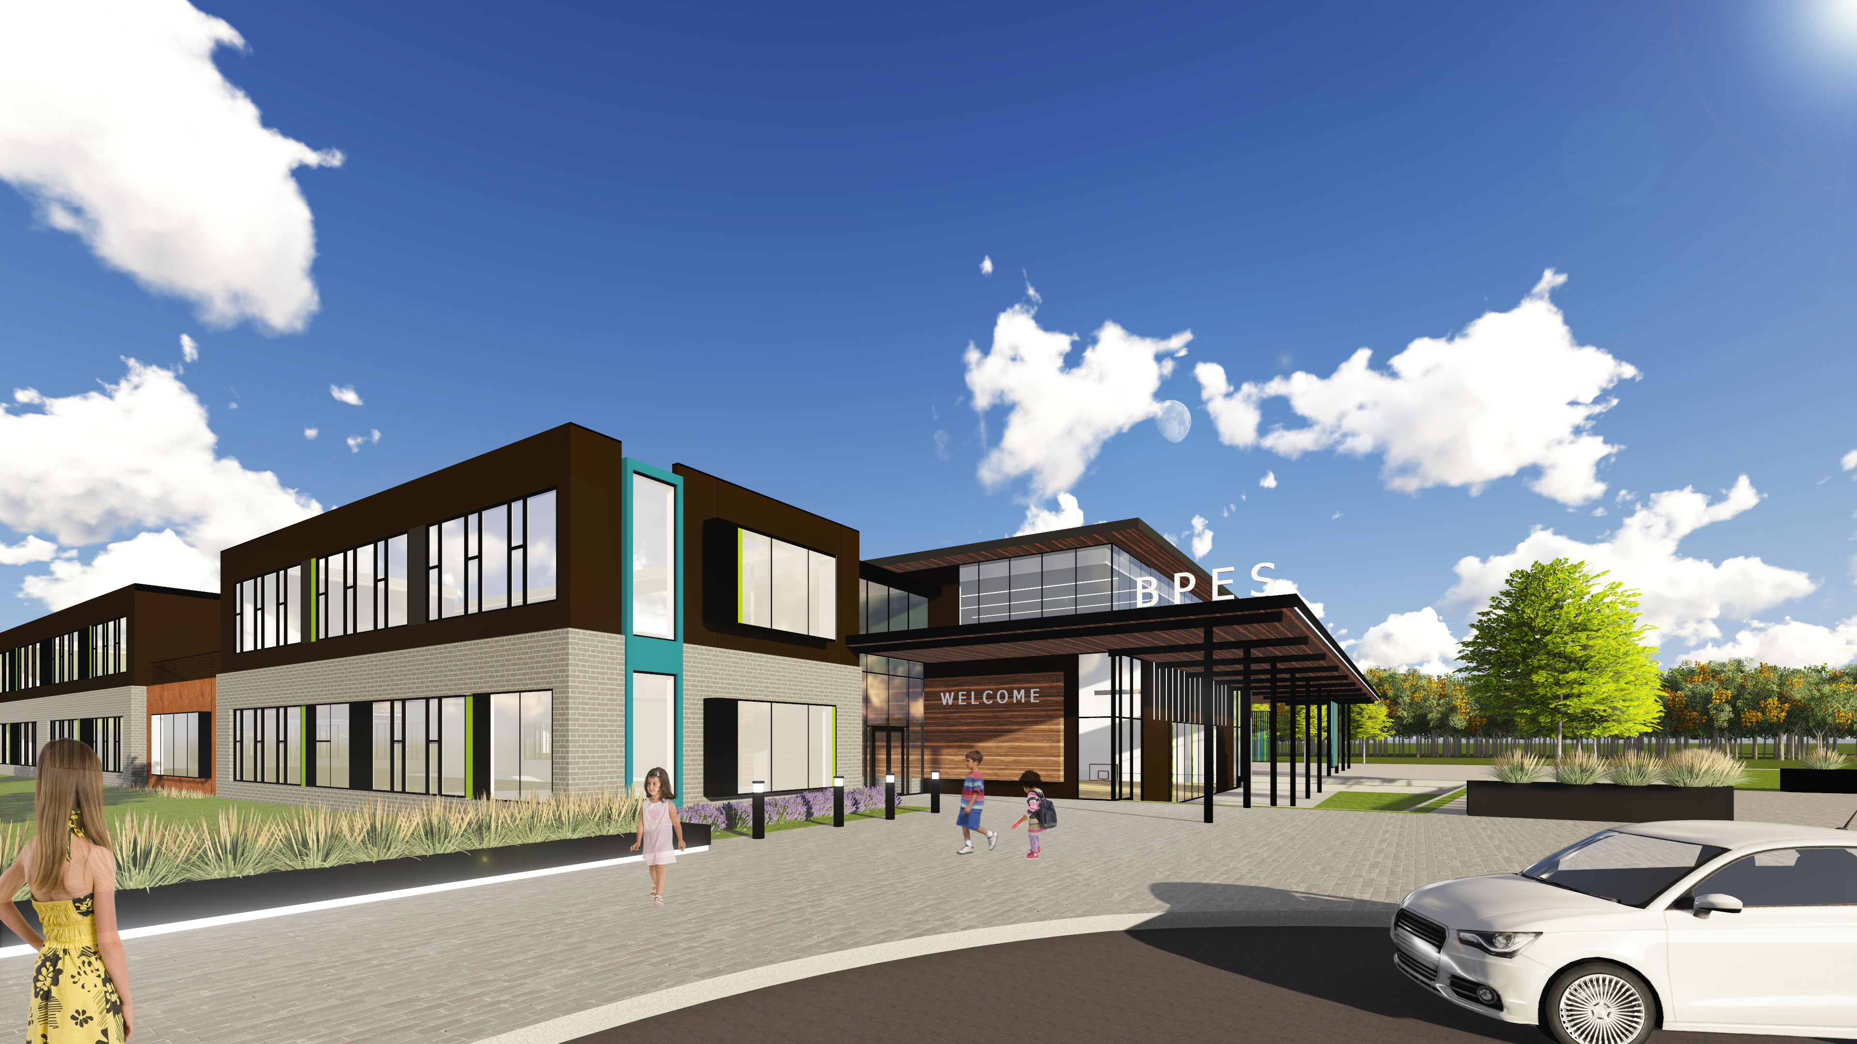
Tacoma Public Schools: 2013
Tacoma approved a $500 M capital bond issue
Comprised of 14 total major capital projects
Includes three (3) GC/CM major capital projects:
  (1) McCarver Elementary School (MES)
  (2) Stewart Middle School (SMS)
  (3) Browns Point Elementary
  School (BPES)

Slide 14
TPS 2013 Capital Bond Program
Notes:
Yellow Highlighted GCCM Projects
Green Highlighted- Just beginning or starting in the next couple of years
May or may not be occupied

Slide 15
TPS Public Body Experience: 2001 - 2016
Notes:
As a public body depth of public works experience
TPS is a major capital project builder

Slide 16
TPS Project Delivery Experience & Qualifications
Successfully passed $1.3 B in Capital Improvement Funds
  $299 M between 1983 and 1997
  $450M in 2001
  $500M in 2013
Between 2001 and 2016 alone, funds used for Modernization, Replacement, and/or Building Additions to 37 public schools
  24 projects complete
  5 projects in construction (SMS, WHS, WIS,AES, ELC)
  5 projects in design stages
  3 projects remaining to begin
Notes:
5 projects in construction (SMS, WHS, WIS,AES, ELC)
5 projects in design stages (9B, MLES, BPES, BES, GES)
3 projects remaining to begin (Boze, Downing, Hunt)

Slide 17
TPS Project Delivery Experience & Qualifications
TPS 4 successful GC/CM projects, including 2 in the last three years
Since 2001, TPS has successfully delivered 24 large capital projects valued at approximately $859 million.
Augmenting and Enhancing the internal team – Since 1998 teaming with external consulting teams.
TPS has developed a robust internal staff and control systems to plan and execute the work, select the most appropriate delivery methods and apply GC/CM successfully.
Notes:
Controls
-Weekly Staff Meetings
-Weekly progress meetings
-One on one PM daily and weekly meetings
-Standing daily and weekly meetings with COO
-Multi Vista- Photographic Interactive As-Built
-Digitized As Builts and OEM Manuals in the Cloud (Skisite)
-Chalk Schools- Soup to nuts process for Project approvals

Slide 18
Ability to Properly Plan
Tacoma Public Schools is 3 years through a 7 Year Capital Facilities Plan (CFP) funded through the bond passed in 2013
The CFP, planning and budgeting tools are used to develop strategies to meet the growing capital needs of the District, including new and replacement schools and ongoing maintenance projects.
Building Condition Assessment and District Master Planning in support of the next major capital bond ( Feb 2019) now in progress.

Slide 19
GC/CM Experience
GC/CM Project History – 5:
(1) Stadium High School
(2) Lincoln High School
(3) McCarver Elementary School
(4) Stewart Middle School
(5) Browns Point Elementary School
GC/CM Project Organization Chart
GC/CM Roles and Responsibilities
Notes:
Summary of out GCCM Projects in the past

Slide 20
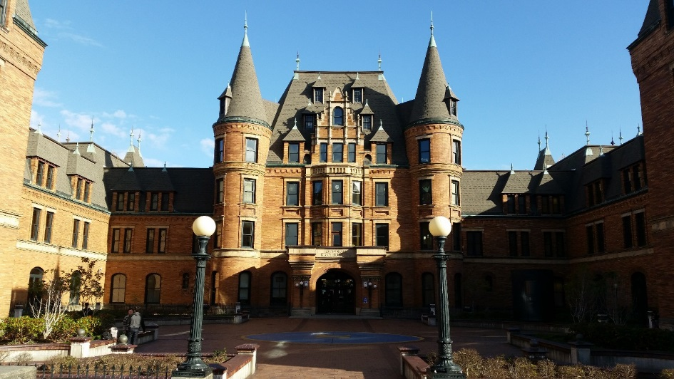
Stadium High School
Historic Modernization and & Additions
Planned Start: 2004
Actual Start: 2004
Planned Finish: 2006
Actual Finish: 2006
Planned Budget: $108,000,000
Actual Budget: $107,967,536
Budget Variance: -0.03%
On time and on budget!
Notes:
1st GCCM project
Finished on time and under budget

Slide 21
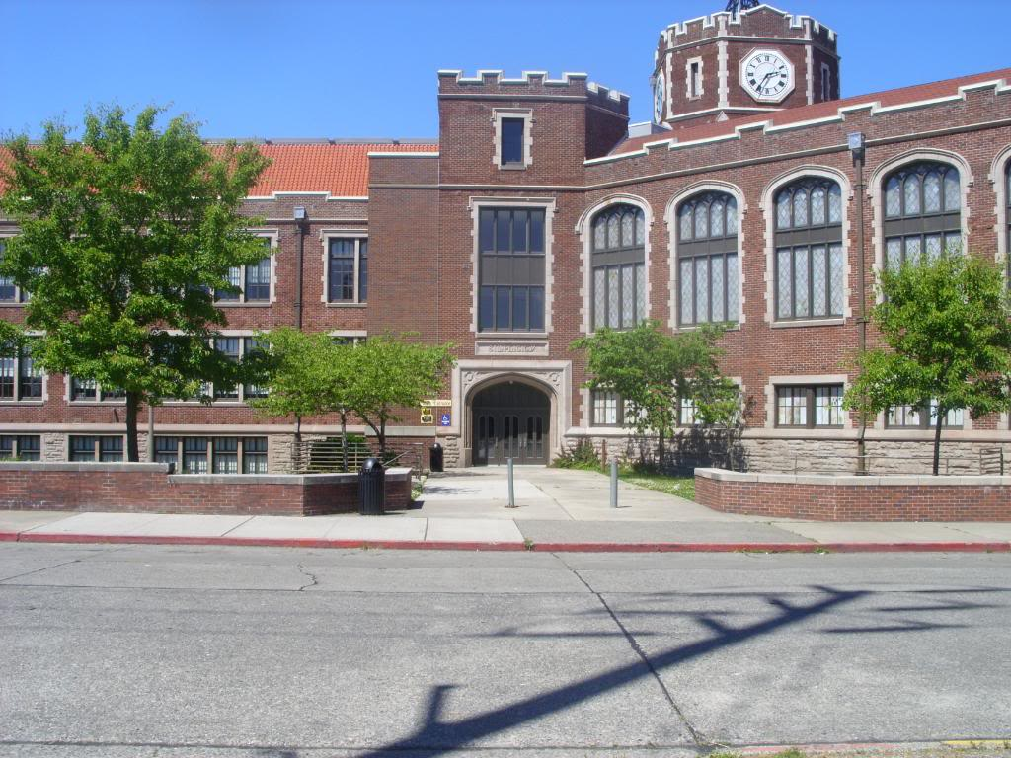
Lincoln High School
Historic Modernization and & Additions
Planned Start: 2006
Actual Start: 2006
Planned Finish: 2008
Actual Finish: 2007
Planned Budget: $75,000,000
Actual Budget: $75,170,798
Budget Variance: 0.23%
Completed one year ahead of schedule.
Notes:
2nd GCCM Project
Finished slightly over budget but 1 year early

Slide 22
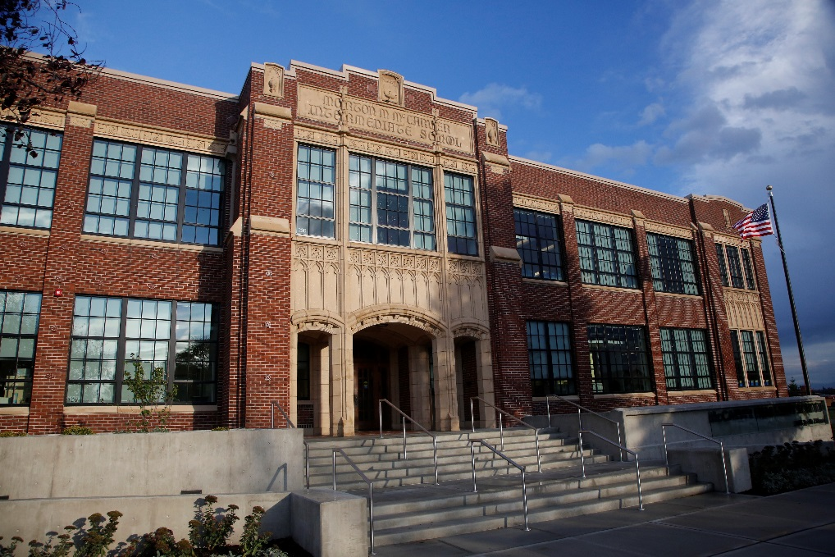
McCarver Elementary School
Historic Modernization
Planned Start: 2015
Actual Start: 2015
Planned Finish: 2016
Actual Finish: 2016
Planned Budget: $39,000,000
Actual Budget: $38,765,433
Budget Variance: -0.60%
On time and on budget!
Notes:
3rd Project
On Time and slightly under budget
King 5 twice , Komo 4, TNT Coverage

Slide 23
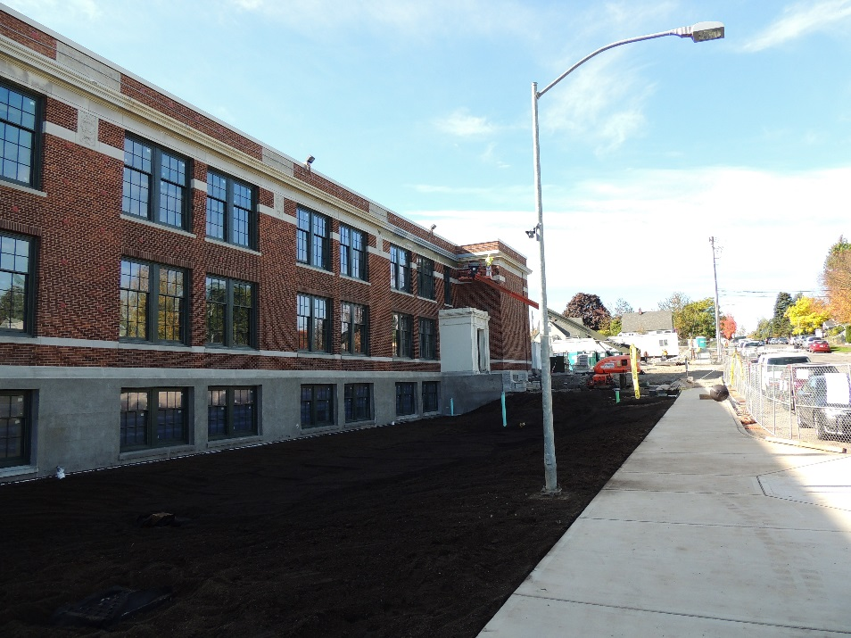
Stewart Middle School
Historic Modernization and & Additions
Planned Start: 2015
Actual Start: 2015
Planned Finish: Feb 2017
Actual Finish: N/A
Planned Budget: $66,000,000
Actual Budget: TBD (In Construction)
Budget Variance: TBD
7 months ahead of schedule!
Notes:
4th project
7 months ahead of schedule
Should be within 1% of the budget

Slide 24
Browns Point Elementary School
Replacement School
Planned Start: Summer 2017
Actual Start: N/A
Planned Finish: Sept 2018
Actual Finish: N/A
Planned Budget: $31,000,000
Actual Budget: TBD (In Design)
Budget Variance: TBD

Slide 25
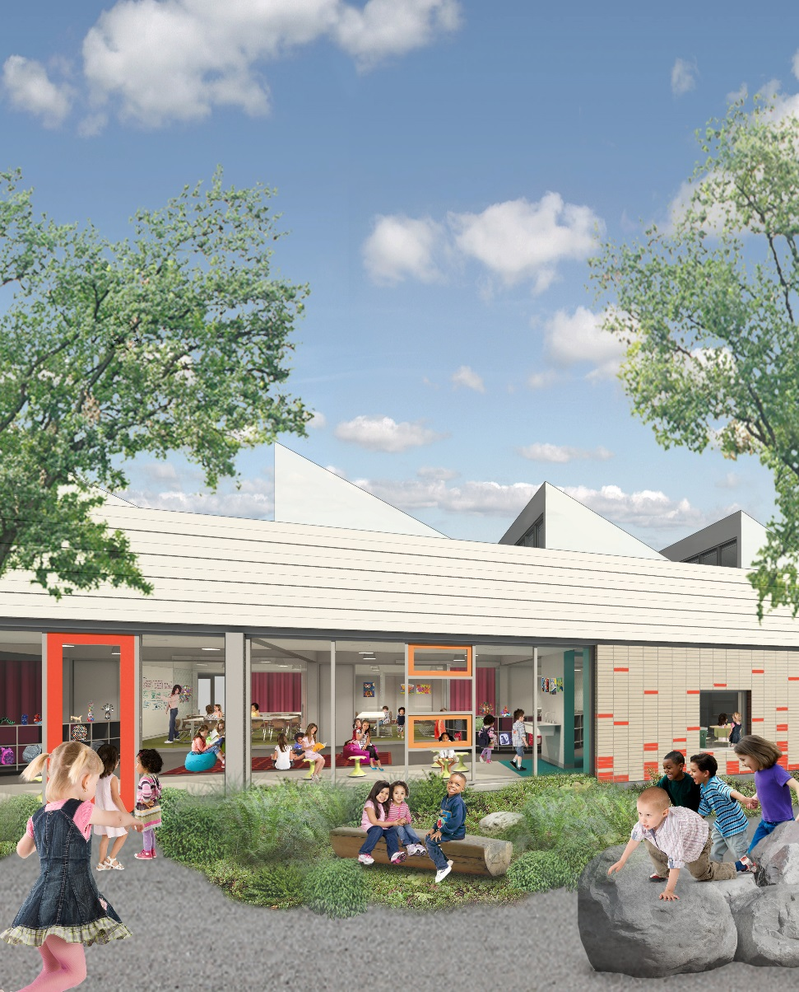
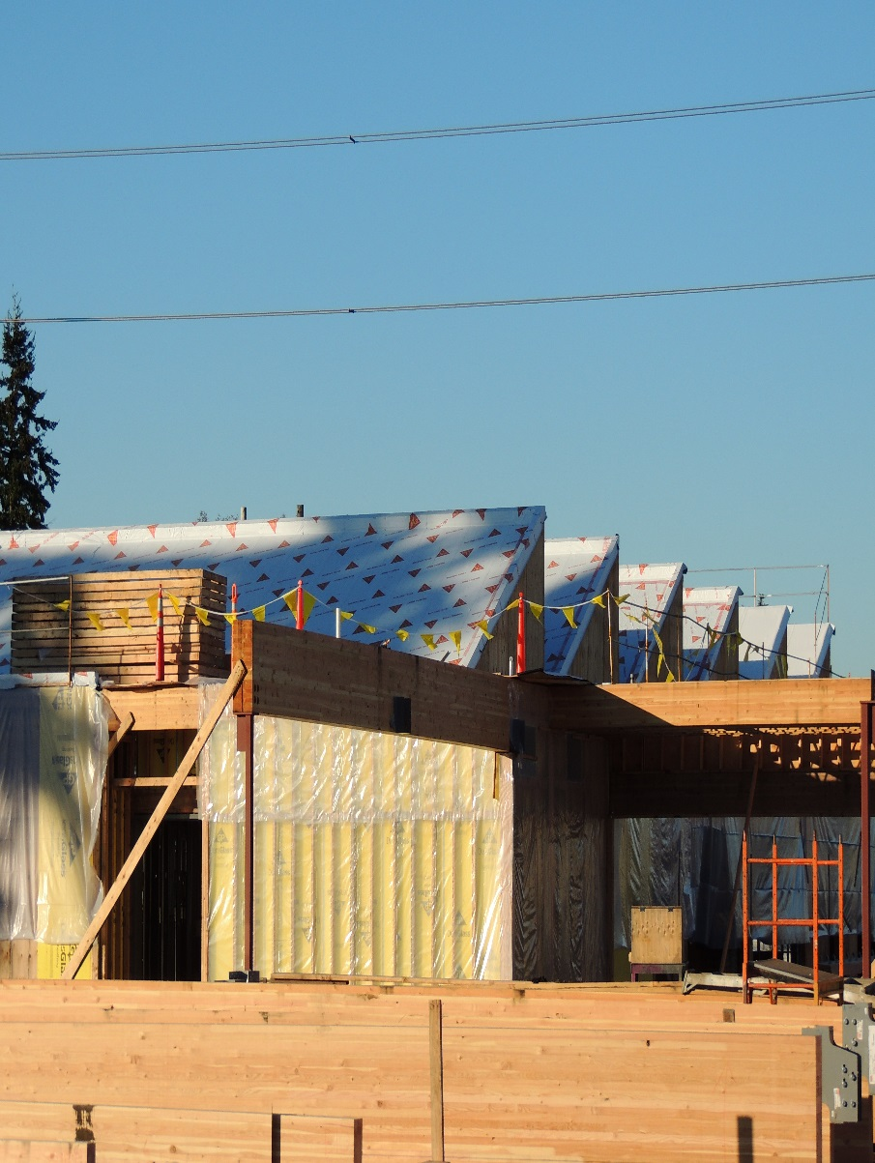
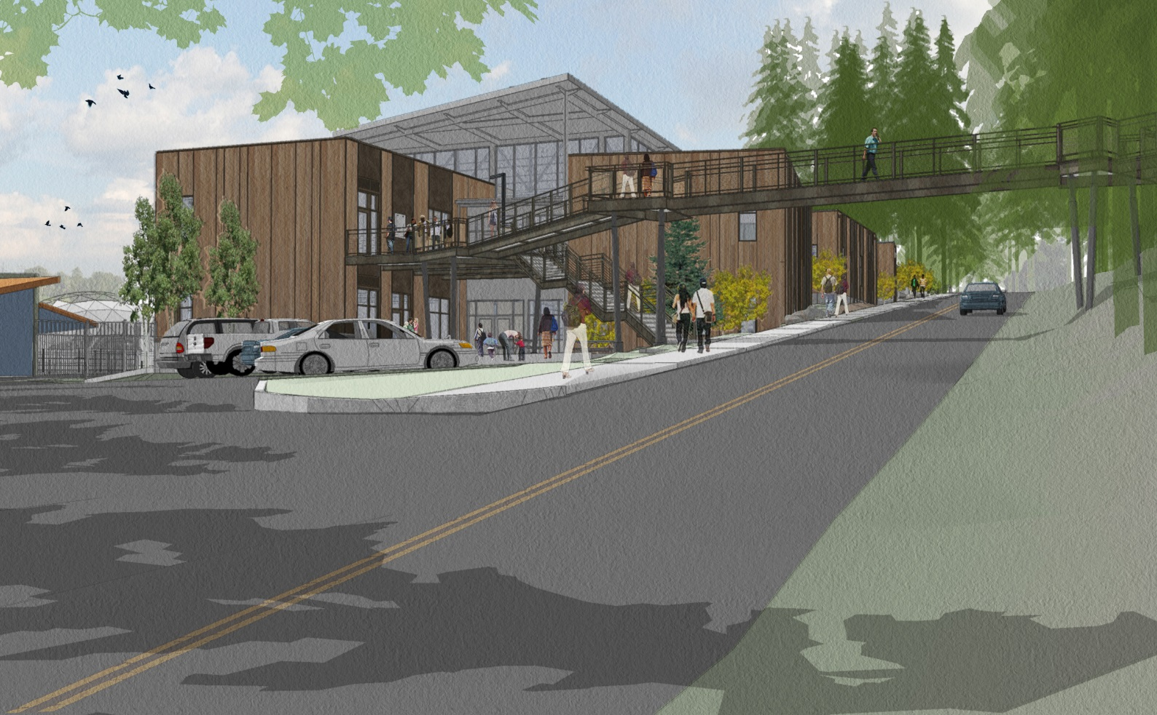
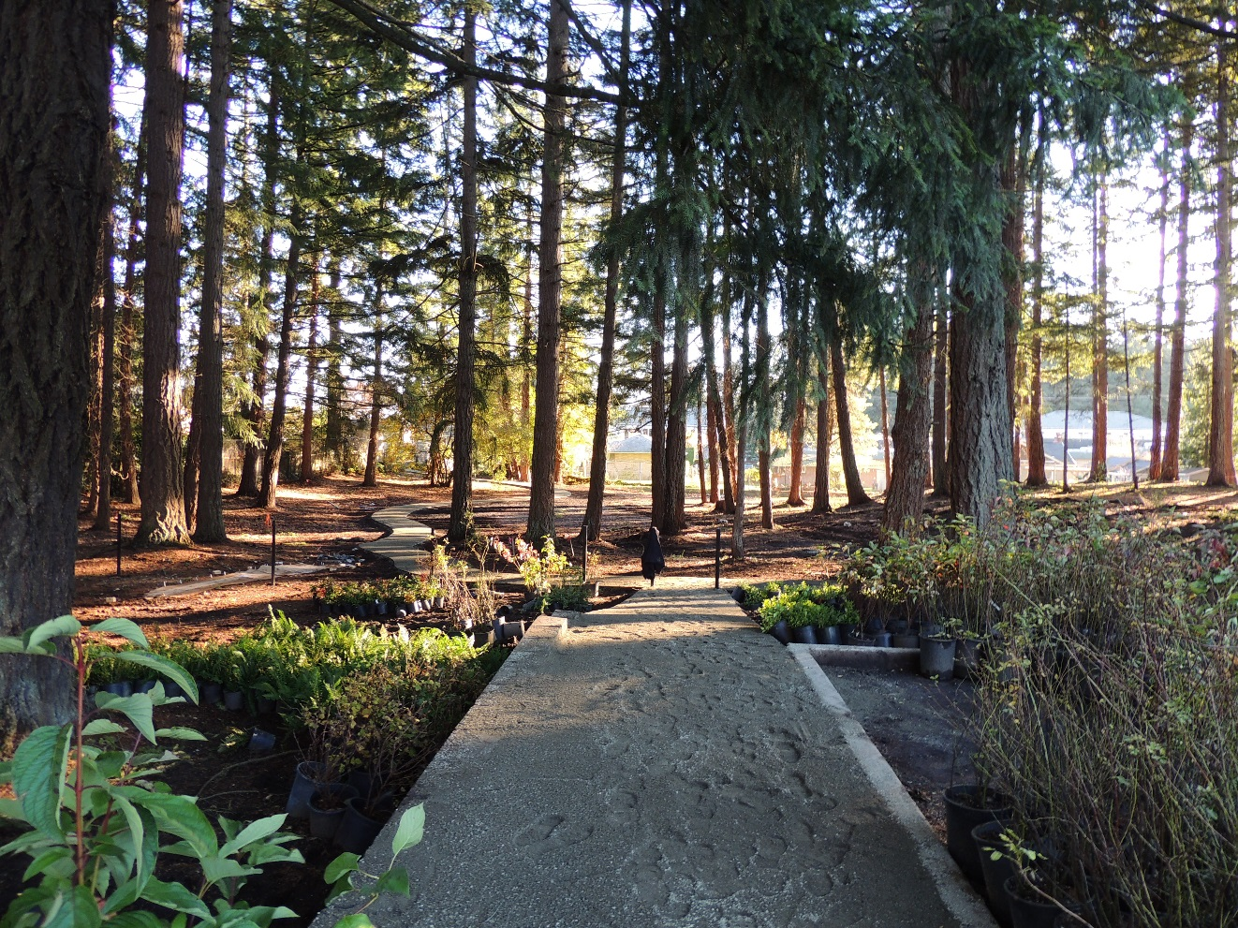
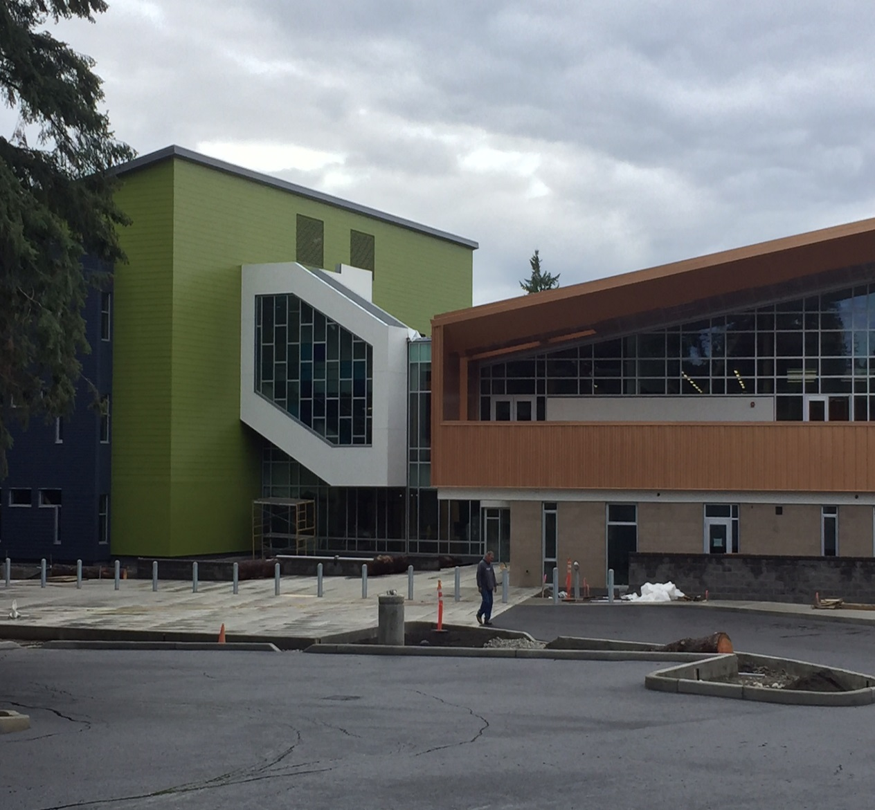
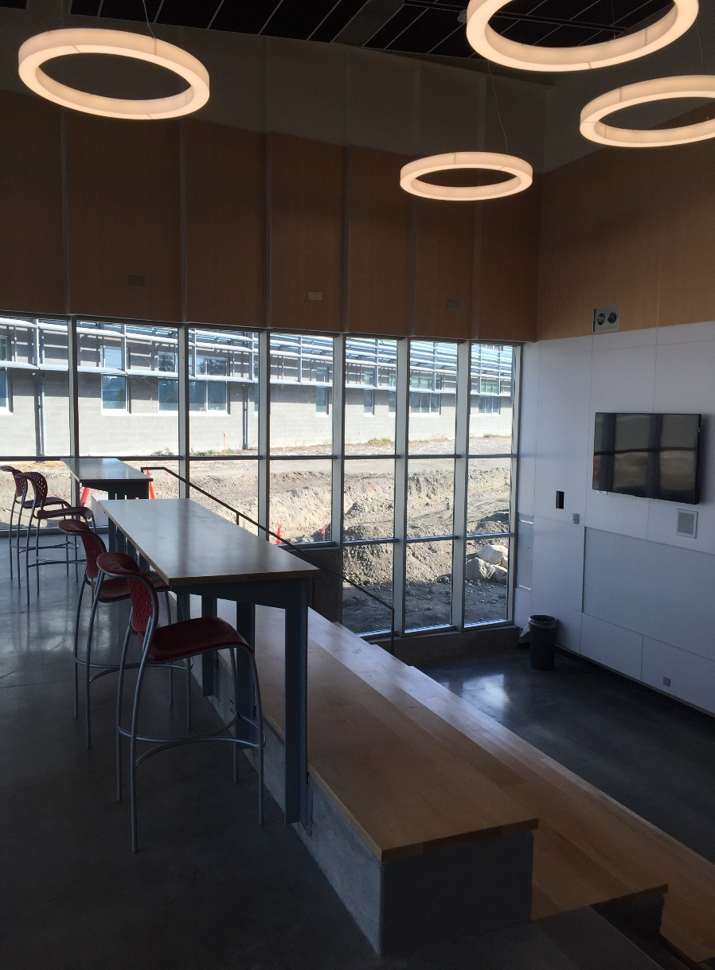
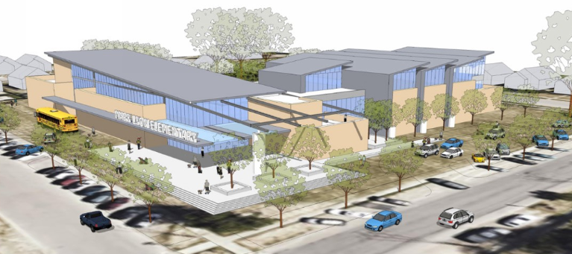
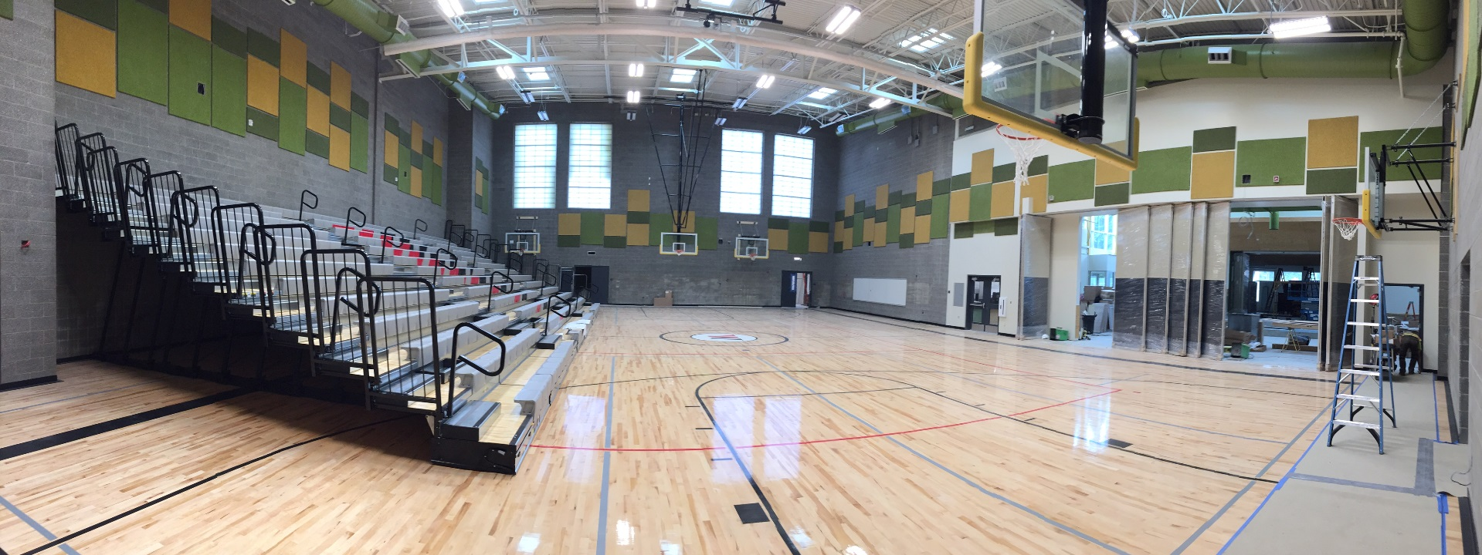
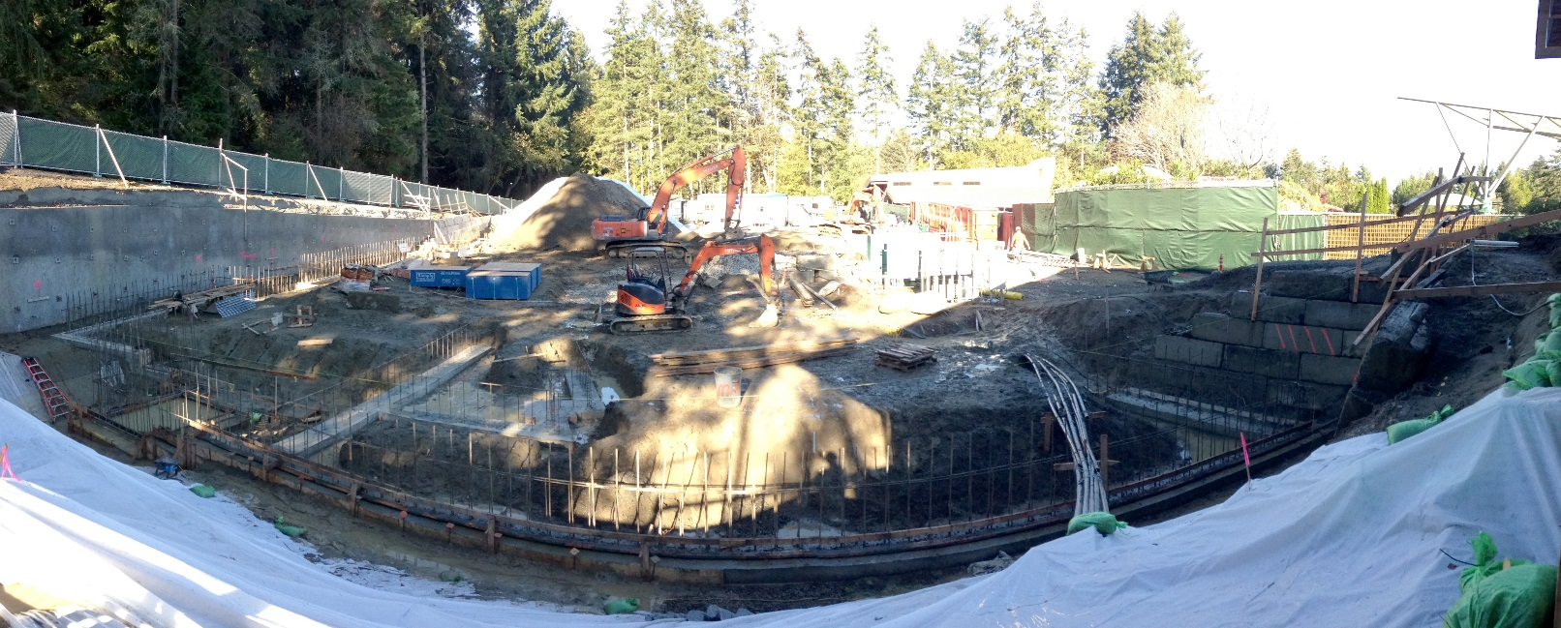
Other Projects in Design and Construction
Notes:
We area major capital projects MACHINE right now!

Slide 26
GC/CM Lessons Learned
The critical importance of extensive due diligence with investigations when designing in older buildings – get the GC/CM on board sooner than the end of Schematic Design (McCarver ES)
The clear definition of risk allocation early in the project, and the careful use of contractor and owner contingency throughout the project to mitigate the remaining risk (Stewart MS)
The value of partners in the room early on (GC, Architect and Owner). Asking for a building that we can afford and the spark created with creative juices to get us there as a team. (Browns Point ES).
Notes:
The unknowns in McCarver and Stewart
Managing the Risk effectively
BPES- 3rd party estimator and GCCM estimator with numbers less $1000 off on a $30 M Project.

Slide 27
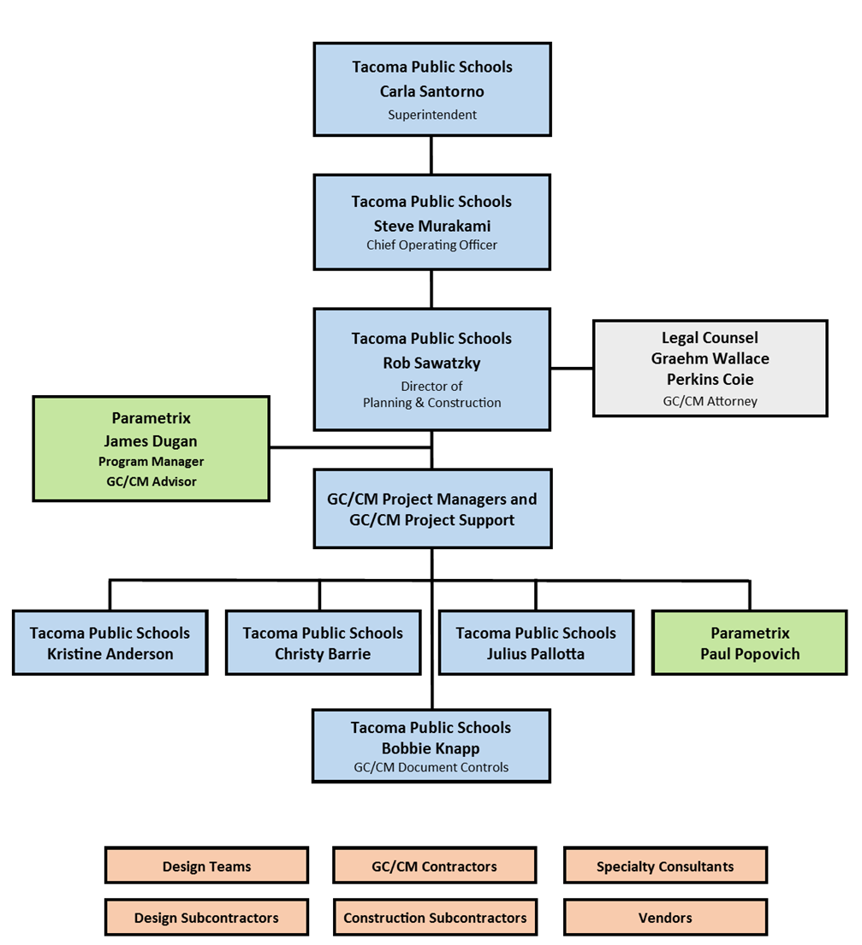
GC/CM Project Organizational Chart
Blue: TPS District Staff
Green: Consultant Staff
Grey: Legal Support
Tan: External Contracts
Notes:
TPS majority of experience is not dependent on consultant staff
TPS augments with consultant staff.
Internal Legal Counsel – Felipe Mendez
External Legal Counsel (Construction)- Graehm Wallace
External Legal Counsel (Real Estate)- Mark Hood

Slide 28
GC/CM Roles and Responsibilities
Superintendent | Approve proposed projects for development, secure funding, report to the public, voters and taxpayers.
Chief Operating Officer | Supervise all support services and oversee execution of projects. Approve capital project budgets, change orders and contract awards, modifications and acceptances for board approval. Approve project delivery method.
Director of Planning and Construction | Supervise capital project decisions, execution and Capital Projects staffing. Concur/overrule delivery method determination by Program Manager. Approve design direction and submittals, project budgets, change orders and prepare contract awards, modifications and acceptances for COO and Superintendent approval.
Legal Counsel | GC/CM contract preparation, legal advice and dispute resolution.
Program Manager | Oversee the execution of the program. Provide direction and recommendations to the Director and Project Managers. Oversight over all projects.
Project Manager | Drive the day to day success of each project. Serve as primary point of contact with Architect and GC/CM
Architect | Lead designer and prime consultant for the design of projects. Contracted to TPS.
GC/CM | General Contractor/Construction Manager selected via qualifications and fee process. Contracted to TPS.
Tacoma Public Schools: Planning and Construction Staffing:
Carla Santorno | Superintendent
Steve Murakami | Chief Operating Officer
Rob Sawatzky | Director of Planning and Construction
Christy Barrie | Capital Projects Supervisor
Julius Pallotta | Capital Projects Supervisor
Kristine Anderson | Capital Projects Supervisor
Jim Dugan | Program Manager, Parametrix
Paul Popovich | Project Manager, Parametrix
Graehm Wallace | Perkins-Coie, GC/CM Attorney
Notes:
Clearly defined roles and responsibilities

Slide 29
GC/CM Delivery Method Determination
Notes:
TPS Process of Determination about whether a project is suitable for GCCM or not

Slide 30
Delivery Method Recommendation
Notes:
This is the cover page of the recommendation questionnaire that PM’s will fill out and submit to me for approval or denial.
Vehicle for our GCCM determination

Slide 31
Future GC/CM Candidate Projects
The following future candidate projects are funded and occupied sites with critical phasing requirements, and as such, are excellent candidates for consideration of the GC/CM delivery method:
Birney Elementary School
Grant Elementary School
Downing Elementary School
Boze Elementary School
Hunt Middle School
Notes:
Next Few slides to demonstrate:
-Funded projects in Que
-Potential Occupied sites
-Potential Complex Phasing

Slide 32
GC/CM Candidate Project Locations

Slide 33
Birney Elementary School

Slide 34
Downing Elementary School

Slide 35
Hunt Middle School

Slide 36
Grant Elementary School

Slide 37
Boze Elementary School

Slide 38
TPS Leadership: Education and Development
Industry Leaders
Connectedness in the Community
Professional Associations
Strategic Goals
Notes:
Industry leaders:
-Edspaces- Collaboration with Mahlum National Presentation
-Helping COT come up with a process that would streamline permitting
Connectedness in the community
-MPT- ELC- SAMI built in the zoo at Point Defiance
-MPT- ESCC- Being built on TPS First Creek Middle School Campus
-COT- Coordinating with them to improve offsites with Proposition 3 funding
Professional Associations
A4LE
Strategic Goals (Safety, Early Learning, Academic Excellence, Partnerships)
-Played out in our construction
-Interdepartmental collaboration

Slide 39
Business Equity:
TPS Community Inclusion Plan
Tacoma Public Schools is committed to Community Inclusion, as partnerships are critical to student education and community health and sustainability.
By the end of 2018, Tacoma Public Schools will:
  Maintain and increase contracts with local businesses by:
    Increasing local share of total construction from 15% to 30%
    Completed March 2016
  Adopt Governor’s diverse business goals, including:
    10% Minority-Owned Business Enterprises,
    6% Woman-Owner Business Enterprises, and
    5% Small Business Enterprises (SBE)

Slide 40
Business Equity:
TPS Community Inclusion Plan
Additionally, Tacoma Public Schools will require prime contractors to:
  Include “Voluntary Inclusion Plans” in all bid packages $300,000+ to utilize sub-contractors from: (Completed and Ongoing)
    Minority & Women Owned Business Enterprises (MWBE),
    Small Business Enterprises (SBE), and
    An Apprenticeship Utilization Plan
  Report and make available to the District and Community partners:
    Monthly percentages of MWBE and SBE utilized on the project
    (Completed and Ongoing)
    Prevailing wage intents and affidavits,
    (Completed and Ongoing)
    Monthly certified payrolls with quarterly compliance review
    (In Progress)
    Monthly apprenticeship utilization percentages
    (Completed and Ongoing)

Slide 41
Business Equity:
Current Small Works Projects
2015-16 Inclusion Statistics for Tacoma Public Schools Contracts (Billed)
Project size | Local | MBE | *MBE Not Certified | WBE | SBE
Goal | 30% | 10% | 10% | 6% | 5%
Total construction 2015/2016 $146,433,097 | 40.29% $58,995,189 | TPS does not have large district contracts with MWBE businesses at this time. However, we are working with our prime contractors to encourage and increase use of local, small and MWBE subcontractors. |  |  | Not currently tracked at the district level.
Over $1 million $129,935,274 | 40.62% $52,774,535
Under $1 million $16,497,823 | 37.71% $6,220,654 | 1.03% $169,172 | 3.56% $587,098 | 0.35% $58,009
Under $300,000 $8,029,526 | 56.46% $4,533,439 | 2.1% $169,172 | 7.31% $587,098 | 0.72% $58,009
*Includes spending with businesses we believe are minority-owned, but not certified MBE.

Slide 42
Business Equity:
Current Major Projects
Large Capital Construction Inclusion Statistics | Total Billed: $143,512,665
 | Local | MBE | WBE | SBE | Apprenticeships
Goal | 30% | 10% | 6% | 5% | 15%
Arlington Elementary Neeley Construction $16,930,000 | 60.28% $10,205,268 | 0 | 0 | 13.10% $2,218,387 | 17%
SAMI Forma Construction $12,490,101 | 3.34% $417,438 | 0 | 0.57% $71,465 *114,645 | 0.35% $43,180 | 17%
VIP subtotal: $29,420,101 | 36.11% $10,622,706 | 0 | 0.24% $71,465 | 7.69% $2,261,567
McCarver Elementary Skanska USA $22,628,095 | 14.51% $3,282,249 | 2.2% $498,449 | 2.14% $484,061 | 30.67% $6,940,313 | 18%
Stewart Middle School Skanska USA $39,316,629 | 9.93% $3,902,594 | 2.48% $975,750 | 2.48% $975,750 | 43.01% $16,911,519 | 22%
Wainwright Intermediate Neeley Construction $22,177,840 | 54.2% $12,019,407 | 0.1% $23,000 | 0.8% $177,719 | 49.87% $11,060,847 | 17%
Wilson High School Absher Construction $29,970,000 | None reported | 0% | 1% $205,466 | 83% $25,974,711 | 26%
Total | 20.78% $29,826,956 | 1.04% $1,497,199 | 1.19% $1,708,995 | 44% $63,148,957
*Includes Puget Sound Steel. DBE certified. Woman-owned but not WBE certified.

Slide 43
Summary
Competency
History
Experience
No Audit Findings on Projects
Notes:
Competency
As the 4th largest and one of the fastest growing school districts in Washington, Tacoma Public Schools has proven itself to be a competent, successful public builder well prepared to use GC/CM delivery in accordance with all applicable statutes.
History
With a five (5) GC/CM project history, 4 complete and one in design, TPS has the experience required to utilize the GC/CM delivery method when applicable. The referenced GC/CM projects were primarily historic modernizations of size and significance and difficulty. All were completed on time and on or under budget.
Experience
Currently contracted with Parametrix, one of Washington’s experienced GC/CM project leadership teams, the District is ideally positioned to select GC/CM delivery when appropriate and execute future GC/CM projects successfully on time, on budget, and compliant with the requirements of RCW 39.10. Staff experience is comprised of primarily internal employees (5) and augmented with consultant staff members (2), all co-located at the District Planning and Construction offices.
Audit
The District has received no audit findings on any projects previously identified.

Slide 44

Thank you
Questions?

