Slide 1
Boze Elementary School
RCW 39.10 Alternative Public Works Contracting – Design/Build
July 27, 2017

Slide 2
Agenda
Introductions
Tacoma Public Schools
Agency Organization Chart
Capital Planning & Construction Org Chart
Capital Project History
Business Equity
The Project
Project Budget
Project Schedule
Why Design Build
Qualifications
Summary

Slide 3
Presenting Team
Stephen Story – Interim Chief Operating Officer
Rob Sawatzky - Director, Planning & Construction
Kristine Anderson – Project Manager
Julius Pallotta – Internal D/B Technical Advisor
Jim Dugan – Program Manager
Dan Cody – Design Build Procurement
Graehm Wallace – External D/B Legal Counsel

Slide 4
Additional Team Members
John Palewicz – External Design Build Advisor

Slide 5
Tacoma Public Schools
Founded in 1869
Comprised of:
36 Elementary Schools
11 Middle Schools
10 High Schools
Numerous Special Programs
4th largest school district in the State of Washington
Approximately 30,000 students
Over 5,000 employees
Serving Pre-K thru 12th grade
One of the largest employers in Tacoma

Slide 6
Tacoma Public Schools

Slide 7
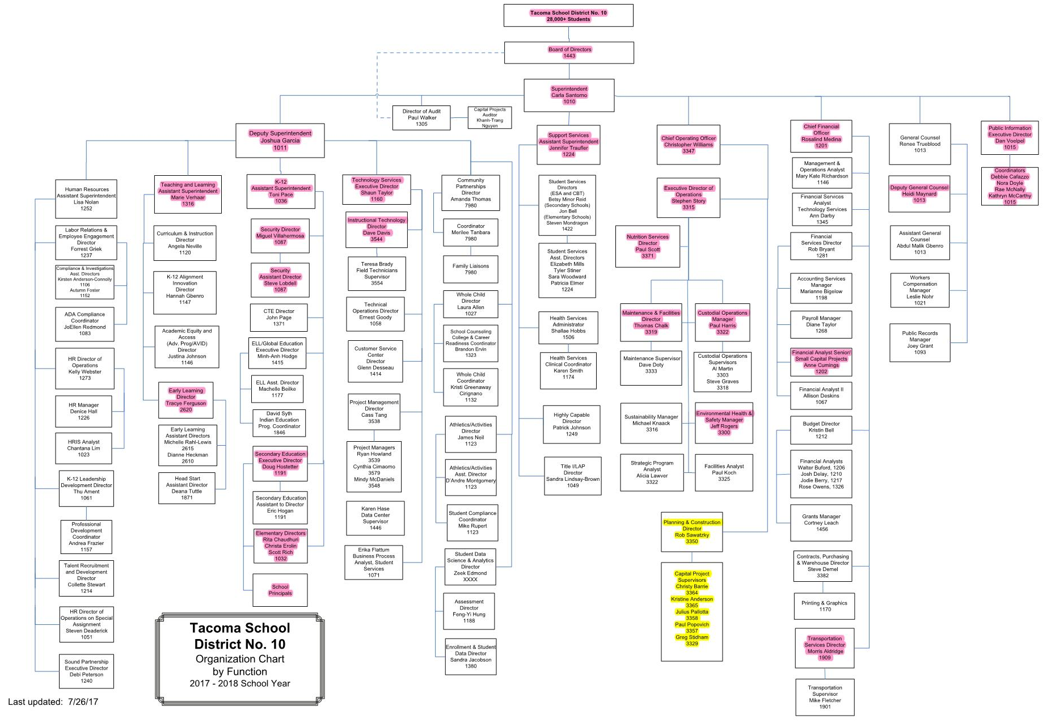
Agency Organization Chart

Slide 8
Capital Planning & Construction Organization Chart

Slide 9
Business Equity: TPS Community Inclusion Plan
Tacoma Public Schools is committed to Community Inclusion, as partnerships are critical to student education and community health and sustainability.
By the end of 2018, Tacoma Public Schools will:
Maintain and increase contracts with local businesses by:
Increasing local share of total construction from 15% to 30%
Adopt Governor’s diverse business goals, including:
10% Minority-Owned Business Enterprises,
6% Woman-Owner Business Enterprises, and
5% Small Business Enterprises (SBE)

Slide 10
Business Equity: TPS Community Inclusion Plan
Additionally, Tacoma Public Schools will require prime contractors to:
Include “Voluntary Inclusion Plans” in all bid packages $300,000+ to utilize sub-contractors from:
Minority & Women Owned Business Enterprises (MWBE),
Small Business Enterprises (SBE), and
An Apprenticeship Utilization Plan
Report and make available to the District and Community partners:
Monthly percentages of MWBE and SBE utilized on the project
Prevailing wage intents and affidavits,
Monthly certified payrolls with quarterly compliance review
Monthly apprenticeship utilization percentages

Slide 11
Capital Project History

Slide 12
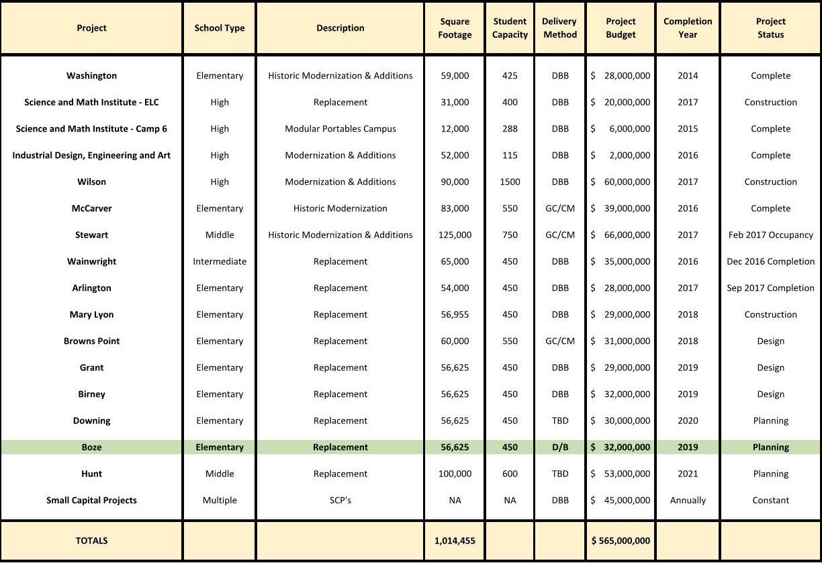
TPS 2013 Capital Bond Program
Notes:
Yellow Highlighted GCCM Projects
Green Highlighted- Just beginning or starting in the next couple of years
May or may not be occupied

Slide 13
TPS Public Body Experience: 2001 - 2016
Notes:
As a public body depth of public works experience
TPS is a major capital project builder

Slide 14
TPS Project Delivery Experience & Qualifications
Successfully passed $1.3 B in Capital Improvement Funds
$299 M between 1983 and 1997
$450M in 2001
$500M in 2013
From 2001 to 2017 alone, funds have been used for Modernizations, Replacements, and/or Building Additions to 35 public schools
25 projects complete
4 projects in construction Arlington ES, Wilson HS, Environmental Learning Ctr., Mary Lyon ES
3 projects in design stages Browns Point ES, Grant ES, Birney ES
3 projects remaining to begin Hunt MS, Boze ES, Downing ES

Slide 15
TPS Project Delivery Experience & Qualifications
Since 2001, TPS has successfully delivered 26 large capital projects valued at approximately $859 million.
Augmenting and Enhancing the internal team – Since 1998 teaming with external consulting teams.
TPS has developed a robust internal staff and control systems to plan and execute the work.
Notes:
Controls
-Weekly Staff Meetings
-Weekly progress meetings
-One on one PM daily and weekly meetings
-Standing daily and weekly meetings with COO
-Multi Vista- Photographic Interactive As-Built
-Digitized As Builts and OEM Manuals in the Cloud (Skisite)
-Chalk Schools- Soup to nuts process for Project approvals

Slide 16
The Project

Slide 17
Project Location
Boze
Elementary School

Slide 18
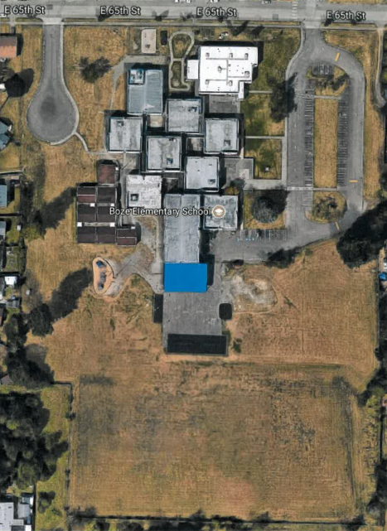
Current Site Overview

Slide 19
Project Description
Located in Southeast Tacoma
15-acre site
Replace the existing facility
Build to house 450 students
56,625 sq. ft.; Single story
Build new school first
Demolish existing buildings next - for development of parking, yards and playfields
Board approved budget: $32 M
Construction timeline: July 2018-August 2019
Occupancy - Fall of 2019

Slide 20
Site Constraints

Slide 21
Possible Site Options

Slide 22
Possible Site Options

Slide 23
Project Budget
Category | Budget
Professional Services (A/E, Legal, etc.) | $2,500,000.00
Project Construction Cost(including 5% construction contingency) | $22,330,000.00
Design Contingencies (7.39%) | $1,625,000.00
Equipment & Furnishing Costs (6.5%) | $1,450,000.00
Contract Administration Costs (Owner, PM, CM, etc.)(2%) | $450,000.00
Owner Contingences (3%) | $650,000.00
Other Related Project Costs (permits, fees, etc.)(3.3%) | $739,670.00
Sales Tax (10.1%) | $2,255,330
TOTAL: | $32,000,000.00

Slide 24
Project Schedule
PRC Presentation and Approval | July 27th, 2017
TPS Board Presentation on Design Build | July 27th, 2017
TPS Board Approval for Design Build | August 10, 2017
Request for Qualifications Advertised | August 11, 2017
Pre-Proposal Meeting | August 16, 2017
Statement of Qualifications Due | September 8, 2017
Shortlist Announced; Interview Format Released | September 11, 2017
Interviews Complete; Award Recommendation | September 29, 2017
TPS Board Approval, Contract Awarded | October 10, 2017
Preliminary Design Phase | October 2017 – January 2018
Final Design Phase; Negotiate GMP | February 2018 – May 2018
Construction | June 2018 – July 2019
Occupancy | August 2019

Slide 25
Project Schedule
Procurement schedule allows for team formation, questions, addenda as needed prior to SOQ’s due
Assumes qualifications-based selection – limited document production by competitors
Interviews will ask for limited design concepts by teams
Assumes cost-reimbursable contract – negotiated GMP
Possible early release of key subs and long lead items
Overall approach follows WSU and UW approach – highly collaborative, open book

Slide 26
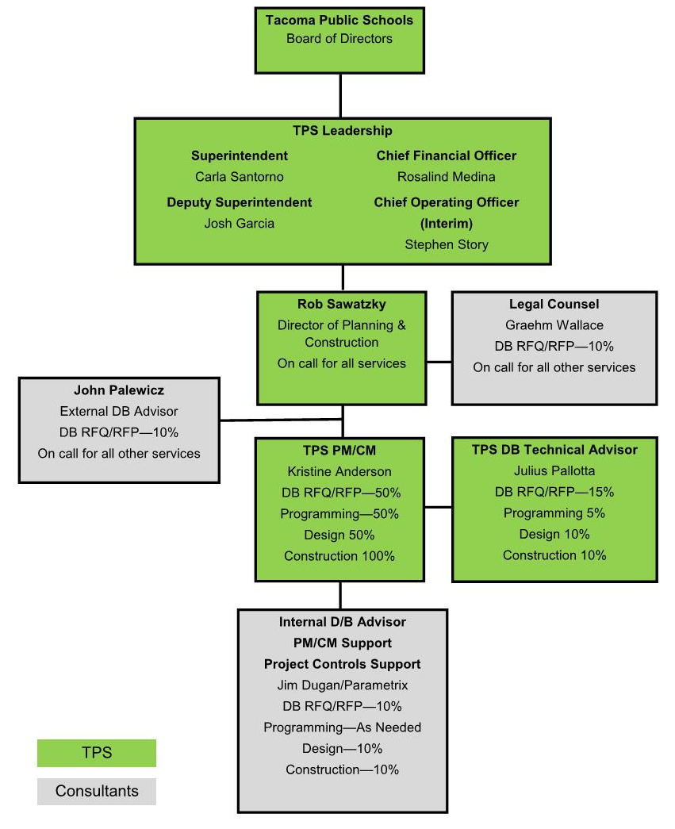
Project Organizational Chart

Slide 27
Why D/B Delivery Method

Slide 28
Market Conditions
In Washington State
Between 2011 and 2017
Voters Approved $11.8 B in K-12 Funding
More Than $2.67 B Planned for 2018 and 2019
Total of $14.47 B in 8 Years - $1.8 B/Yr
Unprecedented Cost Increases in Bid Market @ $20 M to $30 M MACC Range
Budgets at $320/sf – Bidding at 30% to 50% Higher
Need to Reduce Owner Risk
Need to Improve Cost Control
Design/Build is the Owners Best Strategy

Slide 29
Cost Certainty
Need to Know the Project Cost Earlier
Cannot Wait Until Summer of 2018
Cost Increases at Boze ES – Puts Remaining Projects at Risk
Arlington ES Program and Design Specifications – Known
Boze ES Site – Flat, Not Complicated
Site Adaptation – Straight Forward
Cost Known: Fall 2017
Design/Build is the Owners Best Strategy

Slide 30
Escalation
Escalation Continues
No Decrease in Sight
Time is Cost
Goal: Complete Boze ES Sooner if Possible
Original Plan: Open Boze ES in Fall 2020
Using the D/B Method of Delivery
New Plan: Open Boze ES in Fall 2019
Occupies One Year Earlier
Design/Build is the Owners Best Strategy

Slide 31
Statutory Compliance
(5.1) If the construction activities are highly specialized and a D/B approach is critical in developing the construction methodology
(5.2) If the project provides opportunity for greater innovation and efficiencies between the designer and builder
(5.3) If significant savings in project delivery time would be realized
Savings in:
(A) Design Costs
(B) Bid Market Costs
(C) Escalation Costs
(D) Occupy One Year Earlier

Slide 32
Public Benefit
Cost Savings
Risk Mitigation
Early Occupancy
Accountability

Slide 33
Public Body Qualifications

Slide 34
Leadership Team
TPS has extensive K-12 capital projects experience including projects of similar scope and complexity
All of which have been delivered using Design-Bid-Build or GC/CM.
Long track record of building projects on-time and within budget.
Long track record of RCW 39.10 compliance
TPS is new to the Design Build method of project delivery
Assigned TPS PM: Kris Anderson
24 Years Experience as a Project Manager
24 Years as a Licensed Architect
7 Design-Build Projects Experience
Most Recent D/B Project Completed in 2012
Parametrix: PM/CM Support and Internal D/B Advisor
Julius Pallotta: Internal TPS D/B Technical Advisor
John Palewicz: External D/B Advisor
Graehm Wallace: External D/B Legal Counsel
TPS satisfies the public body qualifications by staff augmentation with consultants.

Slide 35
Design Build Experience

Slide 36
Summary
Project is funded with the appropriate budget
Project meets qualifying RCW criteria
Project Management Plan is developed and has clear and logical lines of authority
Project team has the necessary experience
Project team has the capacity
Project team is prepared and ready to move forward

Slide 37
Thank You

