Slide 1


Skyline Elementary School
Replacement
RCW 39.10 Alternative Public Works Contracting – Progressive Design/Build
September 26, 2019

Slide 2

Agenda
Introductions
Tacoma Public Schools
Agency Organization Chart
Capital Planning & Construction Org Chart
Capital Project History
Business Equity
The Project
Project Budget
Project Schedule
Why Design Build
Qualifications
Summary

Slide 3
Presenting Team
Morris Aldridge – Executive Director, Planning & Construction, Tacoma Public Schools
Debbie Boodell - Project Manager/Construction Manager
Jim Dugan – Program Manager
Dan Cody – D/B Procurement

Slide 4
Additional Team Members
Chris Williams – Chief Operating Officer, Tacoma Public Schools
Graehm Wallace – External D/B Legal Counsel
Alicia Lawver – Strategic Program Analyst

Slide 5
Tacoma Public Schools
Founded in 1869
Comprised of:
    36 Elementary Schools
    11 Middle Schools
    10 High Schools
    Numerous Special Programs
4th largest school district in the State of Washington
Approximately 30,000 students
Over 5,000 employees
Serving Pre-K thru 12th grade
One of the largest employers in Tacoma

Slide 6
Tacoma Public Schools

Slide 7
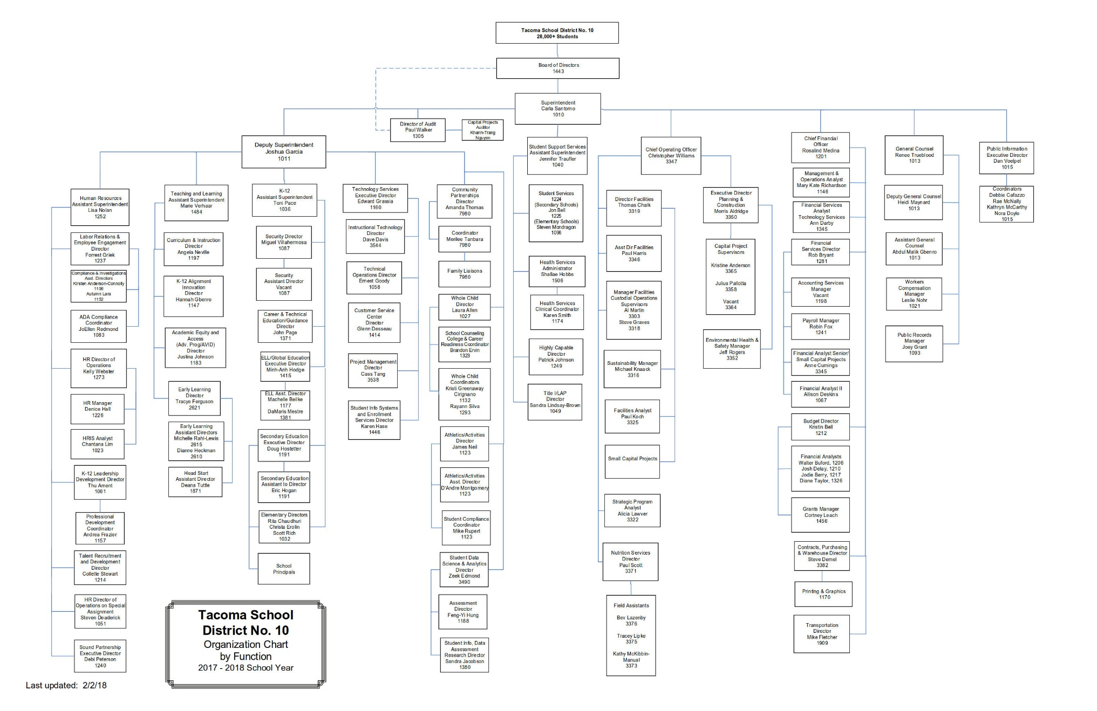
Agency Organization Chart

Slide 8
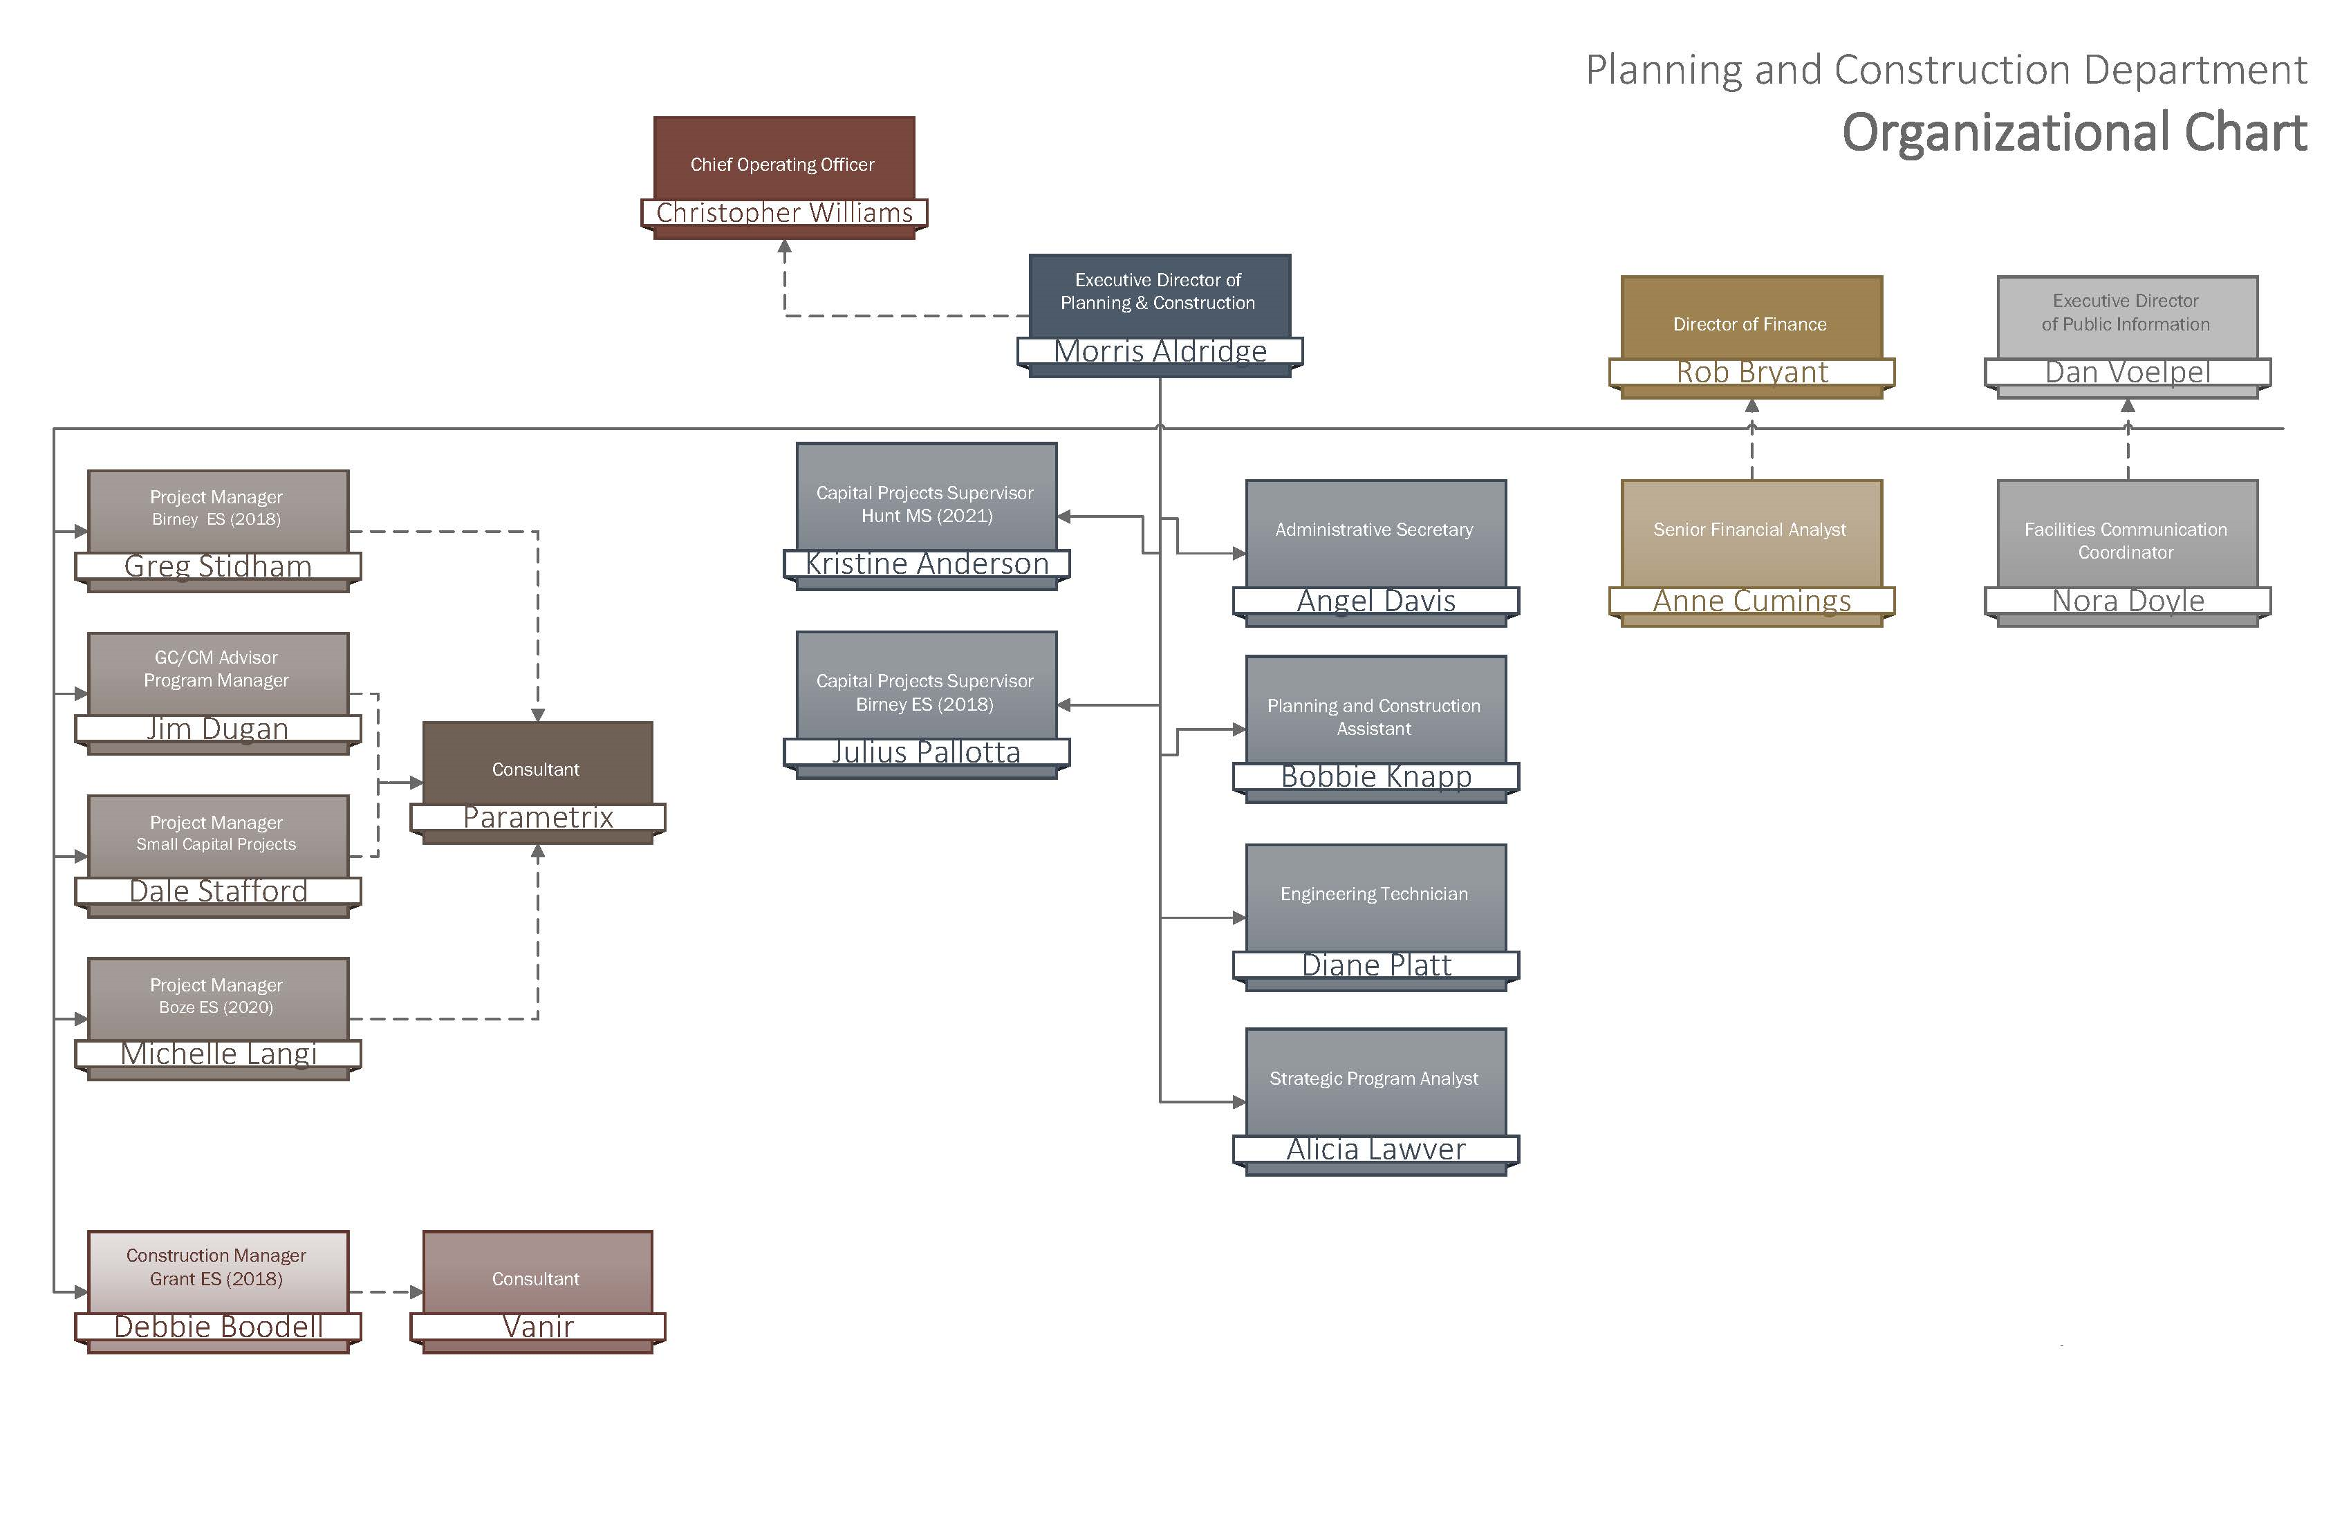
Capital Planning & Construction Organization Chart

Slide 9
Business Equity:
TPS Community Inclusion Plan
Tacoma Public Schools is committed to Community Inclusion, as partnerships are critical to student education and community health and sustainability.
  Local share of construction 30% (Pierce County based)
  Adopt Governor’s diverse business goals, including:
    10% Minority-Owned Business Enterprises,
    6% Woman-Owner Business Enterprises, and
    5% Small Business Enterprises (SBE)

Slide 10
Business Equity:
TPS Community Inclusion Plan
Additionally, Tacoma Public Schools will require prime contractors to:
  Include “Voluntary Inclusion Plans” in all bid packages $300,000+ to utilize sub-contractors from:
    Minority & Women Owned Business Enterprises (MWBE),
    Small Business Enterprises (SBE), and
    An Apprenticeship Utilization Plan
  Report and make available to the District and Community partners:
    Monthly percentages of MWBE and SBE utilized on the project
    Prevailing wage intents and affidavits,
    Monthly certified payrolls with quarterly compliance review
    Monthly apprenticeship utilization percentages

Slide 11
BUSINESS EQUITY AND INCLUSION TACOMA PUBLIC SCHOOLS COMMUNITY INCLUSION PLAN
Performance Dashboard 2018-2019
MBE: Goal: 10%
Actual: 25.3%
Actual/Goal 253% of Goal
WBE: Goal: 6%
Actual: 8.2% Actual/Goal 137% of Goal
SBS: Goal: 5%
Actual: 12.2%
Actual/Goal: 244% of Goal
Local Share: Goal: 30%
Actual: 64%
Actual/Goal: 213% of Goal
Outreach Forums: 4
Incubator Workshops: 4
Required Contract Compliance
All Contracts

Slide 12

Capital Project History

Slide 13
TPS 2013 Capital Bond Program
Notes:
Yellow Highlighted GCCM Projects
Green Highlighted- Just beginning or starting in the next couple of years
May or may not be occupied

Slide 14
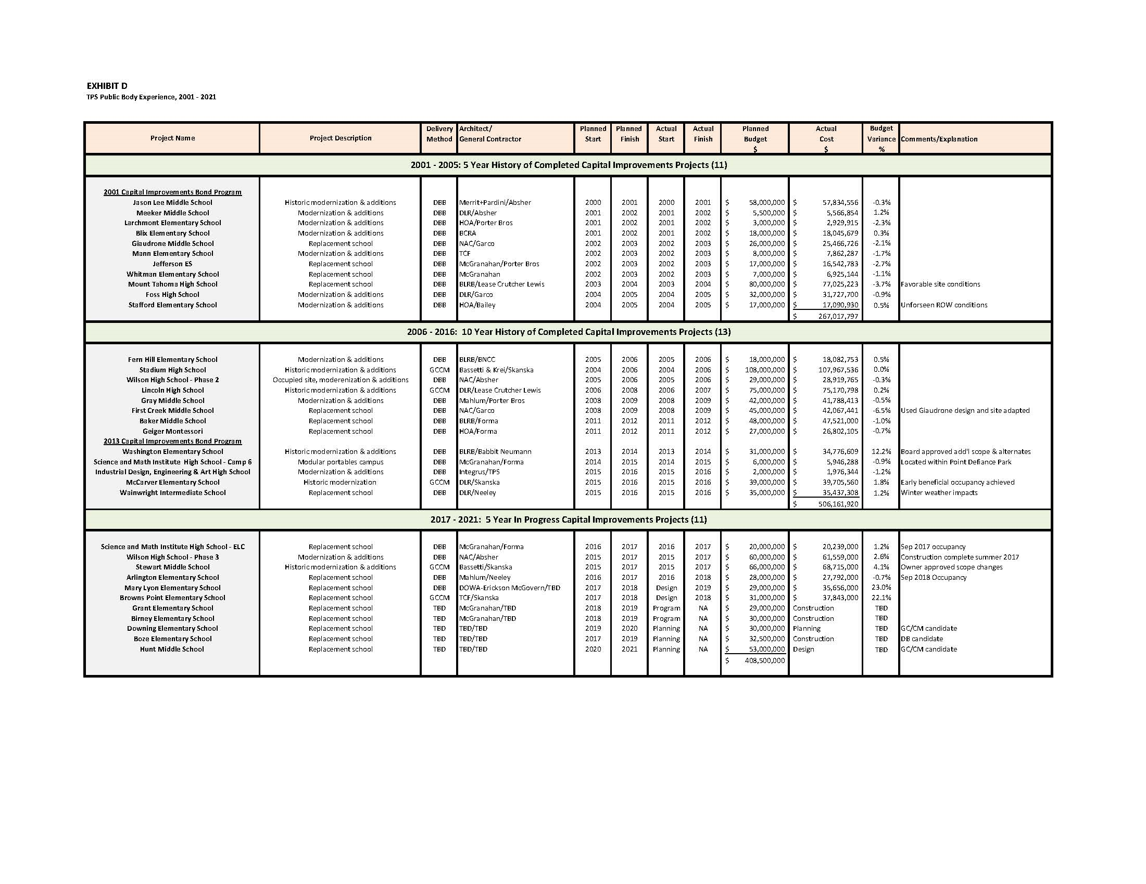
TPS Public Body Experience: 2001 – 2021
Notes:
As a public body depth of public works experience
TPS is a major capital project builder

Slide 15
TPS Project Delivery Experience & Qualifications
Successfully passed $1.3 B in Capital Improvement Funds
  $299 M between 1983 and 1997
  $450M in 2001
  $500M in 2013
From 2001 to 2018 alone, funds have been used for Modernizations, Replacements, and/or Building Additions
to 34 public schools
  30 projects complete
  3 projects in construction
  Grant ES, Birney ES & Boze ES
  1 projects in design stages
  Hunt MS

Slide 16
TPS Project Delivery Experience & Qualifications
Since 2001, TPS has successfully delivered 30 large capital projects valued at approximately $1.01 billion.
Augmenting and Enhancing the internal team – Since 1998 teaming with external consulting teams.
TPS has developed a robust PM/CM Team and control systems to plan and execute the work.
Notes:
Controls
-Weekly Staff Meetings
-Weekly progress meetings
-One on one PM daily and weekly meetings
-Standing daily and weekly meetings with COO
-Multi Vista- Photographic Interactive As-Built
-Digitized As Builts and OEM Manuals in the Cloud (Skisite)
-Chalk Schools- Soup to nuts process for Project approvals

Slide 17
The Project

Slide 18
Project Location
Skyline Elementary

Slide 19
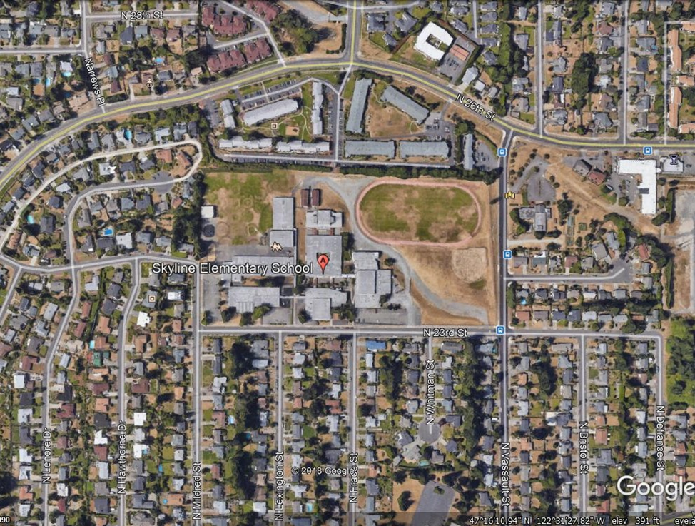
Current Site Overview
New Skyline Location

Slide 20
Project Description
Located in Northwest Tacoma
20-acre site
Replace the existing facility
Build to house 450 students
Build new school while existing remains occupied
Existing school will remain and function as a “swing school” for future projects
Proposed total project budget: $42.67 M
Construction timeline: April 2021 - June 2022
Occupancy – July-August 2022

Slide 21
Site Constraints
Site located in dense residential neighborhood
Required noise control, dust control and pedestrian access
Extensive off-site improvements
Existing school and professional development center to remain occupied and operational

Slide 22
Project Budget
Category | Budget
Cost for Professional Services (A/E provided by D/B) | $3,383,181.00
Estimated Project Construction Costs (including D/B contingency @ 3%) | $28,193,174.00
Equipment and Furnishing Costs (includes technology) | $1,490,000.00
Off-site Costs | $750,000.00
Contract Administration Costs (owner, cm etc.) | $1,350,000.00
Contingencies (Owner Project Contingency @ 5% of MACC) | $1,410,000.00
Other Soft Costs (owner’s consultants, permits/fees, etc.) | $2,905,169.00
Sales Tax (@ 10.1% of A/E + Construction Cost) | $3,189,212.00
TOTAL: | $42,670,736.00
Note: This is a proposed project that would be funded from the proceeds of a $535 million capital bond that will be presented to the voters in February 2020.

Slide 23
Project Schedule
Project Schedule | Start | Finish
PRC Application |  | August 20, 2019
PRC Presentation |  | September 26, 2019
RFQ 1st Advertisement |  | October 2, 2019
RFQ 2nd Advertisement |  | October 9, 2019
Pre-submittal Meeting |  | October 16, 2019
Statement of Qualifications Due |  | October 25, 2019
Score SOQs/Shortlist Finalists | October 28, 2019 | November 1, 2019
Notify Submitters/Release RFP |  | November 4, 2019
Proprietary Meetings w/Finalists |  | November 11, 2019
Proposals Due – Cost Factors and Approach |  | November 20, 2019
Interviews |  | November 26, 2019
Score/Identify Most Qualified D/B | November 26, 2019 | November 29, 2019
Notify Submitters |  | December 2, 2019
Contract Negotiations (3 weeks) | December 2019 | December 2019

Slide 24
Project Schedule
Project Schedule | Start | Finish
TPS Capital Bond Election |  | February 2020
NTP/Board Approval of D/B Contract |  | March 2020
Preconstruction & Design (60%) | March 2020 | November 2020
Negotiate GMP (1 month) | December 2020 | December 2020
Permit & Construction Documents (6 months) | January 2021 | June 2021
Site Permitting (4 months) | December 2020 | March 2021
Building Permitting (4 months) | February 2021 | May 2021
Construction (13 months) | April 2021 | June 2022
Occupancy/Move In | July 2022 | August 2022
First Day of School | September 2022

Slide 25
Project Schedule
Advanced Notice of project published September 11, 2019.
Procurement schedule allows for team formation, questions, addenda as needed prior to SOQ’s due.
Assumes qualifications-based selection – limited document production by competitors.
Interviews will discourage design concepts by teams.
Assumes cost-reimbursable contract – negotiated GMP.
Possible early release of key subs and long lead items.
Overall approach follows WSU and UW approach – highly collaborative, open book.

Slide 26
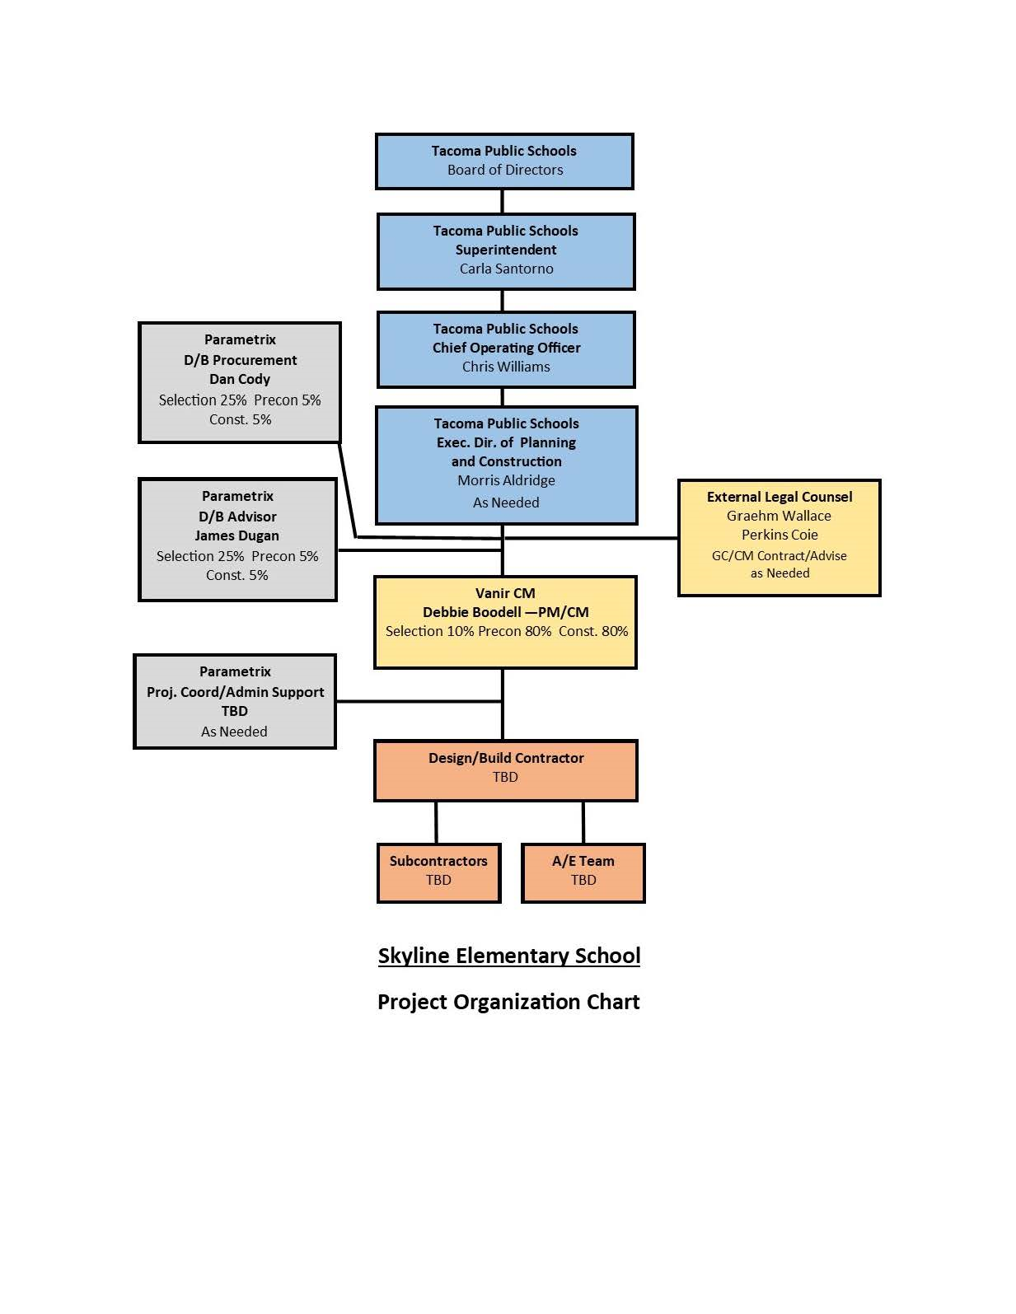
Project Organizational Chart

Slide 27
Why D/B Delivery Method

Slide 28
D/B Delivery Advantages
Earlier Certainty of Project Cost.
Cost Known: Winter 2020
Previous PD/B project at Boze E.S. has shown that design schedule can be greatly reduced over D/B/B or GC/CM
One year from programming to site permit on Boze E.S.
Lower risk of cost increases
Owner only carries one contract with D/B contractor
Design/Build is the Owners Best Strategy

Slide 29
Statutory Compliance
(5.1) If the construction activities are highly specialized and a D/B approach is critical in developing the construction methodology
(5.2) If the project provides opportunity for greater innovation and efficiencies between the designer and builder
(5.3) If significant savings in project delivery time would be realized
Savings in:
(A) Design Costs
(B) Bid Market Costs
(C) Escalation Costs

Slide 30
Public Benefit
Cost Savings
Risk Mitigation
Accountability

Slide 31
Public Body Qualifications

Slide 32
Leadership Team
TPS has extensive K-12 capital projects experience including projects of similar scope and complexity
  Currently delivering Boze ES and Hunt M.S. utilizing Progressive D/B.
  All previous projects have been delivered using Design-Bid-Build or GC/CM.
  Long track record of building projects on-time and within budget.
  Long track record of RCW 39.10 compliance.
TPS currently has two D/B projects underway and is a proponent of D/B delivery.
Debbie Boodell (Vanir CM): Project Manager/Construction Manager
  19 Years of Project experience; 3 Previous Design Build Projects
Parametrix: PM/CM Support and Internal D/B Advisor
Graehm Wallace: External D/B Legal Counsel
TPS satisfies the public body qualifications by staff augmentation with consultants.

Slide 33
Design Build Experience

Slide 34
Summary
Project is planned with the appropriate budget
Project meets qualifying RCW criteria
Project Management Plan is developed and has clear and logical lines of authority
Project team has the necessary experience
Project team has the capacity
Project team is prepared and ready to move forward

Slide 35

Thank You

