Slide 1
Alder Unit 11 Rebuild Project
Project Review Committee | Project Approval Presentation | Design-Build Contracting
May 23, 2019 Presentation

Slide 2
Agenda
Team Introductions
Organization – City of Tacoma, Tacoma Power
Project – Organization Chart/ Background/ Scope/ Budget/ Schedule
Statutory Criteria and Qualifications
Summary

Slide 3
Team Introductions
Tacoma Power
Ram Veeraraghavan, PE, Program Manager
David Wagner, PE, Assoc. DBIA, Project Manager
Martha Lantz, JD, Internal Legal Counsel
Stantec
Richard Patterson, PE, SE, DB Consultant
Stanley Hayes, PE, Hydro Design Consultant
Thaxton Parkinson
Robynne Thaxton (Parkinson), JD, FDBIA, DB and Legal Advisor

Slide 4
Organization - City of Tacoma
City of Tacoma
City Council
Public Utility Board
City Manager
Director of Public Utilities
Environmental Services
Public Works
Planning and Development Services
Tacoma Power
Tacoma Water
Tacoma Rail

Slide 5
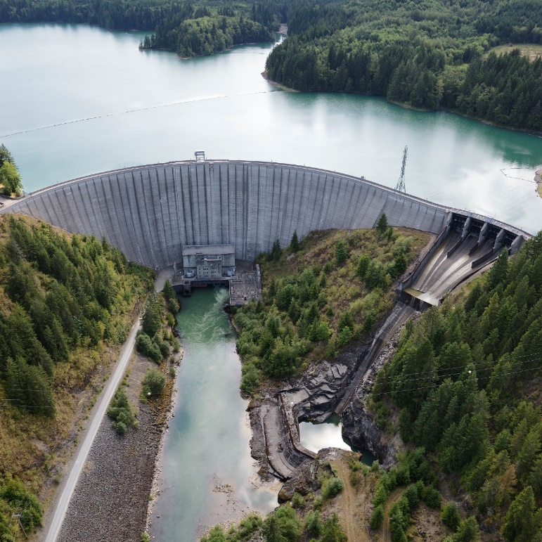
Organization - Tacoma Power
Established in 1893
798 employees
179,000 customers
180 square miles of service area
22 hydro units – 834 megawatts generation
Alder Dam and Powerhouse

Slide 6
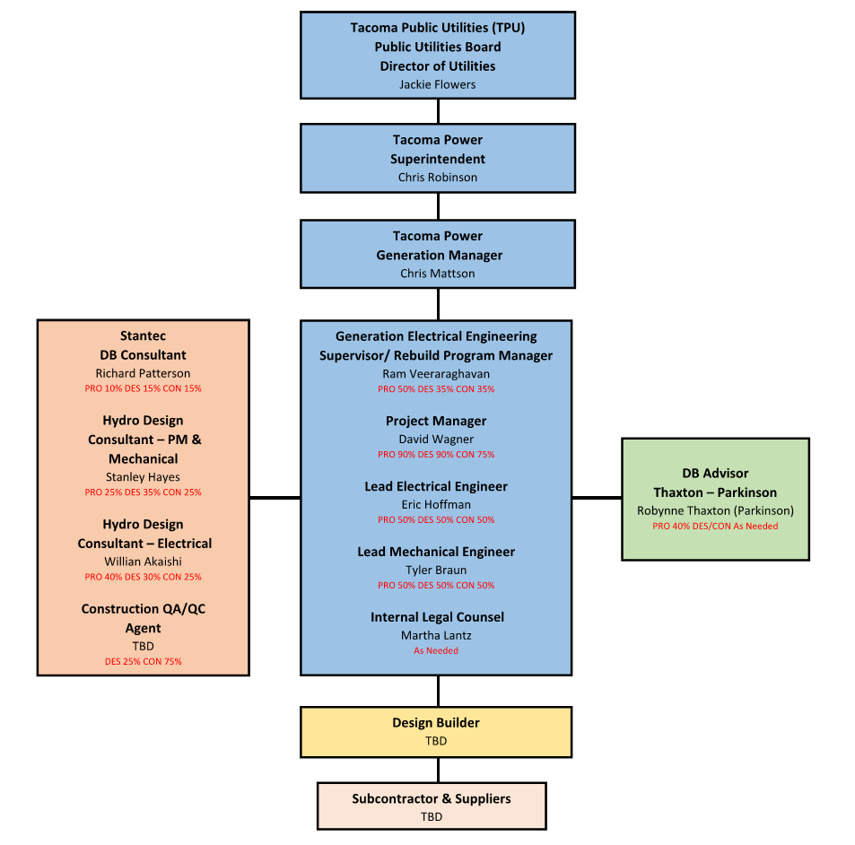
Project - Organization Chart

Slide 7
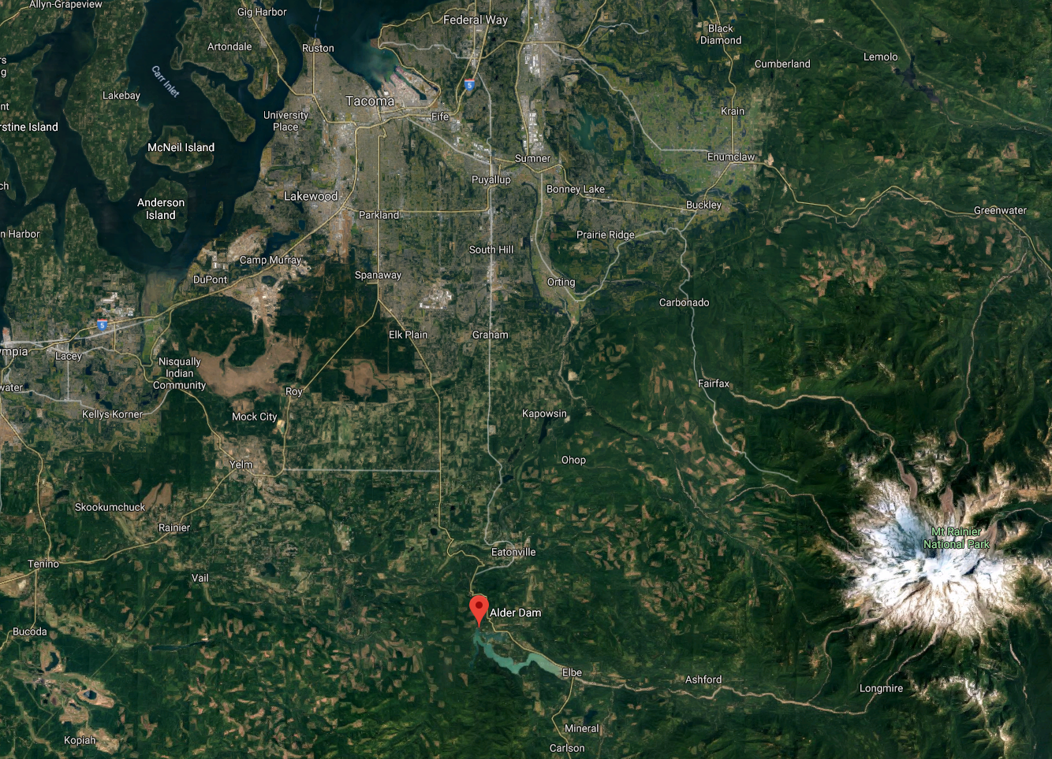
Project - Background
Project Site

Slide 8
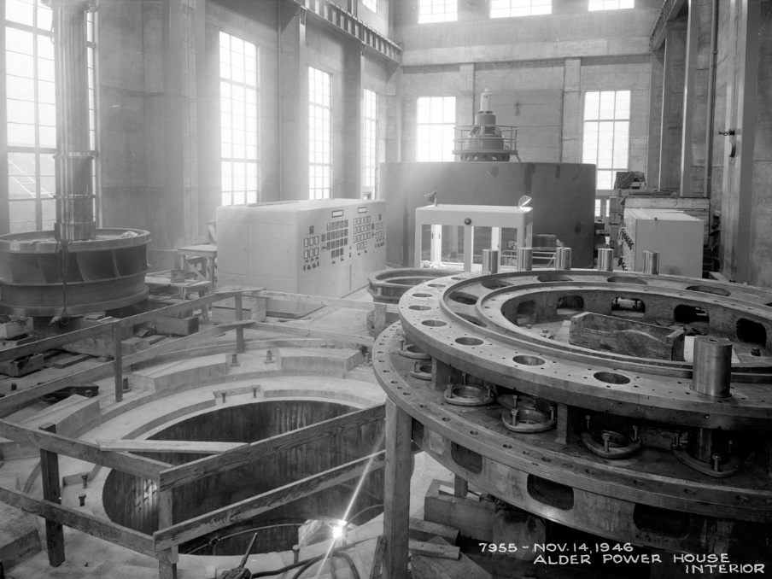
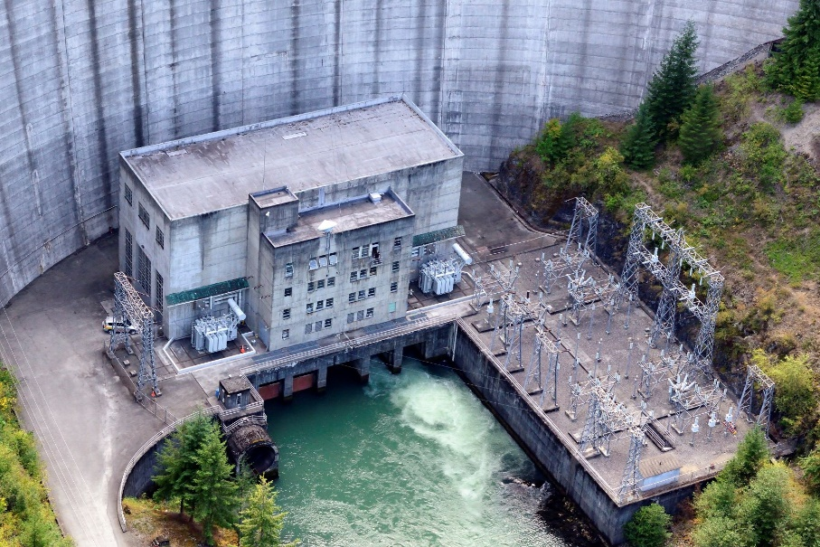
Project - Background
Original construction in 1945
Unit 11 commissioned in 1947
Last major work in 1973
Many original components still in service today
Condition assessment completed in 2016
Business case for project approved in 2018

Slide 9
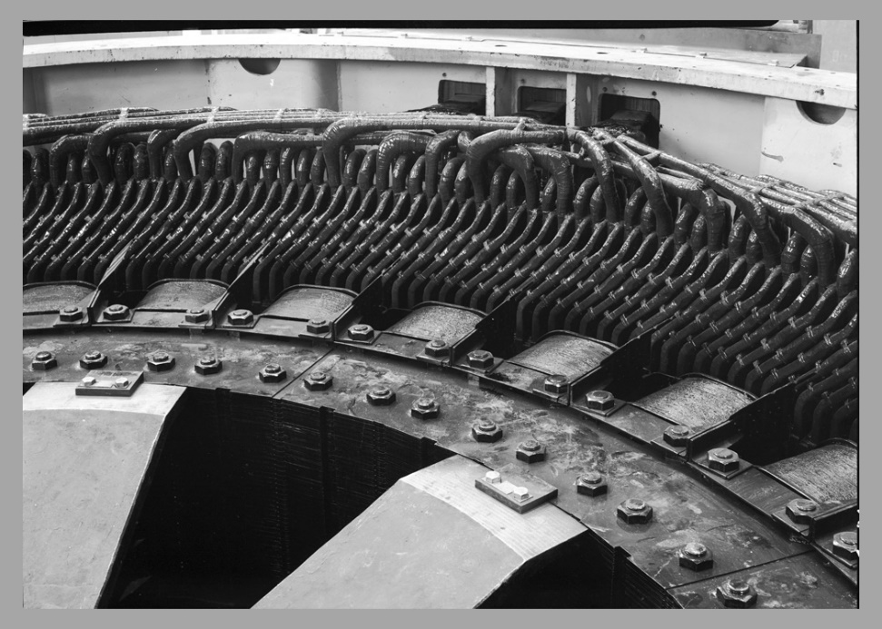
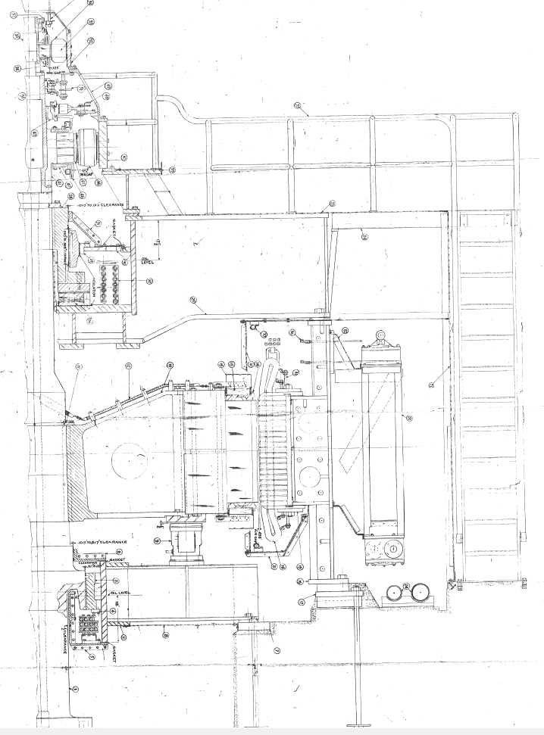
Project - Background
Generator Components
Rotor and shaft (200,000 lbs)
Stator sections (108,000 lbs)
  Frame
  Core
  Windings
Air Gap 0.656”
9

Slide 10
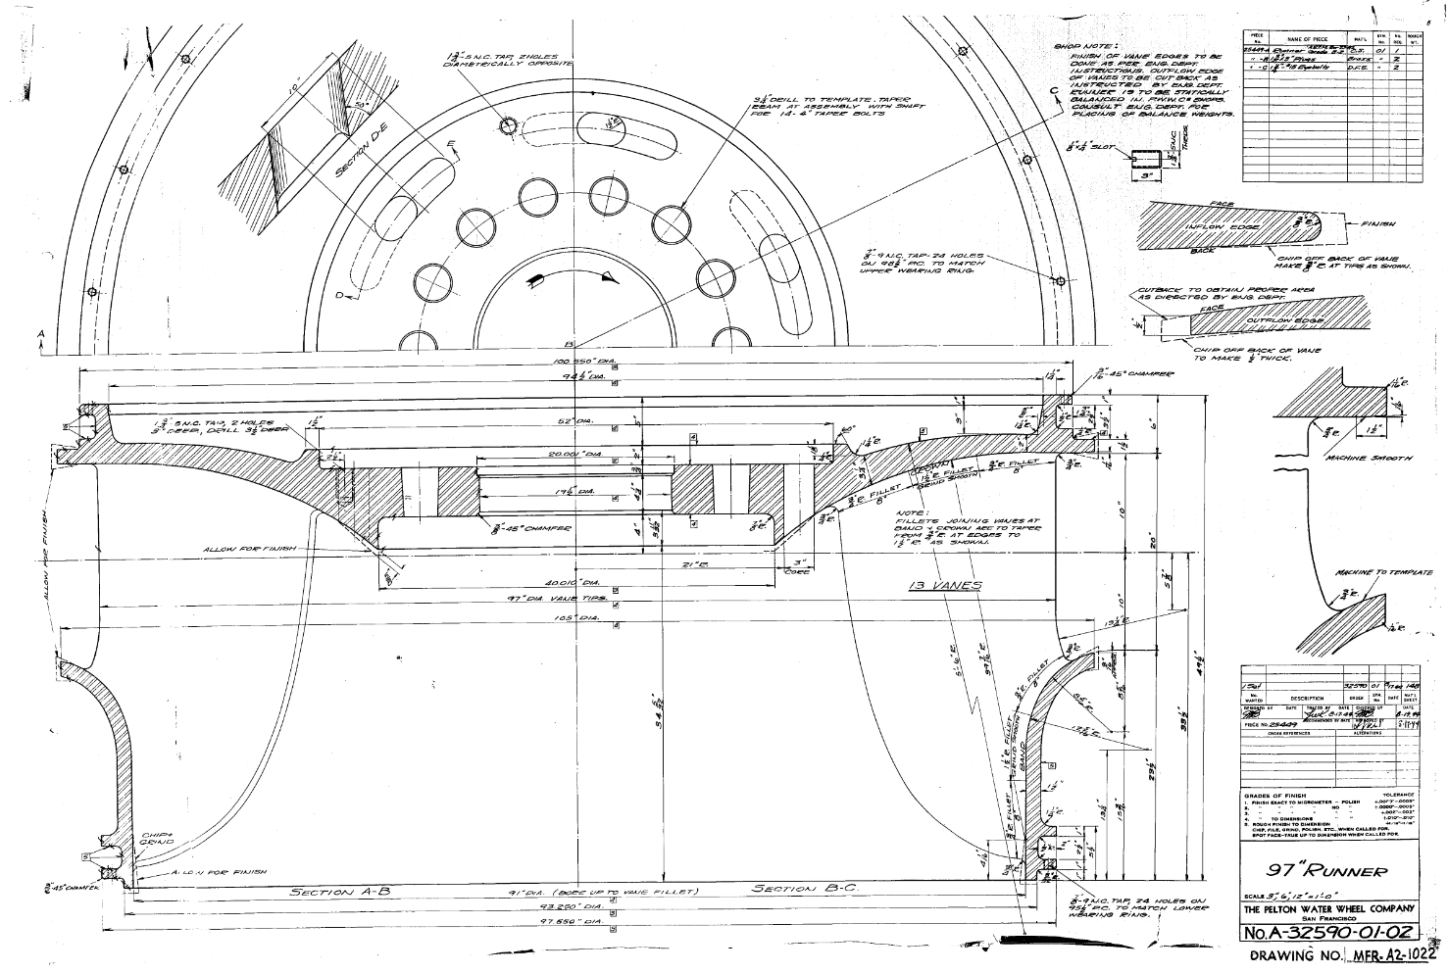
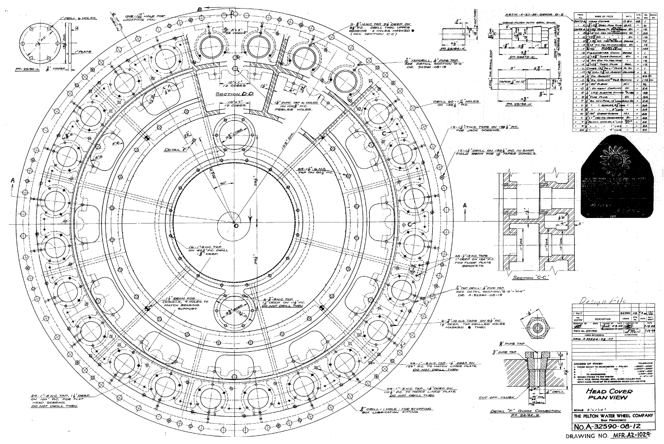
Project - Background
Turbine Components
Runner and turbine shaft (44,500 lbs)
Headcover (35,000 lbs)
Guide vanes and levers (35,000 lbs)
Misc. (28,000 lbs)
10

Slide 11
Project - Scope
Unit disassembly
Assess components
  Disassemble, clean, inspect/assess for re-use
Repair and re-machine to original dimensions and tolerances as necessary
Turbine work
  Weld and machine worn and corroded parts that have 40 years remaining life
  Replace bearing, bushings and seals
  Manufacture and install new parts that do not have 40 years remaining life
Generator work
  Inspect stator frame and rotor spider
  Rewind stator (new windings)
  Restack core (new laminations)
  Refurbish poles
Reassemble components into a functioning turbine generator

Slide 12
Project - Budget
Category | Cost
Costs for Professional Services (A/E, Legal etc.) | $409,000
Estimated project construction costs (including construction contingencies) | $5,854,000
Equipment and furnishing costs | $274,000
Contract administration costs (owner, cm etc.) | $1,459,000
Contingencies (10%) | $814,000
Other related project costs (Owner performed concurrent work) | $148,000
Total | $8,958,000

Slide 13
Project - Schedule
Activity | Estimated Date*
PRC Presentation | May 23, 2019
Publication of RFQ for Design-Build Services | July 1, 2019
RFQ Submittal Deadline | August 2, 2019
Open and Evaluate Submittals | August 14 - 27, 2019
Identify Finalists | August 27, 2019
Issue RFP to Finalists | September 3, 2019
Proprietary Meetings | October 7 - 11, 2019
RFP Submittal Deadline (Price & Technical Proposals) | December 3, 2019
Open and Evaluate Technical Proposals | December 4 - 31, 2019
*Dates in RED differ from dates listed in PRC application

Slide 14
Project - Schedule
Activity | Estimated Date*
Design-Builder Interviews | January 6 - 10, 2019
Open Price Proposals & Complete Scoring | January 10, 2020
Notify Design-Builders of Scoring and Recommendation to Award | February 3, 2020
Design-Build Contract Negotiation | February - March, 2020
Execute Design-Build Contract | April, 2020
Design & Manufacturing | May, 2020 - September, 2021
Site Set-up and Mobilization | May, 2022
Construction Phase | June - November, 2022
Commissioning & Operational Testing | December, 2022 - January, 2023
Final Completion and Closeout | January - March, 2023
*Dates in RED differ from dates listed in PRC application

Slide 15
Statutory Criteria
RCW 39.10.300(1)(a) “The construction activities are highly specialized and a design-build approach is critical in developing the construction methodology”
Limited access for removal and reinstallation
Massive scale/size of components
Very specialized machining/fabrication will be required
Very tight clearances/tolerances required between operational and stationary components
RCW 39.10.300(1)(b) “Greater innovation or efficiencies between the designer and the builder”
Maximum possibility for coordination of design, condition assessment and construction
RCW 39.10.300(1)(c) “Significant savings in project delivery time”
Manufacturing of long lead items can begin much sooner
RCW 39.10.300(5) “Public bodies may use the design-build procedure for public works projects in which the total project cost is between two million and ten million dollars and that meet one of the criteria in subsection (1)(a), (b), or (c)”

Slide 16
Qualifications
City of Tacoma is an approved Public Body to use Design-Build
Tacoma Power has extensive construction experience
Tacoma Power has assembled a team with necessary Design Build, project management, and technical knowledge and experience
Tacoma Power Program Manager and Project Manager have attended DBIA training

Slide 17
Summary
Project is funded with the appropriate budgets
Project meets RCW criteria
Project team has the necessary experience and capacity
Project team is prepared and ready to proceed

Slide 18
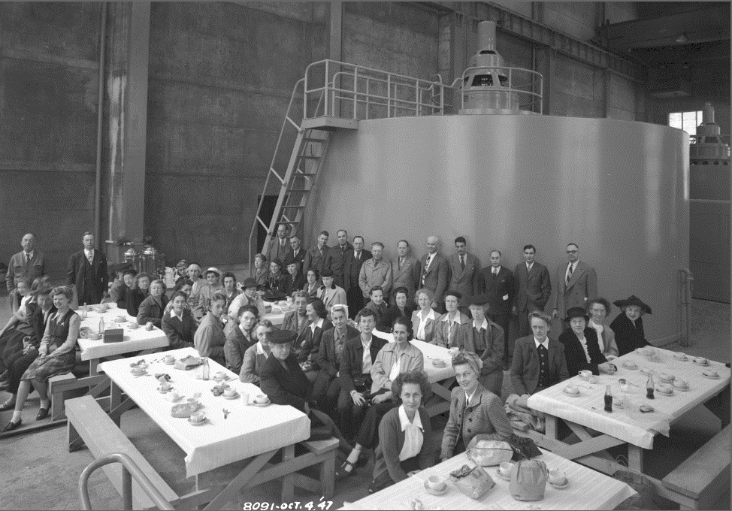
Questions
Alder Powerhouse Teacher’s luncheon - 1947

