Slide 1

Application for
Project Approval
Capital Improvements to Shadow Lake Elementary School
Thursday, January 25, 2018

Slide 2

Agenda
  Introductions
  Scope
  Schedule
  Budget & Funding
  Why this Project is Suited for GC/CM
  Questions
Notes:
Dan Chandler

Slide 3
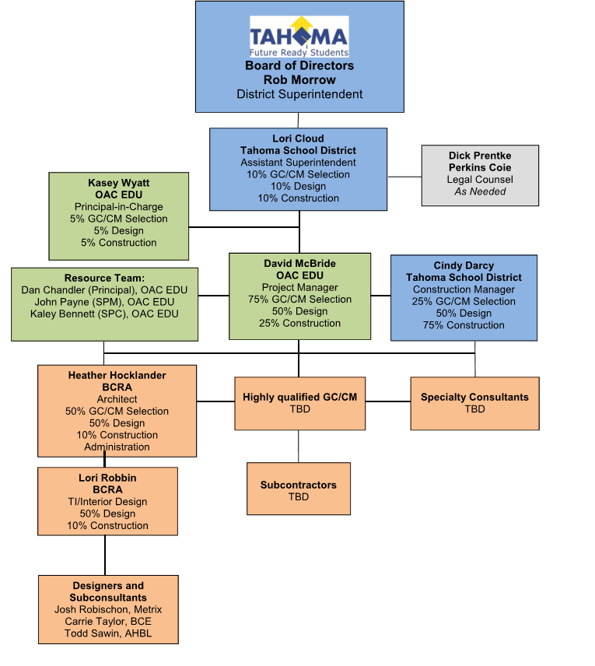
Project Team
Notes:
Kasey Wyatt

Slide 4
Project Team
  Kasey Wyatt, Principal-In-Charge
    23 year Industry Veteran
    Extensive GC/CM Experience
    Over $1 Billion in K12 Project Experience
  Lori Cloud, Assistant Superintendent
    Over 15 years as Director of Finance and Operations
    Oversight on all 2013 Bond projects
    Alternative Delivery Experience
  David McBride, Project Manager
    12 Years Project Management Experience
    GC/CM Experience
Notes:
Kasey Wyatt

Slide 5
Project Team
  Cindy Darcy, Construction Manager
    4 Years Construction Management Experience
    GC/CM Experience
  Heather Hocklander, Architect Project Manager
    17 Year Industry Veteran
    K12 Design Expertise
    GC/CM Experience
Notes:
Kasey Wyatt

Slide 6
Scope
Remodel Admin, Library and Kindergarten Area, Security, Access Control and Fire Alarm Upgrades
Finishes Upgrades
Exterior and Site Improvements
Notes:
David McBride

Slide 7
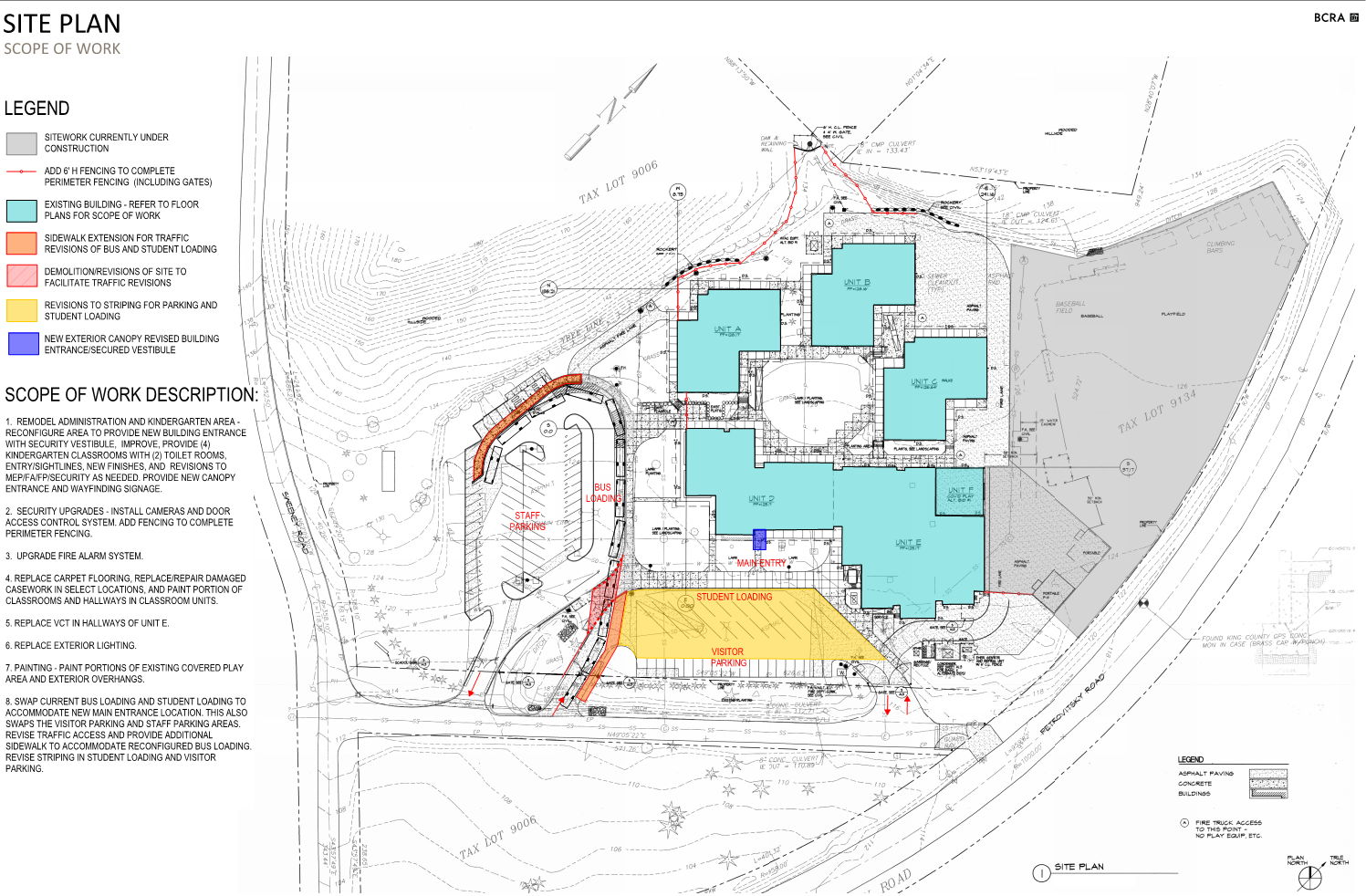
Conceptual Plan
Notes:
Stuart Young

Slide 8
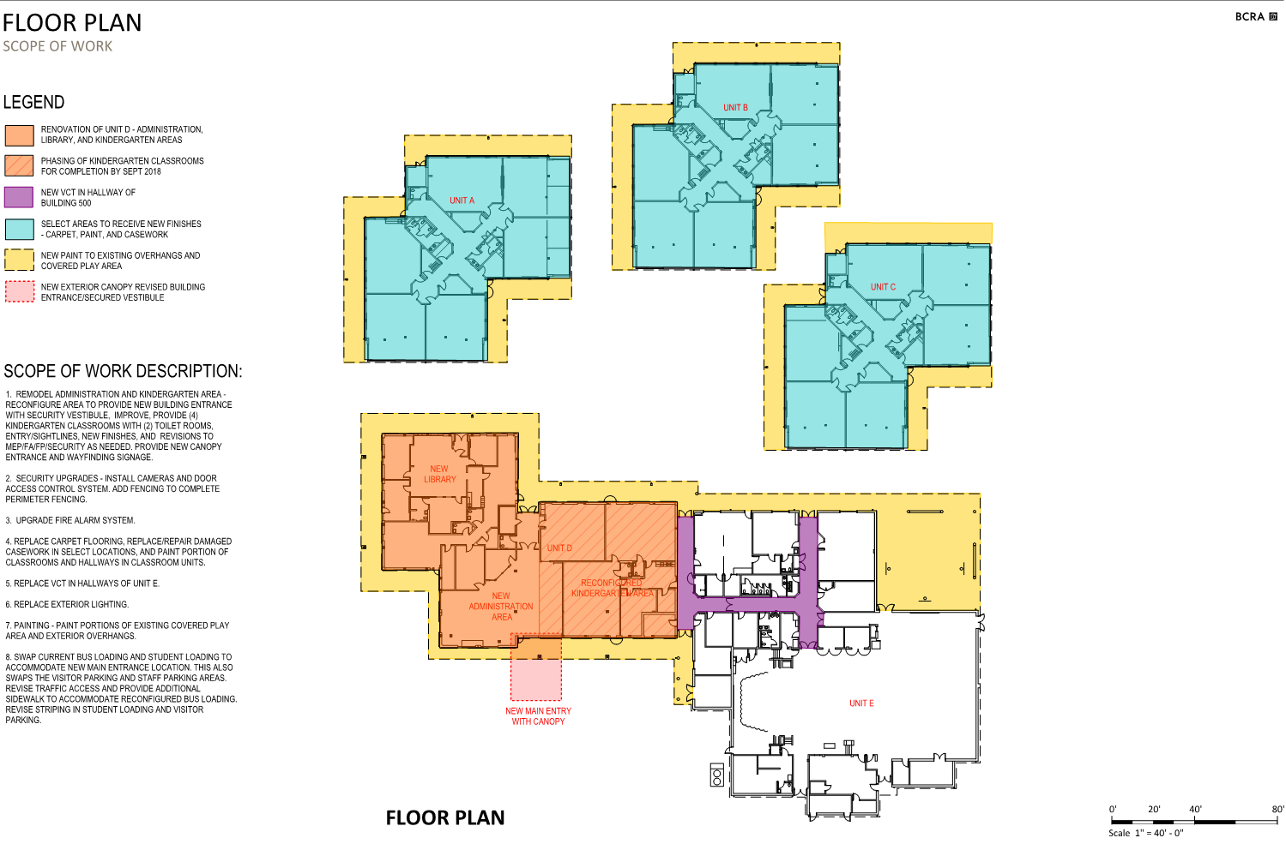
Conceptual Plan
Notes:
Stuart Young

Slide 9
Schedule
Project Scope Development September 2017
Selection of Architect/Engineers October 2017
GC/CM Process January - March 2018
  PRC GC/CM Consideration January 25, 2018
  1st Advertisement for GC/CM RFQ January 30, 2018
  2nd Advertisement for GC/CM RFQ February 6, 2018
  GC/CM Presubmittal Meeting February 9, 2018
  Statement of Qualifications Due February 20, 2018
  Short-list Most Qualified GC/CM’s February 27, 2018
  Interview GC/CM’s March 2, 2018
  Open GC/CM Fee Proposals March 6, 2018
  School Board Award of GC/CM March 27, 2018
Preconstruction Start April 2018
Construction Start July 2018
Substantial Completion May 2019
Notes:
David McBride

Slide 10
Budget
Cost for Professional Services (A/E, Legal, PM) $ 475,735
Estimated project construction costs (including contingency) $ 2,635,298
Equipment and furnishing costs $ 35,000
Contingencies (Design & Owner – 15% construction budget) $ 395,294
Other project costs (permits, moving, testing, etc.) $ 131,764
Sales Tax $ 226,635
Total approved budget $ 3,899,726
Notes:
David McBride

Slide 11
Why Project is Suited for GC/CM
3 Criteria
Complex Phasing and Coordination
Occupied Facility
Involvement of GC/CM is Critical
Notes:
David McBride

Slide 12
Questions?

