Slide 1

Columbia River High School Addition and Modernization Project
Application to use the GC/CM Delivery Method
July 26, 2018 Presentation
“In partnership with home and community, Vancouver Public Schools provides an innovative learning environment that engages and empowers each student to develop the knowledge and essential skills to become a competent, responsible and compassionate citizen. ”

Slide 2
Agenda
Introductions
VPS Capital Improvement Plan
The Project
Project Budget
Project Schedule
Why GC/CM
Qualifications – Public Body
Organization – Project Team
Summary

Slide 3
Introductions

Slide 4
The Project Team – Here Today
Vancouver Public Schools
Todd Horenstein, Assistant Superintendent, Capital Facilities Planning VPS
LSW Architects
Casey Wyckoff, AIA, Principal, LSW Architects
Keith Livie, Project Manager, LSW Architects
Melissa Guarin, Project Architect, LSW Architects
Parametrix
Jim Dugan, GC/CM Program Advisor, Parametrix
Dan Cody, GC/CM Procurement & PM/CM, Parametrix

Slide 5
The Project Team
Other Team Members
Vancouver Public Schools
Jack Claros, VPS Project Lead
LSW Architects
Ralph Willson, AIA, Principal in Charge, LSW Architects
Perkins Coie
Graehm Wallace, Perkins Coie, External GC/CM Legal Advisor

Slide 6
Vancouver Public Schools Capital Improvement Program

Slide 7
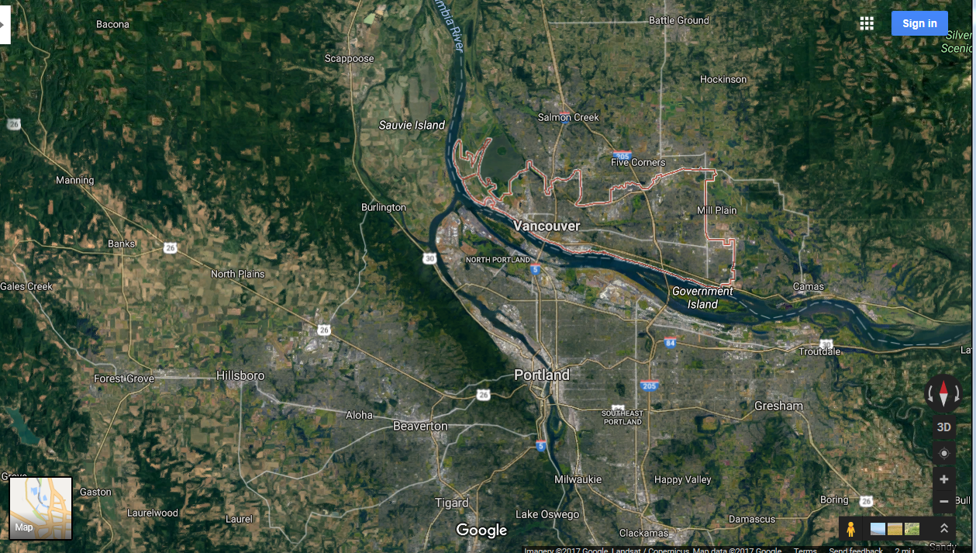
Vancouver Public School District

Slide 8
The District
Located in Clark County, Southwest Washington
Vancouver School District was formed in 1852
Approximately 24,000 student enrollment
Thirty-seven (37) schools comprised of:
  Twenty-one (21) Elementary Schools
  Six (6) Middle Schools
  Five (5) High Schools
  Three (3) Grade 6-12 Magnet Schools
  One (1) Grades K-12 School of Choice
  One (1) High School and Beyond
3,300 teachers, administrators and support staff
Last capital bond passed in 2001 (Phase 3, $400 Million program)
Current capital program - $563 Million, 2017-2022

Slide 9
Business Equity:
Community Inclusion Plan
Vancouver Public Schools is committed to Community Inclusion, as partnerships are critical to student education and community health and sustainability.
Some but not all of the District’s goals in this regard include:
Encouraging local small business participation – working with Oregon Association of Minority Entrepreneurs (OAME)
Contracting with local businesses
Working towards the Governor’s MWBE and SBE diversity goals
Encourage “Voluntary Inclusion Plans” in all large bid packages
Report Monthly percentages of MWBE and SBE utilization

Slide 10
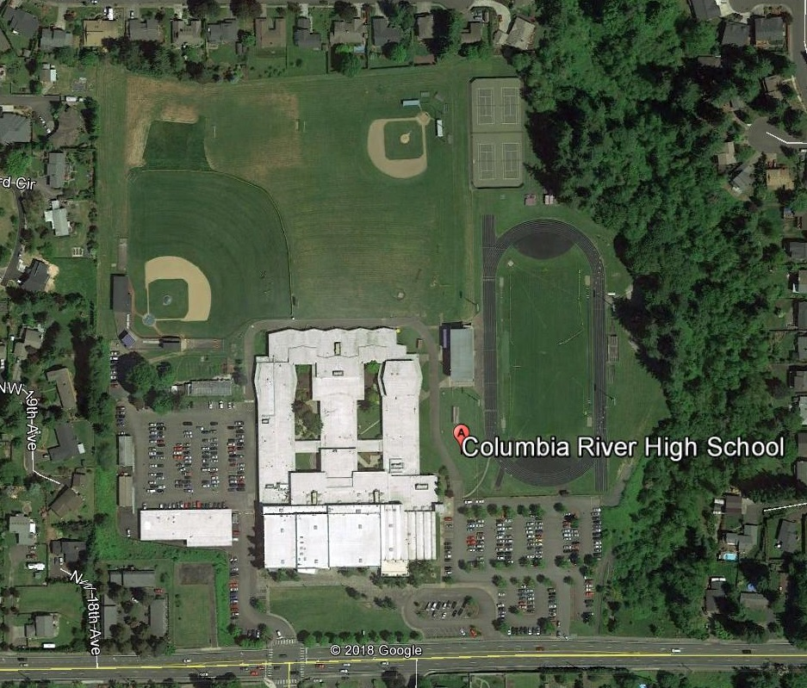
Columbia River High School Additions & Modernization
Occupied Campus
Demolition and replacement of the existing 500 Bldg. classroom wing
New area will be approx. 19,600 sf
Increases student capacity by approximately 200 students
Modernization of approximately 6,400 sf of existing building area.
Anticipated MACC: $13.5 M
Occupancy: Fall 2020
500 Building

Slide 11
Project Budget

Slide 12
Columbia High School Project Budget
Category | Budget
Project MACC (includes GC/CM Risk Contingency @ 3% of MACC) | $11,880,000
GC/CM Fee, SGC’s, Pre-Con Services and NSS Allowance (12% of MACC) | $1,620,000
Subtotal (Owner's MACC) | $13,500,000
Owner’s Construction Contingency (5% of MACC) | $675,000
Furnishings, Fixtures, Equipment, Data/Tech Allowance (10% of MACC) | $1,350,000
Professional Services Allowance (Architects/Engineers) (11% of MACC) | $1,485,000
Owner’s Consultants (PreCon, Survey, Geo-Tech, Hazmat, Insp., etc.) (3% of MACC) | $405,000
Contract Administration Costs (Procurement, PM/CM, etc.) (3% of MACC) | $405,000
Other Project Related Costs (Permits Fees, etc.) | $1,246,000
Sales Tax (8.4% of MACC) | $1,134,000
Total | $20,200,000

Slide 13
Project Schedule

Slide 14
Columbia High School GC/CM Procurement Schedule
Project Schedule | Start
PRC Presentation | July 26, 2018
First Publication of RFP for GC/CM Services | July 31, 2018
Second Publication of RFP for GC/CM Services | August 7, 2018
Project Information Meeting (Date subject to change) | August 17, 2018
RFP Submittal Deadline | August 31, 2018
Open & Score Submittals Received | Sept. 4 – Sept. 6
Notify Submitters of Most Highly Qualified Submitters & Invite to Interview | Sept. 7, 2018
Interviews with Short-listed Firms | Sept. 17, 2018
Notify Submitters of Finalists & Invite to Submit RFFP | Sept. 18, 2018
RFFP Submittal Deadline & Opening | Oct. 2, 2018
Notify Submitters of Scoring and Most Qualified GC/CM | Oct. 5, 2018
Final Pre-Con Work Plan & Fees Due | Oct. 22, 2018
School Board Approval of GC/CM Selection | Oct. 23, 2018
GC/CM Agreement with Pre-Con Services Executed | Oct. 26, 2018

Slide 15
Columbia River High School Design/Construction Schedule
Project Schedule | Start | Finish
Programming (Ed Specs) | May 2018 | July 2018
Schematic Design | August 2018 | October 2018
Design Development | November 2018 | January 2018
Construction Documents | February 2019 | June 2019
Site Development and Land-use Review | March 2019 | April 2019
Building Department Review/Permitting | March 2019 | June 2019
Subcontract Bidding | May 2019 | June 2019
Construction | July 2019 | June 2020
Substantial Completion | July 2020 | July 2020
Punchlist & Closeout | July 2020 | August 2020
Commissioning | May 2020 | June 2020
Owner Move-in | July 2020 | August 2020
Occupancy | September 2020 | September 2020
Warranty Period | July 2020 | July 2021

Slide 16

Why GC/CM Delivery Method for The Columbia River High School Additions & Modernization Project

Slide 17
Complies with 3 of the 5 Statutory Criteria
(1) Implementation of the project involves complex scheduling, phasing, or coordination.
(2) The project involves construction at an occupied facility which must continue to operate during construction.
(3) The involvement of the General Contractor/Construction Manager during the design stage is critical to the success of the project.
(4) The project encompasses a complex or technical work environment.
(5) The project requires specialized work on a building that has historic significance.

Slide 18
Project Complexity
Construction on the existing occupied school site
Maintain campus operations during construction
Construct new 500 Building
Move students/staff to new 500 Building
Modernization of existing building areas
Abatement and demolition of existing 500 Building
Abatement and addition/modernization work at the existing stadium grandstands.
Resurfacing of the existing track
Miscellaneous sitework, cleaning/sealing of existing brick wall and replacement of flooring in existing buildings
Ensure safety and security for all students, staff and community
Complete CRHS addition and modernizations in Fall of 2020

Slide 19
Other Critical Factors
Neighborhood Access/Egress & Traffic Management
Inflation - Escalating Market Costs
Early Site Package(s)
Early Procurement of Long Lead Items
Critical need to manage and communicate with neighborhood

Slide 20
Public Benefit: From this ….
Student, Community and District Safety
Improved Cost Control
Community Relationships
Allocation of Risk
Fiscal Accountability

Slide 21

Public Body Qualifications

Slide 22
VPS Leadership Team
The District has a successful history of building and modernizing schools
Mac/Marshall GC/CM projects currently under construction
Led by Todd Horenstein, District Assistant Superintendent. Licensed Architect, AGC GC/CM Training, currently managing the Mac/Marshall project
District has on-staff team of project managers, project support and administration professionals.
VPS satisfies the public body qualifications by staff augmentation with consultants who provide depth of GC/CM experience
  Parametrix is providing GC/CM Advisory and Procurement Services.
  Graehm Wallace/Perkins Coie provides legal counsel for GC/CM compliance
  LSW Architects provides GC/CM design services

Slide 23
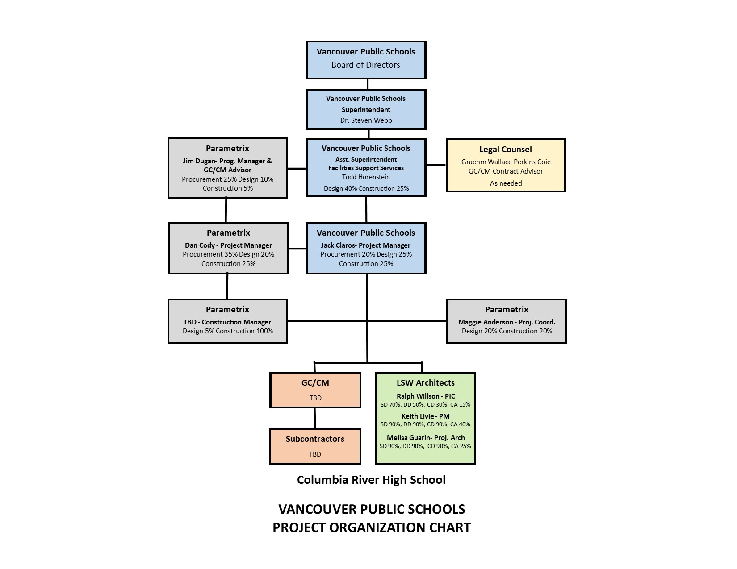
Columbia River High School
Project Organizational Chart

Slide 24
Project Team GC/CM Experience

Slide 25
Todd Horenstein, AIA Assistant Superintendent of Facility Support Services Vancouver Public Schools | 35 yrs. Project Management Licensed Architect, 30 yrs. in K-12: 2001 $400 M VPS Capital Improvement Program.
Jim Dugan GC/CM Program Advisor Parametrix | 40 yrs. Program/Project Management 20+ GC/CM Projects: Recent GC/CM: VPS McLoughlin MS/Marshall ES, TPS Birney ES, TPS Grant ES, ASD Dick Scobee ES, ASD Olympic Middle School, LSSD Lake Stevens HS, MVSD Old Main Building, MVSD Madison Elementary, MVSD East Division Elementary, BISD Blakely Elementary School, MPT Eastside Community Center, TPS Browns Point Elementary School; CKSD Central Kitsap HS/Central Kitsap MS, CKSD Olympic HS TPS Board of Director: 2005 – 2011 Appointed to the Project Review Committee: 3 Year Term – July 2016 to June 2019
Dan Cody GC/CM Procurement & PM/CM Parametrix | 31 yrs. Of Design & PM/CM 3 GC/CM Projects (PM/CM): VPS McLoughlin MS/Marshall ES, LSSD Lake Stevens HS, MPT Eastside Community Center 20+ GC/CM Procurement: Recent GC/CM Procurement: VPS McLoughlin MS/Marshall ES/Lieser, TPS Birney ES, ASD Elem #15/Elem #16/Lea Hill ES, TPS Grant ES, ASD Dick Scobee ES/Pioneer ES/Chinook ES/Terminal Park ES, ASD Olympic Middle School, LSSD Lake Stevens HS, MVSD Old Main Building, MVSD Madison Elementary, MVSD East Division Elementary, BISD Blakely Elementary School, MPT Eastside Community Center, TPS Browns Point Elementary School; CKSD Central Kitsap HS/Central Kitsap MS, CKSD Olympic HS
Ralph Willson, AIA Principal-in-Charge LSW Architects | 35 yrs. Principal In Charge 4 GC/CM Projects: VPS McLoughlin MS/Marshall ES, Ridgefield Elementary Schools, Ridgefield High School modernization & Additions, Sherwood YMCA 6 DBB: Roosevelt ES Additions, Chief Umtuch MS, Amboy Middle School, Kelso HS, Hockinson HS Additions and Modernization, Sherwood HS

Slide 26
Name | Experience
Keith Livie Project Manager LSW Architects | 25 yrs. Project Management 3 GC/CM Projects: VPS McLoughlin MS/Marshall ES, ERSD Ridgefield HS and SSD Sherwood High School 8 DBB: Clark College STEM Building, Clark College at CTC, CC Stout Hall, CC Renovation of AA-5, VPS Franklin Elementary School, SSD Sherwood High School, SSD Middleton Elementary, VPS Hudson’s Bay HS, VPS Lewis and Clark High School
Melissa Guarin Project Architect LSW Architects | 19 yrs. Project Architect 4 GC/CM (CM/GC) Projects: Barlow SD - Gresham High School, Troutdale Elementary Replacement, Fairview Elementary Replacement, Wilkes Elementary Replacement and District Wide Secured Vestibules Phase 1

Slide 27
Summary
Projects are funded with the appropriate budgets
Projects meet qualifying RCW 39.10 criteria
Project Management Plan for this project is developed and has clear and logical lines of authority
Project team has the necessary experience in addition to continuity for this project
Project team has the capacity for this project
Project team is prepared and ready to proceed
GC/CM RFP is nearly complete and will be ready to publish within the next week.

Slide 28
Thank you

