Slide 1

Vancouver Public Schools New Downtown Elementary School
Application to use the GC/CM Delivery Method
July 26, 2018 Presentation
“In partnership with home and community, Vancouver Public Schools provides an innovative learning environment that engages and empowers each student to develop the knowledge and essential skills to become a competent, responsible and compassionate citizen. ”

Slide 2
Agenda
Introductions
VPS Capital Improvement Plan
The Project
Project Budget
Project Schedule
Why GC/CM
Qualifications – Public Body
Organization – Project Team
Summary

Slide 3
Introductions

Slide 4
The Project Team – Here Today
Vancouver Public Schools
Todd Horenstein, Assistant Superintendent, Capital Facilities Planning VPS
Whitney Henion, VPS Project Lead
LSW Architects
Casey Wyckoff, AIA, Principal-in-Charge, LSW Architects
Esther Liu, AIA, Project Manager, LSW Architects
Kurtis Zenner, AIA, Project Architect, LSW Architects
Parametrix
Jim Dugan, GC/CM Program Advisor, Parametrix
Dan Cody, GC/CM Procurement & PM/CM, Parametrix

Slide 5
The Project Team
Other Team Members
Perkins Coie
Graehm Wallace, Perkins Coie, External GC/CM Legal Advisor

Slide 6
Vancouver Public Schools Capital Improvement Program

Slide 7
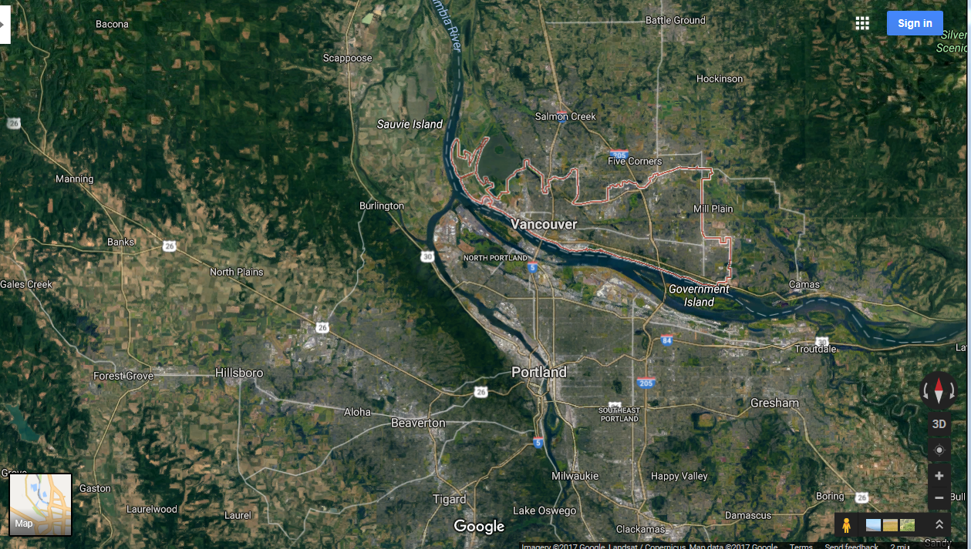
Vancouver Public School District

Slide 8
The District
Located in Clark County, Southwest Washington
Vancouver School District was formed in 1852
Approximately 24,000 student enrollment
Thirty-seven (37) schools comprised of:
  Twenty-one (21) Elementary Schools
  Six (6) Middle Schools
  Five (5) High Schools
  Three (3) Grade 6-12 Magnet Schools
  One (1) Grades K-12 School of Choice
  One (1) High School and Beyond
3,300 teachers, administrators and support staff
Last capital bond passed in 2001 (Phase 3, $400 Million program)
Current capital program - $563 Million, 2017-2022

Slide 9
Business Equity:
Community Inclusion Plan
Vancouver Public Schools is committed to Community Inclusion, as partnerships are critical to student education and community health and sustainability.
Some but not all of the District’s goals in this regard include:
Encouraging local small business participation – working with Oregon Association of Minority Entrepreneurs (OAME)
Contracting with local businesses
Working towards the Governor’s MWBE and SBE diversity goals
Encourage “Voluntary Inclusion Plans” in all large bid packages
Report Monthly percentages of MWBE and SBE utilization

Slide 10
New Downtown Elementary School
Construction of a New Downtown Elementary School for grades Pre-K through 5th in the downtown urban core of Vancouver, WA
Approximately 61,000 sf; designed for 510 students
Program focus on arts and innovation. Classrooms to include innovation labs, art spaces and media center
Multi-story, mixed-use building with commercial and community spaces on street frontage with spaces for school on floors above
Anticipated MACC: $28.1 M
Entrepreneurial and philanthropic partnerships will be encouraged to support both program and capital needs. This would increase the anticipated construction value of the project.
Occupancy: Fall 2021

Slide 11
Project Budget

Slide 12
New Downtown Elementary School Budget
Category | Budget
Project MACC (includes GC/CM Risk Contingency @ 3% of MACC) | $24,728,000
GC/CM Fee, SGC’s, Pre-Con Services and NSS Allowance (12% of MACC) | $3,372,000
Subtotal (Owner's MACC) | $28,100,000
Owner’s Project Contingency (5% of MACC) | $1,405,000
Furnishings, Fixtures, Equipment, Data/Tech Allowance (10% of MACC) | $2,810,000
Professional Services Allowance (Architects/Engineers) (11% of MACC) | $3,091,000
Owner’s Consultants (PreCon, Survey, Geo-Tech, Hazmat, Insp., etc.) (2.5% of MACC) | $702,500
Contract Administration Costs (Procurement, PM/CM, etc.) (2.5% of MACC) | $702,500
Other Project Related Costs (Permits Fees, etc.) | $328,600
Sales Tax (8.4% of MACC) | $2,360,400
Total | $39,500,000

Slide 13
Project Schedule

Slide 14
New Downtown Elementary School GC/CM Schedule
Project Schedule | Start
PRC Presentation | July 26, 2018
First Publication of RFP for GC/CM Services | July 31, 2018
Second Publication of RFP for GC/CM Services | August 7, 2018
Project Information Meeting (Date subject to change) | August 10, 2018
RFP Submittal Deadline | August 20, 2018
Open & Score Submittals Received | Aug. 21 – Aug. 23
Notify Submitters of Most Highly Qualified Submitters & Invite to Interview | August 24, 2018
Interviews with Short-listed Firms | August 31, 2018
Notify Submitters of Finalists & Invite to Submit RFFP | September 4, 2018
RFFP Submittal Deadline & Opening | September 14, 2018
Notify Submitters of Scoring and Most Qualified GC/CM | September 17, 2018
Final Pre-Con Work Plan & Fees Due | September 28, 2018
School Board Approval of GC/CM Selection | October 9, 2018
GC/CM Agreement with Pre-Con Services Executed | October 12, 2018

Slide 15
New Downtown Elementary School Design/Construction Schedule
Project Schedule | Start | Finish
Programming (Ed Specs) | June 2018 | August 2018
Schematic Design | September 2018 | December 2018
Design Development | January 2019 | May 2019
Construction Documents | June 2019 | October 2019
Site Development and Land-use Review | March 2019 | April 2019
Building Department Review/Permitting | November 2019 | December 2019
Subcontract Bidding | November 2019 | December 2019
New Building Construction | January 2019 | June 2021
New Building Commissioning | April 2021 | May 2021
New Building Punchlist | May 2021 | June 2021
New Building Substantial Completion | June 2021 | June 2021
Owner New Building Move-in | July 2021 | August 2021
Final Completion/Closeout | July 2021 | August 2021
Occupancy | September 2021 | September 2021
New Building Warranty Period | June 2021 | June 2022

Slide 16

Why GC/CM Delivery Method for The New Downtown Elementary School Project

Slide 17
Complies with 2 of the 5 Statutory Criteria
(1) Implementation of the project involves complex scheduling, phasing, or coordination.
(2) The project involves construction at an occupied facility which must continue to operate during construction.
(3) The involvement of the General Contractor/Construction Manager during the design stage is critical to the success of the project.
(4) The project encompasses a complex or technical work environment.
(5) The project requires specialized work on a building that has historic significance.

Slide 18
Project Chronology Complexity
Construction to take place in a downtown, urban environment
Assess construction impact to neighboring properties/businesses and infrastructure. Develop a logistics plan to schedule and phase project to achieve maximum efficiency and minimize this impact during construction.
Construct a new multi-story, mixed use building which may include commercial and community spaces on ground level with spaces for the elementary school on the floors above.
Ensure Safety and Security for all Students, Staff and Community
Complete project so that school can be opened in Fall of 2021

Slide 19
Other Critical Factors
Downtown Urban Core Access/Egress & Traffic Management Plan
Manage Escalating Market Costs
Early Site Package(s)
Early Procurement
Improved Cost Control
Critical Need to Manage and Communicate with all Downtown Urban Core Neighbors

Slide 20
Public Benefit: From this ….
Student, Community and District Safety
Ensure Project Completions on Schedule and Budget
Community and Business Relationships
Allocation of Risk
Fiscal Accountability

Slide 21

Public Body Qualifications

Slide 22
VPS Leadership Team
The District has a successful history of building and modernizing schools
Mac/Marshall GC/CM projects currently under construction
Led by Todd Horenstein, District Assistant Superintendent. Licensed Architect, AGC GC/CM Training, currently managing the Mac/Marshall project
District has on-staff team of project managers, project support and administration professionals
VPS satisfies the public body qualifications by staff augmentation with consultants who provide depth of GC/CM experience
  Parametrix is providing GC/CM Advisory and Procurement Services.
  Graehm Wallace/Perkins Coie provides legal counsel for GC/CM compliance
  LSW Architects provides GC/CM design services

Slide 23
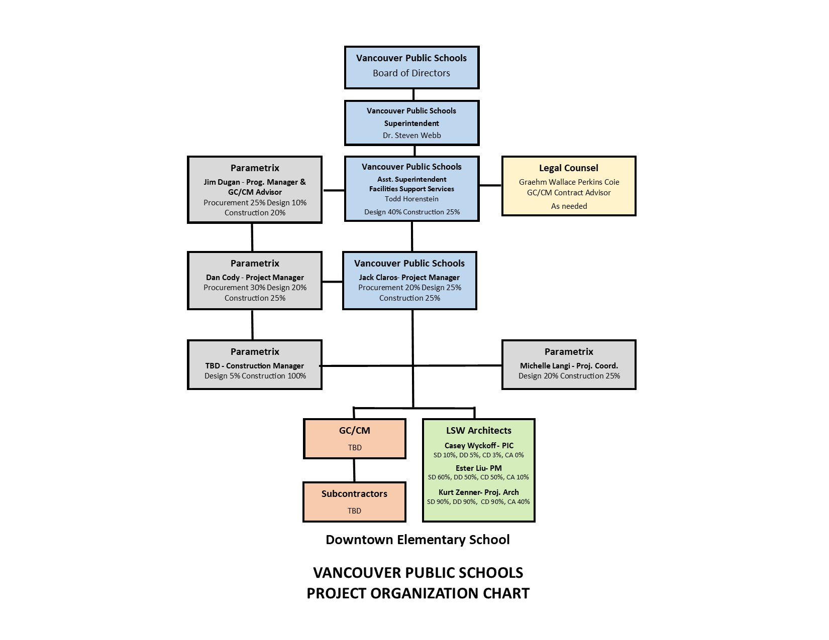
Downtown Elementary School
Project Organizational Chart

Slide 24
Project Team GC/CM Experience

Slide 25
Todd Horenstein, AIA Assistant Superintendent of Facility Support Services Vancouver Public Schools | 35 yrs. Project Management 30 yrs. in K-12: 2001 $400 M VPS Capital Improvement Program.
Jim Dugan GC/CM Program Advisor Parametrix | 40 yrs. Program/Project Management 20+ GC/CM Projects: Recent GC/CM: VPS McLoughlin MS/Marshall ES, TPS Birney ES, TPS Grant ES, ASD Dick Scobee ES, ASD Olympic Middle School, LSSD Lake Stevens HS, MVSD Old Main Building, MVSD Madison Elementary, MVSD East Division Elementary, BISD Blakely Elementary School, MPT Eastside Community Center, TPS Browns Point Elementary School; CKSD Central Kitsap HS/Central Kitsap MS, CKSD Olympic HS TPS Board of Director: 2005 – 2011 Appointed to the Project Review Committee: Start of 3 Year Term – July 1, 2016
Dan Cody GC/CM Procurement & PM/CM Parametrix | 31 yrs. Of Design & PM/CM 3 GC/CM Projects (PM/CM): VPS McLoughlin MS/Marshall ES, LSSD Lake Stevens HS, MPT Eastside Community Center 20+ GC/CM Procurement: Recent GC/CM Procurement: VPS McLoughlin MS/Marshall ES/Lieser, TPS Birney ES, ASD Elem #15/Elem #16/Lea Hill ES, TPS Grant ES, ASD Dick Scobee ES/Pioneer ES/Chinook ES/Terminal Park ES, ASD Olympic Middle School, LSSD Lake Stevens HS, MVSD Old Main Building, MVSD Madison Elementary, MVSD East Division Elementary, BISD Blakely Elementary School, MPT Eastside Community Center, TPS Browns Point Elementary School; CKSD Central Kitsap HS/Central Kitsap MS, CKSD Olympic HS
Casey Wyckoff, AIA, President, Principal LSW Architects | 22 yrs. Design Experience 8 GC/CM Projects: Ridgefield School District; Union Ridge ES, Ridgefield High School Phase 1, Southridge ES, View Ridge MS, New 5-8 Campus. Washougal School District; Jemtegaard Middle School, Excelsior High School. Evergreen Public Schools; Crestline Elementary School

Slide 26
Name | Experience
Esther Liu, AIA Project Manager LSW Architects | 23 yrs. Project Management 2 GC/CM Projects: Southridge Elementary, Ridgefield, WA, Camas Public Library, Camas, WA 1 DBB: International School of Beaverton Middle School, Aloha, OR
Kurtis Zenner, AIA Project Architect LSW Architects | 31 yrs. Project Architect 6 GC/CM (CM/GC) Projects: Beaverton New Middle School, Beaverton OR, Forest Grove HS Additions and Fields, Vancouver, WA, Community Duncan Dunn Residence Hall, WSU Pullman, Riverdale K-8 School, Portland, OR, Sue Buel Elementary School, McMinnville, OR, South Meadows Middle School, Hillsboro, OR

Slide 27
Summary
Projects are funded with the appropriate budgets
Projects meet qualifying RCW 39.10 criteria
Project Management Plan for this project is developed and has clear and logical lines of authority
Project team has the necessary experience in addition to continuity for this project
Project team has the capacity for this project
Project team is prepared and ready to proceed
GC/CM RFP is nearly complete and can be ready to publish within a week

Slide 28
Thank you

