Slide 1

Application for
Design-Build
Project Approval
Washington State School Directors’ Association
Olympia Headquarters Office Building Replacement
Thursday, September 28, 2017

Slide 2


Agenda
Agenda
    Introductions
    Scope
    Qualified Project Team
    Why Project is Suited for Design-Build
    Schedule
    Budget and Funding
    Questions

Slide 3
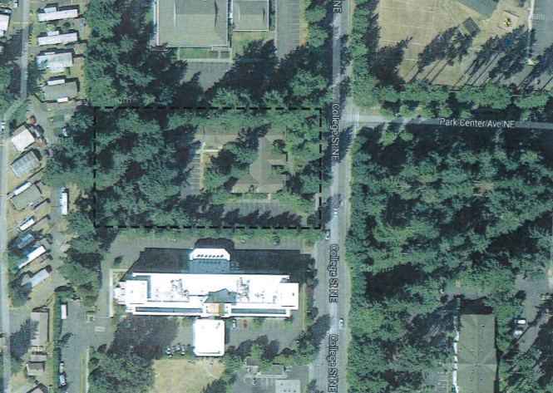
Scope
WSSDA Olympia HQ Office Building Replacement
Existing Site

Slide 4
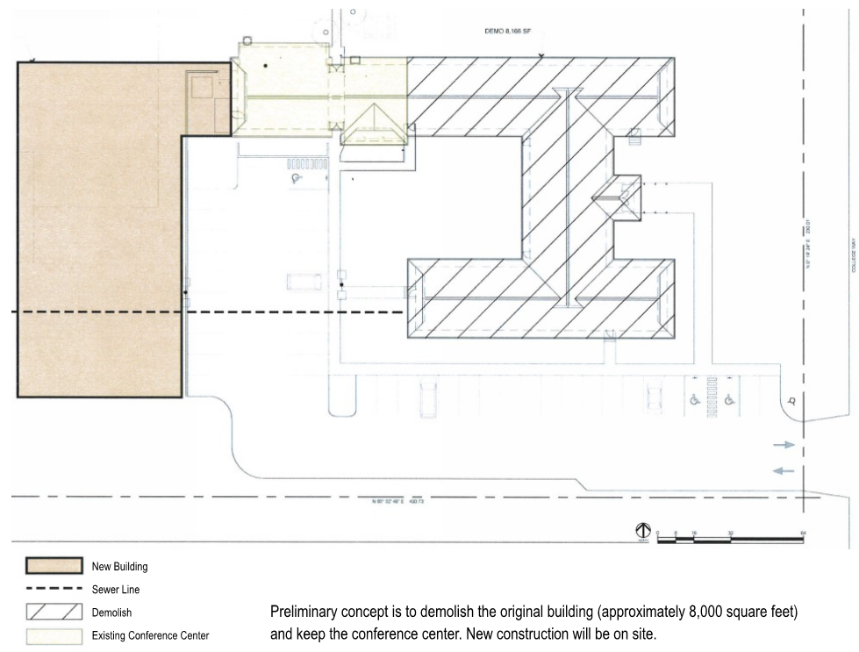
Conceptual Plan
WSSDA Olympia HQ Office Building Replacement

Slide 5
WSSDA Olympia HQ Office Building Replacement
Scope
Replacement of current 10,000 SF structure
  Planned construction 7,500 SF on existing 2.14 acres
  Connect to sewer
  Energy efficient, technically up-to-date, durable

Slide 6
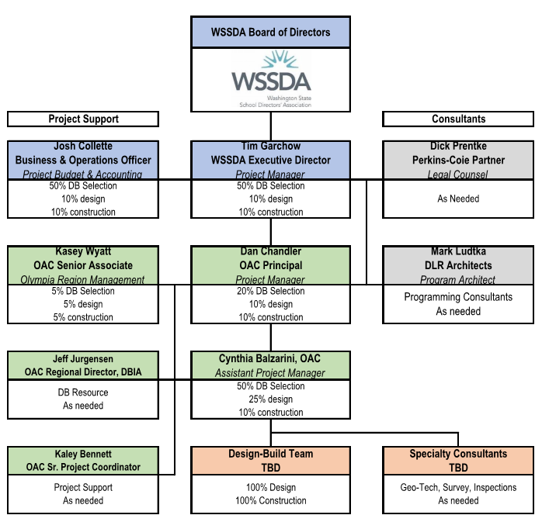
Project Team

Slide 7
Exceeds Statute Requirements
Why Project is Suited for DB
Meets Two RCW 39.10.300 Criteria
Opportunity for greater innovation and efficiencies
Significant savings in project delivery time can be realized
  Early Design and delivery of side sewer
  Offsite fabrication
  Fast tracking design and construction

Slide 8
Schedule
Schedule
DB Process September – November 2017
  Project Review Committee Submit Application September 1, 2017
  Project Review Committee Presentation September 28, 2017
  Advertise for Design-Build RFQ September 29-October 12, 2017
  Statement of Qualifications Due October 30, 2017
  Short-list and send RFP November 3, 2017
  Interview and Fee Proposals November 13-21, 2017
  Select Design-Builder and Award November 22, 2017
Schematic Design November 2017 – January 2018
Design Development January – March 2018
Construction Documents March – April 2018
Permitting March – May 2018
Construction June 2018 – April 2019
Substantial Completion April 2019
Final Completion/Closeout July 2019

Slide 9
Budget
WSSDA Olympia HQ Office Building Replacement
Estimated project design and construction (including construction contingencies) | $1,700,000
Costs for Professional Services (PM/CM Services, Legal) | $100,000
Equipment and furnishing costs | $113,000
Project Contingencies (8%) | $134,000
Other related project Costs (Utilities, Testing/Reports, Permits, Consumables, Moving, etc.) | $379,000
Sales Tax | $200,000
Total Budget | $2,626,000

Slide 10

Centralia High School Modernization
Questions?

