Slide 1
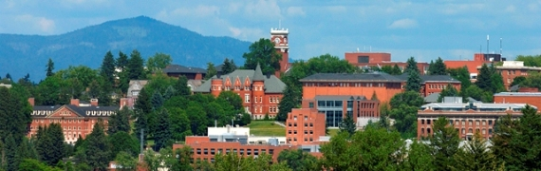
Application for DB and GCCM Recertification
Capital Projects Advisory Review Board
Project Review Committee
March 2019

Slide 2
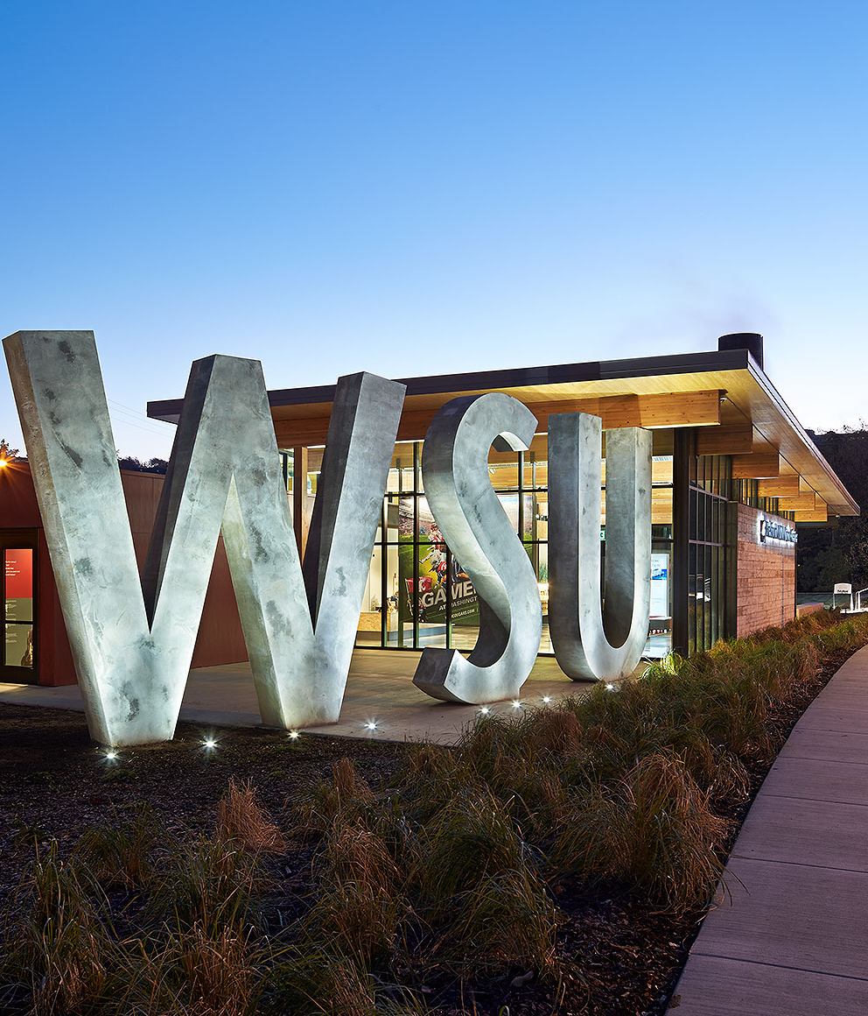
Introductions
Joe Kline
  Assistant Vice President – Capital
Louise Sweeney
  Lead Project Manager
Mike LaVielle
  Lead Construction Manager
Maja Huff
  Contracts Manager

Slide 3
Washington State University
Land Grant, Research University
Five Campuses
    Pullman 1,742 acres, over 12M sq. ft.
    Spokane 40 acres
    Tri-Cities 202 acres
    Vancouver 351 acres
    Everett 5 acres
Research and Extension Centers
    Prosser, Puyallup, Wenatchee and Mt. Vernon
$150M - $300M in our capital project portfolio

Slide 4
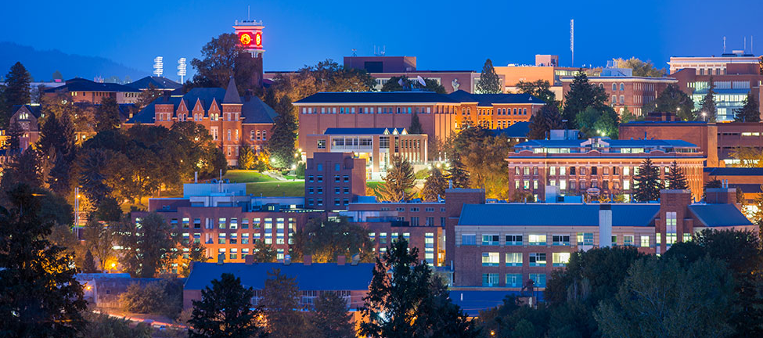
Washington State University
Facilities Services
Associate Vice President for Facilities Services
Operations
385 employees
Finance & Administration
15 employees
Capital
19 employees
FIRM
6 employees

Slide 5
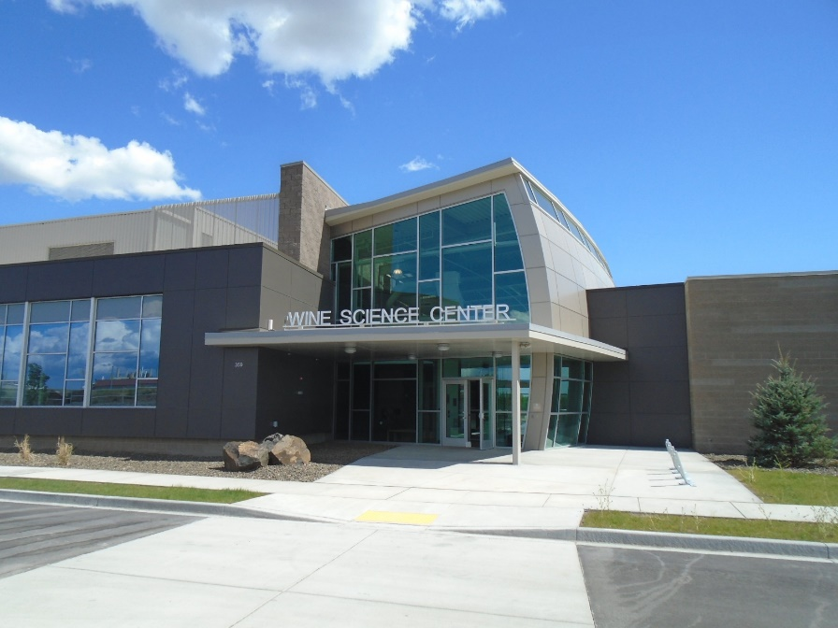
What We Have Done
Design Build Project
Tri-Cities Wine Science Center
Project Budget $23M
DB Contract $12M
DB Team Lydig/ALSC
Completion June 2015
Observation
  Port of Richland, Public Development Authority – Olivia to get name
Design Build Project
Washington Grains Plant Growth Facility
Project Budget $10M
DB Contract $9M
DB Team Hoffman/Hacker
Completion July 2015
Observation
  First version of the validation process

Slide 6
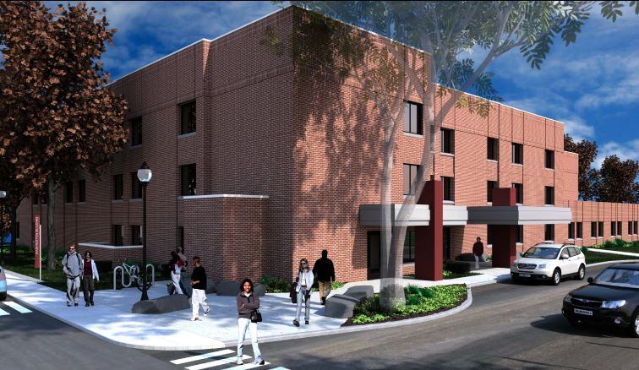
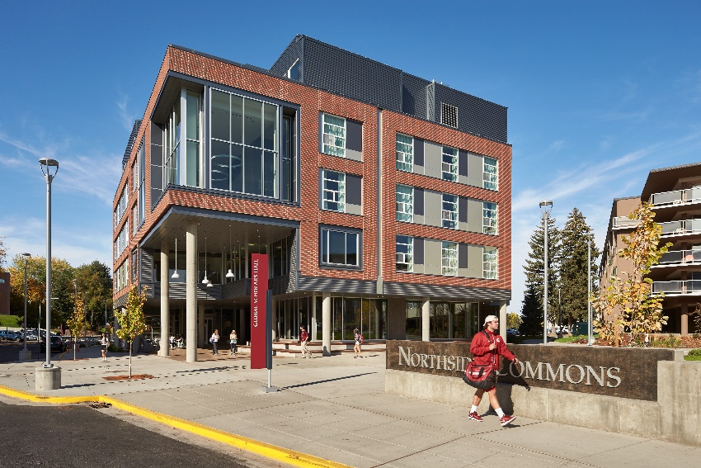
What We Have Done
Design Build Project
Washington Building 3rd Floor Renovation
Project Budget $6.95M
DB Contract $5.6M
DB Team Absher/DBRA
Completion July 2015
Observation
  Medical Clinic Office Space Renovation in
  Occupied Building
Design Build Project
Global Scholars Hall
Project Budget $40M
DB Contract $30M
DB Team BNBuilders/Bernardo Wills
Completion July 2013
Observation
  New housing facility

Slide 7
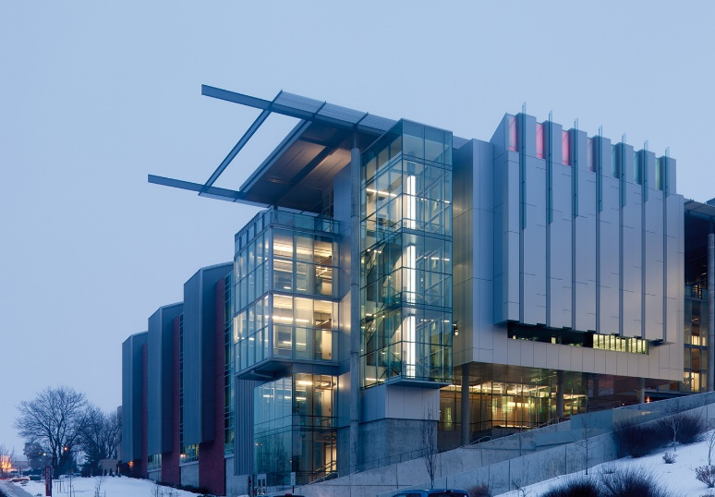
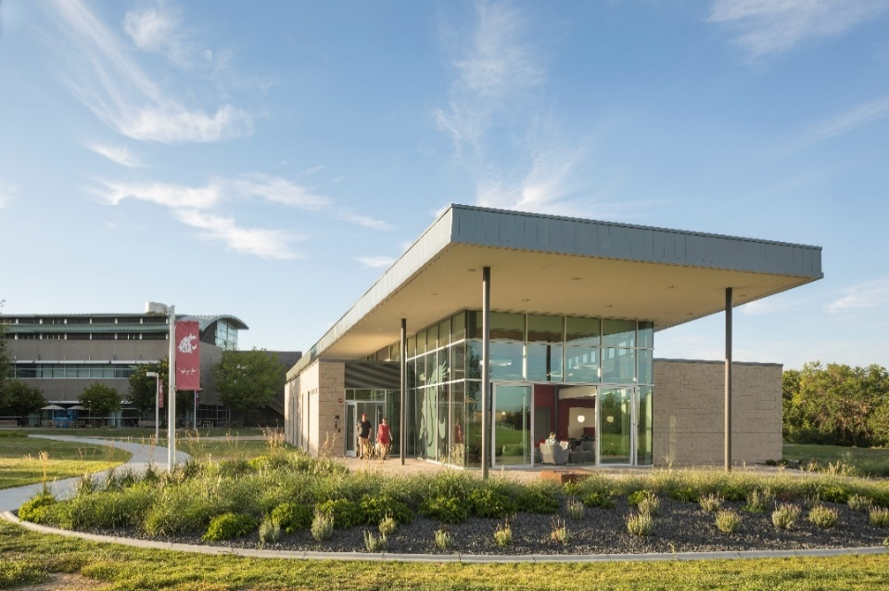
What We Have Done
GC/CM Project
Veterinary Medical Research Building (REC 4)
Project Budget $96M
GCCM Contract $61.9M Lydig
Design SRG
Completion September 2015
Observation
  GC/CM project
Design-Build Project
Tri-Cities Student Union Building
Project Budget $5.7M
DB Contract $4M
DB Team LKI/Schacht Aslani
Completion March 2016
Observation
  Traditional Design Build

Slide 8
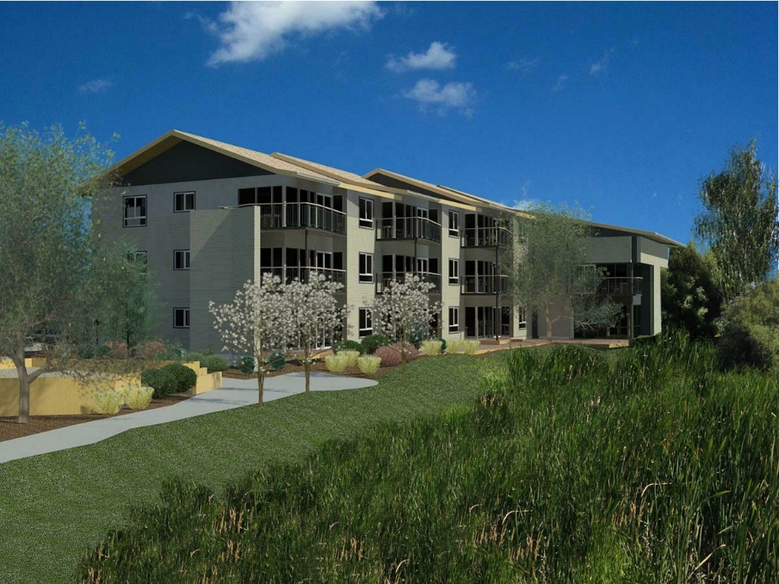
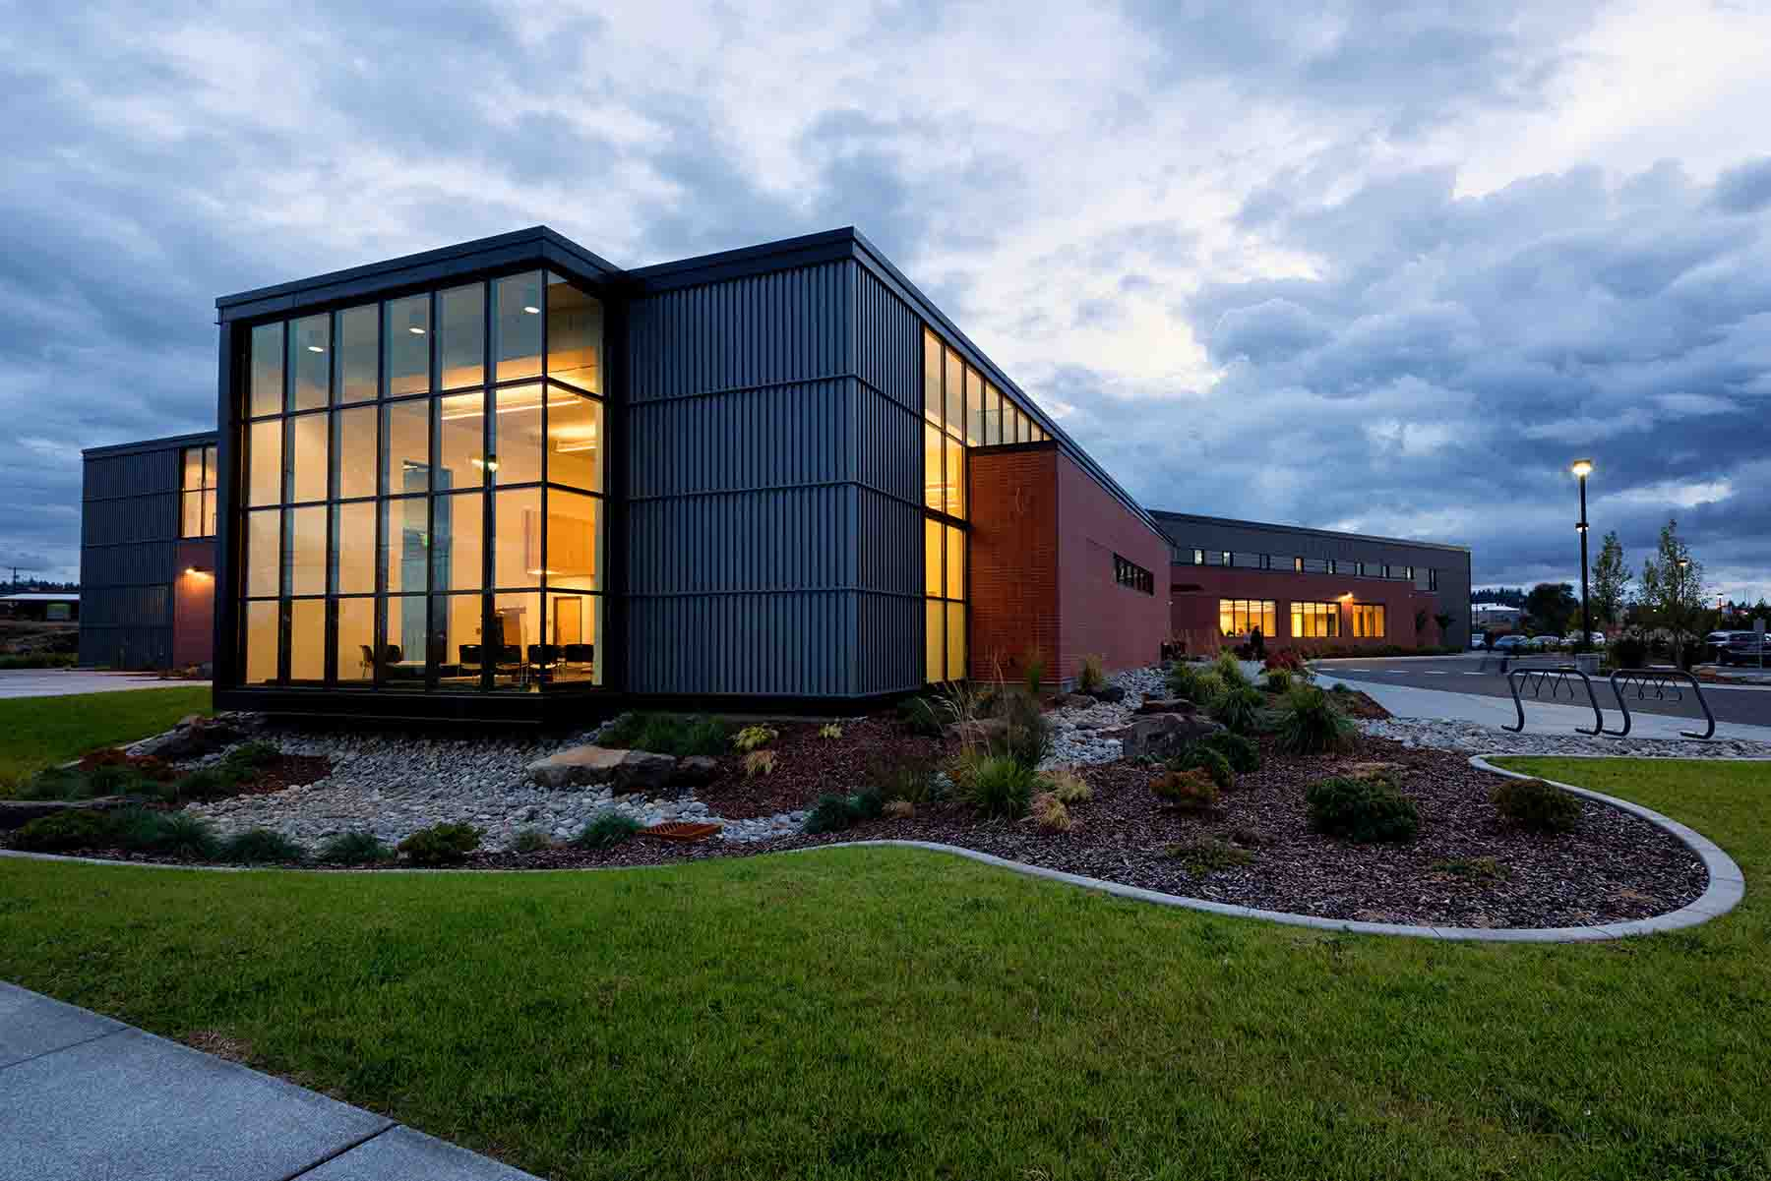
What We Have Done
Design Build Project
Chief Joseph Village Apartments Renovation/Addition
Project Budget $20M
DB Contract $10M
DB Team BNBuilders/Bernardo Wills
Completion April 2016
Observation
  Housing complex renovation
Design Build Project
University District Health Clinic (Spokane Teaching Health Clinic)
Project Budget $16M
DB Contract $13 M
DB Team Bouten/NAC
Completion July 2016
Observation
  First DB project at Spokane Campus

Slide 9
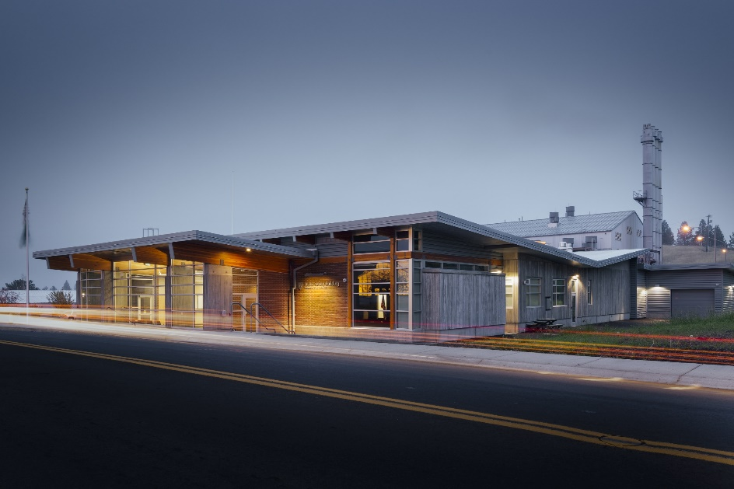
What We Have Done
Design Build Project
Public Safety Building
Project Budget $10M
DB Contract $7.5M
DB Team Walker Const/Design West
Completion September 2016
Observation
  Campus Police Department Building
Design Build Project
Clean Technology Building (PACCAR)
Project Budget $57.7M
DB Contract $42M
DB Team Skanska/LMN
Completion October 2016
Observation
  WSU’s First LEED Gold Lab Building

Slide 10
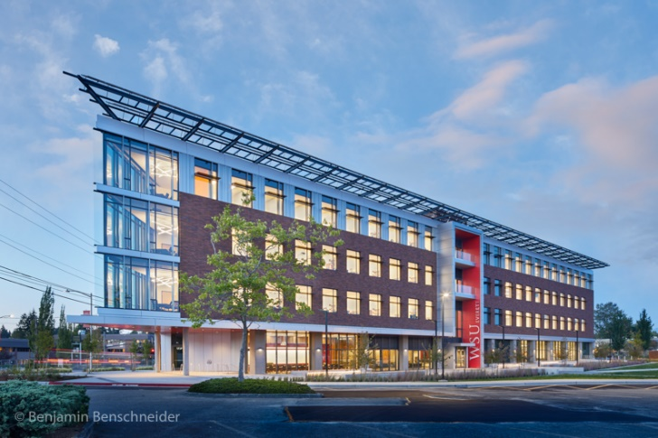
What We Have Done
Design Build Project
WSU Academic Building (Everett)
Project Budget $64.5M
DB Contract $46.6M
DB Team Hoffman/SRG
Completion May 2017
Observation
  First building at Everett Campus
Design Build Project
Digital Classroom Building (the Spark)
Project Budget $56M
DB Contract $44M
DB Team Clark/ZGF
Completion May 2017
Observation
  Very popular with students

Slide 11
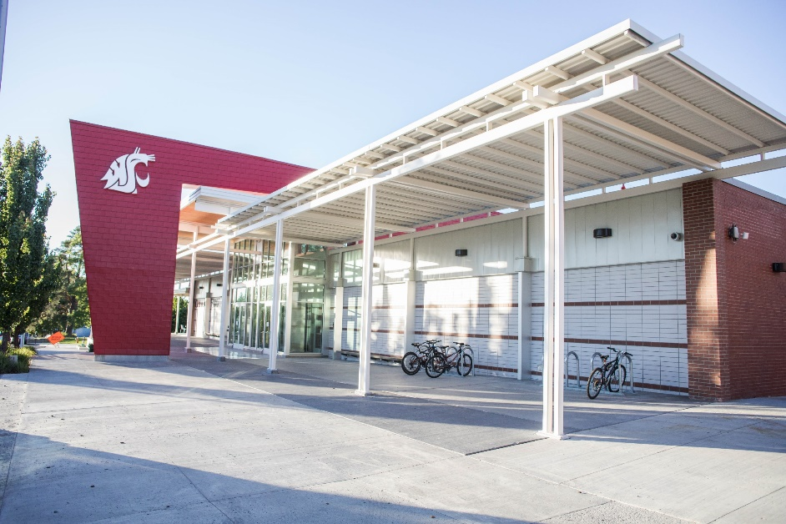
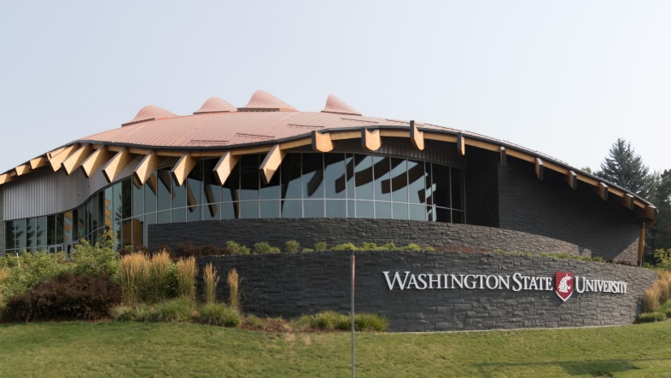
What We Have Done
Design Build Project
Chinook Student Center
Project Budget $32M
DB Contract $24.7M
DB Team Absher/GGLO
Completion May 2017
Observation
  Traditional DB with Tight Timeline
  Major renovation
Design Build Project
Elson S. Floyd Cultural Center (Multicultural Center)
Project Budget $16M
DB Contract $12M
DB Team Absher/GGLO
Completion July2017
Observation
  DBIA National Award of Merit, The Chairman's Award and the Excellence in Design.

Slide 12
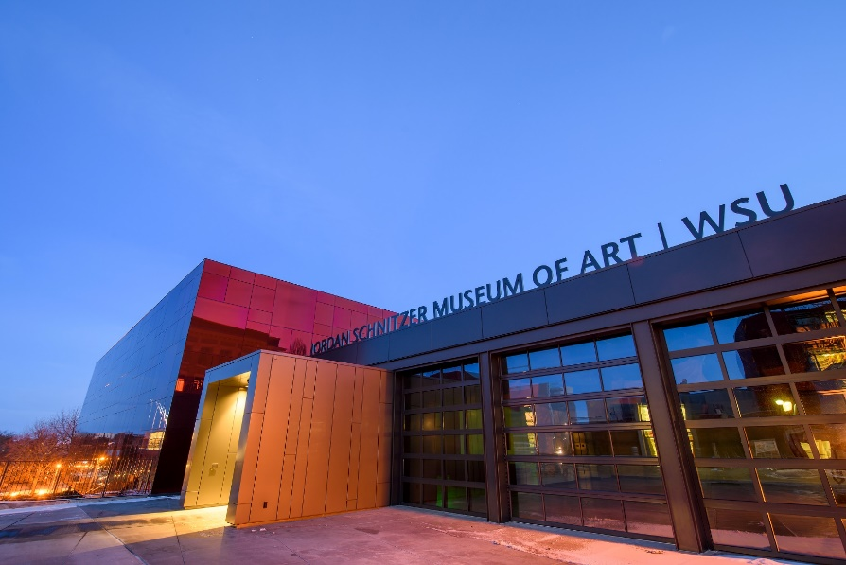
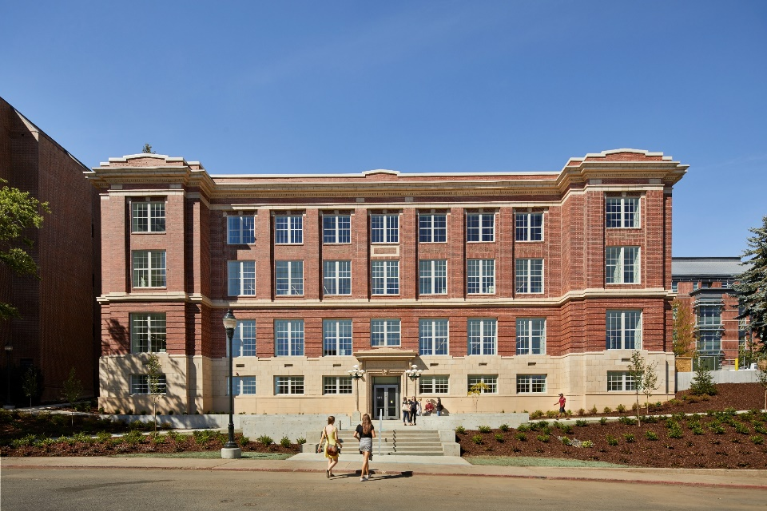
What We Have Done
Design Build Project
New Museum of Art
Project Budget $15M
DB Contract $10.3M
DB Team Hoffman/Design West
Completion December 2017
Observation
  Bridging used for selection of DB Team
  Landmark Building for Pullman Campus
What We Are Doing
Design Build Project
Troy Hall Renovation
Project Budget $32M
DB Contract $29.2M*
DB Team Lydig/Perkins + Will
Completion June 2019*
Observation
  Major renovation on a building of campus significance

Slide 13
What We Are Doing
Design Build Project
Plant Sciences Building (REC 5)
Project Budget $59.1M
DB Contract $52M*
DB Team Skanska/LMN
Completion May 2020*
Observation
  First Progressive DB project
Design Build Project
Tri-Cities Academic Building
Project Budget $30.4M
DB Contract $23.3M*
DB Team Hoffman/ZGF
Completion May 2020*
Observation
  Progressive DB with first time charrette component

Slide 14
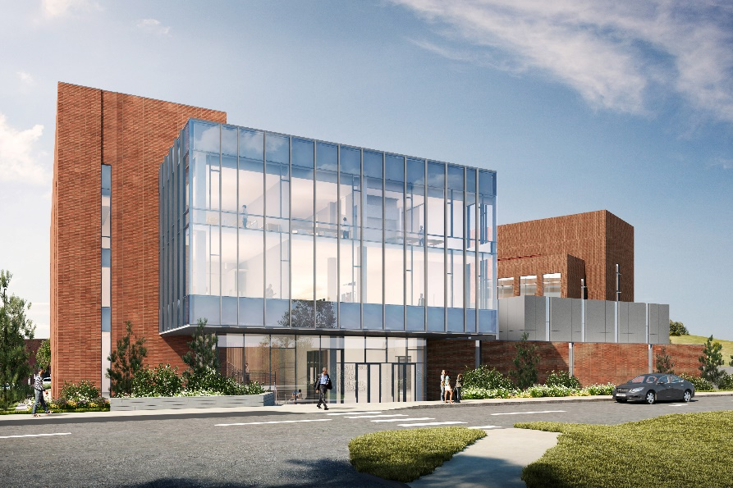
What We Are Doing
Design Build Project
Global Animal Health Building Phase 2
Project Budget $24.9M + 36.4M
DB Contract $20.6M* + Pending
DB Team Bouten/Perkins + Will
Completion October 2019* + Pending
Observation
  Building attached to GC/CM Constructed Facility
  Progressive DB
Design Build Project
Baseball Clubhouse
Project Budget $10M
DB Contract $7.4M*
DB Team Hoffman/SRG
Completion July 2020*
Observation
  Progressive DB with refinement of the design charrette

Slide 15
Why WSU is Ready to be Recertified
    Commitment to process improvement
      5th Annual WSU DB Conference in July
      Participation on CPARB and subcommittees
    Contract Review (Perkins Coie)
      Review and rewrite of DB and GCCM completed in 2015.
      Ongoing updates to reflect best practices and feedback from WSU DB conferences
    Ongoing PM/CM External and Internal Training
      Active in DBIA, CMAA, AIA, other trade organizations
      Ongoing internal training
          This year’s will focus on qualifications based selection processes

Slide 16


Facilities Services Capital Staff
7 Project Managers
3 Construction Managers
2 Interior Designers
6 Engineering Group
Credentials include:
Registered Architect
PE’s – Civil, Structural, Mechanical
Interior Design Certified – NCIDQ
Subject Matter Experts - MEP

Slide 17

Accreditations
5 DBIA Professionals/Associates
4 LEED AP’s
1 CCM
Continuing Education Opportunities
Internal Training
DBIA conferences and Lunch & Learns
SCUP, Tradeline, AIA, AUID, Peers and Trade Partners
Presentations/ Panel Discussions
SCUP, Tradeline, DBIA, AIA, CMAA, AGC
Collaborate w/ WSU Voiland College of Engineering & Architecture
State of Washington Owners Group

Slide 18

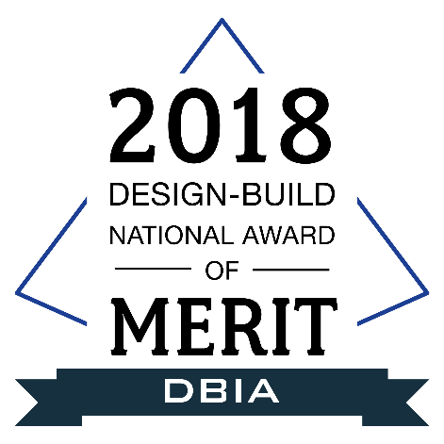
Project Awards
Troy Hall - AIA 2018 Seattle Honor Award
AIA 2018 National Merit Award
AIA WA Council 2017 Civic Design Award
The Spark - DBIA 2018 National Award for Merit
DBIA 2018 Award for Excellence in Teaming
DBIA 2018 Award for Excellence in Process
Cultural Center - DBIA 2018 National Award for Merit
DBIA 2018 Chairman’s Award and Excellence in Design - Architecture
Everett - BD+C Building Team Awards, Silver Award 2018
Champion of Sustainability, McKinstry 2017
VISION 2040 Award, Puget Sound Regional Council, 2017
Washington Building - AGC 2016 Under $10M Public Award

Slide 19
Training
    Developed and trained 45 discrete PM/CM training topics since last certification.
    Continue to develop and provide recurring training for Capital staff with specialized on-boarding training for all new employees.
    Training areas include Source-Selection, Pre-Design/Design & Construction Administration, Close-out, Disputes, Impacts, Cost & Time Changes, Funding & Contract Types, Risk Analysis and Negotiations, Contractor Performance Evaluations
    CM/PM Training Big “Take-aways”
      Standardization across PM/CM Team
      Improved Schedule and Cost Analysis for Contracts and Changes
      PM/CM Roles and Responsibilities
      Risk Analysis and Sharing

Slide 20
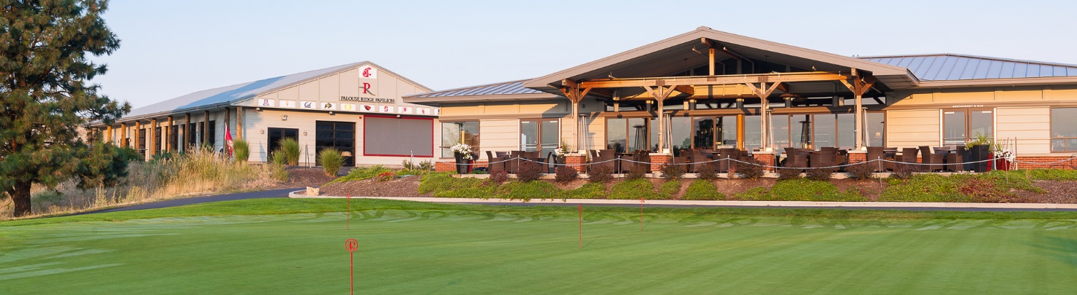
WSU Design Build Forum
Opportunity to engage in meaningful industry conversation
5th consecutive year
Average of 120 people
    contractors, consultants, trades, owners, & federal owners
A few of the highlights WSU has implemented from the conferences
    Pre-Proprietary Conference
    Progressive Design-Build
      Progression from traditional to progressive to progressive w/charrette
    Introducing MWBE strategies as part of the process

Slide 21
Contracting
Legal Counsel
  Nathan Deen, Assistant Attorney General
  Perkins Coie LLP, Dick Prentke and Andrew Greene
Contract Documents Overhaul
  Express goal to be fair, reasonable and consistent across all forms of Public Works
  Implemented continual contract review
During this certification period
  Progressive Design-Build Agreement
    Three phase agreement to mitigate risk for both parties before signing on the GMP.
  Change Orders and Dispute Resolution
    Simplified pricing for changes, and responsive informal dispute resolution process.
  Post Completion Performance Period
    Transition to Substantial Occupancy

Slide 22
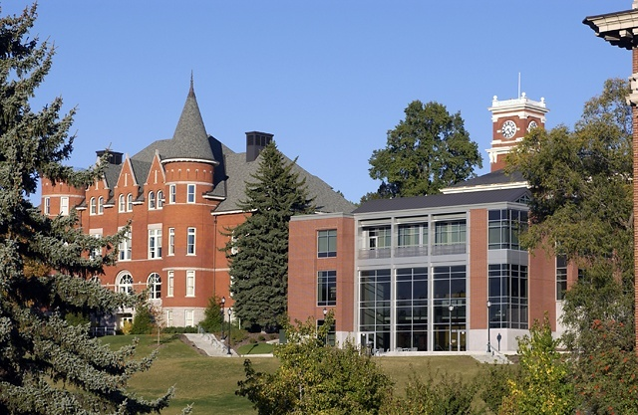
In Summary :
WSU is Ready to be Recertified
History of Alternative Procurement Success
Demonstrated Success on a Wide Variety of Project Types
Well Qualified and Experienced Team of Project Managers and Construction Managers

Slide 23

Questions

