Slide 1

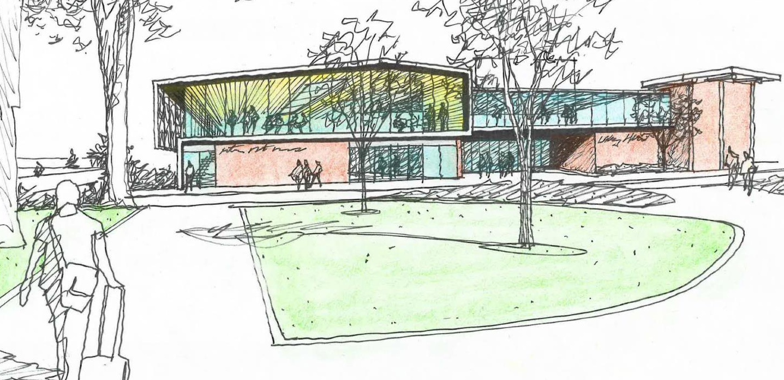
Ethnic Student Center / Multicultural Services
Project Review Committee Presentation
26 January 2017

Slide 2
Agenda
Introductions & Project Overview
WWU & Design Teams
Response to PRC Questions
Project Challenges

Slide 3
Presenters
Rick Benner, FAIA
University Architect,
Director Office of Facilities Development and Capital Budget
Western Washington University
Ed Simpson, AIA
Asst. Director, Facilities Development and Capital Budget
Western Washington University
Jim Kalvelage, AIA
Partner
Opsis Architecture

Slide 4
Project Summary
Project
Area
Construction
Type
Project Budget
Project Schedule
Ethnic Student Center / Multicultural Services addition to Viking Union/Bookstore building
29,000 GSF addition / 14,000 GSF renovation
Steel frame over existing
7-story Concrete Construction
$18,136,000
Summer 2019 Occupancy

Slide 5
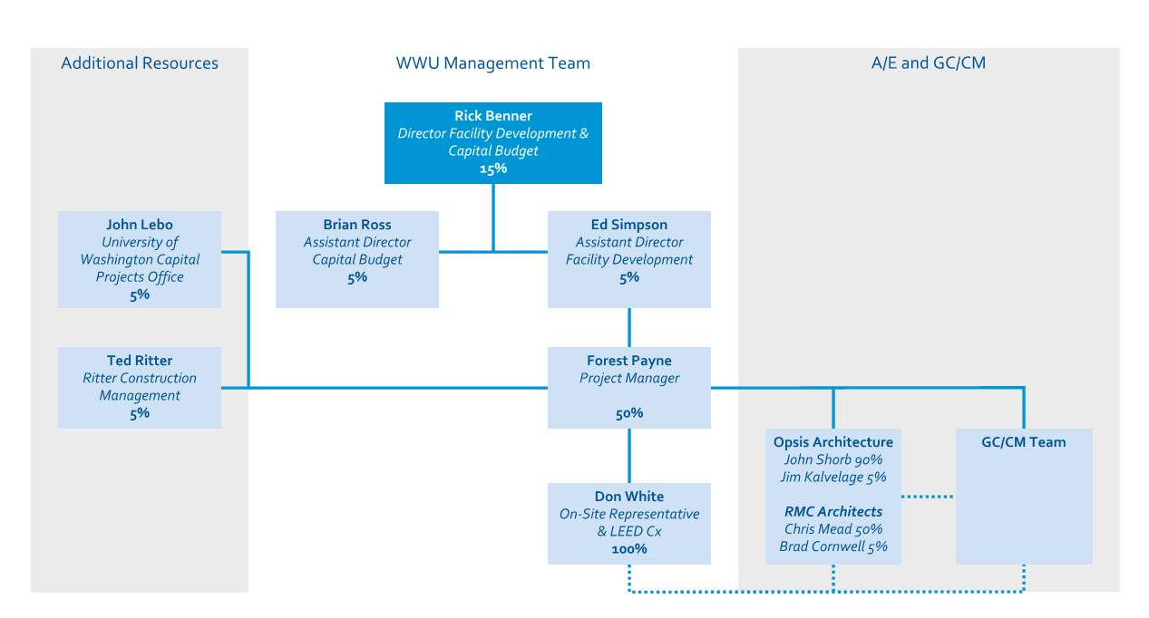
GC/CM Management Plan

Slide 6
PRC Questions

Slide 7
The org chart is cut off on the A/E block on my copy. Can we get a complete copy?
Response:
Another copy is attached and has been included in the presentation and handouts.

Slide 8
Can you please provide additional information on Forest Payne’s GC/CM experience? His biography indicates he has experience with one D-B and three GC/CM projects. Please describe his role in the projects, the scale/complexity of the projects and whether they were successful.
Response:
GC/CM: Issaquah Middle School (2016)
Pine Lake Middle School (2018)
Owner: Issaquah School District
Architect: Mahlum Architects
GC/CM: Cornerstone General Contractors
Role: Project Architect/Project Manager
GC/CM: Cleveland High School (2007)
Owner: Seattle Public Schools
Architect: Mahlum Architects
GC/CM: Absher Construction
Role: Technical Staff
Design-Build (Contractor-led):
Muckleshoot Tribal School K-12 (2009)
Owner: Muckleshoot Indian Tribe
Contractor: BNBuilders
Architect: Mahlum Architects
Role: Project Architect

Slide 9
Forest Payne (50%) and Don White (100%) will be leading the GCCM management obligations for this project based on their org chart. Can we get a detailed description of past GCCM projects and their GCCM role on each? Don may need a bit more support this complex project.
Response:
See response for question 2 for more detail of Forest’s GC/CM experience. Don’s role on projects at Western is an on-site representative with expertise in MEP systems. He is on-site full time throughout the construction phase, as he has been with the Carver Academic Renovation and with the Miller Hall Renovation.

Slide 10
Provide a clear GCCM procurement schedule for the different phases of the RFP, interview and cost proposal. Their current 2017 bar schedule states a February 1st thru ~ April 15th line item.
Response:
Next slide

Slide 11
Response:
February 1, 2017 First publication of RFP for GC/CM Services
February 6, 2017 Informational meeting
February 20, 2017 Proposal submittal deadline from interested GC/CM firms
February 24, 2017 Notification of most qualified firms selected to be interviewed
March 15, 2017 Interviews
March 16, 2017 Notification of firms selected to prepare Final Proposal
March 16, 2017 Distribution of Request for Final Proposal (RFFP) to bidders
March 27, 2017 Final Proposal submittal deadline
Selection of firm with the highest total score
March 28, 2017 Notification of successful and unsuccessful firms
April 3, 2017 Preconstruction Work Plan due
April 7, 2017 Agreement for Preconstruction Services executed
April 11, 2017 GC/CM Preconstruction kickoff
Schematic Design Estimate period begins

Slide 12
On page 1 item 3 of the application, Project Budget first line identifies $2,286,000 for Professional Services. With a MACC cost including construction contingencies of $11,536,000. That seems like a very high percentage, while noting WWU is still including $899,000 for contract administration costs. Please have WWU explain the need for such high budget.
Response:
Because of the complex nature of the programs and project our professional services budget includes a number of extra services such as Bookstore Consultant, Additional LEED Commissioning, On-site services, Hazardous Materials Consulting, Voice/Data Consulting, Radio Broadcast, Testing Services and HVAC Testing & Balancing.

Slide 13
Project Challenges
Site Access During Construction
Limited Laydown Area & Site Logistics
Construction Schedule
Pedestrian Safety
Topography
Complex Existing Building & Systems
Envelope Integrity
High Performance/Sustainable Systems

Slide 14
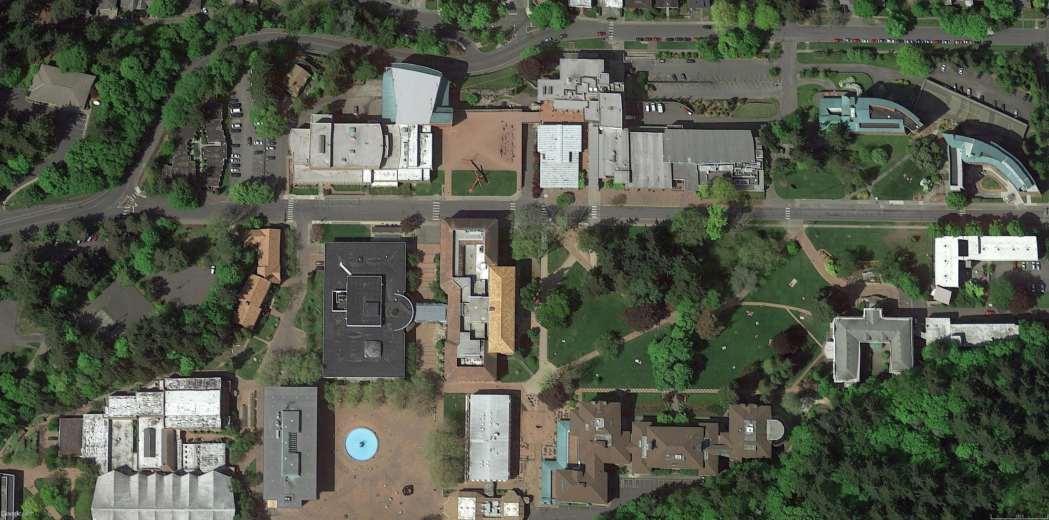
Site Access & Safety

Slide 15
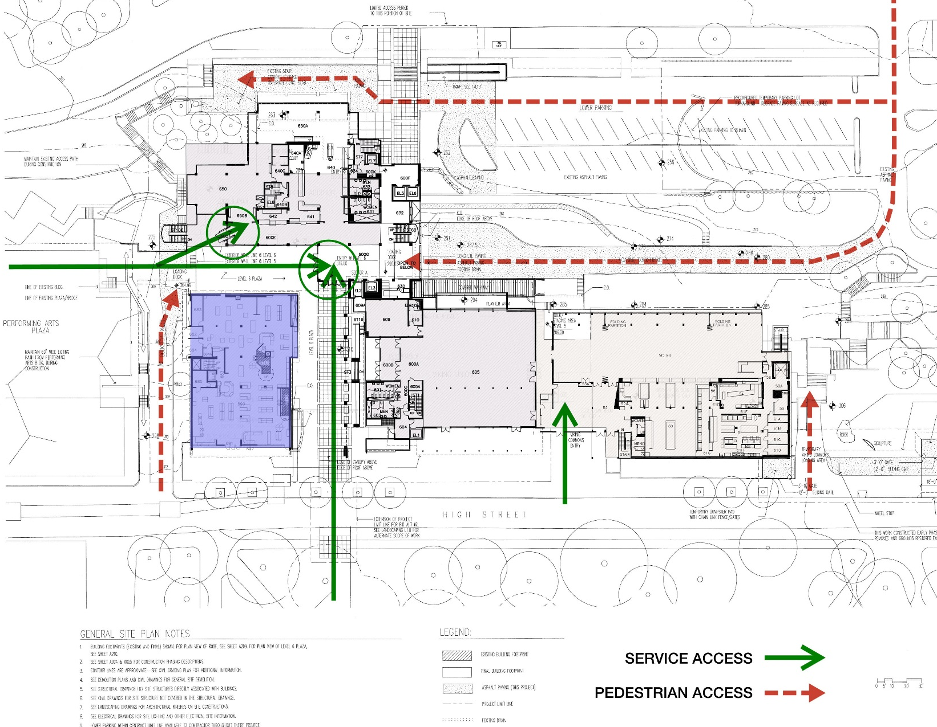
Site Access & Safety

Slide 16
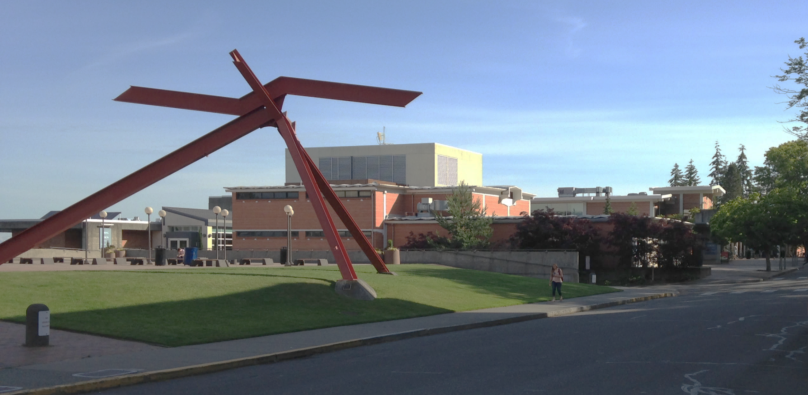
Existing Building - Arts Plaza

Slide 17
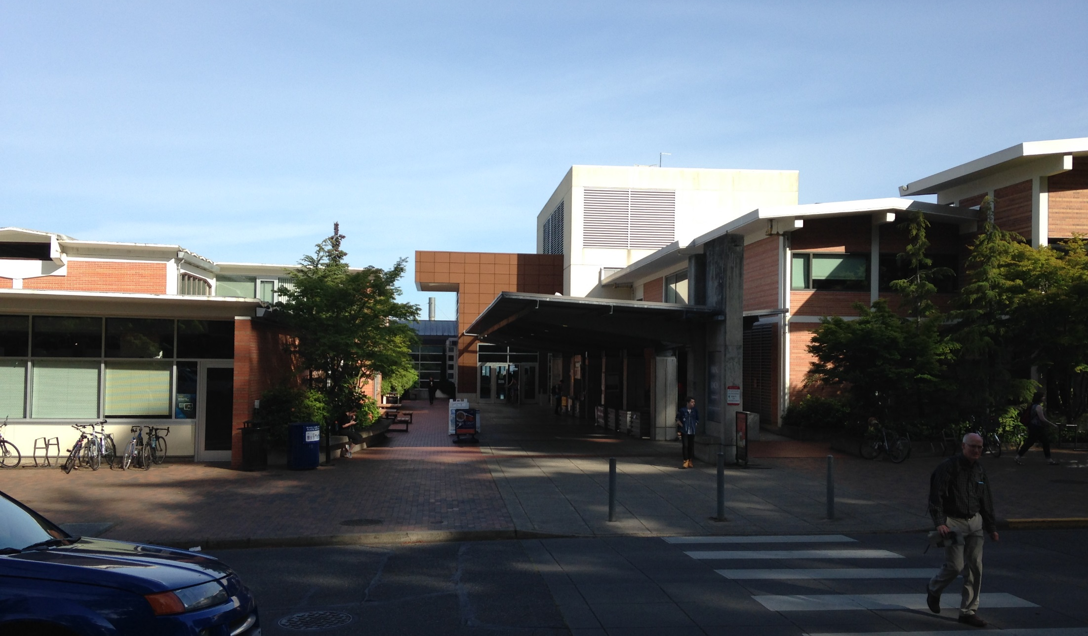
Existing Building - High Street Entry

Slide 18
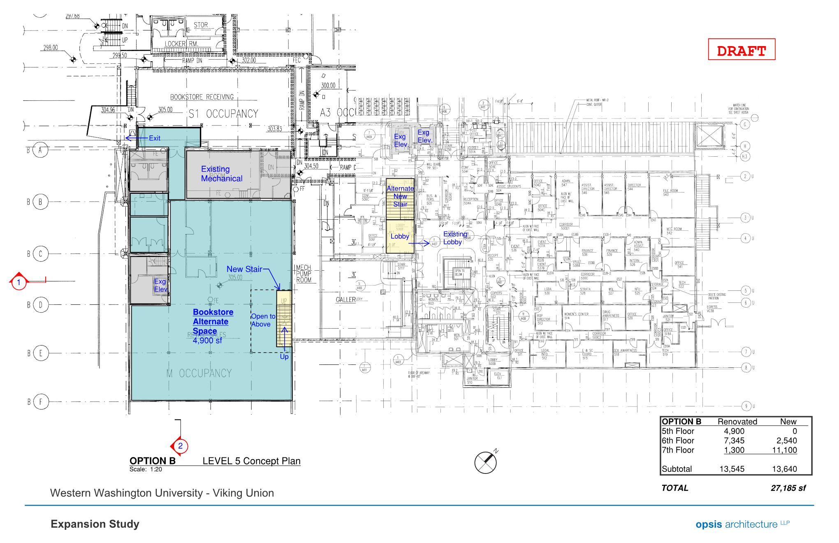
Existing Building - Level 5

Slide 19
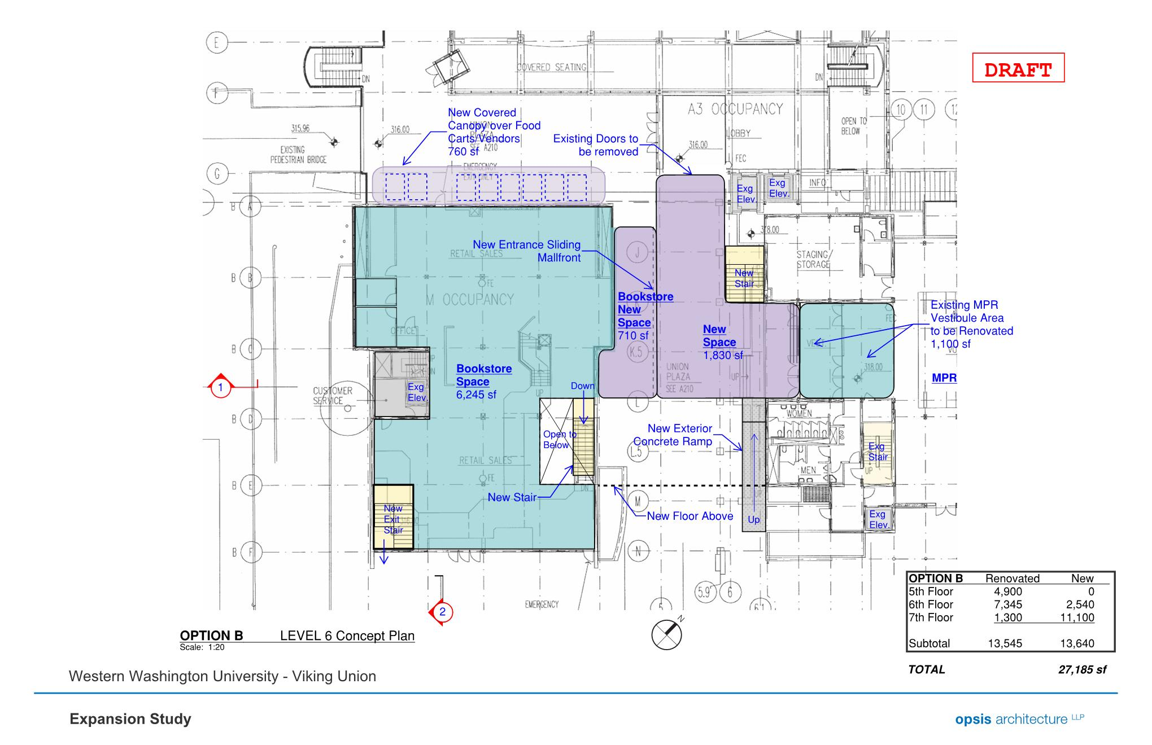
Existing Building - Level 6

Slide 20
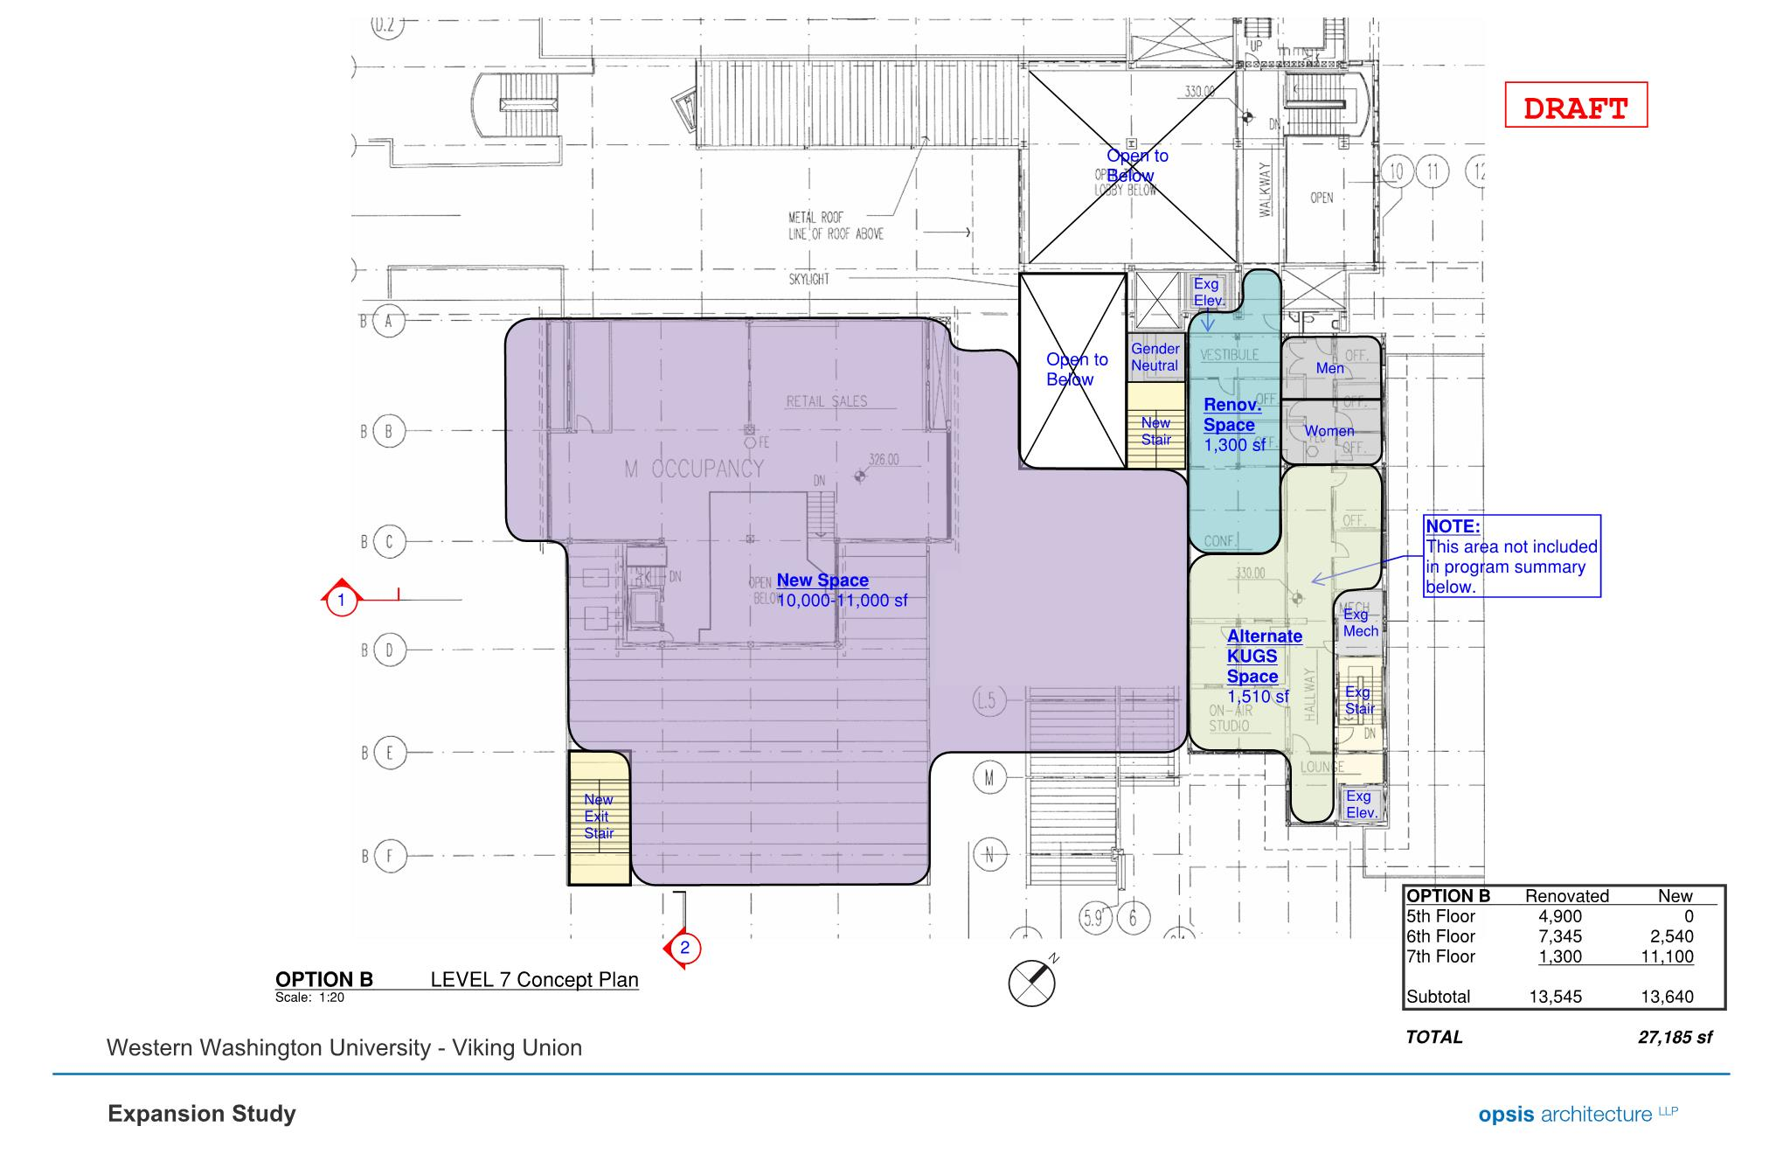
Existing Building - Level 7

Slide 21
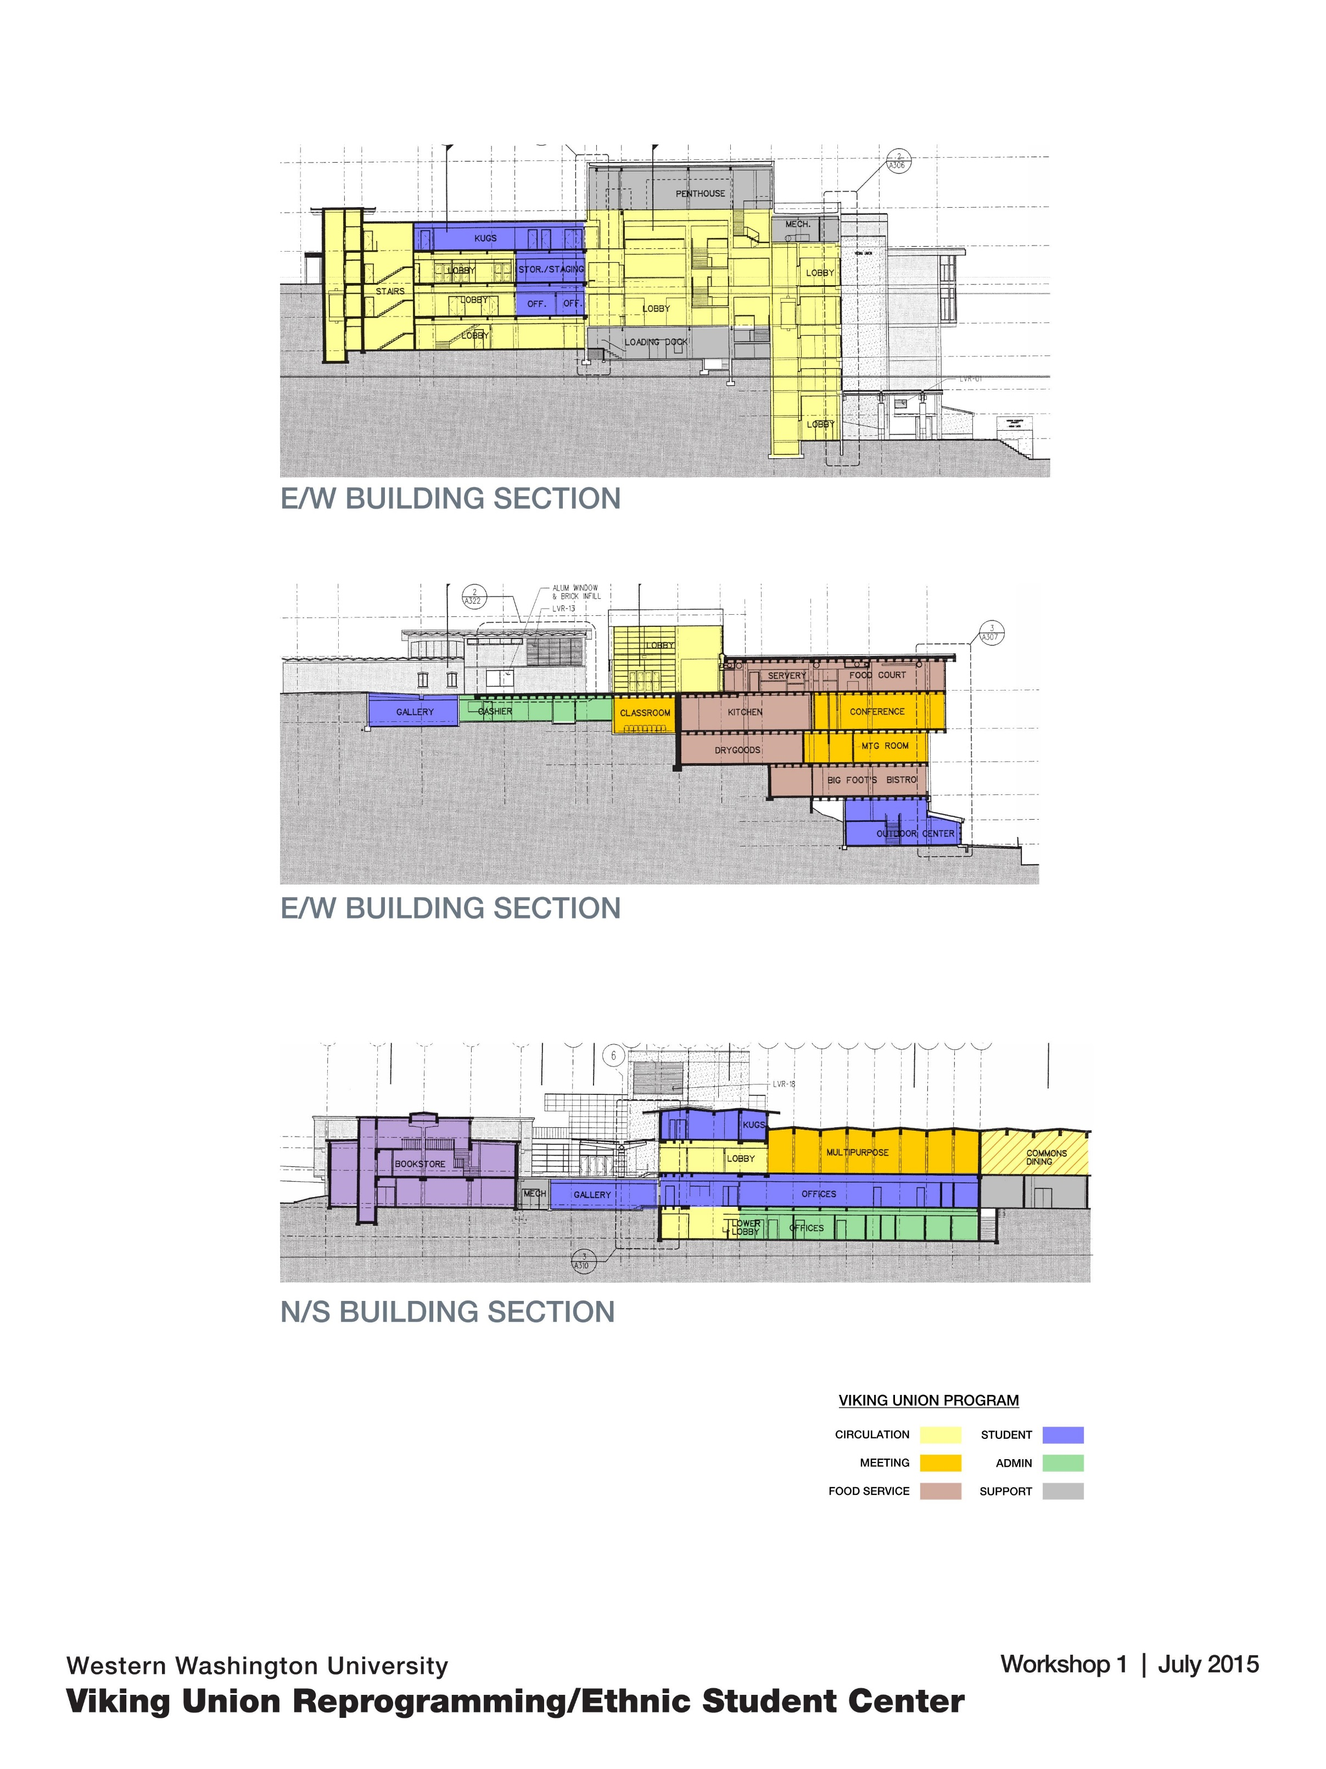
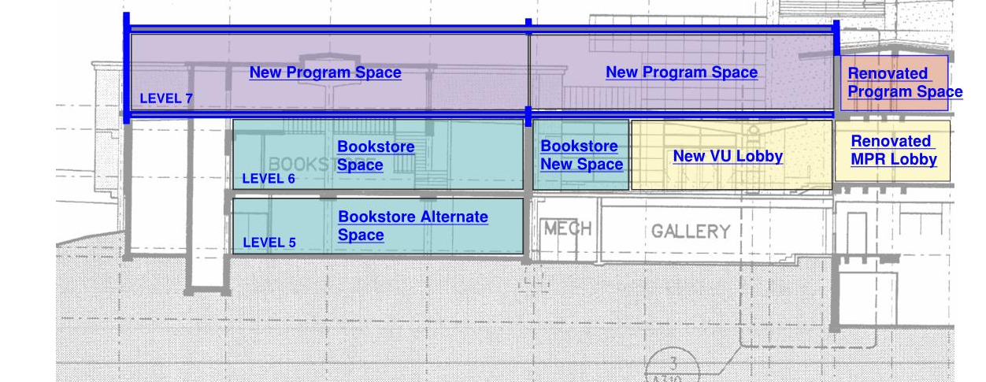
Building Section - N/S

Slide 22
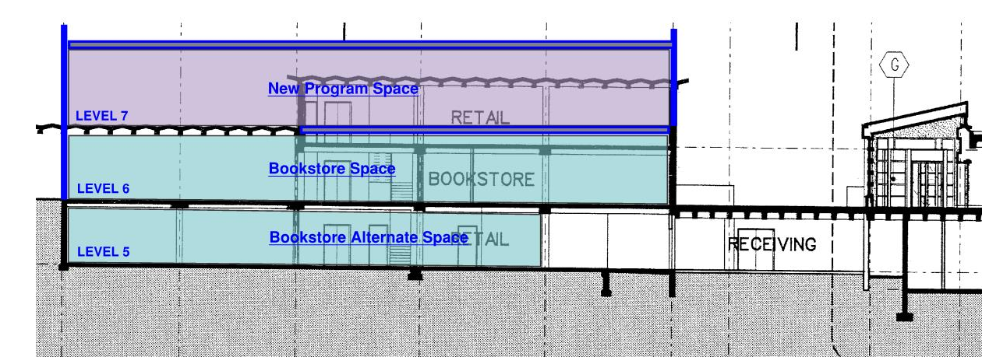
Building Section - E/W

Slide 23
High Performance / Sustainable Design
Natural Ventilation / Daylighting
Passive / Hybrid System
Photovoltaic Array
Biophilia
Educational Tool

Slide 24
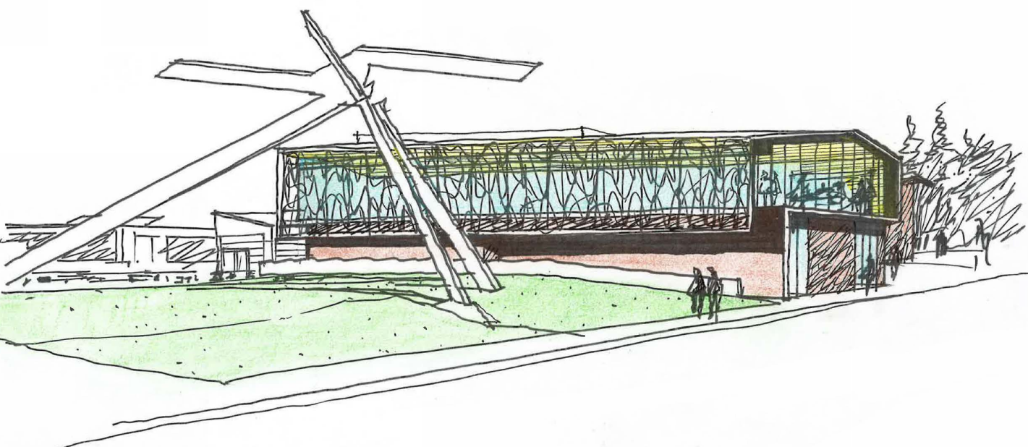
Ethnic Student Center / Multicultural Services
Project Review Committee Presentation
26 January 2017

