Slide 1
Academic Support Services Project
PRC Application
July 26, 2018

Slide 2
Introductions
Rick Benner, Director/University Architect
Josh Kavula, Associate Director, Office of Facilities Development and Capital Budget
Forest Payne, Project Manager/Architect
John Palewicz, John Palewicz Consulting, Design-Build Advisor
Robynne Thaxton Parkinson, Progressive Design-Build Consultants, LLC, Design-Build Advisor
Notes:
Rick introduces the folks at the meeting

Slide 3
Project Overview
20,000 - 25,000 sf office building at the edge of the campus
Moves administrative functions from the academic core
Frees up capacity in academic core for academic use
Limited budget/schedule
Sustainability goals: LEED Platinum, DC Power, CLT, Solar
Possible Phase 2
MWBE/Disadvantaged Business participation
Notes:
Rick generally describes project. Include why the project is necessary and the University’s goals.

Slide 4
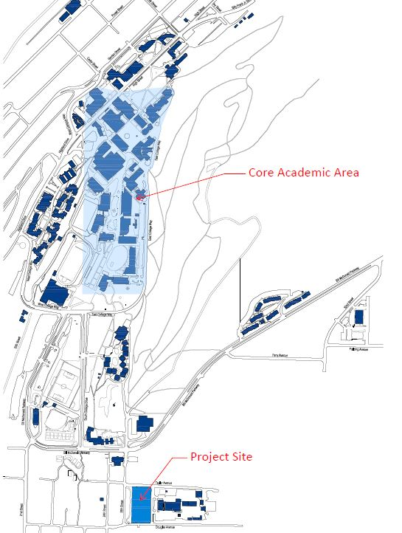
Campus Map
Notes:
Rick

Slide 5
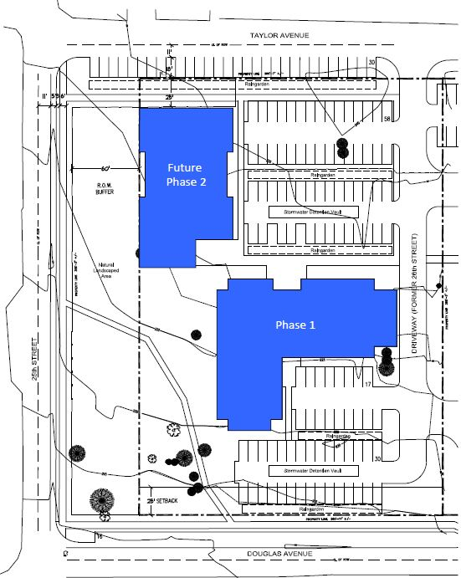
Project Map
Notes:
Rick

Slide 6
Why Design-Build
Schedule and budget is limited. ‘
Progressive design-build is fastest delivery
Fixed GMP and flexible scope more likely to keep within budget
Sustainability Goals
LEED Platinum
DC Powered Building
Cross Laminated Timber
Solar
Incorporate new trends in office configuration
Better able to reach MWBE/Disadvantaged business goals
Possible incorporation of Phase 2
Notes:
Rick describes why the University decided to pursue progressive design-build.

Slide 7
Statutory Requirements
RCW 39.10.300(1)(b) “Greater Innovation or efficiencies between the designer and the builder”
LEED Platinum
RCW 39.10.300 (1)(c) “significant savings in project delivery time”
Progressive Design-Build is the fastest delivery method.
RCW 39.10.280(2) (a) “Substantial Fiscal Benefit”
The GMP will be fixed to fit within the University’s project budget; however, the scope is flexible. The Design-Builder will work with WWU to stay within that budget.
The Design-Builder’s involvement in the development of the scope shifts more risk of the performance of the project to the design-build team
Innovations in office configuration
Incorporate new technology
DC Power
Composite Laminate Timber
Possible incorporation of Phase 2
Solar
Notes:
Rick identifies the specific statutory authorization to use design-build for this project. Hand off to Forest

Slide 8
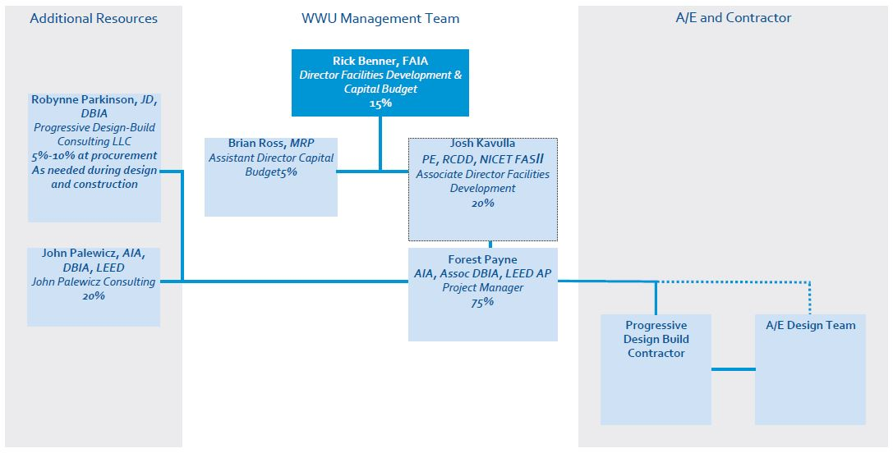
Organizational Chart
Notes:
Forest describes the team. Address the panel’s question regarding past DB experience on projects. The answer provided to the panelists is: “Forest Payne has not managed a design-build project for an owner, but he has experience as a project architect on a design-build project, a K-12 for the Muckleshoot Indian Tribe, completed in 2009, and a design-build lab project at the VA Medical Center in Seattle. He also has experience as lead architect and project manager on several GC/CM projects from the consultant side of the industry. In preparation for this project, Forest has taken the DBIA Certification Workshop and passed the DBIA Certification Exam to be a certified Associated DBIA Professional. Forest, as well as the University, will be mentored and advised by both Robynne Parkinson and John Palewicz during the life of the project. See application form for additional information regarding Forest’s experience and response to question #1 referencing the added table showing Forest’s specific project leadership experience as an architect and as an owner since joining WWU.”
Address the panel’s question regarding design management. The answer provided to the panelists is: “Design Management is the responsibility of the Design-Builder. The Design Manager for the project is employed by either the Design-Builder or the lead Designer, depending on how the Design-Build team is structured. Forrest Payne will be the University’s Project Manager for this project, with day to day responsibility, while reporting to Associate Director Josh Kavulla. Forrest will coordinate the collaborative input into the design from the University as well as the design review by the University, but the University will not be engaged in management of the design.”
John discusses the steps WWU has taken to put together the right design-build team. Include project manager experienced in design-build and taken DBIA Certification Workshop.

Slide 9
Project Budget
Description | Cost
Cost for Professional Services | 1,233,233
Estimated project construction costs (without construction contingency) | 7,524,555
Equipment and furnishing costs | 399,777
Contract Administration Costs | 383,806
Contingencies | 392,000
Other related project costs: Plan Review, In-house assist, Art | 228,457
Sales Tax | 664,000
Total | $10,825,828
Notes:
Forest goes through budget. Address the question regarding the contingency. The answer provided to the panelists is: “Based on the current budget, the anticipated design-build contract would include $$6,913,000 for construction costs and $967,000 for design costs for a total contract value of $7,880,000. The current budget has $330,000 for construction contingencies and $62,000 for design contingencies, totaling $392,000, 5% of the total contract value. During the validation period, the University will work with the design-builder to verify the total project budget.”
Note change in contingency from application. The form in the application is made for GC/CM and does not accurately identify the contingency. In application, WWU included the contingency in the project construction costs. That contingency has been pulled out of the project construction cost and included in the line item for contingency.

Slide 10
Project Schedule
Event | Date
Begin RFQ Development | June 2018
PRC Presentation | July 2018
RFQ Issued, Meeting, Shortlist | September 2018
RFP Issued, Meeting, Interview, Selection | October 2018
Negotiation and Agreement on Contract | November 2018
Board of Trustees Contract Approval | December 2018
Execution of Contract | December 2018
Phase 1 Schematic Design | February 2019
Phase 1 Design Development | May 2019
Contract Amendment – Commercial Terms | June 2019
Board of Trustees Contract Amendment Approval | June 2019
Phase 2 Construction Document Development | June 2019
Construction Begins | November 2019
Construction Substantial Completion | November 2020
Occupancy | December 2020
Notes:
Updated schedule. Note changes in RFQ/RFP. Hand off to Robynne

Slide 11
Procurement Approach
Request for Qualifications
Successful Experience with Projects of Similar Scope and Complexity
Team Organization
Experience developing GMP collaboratively with Owner
Request for Proposal
Management approach specific to the project
Innovation and Problem Solving
Interactive Proprietary Meetings
Price related factor: Fee, General Conditions
Limited required proposal submittals
Innovative Project Ideas
Shortlist no more than five finalists
Sustainability
Office building trends
Notes:
Robynne describes the procurement approach, noting specialized qualifications in sustainability and office building design.

Slide 12
Design-Build Agreement
Validation of GMP and Develop Scope
Validate information from the Owner
Examines options to identify innovation
Commercially reasonable examination of site
Develop Basis of Design Documents, Project Schedule
Contract Amendment
Project Completion
Complete Design
Construction
Close out
Validate GMP
Determination regarding Phase 2 incorporation
Notes:
Robynne describes the Design-Build Agreement. Address the question regarding contract form setting GMP at beginning. The answer provided to the panelists is: “The University intends to use a progressive design-build contract that is based on the DBIA Cost Plus with a Guaranteed Maximum Price form 530. This contract form, which has been used by Robynne Parkinson on several progressive design-build projects in Washington, sets a maximum GMP at the outset and has a flexible scope of work. The Design-Builder and the University will work together to maximize the scope that can be achieved under the GMP that is set. This type of progressive design-build contract form has been used very successfully twice by the City of Richland and twice by the City of Spokane. The maximum GMP is based on assumptions that are set forth in the contract, and the Design-Builder validates those assumptions early in the contract. If those assumptions are incorrect, the Design-Builder will receive a change order.”
Note that this contract form has worked well for many smaller projects such as the Richland Fire Station, the Richland City Hall, the Spokane Riverfront Park project, and the Spokane Post Street Bridge project. Hand back to Forest for questions.

Slide 13
Thank you

