Slide 1
New Sciences Building Addition Project
PRC Application
July 26, 2018
Notes:
Rick

Slide 2
Presenters
Western Washington University
Rick Benner, FAIA
University Architect
Director Office of Facilities Development and Capital Budget
Josh Kavulla, PE, RCDD, NICET FAS II
Associate Director Facilities Development and Capital Budget
Mark Nicasio, AIA, NCARB, GGP, GPCP
Project Manager
Perkins + Will
Anthony Gianopoulos, AIA, LEED AP BD+C, DBIA
Principal-in-Charge
Andy Clinch, AIA, LEED AP BD+C
Project Manager
Notes:
Rick

Slide 3
Project Overview
45,000 GSF
Instructional and research space serving STEM education
Maximize space consistent with national best practices
Two siting options
Notes:
Josh

Slide 4
Two Siting Options – Overall Campus Map
Notes:
Mark
To sites both located near STEM related programs.

Slide 5
Two Siting Options
1
2
Notes:
Mark
Closer image of surrounding site.

Slide 6
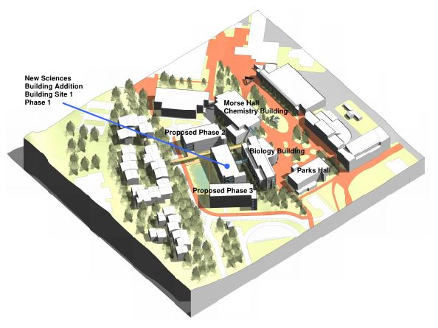
Pre-Design Study – Proposed Building Site 1
Notes:
Mark
Previous study of site 1

Slide 7
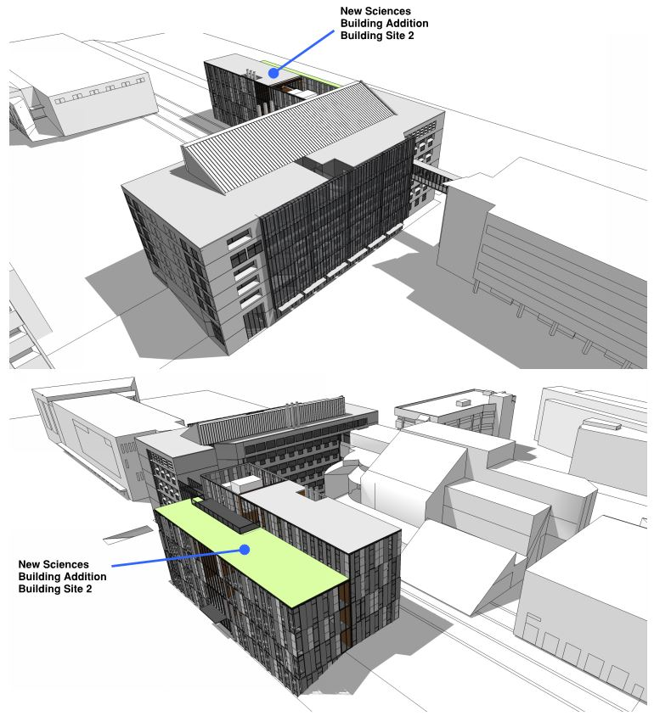
Pre-Design Study – Proposed Building Site 2
Notes:
Mark
Site 2 near the Environmental Studies building on the greenhouse site.

Slide 8
Project Budget
Description | Cost
Cost for Professional Services | $4,400,000
Estimated project construction costs (including construction contingency) | $45,000,000
Equipment and furnishing costs | $5,000,000
Contract Administration Costs | 3,400,000
Contingencies | 2,500,000
Other related project costs: Plan Review, In-house assist, Art | 2,000,000
Sales Tax | 4,200,000
Total | 66,500,000
Notes:
Mark
Part of the estimated project costs are Risk Contingency, GCCM Fee and GC General Conditions.
Contingencies include owner and design contingencies about 5%

Slide 9
MWBE/ Disadvantaged Businesses
WWU is committed to MWBE/Disadvantaged Businesses outreach with the selected GC/CM team.
Develop project aspirational goals and state them in the RFQ.
In the RFQ process have proposers provide an Inclusion Plan addressing how they propose to met the MWBE/Disadvantaged Businesses goals.
Tailor sub packages of work for MWBE/Disadvantaged Businesses.
Notes:
Mark
We will work on developing aspirational goals for the RFQ and work with our GCCM team.

Slide 10
PRC Question – 1
Question 1a Part 1
In Section 1 – it states a planned notice-to-proceed date of July, 2018. What NTP is this intended to describe?
Response
The Notice to Proceed is referring to the PRC approval to start the selection of the GC/CM team.
Notes:
Mark

Slide 11
PRC Question – 1
Question 1a Part 2
Please submit a schedule in larger size so it is readable.
Response
Schedule has been changed to be more readable.
Notes:
Mark

Slide 12
PRC Question - 2
Question 2
Section 4 page 3 identifies the critical importance of the GC/CM involvement in the design phase and to help determine the best site for the project. Attachment A Schedule indicates that the GC/CM will not be selected until after the site has been selected and the SD design phase is completed. Please explain.
Response
Schedule was incorrect and has been changed to reflect GC/CM Team onboard for the Schematic Design phase.
Notes:
Mark

Slide 13
Project Schedule – GC/CM Selection
Event | Date
Publication of RFP for GC/CM Services | August 6, 2018
Informational Meeting | August 13, 2018
Proposal submittal deadline from interested GC/CM firms | August 27, 2018
Notification of most qualified firms selected to be interviewed | August 24, 2018
Interviews | September 17, 2018
Notification of firms selected to prepare Final Proposal | September 18, 2018
Distribution of Request for Final Proposal (RFFP) to bidders | September 18, 2018
Final Proposal submittal deadline Selection of firm with highest total score | September 27, 2018
Notification of successful and unsuccessful firms | September 28, 2018
Preconstruction Work Plan due | October 5, 2018
Agreement for Preconstruction Services executed | October 12, 2018
GC/CM Preconstruction kickoff | October 19, 2018
Notes:
Mark

Slide 14
Project Schedule – Design Schedule
Event | Date
Program verification and site selection begins | November 2018
Start MC/CM and EC/CM selection process | November 2018
Start schematic design Start MC/CM and EC/CM selection process | January 2019
Complete MC/CM and EC/CM selection | January 2019
Complete schematic design | March 2019
Start Design Development | April, 2019
Complete Design Development | September, 2019
Start Construction Documents | October, 2019
Complete Construction Documents | April, 2020
Bidding | May, 2020
Start Construction | July, 2020
Substantial Completion | October, 2021
Occupancy | December, 2021
Notes:
Mark

Slide 15
PRC Question - 3
Question 1b
On the Management Plan, Please show the A/E.
Response
AE is located in grey box. Perkins + Will is the selected AE for the New Sciences Building Addition.
Notes:
Mark

Slide 16
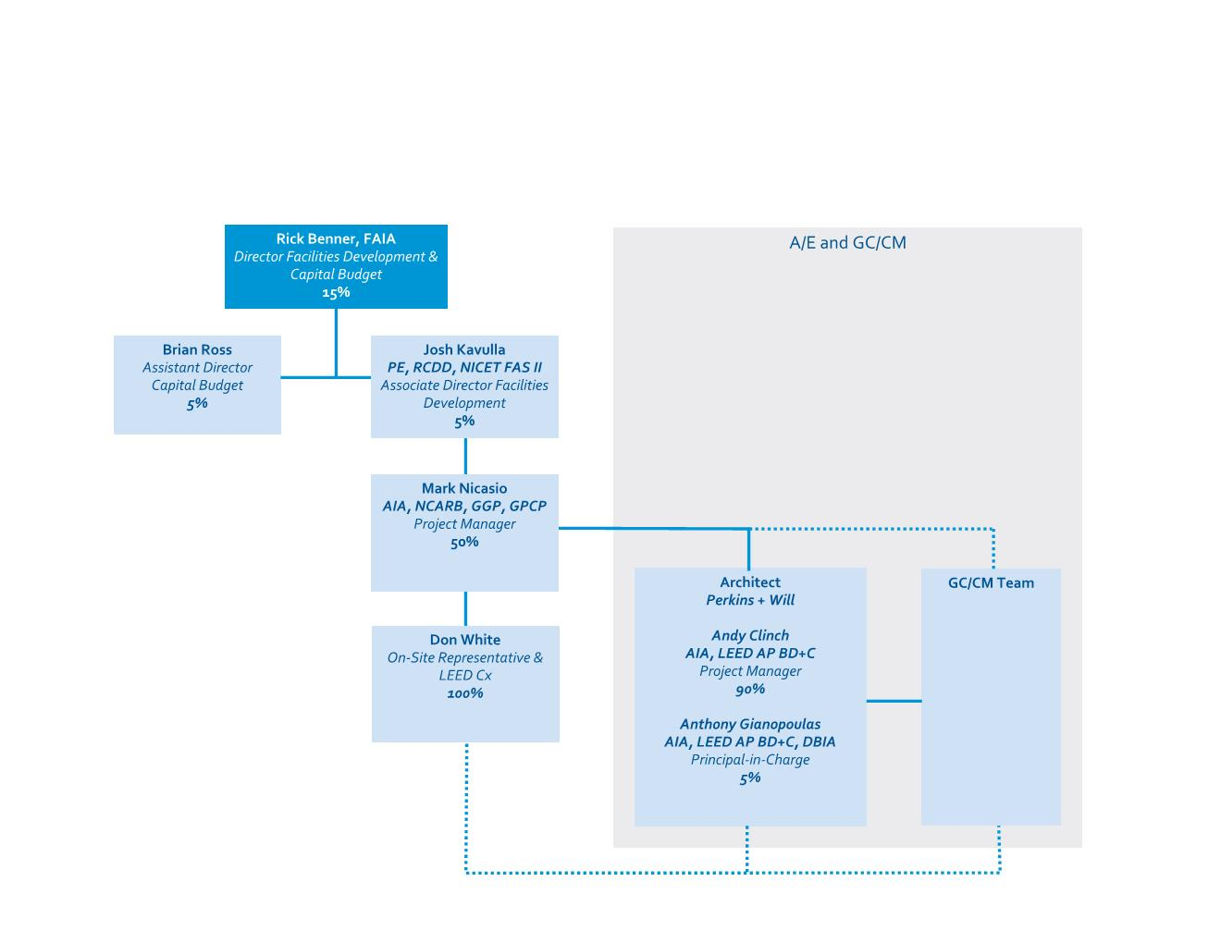
Management Plan
Notes:
Mark to introduce Tony and Andy. Tony and Andy can speak about their GC/CM experience and projects using this delivery method.

Slide 17
PRC Question - 4
Question 1c
In the Construction History, please provide narrative explaining the large amount of cost growth for the CV Renovation project.
Notes:
Rick

Slide 18
PRC Question - 4
Response
The Construction History provided in the application pulled numbers from incorrect cells and will be revised for the committee. However, the Carver project did still come in over its initial budget.
Cost increased significantly from the 90% complete documents to the 100% complete.
The preconstruction services had minimal deconstructive testing.
The collapsed or damaged underground utilities running through the site were undocumented by WWU, clash detection was not completed until well into construction.
Encountered glass material availability problems followed by a glazer’s strike, which in turn caused significant delay.
Notes:
Rick
The Construction History provided in the application pulled numbers from incorrect cells and will be revised for the committee. However, the Carver project did still come in over its initial budget.
The cost increased significantly from the 90% complete documents to the 100% complete including permitting agency required modifications.
The preconstruction services had minimal deconstructive testing and we ended up with many more areas containing asbestos than anticipated.
The collapsed or damaged underground utilities running through the site were undocumented by WWU, clash detection was not completed until well into construction, the exterior envelope was primarily glass curtain wall.
WWU encountered glass material availability problems followed by a glazer’s strike, which in turn caused significant delay to close-in resulting in a two-month delay and significant increase to labor costs and negotiated support services temporary heating costs.

Slide 19
WWU Major Projects Construction History 2011-2018
Notes:
Rick

Slide 20
PRC Question - 5
Question 1d Part 1
What were the lessons learned from the two GC/CM projects previously completed.
Notes:
Josh

Slide 21
PRC Question - 5
Response
In our current market, the GMP, MACC negotiation and the Total Contract Cost is not awarded until after the bid packages have all been bid on 100% complete documents including permitting agency modifications needed to obtain the building permit.
Increase Preconstruction services for deconstruction investigations to minimize the risk of unforeseen conditions.
Use of BIM clash detection to solve problems before they are encountered during the work.
Additional oversight of the project in monthly meetings with the project delivery team including the principals of the A/E, GCCM, and WWU to discuss progress and risks to the project success.
Use of project management software (e-Builder) by WWU, the A/E and the GC/CM to track and expedite decision-making.
Additional review of experience that the design consultant ME, EE, MCCM, and ECCM working in alternative delivery project to help improve the design and construction of the project.
Notes:
Josh
In our current market, the MACC negotiation and the Total Contract Cost is GMP is not awarded until after the bid packages have all been bid on 100% complete documents including permitting agency modifications needed to obtain the building permit.
Preconstruction services have increased including deconstruction investigations to minimize the risk of unforeseen conditions.
Discussions are on-going about who performs BIM clash management and when that occurs. We are using more BIM clash detection to solve problems before they are encountered during the work.
In order to have Additional oversight of the project is provided in monthly meetings with the project delivery team including the principals of the A/E, GCCM, and WWU to discuss progress and risks to the project success. These include review of change order proposal action plans, schedule review, budgets review, including risk and owner contingencies, negotiated support services, and general conditions.
Use of project management software (e-Builder) by WWU, the A/E and the GC/CM to track and expedite decision-making.
With each new project, we actively engage the Additional review of experience that the design consultant ME, EE, MCCM, and ECCM working in alternative delivery project to help improve the design and construction of the project.

Slide 22
PRC Question - 6
Question 1d Part2
Is anyone still on staff from those projects?
Response
Rick Benner - Director
Dale Krause - On-Site Construction Representative
Sherrie Montgomery - Project Manager
Don White - On-Site Construction Representative
WWU Director of Space Administration
Vice President for Business & Financial Affairs, and the Provost
Notes:
Mark
Read slide

Slide 23
Thank you
Notes:
Mark

