Slide 1
New Residence Hall Project
PRC Application
July 26, 2018

Slide 2
Introductions
Rick Benner, Director/University Architect
Leonard Jones, Director University Residences
Josh Kavula, Associate Director, Office of Facilities Development and Capital Budget
Sherrie Montgomery, Project Manager/Architect
John Palewicz, John Palewicz Consulting, Design-Build Advisor
Robynne Thaxton Parkinson, Progressive Design-Build Consultants, LLC, Design-Build Advisor
Notes:
Rick introduces the folks at the meeting

Slide 3
Project Overview
At least 400 Bed Student Housing Facility
State of the Art Facility
Various siting options
Competitive Student Amenities
Notes:
Leonard: Description of project
SET THE NEED
Speak to vision and need
Note we have fixed cost, limited time (perfect for progressive design-build)
Panel is interested primarily in two things: Is progressive design-build appropriate for the project, and is the team prepared to use this method
Describe the project
Specific expertise of the team is needed
Sequencing and scheduling construction on an active campus
Need help with siting and configuration - amenities, close to dining halls
State of the art
Broad experience with residence facilities
Based on demand studies, which shows we have a great demand for housing students
Will also help with marketing to prospective students
Speed – must make fall quarter opening
Funds are limited

Slide 4
Why Design-Build?
Various options for siting
Best configuration for:
Cost effectiveness
Marketing to students with amenities that compete with other universities
Least impact on scheduling/sequencing on an active campus
Complex buildings
Focus on MWBE/Disadvantaged Businesses in selection
Notes:
Rick: Challenge is to deliver to Leonard the building he needs within the budget on an active university campus.
With history on PRC and as Campus Architect, looked at various delivery models and arrived at progressive design-build because it best fits the needs of this project.
In addition, the PRC has recently approved other residence hall facilities for design-build; therefore, there is precedence for its use for residence halls.

Slide 5
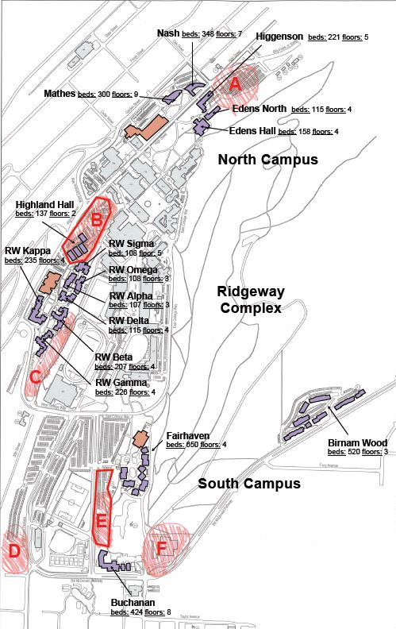
Siting Options
Notes:
Rick

Slide 6
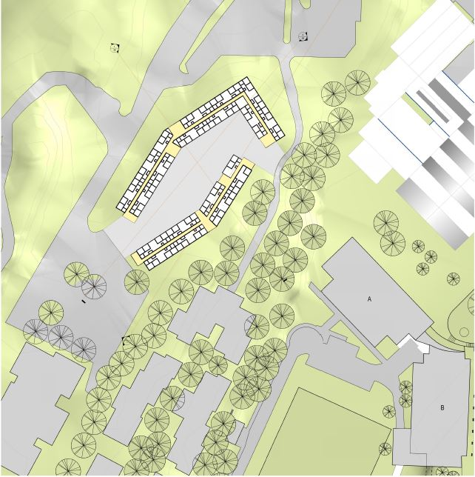
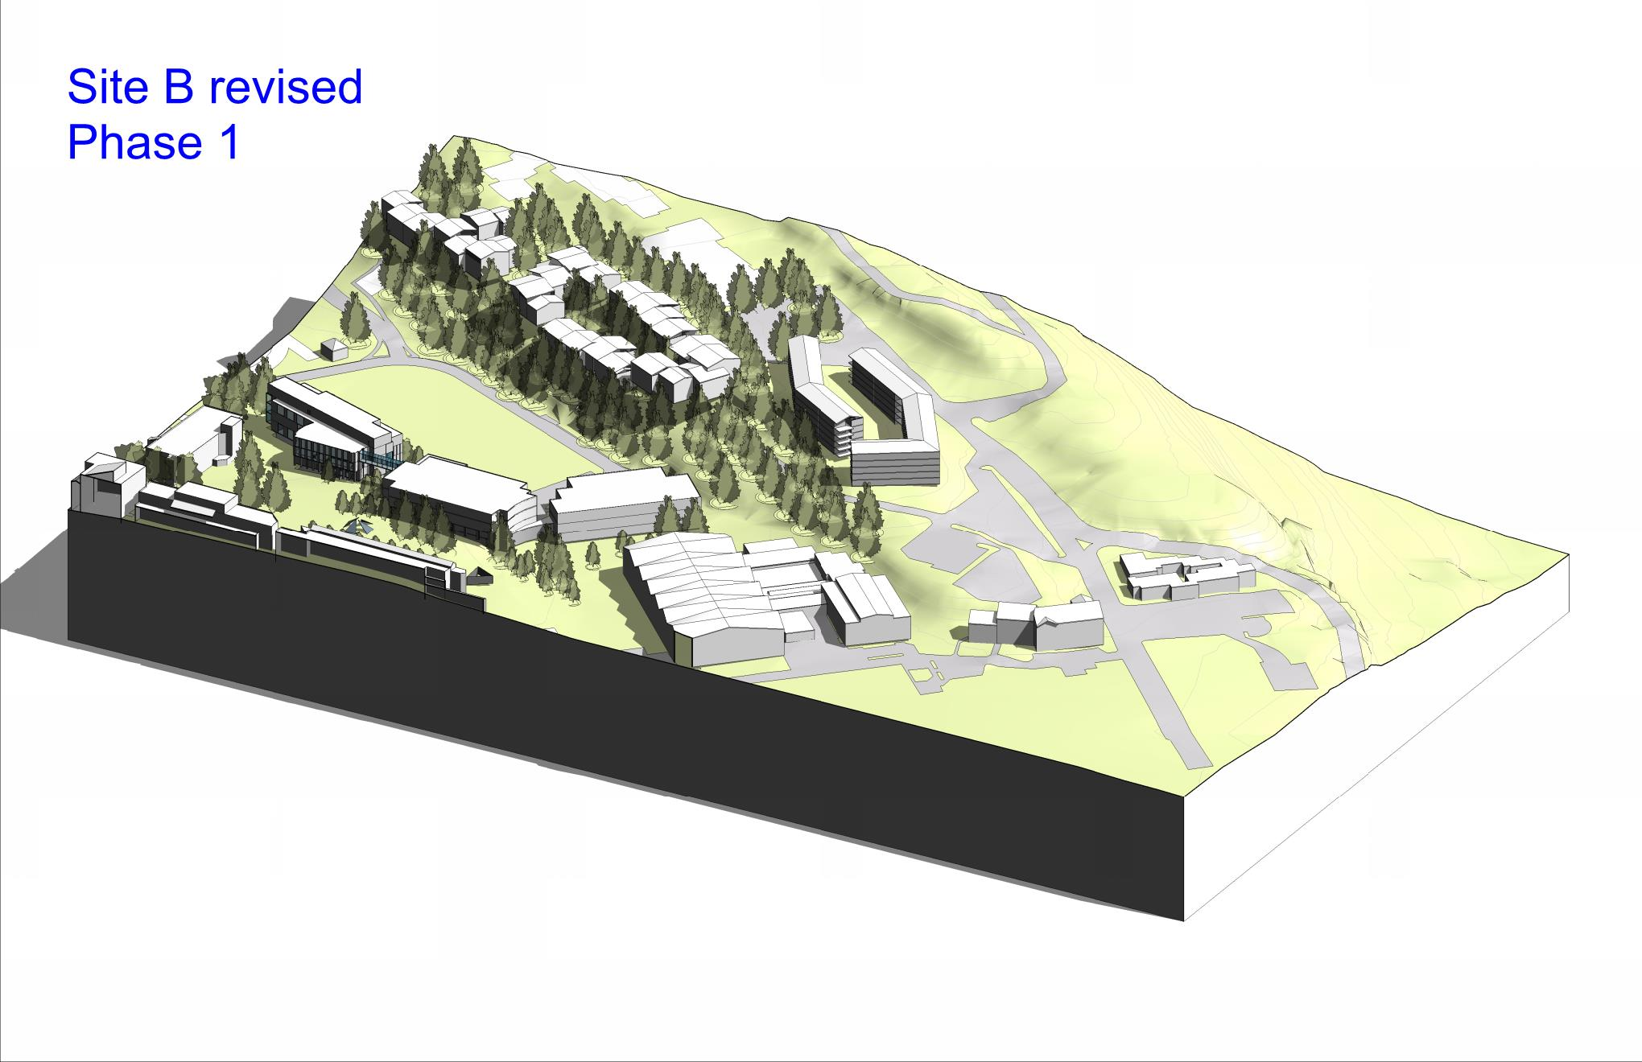
Multiple Siting Options
Site B Floor Plan
Site B Revised Isometric
Notes:
Rick

Slide 7
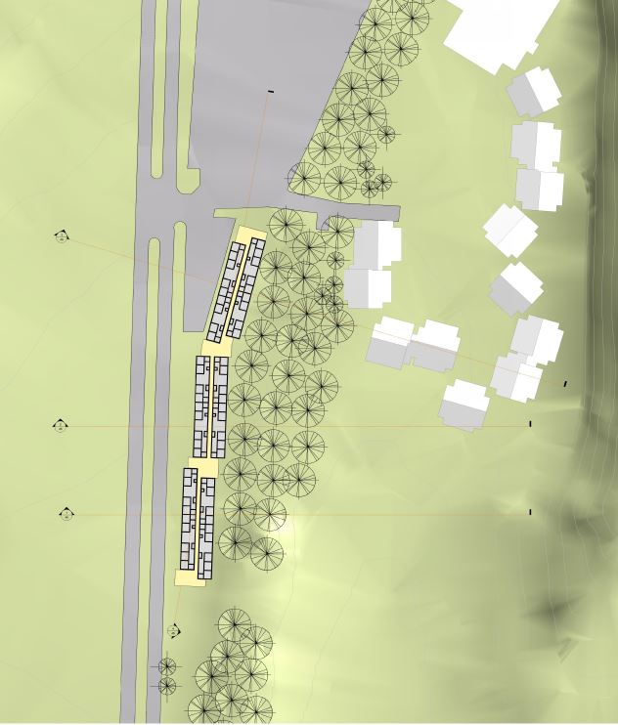
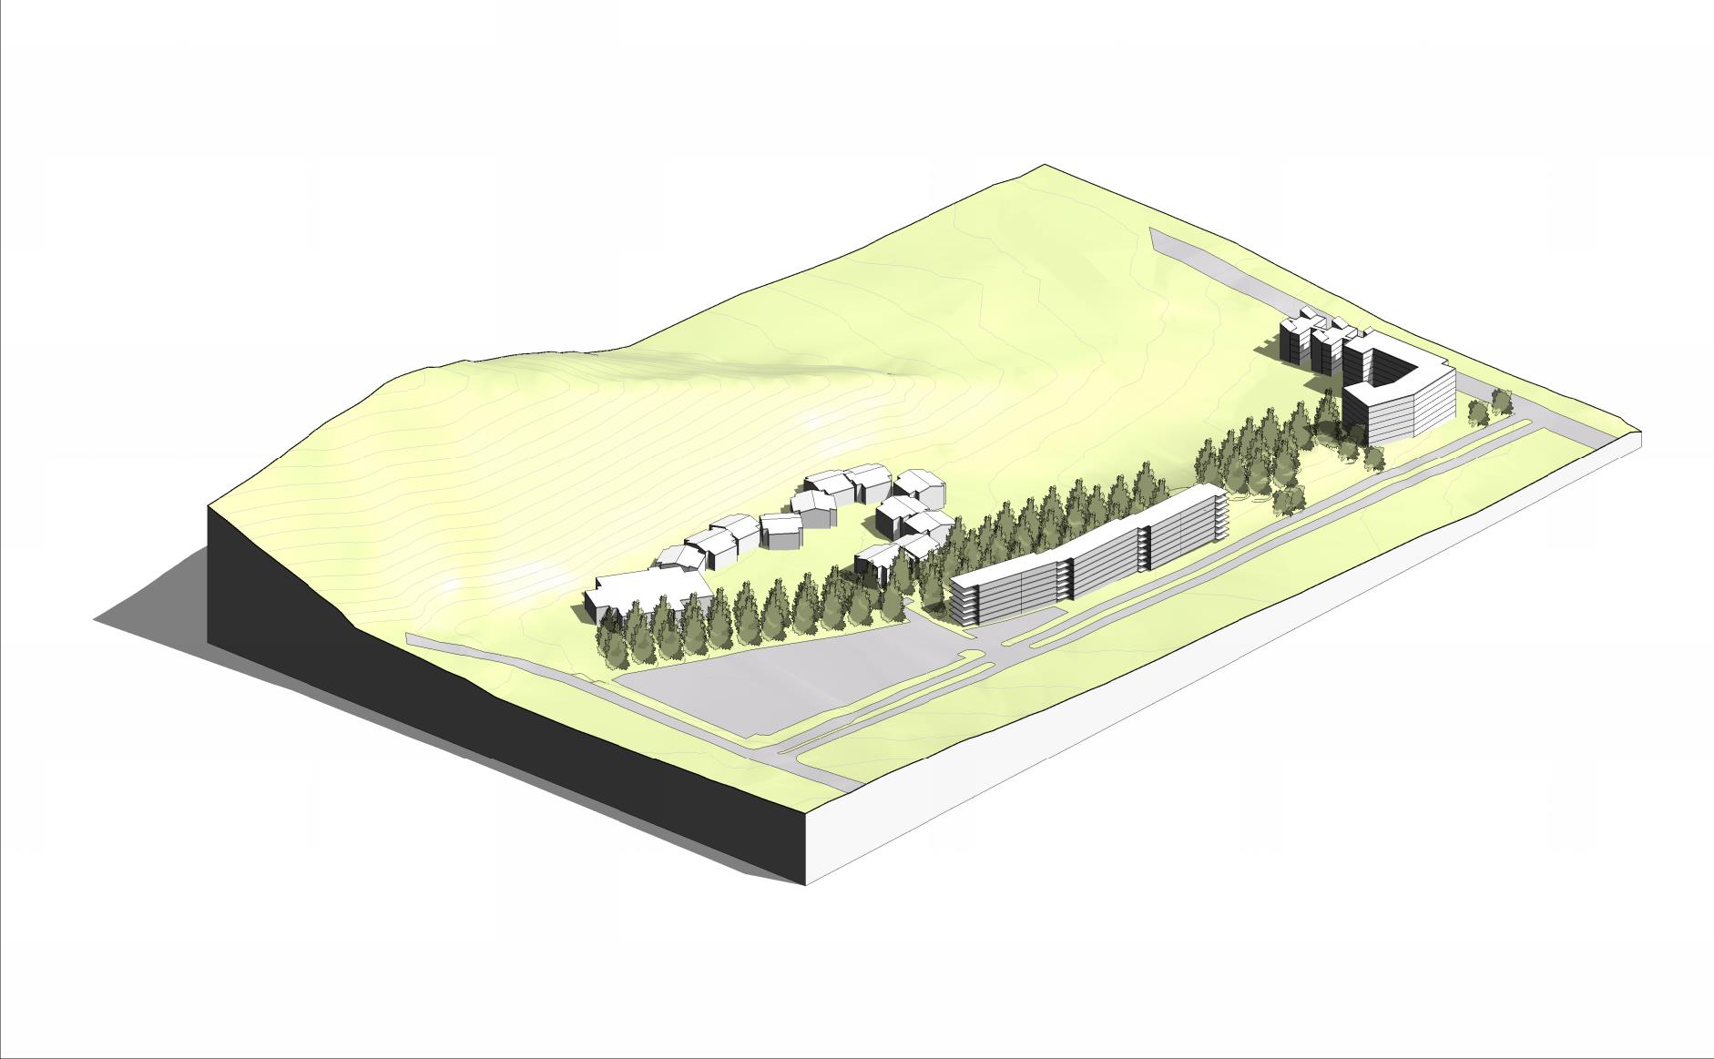
Multiple Siting Options
Site E Floor Plan
Site E Revised Isometric
Notes:
Rick

Slide 8
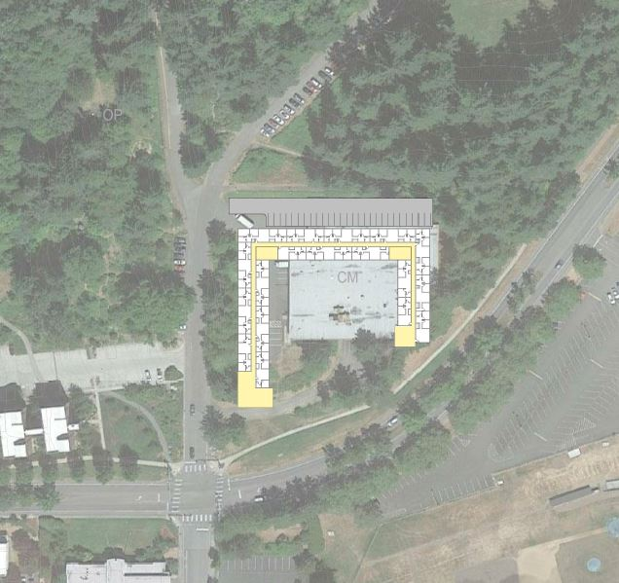
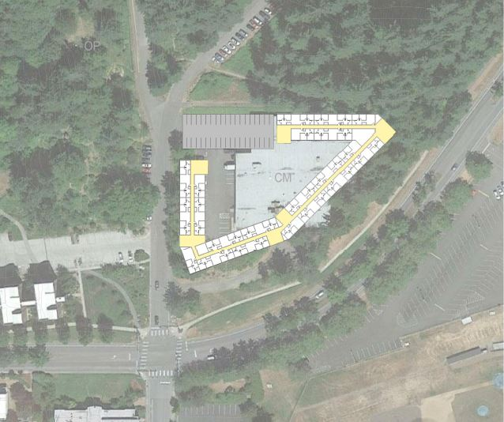
Multiple Siting Options
Site F Option A
Site F Option B
Notes:
Rick

Slide 9
Statutory Requirements
RCW 39.10.300(1)(b) “Greater Innovation or efficiencies between the designer and the builder”
Determining a siting option that will maximize cost effectiveness
RCW 39.10.300 (1)(c) “significant savings in project delivery time”
Progressive Design-Build is the fastest delivery method.
RCW 39.10.280(2) (a) “Substantial Fiscal Benefit”
Creating an optimal configuration will attract more students and maximize appropriate scope, creating a cost effective solution.
Using construction means and methods and sequencing to minimize impacts to a busy campus
Innovation in residence hall design
Progressive Design-Build minimizes disputes and provides more reliable cost data earlier in the project.
Notes:
Rick,
The statutory factors fit squarely with this project. The University will be using the procurement to select the best Design-Builder with an experienced team who can assist the University with siting, develop a state of the art facility that will attract students, and more effectively manage the budget and schedule.

Slide 10
Organizational Chart
Notes:
Sherrie: Describe the team and their roles
John: WWU has put together the right team for the project

Slide 11
Project Budget
Description | Cost
Cost for professional services | 5,189,000
Estimated project construction costs | 45,038,000
Equipment and furnishing costs | 4,297,000
Contract administration costs | 1,231,000
Contingencies | 3,840,000
Other related project costs: Plan review, In-house assist | 839,000
Sales tax | 4,561,000
Total | 64,998,000
Notes:
Sherrie:
Contingencies are (including risk)
Professional Services - $751,633
Construction - $3,088,900
Taxes are
Construction $4,187,113
FFE $373,981
If asked:
(WWU is providing $4-5 million up front)

Slide 12
Project Schedule
Event | Date
Begin Siting Study Options | May 2018
Begin RFQ Development | May 2018
Approve Siting Options | June 2018
PRC Presentation | July 2018
RFQ Issued, Meeting, Shortlist | September 2018
RFP Issued, Meeting, Interview, Selection | November 2018
Board of Trustees Contract Approval | December 2018
Execution of Contract | December 2018
Phase 1 Schematic Design | May 2019
Phase 1 Design Development | July 2019
Contract Amendment – Commercial Terms | August 2019
Board of Trustees Contract Amendment Approval | August 2019
Phase 2 Construction Document Development Complete | January 2020
Construction Substantial Completion | July 2021
Occupancy | September 2021
Notes:
Sherrie
If asked:
(Bonds will be issued before the 2nd amendment of the contract)
Substantial in July allows us to:
Create and program key cards/fobs
Install furniture and equipment
Early move-in for RAs and RDs
Any decorations the RD and RAs and other pre-occupancy things the client wants to do
Majority of moves occurs the weekend before classes start
Classes start usually the third or fourth week of September

Slide 13
Procurement Approach
Request for Qualifications
Successful Experience with Projects of Similar Scope and Complexity
Team Organization
Experience developing scope and GMP collaboratively with Owner
Shortlist no more than five finalists
Request for Proposal
Management approach specific to the project
Innovation and Problem Solving
Interactive Proprietary Meetings
Price related factor: Fee
Limited required proposal submittals
Experience Designing Residence Halls
Siting Experience
Experience working on an active campus
Approach to Siting
MWBE/Disadvantaged Business outreach
Notes:
Robynne: Explain procurement approach

Slide 14
Design-Build Agreement
Validation and GMP Development Period
Validate information from the Owner
Examines options to identify innovation
Commercially reasonable examination of site
Develop Basis of Design Documents, Project Schedule, GMP
Contract Amendment
GMP Execution Period
Complete Design
Construction
Close out
Notes:
Robynne: Explain contract. Note its use in other projects

Slide 15
Thank you
Notes:
Rick: Hand out corrected information on WWU experience
Sherrie: Thank you and do you have any questions? punt as needed

