Slide 1
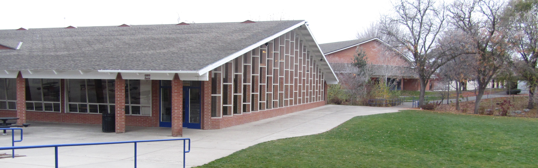
Walla Walla High School Renovation
Capital Projects Advisory Review Board – Project Review Committee Meeting – November 29, 2018

Slide 2
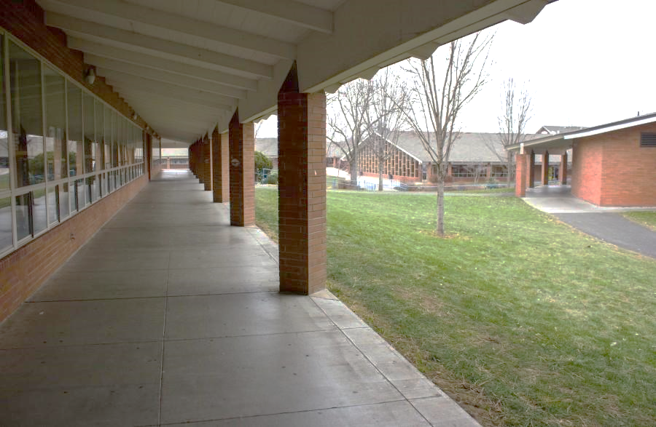
Agenda
Wa-Hi Scope of Work
Why GC/CM?
Understanding of Washington GC/CM Process
Project Team Qualifications
Unique Site Constraints
Q&A Session
Notes:
Wade – Agenda (30 sec)

Slide 3
Scope of Work
Major renovation of Walla Walla High School campus (230,000 SF) constructed in 1963 with additions in 1984 and 1990
$77.25M budget; $56.2M estimated construction cost
Renovate all 1963-era classrooms, commons, kitchen, original gym
Replace original HVAC system/energy efficiency upgrades, safety and security, life-safety, ADA
New science wing to match existing campus architecture
Additional classrooms for culinary arts and CTE
Remove portables; improve traffic flow, parking, and service area
Science building construction: Dec 2019-Aug 2020
Main renovation: Sep 2020-Dec 2022
Notes:
Wade – describe Wa-Hi scope of work (1 min)
Contingency 10% (min 5%)

Slide 4
Why GC/CM?
Wa-Hi is an open (e.g. California-style) campus with 1,800 students and staff. Must remain fully operational throughout construction process
Community driven bond to renovate rather than replace infrastructure, while preserving nostalgic facade and campus frontage
Results in extensive phasing and multiple moves of every student/staff/facility, including many sensitive student populations/programs (e.g. medically fragile, performing arts, CTE)
Coordination of mechanical/electrical replacement and life-safety upgrades during occupancy
Involvement of the GC/CM during design stage will be critical to project success
A complex and technical site with extensive environmental Issues
WDFW/Tribal recognized “high-priority” spawning ground, Yellow Hawk Creek winds through entire campus
Soils likely to require specialized deep foundation systems
Parking and traffic improvements performed within tight confines
Notes:
Wade – describe why GC/CM – 1 min
39.10.340

Slide 5
Understanding of Washington GC/CM Process
We recognize and are well versed in the statutory and programmatic differences between Washington GC/CM and Oregon CM/GC
Team has worked to build understanding of Washington process through research, strategic selection of team members
Walla Walla Superintendent Wade Smith
Walla Walla Facilities Director Michael Kay
GC/CM Advisor – Ed Champagne
Design Team – Architects West
Wenaha Group – extensive CMGC experience
Dave Fishel, Vice President
Heath Gardner, Senior Project Manager
Legal Council – Perkins Coie
Evaluation considerations and intentional weighting of GC/CM’s personnel experience with the delivery model
Notes:
Wade – introduce differences between Wash GC/CM and Oregon CMGC – 2 minutes
Wade – provide short background – 1 min
Kevin – short background – 1 min
Ed – short background – 1 min
Dave – short background – 1 min
Heath – short background – 1 min
Heath – describe Perkins Coie and GC role
Wade – RFP eval considerations 30 sec.

Slide 6
Understanding of Washington GC/CM Process
Proactive steps to address differences in Washington method:
Early creation of RFP, RFFP, GC/CM cost matrix and A133 contract with legal review/guidance from Perkins Coie
Clearly defined evaluation/protest criteria, including proposer’s qualifications and accident prevention program submission
Detailed procurement schedule, including public opening of sealed bids from finalists with fixed fee percentage of estimated MACC/fixed general condition fees, in addition to releasing scoring results based on advertised criteria
Working with selected GC/CM to plan formal subcontractor bidding & ensuring bid packages are prepared appropriately
Working with selected GC/CM to ensure subs bidding work over $300,000 post bid bond and awarded subs provide performance and payment bonds
Superintendent, senior project manager, and key team members will attend AGC GC/CM training on Jan 31 and Feb 1, 2019 for continuing education (best practices from industry practitioners)
Notes:
Heath and Ed (tag team discussion) – Discuss proactive steps – 1-2 min

Slide 7
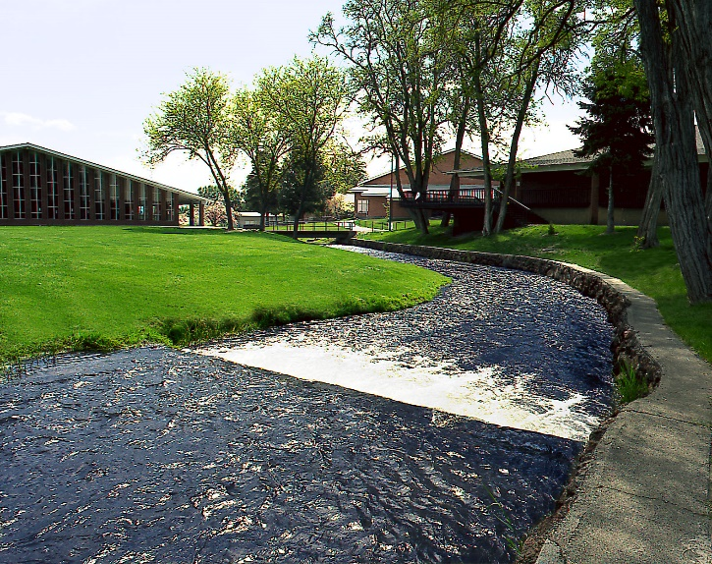
Why GC/CM? Site Constraints – Cumulative
Yellow Hawk Creek
Notes:
Kevin – Quick overview of Site constraints

Slide 8
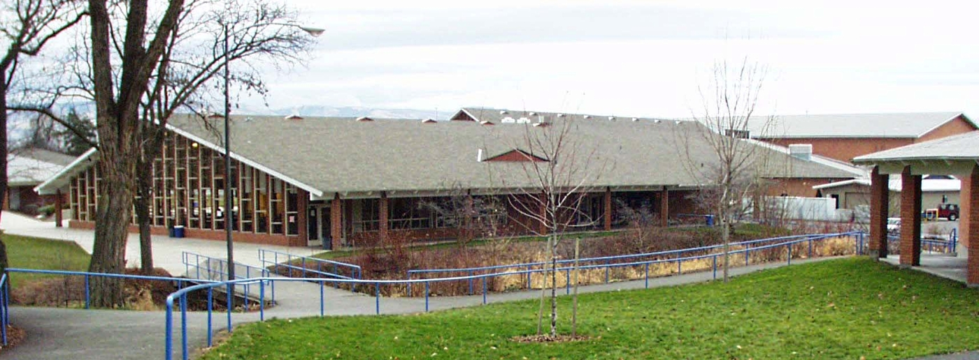
Right Project (RCW 39.10.340)
Complex phasing and coordination
Occupied facility
Early onboarding of GC/CM critical
Complex environment (Yellowhawk Creek)
Right Project Team (RCW 39.10.280)
Experienced Superintendent
Experienced GC/CM Advisor
Experienced Architect
CM/GC Experienced Project Manager
Anticipated Experienced GC/CM
Notes:
Wade – thank panel and ask for questions

Slide 9
Supplementary Documents
Why GC/CM? Site Constraints – Existing Buildings
Why GC/CM? Site Constraints – Vehicular Circulation
Why GC/CM? Site Constraints – Parking
Why GC/CM? Site Constraints – Athletics, Recreation, CTE
Why GC/CM? Site Constraints – Environmental
Why GC/CM? Site Constraints – Slopes
Why GC/CM? Site Constraints – Construction Influences

Slide 10
Why GC/CM? Site Constraints – Existing Buildings
Notes:
Back up slides w/ diagrams to use as needed

Slide 11
Why GC/CM? Site Constraints – Vehicular Circulation

Slide 12
Why GC/CM? Site Constraints – Parking

Slide 13
Why GC/CM? Site Constraints – Athletics, Recreation, CTE

Slide 14
Why GC/CM? Site Constraints – Environmental

Slide 15
Why GC/CM? Site Constraints – Slopes

Slide 16
Why GC/CM? Site Constraints – Construction Influences

