Slide 1

CPARB
Project Review Committee
GC/CM Application for Project Approval
Apple Valley and Summitview Elementary School Replacements
June 27, 2019
Notes:
Mike B – Thank you and excitement for our project! – 20 seconds

Slide 2
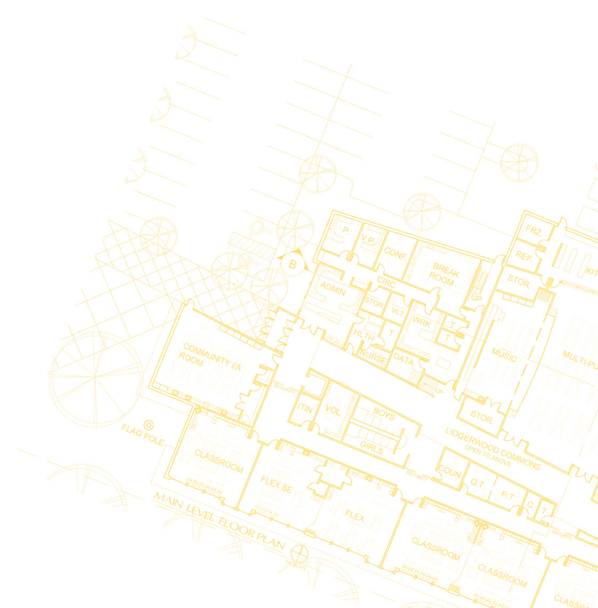
Agenda
Project Team
Project Overview
Project Budget
Project Schedule
Why this Project is Suited for GC/CM?
Summary
Questions and Answers
Notes:
Mike B – Quick summary of agenda – 20 seconds

Slide 3
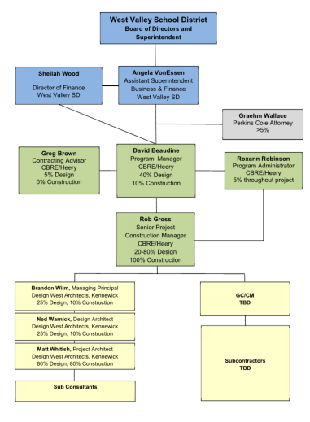
Project Team & Roles
Notes:
Mike – Have assembled a strong team to execute this program and the District and community is excited to add a qualified GCCM onto the team.
See that Angela Von Essen is placed into the position of the District’s main Point of Contact for the team and has been given the authority to make decisions
Allow each team member to introduce themselves – 45 seconds

Slide 4
Project Team Qualifications
Dr. Mike Brophy - Superintendent
Oversees Operations for West Valley School District
$72 million operating budget, 5,500 students
District Leader and responsible for educational programming
Angela VonEssen – Assistant Superintendent for Business & Operations
District’s Point of contact for the Bond Program
Oversees the District’s $72M operations budget & operational departments
Will be involved in all aspects of the project as district liaison to the project team
22 years of school district bond and construction experience
Notes:
4
Each person to spend 0.5 minute on themselves
Angela to stress her experience in capital construction at other District’s and WVSD, including some GCCM on previous WVSD HS project

Slide 5
Project Team Qualifications
Rob Gross – Sr. Project Construction Manager, CBRE|Heery
19 years Project Management, 4+ years in K-12
Managed over $100M in K-12 construction work
Experience directly in the Central WA market
Successful completion of AGC’s GC/CM certification program
David Beaudine, CCM – Managing Director, CBRE|Heery
16 years K–12 Program Management
Managed over $700M in K-12 projects
Directly managed 6 GC/CM projects valued over $320M, assisted in 4 others
Responsible for all CBRE|Heery work in Central and Eastern WA and Washington K-12 operations
Notes:
5
Each person to spend 0.5 minute on themselves
Rob to note experiences in Oregon’s CM/GC process which is similar and then completion of the AGC’s program to help see differences

Slide 6
Project Team Qualifications
Greg Brown, AIA, LEED AP – Program Manager, CBRE|Heery
30 years K–12 Program Management
Director at Spokane Public Schools for 12 years
Director of 10 successful GC/CM projects
Responsible for over $1 Billion in bond projects
Led application for Spokane Public Schools to obtain Public Body Certification – First school district in State
Roxann Robinson
20 years K–12 Management Support
Supported 17 GCCM projects from selection through construction valued at over $700M total project cost
Project Controls Specialist – Budget, MICS…
Notes:
6
David to make note of these team members – 30 seconds

Slide 7
Project Team Qualifications
Matt Whitish – Architect, Design West Architects
16 years experience including 5 years with Design West Architects
Majority of experience is in K-12 facilities
8 K-12 schools projects for 4 school districts in past 8 years
K-12 alternative delivery experience with Richland and Pasco School District
Brandon Wilm, AIA, LEED AP – Principal, Design West Architects
18 years experience including 17 years with Design West Architects
Majority of experience is in K-12 facilities
16 K-12 schools projects for 8 school districts in past 14 years
K-12 alternative delivery experience with Richland and Pasco School District
Notes:
7
Each person to spend 0.5 minute on themselves
Matt to introduce himself and his experience and then to note Brandon who was unavailable

Slide 8
Project Team Qualifications
Ned Warnick, LEEP AP – Principal, Design West Architects
33 years experience including 25 years with Design West Architects
Multiple project experience in GC/CM & CM/GC deliver method
Multiple K-12 projects throughout Washington State
Notes:
8
Each person to spend 0.5 minute on themselves

Slide 9
Project Team Qualifications
Graehm Wallace – Partner, Perkins Coie
20 Years Experience primarily representing
  school districts on Construction Law issues
Provides Family of Contracts to WVSD:
    Architect contract
    GC/CM contract
    GC/CM general conditions
Contracts updated to new RCW’s
Contracts reflect GC/CM experiences and improvements
Has provided GC/CM contracts for the following School Districts: Auburn, Bainbridge Island, Bellingham, Centralia, Central Kitsap, Central Valley, Clover Park, Edmonds, Evergreen, Federal Way, Fife, Kalama, Lake Stevens, Mead, Mount Vernon, Port Townsend, Puyallup, Seattle, Shoreline, Spokane, Tacoma, Tahoma, Vancouver, and Yelm; also for Columbia County Health System, Grays Harbor Public Hospital District, Lake Chelan Community Hospitals, Chelan County PUD, and Spokane Public Libraries; as well as for the Cities of Oak Harbor and Spokane
Notes:
9
David to make note of Graehm being contracted by the District to assist in contracting and all bond related matters

Slide 10
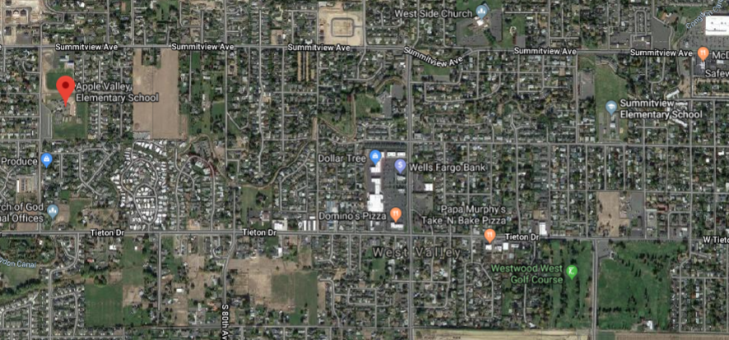
Conceptual Site Plan
2 Miles
Notes:
10
Rob or Angela – Summary of the project.
2 outdated elementary schools separated by 2 miles
District is currently relocating students out of each school to the Freshman campus (Freshman moving up to the HS)
Desire to complete both schools prior to the start of the 2021-2022 school year.
Send to Matt to discuss the two site plans

Slide 11
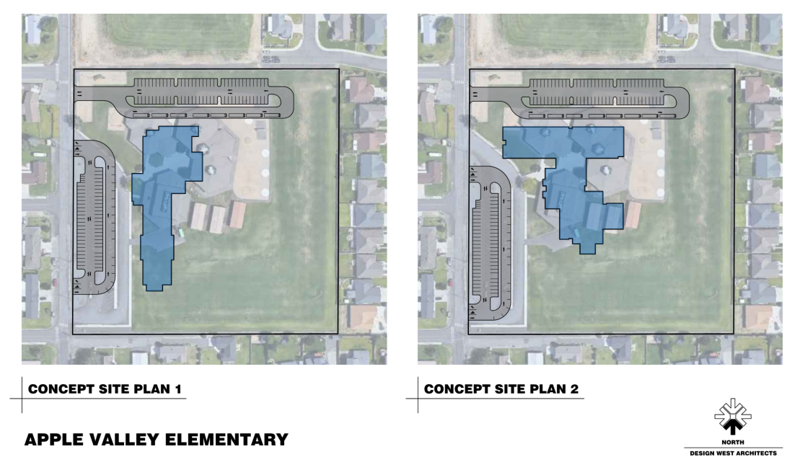
Conceptual Site Plan
Notes:
11
Matt –
Make note of looking to stay within footprint of existing due to contaminated soils which we would like to try to avoid but recognize may need to address, in addition the sloping hill to the north.
90 seconds

Slide 12
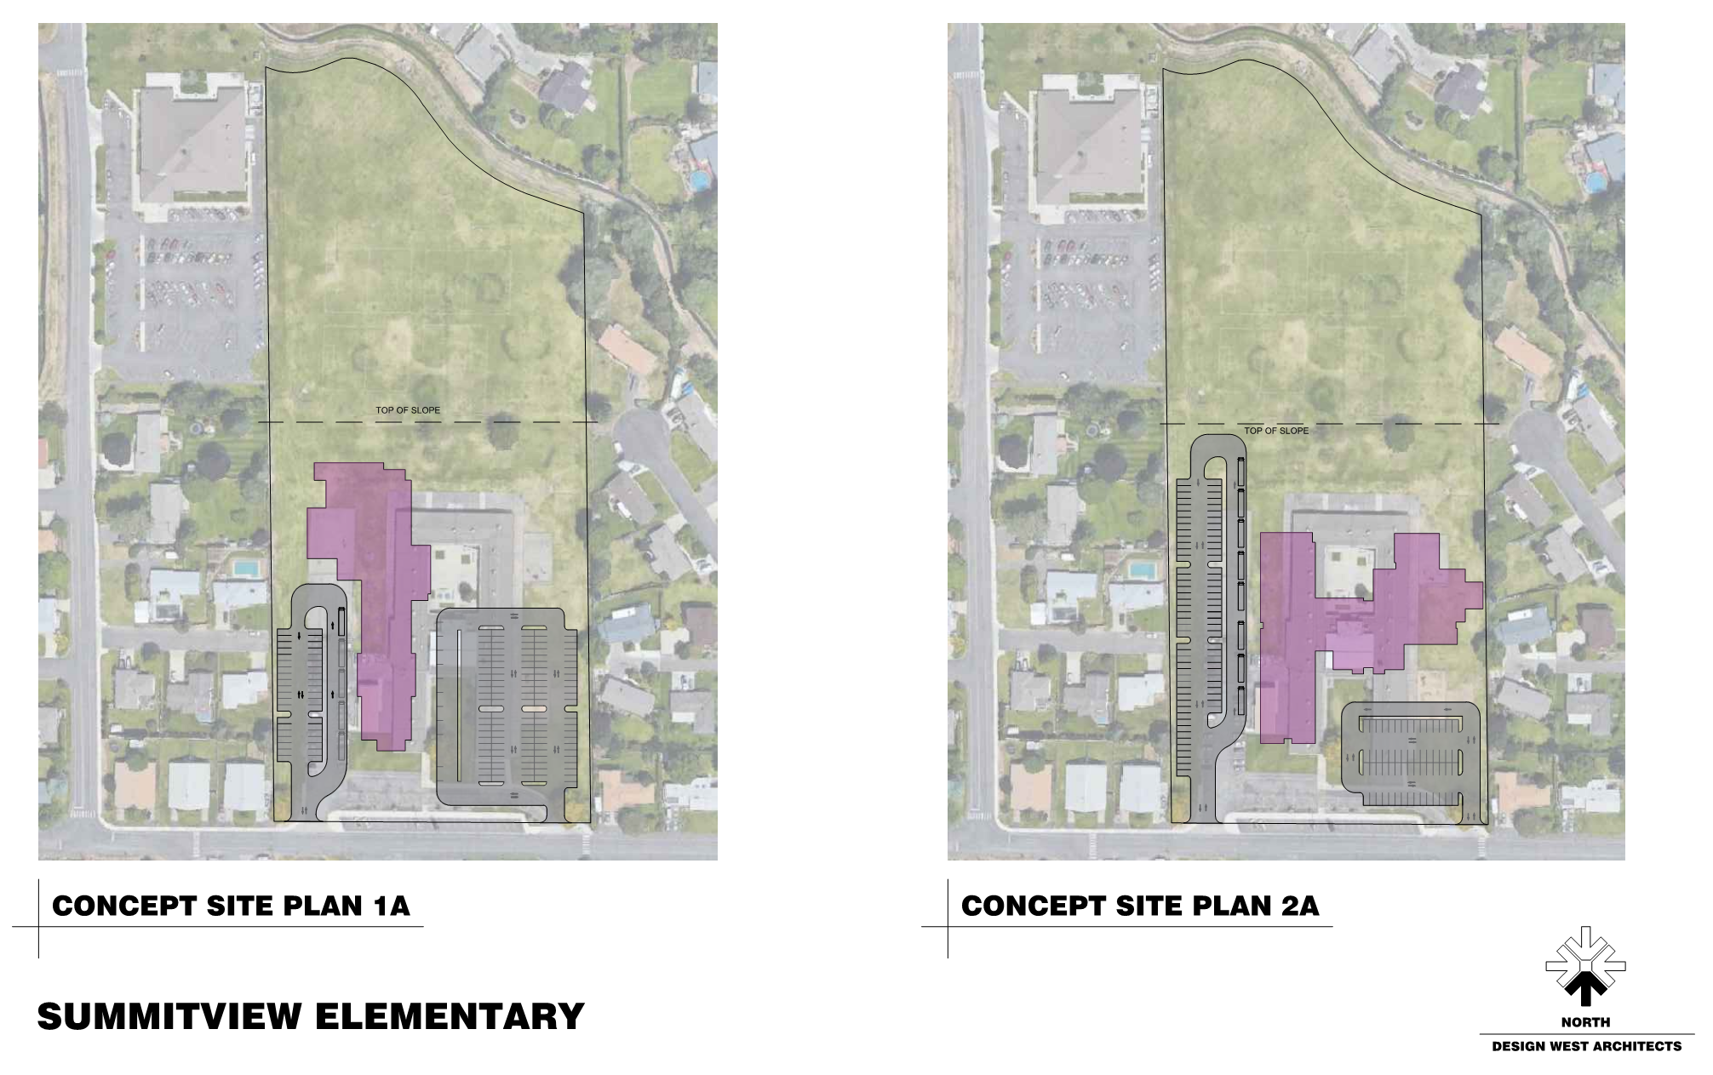
Conceptual Site Plan
Notes:
12
Matt
Note constrained site, close neighbor proximity to east and west and sloping hillside to the north.
90 seconds

Slide 13
Project Budget
 | Apple Valley | Summitview | Total
Professional Services Costs | $2,375,700 | $1,816,600 | $4,192,300
Construction Costs | $24,173,600 | $24,493,500 | $48,667,100
Equipment & Furnishings | $1,514,800 | $1,514,800 | $3,029,600
Off Site | $700,000 | $700,000 | $1,400,000
Construction Administration | $875,000 | $875,000 | $1,750,000
Contingencies | $2,004,400 | $1,997,400 | $4,001,800
Other Related | $1,064,800 | $1,048,000 | $2,112,800
Sales Tax | $1,775,800 | $1,797,700 | $3,573,500
TOTAL | $34,484,100 | $34,243,000 | $68,727,100
Notes:
13
Angela to review project budget with emphasis on 8% owner’s contingency plus construction contingencies and escalation potentials (7%-6%-4%) within Construction line.
Summitview realized the prototype savings for the design but has more HAZMAT work to occur
90 seconds

Slide 14
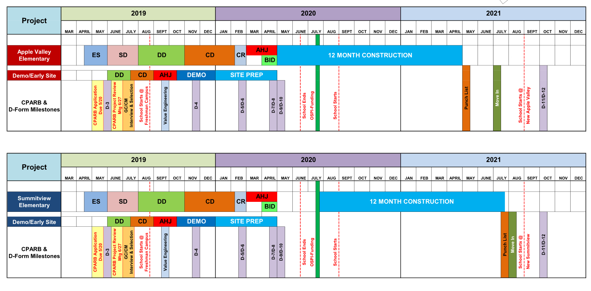
Project Schedule
Notes:
14
Rob –
Discuss currently approving ed specs and have begun schematics
Intent is for the GCCM to be selected at end of June and to board either at special meeting or at August 12 board meeting, at which point will immediately begin work into Schematic estimate and providing VE opportunities alongside the 3rd party VE.
Early Demolition to show Community getting to work early and prepping site to be able to get construction completed within the tight timelines.
Able to front fund the first school, and 2nd must wait till OSPI funding although working alongside OSPI for early work options as state match, while necessary to complete will come in near the end of the program.
Already solicited GCCM’s due to tight timelines and scheduled to receive RFQ’s on 7/1 and a tentative interview date of 7/24 and pricing 7/29.
120 seconds

Slide 15
Why is the Apple Valley & Summitview Replacement Project suited for GC/CM ?
RCW 39.10.340:
The project involves complex scheduling, coordination and phasing:
  The district is growing in an upward trend and all students are currently being housed in the freshman campus and therefore the schools needs to be on-line as soon as possible. Hiring the GC early is critical to maintaining this aggressive schedule.
  A phased approach to construction will help solve volatile escalation concerns and a skilled GC/CM can coordinate early bid packages and release of main bid packages in order for work to phase in a manner that will result in success for the project.
Notes:
15
David
- Summarize that we believe while only needing to meet one of the criteria for GCCM utilization, this project meets 3 of the criteria
District growing and needs the additional space, able to move kids into Freshman campus to do this work all in a short time frame. While it tightens the timelines up it saves on escalation and that savings can be utilized as needed for escalation if unforeseen occur
Early bid packages to get project started strong. Early demo and site prep/off site development to prep the site for building
Coordination of bid packages for execution of work in phased manner
90 seconds

Slide 16
Why is the Apple Valley & Summitview Replacement Project suited for GC/CM ?
RCW 39.10.340:
The involvement of the GC/CM is critical during the design phase:
  The GC/CM’s involvement during the design phase is especially critical in our regional construction market, where cost escalation is high, subcontractors and suppliers are at capacity, and bidding conditions are unpredictable.
  The local Yakima market is extremely limited and busy and stretching the limits of the local area subcontractors.
  GC/CM will also provide input into the products, installation methods and materials used to optimize the return on investment.
  On-going value engineering and constructability review provides real time information in a uncertain market.
Notes:
16
David
- Able to provide timeline cost estimates
- Insights into the local contracting community
- Better ways to make the design efficient for construction, especially being 2 schools in a prototype design
- VE and constructability throughout to help save costs and provide efficiencies to the design and construction
90 seconds

Slide 17
Why is the Apple Valley & Summitview Replacement Project suited for GC/CM ?
RCW 39.10.340:
The project encompasses a complex or technical work environment:
  The neighborhood will be skeptical that this project can be delivered with minimal disruption to the neighborhood. Having the contractor mitigate these concerns early will ease their anxiety and help the public hearing process go more smoothly.
  Preliminary understanding of soil conditions notes contaminated soils at Apple Valley which have to be addressed
  Sites are located two miles from each other on staggered schedule which only a skilled GC/CM can properly oversee and move contracting crews between.
Notes:
17
David –
Schools are very close to neighborhoods, and District has long spoken about being good neighbors in the community and have already received concerns/feedback in open house meetings.
Steep slopes keeping the footprints of the building set to specific areas of the site, so while have plenty of land not all is usable
Apple Valley contaminated soils which have currently been capped will likely come into play as the building footprint is established, although doing everything to avoid. Looking at different ways to approach the site
Two projects that are overlapping, need skilled GCCM who can navigate subcontractors potentially between the two sites and utilize lessons learned from one building to the other.

Slide 18
Summary
The Apple Valley & Summitview Elementary School Replacement project is a good candidate for the GC/CM alternative delivery model.
The WVSD has assembled a high qualified management team to execute the project and look to add to that a qualified GC/CM
The CBRE/Heery and Design West project team has demonstrated GC/CM successes
Resources and controls in place
Notes:
18
Mike –
Note that project meets 3 of the criteria making it a solid candidate for GC/CM
Assembled a qualified management team that has authority and ability to act fast as required to keep the project on schedule
Previous successes by CBRE|Heery and DW along with guidance from Perkins Coie
60 seconds

Slide 19
Questions & Answers
Notes:
19
Mike –
Thank you and welcome questions

