Slide 1



Application for Project Approval
Yelm Middle School
&
Southworth Elementary School
Replacement Projects
Thursday, March 28, 2019

Slide 2



Agenda
  Project Team / Introductions
  Scope
  Schedule
  Budget & Funding
  Why this Project is Suited for GC/CM
  Questions
Notes:
Brian

Slide 3
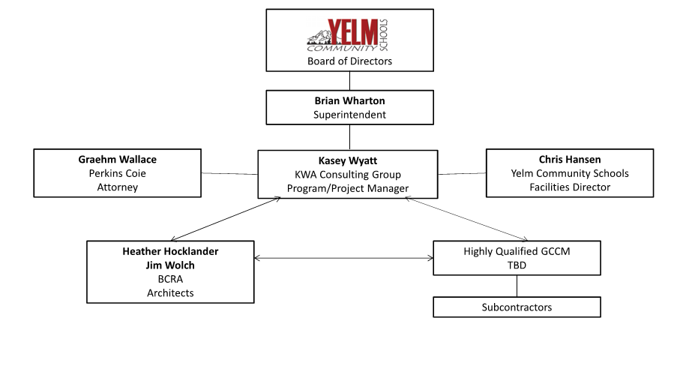
Project Team
Notes:
Kasey Wyatt

Slide 4
Project Team
  Kasey Wyatt, Program/Project Manager
    24 year Industry Veteran
    Extensive GC/CM Experience
    Over $1 Billion in K12 Project Experience
  Heather Hocklander, Architect Project Manager
    18 Year Industry Veteran
    K12 Design Expertise
    Extensive GC/CM Experience
  Jim Wolch Project Manager
    30 Year Industry Veteran
    GC/CM Experience
Notes:
Kasey Wyatt

Slide 5
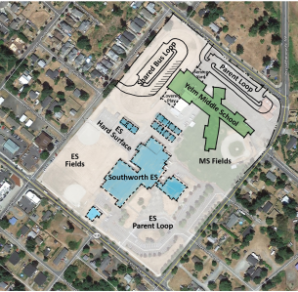
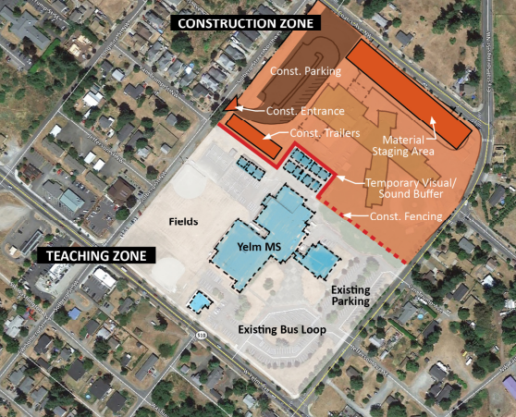
Yelm Middle School Scope
Grades 6-8
100,000SF / 19 Acres
725 Students
Notes:
Heather

Slide 6
Yelm Middle School Schedule
Pre Design/Programming March 2019 – July 2019
Schematic Design April 2019 – August 2019
GC/CM Process March – June 2019
  PRC GC/CM Consideration March 28, 2019
  1st Advertisement for GC/CM RFQ April 1, 2019
  2nd Advertisement for GC/CM RFQ April 8, 2019
  GC/CM Presubmittal Meeting April 9, 2019
  Statement of Qualifications Due April 19, 2019
  Short-list Most Qualified GC/CM’s April 26, 2019
  Interview GC/CM’s May 10, 2019
  Open GC/CM Fee Proposals May 16, 2019
  School Board Award of GC/CM June 6, 2019
Preconstruction Start June 2019
Construction Start May 2020
Substantial Completion July 2021
Demo Old Bldg / Complete Fields June 2022 – November 2022
Notes:
Kasey

Slide 7
Yelm Middle School Budget
Cost for Professional Services (A/E, Legal, etc) $ 6,312,600
Estimated project construction costs (including contingency) $ 49,515,000
Equipment and furnishing costs $ 1,250,000
Offsite costs $ 1,200,000
Contract Admin. (Owner, CM, etc.) $ 1,300,000
Contingencies (Owner) $ 2,300,000
Other project costs (permits, utilities, moving, testing, etc.) $ 2,120,500
Sales Tax $ 4,412,205
Total approved budget $ 68,410,305
Notes:
Kasey

Slide 8
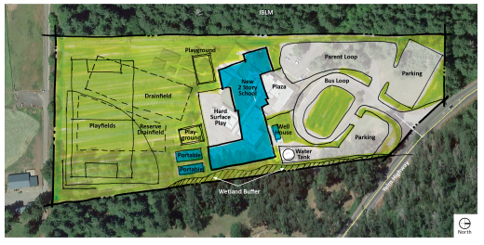
Southworth Elementary Scope
Grades K-5
65,000 SF / 13.5 Acres
550 Students
Notes:
Heather

Slide 9
Southworth Elementary School Schedule
Pre Design/Programming March 2019 – July 2019
Schematic Design April 2019 – August 2019
GC/CM Process March – June 2019
  PRC GC/CM Consideration March 28, 2019
  1st Advertisement for GC/CM RFQ April 1, 2019
  2nd Advertisement for GC/CM RFQ April 8, 2019
  GC/CM Presubmittal Meeting April 9, 2019
  Statement of Qualifications Due April 19, 2019
  Short-list Most Qualified GC/CM’s April 26, 2019
  Interview GC/CM’s May 10, 2019
  Open GC/CM Fee Proposals May 16, 2019
  School Board Award of GC/CM June 6, 2019
Preconstruction Start June 2019
Interim School Renovations May 2021 – August 2021
Construction Start June 2021
Substantial Completion July 2022
Notes:
Kasey

Slide 10
Southworth Elementary School Budget
Cost for Professional Services (A/E, Legal, etc) $ 4,119,960
Estimated project construction costs (including contingency) $ 31,252,000
Equipment and furnishing costs $ 1,250,000
Offsite costs $ 500,000
Contract Admin. (Owner, CM, etc.) $ 870,000
Contingencies (Owner) $ 1,440,000
Other project costs (permits, utilities, moving, testing, etc.) $ 1,490,500
Sales Tax $ 2,762,424
Total approved budget $ 43,684,884
Notes:
Kasey

Slide 11
Why Project is Suited for GC/CM
4 Criteria RCW 39.10
Complex Schedule, Phasing and Coordination
Occupied Facility
Involvement of GC/CM is Critical
Complex or Technical Work Environment
Notes:
Brian

Slide 12

Questions?

