Slide 1
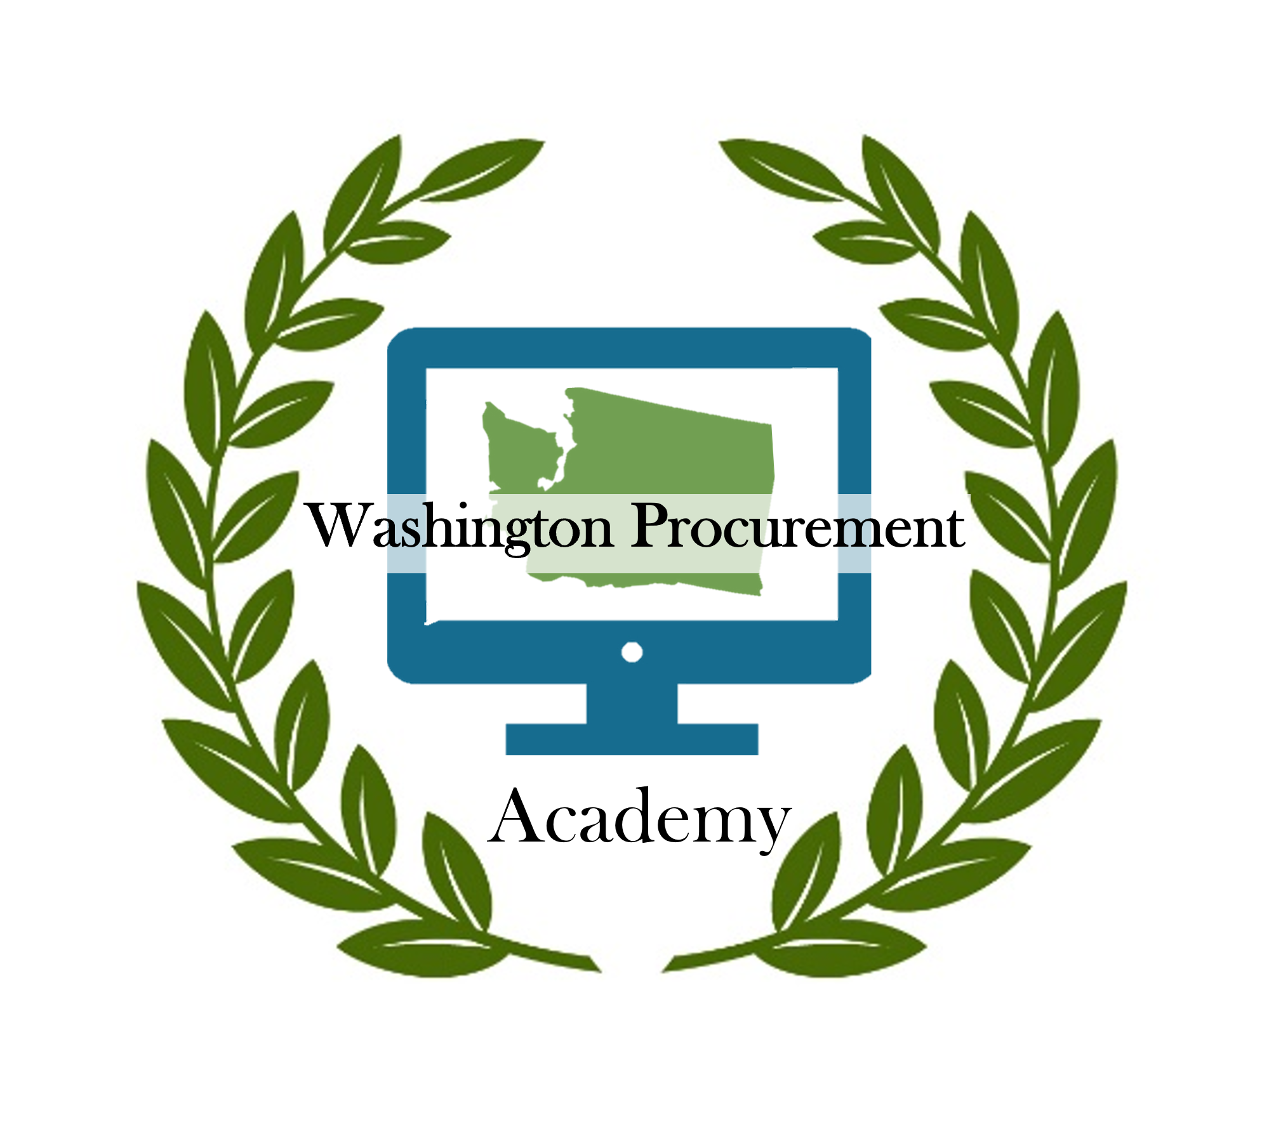
Washington Procurement Academy
Part of the Contracts & Procurement Division
Sundae Delgado, C&P Statewide Training Manager
WACS Meeting SEPTEMBER 2024

Slide 2
Review of WPA
Online Academy including required and optional courses.
Limited in scope under RCW 39.26.
Always changing based on RCWs, policies, and executive orders.

Slide 3
3 WPA Updates
The following courses are no longer required:
Wage Theft
18-03
PCBs & Procurement
Anti-discrimination
1
2
6
Beginning in January of 2027, DES requires learners to repeat each of the below courses:
Environmental Procurement 6
Supplier Diversity 6
Procurement Ethics 6
Small Purchases 6
!
These courses are currently being written and will be required for those enrolled in the School of Procurement Professionals:
3
Sole Source Purchases – Coming 2025 ! RCW 39.26 basics – Coming 2025 ! IT Purchases – Coming 2026 ! IAA Purchases – Coming 2026 ! Contract Manager Updates – Coming 2027 ! 6 Procurement Professional Updates – Coming 2027 !6

Slide 4












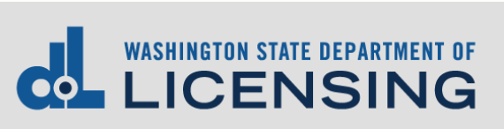







Training Advisory Group
Notes:
In order for DES to meet our part of the training and certification requirements within RCW 39.26, we called together many agencies and institutions of higher education, and formed an enterprise wide Training Advisory Group made up the top procurement minds at each of the agencies or higher eds represented on the screen which shows WSP, DSHS, LNI, DOT, OFM, DCYF, DES, Evergreen State College, OSPI, Ecology, WSDA, OMWBE, Fish & Wildlife, Parks, Treasurer, SCTC, DOH, DOL, DOR.
Am I missing any of us?
We have done a great job, but at DES we are also insecure that we are doing our job.

Slide 5
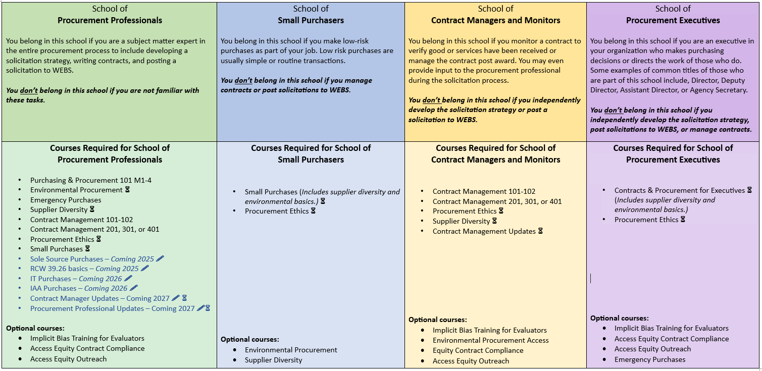
There are four schools within the Washington Procurement Academy. Read the descriptions to find in which school you belong or use our Virtual Guidance Counselor.

Slide 6
Resources
Required Contract and Procurement Courses
Learn more or Join Tag
Feedback/Questions: Sundae Delgado, C&P Statewide Training Manager

