Slide 1

Capitol Campus Parking Rulemaking (WAC 200-200)
Clarification, clean-up & alignment with existing policy
Notes:
Pick a logo for the main page of your presentation. Delete the other logo.

Slide 2
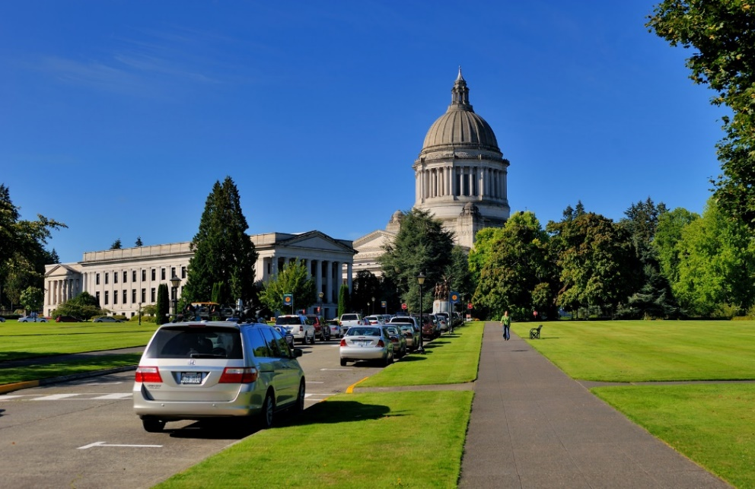
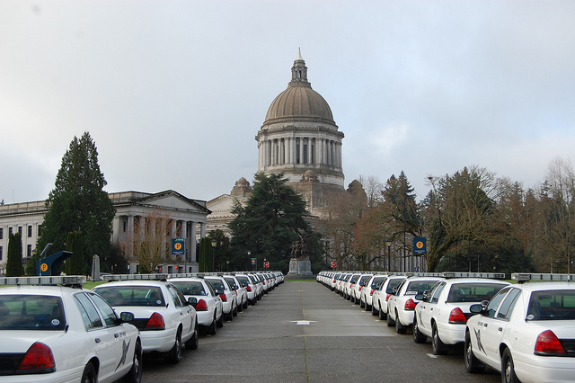
Purpose of Parking Rule Update
Clarify, clean-up, and align the rules with the Capitol Campus parking policy and procedures.
Implement a key recommendation of the:
  2014 Transportation and Parking Study
  2015 Parking Strategy Plan.

Slide 3
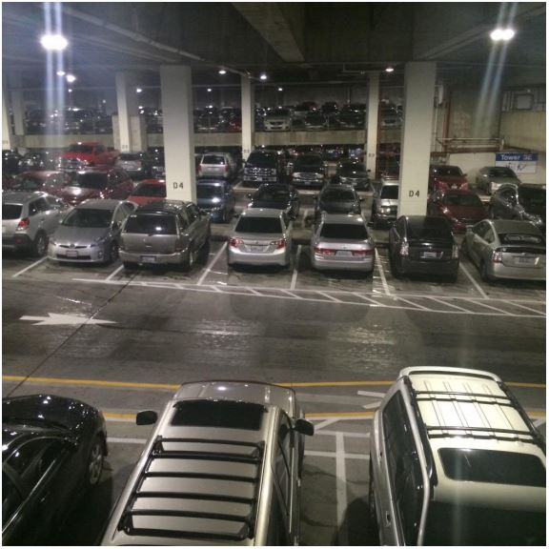
Background
2018: Enterprise Services consolidated parking requirements into a single policy with extensive stakeholder engagement.
Building on past efforts, Enterprise Services is seeking input on a discussion draft from stakeholders before formally proposing any changes,.
Notes:
The policy now serves as an improved resource guide.
Study recommendations: through the proviso outlined in 2EHB 1115 (WAC 200-200 is a key tool).

Slide 4

Key Areas of Focus
Hours of operation for parking on the Capitol Campus is consistently noted
Definitions are aligned with policy
Importance of signage and paint colors for striping are clarified to support enforcement

Slide 5
WAC 200-200 Rule Update Process
CR-101-Best time to provide input – Fall 2019
1
CR-102 – Formal comment period & hearing – Late Fall 2019
2
CR-103- Adoption & implementation – Early Winter 2020
3

Slide 6
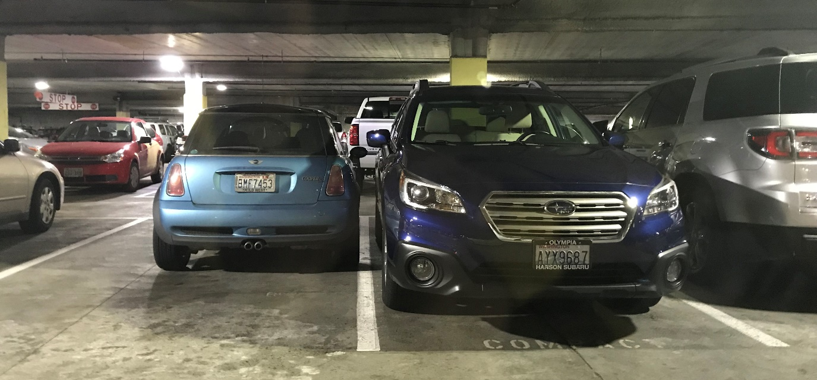
CR 101-Seeking Feedback
Helpful feedback from customers so far:
Enforcement of non-compliant parkers
Consistent signage
Clear messaging on rules

Slide 7
CR 101-Seeking Feedback
Is the discussion draft of the parking rules clear and easy to understand?
Did we missed content that should be cleaned up or better aligned?
Are there any inconsistencies, including use of terminology and definitions?

Slide 8
Upcoming Steps in 2019
Current Efforts: Incorporate feedback, share a near final discussion draft of the rule externally before officially filing a proposed rule.
November: Officially file proposed rule: Formal public comment period begins, including a public hearing.
November: Share a transcript of public hearing comments and our response to all comments before finalizing the parking rule.

Slide 9

Questions

