Slide 1
Procurement Reform 2SHB 2452
Procurement for the State of Washington
East Side Vendor Training
June 20, 2012

Slide 2
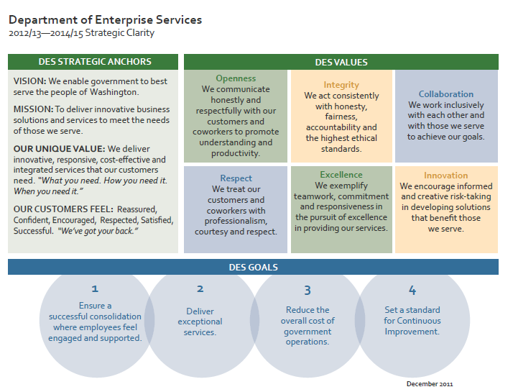
Department of Enterprise Services

Slide 3
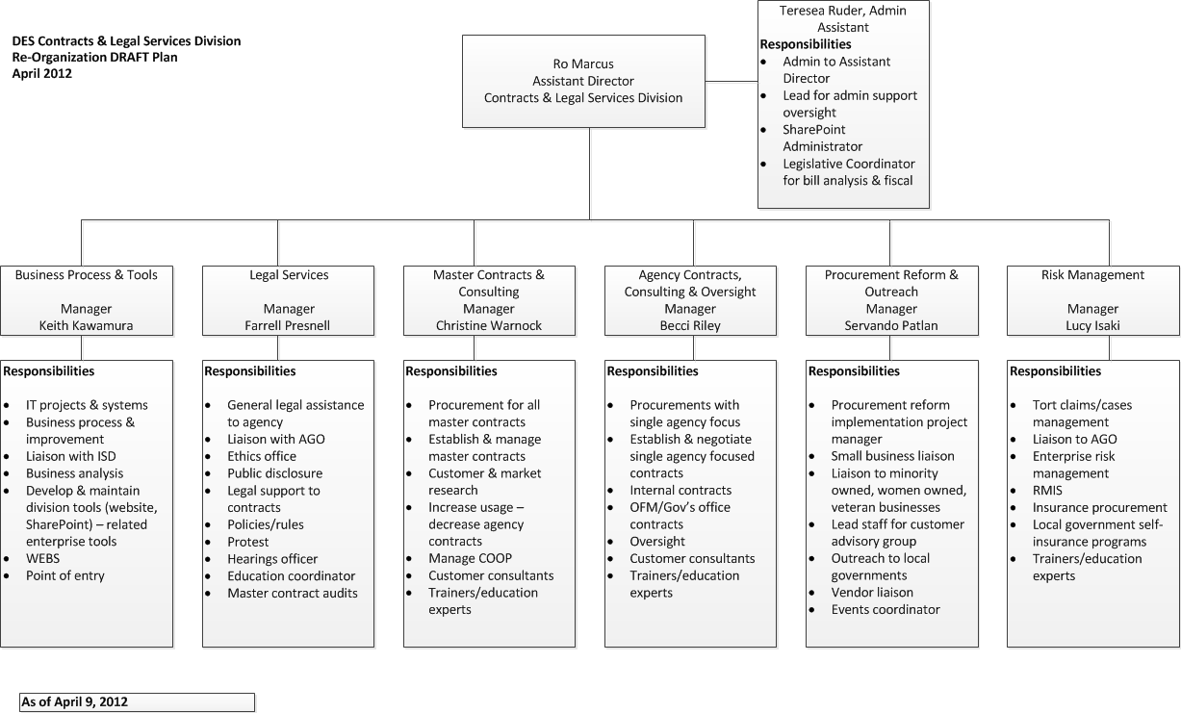
Contracts & Legal Services Division
Services provided
Vision
Re-organization project

Slide 4
Procurement Reform Positioning
June 1, 2006 Procure To Pay Value Proposition Recommended Changes To Prepare for Modern Financial Systems
HB 1770 Enhance WA Small Business Participation
ESSB 5931 creating the Department of Enterprise Services (DES)
HB 2452 Procurement Reform Bill

Slide 5
Fall 2011 Review Process
Convened Work Group
Developed Guiding Principles
Researched Best Practices
Developed Draft Recommendations
Stakeholder Outreach

Slide 6
Best Practice Research
Reviewed American Bar Association Model Procurement Code
Researched practice in nine similar sized states (AZ, GA, IN, MA, MI, OH, OR, TN, VA)
Reviewed Federal Laws
Reviewed Current WA State Laws (RCW 43.19, RCW 39.29, RCW 43.105)

Slide 7
Guidelines
Accountability to Legislature and Public
Flexibility to Adapt to Changing Markets and Conditions
Assessing Risk Factors
Economies of Scale
Eliminating barriers and Easing Participation for Contractors

Slide 8
Stakeholder Outreach
WACS October meeting
Training Conference and Trade Show
AG Contract Law Forum (Nov. and Jan.)
OMWBE Ad Hoc Advisory Committee
Survey on Draft Recommendations
1200 responses (75% vendors)
3,000 individual comments

Slide 9
Procurement Reform Legislation
Incorporates comments from outreach and state agencies
Supported by state agencies, labor, small business and OMWBE Ad Hoc Advisory Committee
Passed legislature and signed by Governor (2SHB 2452) on March 30, 2012

Slide 10
Procurement Reform Legislation
Combines 3 statutory chapters into one new chapter, that will govern all state procurements for goods and services.
Makes procurement process more transparent, competitive and efficient.
Effective January 1, 2013

Slide 11
What Will Be Different?
A common approach for the procurement of all goods and services will be developed.
Requires training for all employees who develop, manage or execute contracts.
Oversight of all sole source contracts, except those otherwise exempt, in place of oversight of only personal services contracts.
Contractors and agencies will be allowed to submit bid documents and signatures electronically for ease of transaction.

Slide 12
What Will Be Different?
Allows use of best value criteria to award contracts.
Agencies will notify bidders and identify awarded contractors in a central system.
Agencies will post information about awarded contracts with DES so the public can see basic information about all awarded contracts on a single site.
DES will be able to debar contractors for cause.

Slide 13
What Will Be The Same?
The bill keeps the same exemptions for the Legislature, higher education, public hospitals, client services and the data center as in current law.
DES will establish rules and guidelines for procurement of goods and services.
Agencies can continue to make emergency purchases, direct buy purchases and negotiate contracts when appropriate.

Slide 14
Next Steps
DES will invite customer agencies, vendors and other interested parties to provide input during the development of new procurement guidelines, policies and rules.
DES will issue the new policies and rules in fall 2012, so that agencies have time to adopt their own corresponding policies before the new law takes effect.

Slide 15
Implementation Timeline
April
Convene Advisory Committee
Identify workgroup leads and members
May/June
Weekly meetings for workgroups
Monthly meetings for Advisory Committee (continue through October)
July/August
Begin formal rulemaking

Slide 16
Implementation Timeline
July/August continued
Policy development outreach
September/October
Finalize and adopt rules and policies
Plan for training on implementation
November/December
Agency implementation
January 1, 2013 – Effective Date

Slide 17
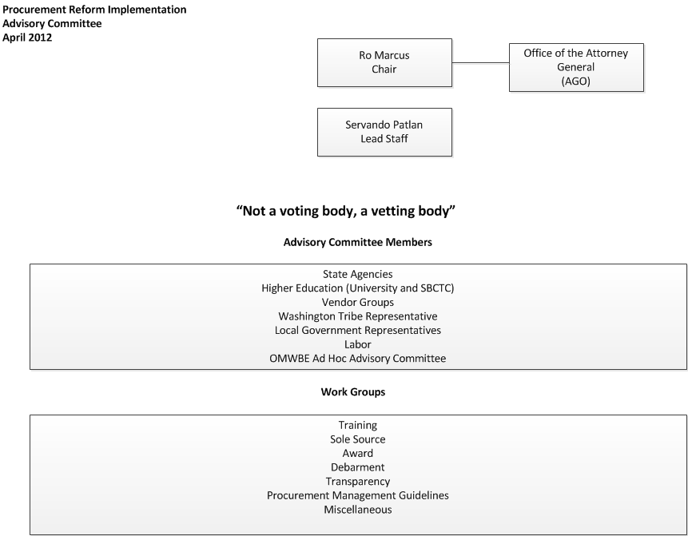

Slide 18
Work Groups
Training
Criteria for training before delegating authority
Criteria for who must be trained
Criteria for approval of existing training
List of other training programs
Criteria for exemptions

Slide 19
Work Groups
Sole Source
Sole source justification
Posting on vendor system
Posting for public inspection
Criteria for exemptions

Slide 20
Work Groups
Award
Award options (reject, BAFO, Award)
Define responsible bidder
Define best value criteria
Rules for using best value criteria
Identifying successful bidder in system
Release of Bid Documents
Complaint and Protest Process

Slide 21
Work Groups
Debarment
Criteria for debarment
Notice process
Process for issuing a decision
Due process and appeal rules

Slide 22
Work Groups
Transparency
Develop policy and process for annual posting of contracts
Criteria for exemptions

Slide 23
Work Groups
Procurement Mgt Guidelines
Precontract procedures
Alternative dispute resolution process
Performance measures and benchmarks
Model contract terms
Electronic Signature guidelines
Criteria for contract amendments
Postcontract procedures
Procedures and criteria for terminating contracts
Requirements for contractor to provide data to review committees
Guidelines for performance based contracts

Slide 24
Work Groups
Miscellaneous
Ethics
Cost recovery
Cooperative Purchasing
Convenience Contract
Performance Bonds
Master Contracts
Risk Assessment for delegating authority
Small, micro, mini and minority businesses
Direct buy purchases
Emergency purchases

Slide 25
Procurement Reform Questions
Lead - Servando Patlan
Department of Enterprise Services
Email servando.patlan@des.wa.gov
Phone 360-407-9390
Visit the Procurement Reform Website at
http://www.des.wa.gov/Procurement_reform
Notes:
Servando is the leading the implementation for procurement reform.

