Slide 1



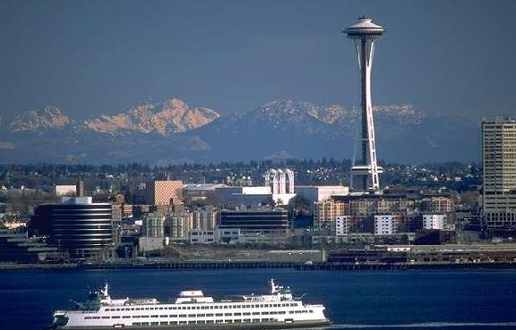
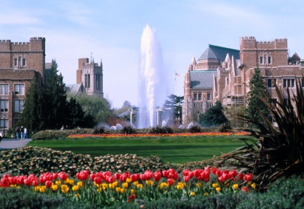
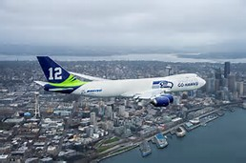
Results Washington
KayLyne Newell, Sr. Performance Advisor
Todd MacDonald, Enterprise Transformation Architect
Office of Governor Jay Inslee

Slide 2
Agenda for Today
Results Washington
  History
  5 goal areas
Lean
  History
  Thinking and tools
  Visual management
  Lean discussion / stories
Resources

Slide 3
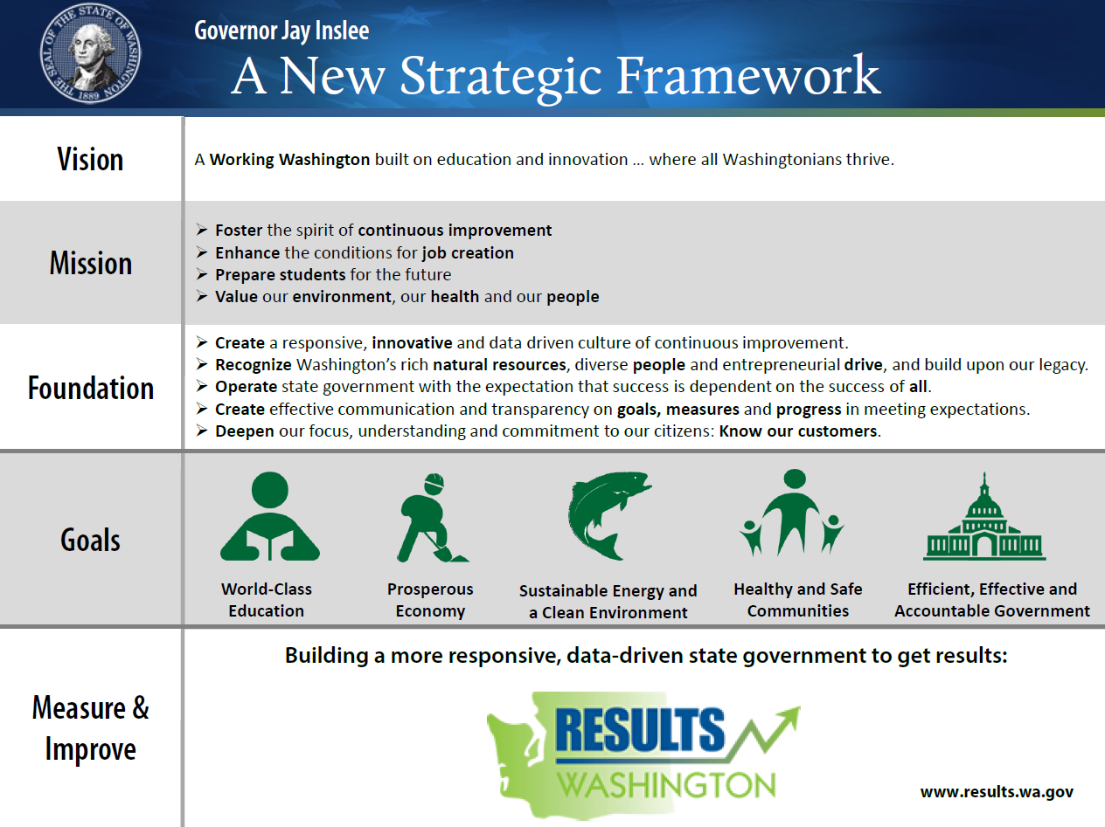
Governor Inslee’s Strategic Framework

Slide 4
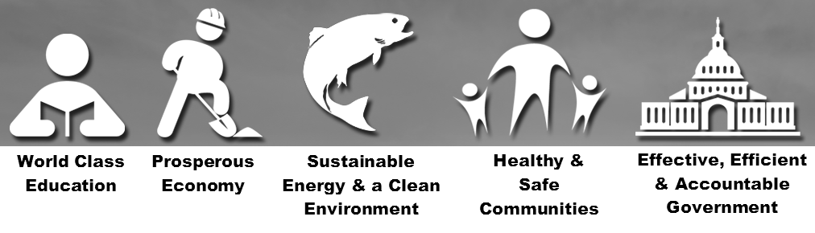
Results Washington Goal Councils
53
State Agencies, Boards & Commissions

Slide 5
Robust System of Performance
Measuring what matters
Continuously
Improving with Lean thinking & tools
Engaging with customers
Reviewing
& reporting

Slide 6
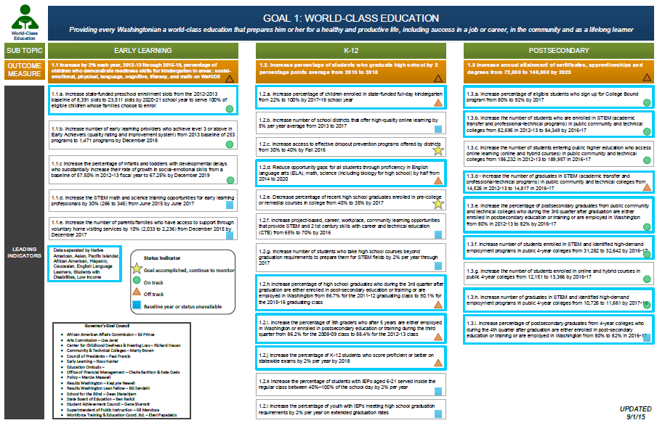
Measure Maps
1.2. Increase percentage of students who graduate high school by 2 percentage points average from 2013 to 2018
1.2.e. Decrease percentage of recent high school graduates enrolled in pre-college or remedial courses in college from 40% to 35% by 2017
1.3.f. Increase number of students enrolled in STEM and identified high-demand employment programs in public 4-year colleges from 31,282 to 32,642 by 2016-17

Slide 7

A pause for questions

Slide 8
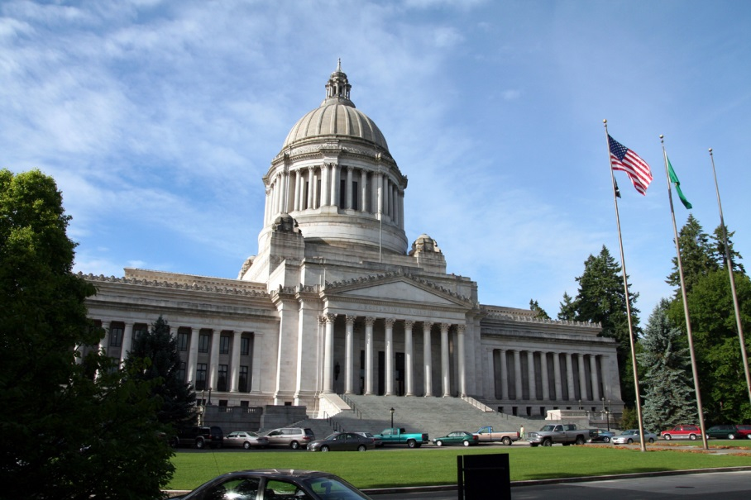
Lean in State Government
Every employee is a problem solver.
Every leader is a coach.

Slide 9
The Lean Vision
To adapt Lean thinking principles and tools to state government operations so we can create a way of working that:
delivers better value to more Washingtonians for generations to come
makes public service a deeply gratifying experience for employees.

Slide 10
What is “Lean Thinking”
Objective
What problem do we really need to solve?
Root cause analysis
What are the root causes of the problem?
Improvement plan
Specific strategies and metrics

Slide 11
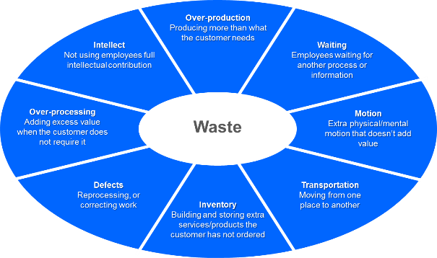
What is Lean?
A continuous improvement methodology:
Facilitates environment of RESPECT
Focuses on the CUSTOMER
Encourages a “why” MINDSET
Actively identifies and helps eliminate WASTE

Slide 12
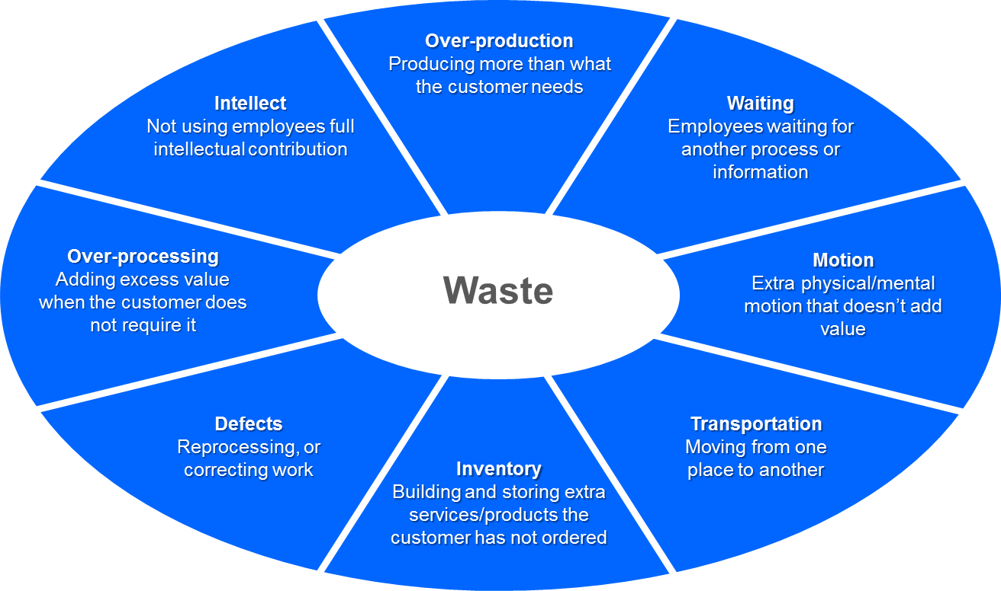
Lean Waste

Slide 13
Key Lean Concepts
Problems are opportunities
Leaders go to the problem to SEE what’s happening
Focus on process and standard work is sought
People/teams are developed and maximized
Staff are empowered to learn by doing
Customer value is the goal
Respect and humility are the culture

Slide 14
Lean Management
Employees take directions and don’t question or offer ideas.
Leaders boss, tell and direct.
Leaders coach, mentor, teach.
Employees are problem solvers,
trusted and respected as capable and knowledgeable.
Lean
Conventional

Slide 15
What is a “Lean Culture”
Lean is more than just tools…
People operate without fear
Management allows time for Lean efforts
Employees turn to the Lean tools without prompting
Everyone feels ownership of a process
The Lean approach respects people and honors their contributions

Slide 16
A pause for questions

Slide 17
A tool to take home
Visual Management

Slide 18
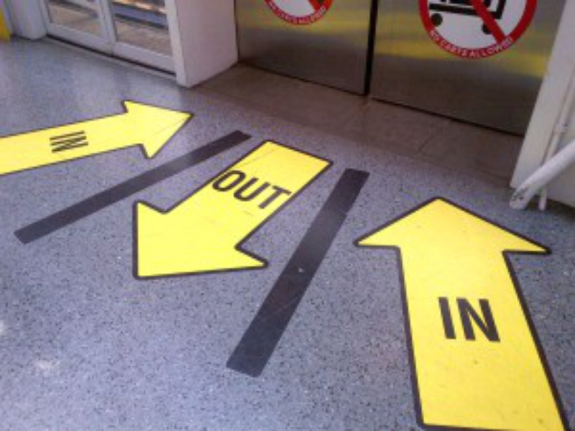
Visual Management
What visual management is and why it is important
Recognize good examples of visual management
Learn how to put visual management to work
Notes:
Here are the objectives for this CoP. We hope you gain knowledge and are able to implement:
What visual management is and why it is important
Recognize examples of visual management and understand what it is explaining
Put visual management to work in your own work environment

Slide 19
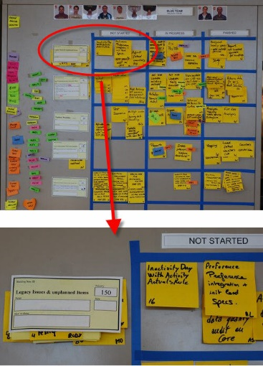
What is Visual Management?
A strategy for planning, control, and continuous improvement that integrates
Simple visual tools that enable understanding at a glance
Allows you to see the abnormal state from the normal state
Notes:
Visual management allows you to see the normal state, which is your standard, and it allows you to quickly see when something abnormal happens
It is a management tool that invites everyone to participate

Slide 20
Effective Visual Management
Provides “understanding at a glance”
Uses graphics to tell a story
Identifies the standard
Provides trigger that something is abnormal
Gives a reason to ask “why”?
Notes:
Provides visual trend of progress against goals and objectives
Identifies opportunities for improvement and correction
We know that good visual management needs no interpretation and immediately provokes the correct reaction.

Slide 21
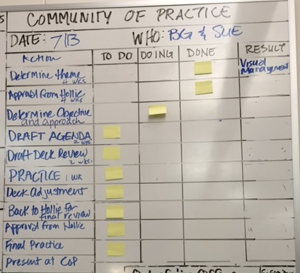
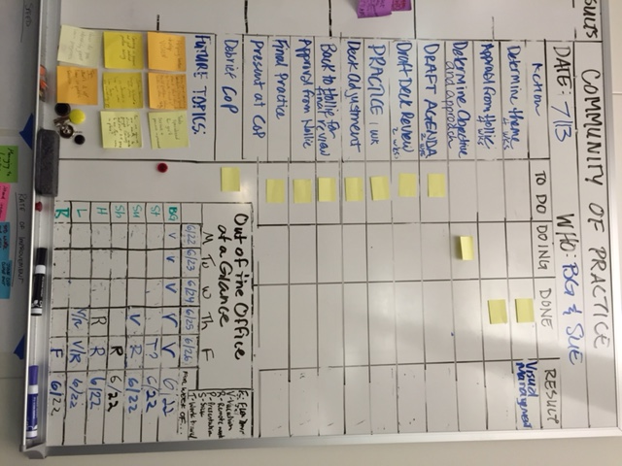
Understanding at a Glance
Notes:
Take a look at these pictures. There are actually two visual management tools here. Let’s look at the CoP. Do you understand what is happening? What do you see? What is the status?
We are still adjusting this but it helps us stay on track.
Also, look at the Out of Office. How many of you have these in your office? How many of them are always used? Do you have a management system built around them to hold everyone accountable to them? Why do you have them if you do not?
IF YOU GET THE OUTLOOK QUESTION:
Outlook works but this is a simple and quick snapshot that ANYONE can see and react to.
Many Outlook calendars are not up to date. This information is current because of our management system behind it.
There are 7 people on this board. Don’t have to open 7 calendars to get the information.
We actually have a “standard work” tracking board that tracks whether we met intent of the standard work.

Slide 22
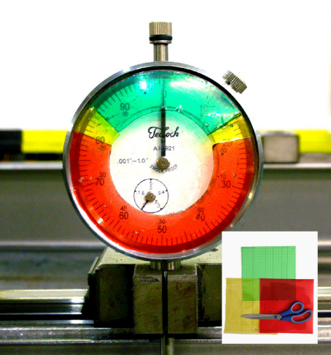

They don’t have to hang on a wall
Notes:
Take a look at these pictures. There are actually two visual management tools here. Let’s look at the CoP. Do you understand what is happening? What do you see? What is the status?
We are still adjusting this but it helps us stay on track.
Also, look at the Out of Office. How many of you have these in your office? How many of them are always used? Do you have a management system built around them to hold everyone accountable to them? Why do you have them if you do not?
IF YOU GET THE OUTLOOK QUESTION:
Outlook works but this is a simple and quick snapshot that ANYONE can see and react to.
Many Outlook calendars are not up to date. This information is current because of our management system behind it.
There are 7 people on this board. Don’t have to open 7 calendars to get the information.
We actually have a “standard work” tracking board that tracks whether we met intent of the standard work.

Slide 23


Standard visuals simplify things…usually
Notes:
What type of visual management tools do you see that make up this management system?
Can anyone come in to this office and wee what is going on?
Is there room for the mouse in your office or cubicle?

Slide 24
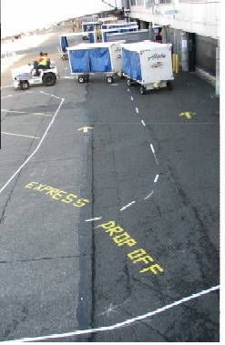
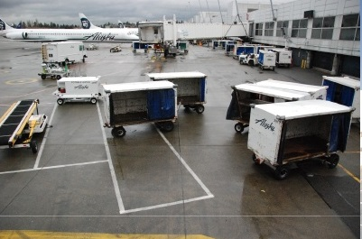
Determine the Purpose
Is the information on your visual important?
Is your visual easy to understand?
Does your visual drive improvement?
BEFORE
AFTER
Notes:
We are handing out examples of visual management and want you to spend the next 3-4 minutes at your table to determine if these three questions are answered. We will do a quick report back on your thoughts.
Hand out visuals and have tables work on reviewing them and report back about what they think.

Slide 25
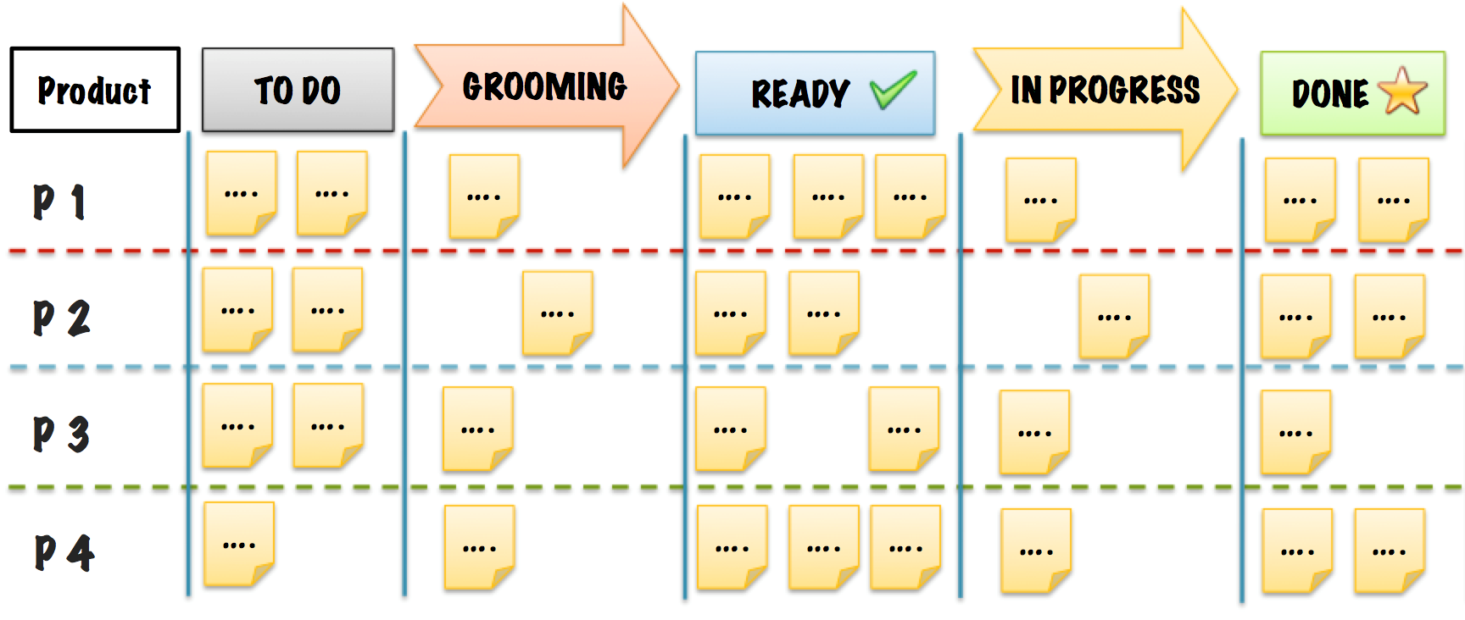
Why Visualize Your Work
It is hard to understand what we cannot see
It makes customer demand visual
It allows for level loading across the team to balance work
Notes:
Visualizing work helps put it into context, and makes trade-offs, priorities, and outcomes become more clear.
Example: Shawn is going to give his gas gauge story here.

Slide 26
A pause for questions

Slide 27
Lean Culture in State Government
Communities of Practice
More than 50 agency advisors
1000+ agency practitioners
Lean Expert Partnership Program
private-sector partners
provide advice, coaching, training, and tours
231 partners
106 organizations
Lean Conference
free to state employees
4th annual conference last month
2,000+ attendees
40+ expert-led workshops
Fellowship Program
5 fellows on loan from state agencies for 1 year
learning and coaching experience
Notes:
Key Strategies we are deploying to build our lean cultures are:
Communities of practice, a fellowship program, the Lean expert partnership and our Lean Conference

Slide 28
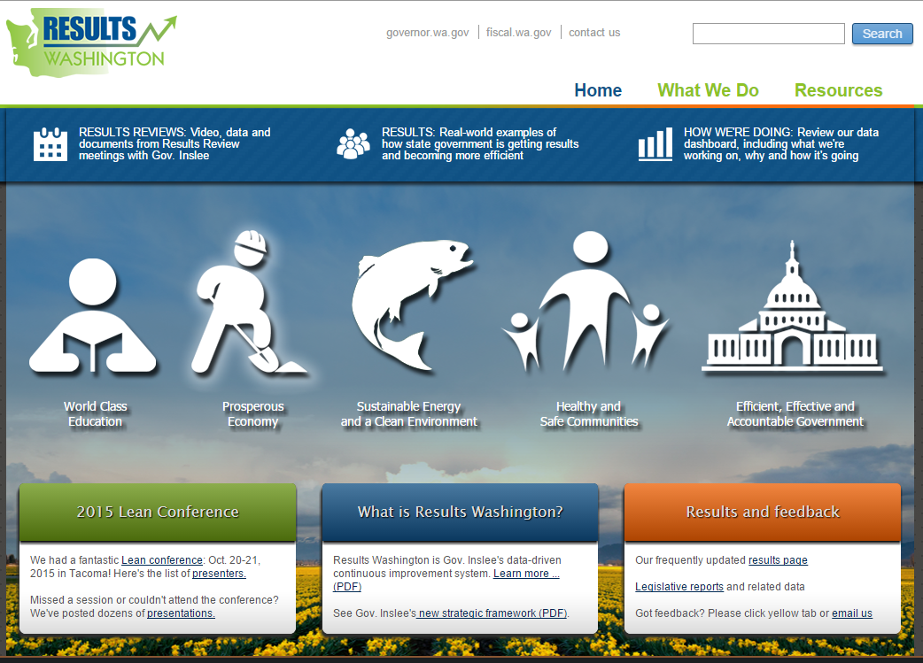
Resources
  Website www.results.wa.gov
  Lean community of practice: To sign up, send an email to Results@gov.wa.gov

Slide 29


Reflecting on Today
What went well?
What needs to be improved?

Slide 30
Final questions

Slide 31

For more information:
KayLyne Newell
360.902.0849
kaylyne.newell@gov.wa.gov
Todd MacDonald
Todd.macdonald@gov.wa.gov
results@gov.wa.gov
www.results.wa.gov

Slide 32
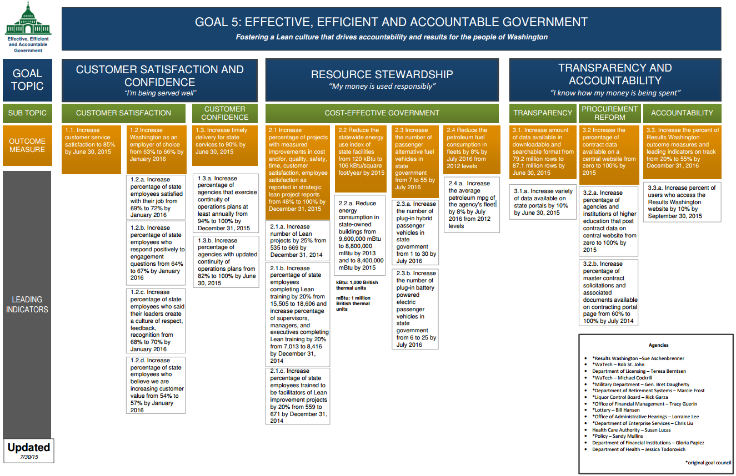
Effective, Efficient, Accountable Government

