Slide 1

Technology Leasing 101
Notes:
Pick a logo for the main page of your presentation. Delete the other logo.

Slide 2


Slide 3

DES Leasing Team
Jamie Langford – Deputy Chief Financial Officer
Darrell Damron – Business Manager
Aaron Pittelkau – Business Coordinator
Marsha Adams – Tech. Leasing Associate
Steve Voigt – Data and Statistical Analyst

Slide 4
What is a lease?
A contractual arrangement between the Lessee (the customer) and the Lessor (DES Financial Services).
DES purchases the equipment from your technology supplier (i.e., Dell, HP, or IBM) of choice and leases it to the customer for a fixed, regular payment.

Slide 5

DES Capital Lease
How does it work?
This program is a continuation of the leasing program agencies have used for years.
  DES acquires computers for the agency and then funds the purchase through Certificate of Participation (COP) financing with the State Treasurer.
  At the end of the lease agencies then have the preferred option to renew their lease by engaging in the lease refresh process.
The agency makes monthly lease payments to DES through the term of the COP.
Warranty coverage is included with the lease to coincide with the useful life of the computer.
DES is responsible for asset management and holds title to the equipment.
Notes:
NOTE: Define COP

Slide 6
DES Capital Lease
How does it work?
At the end of the lease term, the agency can choose for DES to:
  Renew/Refresh the agency’s lease and modernize their current IT assets.
  Extend the lease for an agreed period of time. Lease payments do not continue, but service fees remain through the extension.
  Transfer ownership of the computer to the agency. No further acquisition related payments are due.

Slide 7
Accounting for the
DES Capital Lease
Leased computers are owned by DES and are carried as assets on DES’s books.
Agencies with leased computers show a monthly expense for the use of the computers, but do not own them.

Slide 8
Why do Washington State Agencies lease equipment?
The DES Capital Leasing model will change your variable IT costs to fixed operating costs making your budgeting process easier and more predictable.
Leasing is cost effective, practical, & flexible.
Leasing helps increase your working capital over two biennium’s.

Slide 9
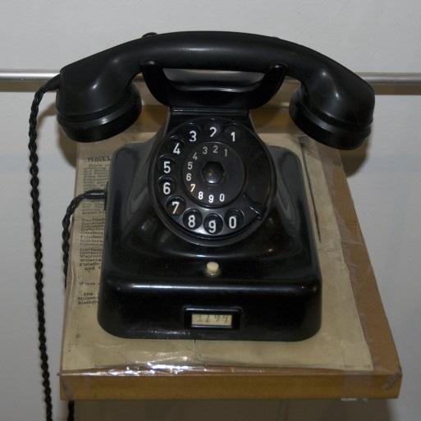
Benefits to leasing other than financial
Leasing can help expedite equipment replacement and modernization. It keeps your technology current and fresh.
This creates a positive impact across all aspects of an agency.
Who wants to use outdated technology?
Notes:
Additionally, most lease arrangements free managers from worrying about technology end-of-life disposition issues, including environmental considerations, data security and destruction, and compliance with ever-changing disposition laws. These become the responsibility of DES.
Photo courtesy of http://upload.wikimedia.org/wikipedia/commons/2/2f/Old_telephone_%285983560279%29.jpg .

Slide 10
Thank you
If you have questions, please feel free to contact:
Aaron Pittelkau aaron.pittelkau@des.wa.gov (360) 407-8712

